Slide 1
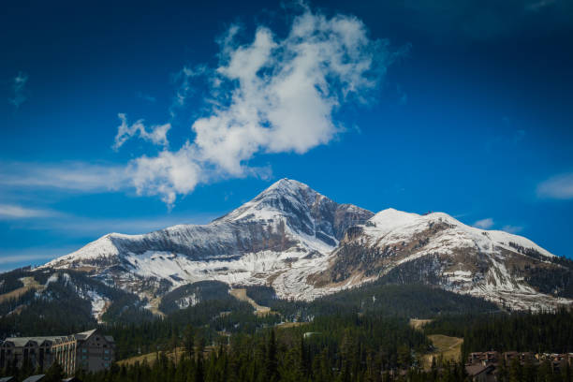
RESEARCH UPDATE
FEBRUARY 2024 REVIEW

Slide 2
EXECUTIVE SUMMARY
Big Sky Travel & Tourism Trends
192,315 total revenue passengers passed through the Bozeman Yellowstone International Airport in February 2024, a gain of 2.3% compared to the same month last year.
Occupancy at Airbnb/Vrbo short term rentals in Big Sky fell from 86% in February of 2023 to 82% in February of 2024. Average Daily Rate at these same properties declined by $25 YoY to $913 in February of 2024.
Professionally managed short-term rentals saw Occupancy decline from 63% in February 2023 to 58% in February 2024. Average Daily Rate dropped from $1,024 in February of last year to $969 in February of this year.
Visa credit card spend in Big Sky was flat YoY for January 2024, with $8.9 million being spent by domestic visitors and residents in the month. International Visa card spend declined slightly YoY, with $211,435 being spend during the month of January 2024.

Slide 3
ANALYST NOTES
West Region Mountain Market Summary
“Following a month of sparse snowfall, precipitation picked back up in February, stoking hopes that the ski season won’t be shortened and may in fact lengthen this year. All of the pieces of the puzzle came together in February; economic indicators were mostly positive, and skiers and snowboarders flocked to their favorite mountain destinations to enjoy the snowy conditions.”
“The right economic conditions are also key to consumers’ booking, and February delivered as economic indicators showed mostly growth, especially with continued record performance on Wall Street. The Dow Jones Industrial Average (DJIA) stands out, posting a 2.2 percent (or 846.1-point) gain in February and closing the month at 38,996.4 points. This marks the third consecutive monthly record-high close as financial markets continue to display strength.”
“However, Main Street holds a slightly different perspective, according to the Consumer Confidence Index (CCI), a measure of consumers’ confidence in the economy. CCI declined from last month, down -3.8 percent to 106.7 points (1985=100) following a downward revision to January’s result. Dana Peterson, Chief Economist at The Conference Board said, “Confidence deteriorated for consumers under the age of 35 and those 55 and over, whereas it improved slightly for those aged 35 to 54.”
“But overall, the momentum gained in February was strong. If the economy continues the current trajectory and mother nature plays nice occasionally, the season may in fact show further compression in the next 2 months, or potentially lengthen into May.”
Source: DestiMetrics and The Conference Board

Slide 4
U.S MARKET REVIEW
Macroeconomic Trends
“February economic data was mostly benign. Macroeconomists and market participants have paid close attention to the balance of labor market tightness and inflation in anticipation of interest rate cuts from the Federal Reserve. Interest rates are of note because they strongly influence mortgage rates and overall economic activity.”
“The jobs report for February added 275,000 jobs and noted a slight increase in unemployment, boosting the likelihood that interest rate cuts are on the way.”
“Wage pressure also eased, with hourly earnings rising about a nickel in February. This is down from an 18-cent uptick in January.”
“On the other hand, the Consumer Price Index (CPI) inflation rate—which measures price changes in consumer goods and services—edged up slightly in February, reaching 3.2% from 3.1% in January.”
“Higher inflation may mean that rates remain high for longer. The need to moderate high inflation motivated the historic Federal Funds Rate increases since March of 2022.”
“Still, core inflation, which ignores fluctuations in volatile food and energy sectors, changed at the same rate in February as in January.”
“The ambiguous signals likely mean that June rate cuts are equally likely to happen or not.”
Source: BLS, Oxford Economics, and AirDNA

Slide 5
U.S MARKET REVIEW
Travel Demand Update
Despite recent slowing, growth trends largely continue across sectors.
U.S. domestic leisure: Trips have fully recovered to 2019 levels, though growth has decelerated due to tighter credit conditions and the restarting of student loan payments.
Air travel: In 2023, TSA air passenger volume increased 13% year-on-year, reaching 102% of 2019 levels and pacing 10% ahead of pre-pandemic levels during the first few weeks of January.
International inbound: Pre-pandemic levels are not expected to return until 2025 as the strong dollar and visa wait times continue to pose challenges, but 2023 ended with international visitation at 84% of 2019 levels.
The U.S. is experiencing a highly unusual travel trade surplus with outbound travel outpacing inbound travel.
However, inbound travel is gaining momentum, with Latin American travelers to the U.S. leading the way at 100% recovered to 2019 levels. Asia is on pace to recover most slowly with a full recovery not likely until 2025.
Source: Tourism Economics, STR, Longwoods International, and Future Partners

Slide 6
U.S MARKET REVIEW
Travel Demand Update (continued)
Hotels: Performance gains are expected to continue even as the economy decelerates.
Modest lodging demand growth will be supported by household prioritization of travel, a continued rebuilding of business travel and group events, and a rebound in international visitation.
The latest STR/Tourism Economics lodging forecast expects RevPAR to grow 4.1% in 2024, moderately slower than 2023 (4.9%), with an expected 3.1% gain in ADR.
Consumer Sentiment: Travelers still feel generally optimistic about their financial circumstances—especially in comparison to the average American adult—and remain financially committed to travel (Future Partners).
That said, a recent Longwoods International study reports 26% of travelers say financial concerns will greatly impact their decision to travel within the next six months—emphasizing the importance of value perception especially among lower-income earners.
Source: Tourism Economics, STR, Longwoods International, and Future Partners

Slide 7
U.S MARKET REVIEW
Short Term Rentals
“Demand for short-term rental (STR) accommodations in the U.S. grew at a brisk rate of 15.6% year-over-year (YOY) in February.”
“While this high growth rate reflects how weak demand was in February 2023 and comes at a seasonal low point, hosts appreciated the abrupt change of pace after dismal weather around the country nearly screeched January’s growth to a halt.”
“February’s surge in traveler demand was enough to push occupancy higher than it was during the same month last year.”
“Since September 2023, occupancy had been tracking very close to 2019 levels before dropping to record lows in January.”
“The return of 2019-like occupancy was a welcome relief, suggesting that January’s performance wasn’t the start of a downward trend.”
“On the other hand, the occupancy bump didn’t seem to give hosts much pricing power. Average daily rates (ADR) remained essentially unchanged in February, declining about 0.1% YOY.”
Source: AirDNA

Slide 8
U.S MARKET REVIEW
Short Term Rentals (continued)
Key U.S. STR Performance Metrics for February 2024
Revenue Per Available Room (RevPAR) grew 0.8% YOY to $173.33
Available Listings were 1.54 million, up 12.3% YOY
Total Demand (nights) rose 15.6% YOY
Occupancy was 0.9% higher YOY at 54.6%
Average Daily Rate (ADR) decreased 0.1% YOY to $317.26
Nights booked increased by 18.9% YOY
Source: AirDNA

Slide 9
U.S. MARKET REVIEW
Key Takeaways from CBRE’s National Hotel Outlook:
Following 3.2% revenue per available room (RevPAR) growth in 2023, CBRE expects another year of growth in 2024, with average daily rates (ADR) increasing 2.3% and occupancy increasing 45 basis points (bps) to 65.3%. 2024 would mark the fourth consecutive year of positive RevPAR growth this cycle with RevPAR forecast to reach 113.2% of 2019’s level on a nominal basis. We expect growth to be strongest at urban and airport locations in 2024, given the continued recovery in group and inbound international demand and the normalization in leisure travel.
CBRE Hotels Research’s Baseline forecast incorporates a full-year 2024 GDP growth outlook of 1.6%, employment gains of 0.5% and CPI of 2.5% both of which have been positively revised by 37 bps and 42 bps since our prior forecast release in October. However, despite the positive revision to the macroeconomic outlook, we are reiterating our 3% RevPAR growth outlook for 2024 to account for the higher degree of competitive encroachment from alternative lodging sources, and the persistent gap between inbound and outbound international travel.
In 2023, the U.S. economy grew at an annualized rate of 2.5%, besting expectations of 0.2% growth at the start of the year. The uptick in economic growth drove record RevPAR of $95.84 up 3.2% year-over-year. RevPAR growth was driven by a 2.7% increase in ADR and 0.31 percentage point increase in occupancy. Growth was attributable to continued improvement in group and business travel, and inbound international visitation, partially offset by a slight contraction at resort locations.
With respect to supply growth, 2023 marked a low point at less than 0.5%, and CBRE expects supply growth to remain muted owing to elevated financing and construction costs, and the number of assets in the market available at below replacement costs. For 2024, CBRE expects supply growth of just under 1% (net), and CBRE expects hotel supply to grow at a 0.87% CAGR over the next three years.
Source: CBRE

Slide 10
AIRPORT
DATA

Slide 11
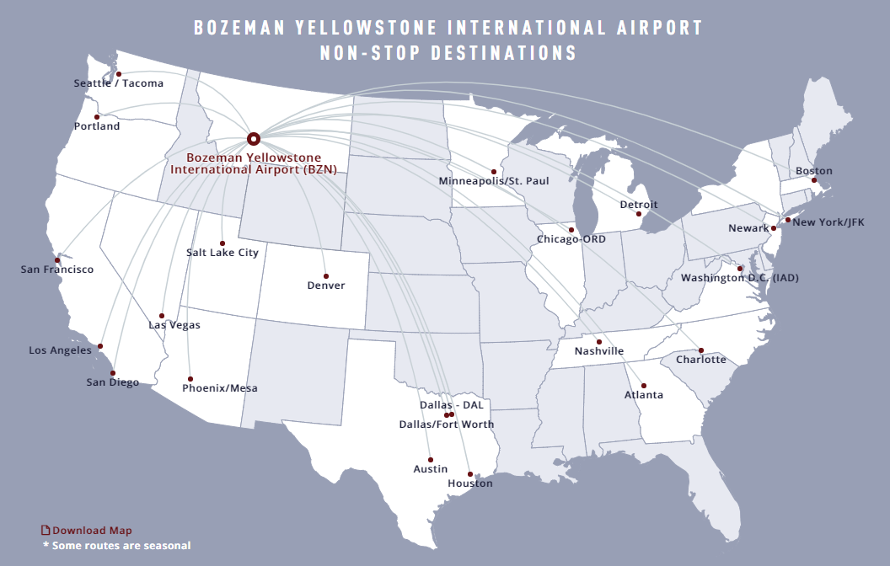
BOZEMAN YELLOWSTONE INTERNATIONAL AIRPORT NON-STOP DESTINATIONS
Source: Bozeman Yellowstone International Airport

Slide 12
BOZEMAN YELLOWSTONE INTERNATIONAL AIRPORT - TOTAL PASSENGERS YEAR-TO-DATE
Total Revenue Passengers | Total Revenue Passengers
Month | 2024 | 2023 | % Change vs. 2023 | 2022 | % Change vs. 2022
January | 184,239 | 182,309 | 1.1% | 167,043 | 10.3%
February | 192,315 | 188,040 | 2.3% | 171,096 | 12.4%
March |  | 212,084 |  | 206,216
April |  | 144,862 |  | 140,031
May |  | 173,251 |  | 165,145
June |  | 248,492 |  | 225,410
July |  | 286,163 |  | 256,234
August |  | 281,444 |  | 254,445
September |  | 234,589 |  | 203,844
October |  | 185,605 |  | 167,851
November |  | 142,205 |  | 132,939
December |  | 185,281 |  | 174,170
Year-to-Date | 376,554 | 2,464,325 | -84.7% | 2,264,424 | -83.4%
Total |  | 2,464,325 |  | 2,264,424
Source: Bozeman Yellowstone International Airport
Notes:
https://bozemanairport.com/reports-and-statistics-financial-documents

Slide 13
BOZEMAN YELLOWSTONE INTERNATIONAL AIRPORT - YEARLY TOTAL PASSENGERS
(Jan-Feb 2024)
Source: Bozeman Yellowstone International Airport

Slide 14
AIRDNA
DATA

Slide 15
AIRDNA SHORT TERM RENTAL (INCLUDES AIRBNB & VRBO LISTINGS) DEFINITIONS
Definitions (provided by AirDNA)
Available Listings – Total number of listings whose calendars had at least one day classified as available or reserved during the reporting period.
Average Daily Rate – Average daily rate (ADR) of booked nights in USD (ADR = Total Revenue / Booked Nights).
Booked Listings – Total number of listings that had at least one reservation during the reporting period.
Demand (Nights) – Total number of Booked Nights during the reporting period.
Entire Place – Type of listing in which guests have the whole home to themselves. This usually includes a bedroom, a bathroom, and a kitchen.
Hotel Comparable Listings – Studio and one-bedroom Entire Home vacation rentals. AirDNA believes these are the type of listings most likely to compete directly with hotels.
LTM – Last Twelve Months
Occupancy Rate – Occupancy Rate = Total Booked Days / (Total Booked Days + Total Available Days). Calculation only includes vacation rentals with at least one Booked Night.
Private Room – Type of listing in which guests have their own private room for sleeping. Other areas could be shared.
Revenue (USD) – Total revenue (in US dollars) earned during the reporting period. Includes the advertised price from the time of booking, as well as cleaning fees.
RevPAR – Revenue Per Available Rental = ADR * Occupancy Rate
Shared Room – Type of listing in which guests sleep in a bedroom or a common area that could be shared with others.
Supply (Nights) – Total number of Available Nights and Booked Nights from Active Listings.
Source: AirDNA (Includes Airbnb and Vrbo data)

Slide 16
AIRDNA – OCCUPANCY (%) BY MONTH
Source: AirDNA (Includes Airbnb and Vrbo data)
Notes:
~150 more available listings this year than July 2021

Slide 17
AIRDNA – AVERAGE DAILY RATE ($) BY MONTH
Source: AirDNA (Includes Airbnb and Vrbo data)

Slide 18
KEY DATA
DATA

Slide 19
KEY DATA DIRECT SOURCE LODGING PARTNERS
Key Data currently partners with 12 Big Sky property management companies and hotels.
In total, this represents ~1,439 rental units in the Big Sky area.
All figures in the following slides are taken exclusively from the following 12 property management companies and hotels:
Big Sky Luxury Vacations, Big Sky Resort, Big Sky Vacation Rentals, EVOLVE, Lone Mountain Ranch, Montage Big Sky, Moonlight Basin, Natural Retreats, Stay Montana, Two Pines, Vacasa, and Wilson Peak Properties
We hope to add additional property management companies to the platform in the future, which will improve data quality and increase the total rental unit count.

Slide 20
KEY DATA DIRECT SOURCE DEFINITIONS
Average Daily Rate (ADR) - The average Unit Revenue paid by guests for all the Nights Sold in a given period. ADR, along with the property's Occupancy, are the foundations for the property's financial performance.
= Total Unit Revenue / Nights Sold
Adjusted Paid & Owner Occupancy - The percentage of nights occupied by guests and owners out of the Total Nights minus hold nights in the period.
= (Nights Sold + Owner Nights) / (Total Nights - Hold Nights)
Adjusted Revenue Per Available Room (RevPAR) - A critical KPI for measuring revenue performance, RevPAR takes into account both the average rate at which you booked the property (ADR) and the number of nights it was booked (Occupancy). This provides a better indicator of overall performance when compared to looking at the ADR or the Occupancy alone.
= Occupancy x ADR (or) Total Unit Revenue / Nights Available in a given period
Average Revenue (Nightly) - The amount charged to guests, excluding taxes. The total property revenue generated directly from the property rental, including any mandatory, non-discretionary or other charges automatically added to a guest account in which a guest has no ability to “opt-out.”

Slide 21
KEY DATA – OCCUPANCY (%) BY MONTH
Source: AirDNA (Includes Airbnb and Vrbo data)

Slide 22
KEY DATA – AVERAGE DAILY RATE ($) BY MONTH
Source: AirDNA (Includes Airbnb and Vrbo data)

Slide 23
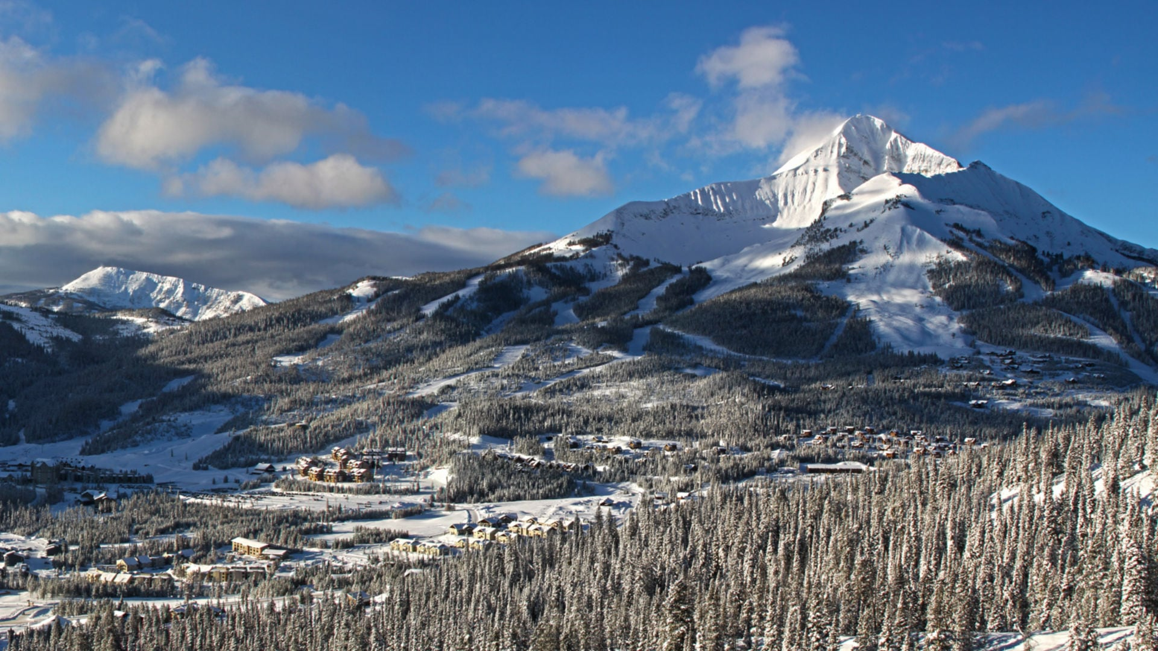
VISA DESTINATION INSIGHTS

Slide 24
VISA VUE – TOTAL DOMESTIC VISA CARD SPEND DATA BY YEAR
+7.8%
+24.2%
Source: Visa Destination Insights
Notes:
Big Sky – Domestic – Card Spend – Card type All – Resident status all

Slide 25
VISA VUE – TOTAL DOMESTIC VISA CARD SPEND DATA (Spend by Month)
Source: Visa Destination Insights
Notes:
Big Sky – Domestic – Card Spend – All – All

Slide 26
VISA VUE – TOTAL DOMESTIC VISA CARD SPEND DATA (Cumulative Spend by Month)
Source: Visa Destination Insights
Notes:
Big Sky – Domestic – Card Spend – All – All

Slide 27
VISA VUE – 2024 YEAR-TO-DATE VISA CARD SPEND DATA (Spend by Market January 2024)
Rank | Market | Total Spend | YoY Change % | Card Count | YoY Change %
1 | Bozeman, MT | $2,426,400 | -11% | 12,006 | -10%
2 | New York-Newark-Jersey City, NY-NJ-PA | $512,855 | -6% | 1,640 | +2%
3 | Chicago-Naperville-Elgin, IL-IN-WI | $434,603 | +14% | 1,045 | -2%
4 | Los Angeles-Long Beach-Anaheim, CA | $279,760 | -18% | 1,072 | -10%
5 | San Francisco-Oakland-Berkeley, CA | $187,673 | -6% | 678 | -15%
6 | Washington-Arlington-Alexandria, DC-VA-MD | $170,755 | -15% | 467 | -13%
7 | Seattle-Tacoma-Bellevue, WA | $155,195 | -33% | 707 | -28%
8 | San Diego-Chula Vista-Carlsbad, CA | $142,995 | +13% | 510 | -4%
9 | Minneapolis-St. Paul-Bloomington, MN-WI | $135,951 | -29% | 579 | -26%
10 | Denver-Aurora-Lakewood, CO | $131,920 | -32% | 727 | -29%
Source: Visa Destination Insights
Notes:
Slide 32 Updated JR 1/24/2024

Slide 28
VISA VUE – TOTAL INTERNATIONAL VISA CARD SPEND DATA (Spend by Month)
Source: Visa Destination Insights
Notes:
Big Sky – International – Card Spend – All – All

Slide 29
VISA VUE – TOTAL INTERNATIONAL VISA CARD SPEND DATA (Cumulative Spend by Month)
Source: Visa Destination Insights

Slide 30
VISA VUE – 2024 YEAR-TO-DATE VISA CARD SPEND DATA (Spend by International Market January 2024)
Rank | Market | Total Spend | YoY Change % | Card Count | YoY Change %
1 | Canada | $74,373 | +13% | 270 | +29%
2 | Australia | $54,566 | -19% | 109 | -6%
3 | New Zealand | $15,693 | +23% | 24 | -23%
4 | United Kingdom | $11,677 | +143% | 30 | +3%
5 | Dominican Republic | $7,581 | NA | 10 | NA
6 | Mexico | $7,343 | +4% | 21 | +24%
7 | Brazil | $6,880 | -1% | 10 | NA
8 | Puerto Rico | $5,427 | -45% | 15 | -48%
9 | Spain | $3,315 | +808% | 13 | NA
10 | Costa Rica | $2,885 | +336% | 15 | NA
Source: Visa Destination Insights
Notes:
Slide 37 Updated JR 1/24/2024

Slide 31
CONSUMER SENTIMENT DATA
LONGWOODS INTERNATIONAL

Slide 32
TRAVEL SENTIMENT STUDY WAVE 83
*Survey fielded March 6, 2024; US National Sample of 1,000 adults 18+
5+ Nights
Day Trip
1 Night
Source: Longwoods International
Notes:
Updated JR 3/20/24

Slide 33
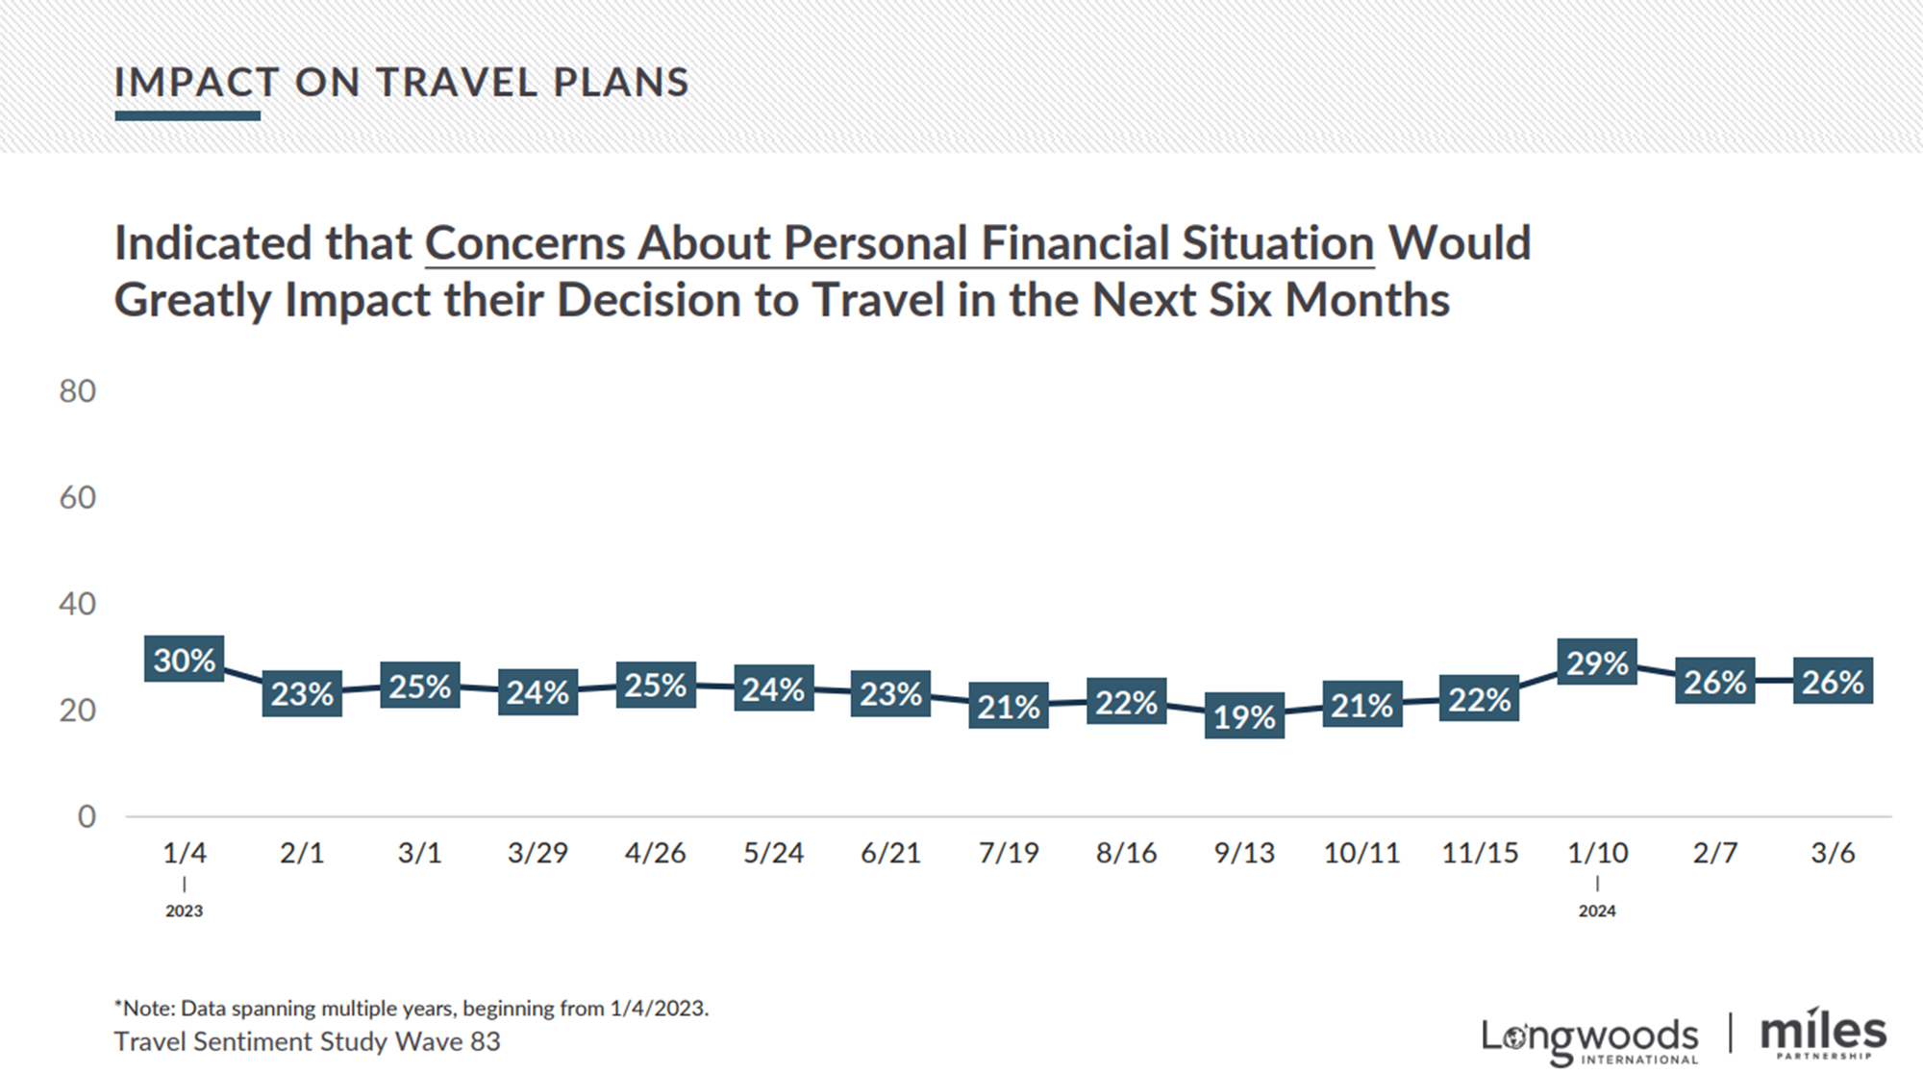
TRAVEL SENTIMENT STUDY WAVE 83
*Survey fielded March 6, 2024; US National Sample of 1,000 adults 18+
5+ Nights
Day Trip
1 Night
Source: Longwoods International
Notes:
Updated JR 3/20/24

Slide 34
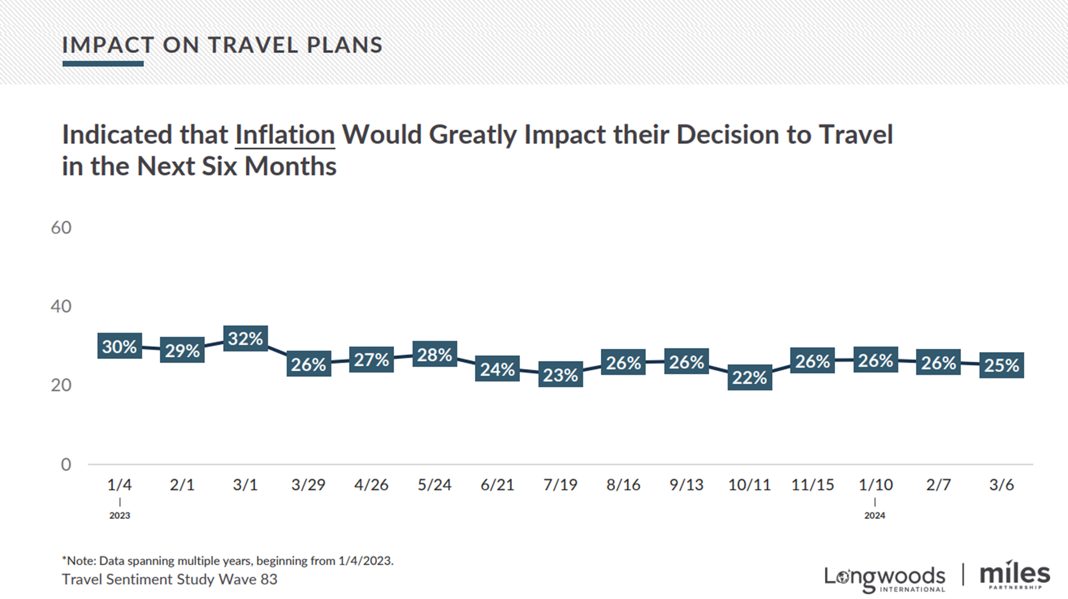
TRAVEL SENTIMENT STUDY WAVE 83
*Survey fielded March 6, 2024; US National Sample of 1,000 adults 18+
5+ Nights
Day Trip
1 Night
Source: Longwoods International
Notes:
Updated JR 3/20/24

Slide 35
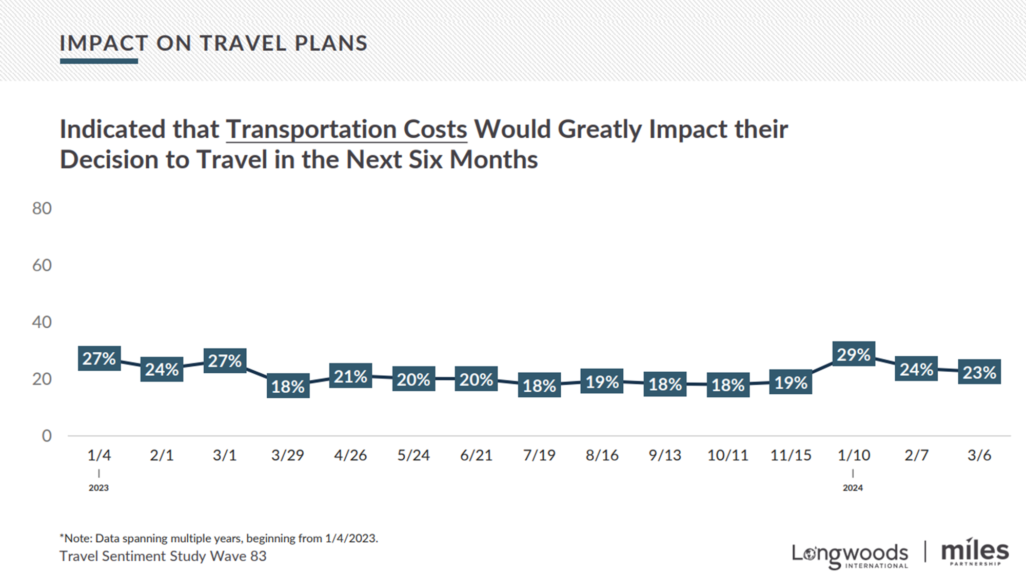
TRAVEL SENTIMENT STUDY WAVE 83
*Survey fielded March 6, 2024; US National Sample of 1,000 adults 18+
5+ Nights
Day Trip
1 Night
Source: Longwoods International
Notes:
Updated JR 3/20/24

Slide 36
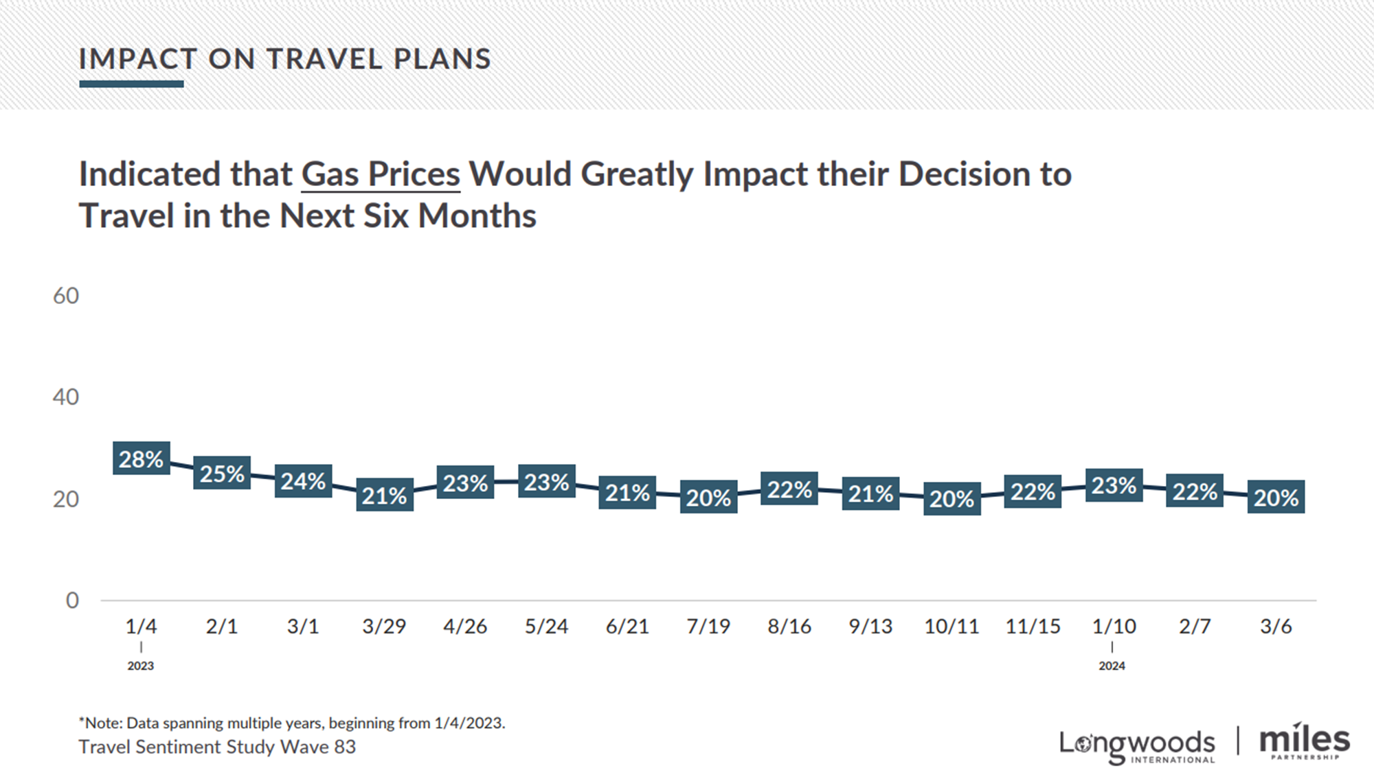
TRAVEL SENTIMENT STUDY WAVE 83
*Survey fielded March 6, 2024; US National Sample of 1,000 adults 18+
5+ Nights
Day Trip
1 Night
Source: Longwoods International
Notes:
Updated JR 3/20/24

Slide 37
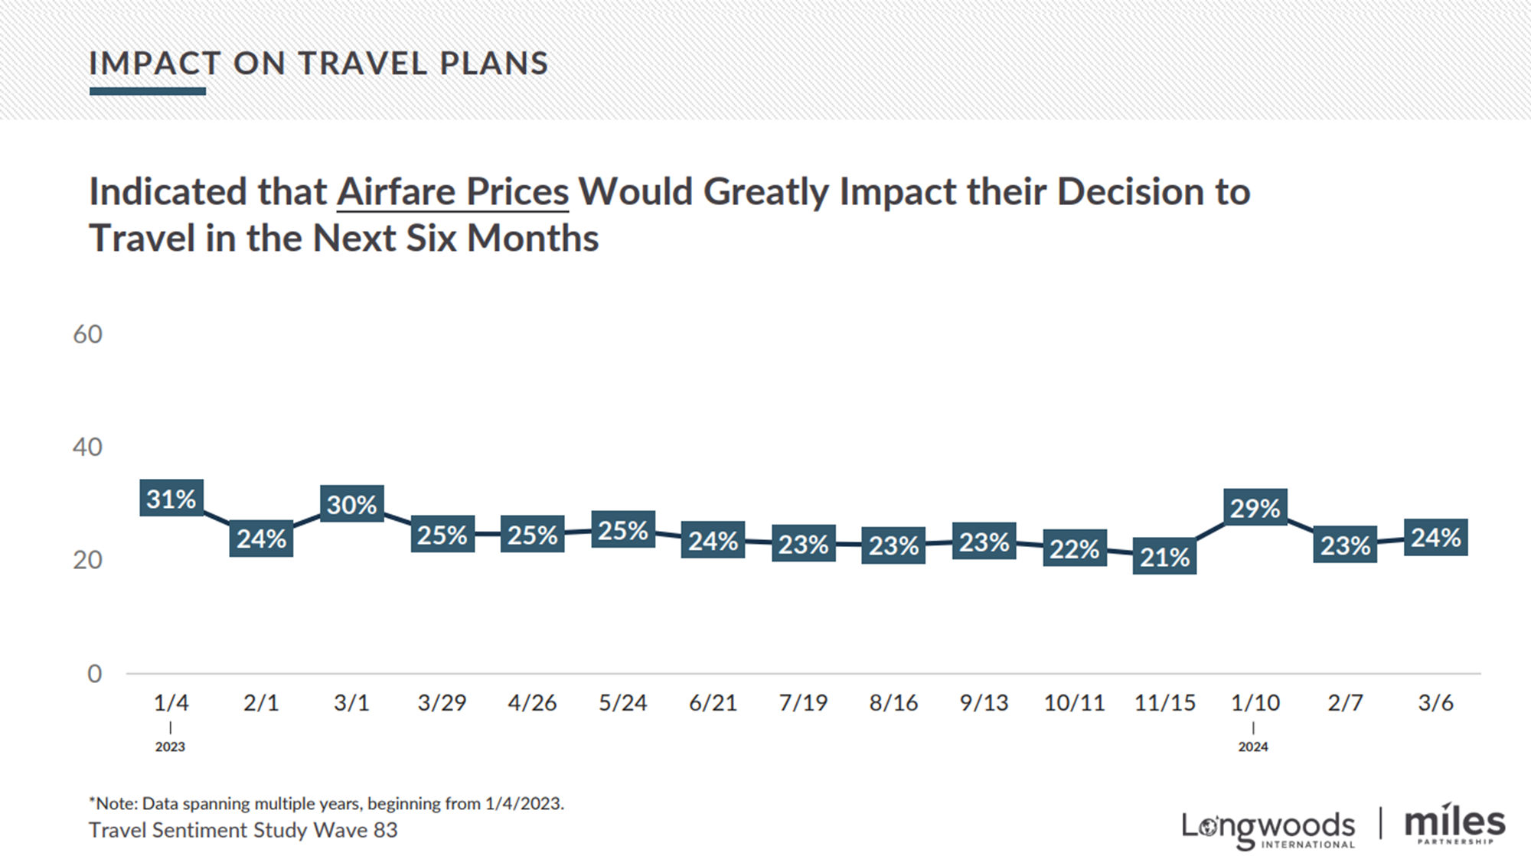
TRAVEL SENTIMENT STUDY WAVE 83
*Survey fielded March 6, 2024; US National Sample of 1,000 adults 18+
5+ Nights
Day Trip
1 Night
Source: Longwoods International
Notes:
Updated JR 3/20/24

