Slide 1
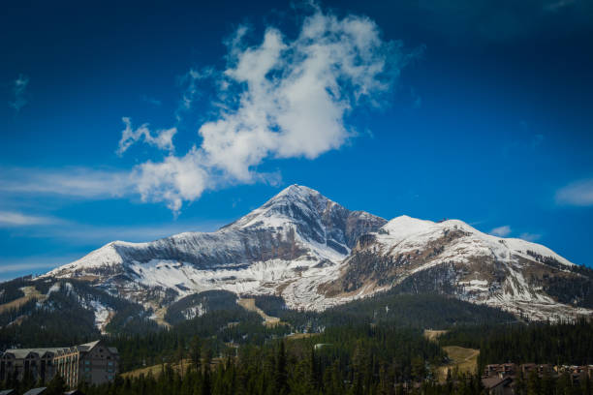
RESEARCH UPDATE
AUGUST 2023 REVIEW

Slide 2
EXECUTIVE SUMMARY
Big Sky Travel & Tourism Trends
The Bozeman Yellowstone International Airport continues to show strong performance, with total passengers Year-to-Date through August 2023 up by more than 8% YoY.
August 2023 saw an increase of 10.6% in Total Revenue Passengers compared to August 2022.
There were 1,070 total Airbnb and Vrbo short term rental listings available in August in Big Sky, which is a YoY increase of 7.2%. Demand remained strong and Occupancy fell by just 0.2%, but Average Daily rate dropped by 12.9%, and RevPAR decreased by 13.0% compared to August of last year.
Because of the significant reduction in ADR, Total Revenue collected from these two short term rental channels totaled just $10.3 million for the month of August, a decrease of 9.3% YoY.
Professionally managed short-term rentals saw a slight increase in YoY Occupancy in August, but Average Daily Rate decreased from $585 to $546, a drop of almost 7%.
Note: The Montage was added to the Key Data data set this month and all historical data has been updated to include this new data.
Visa consumer credit card spend in Big Sky continues to grow, with $51.8 million being spent within Big Sky so far this year (Jan-July 2023).
Note: Visa Destination Insights has not yet reported August data.

Slide 3
EXECUTIVE SUMMARY
U.S. Market Review - Macroeconomic Trends
August travelers benefitted from an economy that continues to reduce inflation without triggering the recession that often follows Federal Reserve tightening.
According to the Bureau of Labor Statistics (BLS), 187,000 jobs were added in August—an improvement on the more than 157,000 jobs added in July.
This signals both a strong August and a sustainable level of hiring moving forward.
Unemployment increased to 3.8% and is expected to remain stable in the long term.
The BLS reported that labor productivity also increased in the second quarter, putting pressure on inflation without the economic drag associated with higher interest rates.
Despite higher gas prices pushing up the CPI, core inflation — which strips out volatile food and energy prices — continued to decline in August.
Prices appear to be stabilizing, the labor market is cooling after a period of overheating, and the Fed has legitimate reasons to hold off on interest rate hikes for the time being.
There are still many recessionary threats, such as student loan repayments resuming, the possibility of a government shutdown, and the dwindling of American savings accounts, but it appears possible that the long-anticipated recession could be avoided.
Source: BLS and AirDNA

Slide 4
EXECUTIVE SUMMARY
U.S. Hotel Performance Summary – August 2023
Following seasonal patterns, the U.S. hotel industry reported lower performance results from the previous month but improved comparisons year over year, according to August 2023 hotel performance data from Smith Travel Research.
August 2023 Statistics (percentage change from August 2022)
Occupancy: 66.0% (-0.3%)
Average Daily Rate: $153.60 (+1.8%)
Revenue Per Available Room: $101.35 (+1.5%)
Top 25 Markets Summary
Among the Top 25 Markets, Oahu Island experienced the highest Occupancy level (84.4%), which was up 3.4% year-over-year.
Markets with the lowest Occupancy included New Orleans (45.7%) and Houston (56.8%).
The Top 25 Markets showed higher Occupancy than all other markets for the month of August 2023.
Source: Smith Travel Research (STR)

Slide 5
EXECUTIVE SUMMARY
U.S. Market Review – Short Term Rentals
After July set the all-time record for nights stayed in one month, U.S. short-term rental (STR) Demand cooled in August.
Demand grew 7.6% Year-over-Year (YoY), compared to the 9.3% growth in July.
Still, this was the biggest August ever, with 21.2 million nights booked, despite a punishing heat wave across much of the nation, devastating wildfires in Hawaii, and a hurricane passing through Florida.
Key U.S. Short Term Rental Performance Metrics – August 2023
Occupancy was 4.2% lower YoY at 60.4% (-0.6% vs. 2019)
Average Daily Rate grew 0.1% YoY to $324.85
RevPAR declined 4.0% YoY to $235.50
Total Available Listings reached 1.53 million, up 13.7% YoY
Total Demand (nights sold) rose 7.6% YoY
Source: AirDNA

Slide 6
AIRPORT
DATA

Slide 7
BOZEMAN YELLOWSTONE INTERNATIONAL AIRPORT - TOTAL PASSENGERS YEAR-TO-DATE
Total Revenue Passengers | Total Revenue Passengers
Month | 2023 | 2022 | % Change vs. 2022 | 2021 | % Change vs. 2021
January | 182,309 | 167,043 | +9.1% | 86,606 | +110.5%
February | 188,040 | 171,096 | +9.9% | 99,083 | +89.8%
March | 212,084 | 206,216 | +2.8% | 133,705 | +58.6%
April | 144,862 | 140,031 | +3.4% | 98,434 | +47.2%
May | 173,251 | 165,145 | +4.9% | 131,968 | +31.3%
June | 248,492 | 225,410 | +10.2% | 223,827 | +11.0%
July | 286,163 | 256,234 | +11.7% | 277,355 | +3.2%
August | 281,444 | 254,445 | +10.6% | 254,975 | +10.4%
September |  | 203,844 |  | 195,262
October |  | 167,851 |  | 156,192
November |  | 132,939 |  | 117,516
December |  | 174,170 |  | 165,268
Year-to-Date | 1,716,645 | 1,585,620 | +8.3% | 1,305,953 | +31.4%
Total |  | 2,264,424 |  | 1,940,191
Source: Bozeman Yellowstone International Airport
Notes:
https://bozemanairport.com/reports-and-statistics-financial-documents

Slide 8
AIRDNA
DATA

Slide 9
AIRDNA SHORT TERM RENTAL (INCLUDES AIRBNB & VRBO LISTINGS) DEFINITIONS
Definitions (provided by AirDNA)
Available Listings – Total number of listings whose calendars had at least one day classified as available or reserved during the reporting period.
Average Daily Rate – Average daily rate (ADR) of booked nights in USD (ADR = Total Revenue / Booked Nights).
Booked Listings – Total number of listings that had at least one reservation during the reporting period.
Demand (Nights) – Total number of Booked Nights during the reporting period.
Entire Place – Type of listing in which guests have the whole home to themselves. This usually includes a bedroom, a bathroom, and a kitchen.
Hotel Comparable Listings – Studio and one-bedroom Entire Home vacation rentals. AirDNA believes these are the type of listings most likely to compete directly with hotels.
LTM – Last Twelve Months
Occupancy Rate – Occupancy Rate = Total Booked Days / (Total Booked Days + Total Available Days). Calculation only includes vacation rentals with at least one Booked Night.
Private Room – Type of listing in which guests have their own private room for sleeping. Other areas could be shared.
Revenue (USD) – Total revenue (in US dollars) earned during the reporting period. Includes the advertised price from the time of booking, as well as cleaning fees.
RevPAR – Revenue Per Available Rental = ADR * Occupancy Rate
Shared Room – Type of listing in which guests sleep in a bedroom or a common area that could be shared with others.
Supply (Nights) – Total number of Available Nights and Booked Nights from Active Listings.
Source: AirDNA (Includes Airbnb and Vrbo data)

Slide 10
AIRDNA SHORT TERM RENTAL DATA (Airbnb & Vrbo)
August 2023 = 1,070 Available Listings
Vrbo
Airbnb
Source: AirDNA (Includes Airbnb and Vrbo data)

Slide 11
AIRDNA – OCCUPANCY (%) BY MONTH
Source: AirDNA (Includes Airbnb and Vrbo data)
Notes:
~150 more available listings this year than July 2021

Slide 12
AIRDNA – AVERAGE DAILY RATE ($) BY MONTH
Source: AirDNA (Includes Airbnb and Vrbo data)

Slide 13
KEY DATA
DATA

Slide 14
KEY DATA DIRECT SOURCE LODGING PARTNERS
Key Data currently partners with 12 Big Sky property management companies and hotels.
In total, this represents ~1,439 rental units in the Big Sky area.
All figures in the following slides are taken exclusively from the following 12 property management companies and hotels:
Big Sky Vacation Rentals, Gather Vacations, Big Sky Resort, Wilson Peak Properties, Two Pines, Moonlight Basin, Natural Retreats, VillaStay Vacation Rentals, EVOLVE, Stay Montana, The Montage, and The Wilson Hotel
We hope to add additional property management companies to the platform in the future, which will improve data quality and increase the total rental unit count.

Slide 15
KEY DATA DIRECT SOURCE DEFINITIONS
Average Daily Rate (ADR) - The average Unit Revenue paid by guests for all the Nights Sold in a given period. ADR, along with the property's Occupancy, are the foundations for the property's financial performance.
= Total Unit Revenue / Nights Sold
Adjusted Paid & Owner Occupancy - The percentage of nights occupied by guests and owners out of the Total Nights minus hold nights in the period.
= (Nights Sold + Owner Nights) / (Total Nights - Hold Nights)
Adjusted Revenue Per Available Room (RevPAR) - A critical KPI for measuring revenue performance, RevPAR takes into account both the average rate at which you booked the property (ADR) and the number of nights it was booked (Occupancy). This provides a better indicator of overall performance when compared to looking at the ADR or the Occupancy alone.
= Occupancy x ADR (or) Total Unit Revenue / Nights Available in a given period
Average Revenue (Nightly) - The amount charged to guests, excluding taxes. The total property revenue generated directly from the property rental, including any mandatory, non-discretionary or other charges automatically added to a guest account in which a guest has no ability to “opt-out.”

Slide 16
KEY DATA – OCCUPANCY (%) BY MONTH
Source: AirDNA (Includes Airbnb and Vrbo data)

Slide 17
KEY DATA – AVERAGE DAILY RATE ($) BY MONTH
Source: AirDNA (Includes Airbnb and Vrbo data)

Slide 18
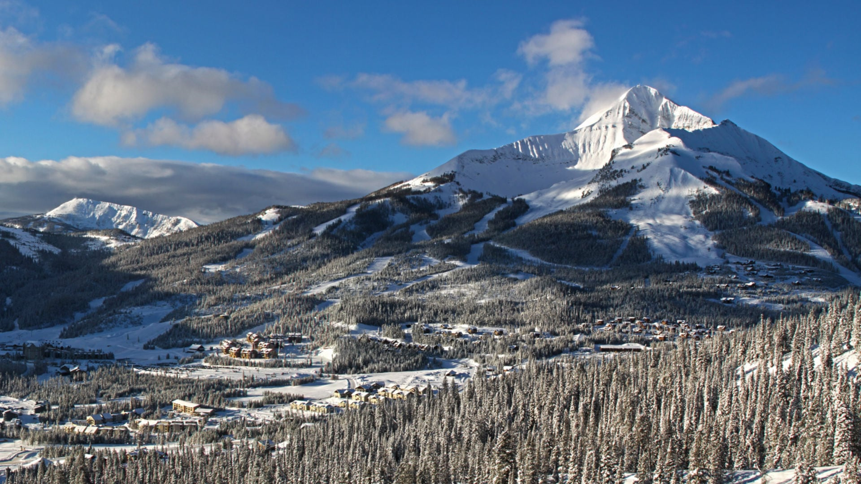
VISA DESTINATION INSIGHTS
*Note – Visa data has been updated through July 2023

Slide 19
VISA VUE – TOTAL VISA CARD SPEND DATA (Spend by Month)
Source: Visa Destination Insights

Slide 20
VISA VUE – TOTAL VISA CARD SPEND DATA (Cumulative Spend by Month)
Source: Visa Destination Insights

Slide 21
VISA VUE – 2023 YEAR-TO-DATE VISA CARD SPEND DATA (Spend by Market January – July 2023)
Rank | Market | Total Spend | YoY Change % | Card Count | YoY Change %
1 | Bozeman, MT | $14,957,114 | +26% | 39,291 | +19%
2 | New York-Newark-Jersey City, NY-NJ-PA | $2,396,749 | +12% | 6,938 | +7%
3 | Los Angeles-Long Beach-Anaheim, CA | $1,670,610 | +18% | 5,150 | +3%
4 | Chicago-Naperville-Elgin, IL-IN-WI | $1,614,039 | +20% | 4,324 | +10%
5 | Seattle-Tacoma-Bellevue, WA | $1,232,810 | +9% | 4,725 | +5%
6 | Boston-Cambridge-Newton, MA-NH | $1,102,730 | +20% | 3,457 | +10%
7 | Denver-Aurora-Lakewood, CO | $997,976 | +20% | 4,897 | +11%
8 | San Francisco-Oakland-Berkeley, CA | $995,884 | +3% | 3,428 | +2%
9 | Minneapolis-St. Paul-Bloomington, MN-WI | $926,267 | -5% | 3,611 | -9%
10 | Washington-Arlington-Alexandria, DC-VA-MD | $824,667 | +20% | 2,231 | -3%
Source: Visa Destination Insights

Slide 22
VISA VUE – 2022 & 2023 YTD VISA CARD SPEND VISITORS VS. RESIDENTS (AS A PERCENT OF TOTAL SPEND)
Source: Visa Destination Insights

Slide 23
CONSUMER SENTIMENT DATA
LONGWOODS INTERNATIONAL & FUTURE PARTNERS

Slide 24
TRAVEL SENTIMENT STUDY WAVE 77
*Survey fielded August 16, 2023; US National Sample of 1,000 adults 18+
5+ Nights
Day Trip
1 Night
Source: Longwoods International

Slide 25
TRAVEL SENTIMENT STUDY WAVE 77
*Survey fielded August 16, 2023; US National Sample of 1,000 adults 18+
5+ Nights
Day Trip
1 Night
Source: Longwoods International

Slide 26
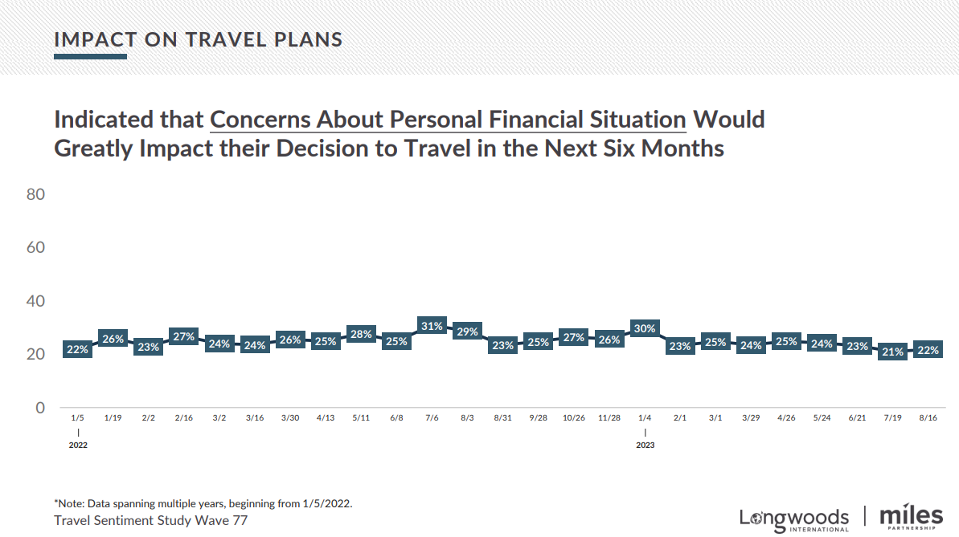
TRAVEL SENTIMENT STUDY WAVE 77
*Survey fielded August 16, 2023; US National Sample of 1,000 adults 18+
5+ Nights
Day Trip
1 Night
Source: Longwoods International

Slide 27
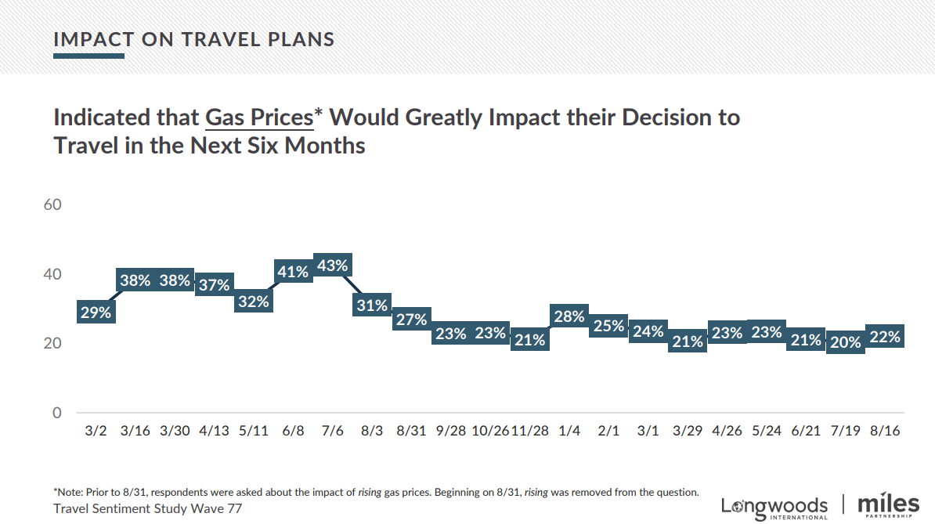
TRAVEL SENTIMENT STUDY WAVE 77
*Survey fielded August 16, 2023; US National Sample of 1,000 adults 18+
5+ Nights
Day Trip
1 Night
Source: Longwoods International

Slide 28
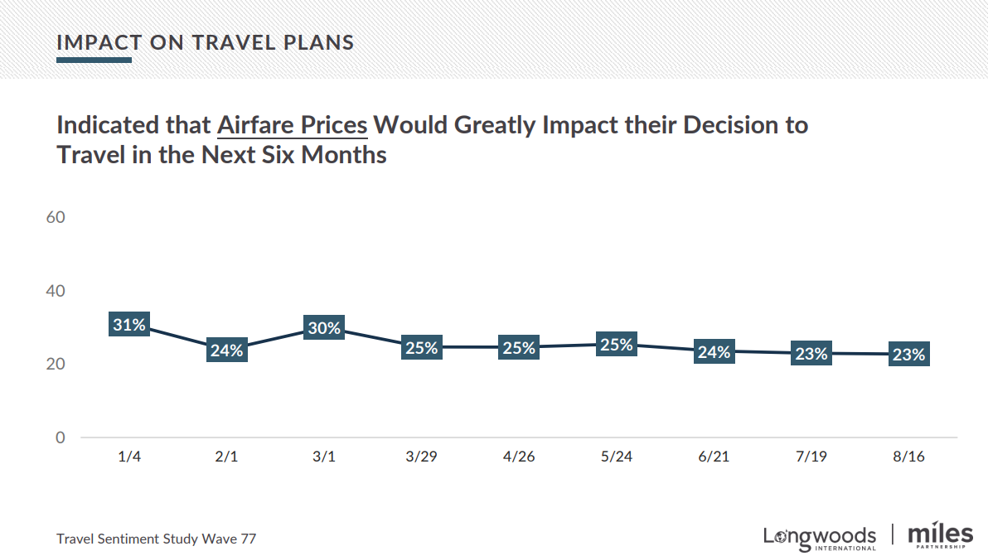
TRAVEL SENTIMENT STUDY WAVE 77
*Survey fielded August 16, 2023; US National Sample of 1,000 adults 18+
5+ Nights
Day Trip
1 Night
Source: Longwoods International

Slide 29
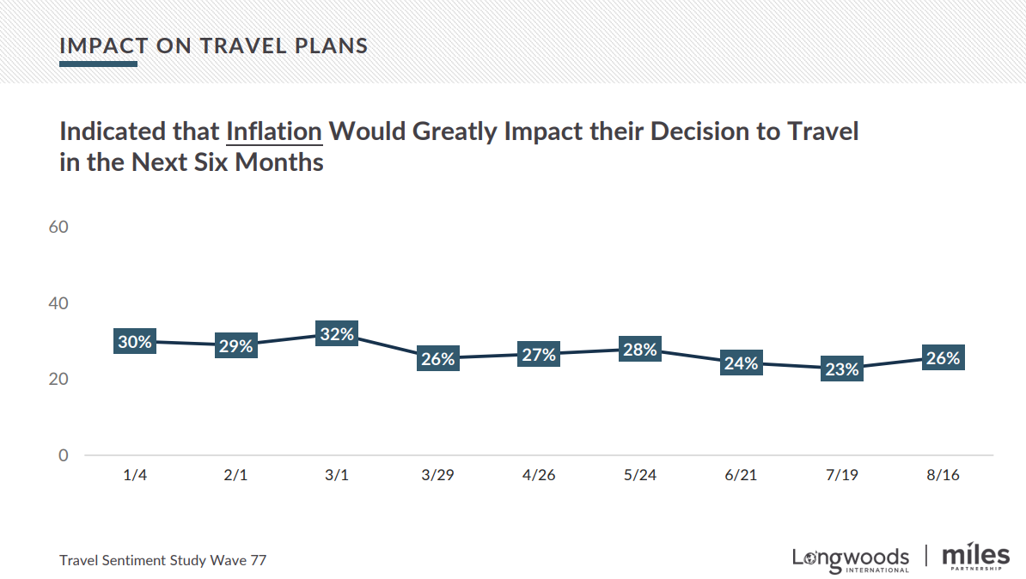
TRAVEL SENTIMENT STUDY WAVE 77
*Survey fielded August 16, 2023; US National Sample of 1,000 adults 18+
5+ Nights
Day Trip
1 Night
Source: Longwoods International

Slide 30
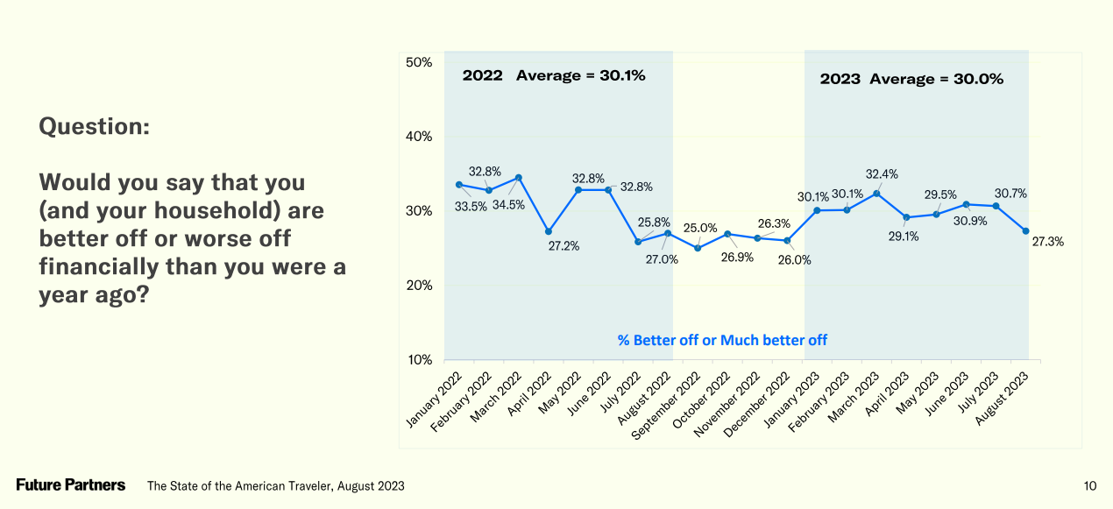
STATE OF THE AMERICAN TRAVELER
*Survey fielded August 17-21, 2023; Representative sample of adult American travelers; N = 4,000+
5+ Nights
Day Trip
1 Night
Source: Future Partners

Slide 31
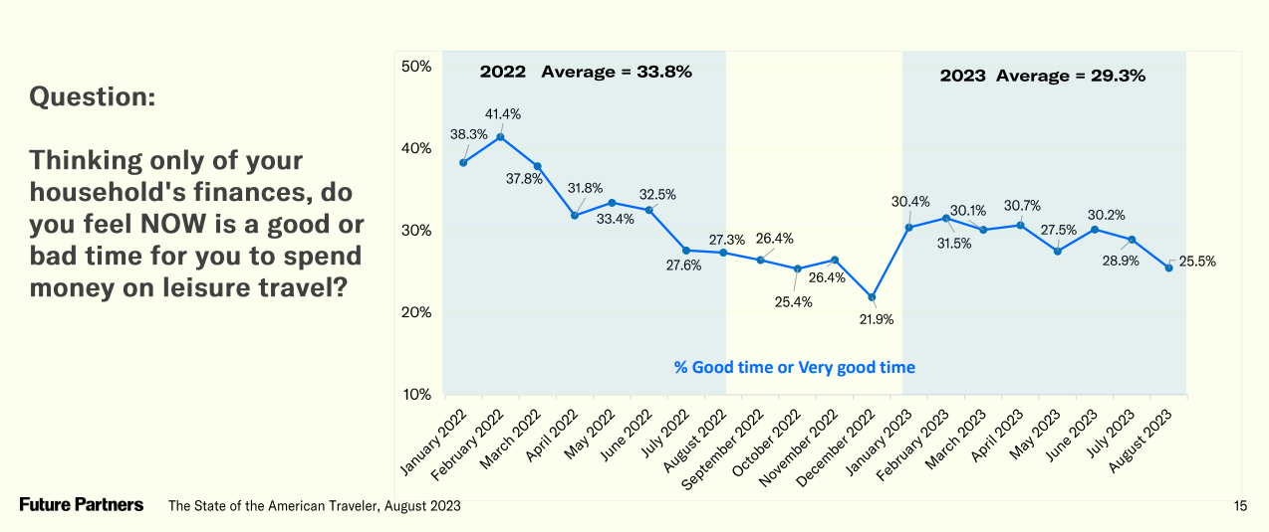
STATE OF THE AMERICAN TRAVELER
*Survey fielded August 17-21, 2023; Representative sample of adult American travelers; N = 4,000+
5+ Nights
Day Trip
1 Night
Source: Future Partners

Slide 32
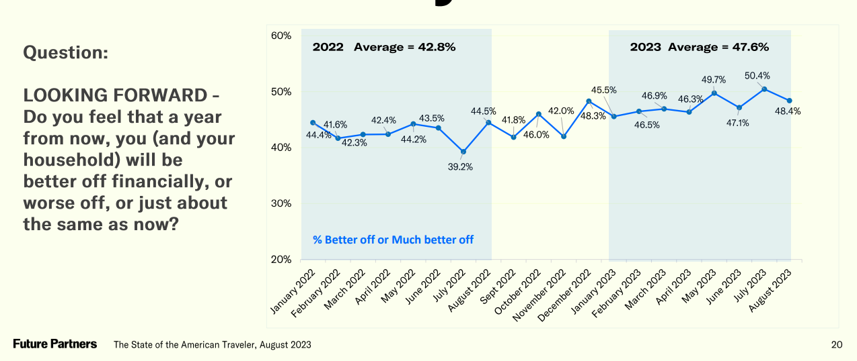
STATE OF THE AMERICAN TRAVELER
*Survey fielded August 17-21, 2023; Representative sample of adult American travelers; N = 4,000+
5+ Nights
Day Trip
1 Night
Source: Future Partners

Slide 33
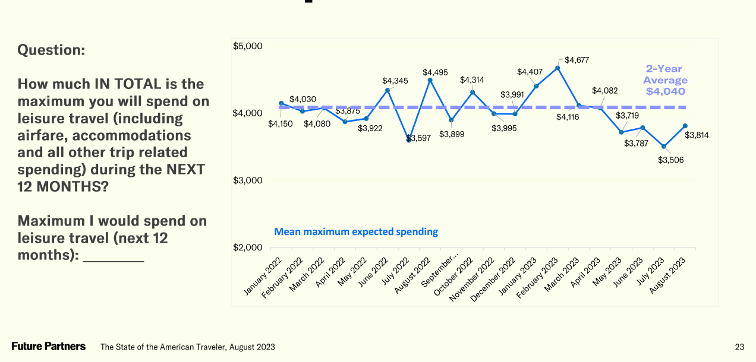
STATE OF THE AMERICAN TRAVELER
*Survey fielded August 17-21, 2023; Representative sample of adult American travelers; N = 4,000+
5+ Nights
Day Trip
1 Night
Source: Future Partners

Slide 34
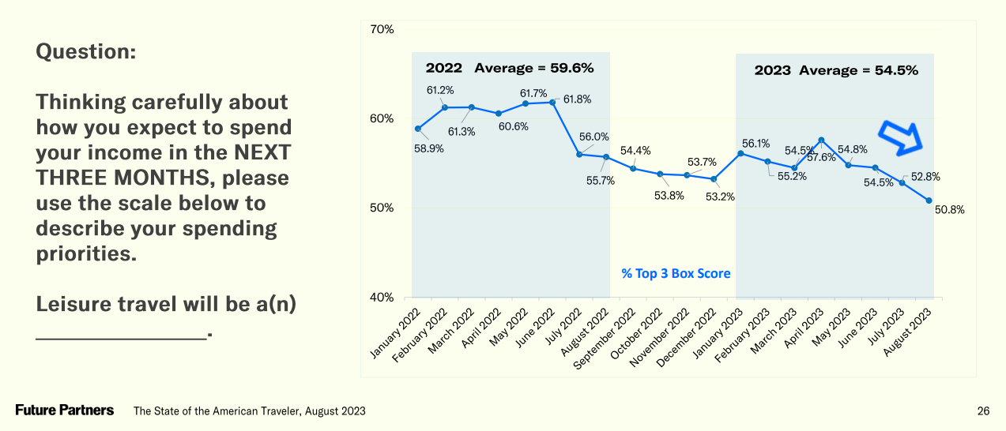
STATE OF THE AMERICAN TRAVELER
*Survey fielded August 17-21, 2023; Representative sample of adult American travelers; N = 4,000+
5+ Nights
Day Trip
1 Night
Source: Future Partners

Slide 35
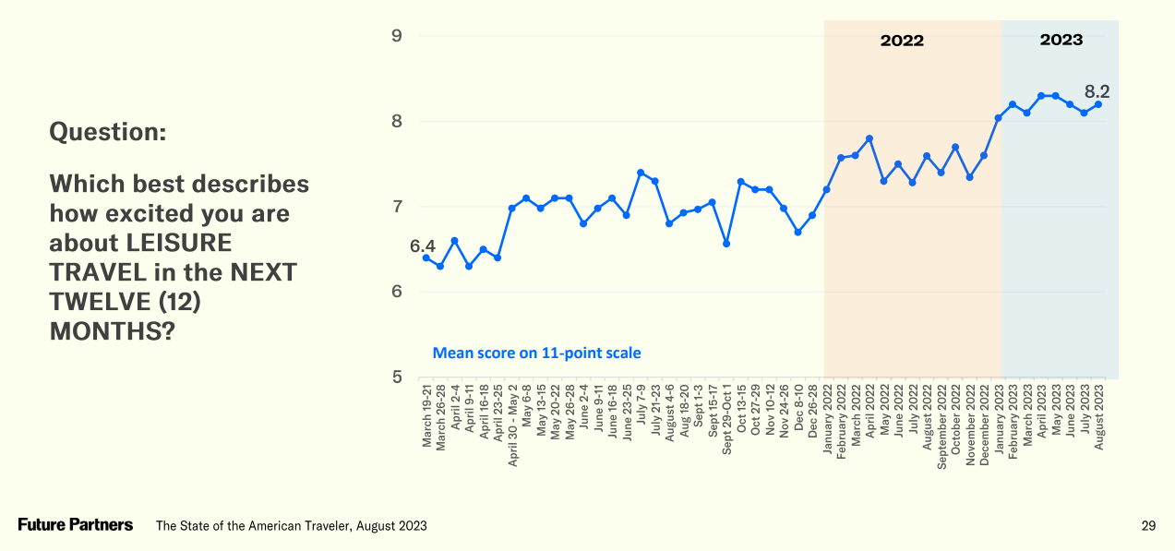
STATE OF THE AMERICAN TRAVELER
*Survey fielded August 17-21, 2023; Representative sample of adult American travelers; N = 4,000+
5+ Nights
Day Trip
1 Night
Source: Future Partners

Slide 36
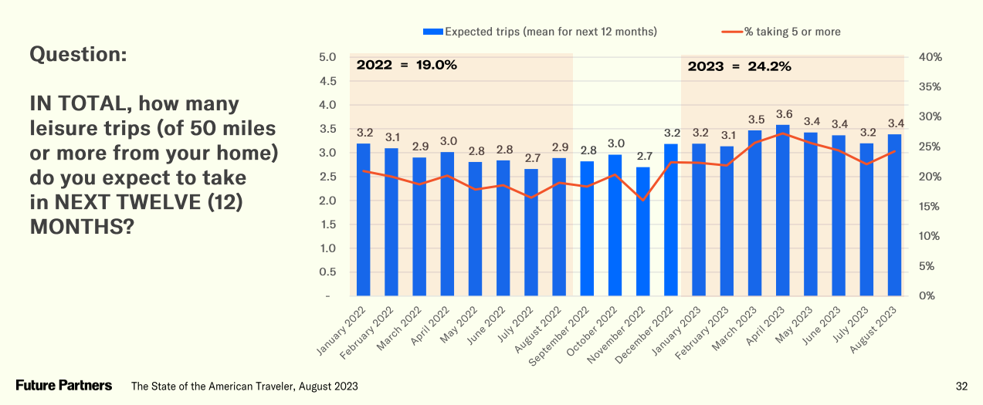
STATE OF THE AMERICAN TRAVELER
*Survey fielded August 17-21, 2023; Representative sample of adult American travelers; N = 4,000+
5+ Nights
Day Trip
1 Night
Source: Future Partners

Slide 37
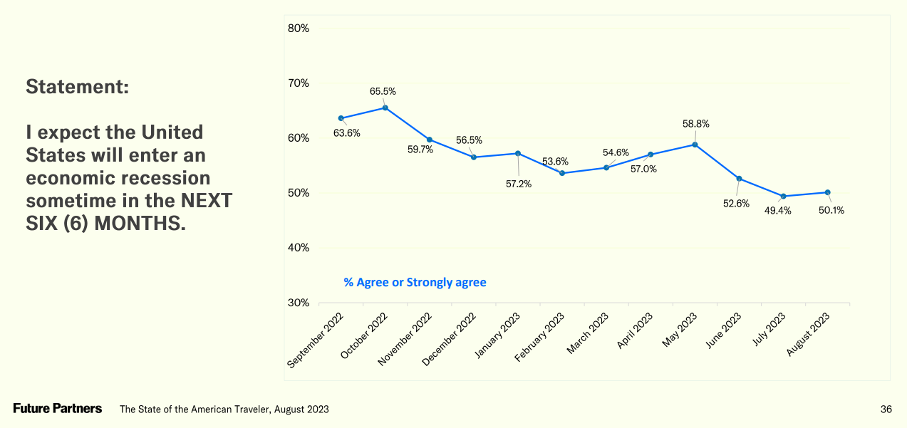
STATE OF THE AMERICAN TRAVELER
*Survey fielded August 17-21, 2023; Representative sample of adult American travelers; N = 4,000+
5+ Nights
Day Trip
1 Night
Source: Future Partners

Slide 38
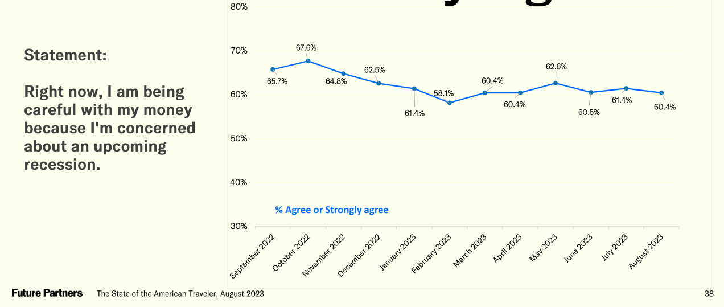
STATE OF THE AMERICAN TRAVELER
*Survey fielded August 17-21, 2023; Representative sample of adult American travelers; N = 4,000+
5+ Nights
Day Trip
1 Night
Source: Future Partners

Slide 39
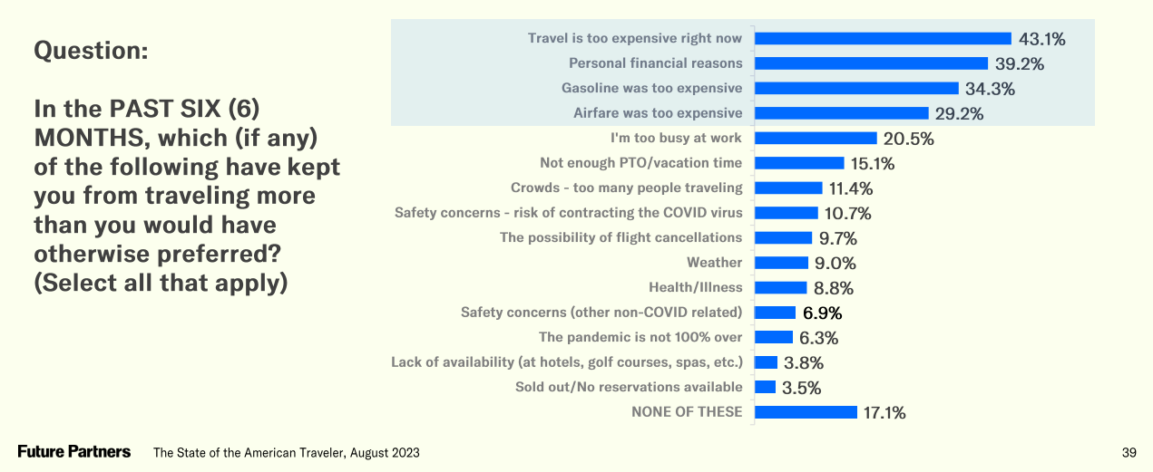
STATE OF THE AMERICAN TRAVELER
*Survey fielded August 17-21, 2023; Representative sample of adult American travelers; N = 4,000+
5+ Nights
Day Trip
1 Night
Source: Future Partners

Slide 40
STATE OF THE AMERICAN TRAVELER
*Survey fielded August 17-21, 2023; Representative sample of adult American travelers; N = 4,000+
5+ Nights
Day Trip
1 Night
Source: Future Partners

Slide 41
STATE OF THE AMERICAN TRAVELER
*Survey fielded August 17-21, 2023; Representative sample of adult American travelers; N = 4,000+
5+ Nights
Day Trip
1 Night
Source: Future Partners

Slide 42
STATE OF THE AMERICAN TRAVELER
*Survey fielded August 17-21, 2023; Representative sample of adult American travelers; N = 4,000+
5+ Nights
Day Trip
1 Night
Source: Future Partners

Slide 43
STATE OF THE AMERICAN TRAVELER
*Survey fielded August 17-21, 2023; Representative sample of adult American travelers; N = 4,000+
5+ Nights
Day Trip
1 Night
Source: Future Partners

Slide 44
STATE OF THE AMERICAN TRAVELER
*Survey fielded August 17-21, 2023; Representative sample of adult American travelers; N = 4,000+
5+ Nights
Day Trip
1 Night
Source: Future Partners

