Slide 1
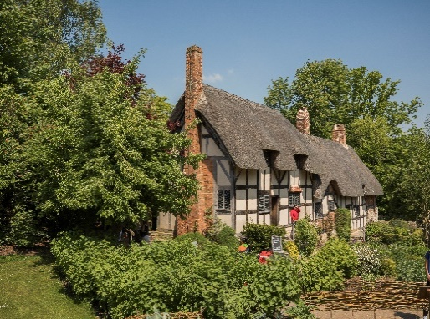
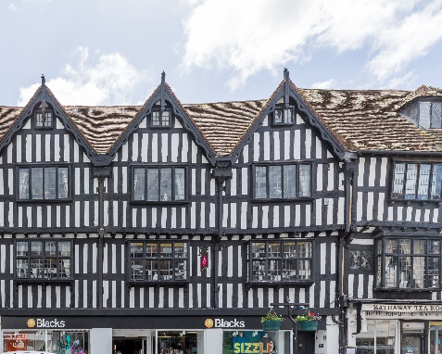
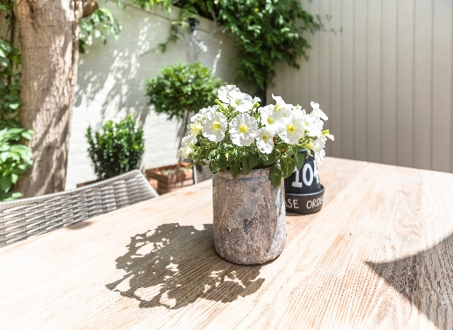

SAMPLE DAY PROGRAMME FOR EXPLORING
STRATFORD-UPON-AVON
Food Themed Day
No matter whether you’re looking for a family meal for five or fine dining for two, Shakespeare’s England has eateries to suit every occasion, and some of the quirkiest venues.
Morning
Start your day with a full English breakfast at the chic-but-comfy Boston Tea Party in Stratford-upon-Avon.
Afternoon
Indulge in a traditional lunchtime cream tea (not forgetting the scones!) at Hathaway’s Tearoom. Spend your afternoon in Henley-in-Arden getting creative in a chocolate making workshop run by Henley Chocolates – try not to get too messy!
Evening
Round the day off with the romantic meal of your dreams at The Cross in Kenilworth, an exquisite, Michelin-starred eatery situated in a quaintly beautiful market town. Or, if a more relaxed setting is more your thing, Stratford-upon-Avon’s The One Elm offers a great range of mouth watering meals, from traditional pub fare to contemporary cuisine, and a fine selection of drinks to wash them down with.
Speaking of drinks, for beer lovers no visit to Shakespeare’s England can be complete without a trip to the Purity Brewing Co.’s brewery and shop, located on a picturesque farm in the gorgeous Warwickshire countryside. Take the brewery tour to discover how Purity’s award-winning ales are made, try a sample or two, and find out why Warwickshire is so renowned for its local artisans and their produce.
For more information about days out in Stratford, visit:
https://shakespeares-england.co.uk/

