Slide 1
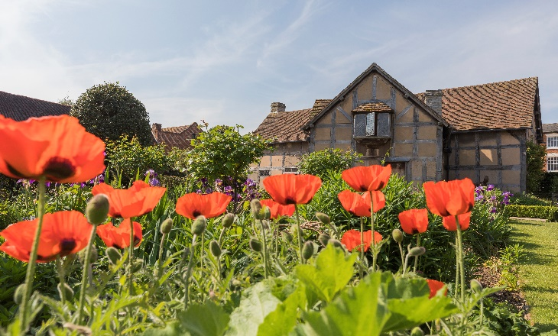
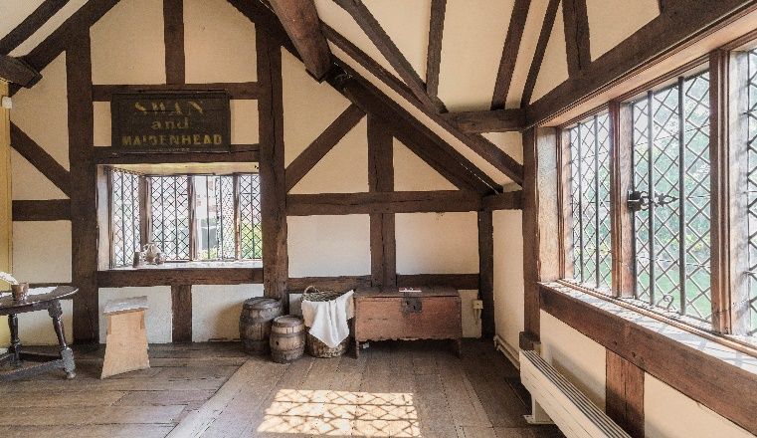


SAMPLE DAY TOUR PROGRAMME FOR EXPLORING
STRATFORD-UPON-AVON
Discover the heart of historical England in the birthplace of the world’s most iconic playwright. Go on a fascinating journey through William Shakespeare’s five family houses, learn about Tudor life and find out the inspiration behind some of the Bard’s famous plays and sonnets.
Highlights of the tour:
Shakespeare’s Schoolroom & Guildhall
Traditional gardens at Anne Hathaway’s Cottage and Hall’s Croft
Live theatre at Shakespeare’s Birthplace
Shakespeare’s grave at Holy Trinity Church
Tudor knot garden and artworks in Shakespeare’s New Place
Stop 1 - Shakespeare’s Birthplace
Duration: 1 hour
Kick off your tour in the house where it all began back in 1564. Explore Shakespeare’s childhood world as you wander through the rooms and hear tales of his life from costumed guides. Discover his father’s glove-making workshop and beautiful gardens featuring live theatre performances.
Stop 2 - Shakespeare’s Schoolroom & Guildhall
Duration: 30 minutes – 1 hour
Just five minutes’ walk away from his place of birth is Shakespeare’s Schoolroom and Guildhall. Sit in the very classroom where young William spent his school years and first experienced theatre as a pupil in the 1570s. Highlights include interactive films, soundscapes and knowledgeable guides that bring Shakespeare’s education to life.

Slide 2
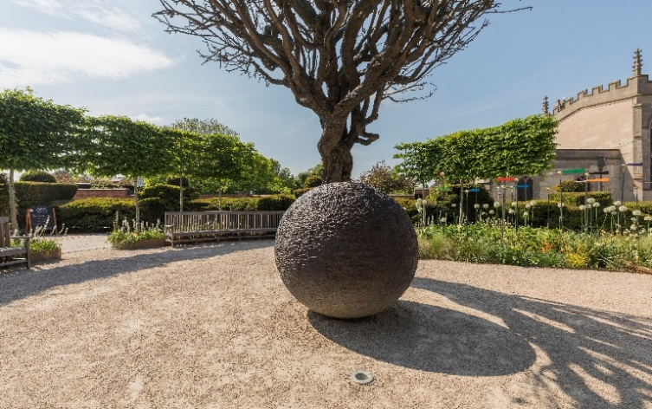
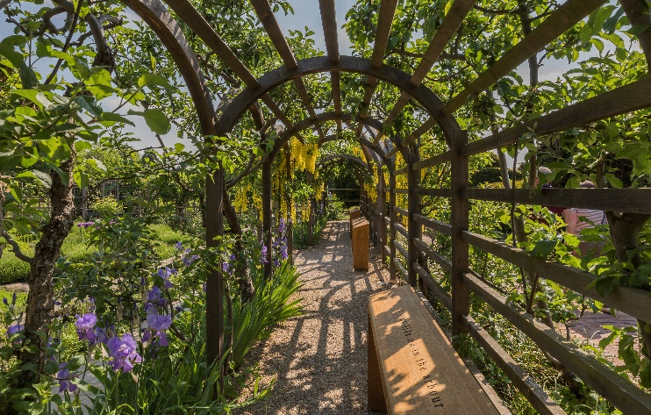
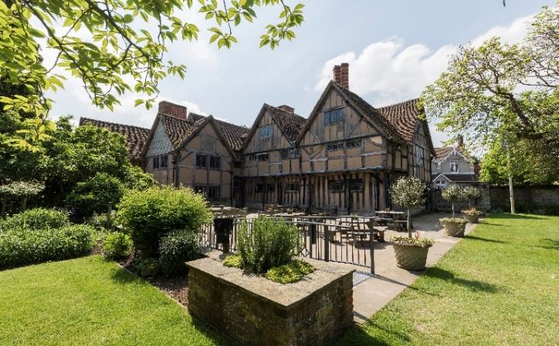
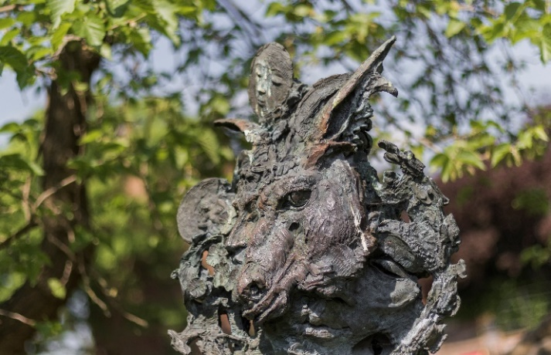
SAMPLE DAY TOUR PROGRAMME EXPLORING STRATFORD
Stop 3 - Shakespeare’s New Place
Duration: 1 hour
A stunning contemporary landscape in the heart of town, Shakespeare’s New Place is the site of Shakespeare’s family home for 19 years. Uncover the tale behind why the house was demolished, marvel at specially commissioned sculptures and wander through the sunken Tudor Knot Garden, now fully restored since its creation in 1920.
Stop 4 - Holy Trinity Church
Duration: 1 hour
A fantastic opportunity to explore one of England's most beautiful parish churches and the Bard of Avon’s final resting place. Visit Shakespeare’s grave and the graves of his family members including Anne Hathaway and Susanna Shakespeare.
Stop 5 – Hall’s Croft
Duration: 1 hour
Once home to Shakespeare’s eldest daughter, Susanna and her husband, Dr John Hall, this magnificent Jacobean property features luxurious rooms and an intriguing collection of medical equipment, books and notes dating back to 1657. Then onto the walled garden with traditional herbs as used by John Hall in his remedies.

Slide 3
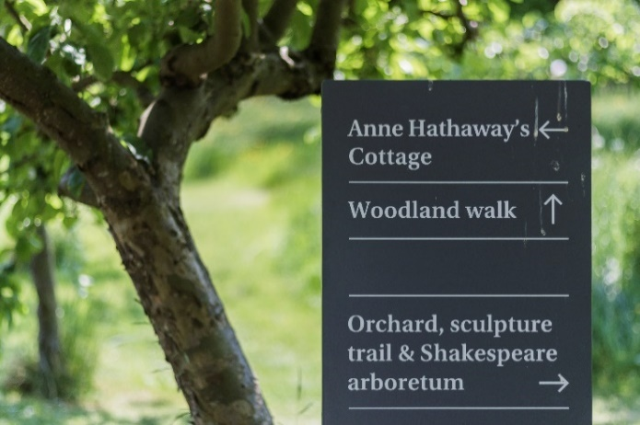
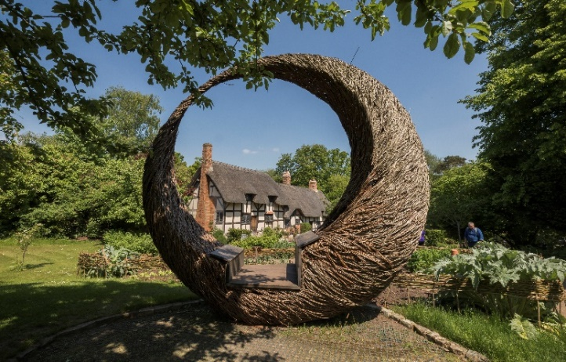
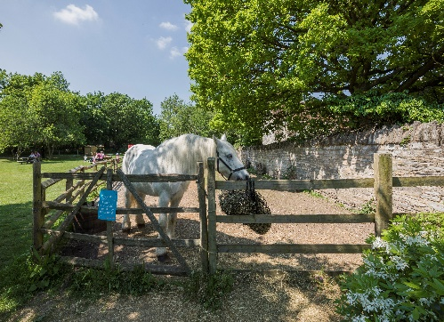
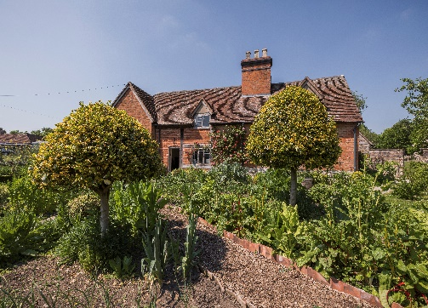
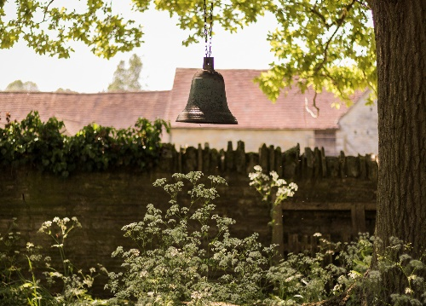
SAMPLE DAY TOUR PROGRAMME EXPLORING STRATFORD
Stop 6 - Anne Hathaway’s Cottage & Gardens
Duration: 2 hours
This charming thatched cottage is one for the hopeless romantics. Anne Hathaway’s Cottage is the family home of Shakespeare’s wife and the location where William is said to have courted his bride-to-be. Explore some of the original family furniture in the farmhouse and take in nine acres of beautiful gardens, sculpture trails and woodland walks.
Stop 7 – Mary Arden’s Farm
Duration: 2 hours
The last stop on the tour tells the story of Shakespeare’s mother, Mary Arden and the Tudor country life as Shakespeare would have experienced it. At the farm, there’s a chance to take part in rural crafts, Tudor food demonstrations and nature trails. Learn from the Tudors who are cooking, tending crops and feeding the animals according to the traditional farming calendar.
For more information about days out in Stratford, visit:
https://shakespeares-england.co.uk/

