Slide 1
ALL TOO REAL TRUTHS ABOUT PREPARING YOUR COMMUNITY FOR AN ECLIPSE

Slide 2
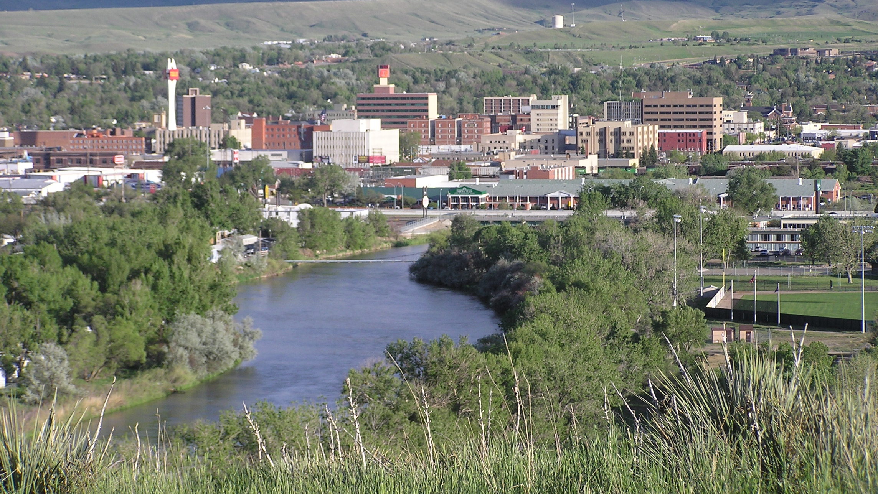
5 YEARS PRIOR…

Slide 3
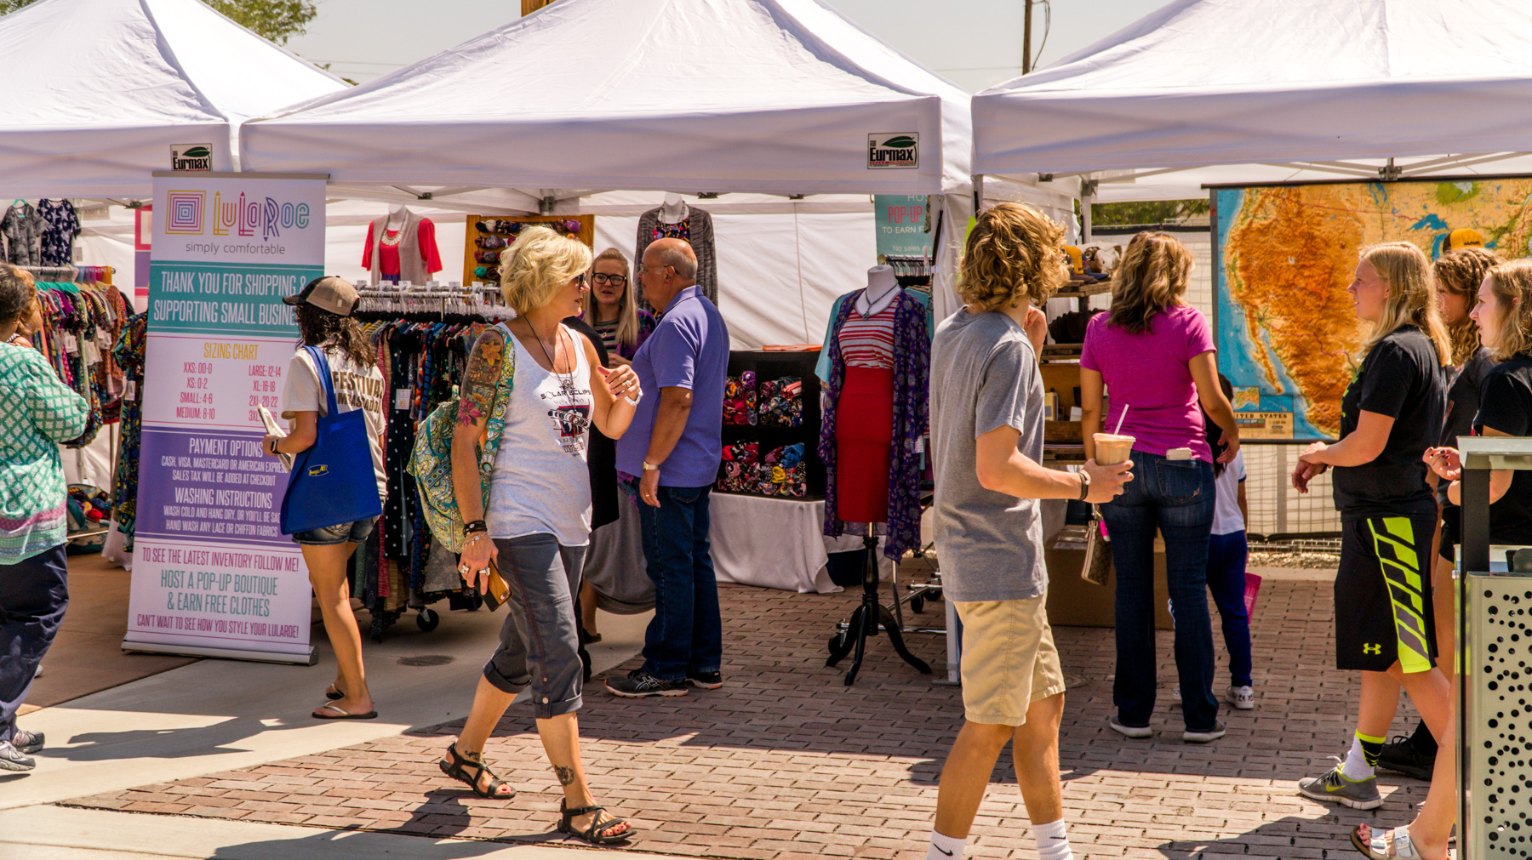
SKEPTICS, PSYCHICS + SEWER SYSTEMS

Slide 4
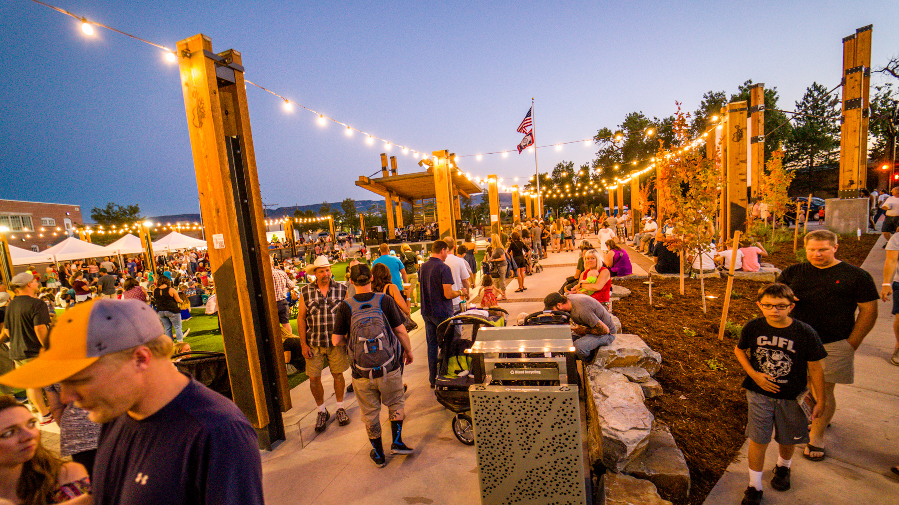
WHO’S IN CHARGE?

Slide 5
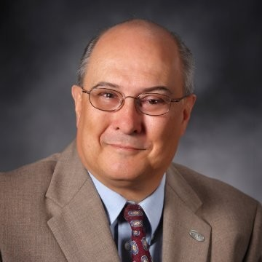
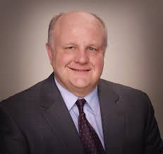
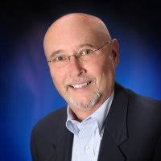
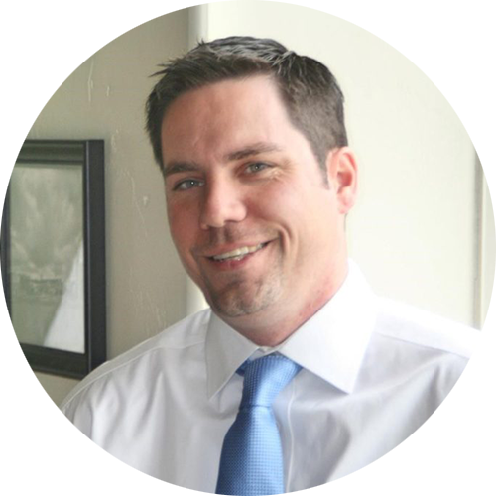
THE SET UP

Slide 6
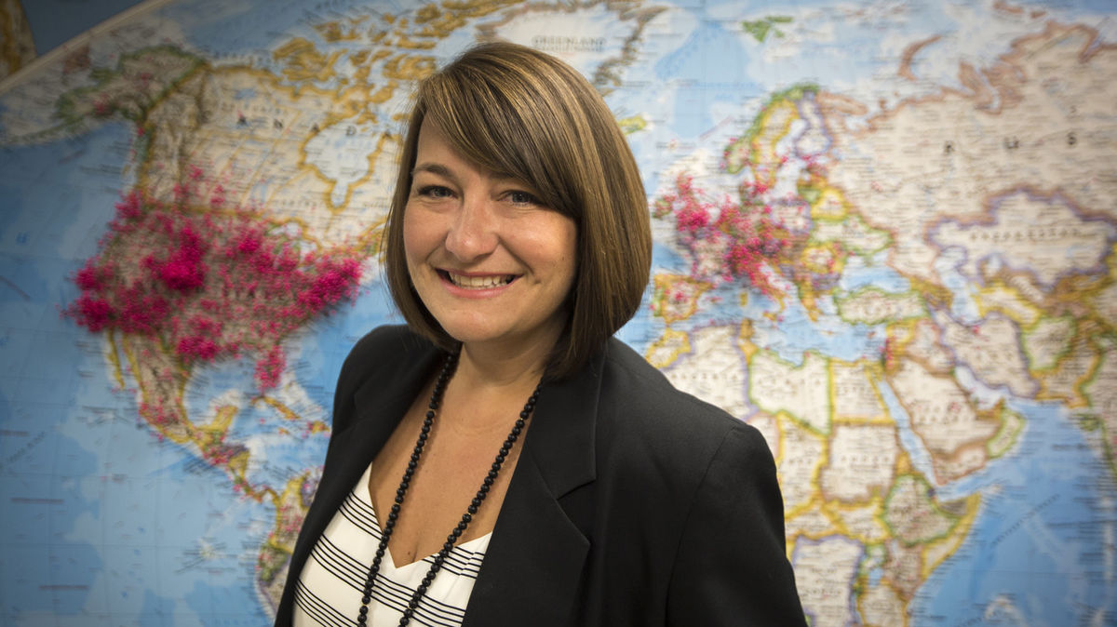
SET PRIORITIES

Slide 7
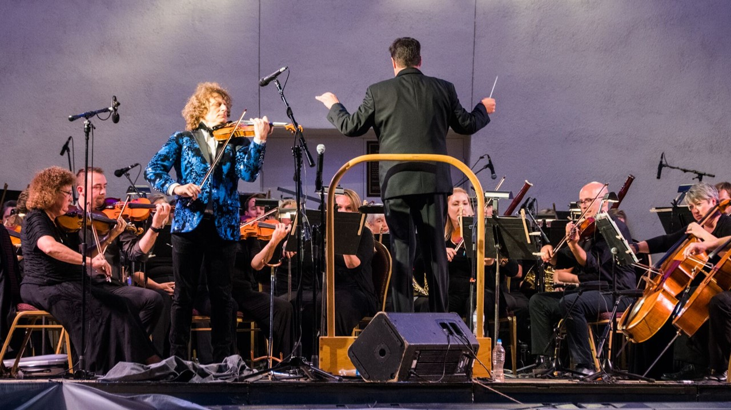
DEMOCRATIC DESIGN

Slide 8
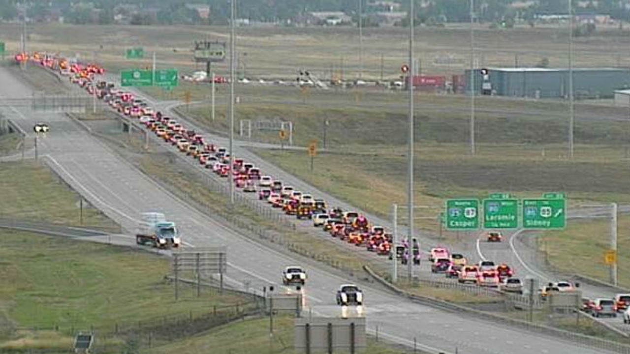
I’LL SHUT DOWN I-25…

Slide 9
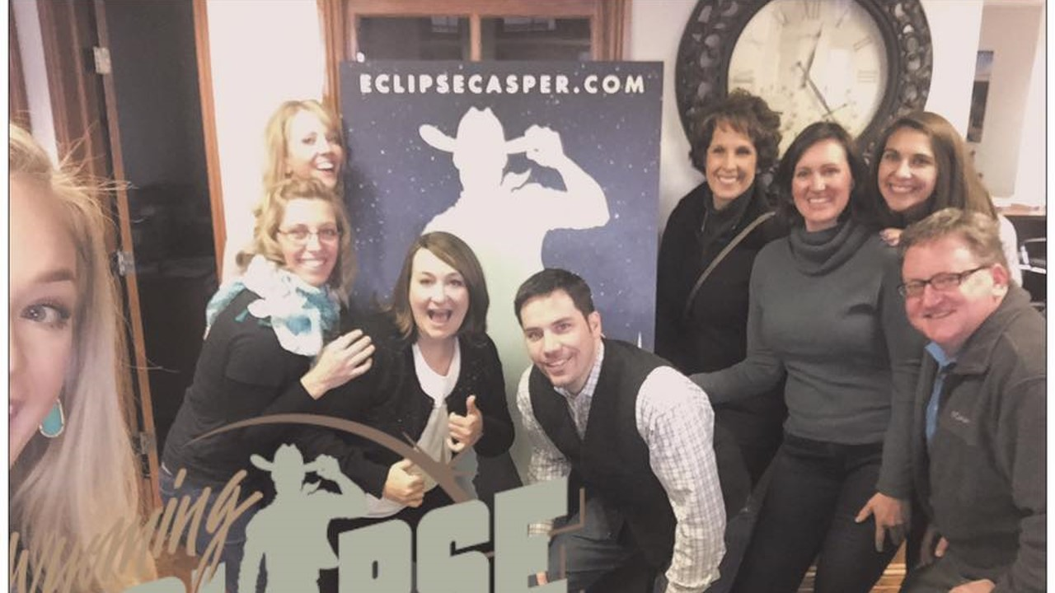
PREPARING A COMMUNITY

Slide 10
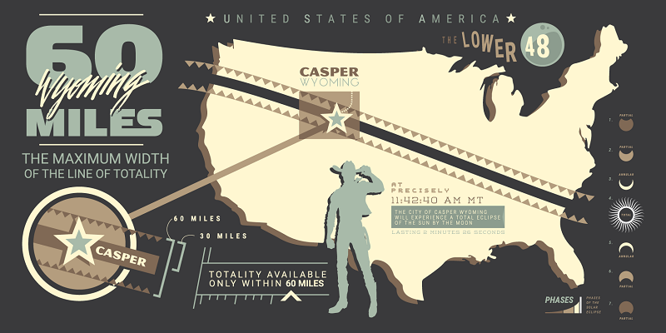
THE ROLE OF THE DMO

Slide 11
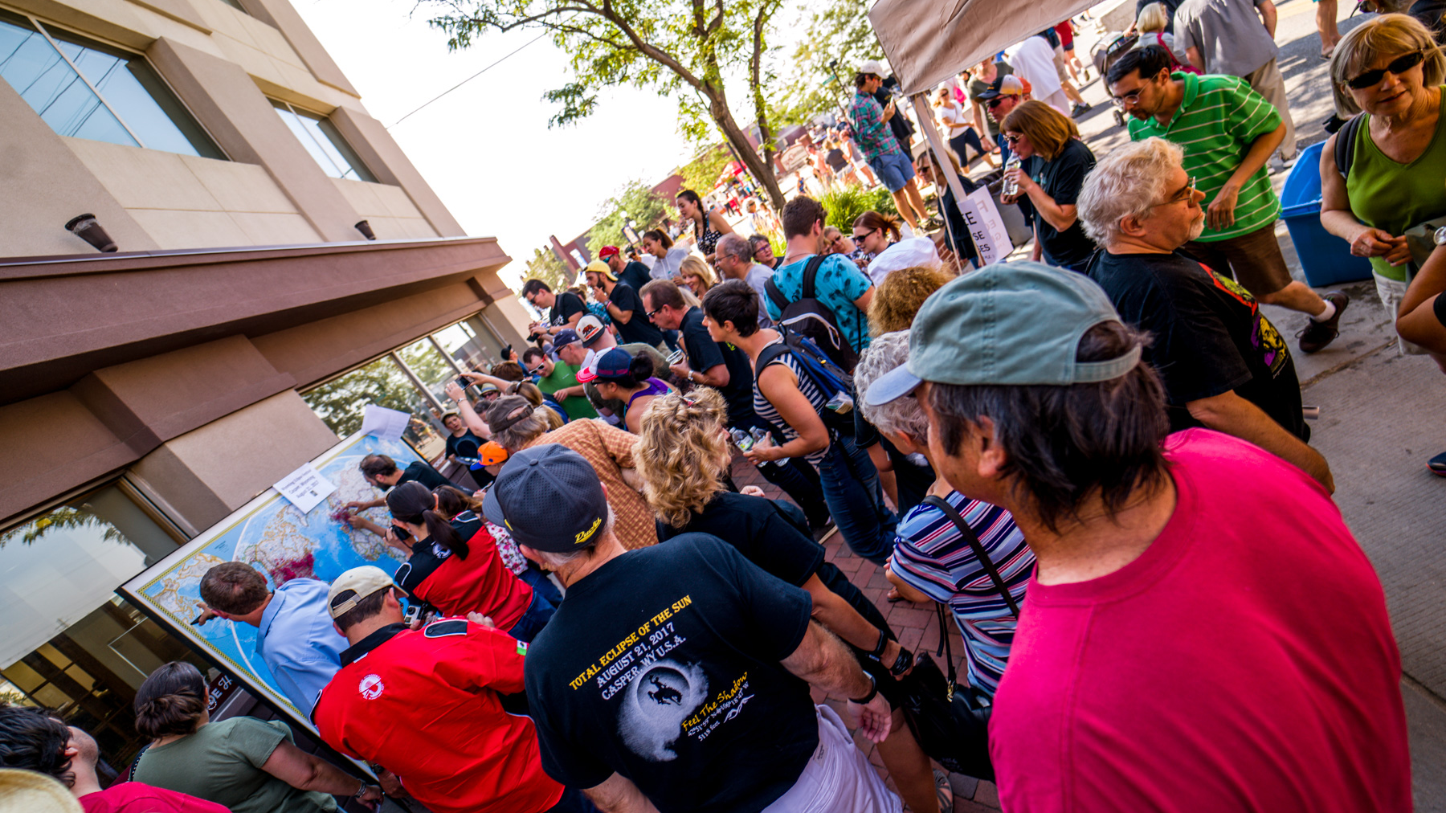
HOW MUCH DID IT COST?

Slide 12
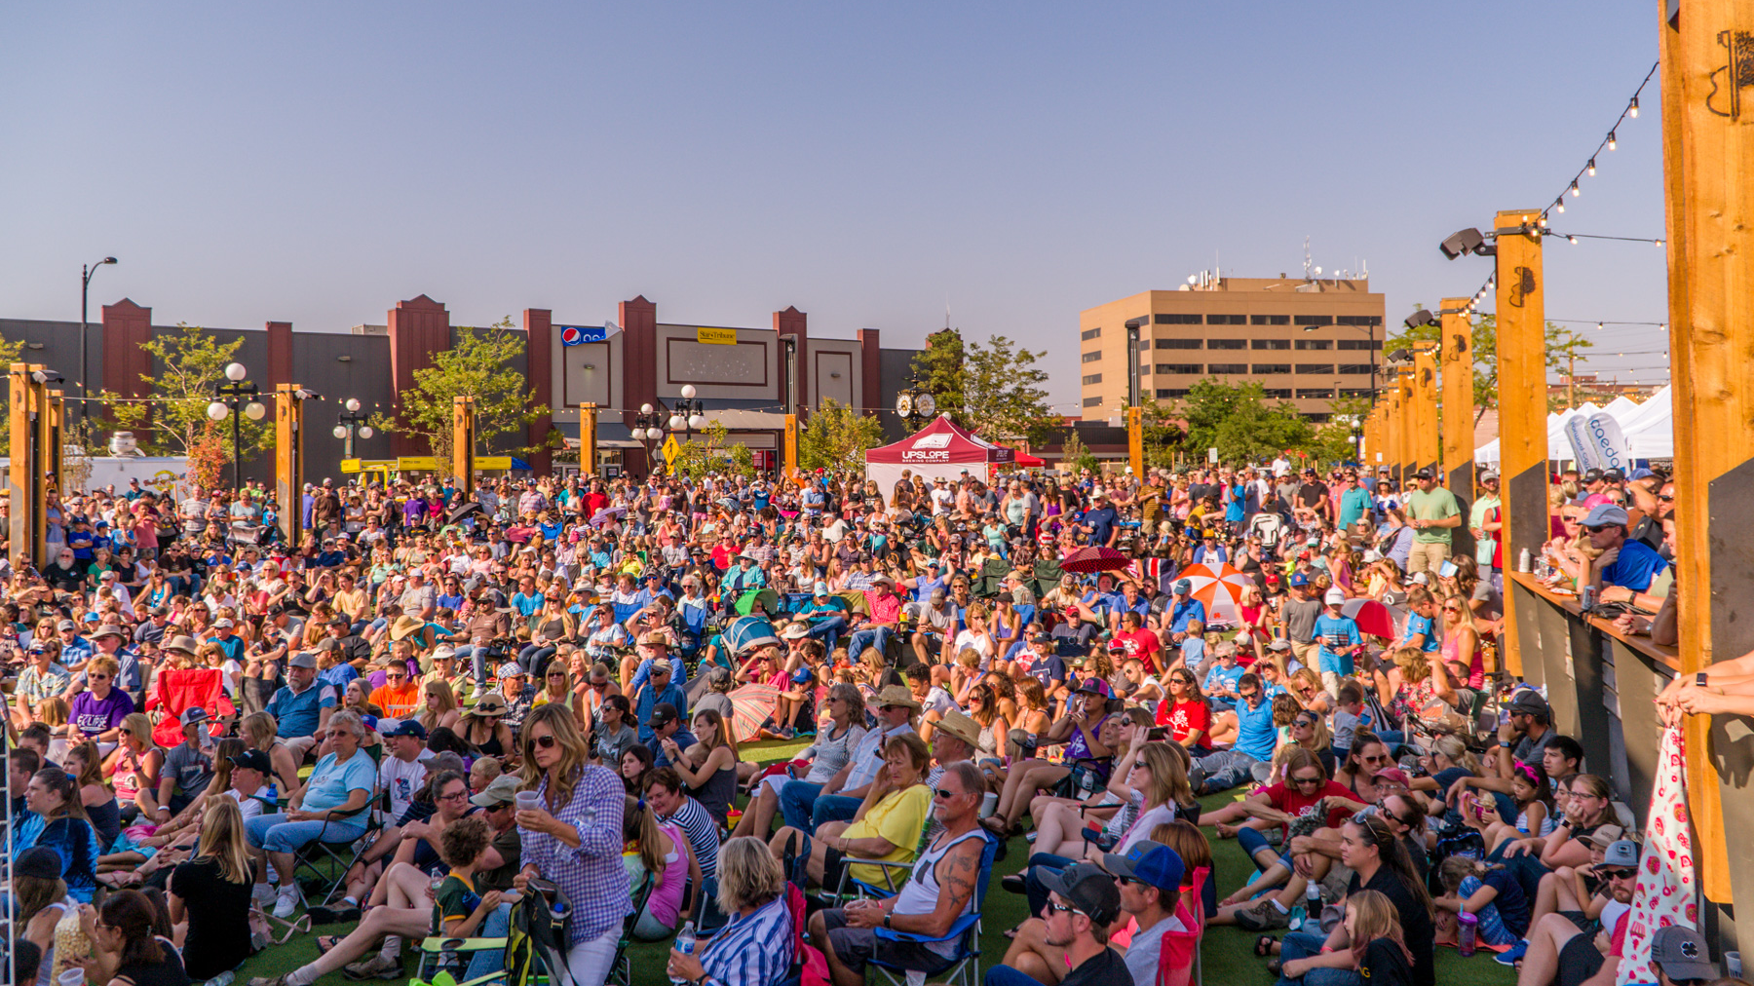
WHAT DID IT GENERATE?

Slide 13
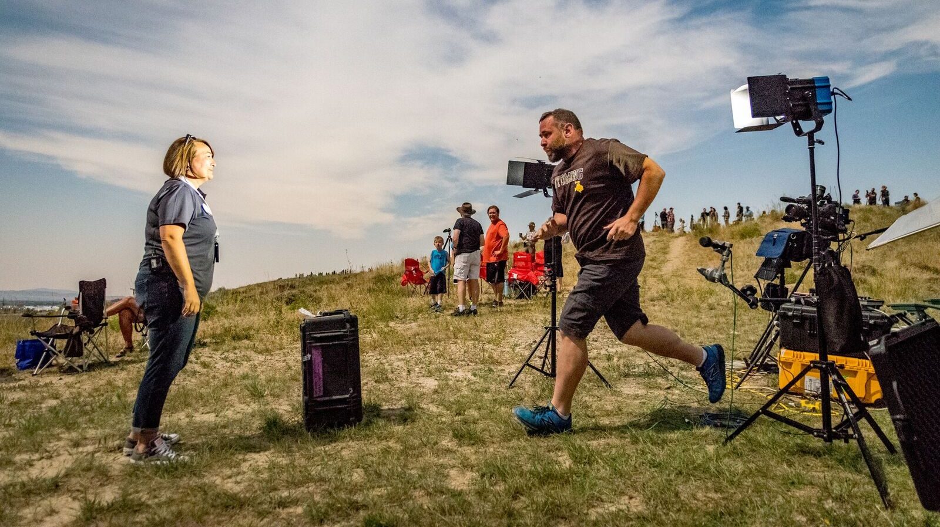
PR VALUE

Slide 14
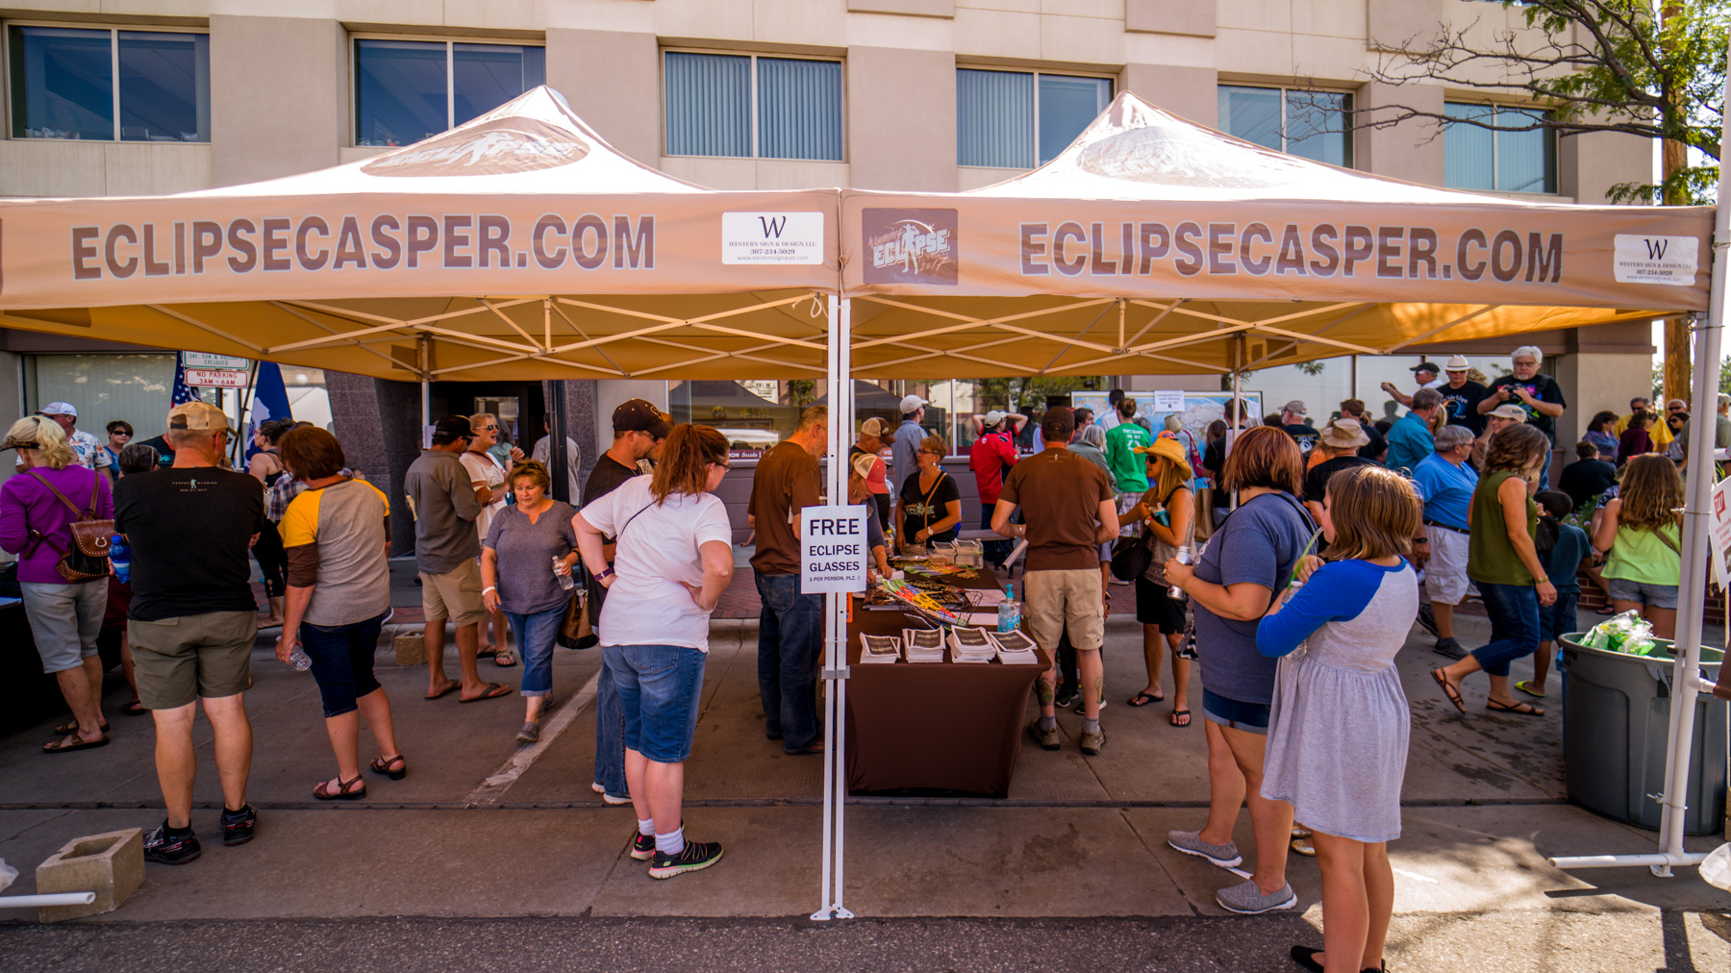
30% INCREASE

Slide 15
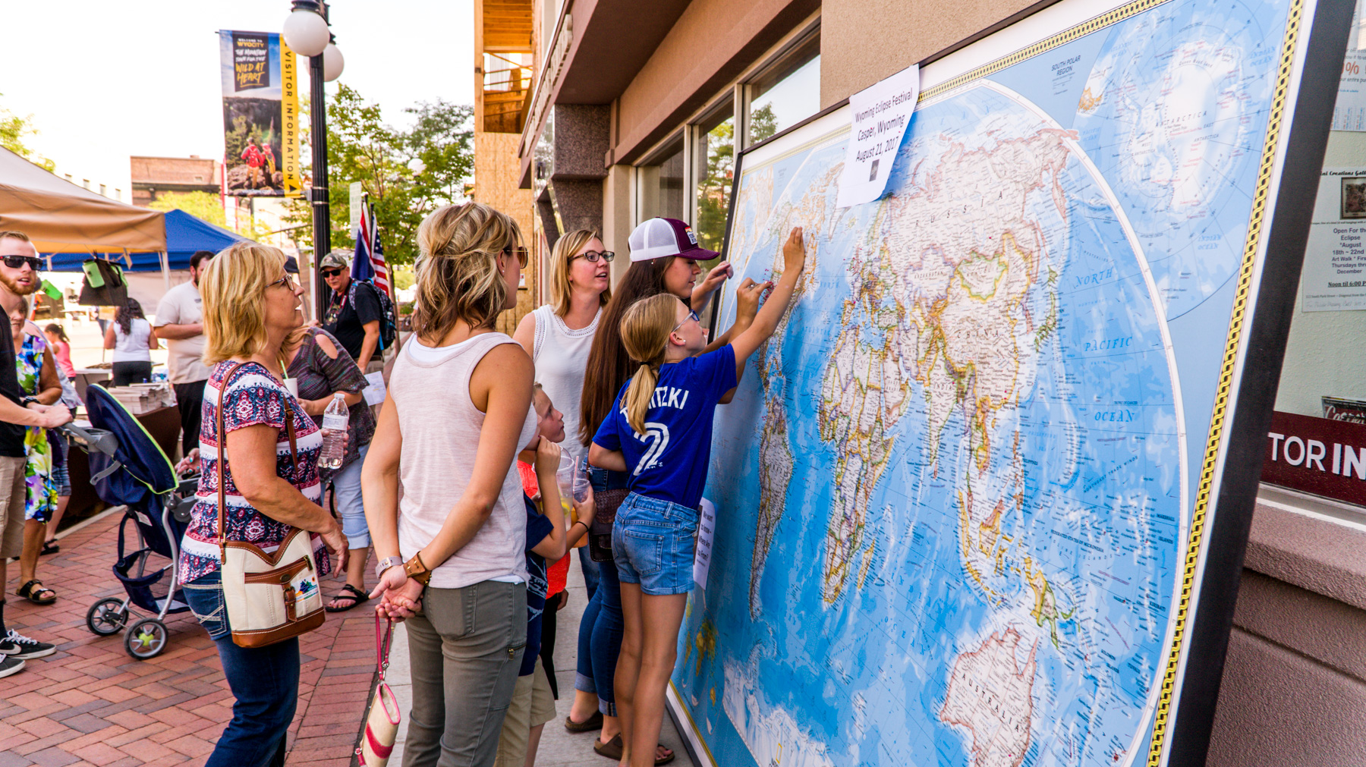
WHAT WENT RIGHT

Slide 16
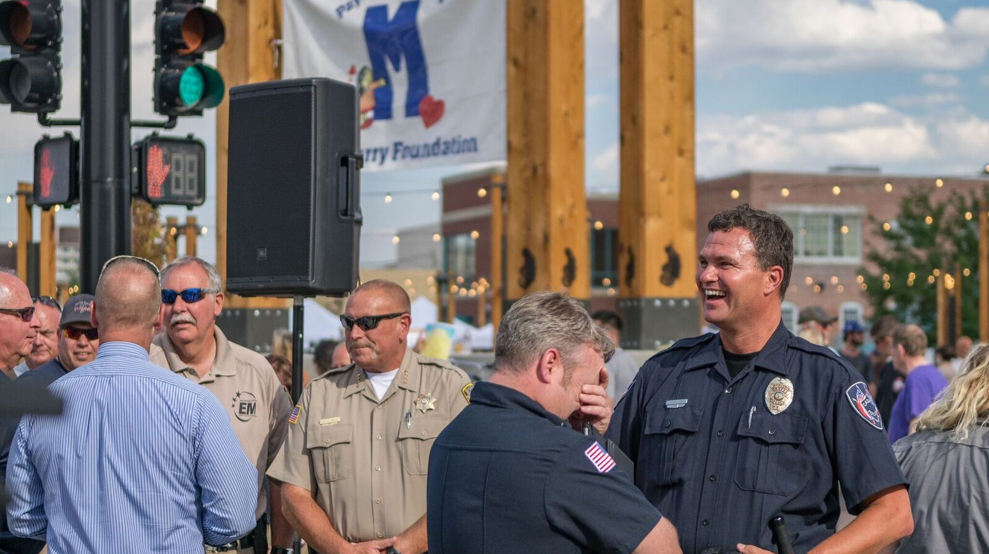
WHAT WENT WRONG

Slide 17
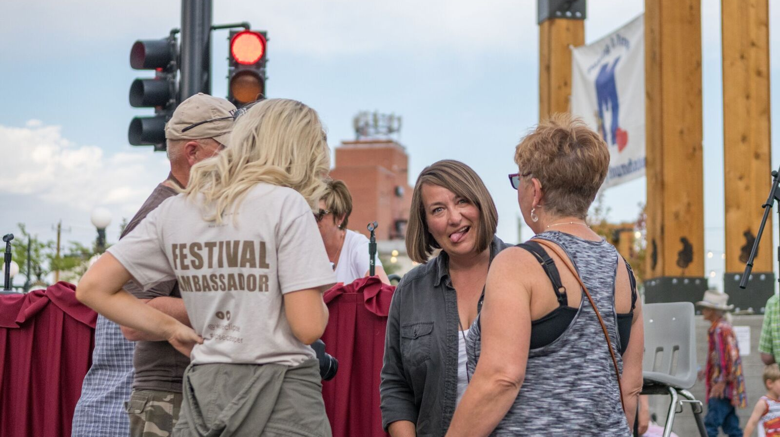
WHAT WE MISSED

Slide 18
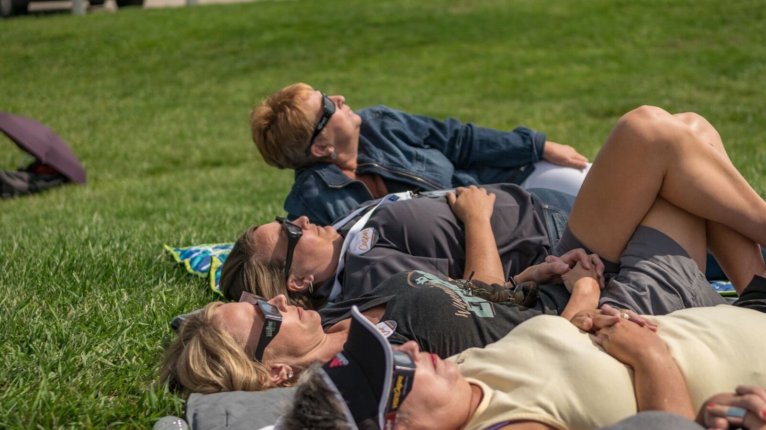
STRANGE BUT TRUE

Slide 19
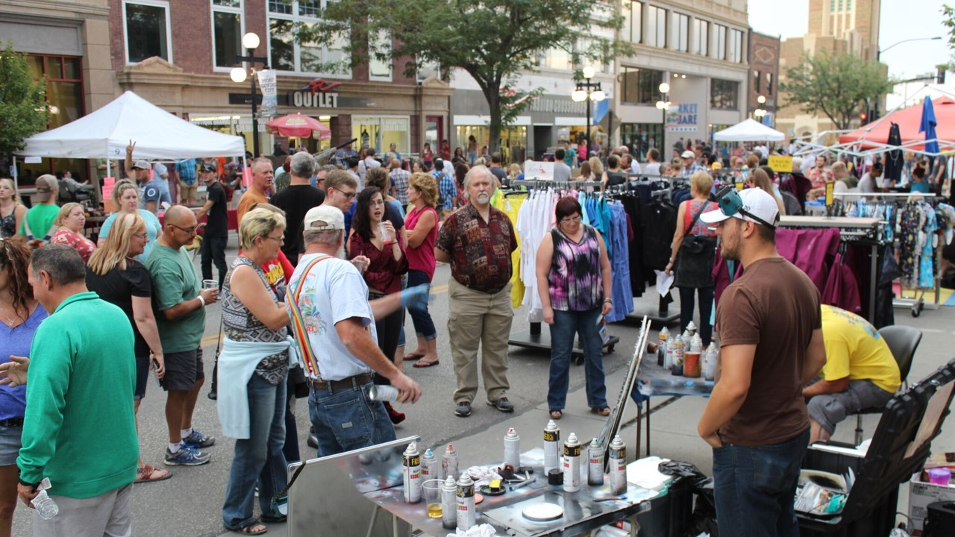
OUTCOMES

