Slide 1

Brand Development
Application and Rollout
The Charlotte Harbor Visitor & Convention Bureau

Slide 2

Agenda
What we set out to do
Need for Branding
Process used
Conclusions and Recommendations
Conclusions Testing
Brand application suggestions
Brand rollout suggestions / Long-term considerations

Slide 3
What we set out to do
Consider Branding the destination
Determine unique, competitive positions in state
Develop Brand and Its Components of Expression
  Message components
  Graphic Look
  Logo
  Tagline

Slide 4
What we set out to do
Consider Branding the destination
Determine unique, competitive positions in state
Develop Brand and Its Components of Expression
Recommend application and use
Consider market adoption

Slide 5
The Need for Branding
What it is

Slide 6
The Need for Branding
What it is
Unique
Desirable

Slide 7
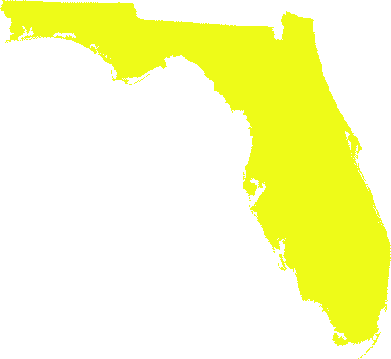
The Need for Branding
Why destinations brand
  To distinctively define to compete for room nights

Slide 8



















The Need for Branding
Why destinations brand
  To distinctively define to compete for room nights

Slide 9


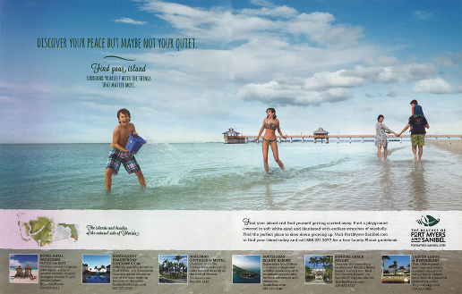
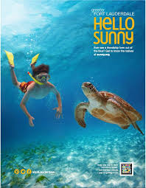
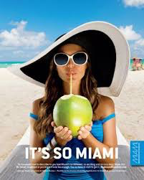
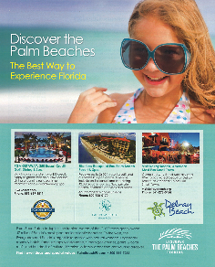


The Need for Branding

Slide 10
The Need for Branding
Why destinations brand
  To distinctively define to compete for room nights
  Marketing efficiency

Slide 11
The Need for Branding
Web/Online
Events
Direct Sales
Sponsorships
Advertising
Managed Social Media
Public Relations
Target/Consumer
Product
Development
In-Market
Communications
Destination Entry
Return / Exit Tactics
In-Market Identification
In-Market Brand/Experience Reinforcement

Slide 12













The Need for Branding
Other destinations are doing it

Slide 13









The Need for Branding
Other destinations are doing it

Slide 14


The Need for Branding
Other destinations are doing it

Slide 15

The Need for Branding
Other destinations are doing it
No brand in place for Charlotte County
  Logo, but no documented Brand explanation
  Tagline previously developed, but unused
  Questions as to whether logo symbolically communicates destination
  Questions as to whether it was clear and understandable
  Questions as whether name was specific, clear and best

Slide 16

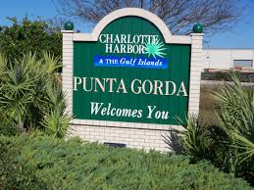
The Process Used
Review of current Brand
  Use
  Development History

Slide 17
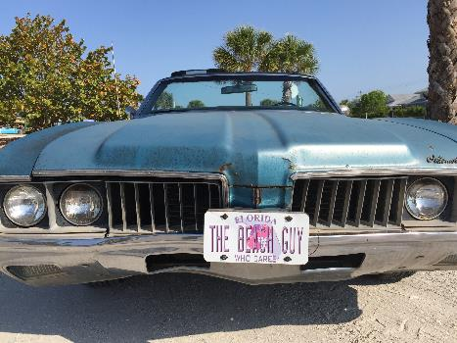
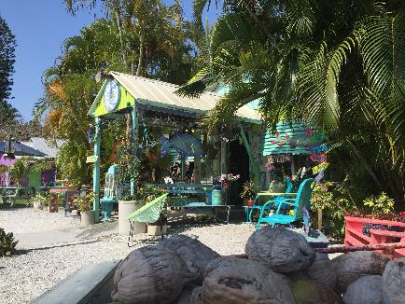
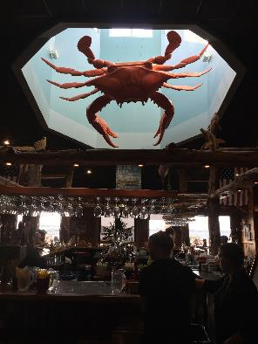
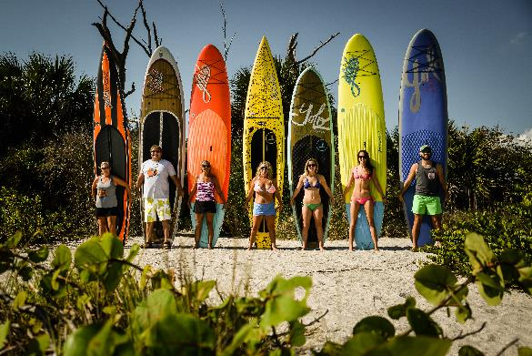
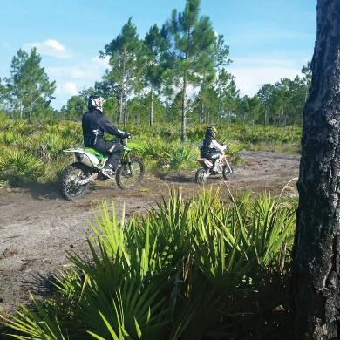
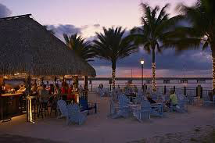
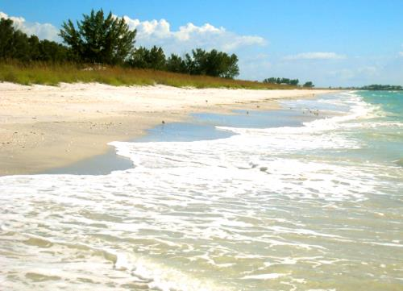
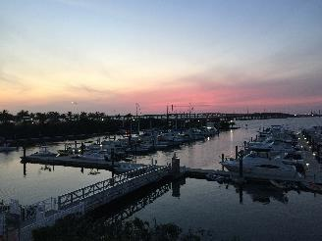
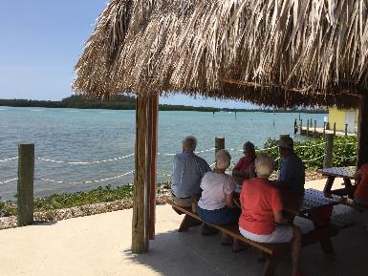
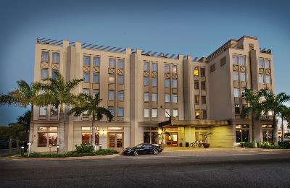
The Process Used
Review of current Brand
Attributes/Assets assessment

Slide 18
The Process Used
Fishermen’s Village
Englewood and Englewood Beach
Dearborn Street, Englewood
Manasota Key
Babcock Ranch Adventures
Boca Grande/Gasparilla Island
Gasparilla Island State Park
Little Garparilla Island
Placida
Cape Haze
Don Pedro Island
Rotonda
Port Charlotte
Port Charlotte Town Center
Punta Gorda Airport
Punta Gorda Visual Arts Center
Charlotte Sports Park
Stump Pass Beach State Park
Florida Track and Trails
Muscle Car City
Charlotte Civic Center
Bayshore Live Oak Park
Port Charlotte Beach Part
Palm Island Resort
Hatch Gallery
Kingfisher Fleet
Laishley Park
Scoops & Bites
Albritton Gallery
Peace River Wildlife Center
Ponce deLeon Park
A Better Scoop
Captain’s Table
Laishley’s Crab House
River City Grill
Turtle Club
Dean’s South of The Border
Dockside Grill
Farlow’s on the Water
Harpoon Harry’s
Jack’s on Marion
JD’s Bistro and Grill
LeRoy’s Southern Kitchen
Peace River Seafood
The Perfect Caper
Leverock’s
Stump Pass Grille and Tiki Bar
The Captain’s Table
Hurricane Charlie’s The Fishery
TT’s Tiki Bar
The Wyvern Hotel
The Four Points by Sheraton
Weston’s WannaB Inn
Punta Gorda Waterfront Hotel
56
Activities
Attractions

Slide 19



The Process Used
Review of current Brand
Attributes/Assets assessment
Promotional History

Slide 20





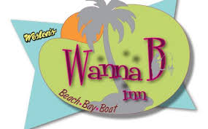



The Process Used
Review of current Brand
Attributes/Assets assessment
Promotional History
Review of Partner Participation

Slide 21
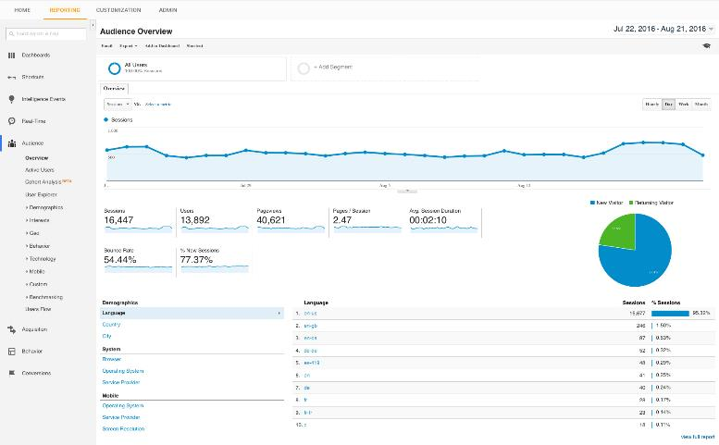
The Process Used
Review of current Brand
Attributes/Assets assessment
Promotional History
Review of Partner Participation
Inquiry fulfilment review

Slide 22
The Process Used
Ed Hill, Englewood Chamber of Commerce
Ken Stead, Cape Haze Marina, Waterfest Chairman
Laurie Farlow, Farlow’s on the Water
Robin Madden, Islander Properties
Hazel Crouch, Place in the Sun
Patti Allen, Fishermen’s Village
Julie Mathis, Charlotte County Chamber
Kim Devine, City of Punta Gorda, Charlotte TDC
Rachel Keesling, City of Punta Gorda, Charlotte TDC
Della Booth, TIME Realty Services
Craig Holt, The Four Points by Sheraton, Punta Gorda
John Wright, Punta Gorda Chamber of Commerce
Gary Quill, Punta Gorda Airport
Nick Nemec, FunkFest/Big Crush Distributors
Review of current Brand
Attributes/Assets assessment
Promotional History
Review of Partner Participation
Inquiry fulfilment review
Stakeholder input

Slide 23
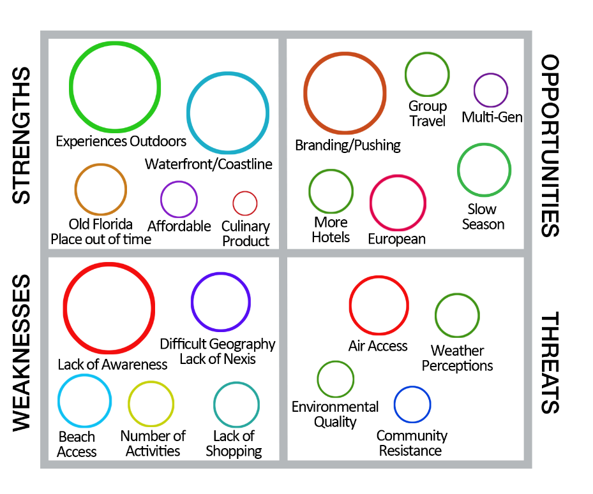
The Process Used
Review of current Brand
Attributes/Assets assessment
Promotional History
Review of Partner Participation
Inquiry fulfilment review
Stakeholder input

Slide 24
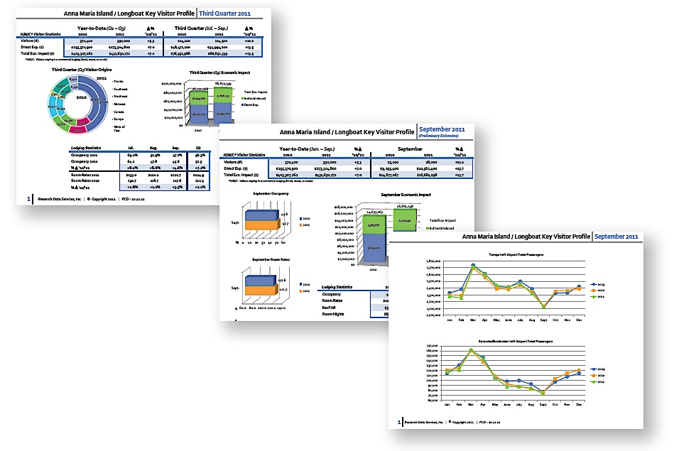
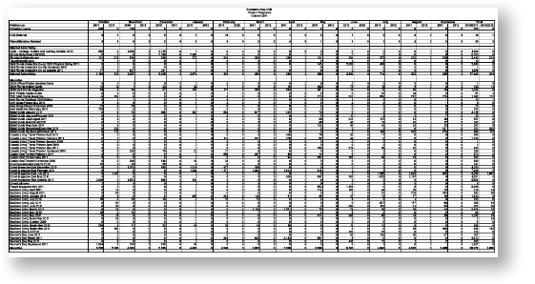
The Process Used
Review of current Brand
Attributes/Assets assessment
Promotional History
Review of Partner Participation
Inquiry fulfilment review
Stakeholder input
Past Target Research / Visitation Patterns

Slide 25
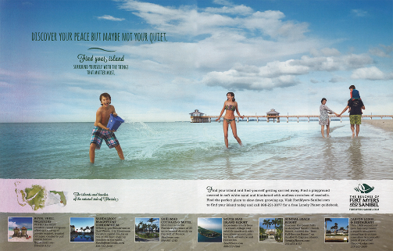



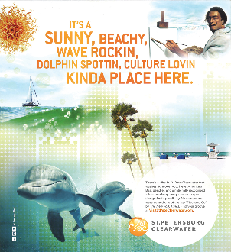
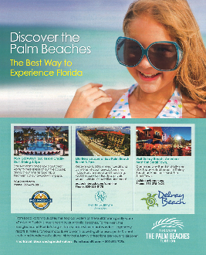
The Process Used
Review of current Brand
Attributes/Assets assessment
Promotional History
Review of Partner Participation
Inquiry fulfilment review
Stakeholder input
Past Target Research / Visitation Patterns
Competitive Review and Analysis

Slide 26
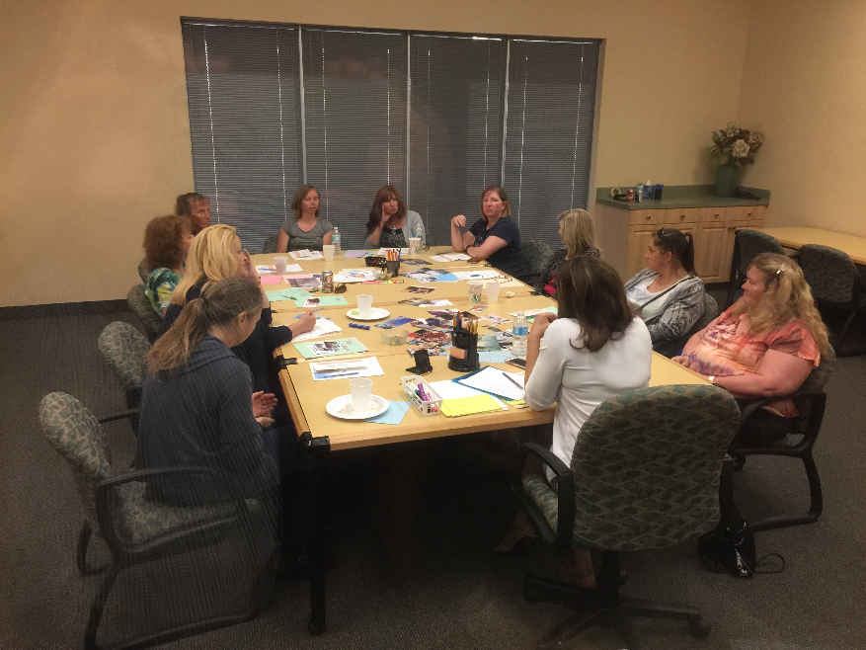
The Process Used
Review of current Brand
Attributes/Assets assessment
Promotional History
Review of Partner Participation
Inquiry fulfilment review
Stakeholder input
Past Target Research / Visitation Patterns
Competitive Review and Analysis
Primary Market Research

Slide 27
The Process Used
Review of current Brand
Attributes/Assets assessment
Promotional History
Review of Partner Participation
Inquiry fulfilment review
Stakeholder input
Past Target Research / Visitation Patterns
Competitive Review and Analysis
Primary Market Research
Brand Strategy, Development, Naming

Slide 28
The Process Used
Review of current Brand
Attributes/Assets assessment
Promotional History
Review of Partner Participation
Inquiry fulfilment review
Stakeholder input
Past Target Research / Visitation Patterns
Competitive Review and Analysis
Primary Market Research
Brand Strategy, Development, Naming
Market testing

Slide 29



The Process Used
PLACE
TARGET
BRAND
ALTERNATIVES

Slide 30
The Process Used
Attributes:
Florida
Beaches
Shelling
Islands (remote & natural)
Boating
Sightseeing cruises
Fishing
Nature/hiking
Nature/observation
Kayaking/Canoeing
Stand up paddle boarding
Track & Trails/Off Road
Biking
Baseball
Culinary
Events & Entertainment
Arts & Culture
PLACE

Slide 31
The Process Used
Characteristics:
Year-round visitation w/high winter
Geographically low density
Difficult logistics
Expansive and disjointed
Competitive intrusion (Lee County/Boca Grande)
Broad range of properties
Good properties
Access issues (Local airport isn’t primary. Distance from Interstate.)
Beach access difficult, but beaches more secluded and pristine
No spectacular shopping
Lack of in-door and “rainy day” activities
PLACE

Slide 32
The Process Used
Seasonal shifts in origin
In-state
Upper Midwest
Northeast
Far less international
Potentially more inclusive of male involvement
in destination decision/choice
Motivations: Beach, weather, relax, food & drink
Lack of destination awareness
Not necessarily seasonally driven
Couple or family
Currently skewing older
PLACE
TARGET

Slide 33
The Process Used
Primary:
Ft. Myers/Sanibel/Captiva
Sarasota/Siesta Key
Secondary:
St. Petersburg/Clearwater
Anna Maria Island/Bradenton Beach
Venice
Tertiary:
Naples
The Florida Keys and Key West
PLACE
TARGET
ALTERNATIVES

Slide 34
Conclusions
No perceived brand that needs reconsideration or enforcement
Needed to consider destination’s assets relative to comp. Set
Needed to consider presentations of the comp. Set
Needed to consider visitor needs and expectations
  Weather
  Relaxation/Escape
  Beach
  Food and Drink

Slide 35
Conclusions
No perceived brand that needs reconsideration or enforcement
Needed to consider destination’s assets relative to comp. Set
Needed to consider presentations of the comp. Set
Needed to consider visitor needs and expectations
Assets are primarily outdoor/outside experiences

Slide 36
Conclusions
Attributes:
Florida
Beaches
Shelling
Islands (remote & natural)
Boating
Sightseeing cruises
Fishing
Nature/hiking
Nature/observation
Kayaking/Canoeing
Stand up paddle boarding
Track & Trails/Off Road
Biking
Baseball
Culinary
Events & Entertainment
Arts & Culture
PLACE

Slide 37
Conclusions
No perceived brand that needs reconsideration or enforcement
Will need to consider destination’s assets relative to comp. Set
Will need to consider presentations of the comp. Set
Need to consider visitor needs and expectations
Assets are primarily outdoor/outside experiences
May be a stronger male consideration than other destinations

Slide 38
Recommendations
Position
No perceived brand that needs reconsideration or enforcement
Will need to consider destination’s assets relative to comp. set
Will need to consider presentations of the comp. Set
Need to consider visitor needs and expectations
Need to engage both male and female
Need to consider younger and international
Assets are primarily outdoor/outside experiences

Slide 39
Recommendations
Position
Florida’s "Outdoor/Outside" destination
Not taken by competitive set or others in the state
Broad enough to include eco/nature, historic attractions, plus beaches and islands
Meets expections of potential visitor
Attractive to international
Authentic, Off-the-Beaten-Path, less branded, attractive to younger demos
Works for both male and female targets
Balances potential negatives of lack of shopping and rainy day
Works for Group and Sports
Has to include dining

Slide 40
Recommendations
Naming
Less awareness provides clean slate
‘’County’’ never resonates
Needs ‘’Google-ability.’’ Specific place names. Consider what’s already drawing traffic.
’’Charlotte Harbor’’ is a body of water. One general area, not specific areas. Far from Englewood
Can’t ingnore the role of the airport
Port Charlotte not strong, marketable visitation area
Needs to reflect what anchors the area geographically, and best sells the area
Need to claim ‘’beach’’
Need to leverage the power of ’’islands’’
Consider how other destinations’ naming decisions

Slide 41


Recommendations
Naming

Slide 42
Recommendations
Naming
Less awareness provides clean slate
‘’County’’ never resonates
Needs ‘’Google-ability.’’ Specific place names. Consider what’s already drawing traffic.
’’Charlotte Harbor’’ is a body of water. One general area, not specific areas. Far from Englewood
Confusion with Charlotte, North Carolina
Can’t ingnore the roll of the airport
Port Charlotte not strong, marketable visitation area
Needs to reflect what anchors the area geographically, and best sells the area
Need to claim ‘’beach’’
Need to leverage the power of ’’islands’’
Consider how other destinations’ naming decisions
Needs to aid geographic location of the destination

Slide 43
Recommendations
Naming Recommendation:
‘’Punta Gorda / Englewood Beach’’
Ties both ends of the county, providing define the area geographically
Allows for cross promotion between the areas, across the county
Research respondents didn’t attach a name to the area
Reflects the area’s two major tourism areas
Allows the use of ‘’beach’’ – A primary draw, plus Englewood an easier point of access
Reflects Punta Gorda’s size, concentration of visitor assets, access to assets outside of core
Reinforces airport

Slide 44
Recommendations
Naming Recommendation:
‘’Punta Gorda / Englewood Beach’’
Secondary Description:
‘’Charlotte Harbor and the Gulf Island Coast’’
Further aids geographic location within the state
Specific as to where the gulf islands are on the gulf coast
Allows for inclusion of the concept of ’’islands’’
Provides for a bridge from current name, in a sense not losing current name
NOTE: The name "Florida" will be shown in conjunction with the name in various applications.

Slide 45
Recommendations
Naming Recommendation:
Punta Gorda / Englewood Beach
Charlotte Harbor and the Gulf Island Coast

Slide 46
Recommendations
Brand Recommendation
Positioning Statement
Brand Description
Brand Promise
Key Brand Words and Phrases

Slide 47
Recommendations
Brand Recommendation
Positioning Statement:
‘’The Punta Gorda/Englewood Beach area is the one Florida destination that provides all the best of Florida’s coveted outdoor activities all in one place.’’

Slide 48
Recommendations
Brand Recommendation:
Brand Description:
“Punta Gorda / Englewood Beach is a relaxing, more secluded Florida destination that offers all the best of Florida’s wonderful outdoor experiences and lifestyle. From beaches to boating, hiking to harbor tours, fishing to nature discovery; to sun, shelling and shark’s teeth, Punta Gorda & Englewood Beach offer visitors more of what they come to Florida for: relaxation and discovery in an outdoor vacationland.”

Slide 49
Recommendations
Brand Recommendation:
Brand Promise:
‘’Punta Gorda / Englewood Beach promises more of and easy access to the primary reason people want to come to Florida – to relax and enjoy Florida – ‘outside.’”

Slide 50
Recommendations
Brand Recommendation:
Key Brand Words and Phrases:
Water
Relaxed
“Old Florida” (less built up and commercialized)
More remote, more pristine, less traveled
Beach
Island
Casual
Florida, as it once was
Fun
All to yourself

Slide 51
Brand Development
Color Palette
Logo
Tagline
Message and Visual Presentation

Slide 52
Brand Development
Considered:
All information from Discovery process
Translation of the Brand as described
Competitive set’s Brand/Message presentations
Utilization through all marketing communications channels

Slide 53
Brand Development

Slide 54
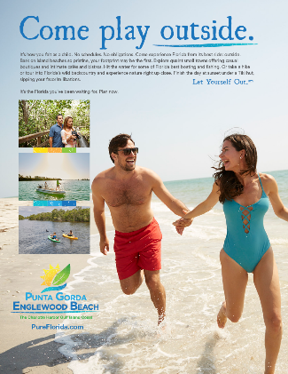
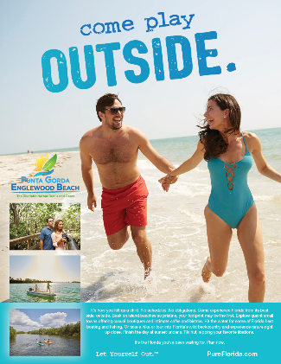
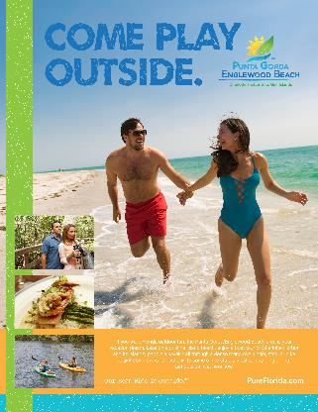
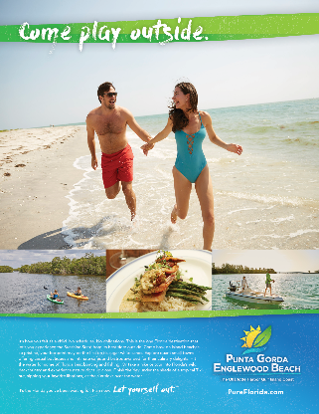
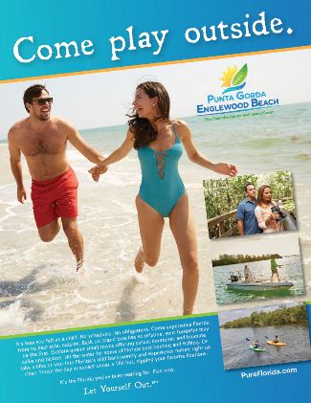
Brand Development

Slide 55
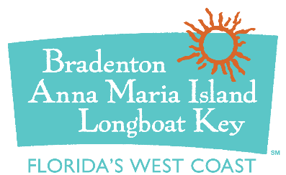




Brand Development

Slide 56




Brand Development

Slide 57
Brand Development
Taglines:
Come Out and Play
Florida’s Outdoor Adventure
Florida’s Outdoor Playground
Florida. Fun. Outdoors.
The Outside is our Best Side
How to get the most out of Florida
Where Florida Outdoor Fun Begins
Florida’s More Fun Outdoors
Come Play Outside
Our Best Side is Outside
Step into the Sunshine.
More Sun. More Fun.
Let Yourself Out.
The Florida yet to be discovered.

Slide 58
Conclusions Testing
Methodology similar as intake
  Tampa, Chicago, Indianapolis
  Tested new Brand and expressions against comp. set
  Tested range of Brand expressions and elements

Slide 59


Conclusions Testing
Tampa
  Quick selection of lead Brand presentation vis-à-vis comp.
  Able to explain why it would draw them
  Stark difference from apathetic intake
“Let Yourself Out.”

Slide 60
Conclusions Testing
Chicago
  Diverse, less unified, argumentative
  Generalized Florida, but had specific favorite destinations
  Bias for known destinations, against unknown
  Males matching profile gravitated positively to Brand
  Suggested text be specific to the Brand message. Include food.
”Our Best Side is Outside”

Slide 61
Conclusions Testing
Indianapolis
  As with Tampa, quickly embraced Brand
  Diverse in opinions, but gravitated to new Brand
  Demonstrated inclination to visit destination as result
  Males matching profile gravitated positively to Brand
”Our Best Side is Outside”

Slide 62
Conclusion
Awareness primary concern
New Brand should resonate and encourage consideration
Proceed with Brand, logo, tagline
Adjust text/messaging to be specific to Brand
Include food
”Our Best Side is Outside”

Slide 63

Conclusion
”Our Best Side is Outside”

Slide 64

Conclusion

Slide 65

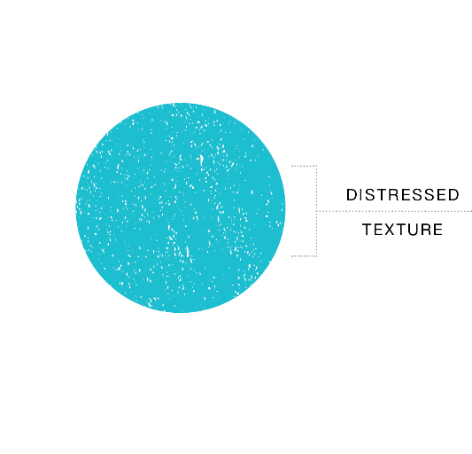
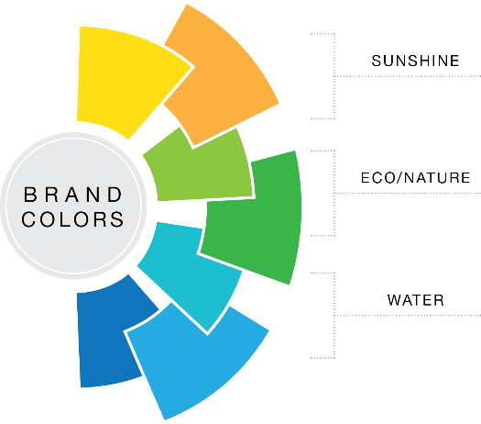
Brand Application Suggestions
”Our Best Side is Outside”

Slide 66


Brand Application Suggestions

Slide 67
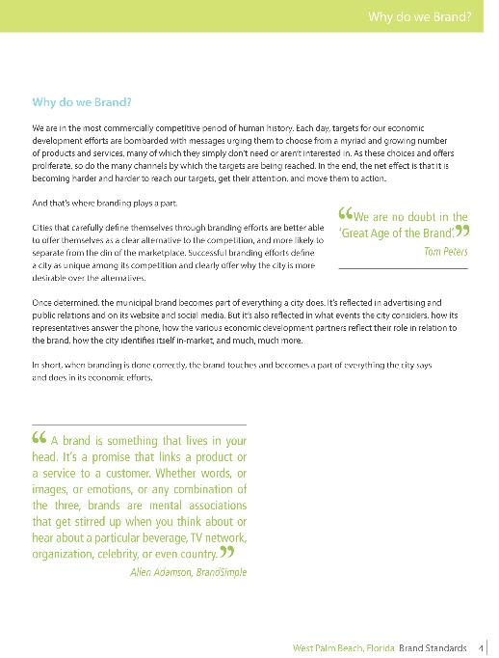
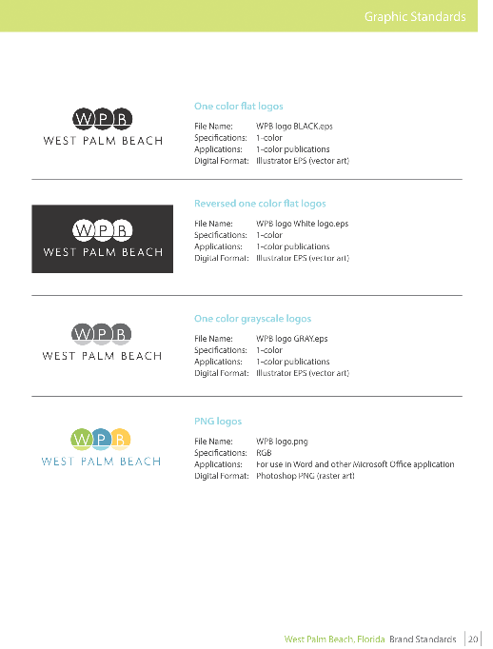
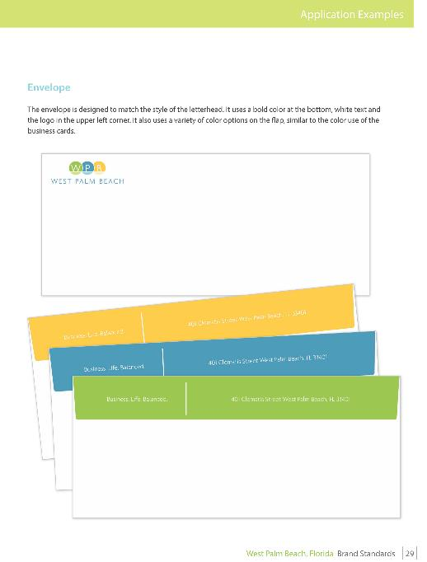
Brand Application Suggestions

Slide 68
Brand Application Suggestions
How will we apply the Brand?
How will we get others to adopt and help reflect?
How will we ensure continuity and avoid ’’Brand drift’’?

Slide 69
Brand Application Suggestions
Web/Online
Events
Direct Sales
Sponsorships
Advertising
Managed Social Media
Public Relations
Target/Consumer
Product
Development
In-Market
Communications
Destination Entry
Return / Exit Tactics
In-Market Identification
In-Market Brand/Experience Reinforcement

Slide 70
Brand Application Suggestions
How we might apply the Brand
  Brand is more than logo, taglines and design – at its heart, it’s about meaning.
  Proclaimed through all channels – but actually proven when doing so.
  Beyond consistent design, it’s the selection of lead branding image(s), consistent verbiage, consistent actions at all times

Slide 71
Brand Application Suggestions
How we might apply the Brand
  Website
    Visual application of presentation
    Sections/text on:
      Exclusive claim of outdoor/outside position
      Clear offering of activities related to outdoor/outside
      Itineraries to let you get it all in
      Visitor testimonials extolling the brand experience
      Each section or area of the site bolstered to proclaim the position

Slide 72
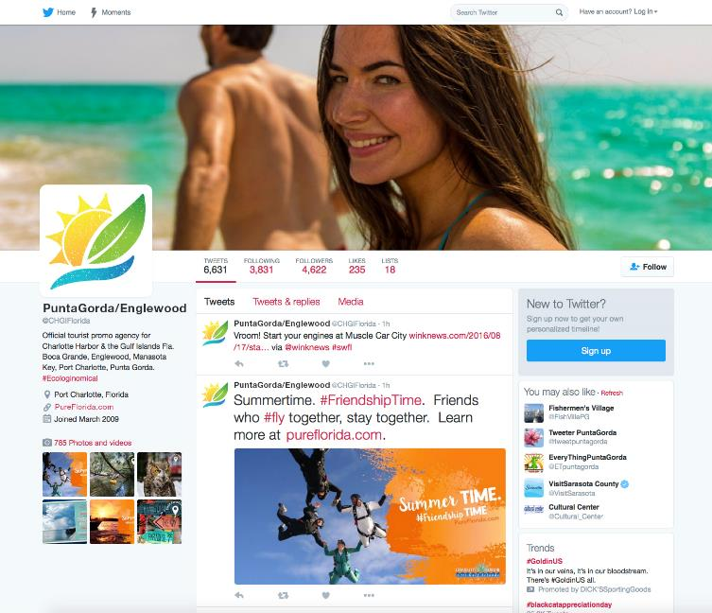
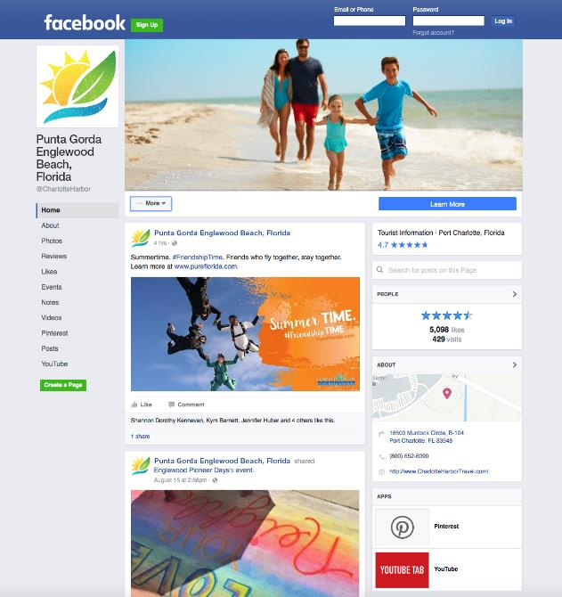
Brand Application Suggestions
How we might apply the Brand
  Website
  Social Media
    Great opportunity to prove the Brand
    Concentration on posts, etc. that claim and support the brand
    “Discovery words” should infuse text
    Artwork for “Greetings” postcard
    Descriptions of referral / reputation sites

Slide 73
Brand Application Suggestions
How we might apply the Brand
  Website
  Social Media
  Staff email signatures
  Office identification
  New info centers
  Public Relations
    Best if those tactics are exercised through the “Brand lens”
    Provides the “of what” of awareness
    Consistently consider the Brand in all efforts
    Provide ways to prove the Brand’s claims
    Bring to life the destination’s “Brand Words and Phrases”

Slide 74
Brand Application Suggestions
How we might apply the Brand
  Website
  Social Media
  Staff email signatures
  Office identification
  New info centers
  Public Relations
  In-Market visitor touchpoints
    Points of destination entry and arrival – Gateways/PGD
    All area partners
    In-room
    Areas of visitor activity or congregation

Slide 75
Brand Application Suggestions
How we might apply the Brand
  Website
  Social Media
  Staff email signatures
  Office identification
  New info centers
  Public Relations
  In-Market visitor touchpoints
  Visit Florida
    Online description
    Welcome Center duratrans, V.G.

Slide 76
Brand Application Suggestions
How we might apply the Brand
  Website
  Social Media
  Staff email signatures
  Office identification
  New info centers
  Public Relations
  In-Market visitor touchpoints
  Visit Florida
  Tradeshow presentation

Slide 77
Adoption and Dissemination
Unleashing the Power of Stakeholders
Identify the Stakeholders
Present the Brand and its benefits to those Stakeholders
Provide the materials, support and/or incentive to embrace and disseminate the Brand
Continue to remind Stakeholders of and involve them with the Brand
Repeat

Slide 78
Adoption and Dissemination
Unleashing the Power of Stakeholders – Step 1: Identify
Who needs to know and understand the destination Brand?
Who needs to provide support for the Brand?
Who can be a partner in disseminating the Brand?

Slide 79
Adoption and Dissemination
Unleashing the Power of Stakeholders – Step 1: Identify
County Commissioners
County administrative staff
Tourism Development Council members
Area Chambers of Commerce
Airport
State tourism marketing organizations (Visit Florida)
Area property Owners, Managers and Directors of Sales
Area activity vendors, including:
  Recreational vendors
  Sight-seeing/tour vendors
  Shopping
  Dining
Various local economic development interests

Slide 80
Adoption and Dissemination
Unleashing the Power of Stakeholders – Step 2 – Present
Each should receive a tailored presentation explaining the Brand, its development, and their particular role in Brand support.
Internal
One-on-One
Groups

Slide 81
Adoption and Dissemination
Unleashing the Power of Stakeholders – Step 3 – Provide
Identify their unique role
Provide tools to engage their role
Incentives to participate and provide their support

Slide 82
Adoption and Dissemination
Unleashing the Power of Stakeholders – Step 3 – Provide
VCB marketing partners – Provision of the Brand Guidelines, logo files or other key materials once developed for their use in their activities.
VCB Staff – Provision of Brand Guidelines, logowear and other personal items to help personally appropriate the Brand.
County Commissioners – Key Brand points (Brand “cheat sheet”) along with key sound bites supporting the Brand and area visitation. If permissible, logowear or other items to remind Commissioners of VCB efforts and encourage their personal promotion of the Brand.

Slide 83
Adoption and Dissemination
Unleashing the Power of Stakeholders – Step 3 – Provide
Tourist Development Council members –
  Key Brand points (Brand “cheat sheet”)
  Logowear or other items to remind them of Brand and encourage their personal involvement.
  The TDC may also be encouraged to formally adopt the Brand or move to “accept” the new Brand direction.
  TDC members may be asked to become “Brand Champions” and find ways to promote and disseminate the Brand through their own businesses.
Group presentation to County administrative staff – Presentation of Key Brand points, discussion of how the various departments can benefit from the destination Brand and the initial coordination of how various, appropriate departments may incorporate the Brand.

Slide 84
Adoption and Dissemination
Unleashing the Power of Stakeholders – Step 3 – Provide
County PIO staff – Clarifying their understanding of the Brand, and discussion as to the role PIO may play in the Brand/Use of coordination with County government TV.

Slide 85
Adoption and Dissemination
Unleashing the Power of Stakeholders – Step 3 – Provide
One-on-one presentations to key Property Owners, General Managers and Directors of Sales :
Program could include:
  Incentivized program encouraging their dissemination of the Brand
  Destination “Partner Pack” empowering properties to promote the Brand

Slide 86
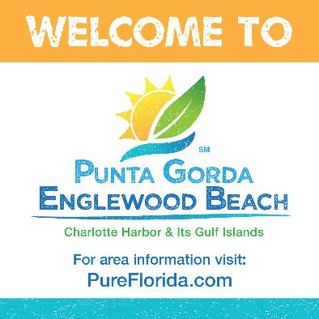
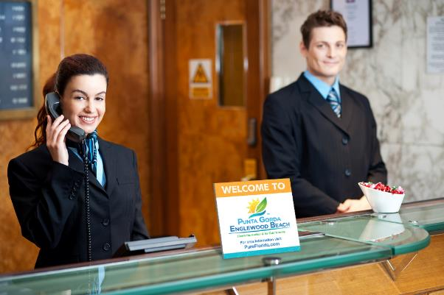
Adoption and Dissemination
Unleashing the Power of Stakeholders – Step 3 – Provide
One-on-one presentations to key Property Owners, General Managers and Directors of Sales :
Program could include:
  On-site materials for in-market identification with the Brand
    Door/window clings
    Counter cards
    In-room materials
    Destination video for guest television system

Slide 87

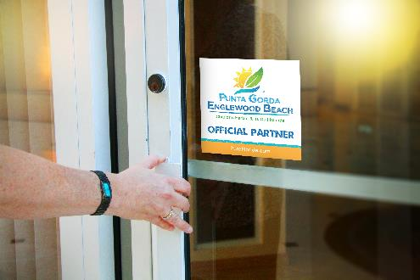
Adoption and Dissemination
Unleashing the Power of Stakeholders – Step 3 – Provide
Group presentation to area Lodging, Restaurant or other industry associations –
Explaining the importance and power of destination Branding
What the destination Brand is
Materials allowing them to leverage the increased Brand awareness the VCB will provide.
As with properties, association members could be provided materials allowing them to associate with or display the Brand.
Incentivize their use and dissemination.
Possibly include in co-op plan

Slide 88
Adoption and Dissemination
Unleashing the Power of Stakeholders – Step 3 – Provide
One-on-One presentations to Directors of local Chambers
Explaining new brand
Encouraging adoption and display
How Brand can be configured onsite
One-on-One presentations with key activity providers
Explaining new brand
As with properties, provide materials for adoption and display on/off line
Inclusions in in-market deals promotion as incentive

Slide 89
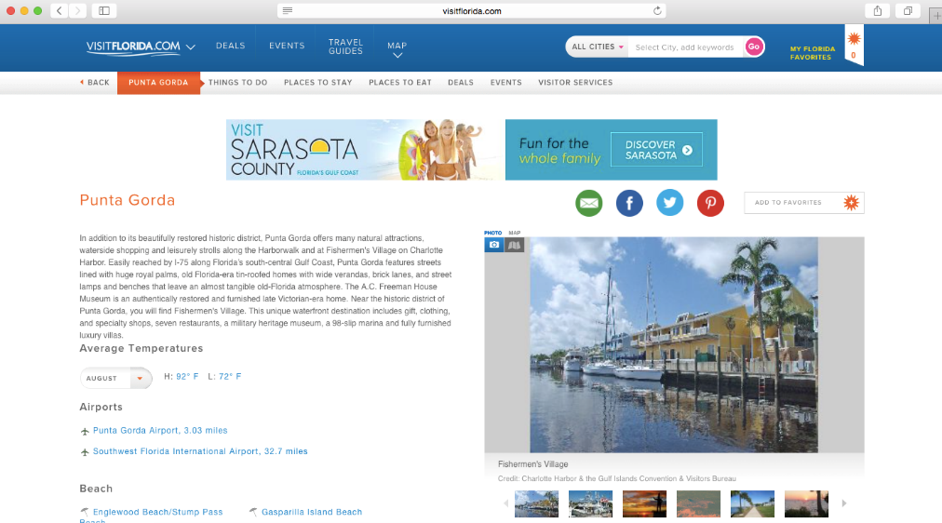
Adoption and Dissemination
Unleashing the Power of Stakeholders – Step 3 – Provide
Contact with Visit Florida
Discussion to bring their mentions of area into alignment with Brand

Slide 90
Adoption and Dissemination
Unleashing the Power of Stakeholders – Step 3 – Provide
Community-wide Brand rollout
Attendees should come away with tangible items allowing them to embrace, display and appropriate the Brand. The event should give them every reason to do so.
A reminder of the benefits of visitation and the strong role the VCB plays in this vital economic activity

Slide 91
Long-Term Considerations
Unleashing the Power of Stakeholders – Step 4 – Remind & Involve
Continuously remind key Stakeholders of the Brand’s importance
Demonstrate and demand effective use
Demonstrate a need for the market to continue to embrace the Brand

Slide 92
Long-Term Considerations
Examples:
Consistent, ubiquitous use of the Brand (colors, logo, etc.), by the VCB:
  All email signatures
  All forms and materials coming from the department
  All stationery, cards and other identification
  Use and embrace of logowear
  All presentations and PowerPoints templates displaying Brand
  In-office display of Brand and branding (such as in-office décor and design)
  Use of Brand name and taglines on voicemail or other message systems

Slide 93
Long-Term Considerations
Examples:
Consistent, ubiquitous use of the Brand (colors, logo, etc.), by the VCB:
Inclusion and recognition of Brand during/through Tourism Week
Consider an annual VCB award for best “Brand Ambassador”
Strong inclusion/reminder during annual co-op – urge inclusion in their own efforts
On-going in-market partners’ e-newsletter reflecting brand and continuing to encourage use and engagement
Consider select retailers merchandising the brand through approved items

Slide 94
Long-Term Considerations
Brands tend to stand the test of time better if Brand Guardians repeatedly
re-engage Brand adoption actions over time.
Meeting with and presenting to new County Commissioners and TDC members unfamiliar with the Brand or how it was established.
Meeting with new General Managers or property Sales Directors to explain the Brand, its background and benefits. Re-supply the property with any Branding materials initially provided to help the property extoll and disseminate the brand.
Provide new VCB staff members with a review of the Brand, how it was established, and their role in branding the area.

Slide 95
Long-Term Considerations
Brands tend to stand the test of time better if Brand Guardians repeatedly
re-engage Brand adoption actions over time.
Be certain to review the Brand with new marketing partners, ensuring that they understand the Brand, their role in defining and conveying the Brand and are familiar with Brand Guidelines.
Annually, formally re-present and remind the TDC and VCB staff of the Brand, its meaning and use.
Devote a period of the VCB Annual Planning Retreat to review the Brand with the VCB’s marketing partners, and discuss destination branding in general.
Require Brand considerations in the annual VCB plan reinforcing and defining the Brand, but also seeking new ways to convey and disseminate the Brand.

Slide 96
Long-Term Considerations
Check periodically to see if it’s working…
Through ongoing VCB consumer research, testing “brand resonance” with the target, how it’s perceived, and how competitive it may be against the competition.
An annual review of the competitive set, its use of branding and any changes in their directional approach.
A formal review of all VCB efforts and materials, checking for Brand consistency and complete integration.

Slide 97
Agency Next Steps
Create Brand Guidelines for review
Meet with Key Stakeholders in advance of TDC
Plan TDC presentation
Determine initial Brand applications and develop
Finalize rollout plan beyond TDC

Slide 98
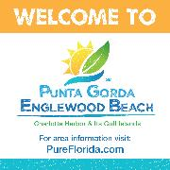






The Charlotte County Tourism Brand
”Our Best Side is Outside”
Community Entry Sign showing Branding
To Come

Slide 99


