Slide 1
Workforce Development & Transportation
Prepared for: Hospitality Workforce Summit
Amanda Wanke, Chief External Affairs Officer
September 6, 2019

Slide 2
Mission / Vision
Mission
Vision
Enriching Lives,
Connecting Communities,
Expanding Opportunities
Facilitate affordable, seamless mobility options that support economic prosperity for all

Slide 3
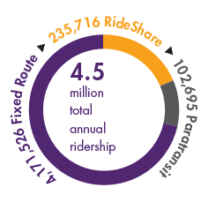
DART
Formed in 2006
Regional transit agency
Serve 13 cities and Polk County
14-member Board of Commissioners
1,700+ bus stops

Slide 4
DART services

Slide 5
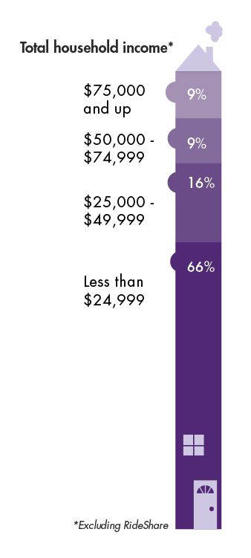
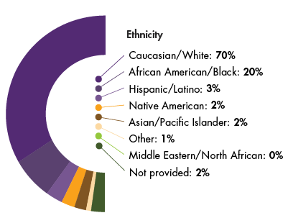
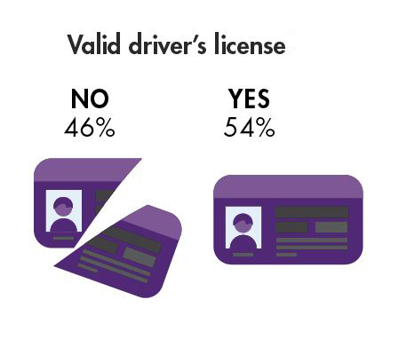
Who uses DART?

Slide 6
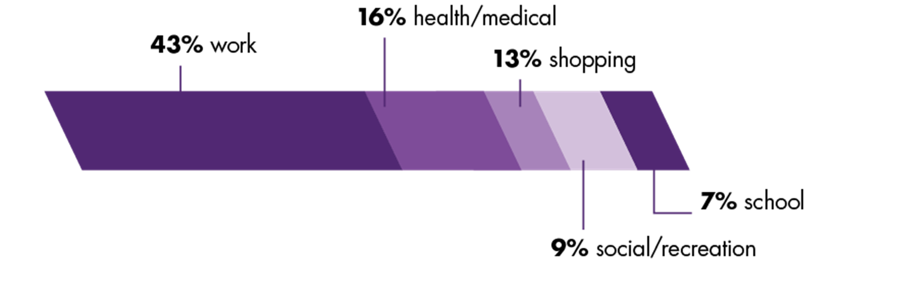
Why do they ride?

Slide 7
DART service priorities
Employment
Healthcare
Education

Slide 9
Economic impact through transit
Fosters economic activity
Workforce recruitment and retention
Supports job creation

Slide 11
Transportation Makes a Difference
Access = opportunity
Reduce barriers
Workforce attraction/retention
Quality of life

Slide 12
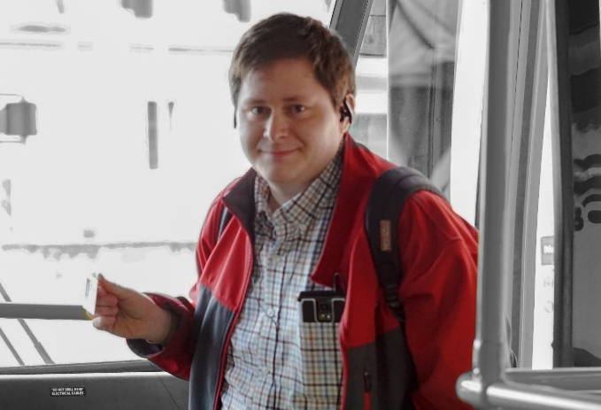
DART Resources
Business partnership opportunities
Bulk pass purchases
Unlimited Access program
RideShare vanpooling
Mobility training and employee education

Slide 13
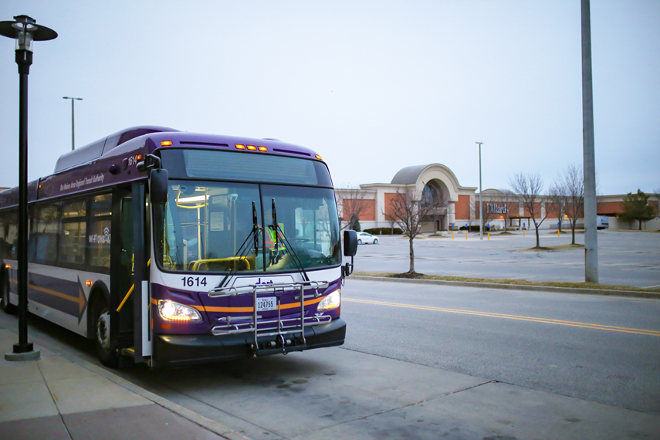
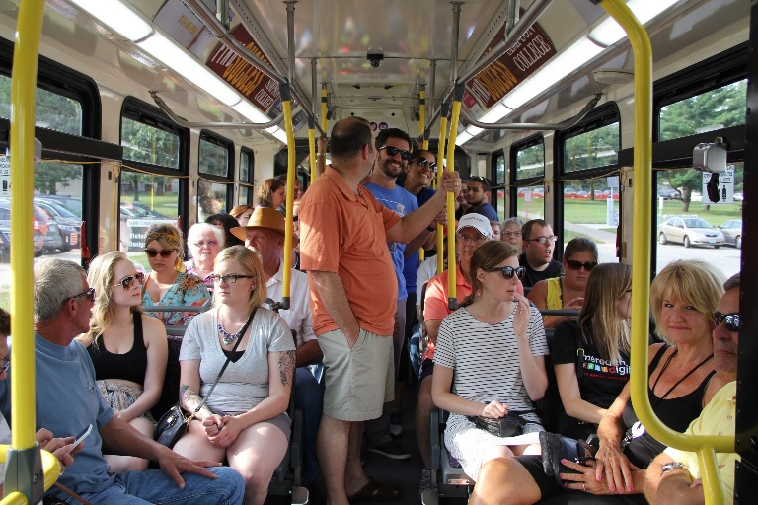
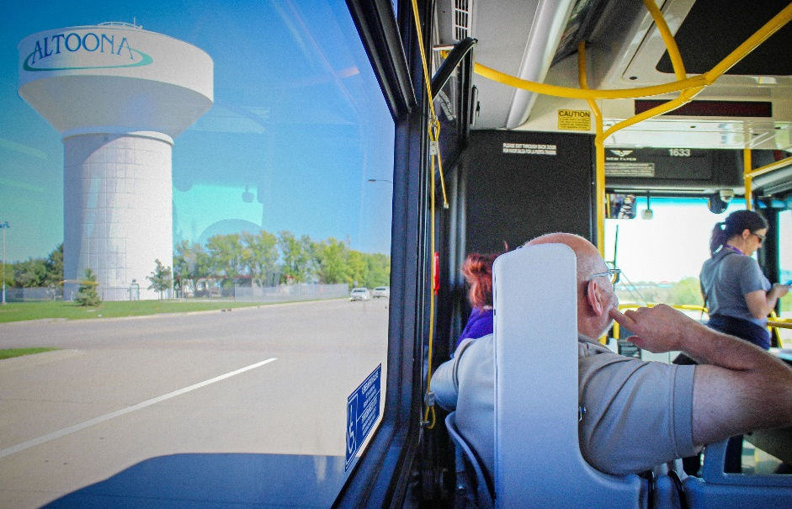
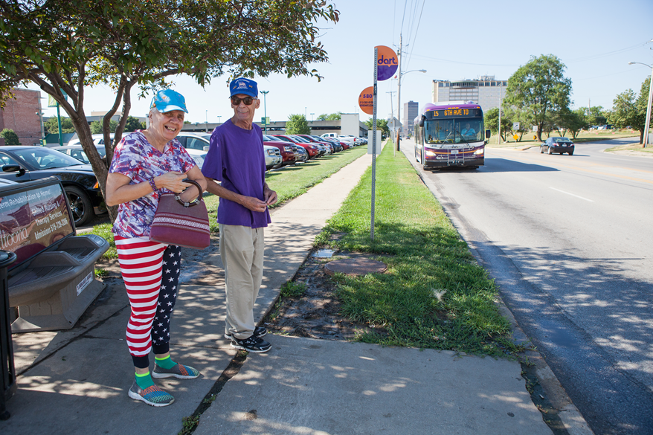
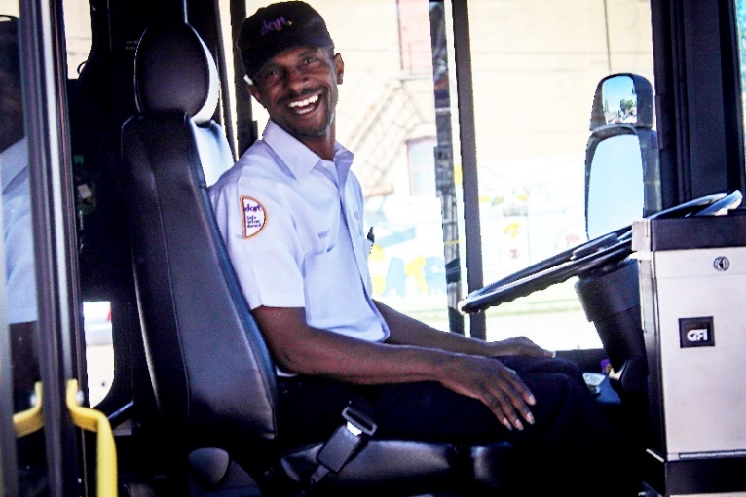
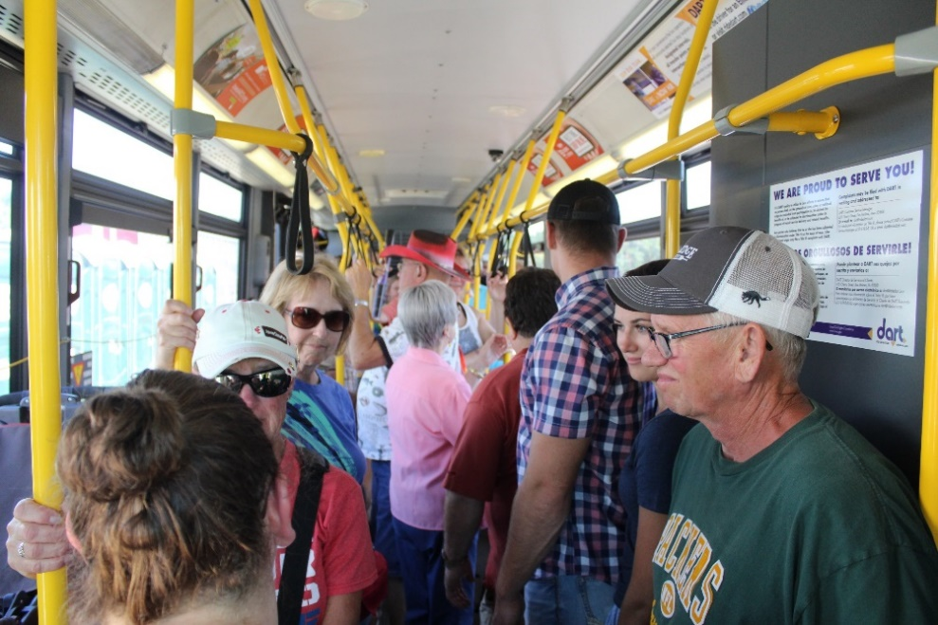
Thank you!

