Slide 1


September 6, 2019
Labor market information
Donna Burkett

Slide 2
Iowa Workforce Development
what Is Labor Market Information (LMI)?
Labor market information is data related to employment and the workforce
The information is collected, analyzed and disseminated in cooperation with the U.S. Department of Labor's Bureau of Labor Statistics (BLS) and Employment and Training Administration (ETA)
The LMI Division of Iowa Workforce Develop is responsible for collecting, analyzing and reporting data related to Iowa’s workforce and the economy
The goal of LMI is to help customers make informed plans, choices, and decisions for a variety of purposes, including business investment decisions, career planning and preparation, education and training offerings, job search opportunities, hiring, and public or private workforce investments

Slide 3
Iowa Workforce Development
Notable Numbers www.iowalmi.gov
Labor market information is data related to employment and the workforce
The information is collected, analyzed and disseminated in cooperation with the U.S. Department of Labor's Bureau of Labor Statistics (BLS) and Employment and Training Administration (ETA)
The LMI Division of Iowa Workforce Develop is responsible for collecting, analyzing and reporting data related to Iowa’s workforce and the economy
The goal of LMI is to help customers make informed plans, choices, and decisions for a variety of purposes, including business investment decisions, career planning and preparation, education and training offerings, job search opportunities, hiring, and public or private workforce investments
Career Publications
Laborshed Studies (Labor Availability)
Occupational and Industry Wages
Occupational and Industry Forecasts/Projections
Occupation and Industry Employment
Unemployment Insurance Statistics
Unemployment Rate

Slide 4
Labor Market Trends

Slide 5
Status of the Iowa Economy
July 2019 Iowa’s unemployment rate was 2.5%, the U.S. was 3.7%
The total number of Iowans working was 1,680,500.
  Number of unemployed was 42,800
Iowa’s nonfarm employment grew by 1,800 jobs since last month.
Manufacturing continues to lead. It has grown by 6,100 jobs since last July.
Leisure and hospitality has added 1,200 jobs from 1 year ago.
  The sector has advanced by 1,100 and has been propelled by hiring in accommodations and food services (+900). The hiring has been especially strong in the Des Moines area.
Iowa’s nonfarm employment is up 10,200 from a year ago.

Slide 6
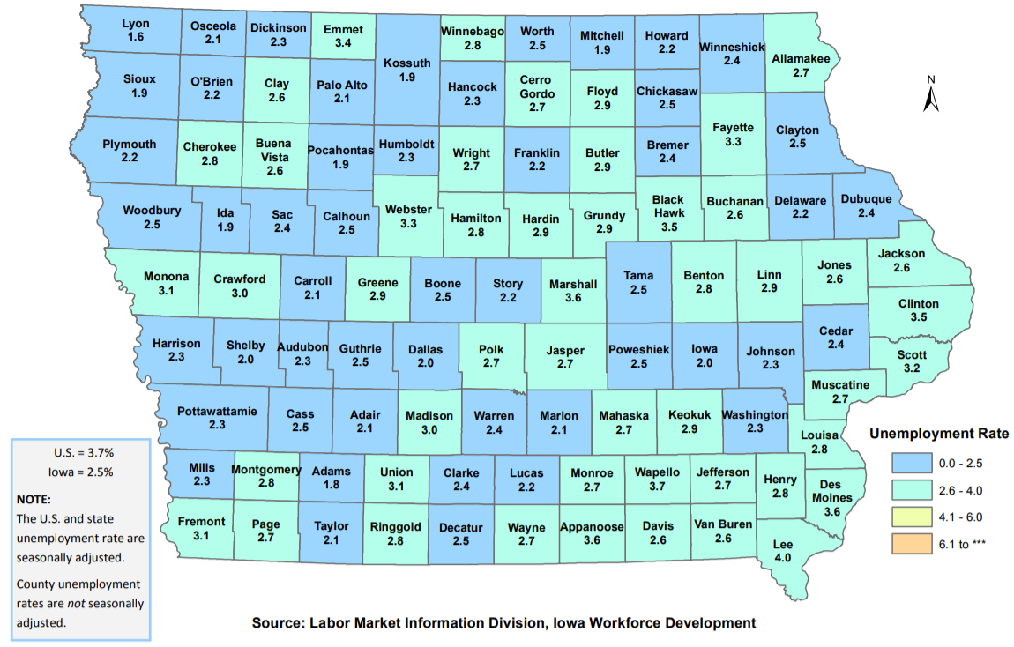
July 2019
County Unemployment Rates
Source: Local Area Unemployment Statistics (LAUS), Iowa Workforce Development (iowalmi.gov/local-area-unemployment-statistics)

Slide 7
labor market information from:
2018 laborshed studies

Slide 8
Laborshed Hospitality Industry Characteristics
IOWA | DES MOINES
63% are employed 32% likely to change employment | 68% are employed 37% likely to change employment
14% are unemployed 67% likely to change employment | 12% are unemployed 62% likely to change employment
82% are paid an hourly wage | 76% are paid an hourly wage
66% are employed full-time | 67% are employed full-time
12% hold more than 1 job | 12% hold more than 1 job
61% education beyond high school 32% Associate degree or higher | 63% education beyond high school 36% Associate degree or higher
Nearly 20% are underemployed | Nearly 25% are underemployed
Job Search Resources: | Job Search Resources:
Internet 64% | Internet 67%
Newspapers 26% | Newspapers 22%
Iowa WORKS Centers 19% | Iowa WORKS Centers 18%
Networking 15% | Networking 13%

Slide 9
Laborshed Hospitality Industry Characteristics
IOWA | DES MOINES
Top desired benefits: | Top desired benefits:
Health insurance | Health insurance
Pension/retirement | Pension/retirement
Dental coverage | Dental coverage
Paid vacation | Vision coverage
Vision coverage | Paid vacation
Workplace Interest: | Workplace Interest:
Job teams 79% | Cross-training 67%
Cross-training 71% | Job teams 67%
Job sharing 48% | Job sharing 51%
Different shifts 42% | Different shifts 36%
Temporary work 53% | Seasonal work 49%
Seasonal work 53% | Temporary work 46%

Slide 10
labor market information from:
quarterly census of employment and wages
industry and occupation forecasts and
local employment dynamics

Slide 11
Iowa and the Des Moines Area
In 2018 the Accommodation and Food Services sector in Iowa
  8% of Iowa’s employment,
  123,589 jobs
  Nearly 7,200 locations
    (83% of the workers were employed in Food Service and Drinking Places)
  $47,511 is the average annual wage for all industries
    $16,719 was the annual wage for Accommodation and Food Services
The Des Moines area
  10% of the state’s employment in Leisure and Hospitality
  36,514 jobs
  Nearly 1,800 locations
  $55,980 is the average annual wage for all industries
    $19,302 was the annual average wage for Leisure and Hospitality
Polk had the 6th highest annual county wage in the sector, $19,612
The average wage for all industries in Polk county was $57,185
More females than males are employed in the sector
The largest age group consisted of 25-34 year olds followed by 35-44 year olds
Notes:
Iowa- leisure & hospitality although wages have been increaseing for the last 10 years (35%) it is the lowest paying sector at nearly $17,000 annually
Since 2010 Following the last recession, employment has increased in the sector all years (minimum growth from 2017 to 2018 of just over 100 jobs
74% of the jobs are in restaurant and other drinking places – 91,953
17% of the jobs are in traveler accomodations – 20,871
Remaining jobs can be founds in mostly drinking places 5%, special food places 3% and rv parks 1%
Highest county wages for accomodation & Food services
Tama $29,586
Lyon $27,170
Washington $27,117
Pottawattamie $23,467
Clarke $20,625

Slide 12
The Hospitality
Industry and Job Outlook

Slide 13
IOWA
HOSPITALITY INDUSTRY PROJECTIONS 2016-2026
Source: Industry Forecasts, Iowa Workforce Development.

Slide 14
IWD REGION 11
HOSPITALITY INDUSTRY PROJECTIONS 2016-2026
(IWD Region 11 includes the counties of: Boone, Dallas, Jasper, Madison, Marion, Polk, Story, Warren)
Source: Industry Forecasts, Iowa Workforce Development.

Slide 15
Hospitality
Iowa Occupations with the Largest
Employment Change 2016-2026
Source: Occupational Forecasts, Iowa Workforce Development.

Slide 16
Hospitality
IWD Region 11 Occupations with the Largest Employment Change 2016-2026
Source: Occupational Forecasts, Iowa Workforce Development.

Slide 17
What labor market information
do you need?

Slide 18
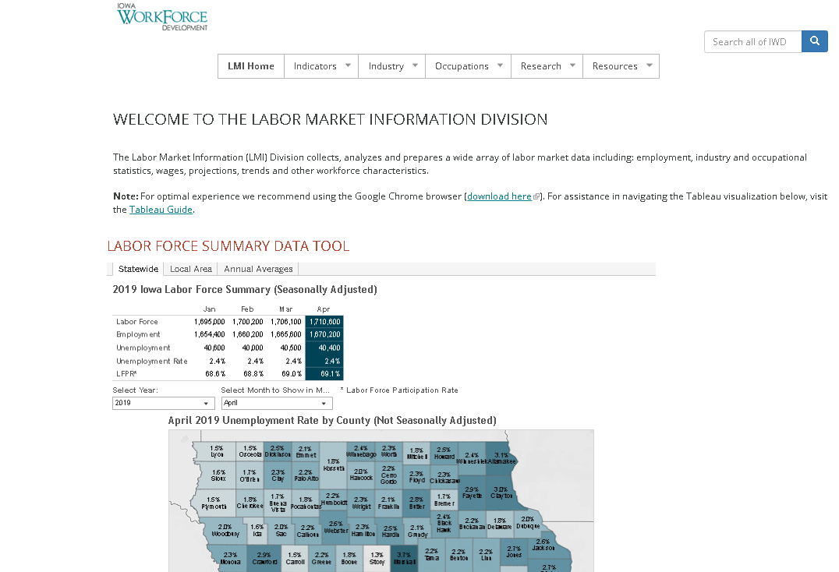
Iowalmi.gov
What type of question am I trying to answer?

Slide 19
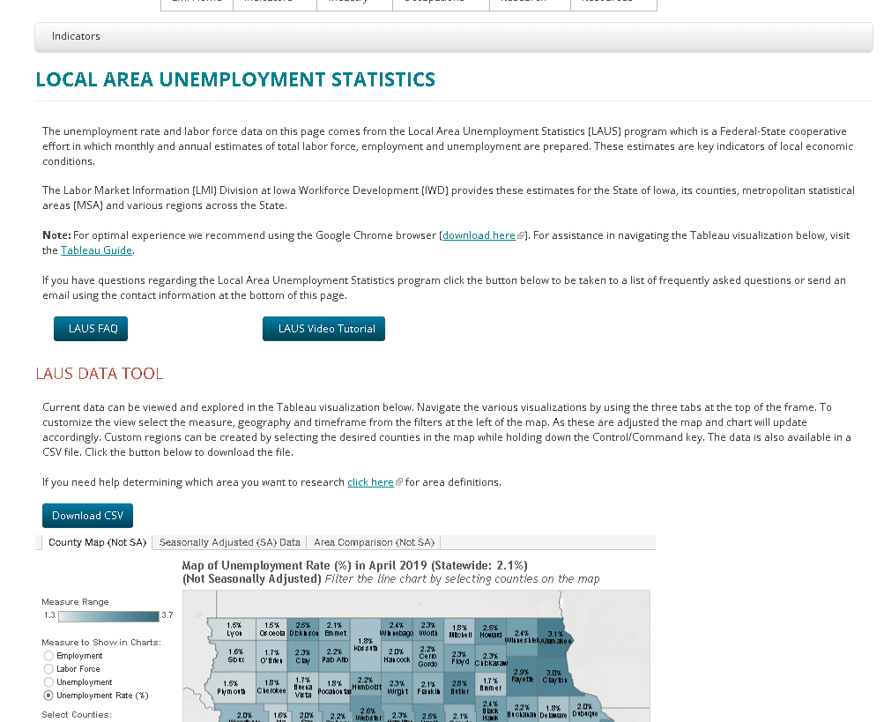
Local Area Unemployment Statistics (LAUS)
Select Labor Force Measurement & County/Region

Slide 20
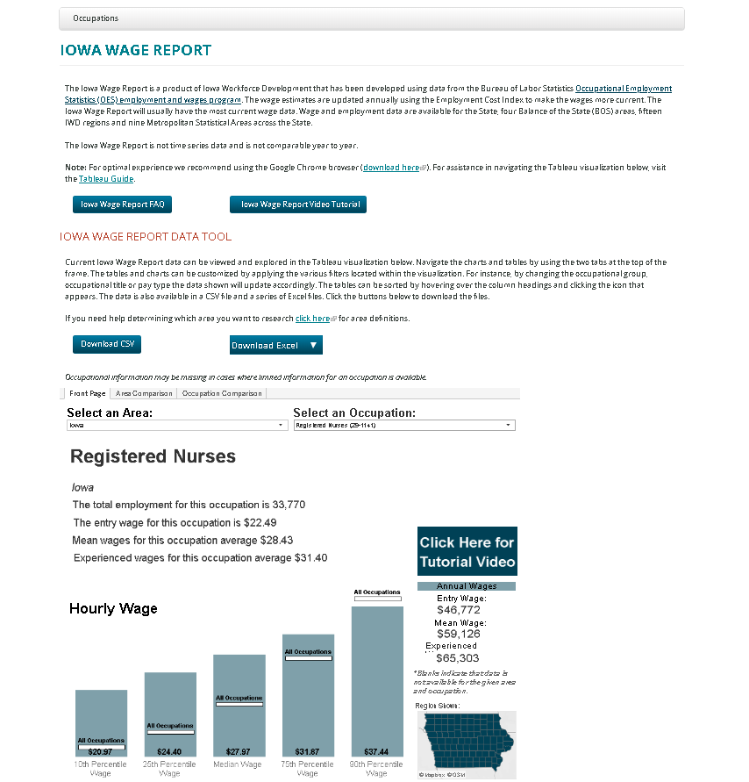
Occupational wages - Iowa wage report
Select your occupation and Geography

Slide 21
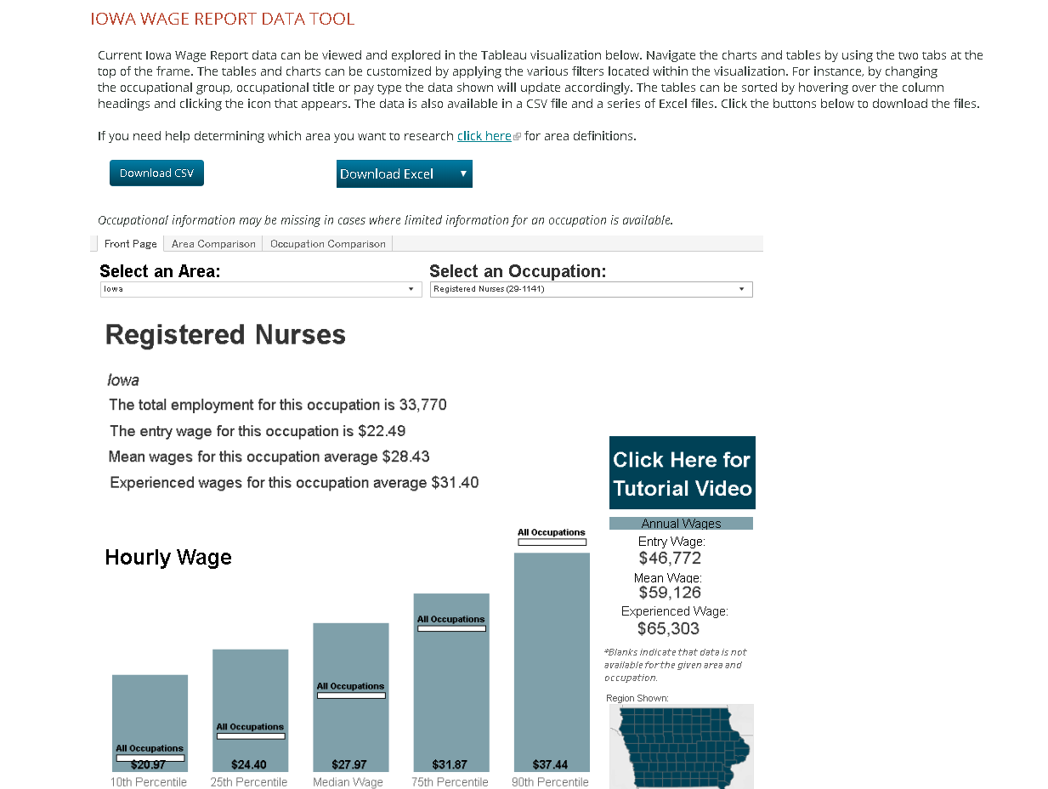
Occupational wages - Iowa wage report
Select your occupation and Geography

Slide 22
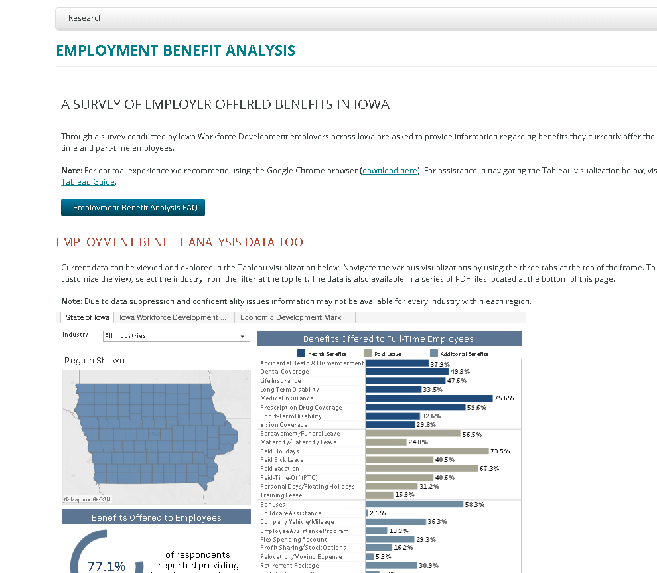
Benefits offered by employers
Select your Industry, regional data on additional tabs

Slide 23
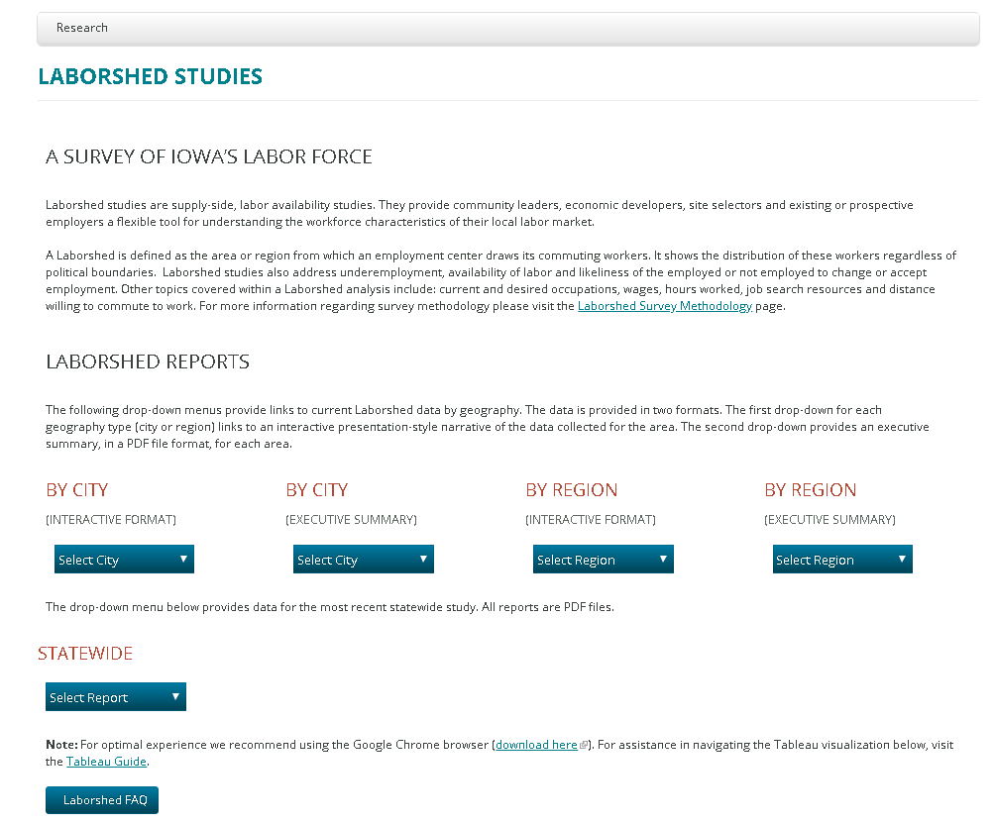
Laborshed Study (Labor supply & Characteristics)
Select your City, County, or region

Slide 24
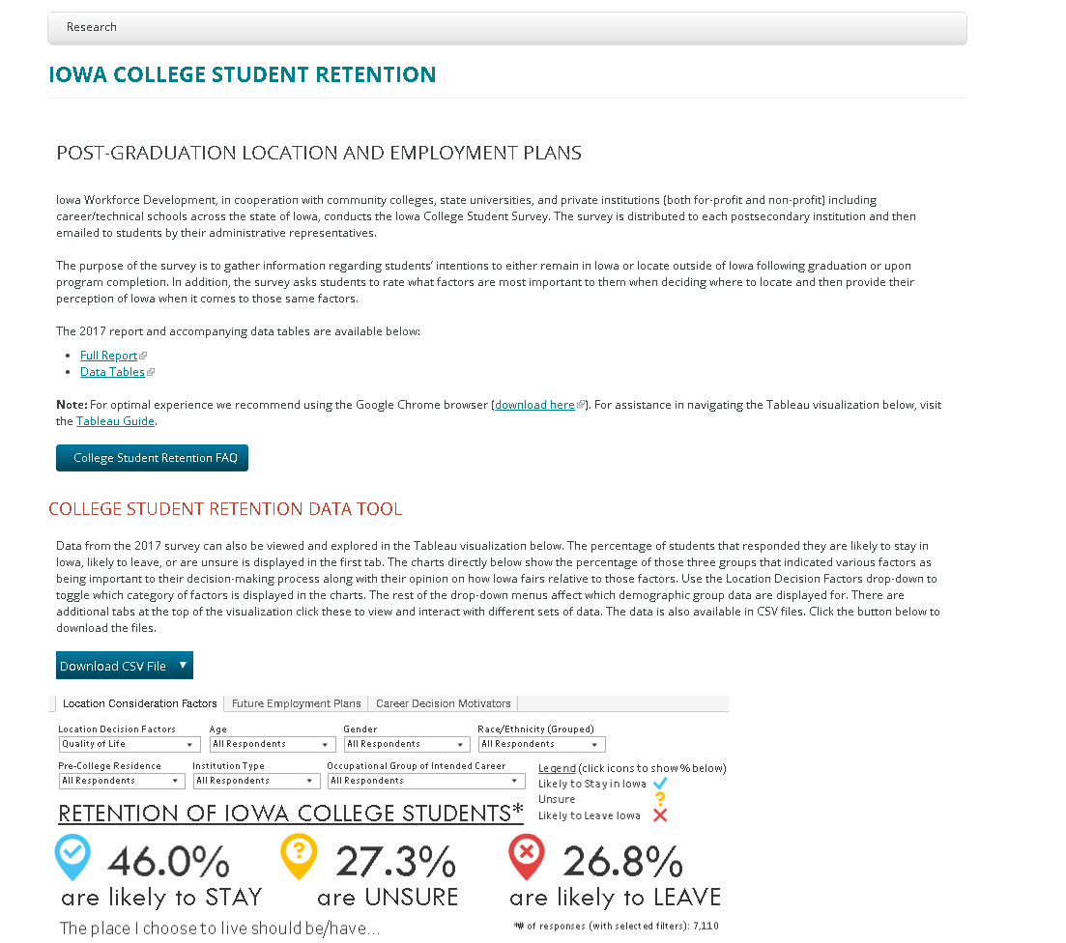
College student retention
Select
Decision factors, Intended occupation, institution type, Demographics

Slide 25
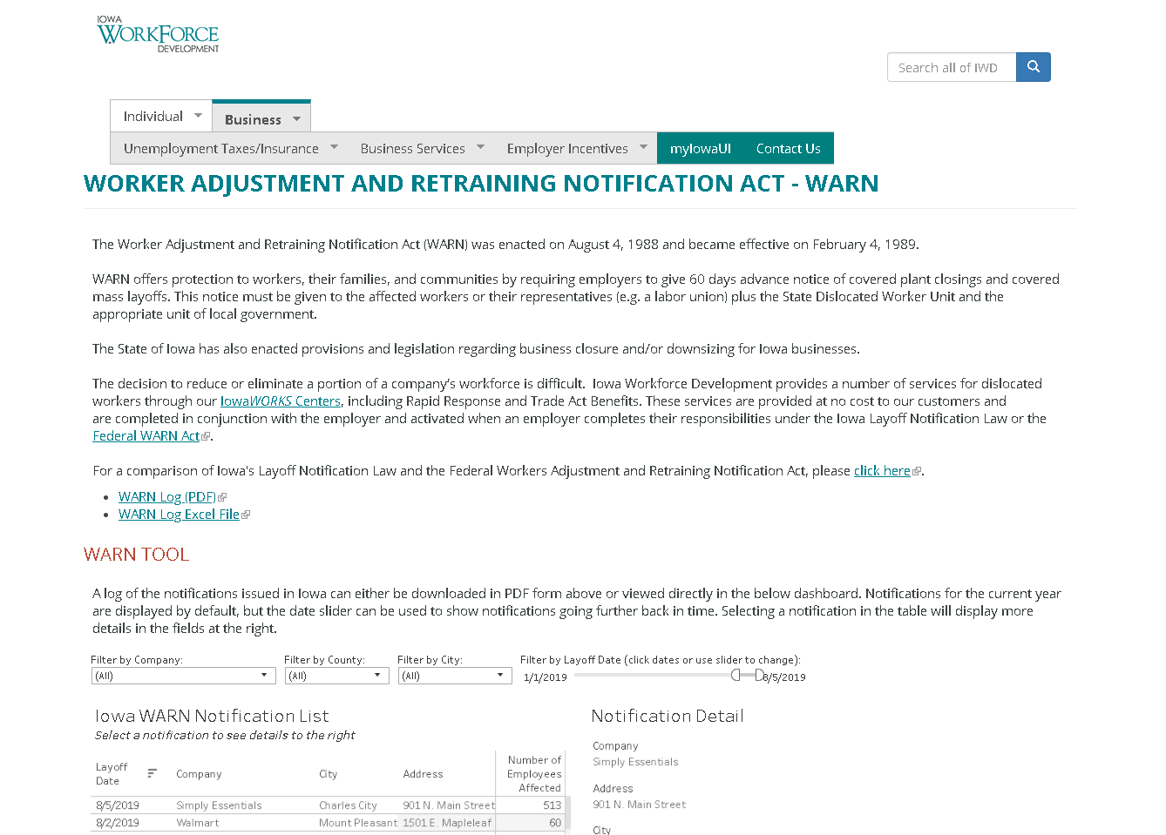
Worker Adjustment Retraining Notification (Warn)
Select Company, City, county, Date of impact

Slide 26
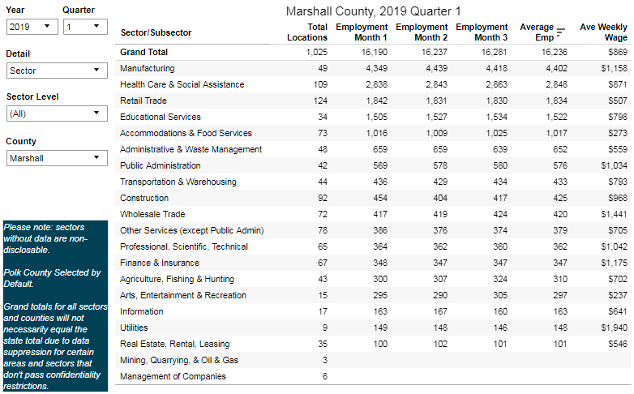
Unemployment Rates
Quarterly Industry Employment and Wages
Source: Quarterly Census of Employment and Wages (QCEW), Iowa Workforce Development (iowalmi.gov/qcew)

Slide 27
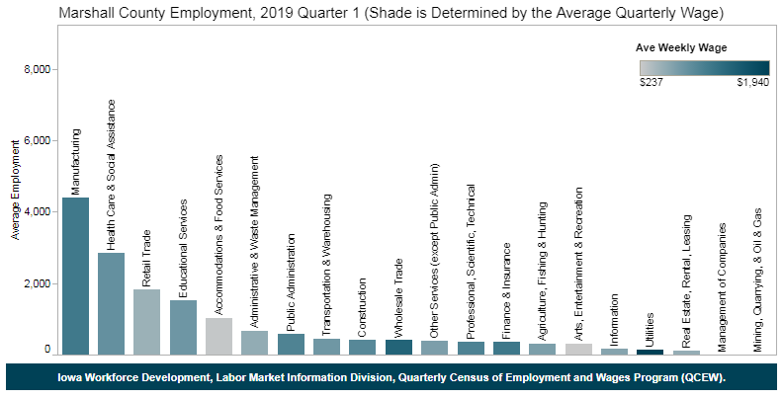
Quarterly Industry Employment and Wages
Source: Quarterly Census of Employment and Wages (QCEW), Iowa Workforce Development (iowalmi.gov/qcew)

Slide 28
Iowa Workforce Development
Resources & Related sites:
Iowaworkforcedevelopment.gov
Iowalmi.gov – Labor market information
Futurereadyiowa.gov – connecting iowans to
post-secondary education, training, & careers
  Clearinghouse for work-based learning
  Last-Dollar Scholarship
  Future ready iowa grant
  employer innovation fund
  Work-based learning https://clearinghouse.futurereadyiowa.gov/how-it-works/
iowaCareercoach.gov – Career exploration information, Assessments tools, & resources
Earnandlearniowa.gov – Connecting Iowans & employers registered apprenticeship opportunities
Homebaseiowa.gov – connecting veterans to careers and resources

Slide 29
Future Ready Iowa
Labor market information:
Ryan west, Labor market information Director
  ryan.west@iwd.iowa.gov
  515.725.3896
Donna Burkett
  donna.burkett@iwd.iowa.gov
  515.242.5862
Ryan murphy
  ryan.murphy@iwd.iowa.gov
  515.281.7505

Slide 30

Unleashing opportunities to get Iowa Future ready.

