Slide 1
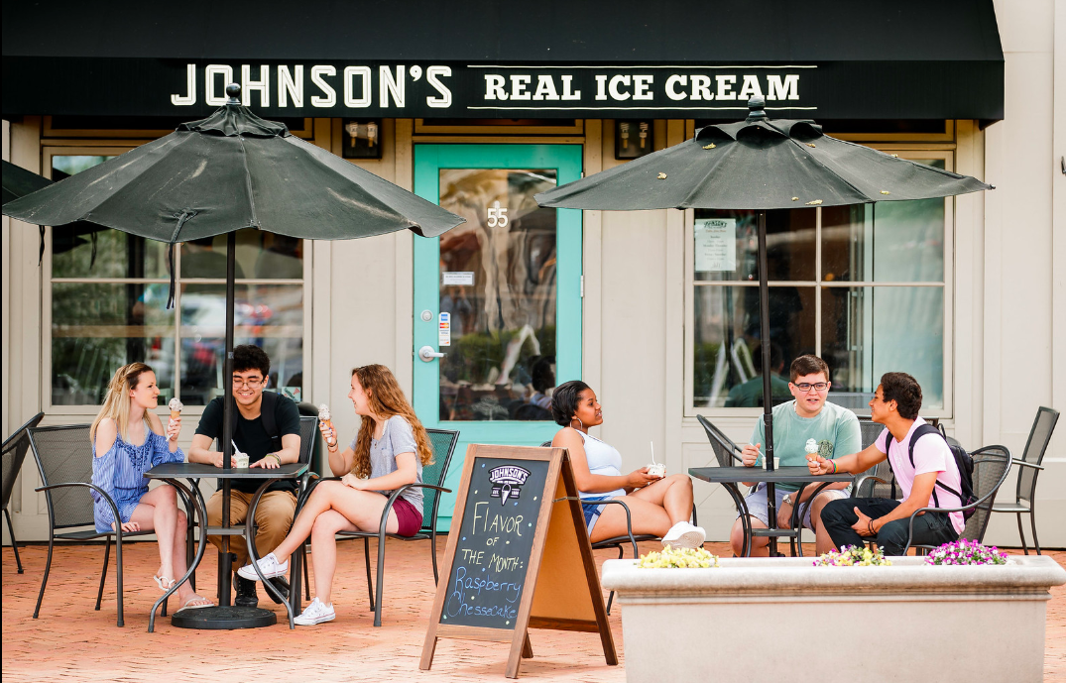
Dublin Ohio CVB
2019 Summer Campaign: Partner Participation Kit
Notes:
Winter image folder: https://drive.google.com/a/destinationthink.com/file/d/1fZQFa_gnSSok1mGCxJwxbIKpVCqXZoP6/view?usp=sharing
https://www.flickr.com/photos/157701276@N03/albums/with/72157697763695301

Slide 2
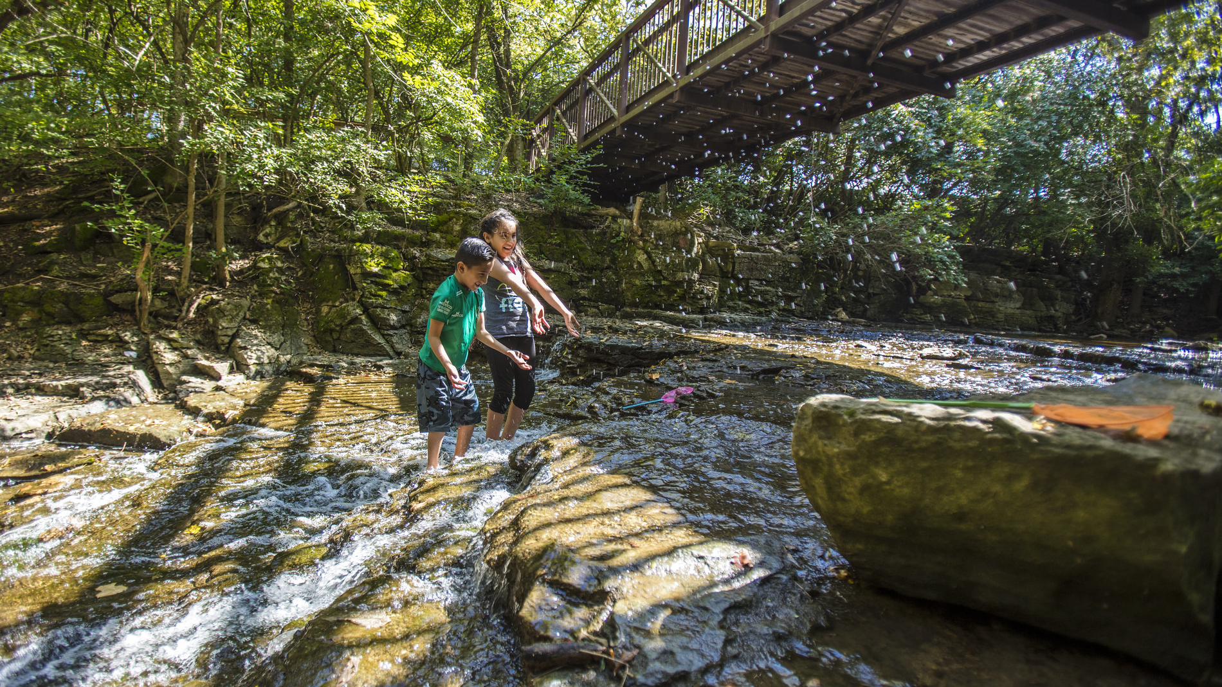
ABOUT THE CAMPAIGN
As a Dublin, Ohio business or organization, you have a tremendous influence on what people think of our city. Your products and services are vital to the experiences that we collectively offer to travelers. Those experiences shape the stories that people tell about Dublin. They also affect the decisions people make when they consider a visit.
That’s why we invite you to join your tourism colleagues by participating in the Right Here in Dublin campaign.
This initiative has been developed to inspire visitors and locals alike to experience Dublin. It supports local businesses by highlighting what makes “Right Here” so special. In doing so, the campaign will build awareness and create urgency to visit the city.
This is your opportunity to help this campaign succeed. Together as an industry, our online voices will amplify the distinctive, fun and welcoming experiences that Dublin has to offer.
Notes:
(Pittsburgh, Detroit, Indianapolis, Charleston/Huntington, Cleveland, Toledo, Cincinnati).
(Columbus, Dayton, Akron, Mansfield)
BUILD REPUTATION: Inspire traveler’s with the idea of Dublin as the perfect getaway in longer drive markets amongst visitors within a 3.5 - 5 hour driving radius.
CREATE URGENCY: Move travelers from considering Dublin to intent in key near-in markets with a 1.5-hour driving radius.
EXPERIENCE ENRICHMENT: Generate advocacy for the Dublin experience by delivering true Irish hospitality.
.

Slide 3
INSPIRE
TRAVELERS
CREATE URGENCY
Inspire would-be guests from near and far
Compel action; motivate travelers to visit now
Notes:
(Pittsburgh, Detroit, Indianapolis, Charleston/Huntington, Cleveland, Toledo, Cincinnati).
(Columbus, Dayton, Akron, Mansfield)
BUILD REPUTATION: Inspire traveler’s with the idea of Dublin as the perfect getaway in longer drive markets amongst visitors within a 3.5 - 5 hour driving radius.
CREATE URGENCY: Move travelers from considering Dublin to intent in key near-in markets with a 1.5-hour driving radius.
EXPERIENCE ENRICHMENT: Generate advocacy for the Dublin experience by delivering true Irish hospitality.
.

Slide 4
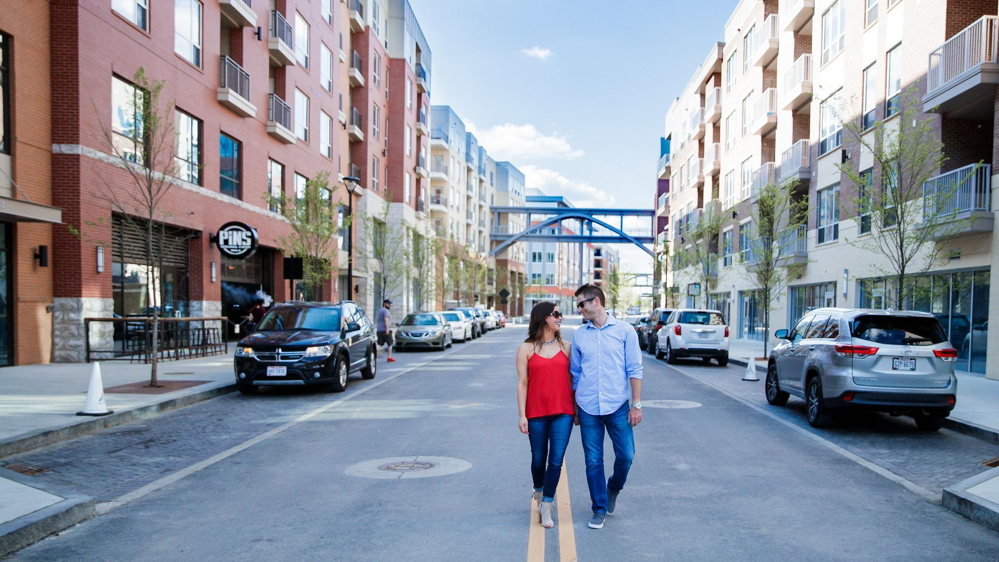
WHAT’S INSIDE THE KIT
Creative Concept:
Learn about the Right Here in Dublin campaign and view example messaging.
Videos:
View all three videos for the Right Here in Dublin campaign.
Photography Assets:
View or download imagery you can share on your social networks.
Blog Posts:
View all of the blog posts that you can share on your social networks.
Calendar of Events:
View a calendar of events that will be taking place in Dublin this Summer and Fall.
Content Sharing Tips & Best Practices:
View tips on the best ways to share this content on your social channels.
Notes:
(Pittsburgh, Detroit, Indianapolis, Charleston/Huntington, Cleveland, Toledo, Cincinnati).
(Columbus, Dayton, Akron, Mansfield)
BUILD REPUTATION: Inspire traveler’s with the idea of Dublin as the perfect getaway in longer drive markets amongst visitors within a 3.5 - 5 hour driving radius.
CREATE URGENCY: Move travelers from considering Dublin to intent in key near-in markets with a 1.5-hour driving radius.
EXPERIENCE ENRICHMENT: Generate advocacy for the Dublin experience by delivering true Irish hospitality.
.

Slide 5
Notes:
Pride of place - RIGHT HERE this happened
Awareness building - Dublin is RIGHT HERE under your nose - waiting to be discovered
Illustrate how much is going on RIGHT HERE in Dublin - what makes it SPECIAL

Slide 6
RIGHT HERE IN DUBLIN
It's your weekend—find your escape.
Right here in Dublin.
Dublin is the getaway you never knew you needed. A vibrant oasis, where calming nature meets an urban experience; where the golf course recognizes legends of the past and the zoo educates generations for the future. Here, Downtown Dublin bridges historic appeal with modern amenities. Here, you’ll find a charming city where good fortune is more than an attitude—it's the inspiration for our character and the foundation of our community. And it’s all right outside your door.
You don't have to go far to get away. Hassle-free fun is waiting for you...
Right here in Dublin.
Notes:
RIGHT HERE IN DUBLIN
It's your weekend—find your escape.
Right here in Dublin.
Dublin is the getaway you never knew you needed. A vibrant oasis, where calming nature meets an urban experience; where the golf course recognizes legends of the past and the zoo educates generations for the future. Here, Downtown Dublin bridges historic appeal with modern amenities. Here, you’ll find charming city where good fortune is more than an attitude—it's the inspiration for our character and the foundation of our community. And it’s all right outside your door.
You don't have to go far to get away. Hassle-free fun is waiting for you...
Right here in Dublin.

Slide 7
RIGHT HERE IN DUBLIN
Right here, Ireland becomes a weekend trip.
Right here, fun is par for the course.
Right here, adventure lives Downtown.
Right here, nature is all around us.
Right here, past legends live on.
Right here, community comes first.
Right here, remarkable events are homegrown.
Right here, the grass is always greener.
RIGHT HERE IN DUBLIN.
Notes:
Right here, fairies lead the way.
Right here, flavors set the table.

Slide 8
ACTIVATE
STORYTELLERS
Grow Dublin’s reputation through word of mouth.
Notes:
(Pittsburgh, Detroit, Indianapolis, Charleston/Huntington, Cleveland, Toledo, Cincinnati).
(Columbus, Dayton, Akron, Mansfield)
BUILD REPUTATION: Inspire traveler’s with the idea of Dublin as the perfect getaway in longer drive markets amongst visitors within a 3.5 - 5 hour driving radius.
CREATE URGENCY: Move travelers from considering Dublin to intent in key near-in markets with a 1.5-hour driving radius.
EXPERIENCE ENRICHMENT: Generate advocacy for the Dublin experience by delivering true Irish hospitality.
.

Slide 9
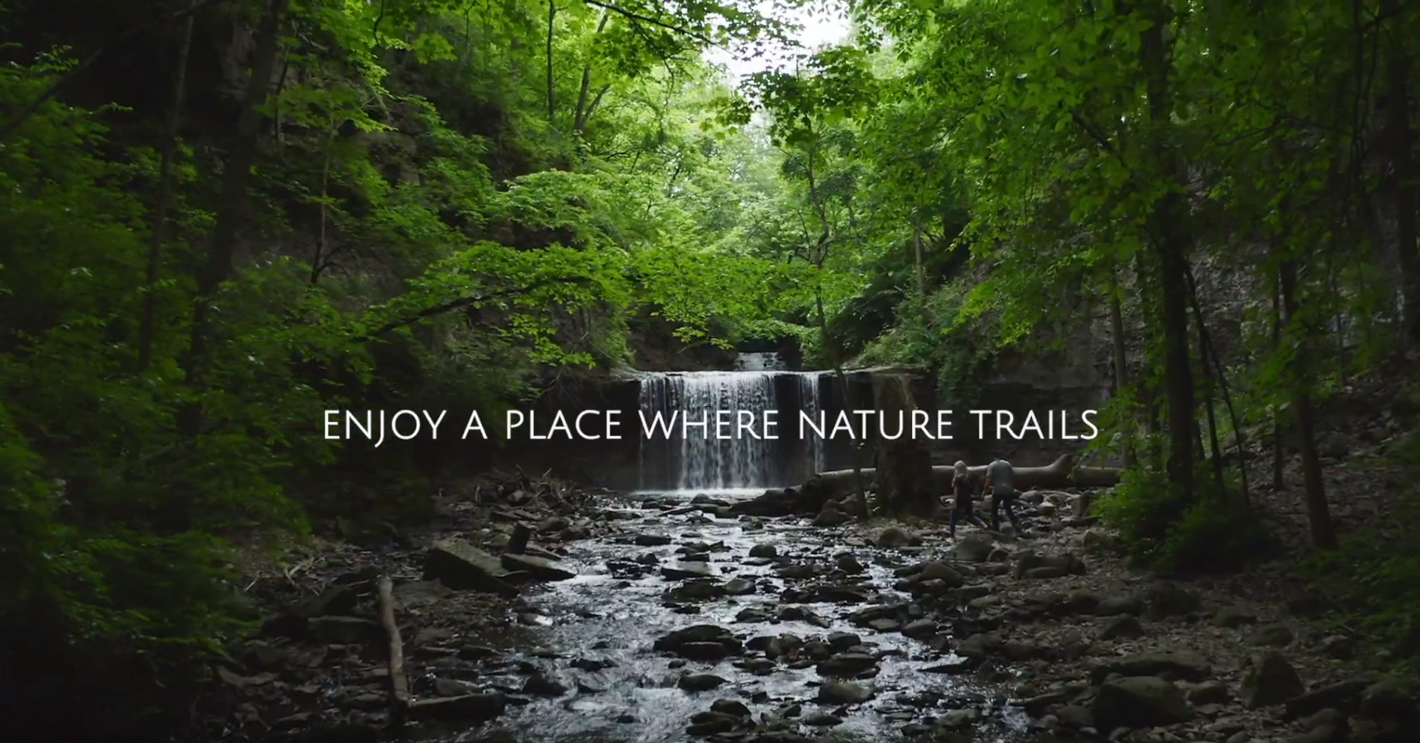
FROM NATURE TRAILS TO COCKTAIL TRAILS
Enjoy a place where nature trails can lead to Celtic cocktail trails, right here in Dublin. Spend the day exploring Dublin's outdoor spaces where you'll discover waterfalls, public art and the perfect parks to experience our natural beauty. After a day of adventuring, head to Downtown Dublin to experience the best in Dublin dining and craft cocktails on the Celtic Cocktail Trail.
Video Link: https://youtu.be/DV9CTM31M0U
Notes:
Our audience of millennial travellers is interested in cultural immersion;
mixing with the locals and really getting to know what it is to live in a place.
Let’s capitalize on who we are by profiling our most Canadian experiences
and appealing to their desire to really get to know Canada.
We’ll make Calgary the ultimate Canadian destination because of all the
iconic Canadian things you can accomplish when you’re here.
Millennial travellers don’t want to just do one thing. They want to
do all the things. The more experiences on offer, the greater the
selection and diversity, the more interesting a destination becomes.
By pairing and contrasting all the things to see and do in and
around Calgary, we can appeal to our audience’s unrelenting #fomo.
BUILD REPUTATION: Inspire traveler’s with the idea of Dublin as the perfect getaway in longer drive markets amongst visitors within a 3.5 - 5 hour driving radius.
CREATE URGENCY: Move travelers from considering Dublin to intent in key near-in markets with a 1.5-hour driving radius.
EXPERIENCE ENRICHMENT: Generate advocacy for the Dublin experience by delivering true Irish hospitality..

Slide 10
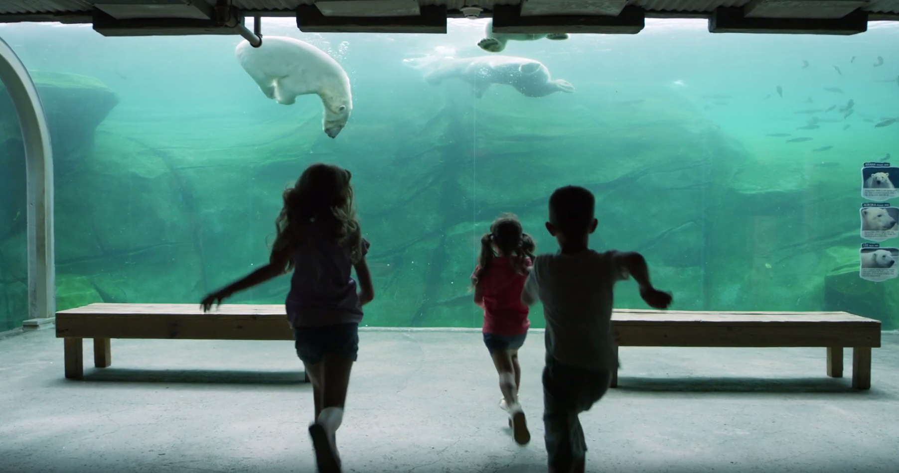
FAMILY FUN
Say hello to over 600 species, right here in Dublin. Spend the weekend exploring six regions and creating lifelong memories while visiting the Columbus Zoo and Aquarium.
Video Link: https://youtu.be/WT3Xx3b6rGg
Notes:
Our audience of millennial travellers is interested in cultural immersion;
mixing with the locals and really getting to know what it is to live in a place.
Let’s capitalize on who we are by profiling our most Canadian experiences
and appealing to their desire to really get to know Canada.
We’ll make Calgary the ultimate Canadian destination because of all the
iconic Canadian things you can accomplish when you’re here.
Millennial travellers don’t want to just do one thing. They want to
do all the things. The more experiences on offer, the greater the
selection and diversity, the more interesting a destination becomes.
By pairing and contrasting all the things to see and do in and
around Calgary, we can appeal to our audience’s unrelenting #fomo.
BUILD REPUTATION: Inspire traveler’s with the idea of Dublin as the perfect getaway in longer drive markets amongst visitors within a 3.5 - 5 hour driving radius.
CREATE URGENCY: Move travelers from considering Dublin to intent in key near-in markets with a 1.5-hour driving radius.
EXPERIENCE ENRICHMENT: Generate advocacy for the Dublin experience by delivering true Irish hospitality..

Slide 11
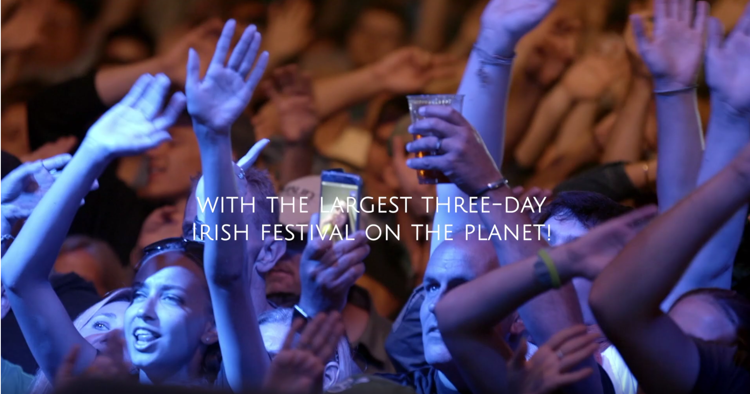
IRISH FESTIVAL & HOSPITALITY
Attracting over 100,000 guests a year, the Dublin Irish Festival is the event of the year and the largest three-day Irish festival in the world! We can’t wait to welcome you to experience cultural awareness, music, sustainability and of course, foot-tapping fun for the whole family.
Video Link: https://youtu.be/FdOS1e3EnMw
Notes:
Our audience of millennial travellers is interested in cultural immersion;
mixing with the locals and really getting to know what it is to live in a place.
Let’s capitalize on who we are by profiling our most Canadian experiences
and appealing to their desire to really get to know Canada.
We’ll make Calgary the ultimate Canadian destination because of all the
iconic Canadian things you can accomplish when you’re here.
Millennial travellers don’t want to just do one thing. They want to
do all the things. The more experiences on offer, the greater the
selection and diversity, the more interesting a destination becomes.
By pairing and contrasting all the things to see and do in and
around Calgary, we can appeal to our audience’s unrelenting #fomo.
BUILD REPUTATION: Inspire traveler’s with the idea of Dublin as the perfect getaway in longer drive markets amongst visitors within a 3.5 - 5 hour driving radius.
CREATE URGENCY: Move travelers from considering Dublin to intent in key near-in markets with a 1.5-hour driving radius.
EXPERIENCE ENRICHMENT: Generate advocacy for the Dublin experience by delivering true Irish hospitality..

Slide 12
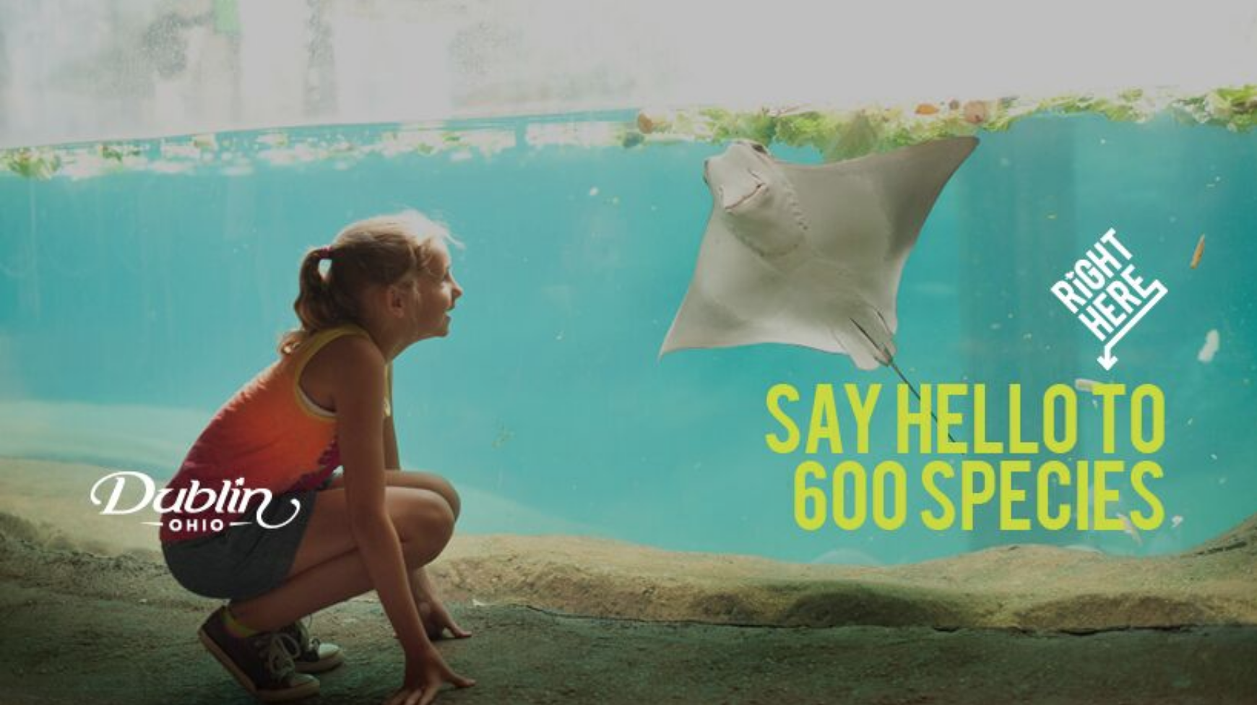
PHOTOGRAPHY ASSETS
Below are a variety of images and image sizes that you can use to share the Right Here in Dublin campaign on your social channels & websites.
Facebook Cover Images
Update your Facebook business page with one of five covers sized to 820 x 461 with the Right Here in Dublin Creative. Download link
Twitter Header Images
Update your Twitter header page with one of five covers sized to 1500 x 500 with the Right Here in Dublin Creative. Download link
Instagram Post Images
Share an Instagram post with one of five images sized to 1080 x 1080 with the Right Here in Dublin Creative. Download link
Notes:
Place that is better than where you live, it is a place where you connect with the people that bring and the people that you
Get away from the daily grind and tap into a nearby oasis
A lot of specific experiences - it’s about what’s really important in life, in a safe friendly quality way
With an Irish signature

Slide 13
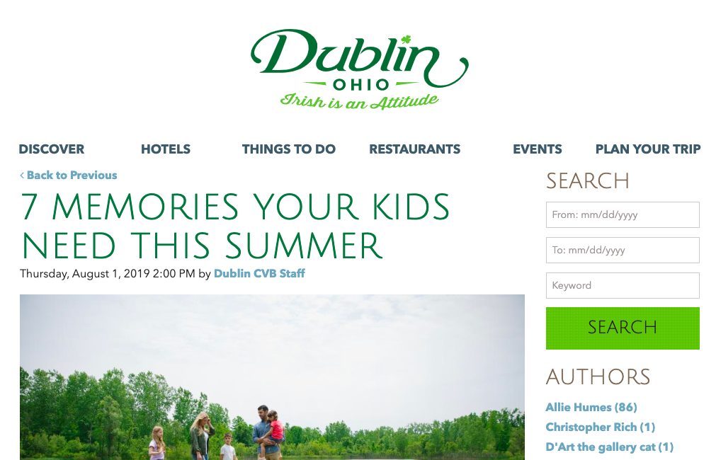
BLOGS TO SHARE
Below are a variety of blogs that have been created for the Right Here in Dublin campaign. As a partner, you can share these blogs on your social channels.
Kid-friendly Activities that Make Dublin a Fun Getaway for the Whole Family
Irish Inspired Getaways in Dublin, Ohio
5 Paths to Outdoor Bliss in Dublin
A Crowd Sourced Family Itinerary for Dublin, Ohio
A Local’s Guide to Outdoor Adventure in Dublin, Ohio
A Touch of Irish Right Here in Dublin, Ohio
9 Tips for a Dublin-Style Romantic Getaway
7 Memories Your Kids Need This Summer
Last Chance for Summer! 5 Tips for a Great Couples Weekend
Five Tips for Planning a Last-Minute Weekend Getaway before Summer Sneaks Away.
Click on the links above to view and share the blog!
Notes:
Place that is better than where you live, it is a place where you connect with the people that bring and the people that you
Get away from the daily grind and tap into a nearby oasis
A lot of specific experiences - it’s about what’s really important in life, in a safe friendly quality way
With an Irish signature

Slide 14
CALENDAR OF EVENTS
August | September | October
Irish Festival 5k & Dub Crawl (Aug 1st) Celebrate the start of the Irish Festival with a 5K in Historic Dublin. | Holiday: Labor Day (September 2) | Boo at the Zoo: (October 18-27)
Irish Festival (Aug 2nd - Aug 4th) | Historic Dublin White Wine Trail (Sept 14th) Sample different white wines, with a delicious food pairing sample, and a commemorative wine tasting glass. | 39th Annual Fall Festival and Pumpkin Weigh Off (October 12-13)
Emerald City Half & Quarter Marathon (Aug 25th) End your summer with plenty of Irish Attitude stretching 6,000 ft. and more than 13 miles.
Craft Brew at the Zoo August 23
Dublin Market Every Saturday from May 18th through September 28th and enjoy all the best Dublin has to offer! The market is held from 9am-12pm. | Dublin Market Every Saturday from May 18th through September 28th and enjoy all the best Dublin has to offer! The market is held from 9am-12pm
Notes:
Right here, fairies lead the way.
Right here, flavors set the table.

Slide 15
HOW TO PARTICIPATE

Slide 16
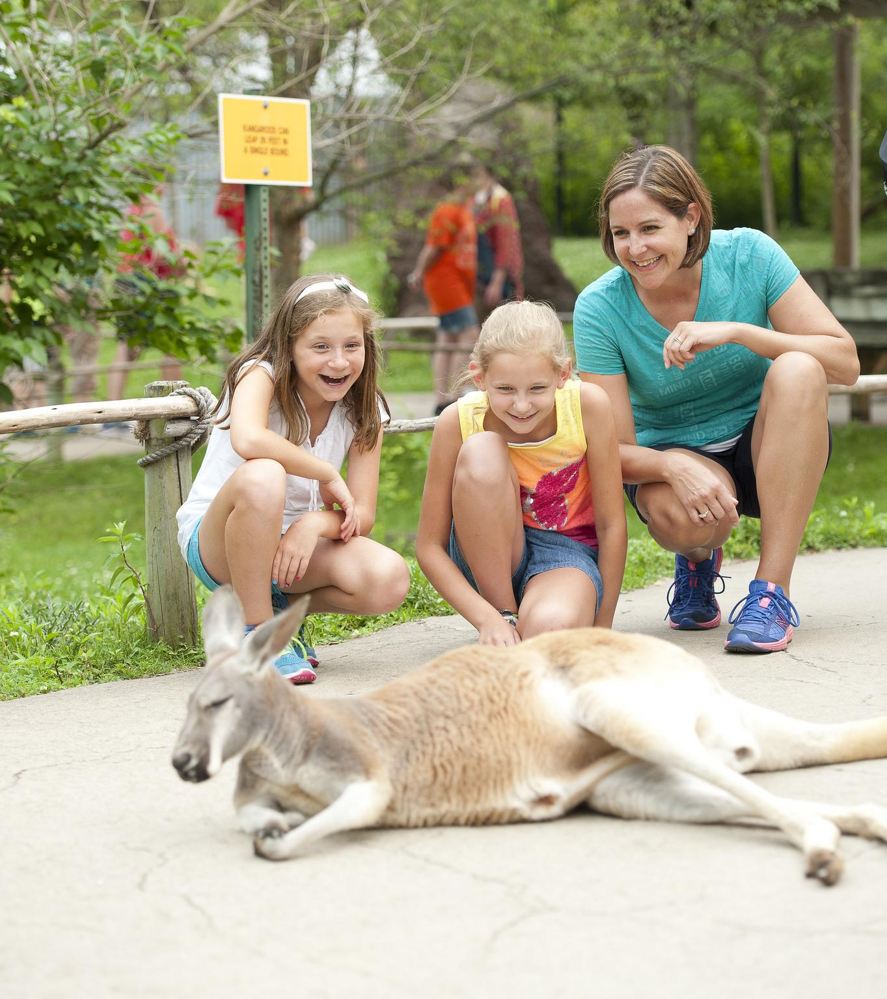
HOW TO PARTICIPATE
Now it’s time to show people what makes Dublin so special. Our community will benefit the most when Dublin’s businesses and tourism partners like you join the campaign.
Here is how you can get involved by using social media to share your Right Here in Dublin stories and experiences.
Curate and create engaging content
Tell Dublin stories by posting content on your social media channels, or by sharing content from places like Dublin CVB, other local businesses and organizations, or even residents.
On social media, always focus on your audience first. Ask yourself, “What’s in it for them?” This way, you will have a better chance of sharing content that is engaging and relevant. Think about how your business or organization meets your audience’s needs through its products and experiences. Then, identify how those products are connected to Dublin’s overall story.
Notes:
Place that is better than where you live, it is a place where you connect with the people that bring and the people that you
Get away from the daily grind and tap into a nearby oasis
A lot of specific experiences - it’s about what’s really important in life, in a safe friendly quality way
With an Irish signature

Slide 17
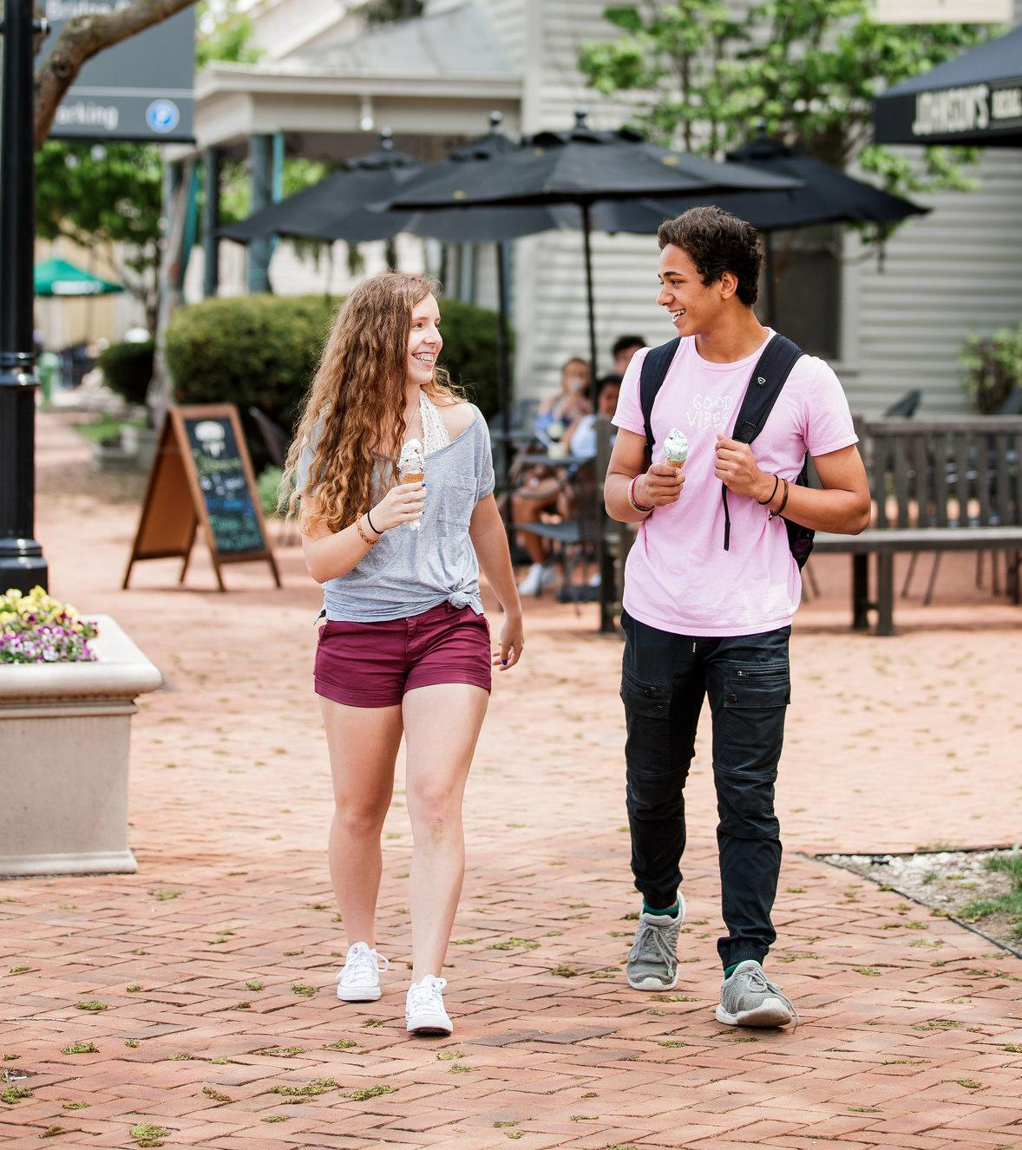
HOW TO PARTICIPATE
Here are some more questions that will help you come up with ideas for new content that tells our story:
Does your business have a unique origin story that reflects the special community spirit Right Here in Dublin?
Is there something special (a story, proof points, etc.) about a product or experience that you offer Right Here in Dublin that visitors or locals may not know about?
Are there special events that happen (or have happened) Right Here in Dublin that would inspire people to visit? Some examples have been included above in the calendar of events.
Notes:
Place that is better than where you live, it is a place where you connect with the people that bring and the people that you
Get away from the daily grind and tap into a nearby oasis
A lot of specific experiences - it’s about what’s really important in life, in a safe friendly quality way
With an Irish signature

Slide 18
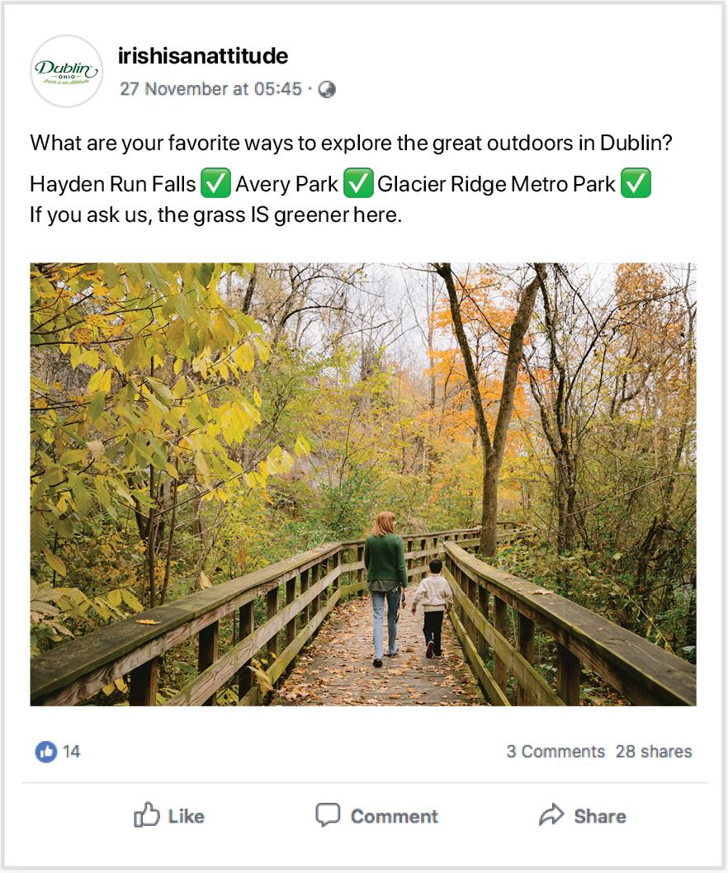
HOW TO PARTICIPATE
As you create new content, consider these best practices. What is the purpose of your new post?
Effective content should check one or more of these boxes:
Inspires interest or intrigue – Motivate action and travel; videos or photo albums are often used to accomplish this.
Grabs attention – Stop people from scrolling past and immediately focus their attention.
Entertains – Show remarkable visuals or a sense of humor.
Informs – Give people local tips or insider information. Provide event dates and suggest times of year to visit.
Adds value – Provide exclusive offers or demonstrate value in terms of money and time.
Notes:
Place that is better than where you live, it is a place where you connect with the people that bring and the people that you
Get away from the daily grind and tap into a nearby oasis
A lot of specific experiences - it’s about what’s really important in life, in a safe friendly quality way
With an Irish signature

Slide 19
Here are some more tips for creating content and managing your online community:
Engage with others to grow your network and start the conversation! Social media is not a one-way broadcasting channel - it’s meant to engage with users all over the world and get people talking. Sometimes a simple ‘like’ or well-crafted comment/question is enough to gain a follower or engage with a social user. Avoid comments that are generic and overused such as “Great photo!”. Genuine comments resonate best because they show that you care. For example, ‘Can’t wait to welcome you to our pub! When will you be visiting?’ Channel engagement should be completed at least once a day.
Post your very best content. Social media is all about quality images. We have supplied you with a library of great photos and videos that you can use to promote the experiences in Dublin. Please use them! The better the images/video, the more followers you will attract and engage. Encourage your community to share their best photos/videos too.
Keep your captions short. Get to the point. Most social post captions are cut off after the first 80 characters, so lead with what you need to say in the first sentence. This way, people will be curious enough to press the “more” button. For example: ‘Homegrown events happen right here in Dublin. Visit the @TheDublinMarket on Saturday mornings this spring and summer!’
Use hashtags wisely. Only use hashtags that are related to your product or to Dublin, and only on Instagram and Twitter. For a more impactful caption, post the majority of your hashtags in the first comment.
Tag your geo-location and other Dublin partners. This is one more opportunity to engage with people and help new followers find your content. Always include the geo-location of where your photo was taken, other partners highlighted in your content and encourage users to tag their locations, too. Tagging your social content can spread to many more other audiences in and out of your social community, so share the love!
Notes:
Right here, fairies lead the way.
Right here, flavors set the table.

Slide 20
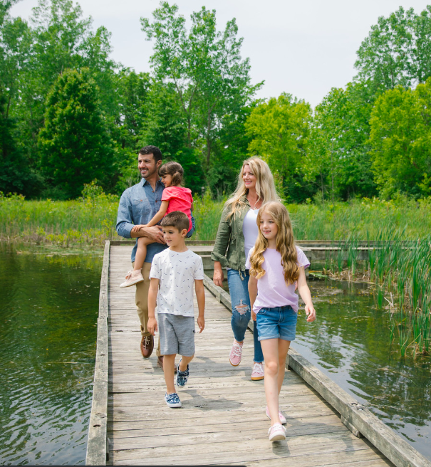
POSTING SOCIAL CONTENT
Follow these steps when posting content.
Choose the piece of content or link that you would like to share.
When sharing a link, make sure to select the appropriate image from the content above.
If applicable, Include the Right Here in Dublin campaign messaging into your post.
Tag all applicable partners and locations (geo-tag) that appear in the post, by taking the following steps:
Type @ before typing the business name you would like to tag.
Tap the name of the business you want to tag when it appears.
Alternatively, start typing a business page’s name anywhere in the post or comment. Facebook will make suggestions as you type. Please note this last approach will only work on Facebook.
Notes:
Place that is better than where you live, it is a place where you connect with the people that bring and the people that you
Get away from the daily grind and tap into a nearby oasis
A lot of specific experiences - it’s about what’s really important in life, in a safe friendly quality way
With an Irish signature

Slide 21
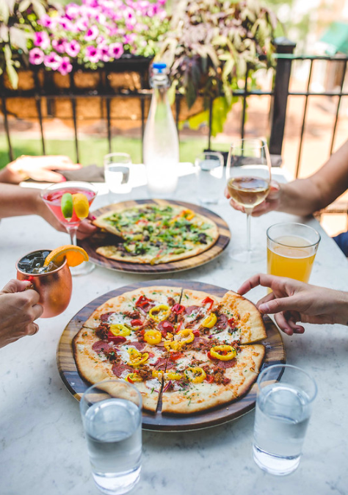
SAMPLE MESSAGING
Discover a friendly, vibrant and welcoming destination. It's your weekend—find your escape right here in Dublin.
Homegrown events happen right here in Dublin. Visit the @TheDublinMarket on Saturdays mornings this spring and summer.
Notes:
Place that is better than where you live, it is a place where you connect with the people that bring and the people that you
Get away from the daily grind and tap into a nearby oasis
A lot of specific experiences - it’s about what’s really important in life, in a safe friendly quality way
With an Irish signature

Slide 22
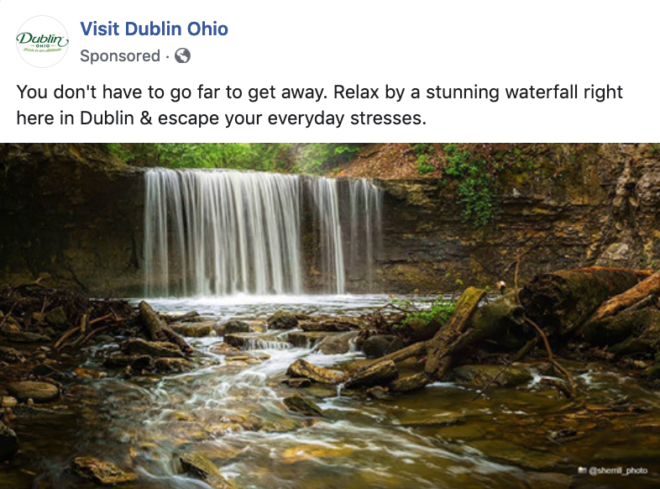
TIPS FOR SHARING POSTS
Need a no-hassle way to participate? Re-post, share and retweet content from the Visit Dublin, Ohio social media channels. You can easily find and share these posts through your business’ page by visiting any of the social channels listed here:
Facebook
To share an existing post, visit the Visit Dublin Facebook page.
Identify the post you would like to share.
Click Share below a post.
Select Share in the dropdown menu.
To choose where you want to share, click Share on your own timeline at the top of the popup menu, and select the following option: Share on your Page you manage.
Write a message.
Notes:
Place that is better than where you live, it is a place where you connect with the people that bring and the people that you
Get away from the daily grind and tap into a nearby oasis
A lot of specific experiences - it’s about what’s really important in life, in a safe friendly quality way
With an Irish signature

Slide 23
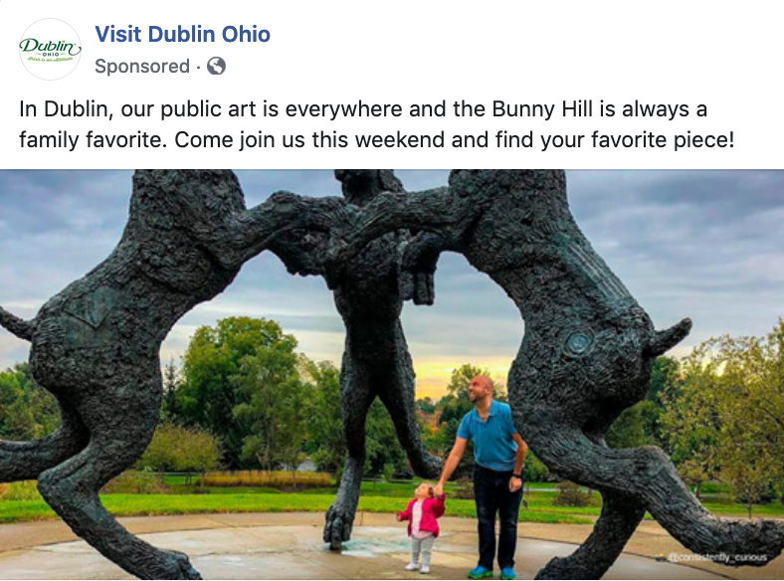
TIPS FOR SHARING POSTS
Twitter
To retweet an existing tweet, visit the Visit Dublin Twitter account.
Identify the tweet you would like to share.
Click retweet underneath the tweet. This will share it to your timeline.
Notes:
Place that is better than where you live, it is a place where you connect with the people that bring and the people that you
Get away from the daily grind and tap into a nearby oasis
A lot of specific experiences - it’s about what’s really important in life, in a safe friendly quality way
With an Irish signature

Slide 24
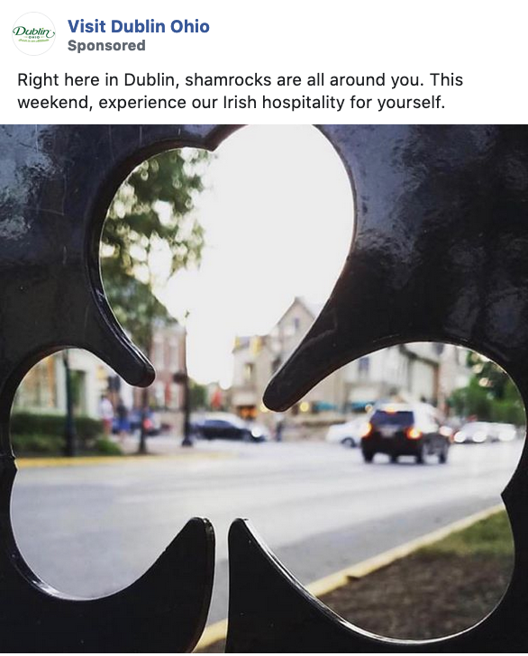
TIPS FOR SHARING POSTS
Instagram & Youtube
Please note that Instagram and Youtube do not allow people to share existing posts within their respective networks.
However, you can share an existing Instagram or Youtube post on Facebook or Twitter. To do so, simply copy and paste the link to the Instagram or Youtube post, and follow the four steps for posting content outlined above.
Visit Dublin Social Channels
Facebook: https://www.facebook.com/DublinCVB/
Twitter: https://twitter.com/visitdublinohio
Instagram: https://www.instagram.com/visitdublinohio/
Youtube: https://www.youtube.com/user/DublinCVB
Blog: https://www.visitdublinohio.com/blog/
Hashtag: #sodublin
Notes:
Place that is better than where you live, it is a place where you connect with the people that bring and the people that you
Get away from the daily grind and tap into a nearby oasis
A lot of specific experiences - it’s about what’s really important in life, in a safe friendly quality way
With an Irish signature

