Slide 1
Facebook Marketing & Advertising

Slide 2
Website Vs Facebook
Ownership
Information
Marketing

Slide 3
Facebook Algorithm
Posting Times
Posting Frequency
Boosting

Slide 4
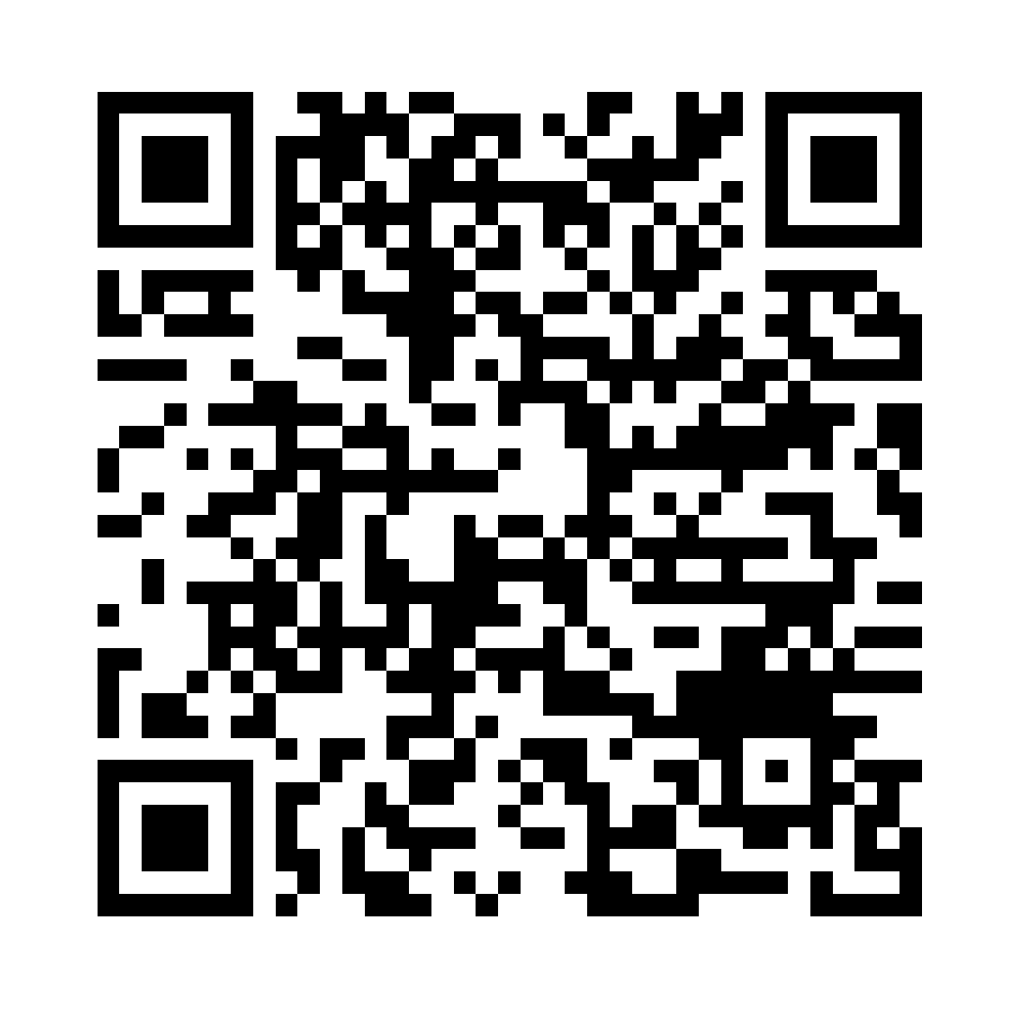
When to Boost
Engagement, Events, Likes
When not to Boost
Facebook Ads

