Slide 1

FY25 TRIPP Program
Tourism Reinvestment In Promotion & Product
Tourism Advertising Awards
& Development Grants

Slide 2

“TRIPP”
Tourism Reinvestment in Promotion & Product
A program through which Visit Frederick partners with non-profit attractions and government agencies to encourage potential visitors to experience Frederick County.
TRIPP Award $500,000

Slide 3
Goals of the TRIPP Program
Increase
Visitation
Increase the number of people visiting Frederick County and the amount of money spent while visiting.
Encourage
Hotel Stays
Increase overnight stays in Frederick County hotels, thereby replenishing and increasing the hotel tax revenue that is used to fund this program.
Enhance
Visitor Experience
Enhance the overall attractiveness and marketability of Frederick County as a destination.

Slide 4
TRIPP Categories
Tourism Advertising Award
Placement of advertisements promoting local non-profit attractions and their events to non-local audiences.
Tourism Development Grant
Development of tourism product through non-profit attractions, events and activities.

Slide 5
Legacy Development Grants
This is a one-time investment by Visit Frederick in preparation for the US 250th in 2026.
Legacy Projects will result in an immediate impact on Frederick County tourism as well as contribute to the long-term improvement of the visitor experience in Frederick County.
Projects that connect to themes outlined by the Maryland 250th Commission will receive preference.
  Criteria: https://mdtwofifty.maryland.gov/

Slide 6

Other TRIPP Components
Group Overnight Incentive Program
Reimbursement of $10 per room night generated to organizations generating a quantity of overnight hotel stays.
Unanticipated Opportunity Fund
Advertising or development opportunities which could not have been anticipated prior to March 31.

Slide 7
TRIPP Funds Available
$500,000 for FY25 to be allocated as follows:
$200,000 for Advertising Awards
$150,000 for Development Grants
$150,000 for Legacy Projects
Group Overnight Incentive Program and Unanticipated Opportunity Fund applications will also be accepted until an additional $20,000 has been awarded.

Slide 8
Advertising and Development Funding
TRIPP Advertising Award: $40,000 maximum ($60,000 media schedule) and $2,000 minimum ($3,000 media schedule).
  The cash match requirement is 33.3%, providing $2 in TRIPP funds for each $1 in applicant match.
  All TRIPP funded advertisements are to be placed with non-local media outlets that demonstrate at least half of their audience is outside of Frederick County.
Development Grants: $25,000 maximum grant request ($50,000 project), and $1,500 minimum grant request ($3,000 project).
  50% Match
Legacy Projects: $25,000 maximum grant request ($31,200 project), and $8,000 minimum grant request ($10,000 project).
  20% Match

Slide 9
Successful Applicants…
Provide details when completing the application.
Identify attributes of their attraction or event that would motivate residents from outside of Frederick County to visit/attend.
Demonstrate the ability to attract and measure the number of visitors from outside of Frederick County.
    Ask for ZIP Codes of attendees as they enter attraction/event.
    Count out-of-state license plates at your site or event.
    Have participants fill out a survey.
    Post a map and have participants mark their hometown.

Slide 10
Tips for Success
The applicant should be able to measure successes tied to the funding and information about visitors.
  Compared to last year, sales during the festival increased __%
  __% of attendees were from outside of Frederick County
  __% of survey respondents spent over $__ at the event

Slide 11
Tips for Success
Ask
Ask someone to read your application to ensure it will be clear to the committee.
Complement
Complement Visit Frederick’s goals of increasing the number of visitors, visitor spending and length-of-stay.
Partner
Partner with other entities to achieve goals
Partners do not need to be non-profits
Partners cannot include hotel, motel or other lodging businesses located outside of Frederick County.

Slide 12
Application Deadline
Sunday, March 31, 2024, at 5:00 PM
FY25 TRIPP Applications are due electronically no later than 5pm.
Each application with any attachments should be one PDF file.

Slide 13
Award Limits: Advertising
Cash match is 33.3%
Minimum request is $2,000
(total media schedule of $3,000)
Media schedule maximum request is $40,000 (total schedule of $60,000)

Slide 14
Award Limits:
Development
Cash match is 50%
Minimum request is $1,500
(total project of $3,000)
Maximum request is $25,000 (total project of $50,000)

Slide 15
Award Limits: Legacy Projects
Cash match is 20%
Minimum request is $8,000
(total project of $10,000)
Maximum request is $25,000 (total project of $31,250)

Slide 16
Project Time Frame
Advertising must run in FY25
(July 1, 2024 – June 30, 2025).
Development Grant projects must begin in FY25. It is recognized that some projects may require more than a year to complete. Up to 24 months will be allowed. If a project will take longer than 24 months, prior approval via a written request for a project extension is required.

Slide 17
Match
For Advertising Awards, match must be all cash. Cash match is 33.3%.
For Development Grants, a 50% match is required.
  25% of the match can be in-kind (documented donations of goods or services for the project, but not staff or volunteer time).
For Legacy Development Grants, a 20% match is required.
  If a Legacy project is determined by the TRIPP committee to not be a Legacy project, it may still be selected as a Development Grant. In this case the awardee will be responsible for a 50% match.

Slide 18
FY25 Application
One application to apply for either Advertising Award, Development Grant, or Legacy Project.
You may submit 2 separate applications (one Advertising and one Development/Legacy Project) if your proposed projects are not closely related.

Slide 19
Advertising Media Selection
FY25 All non-local media (Maximum request of $40,000)
The media schedule budget must be placed with only non-local media outlets that can demonstrate at least half of their audience resides outside Frederick County.

Slide 20

Digital and Online Advertising
Ads placed on websites, native / sponsored content on relevant web channels, mobile advertising, etc.
Pay at Placement Advertising, such as direct social media ads, does NOT qualify for the TRIPP Advertising program.
Social media advertising through a third-party media outlet that provides invoicing is permitted. The name of the media outlet being utilized must be included in the digital media schedule.

Slide 21

Digital and Online Advertising
All paid digital content and online advertising funded through TRIPP must include a link to a page with related content on the awardee’s website.
That landing page on the awardee’s website must include the TRIPP “Visit Frederick City & County” logo graphic with a live link to the VisitFrederick.org website

Slide 22
TRIPP Advertising
Applicant places the ads. Visit Frederick must directly pay the media outlet. The awardee will submit a Request for Payment form, media outlet invoice(s), proof of performance (original tear-sheet, radio spot audio file, screenshot, etc.) and 33.3% of total invoice amount* as cash match payable “Tourism Council of Frederick County.”
Request for payment must be submitted at least 10 days prior to the due date on the invoice
* Until TRIPP award is expended, then awardee pays match plus remainder.

Slide 23
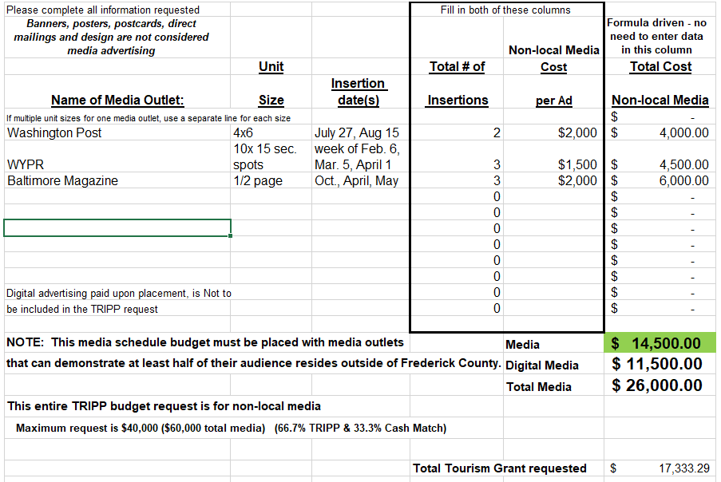

New Media Schedule
File is formula driven, no need to enter data in Total Cost Column.

Slide 24
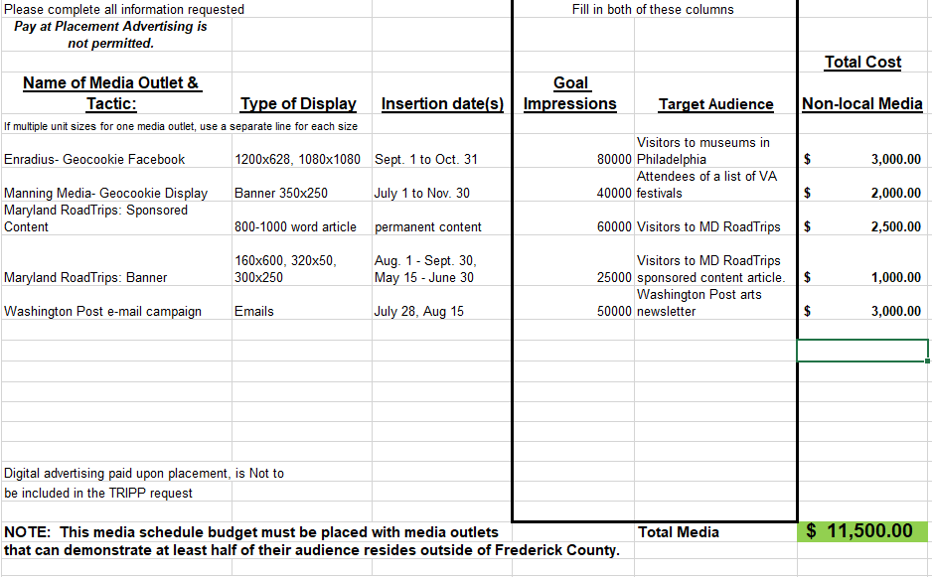

Slide 25
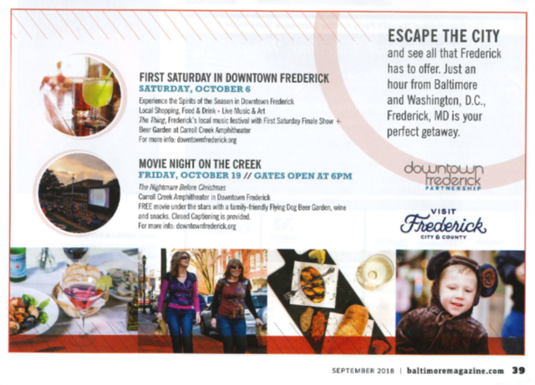
Logo Requirements in Advertising
Don’t forget to include Maryland or MD.

Slide 26
Logo/Copy Requirement in Broadcast Advertisements
Television spots must include the TRIPP logo. This logo should appear on the screen at least 3-5 seconds.
Radio spots must include the words “Visit Frederick, Maryland.”
Tear sheets, audio or video recordings, or similar proof of performance will be required before invoices are paid.

Slide 27
Advertising Award Note
Advertising awardee will open a separate account for TRIPP with vendor setting up as Visit Frederick / (awardee name and address).
The awardee will provide vendor’s W-9 form with first payment request. This form verifies the vendor’s taxpayer identification number. Payment will be held until W-9 is received.

Slide 28
TRIPP Development Grant
Development Grants are available to non-profit organizations (potentially in partnership with for-profit organizations) to assist with up to 50% of the cost of tourism projects in Frederick County, to include: exhibits, events, activities, festivals, conferences, or programs in order to develop new tourism products for Visit Frederick to promote.

Slide 29
TRIPP Development Grant
The preferred use of funds is for one-time or start-up project costs. Applicants proposing ongoing activities are encouraged to work toward becoming self-sustaining.
Create new reasons for residents of other areas to want to visit Frederick County. A new or enhanced attraction, exhibit, or a major event (those attracting at least 500 attendees).
Capital projects (construction, acquisition or renovation of fixed assets), particularly those that directly improve the visitor experience, will also be considered.

Slide 30
TRIPP Legacy Projects
Projects should have a lasting impact and contribute to the long-term improvement and development of Tourism in Frederick County.
Photography and video can qualify as part of a legacy project, provided Visit Frederick is given access to use those images or video for tourism promotion.
Projects that are temporary in scope or one-time events, are not eligible for legacy funding.
Marketing expenses may not be covered with Legacy Grant funds, including poster printing, direct mail advertising, or trade show registrations.
If a project is determined to not be eligible for Legacy funding, it may still be approved for Development funding.

Slide 31


TRIPP Development Grant and Legacy Project Proof of Performance
All printed materials printed with TRIPP Program funds must include the Visit Frederick logo that is included in TRIPP agreements AND the phrase “For information about the other great things to see and do in Frederick County: 1-800-999-3613 or www.visitfrederick.org”.
Samples of printed materials must be submitted as proof of performance with final report. The TRIPP logo for FY25 will be sent by email after contract has been executed.

Slide 32
TRIPP Development Grant
Previous grants - Applicants must close out all projects awarded prior to FY23 by the application deadline. No applicant can have more than two Product Development Grants open at one time.
Organizations may apply for either a Development Grant OR a Legacy Project.

Slide 33
TRIPP Group Overnight Incentive Program
Provides a cash incentive for local non-profit organizations and events that generate a quantity of overnight hotel stays in Frederick County during FY25.
At least 10 hotel room nights per hotel must be sold within a single month as a result of the applicant’s efforts on behalf of visitors to their attraction or event.

Slide 34
TRIPP Group Overnight Incentive Program
Maximum cash payment to a single organization is $4,000 in a single calendar month, beginning with July, 2024. (May apply for additional funds in future months if funding remains in the incentive pool.)
First-come basis until the pool is depleted. If multiple organizations involved with the same tour group or room block submit for the same hotel room nights, the incentive will be shared among the organizations.
The General Manager or Sales Manager of the hotel(s) where the group stayed will need to sign documentation to certify that the room nights were sold and used as a result of applicant’s efforts, prior to the organization receiving the incentive payment.

Slide 35
TRIPP Unanticipated Opportunities
Funds to be awarded in FY25 for marketing or development opportunities that could not have been anticipated at the time of the TRIPP application deadline.
Use FY25 Grant application.
Explain in a cover letter why the opportunity could not have been anticipated prior to the regular TRIPP program deadline.
Applications may be submitted after the regular TRIPP application deadline for opportunities in FY25.

Slide 36
For the person implementing the grant, if not you…
Ensure the person implementing the grant understands how the grant process works, especially for advertising awards.
If an organization does not follow the grant process, the organization will be liable for advertising and development expenses.

Slide 37
TRIPP Timeline
31 Mar.
Deadline for applications to be submitted to TCFC
April
First week in April - Applications with scoring sheets distributed to Selection Committee
May
First week in May - Committee meets for Selection Day
May
Visit Frederick Board consideration of recommendations
May
Mid-May - Announcement of TRIPP awards

Slide 38
Questions?
visitfrederick.org/TRIPP
Katie Reichard
kreichard@fredco-md.net
301-600-4043
Dave Ziedelis
dziedelis@fredco-md.net
301-600-4041

