Slide 1
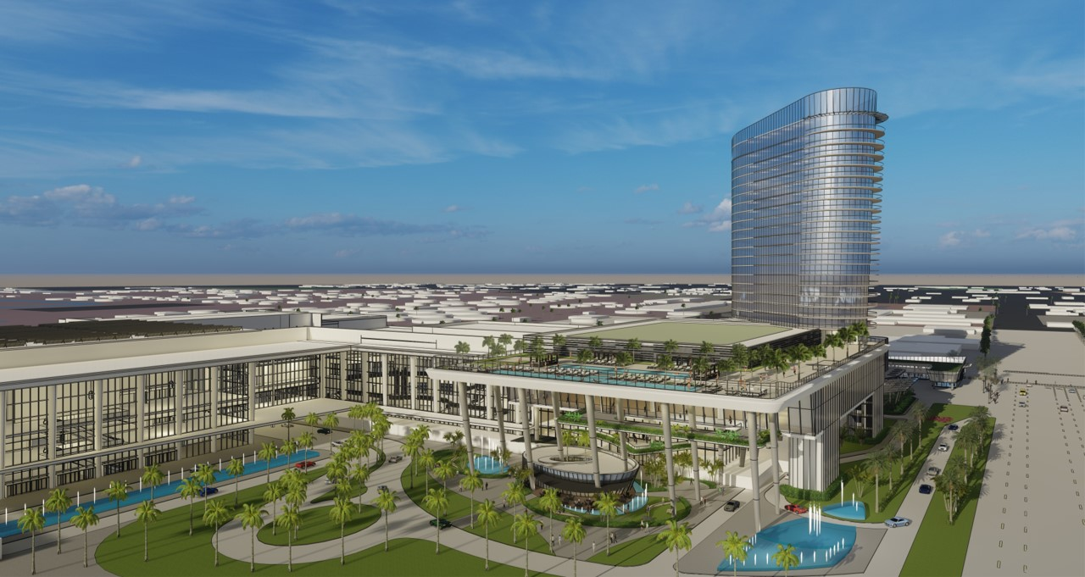
National Tour Association Travel Exchange
November 9-16, 2023
Convention Center Overview

Slide 2
BIGGER AND GREATER
SOUTH FLORIDA’S PREMIER WATERFRONT CONVENTION CENTER

Slide 3
Features
Located minutes from Fort Lauderdale's famed Blue Wave Beaches
Adjacent to Broward County's Port Everglades
Five-minute drive from the Fort Lauderdale / Hollywood International Airport
LEED for Existing Buildings Gold-certified facility

Slide 4
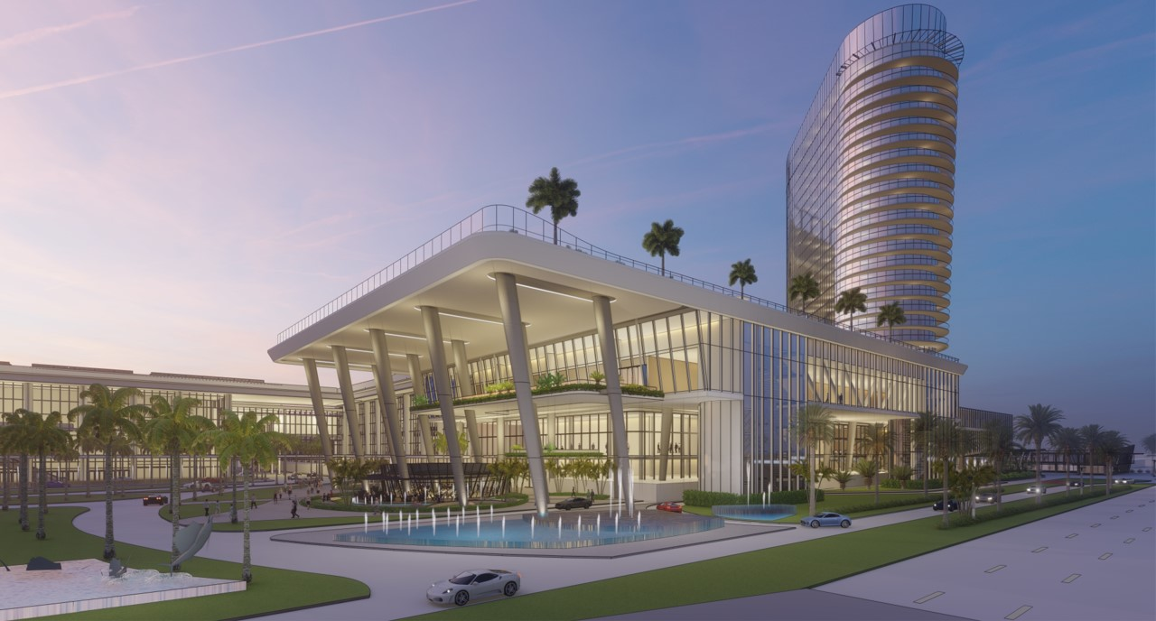
The expansion project will add an additional 600,000 sq. ft. of versatile, state-of-the-art space to the existing 600,000-sq.-ft. building and an upscale 800-room, four-diamond Omni Hotels & Resorts headquarters hotel.

Slide 5
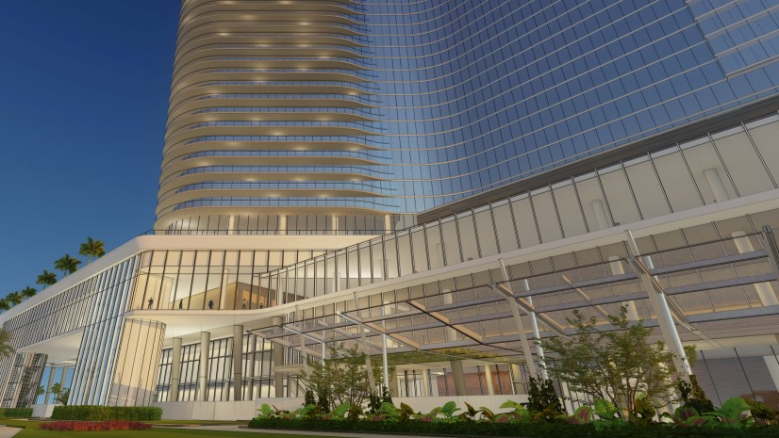
Expansion Highlights
350,000 sq. ft. of contiguous space
132,000 sq. ft. in four elegant ballrooms
95,000 sq. ft. of total flexible meeting space
202,000 sq. ft. of total pre-function space
1,800+ parking spaces
7 acres of outdoor waterfront plaza
1.2 million sq. ft. of total Convention Center space

Slide 6
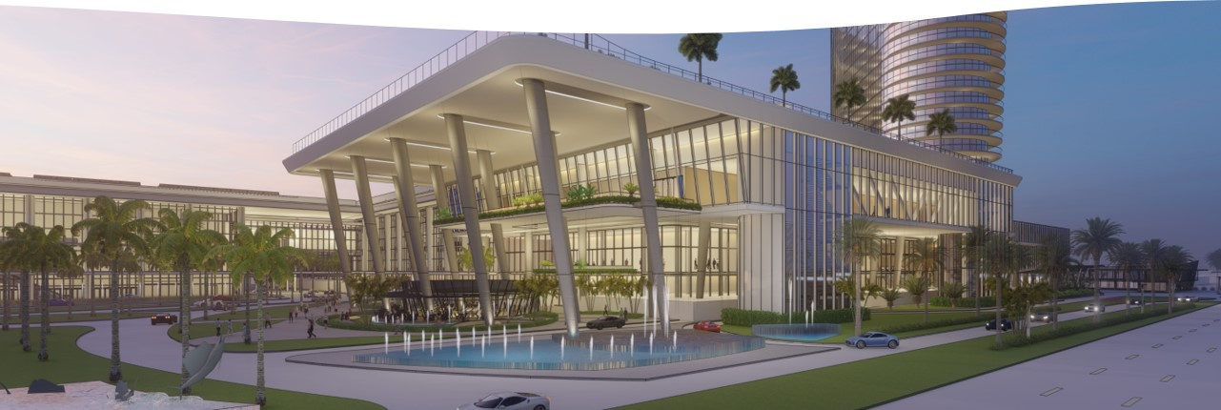
Upgrades & Amenities
State-of-the-art technology
Outdoor plaza with waterfront view
Innovative dining concepts
Eco-friendly design and operation
Improved traffic flow around the Convention Center
Garage parking with covered skywalks to Convention Center
Proximity to airport, seaport, local dining, shopping and beaches

Slide 7
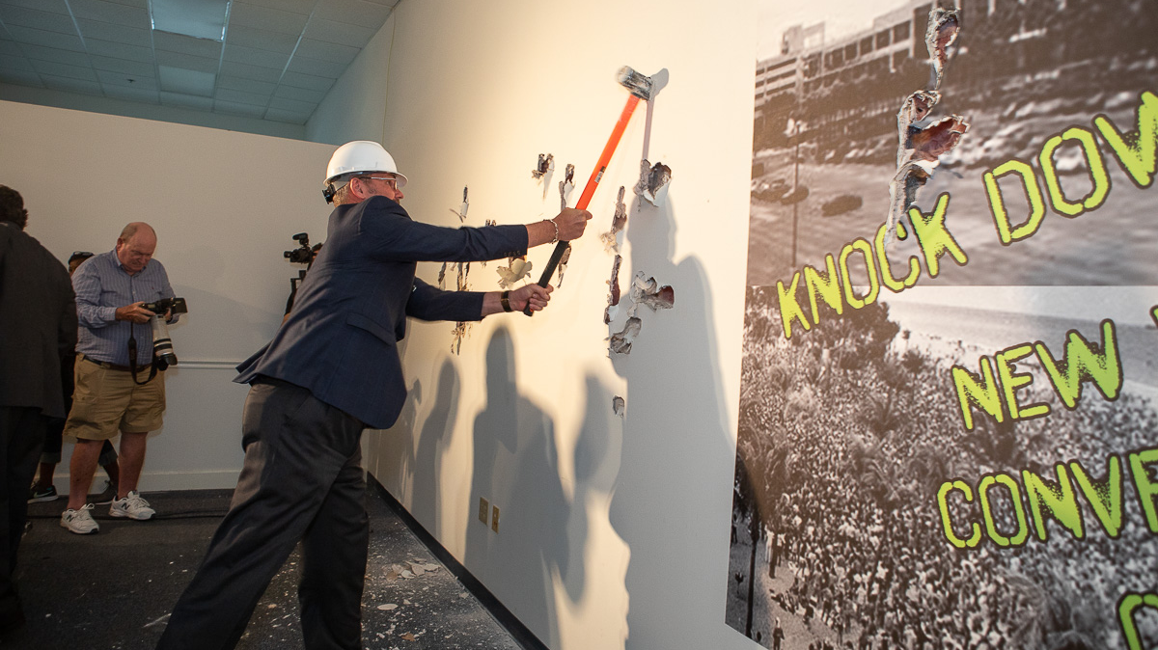
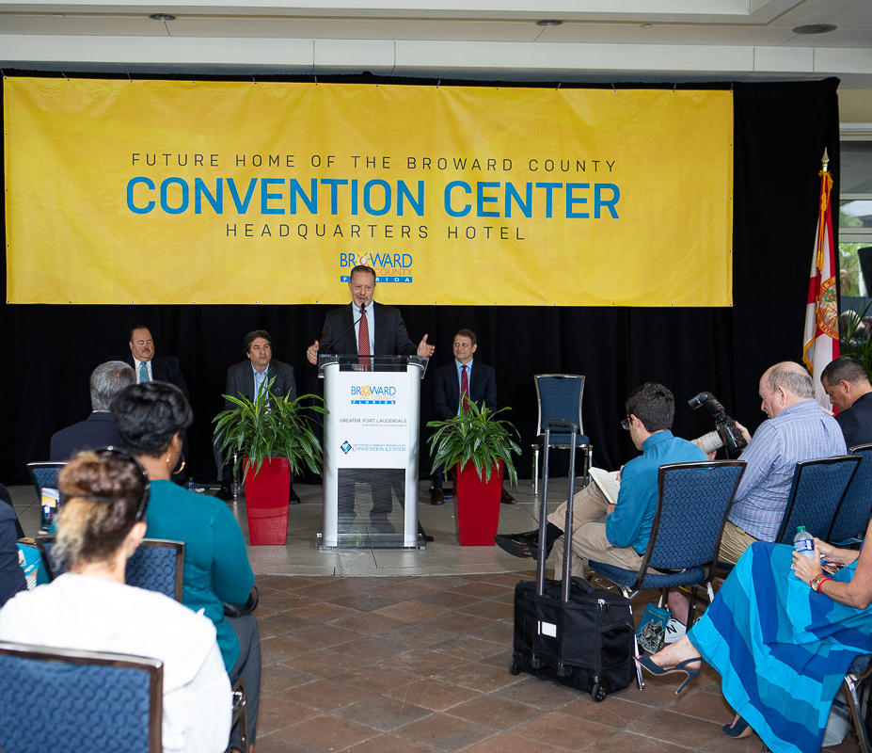
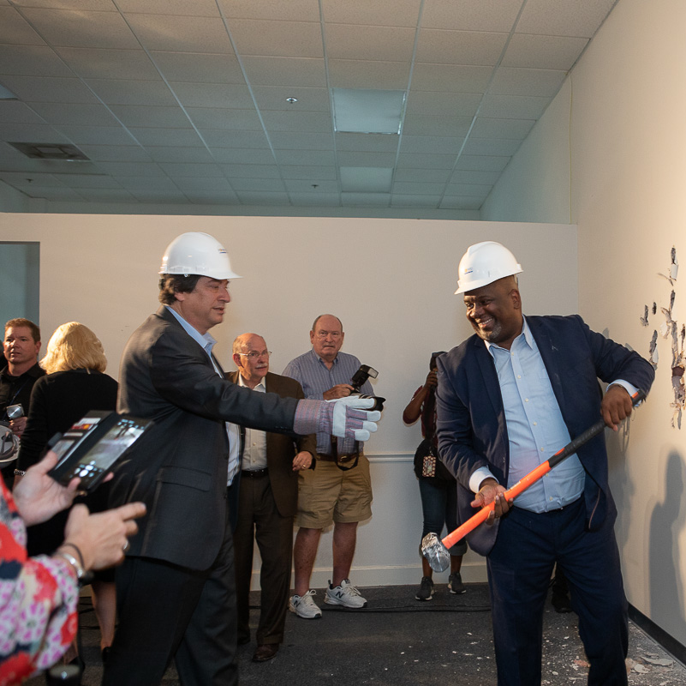
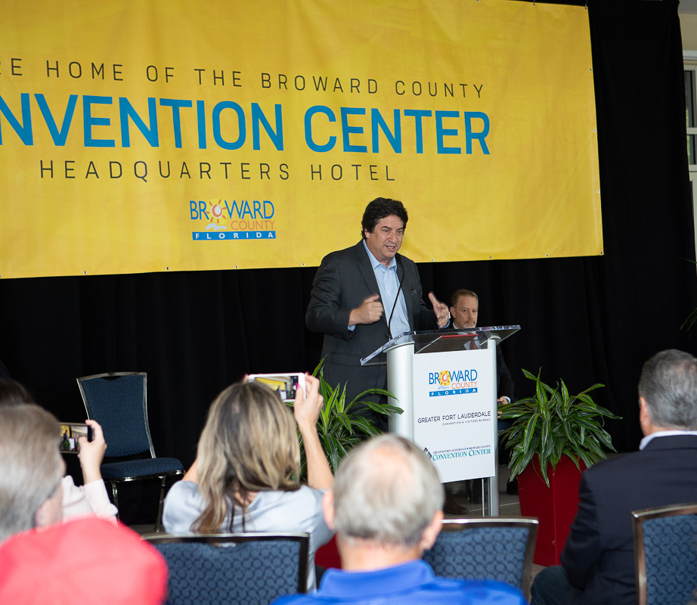
Project Timeline
October 2021
Phase I Opening – Western Building Expansion
2023
Phase II Opening – New Waterfront Building Addition
2024
Headquarter Hotel Opening

Slide 8
NTA TRAVEL EXCHANGE 2023 SPACE UTILIZATION OVERVIEW NOVEMBER 9 -16, 2023
SPACE EVENT & DATE
Exhibit Hall C Thursday - Thursday
2nd Floor Meeting Rooms & Ballrooms – 15 Seminar, Offices & Board Rooms
3rd Floor Meeting Rooms & Ballroom – 10 Thursday - Thursday
Grand Ballroom Dining Room
Thursday - Thursday
TOTAL RENTAL: $115,000

Slide 9
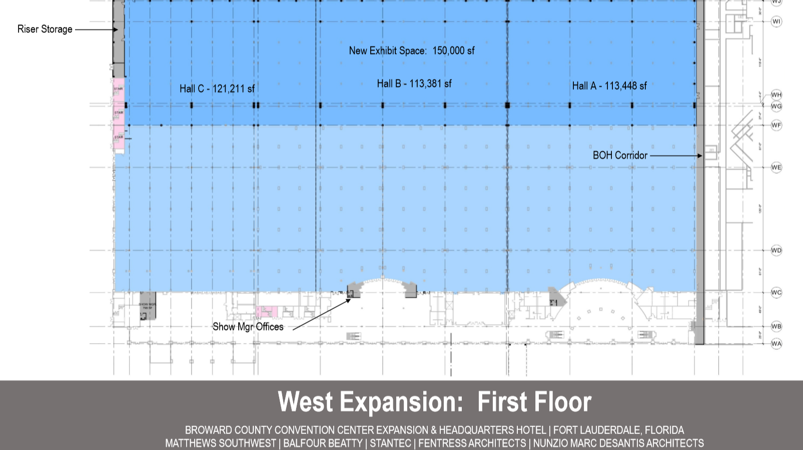
Exhibit Hall C

Slide 10
Commitment to Safety
The newly expanded Greater Fort Lauderdale/Broward County Convention Center is being designed with ASM Global’s VenueShield protocol to provide the highest levels of cleanliness and safety while inspiring the confidence of planners and attendees, all in partnership with leading medical professionals, industry experts and public health officials.

