Slide 1
Grapevine, Texas

Slide 2
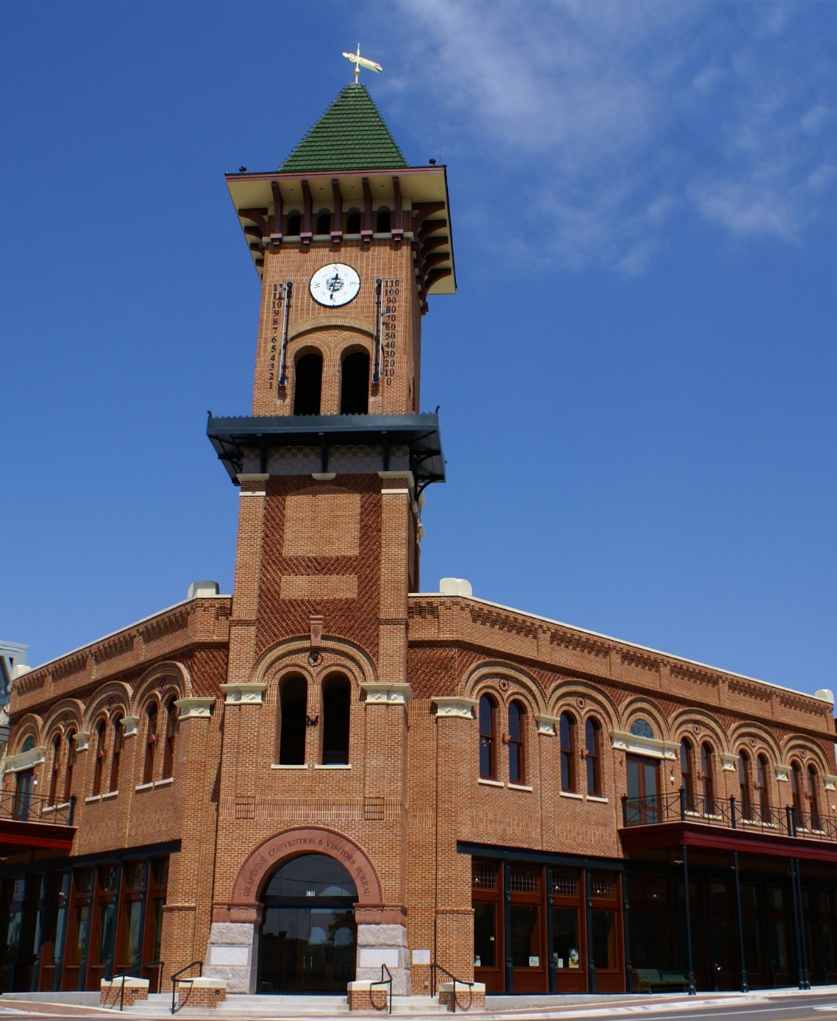
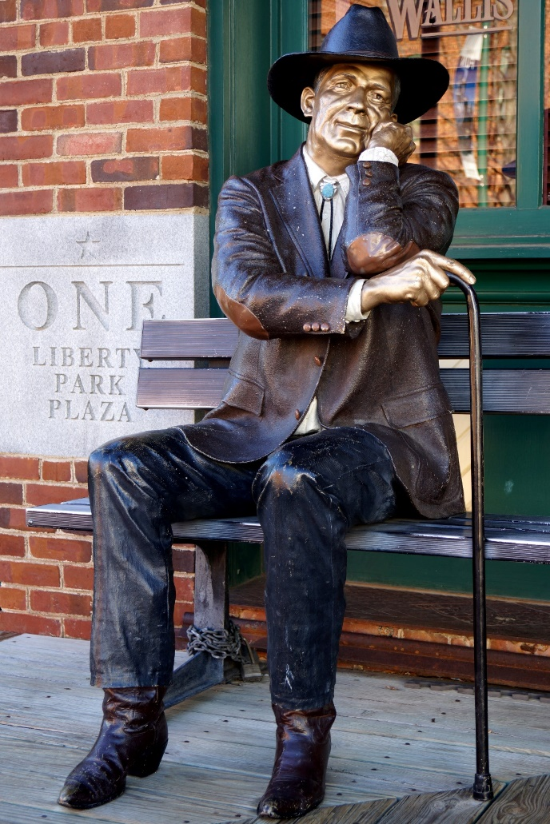
Historic Downtown Grapevine
#1

Slide 3
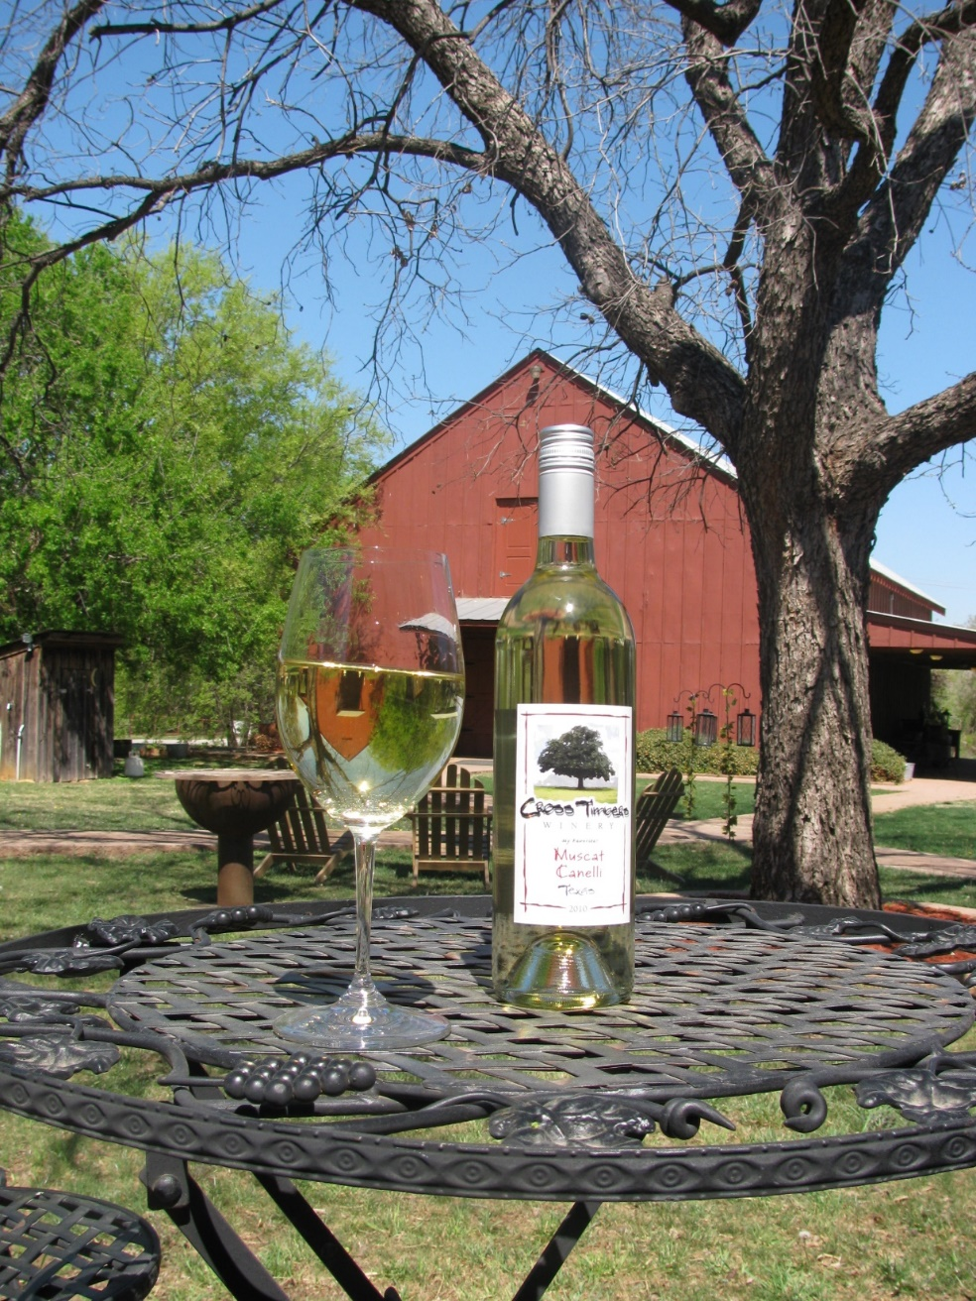
Grapevine Urban Wine Trail
#2

Slide 4
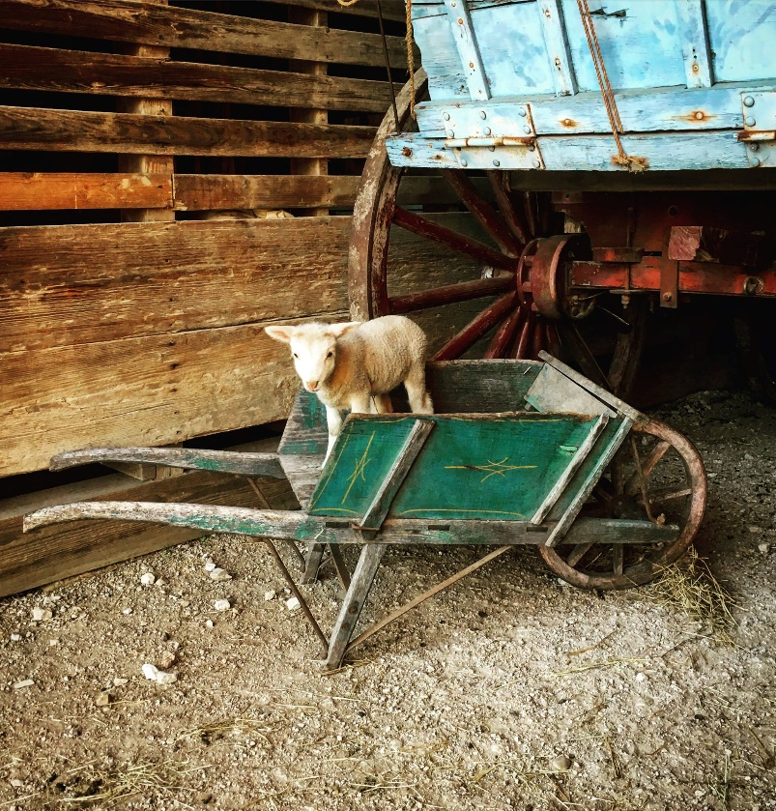
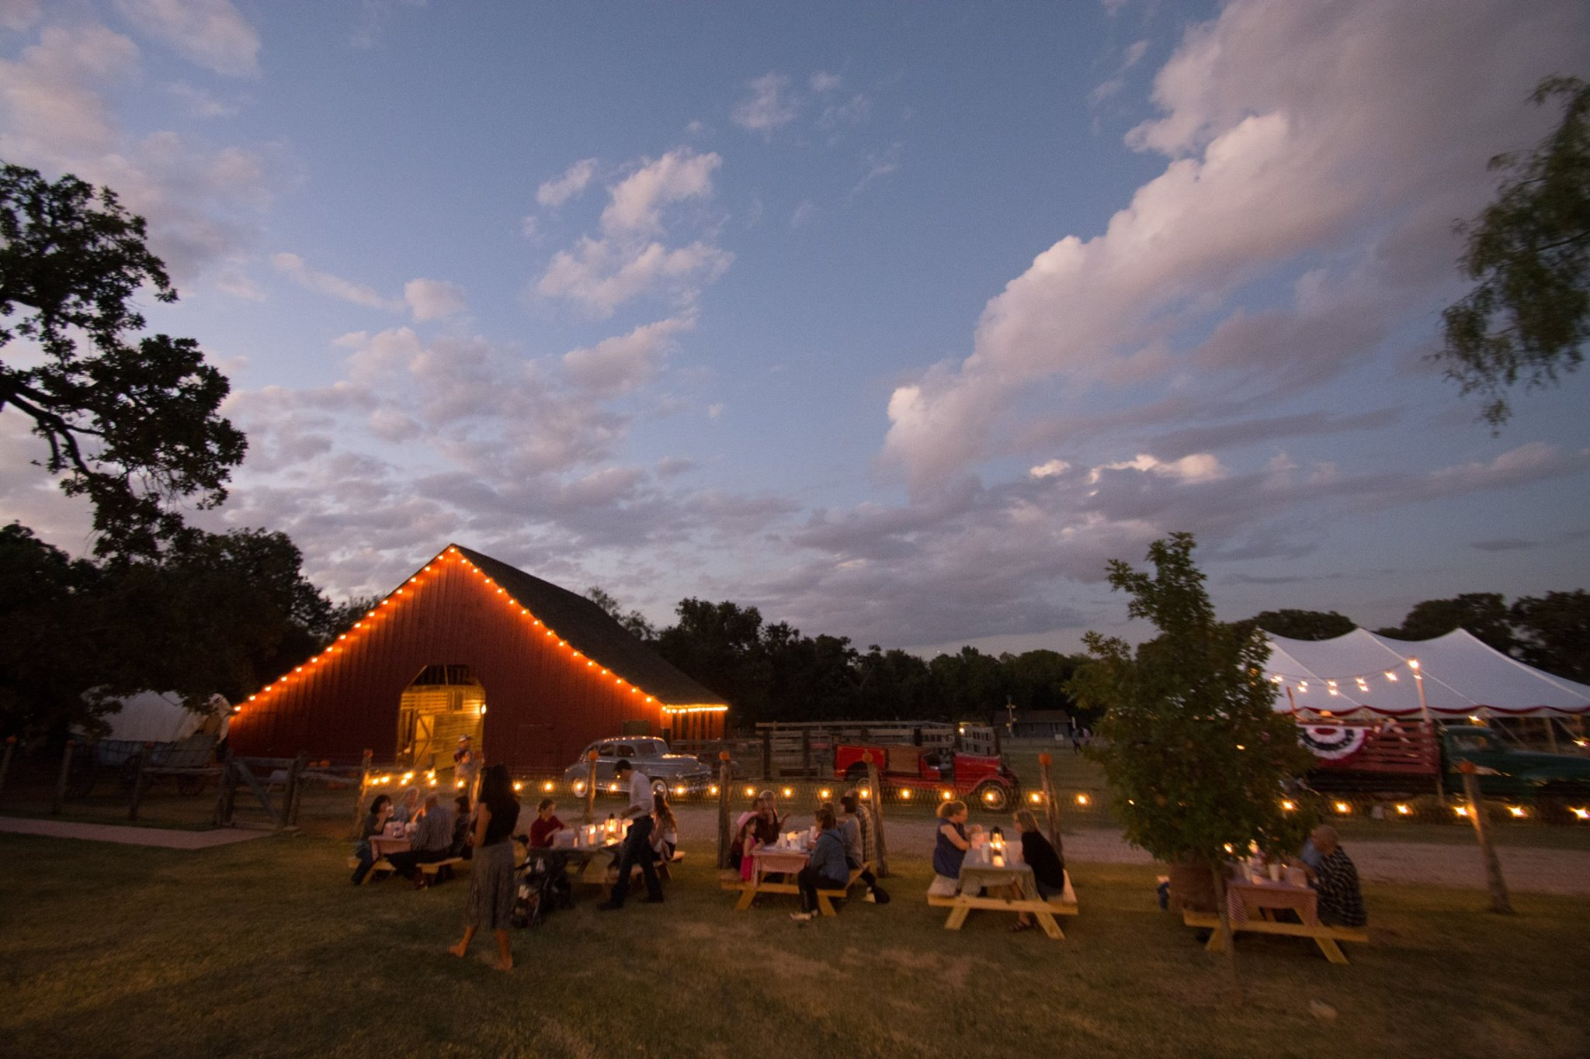
Historic Nash Farm
#3

Slide 5
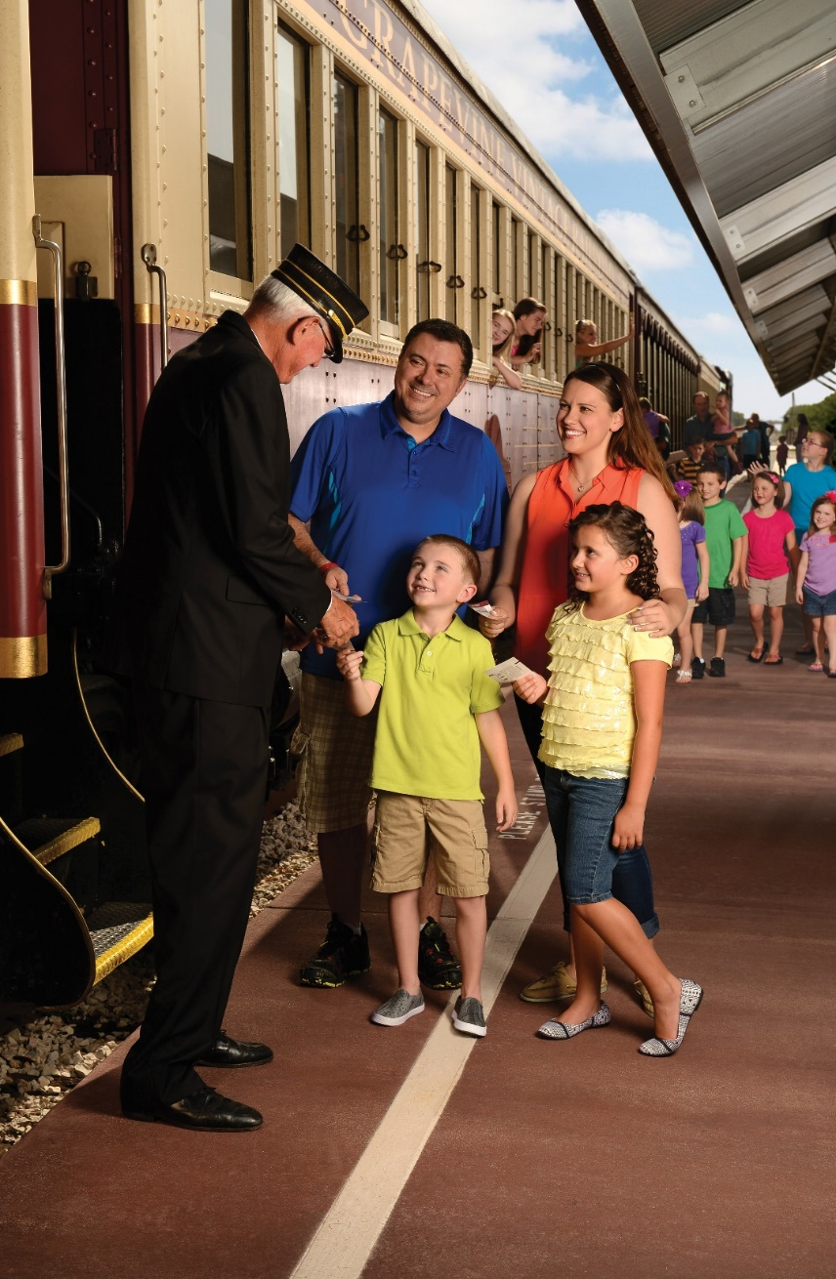
Grapevine Vintage Railroad
#4

Slide 6
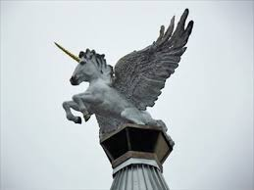
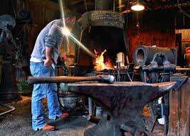
Working Artisans
#5

Slide 7
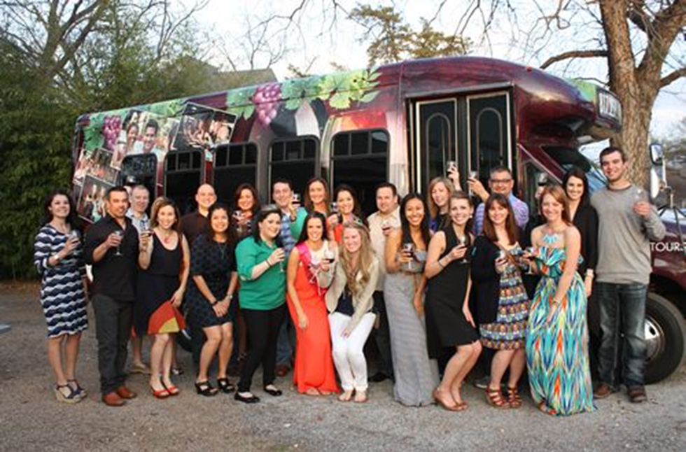
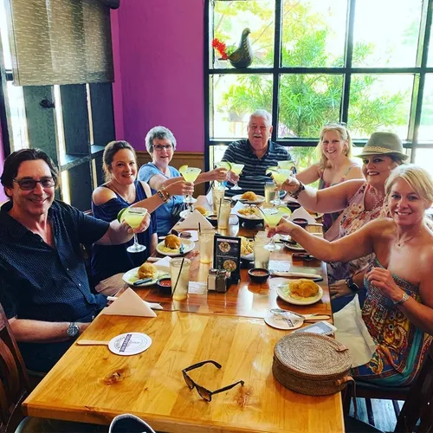
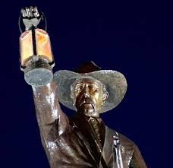
Grapevine Escorted Tours
#6
Grapevine Food Tour
Grapevine Nightwatchman Ghost Tour

Slide 8
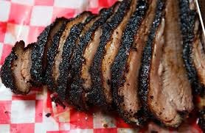
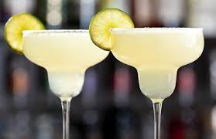
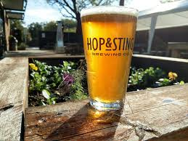
Dine like a Texan
#7

Slide 9
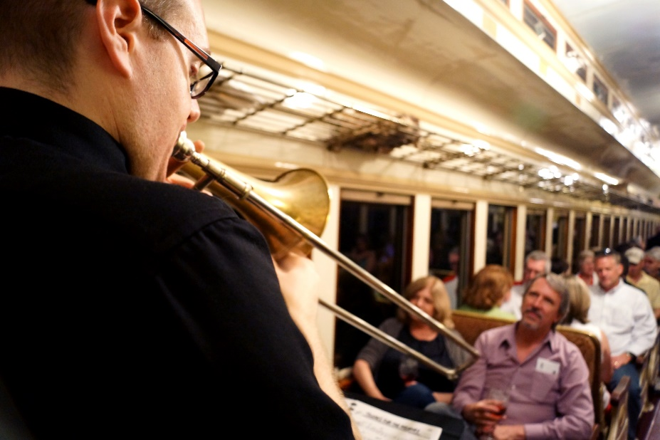
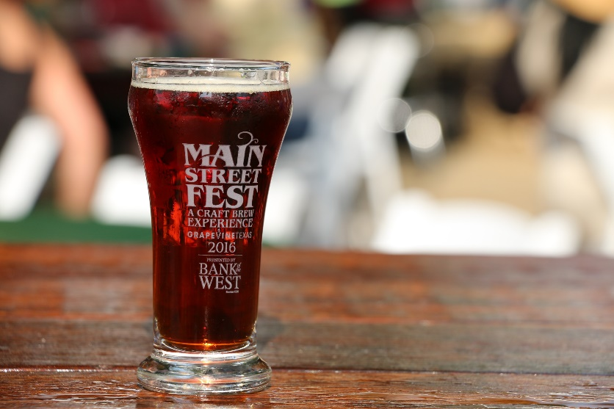
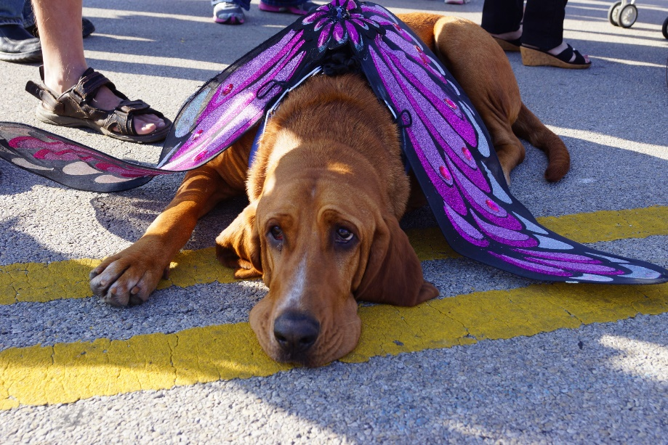
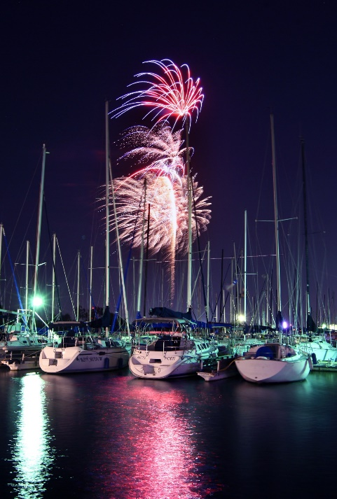
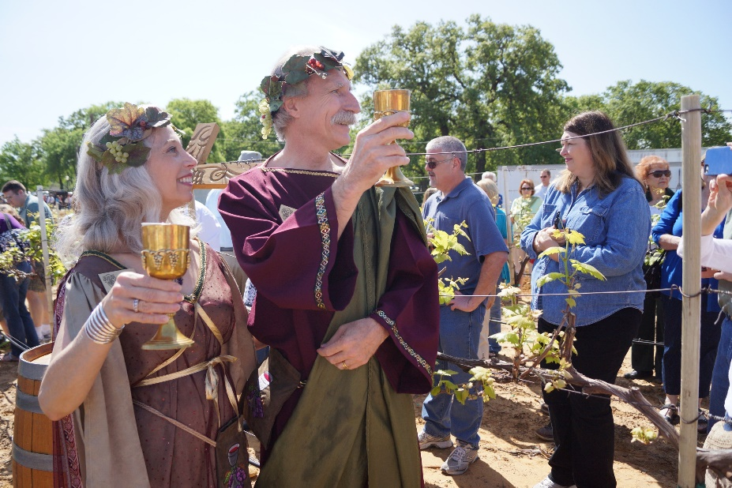
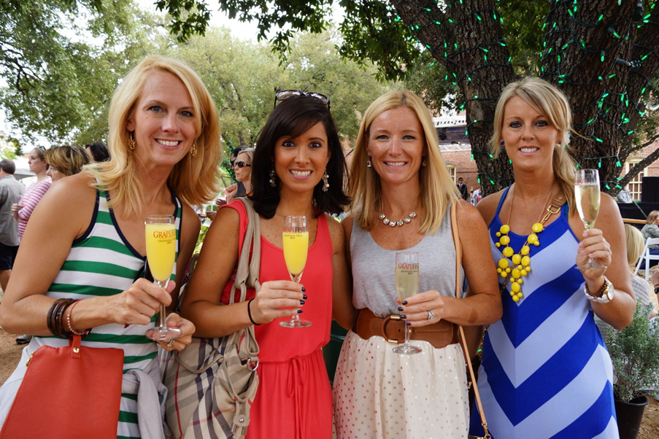
Year-Round Festivals & Events
#8

Slide 10
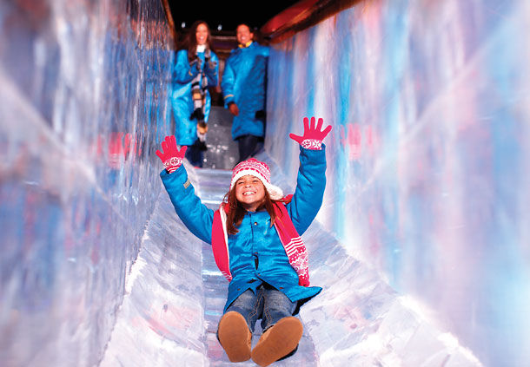
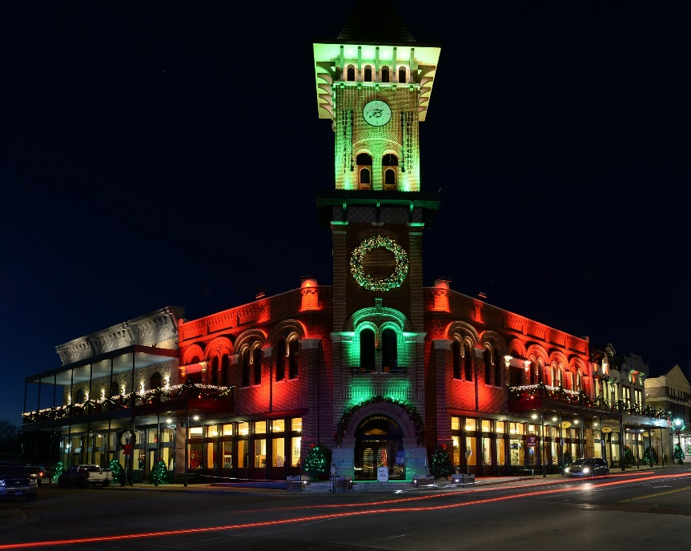
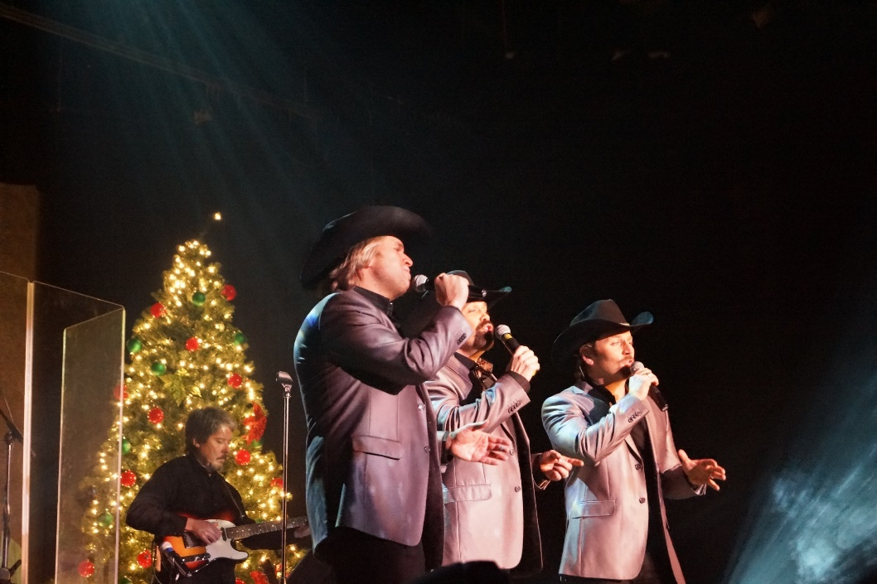
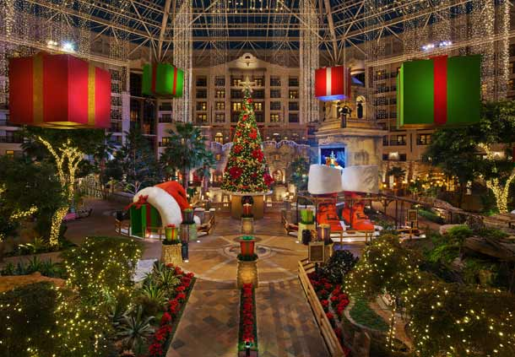
Christmas Capital of Texas®
#9

Slide 11
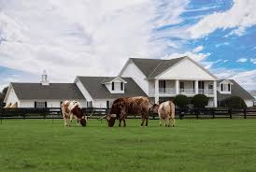
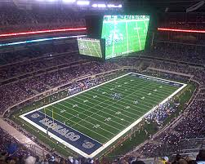
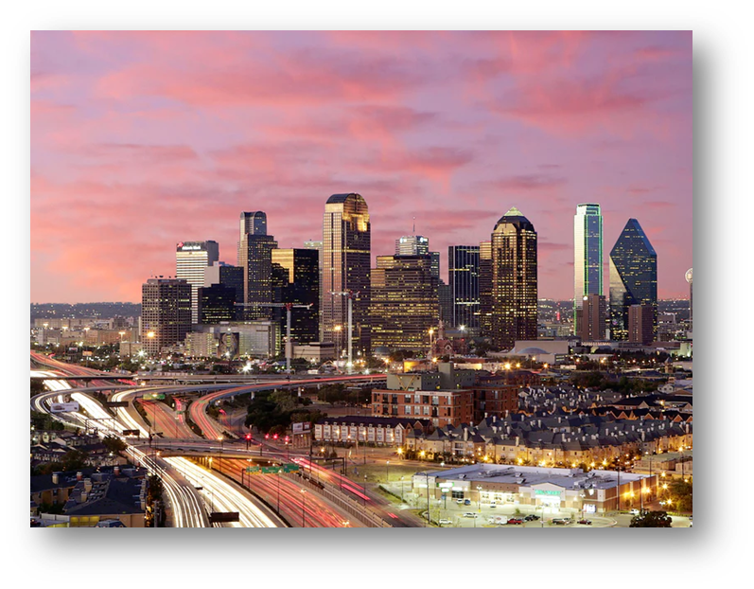
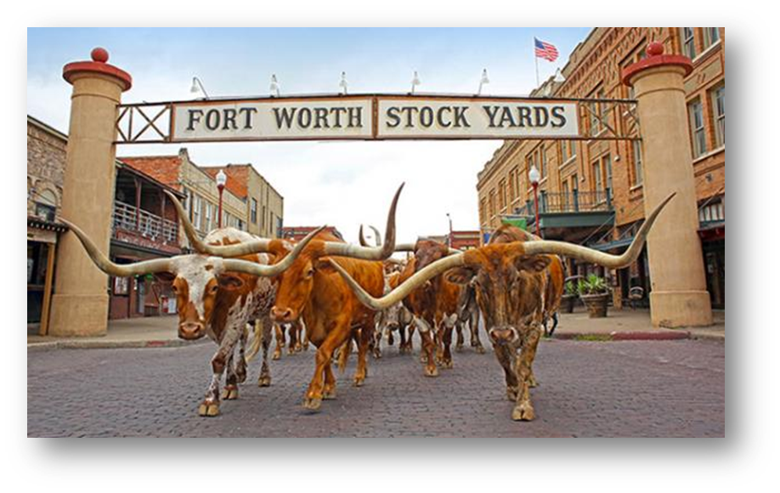
Convenient Hub & Spoke location Conveniently located between Dallas & Fort Worth
#10

Slide 12
Motorcoach Friendly Hotels
Gaylord Texan Resort
Hyatt Regency DFW
Great Wolf Lodge
Hilton DFW Lakes
Embassy Suites by Hilton DFW Airport North
Courtyard/Towneplace Suites by Marriott
Hotel Vin
Comfort Inn
Comfort Suites
Hampton Inn & Suites
Hilton Garden Inn
Holiday Inn Express Hotel & Suites
Homewood Suites by Hilton
Hyatt Place
Springhill Suites by Marriott
Super 8 by Wyndham Grapevine

