Slide 1
Scott Crisp, Ph.D., Assistant Superintendent
TCSD1 is developing a shared community vision of learning to ensure students not only meet Wyoming Content and Performance Standards but also apply what they learn to life in grades K-5, 6-8, and 9-12.
Your feedback is critical.

Slide 2
Listen and watch to this short 3 min. video
What stands out as you listen to the summary? Does anything surprise you?

Slide 3
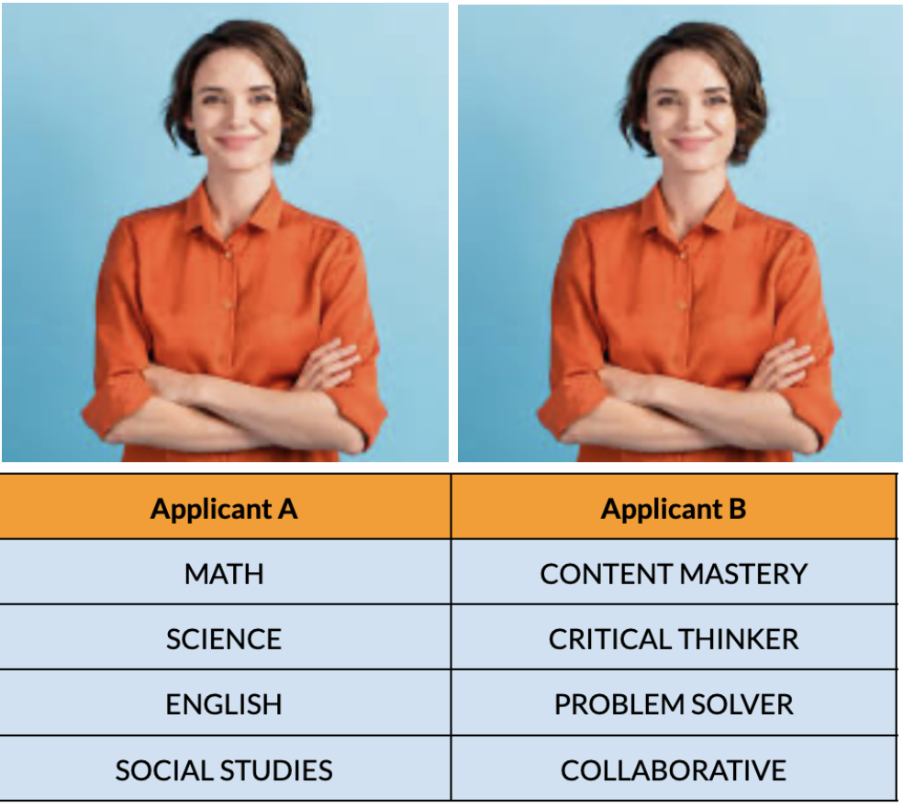
Who would you rather hire?

Slide 4
A snap shot of data:
58% of employers say recent students entering the workforce do not demonstrate the required skills to be prepared, while nearly 50% of employers have fired a recent college graduate.
During a job interview, employers say students entering the workforce (post high school/college): struggle with eye contact (54%); asked for unreasonable compensation (52%); dressed inappropriately (48%); brought a parent to the interview (24%); cannot manage workloads (70%).
Skills employers seek from candidates: problem solving skills (88%); ability to work in a team (78%); written communication skills(72%); strong work ethic (71.6%); flexibility (70%); verbal communication (67%); analytic quantitative skills (66%); initiative (65.5%); detail-oriented (61%); interpersonal skills (58%); leadership (52%)
1 in 10 (11%) business leaders strongly agree that college graduates have the skills and competencies that their workplaces need.
PEW Research Center (2024), National Association of College and Employers, 2024 (800+employers polled), Gallup Poll, 2024 (623 employers polled)

Slide 5
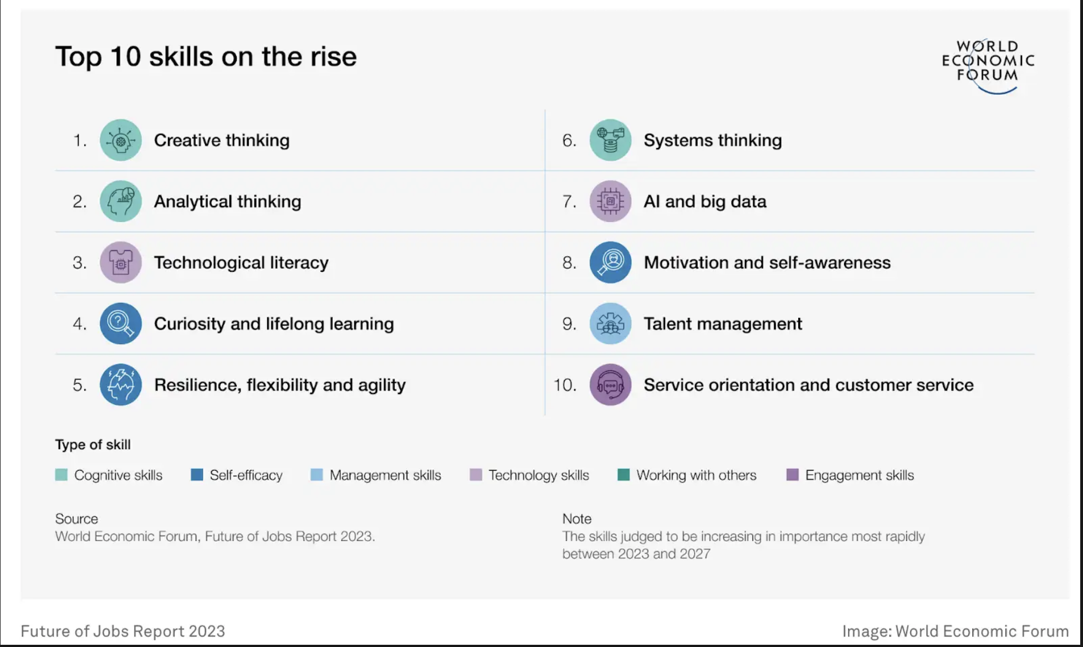

Slide 7
Scott Crisp, Ph.D., Assistant Superintendent
scrisp@tcsd.org

