Slide 1
Grow Bookings,
Harvest Value.

Slide 3
Clients
With Ripe, destinations across North America are fully capitalizing on the demand they create, along with a wide variety of events, resorts, and attractions.

Slide 4
A locally focused lodging solution that
enhances the traveler booking experience,
promotes lodging partners,
and provides DMOs with a powerful marketing tool.

Slide 5
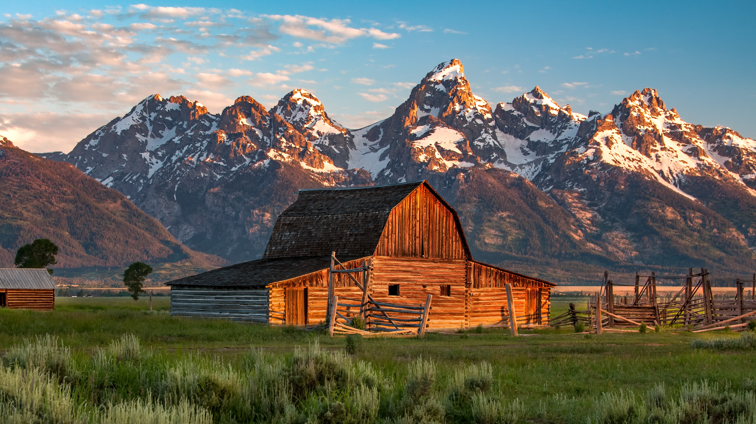

Slide 10
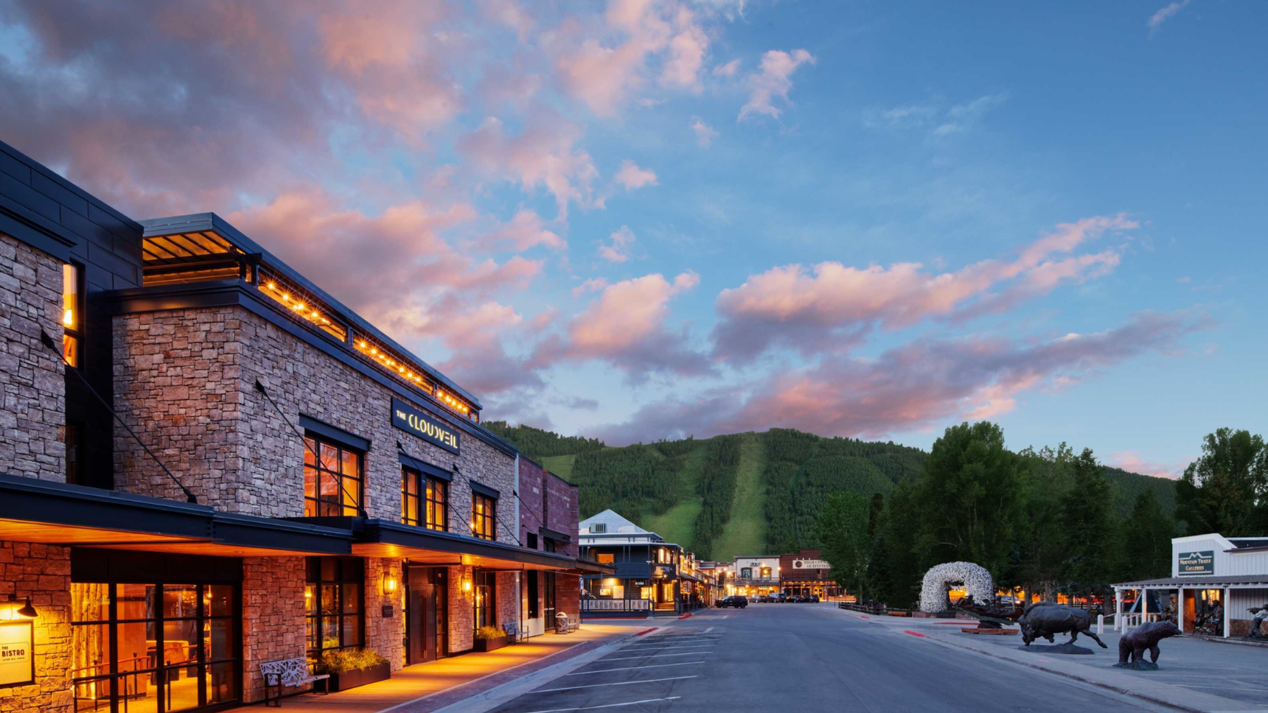
Meet Ripe!
2:30 – 3:30 at The Cloudveil

