Slide 1
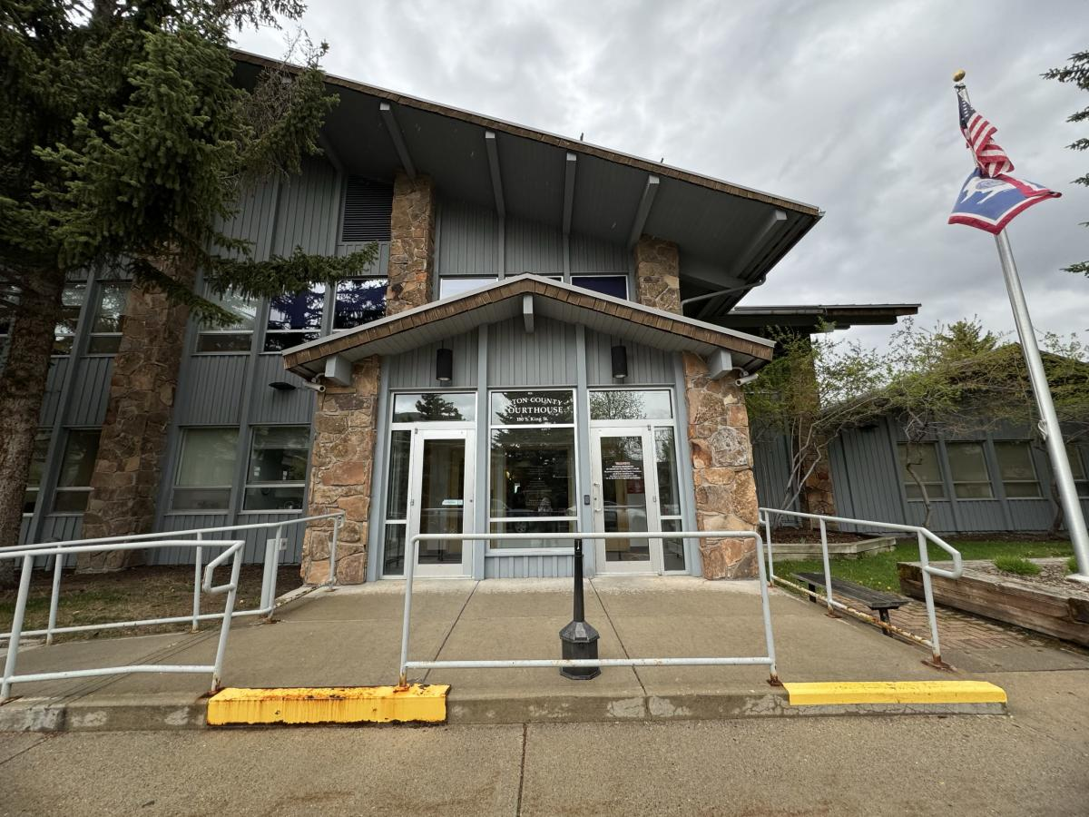
Teton County
Justice Center
SPET Initiative
November 5, 2024
Election

Slide 2
Public Services Provided
Courthouse Building
District Court, 9th Judicial District, Teton County
Circuit Court of the 9th Judicial District
Teton County and Prosecuting Attorney
Clerk of the District Court
Teton County Sheriff's Office
Jail/ Detention Center Building
Teton County Sheriff's Office/ Detention Facility
911 Dispatch

Slide 3
National Center for State Courts (NCSC) Security & Space Analysis Assessment was completed on the Courthouse. Current space is 47,000 SF, the assessment recommended 64,000 SF along with identifying several deficiencies.
“The current courthouse lacks modern courthouse security features which increases risks to staff and public safety. Many of these deficiencies may not be remedied without substantial remodeling and/or additions or new construction”
Insufficient queueing and security screening area
Sub-standard courtroom space (size, site lines, acoustics)
Dysfunctional courtroom layouts
Improper separation of public and staff
Lack of appropriate customer service area in court clerks
Lack of appropriate attorney conference rooms
Lack of proper and secure waiting areas
Lack of ADA facilities throughout
Significant deferred maintenance needs (energy systems)
Significant deferred maintenance needs (finishes and envelope)
Insufficient space for current operations
Lack of growth space
Unsafe in-custody movement from jail to court
Building not seismically stable

Slide 4
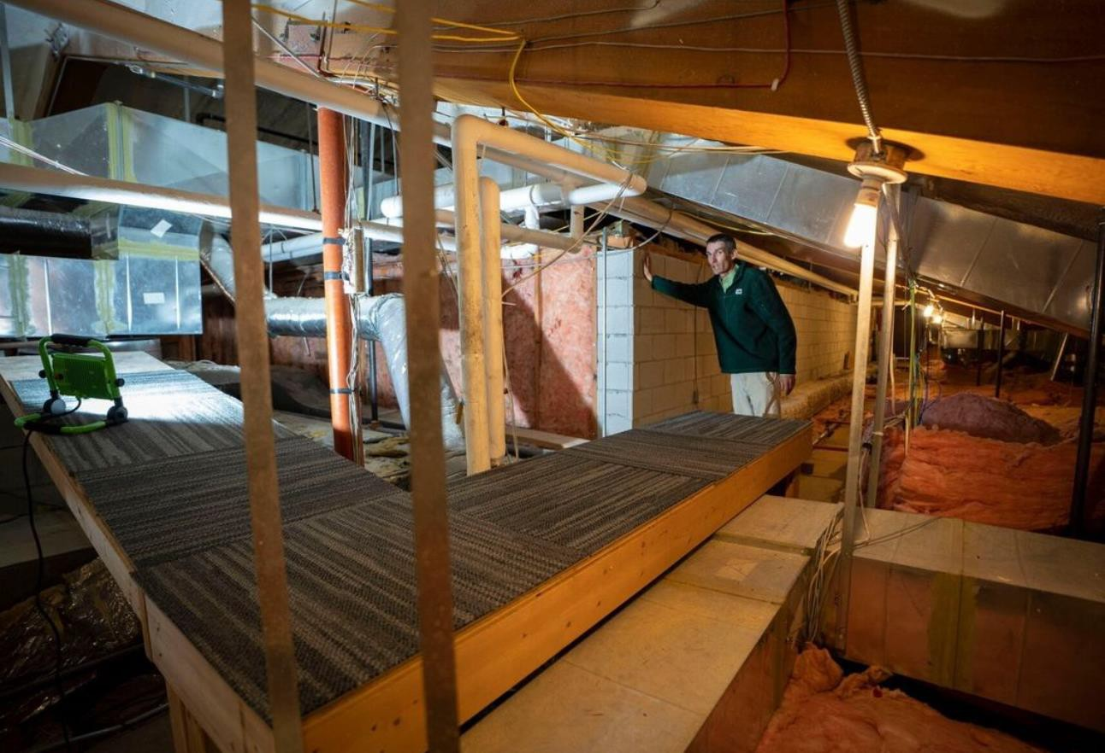

Slide 5
FINANCES
2024
Scenario 1 is when no SPET funding is approved and the County chooses to borrow all the funds.
Scenario 2 with the full penny SPET and Lease Revenue Bonds to cover the cash flow shortfall is the least expensive option, completes the project in the same approximate timeframe as scenario 1, and SPET collections ends in 2029.
Scenario | SPET $ | Approx. Total Cost | SPET per year | SPET collection end year | APPROX. Financing cost
1- NO SPET |  | $198,000,000 | n/a | n/a | $82,000,000
2- 1 PENNY SPET with Lease Revenue Bonds | $88,000,000 | $120,000,000 | $22,000,000 | 2029 | $3,500,000

Slide 6
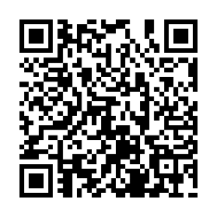
Teton County Justice Center
SPET BALLOT LANGUAGE
$88,000,000.00 for the purpose of planning, designing, engineering, demolition of the old Jail, demolition of the current courthouse, and construction of the new Teton County Justice Center including but not limited to the Teton County Detention Facility, District Courtroom and accompanying office space, Clerk of District Court office space, Circuit Courtroom and accompanying office space, Clerk of Circuit Court office space, County and Prosecuting Attorney’s Office space, Teton County Sheriff’s Office, and other office space. Any unexpended funds, including any unused contingency funds, shall be placed into a designated account, the principal and interest of which shall be used for operations and maintenance of the Teton County Justice Center.
This project is sponsored by Teton County.

