Slide 1
Online Reputation Management
Megan Erney
Marketing Director
Bowser Automotive Inc.

Slide 2
Myths about online review importance
Reviews are only written by angry people
85% of reviews are positive
Reviews are out of my control
Reviews are “user-generated” content but you can control your business listings, menus and services, contact information, website links and conversation-changing review responses
Most reviews are fake, unreliable or unreasonable and they won’t effect my business
Growing thought process that there are increased numbers of online reviews that are fake or paid for by companies – doesn’t mean real people have stopped posting, sharing, reading reviews.
In fact, 80% of American’s purchases are influenced by online reviews

Slide 3
Myths about online review importance
Nothing good ever comes from bad reviews
Negative reviews can be harsh, cruel and anger fueled, but read carefully and learn how to mine the good stuff from the negativity
Negative reviews can help you identify and resolve customer issues, compare your performance to competitors and establish or increase your credibility

Slide 4
Managing Online Reviews
Research
Respond
Negative AND Positive
Don’t give in to pressure from negative reviews
Don’t be held hostage by online “assassins” looking for free services
Encourage
Customers who have positive experiences are more likely to post comments or reviews when asked

Slide 5
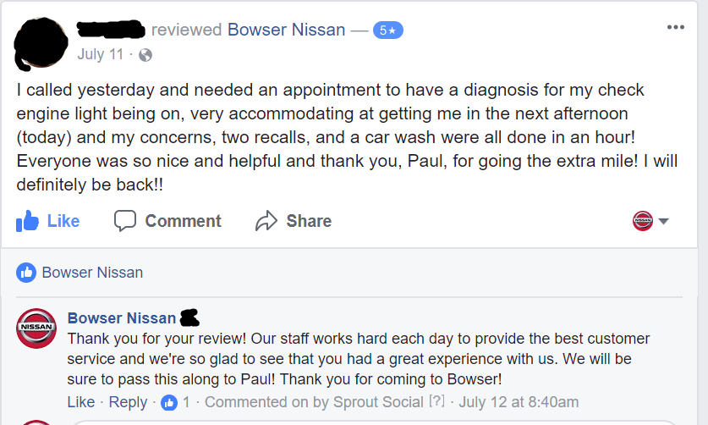
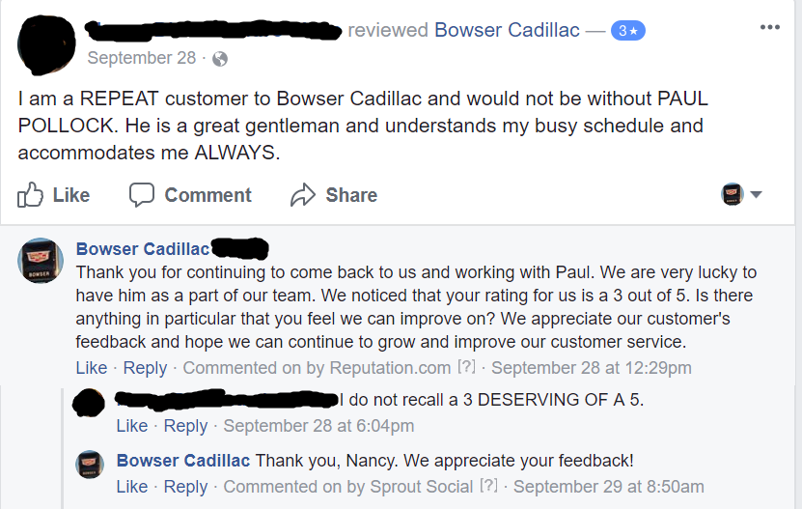
Positive Review Responses
Thank the customer for taking time to review
Make it more personal – highlight what sets you apart from others, be sure to acknowledge staff if mentioned

Slide 6
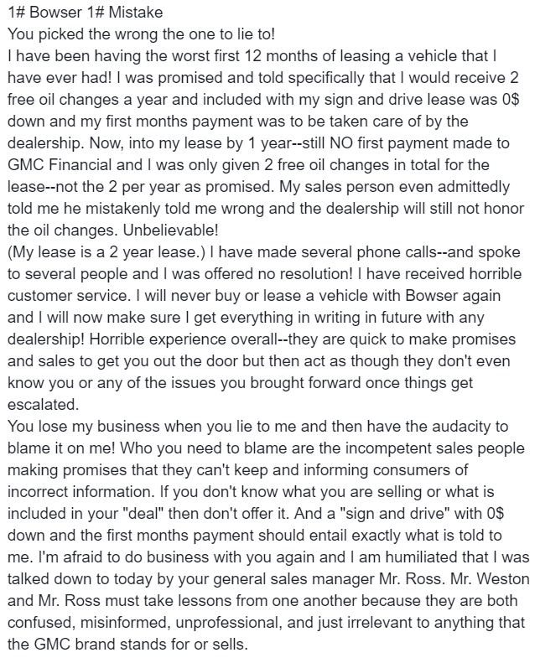
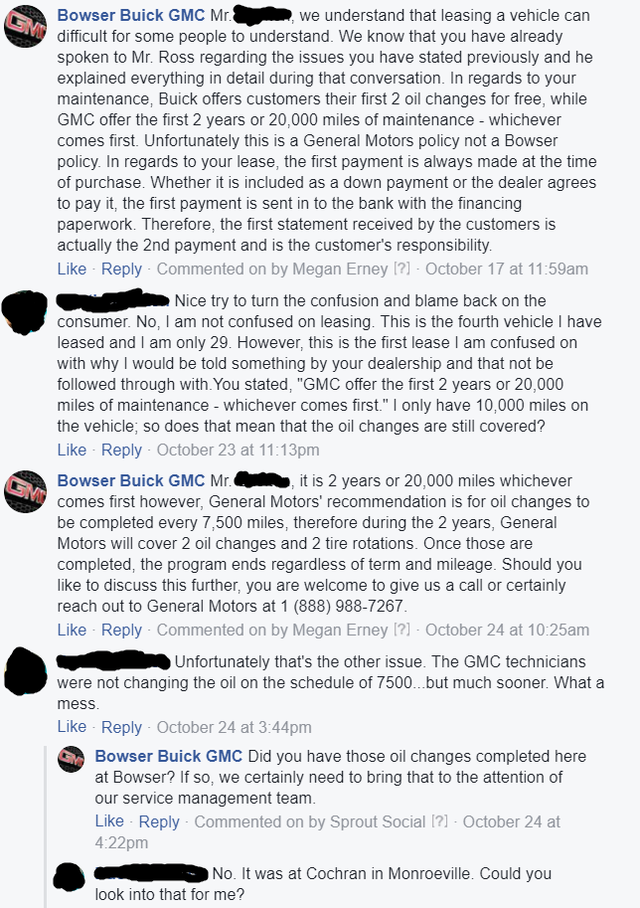
Negative Review Responses
Changing the Conversation

Slide 7
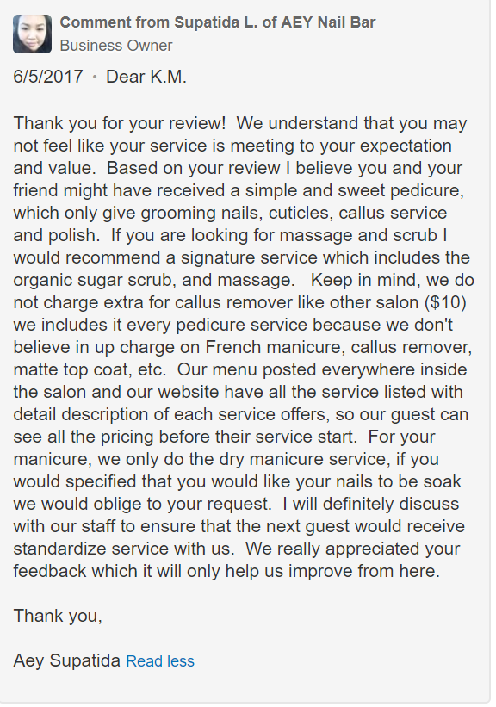
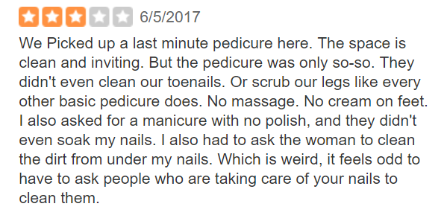
Review Responses – Online “Assassins”

Slide 8
Questions? merney@powerofbowser.com

