Slide 2
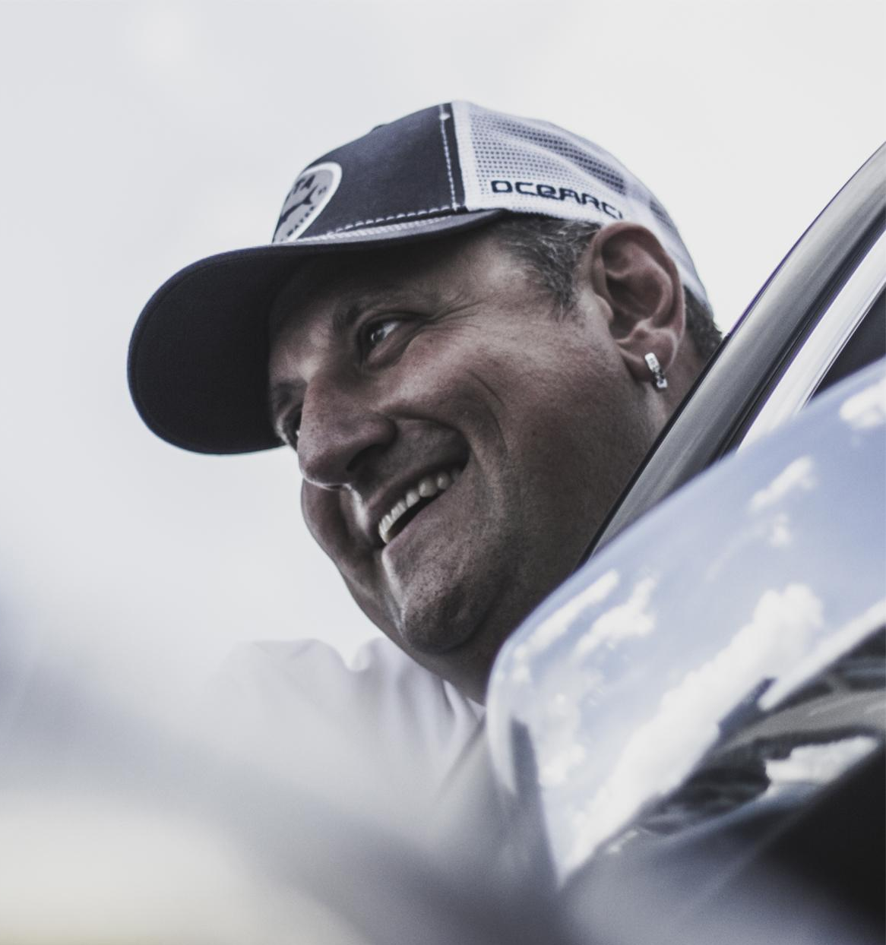
Intro and Background
What qualifies me to be up here speaking today?
JEFF LIZIK
President / CEO

Slide 3






Corporate

Slide 4



E-commerce

Slide 5
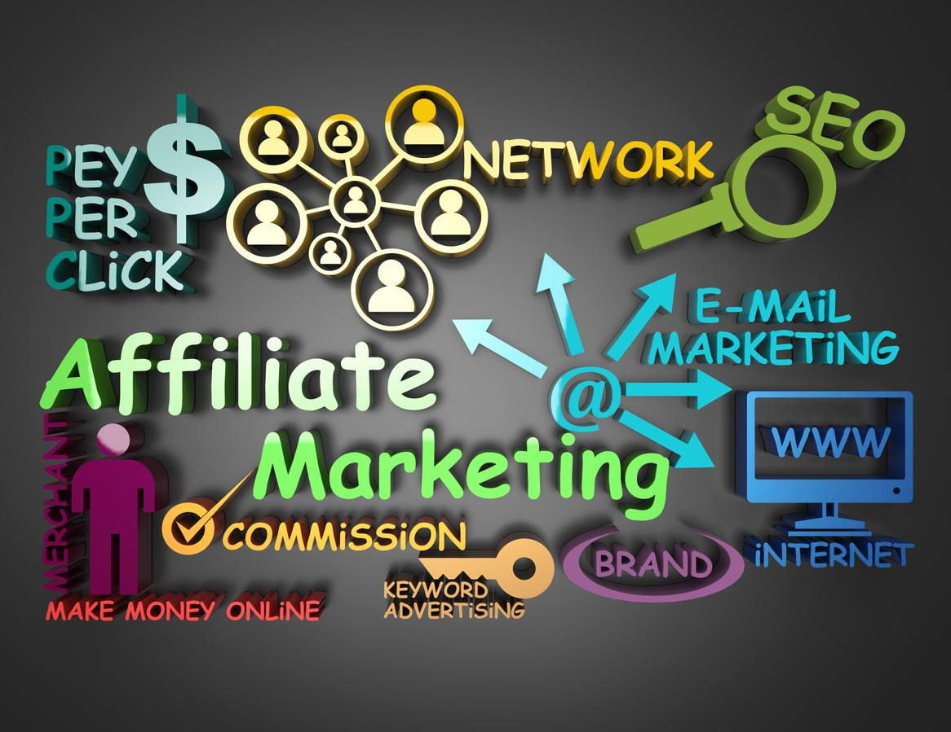
Affiliate Marketing

Slide 6

Digital Agency

Slide 7

Business Consulting Firm
v

Slide 8


Acquired Z-Brand
Rebranded as REDSHIFT

Slide 9
Why I Bought an Agency

Slide 10

Hourly Billing Sucks

Slide 11

Top Horror Stories

Slide 12

Websites Blocked from Search Engines

Slide 13

Where’s My Traffic

Slide 14

$99 SEO

Slide 15

Constant Turnover

Slide 16

Piecemeal Approach

Slide 17

Marketing is Confusing in 2019

Slide 18

But….
What I was
Doing was Working.

Slide 19

I Just Had to Wrap My Head Around Why?

Slide 20

And Define the Difference Makers

Slide 21

Clarity of Communication

Slide 22

Relentless
Accountability

Slide 23

Unwavering Service

Slide 24
So I called it…..
Digital Marketing Essentialism

Slide 25
There are foundational components of digital marketing that all businesses need in order to find success online.

Slide 26
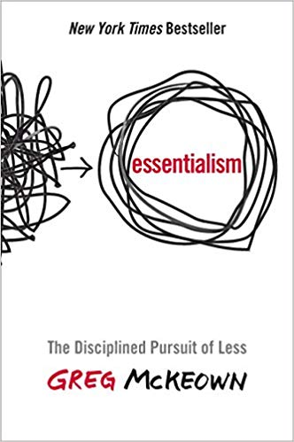
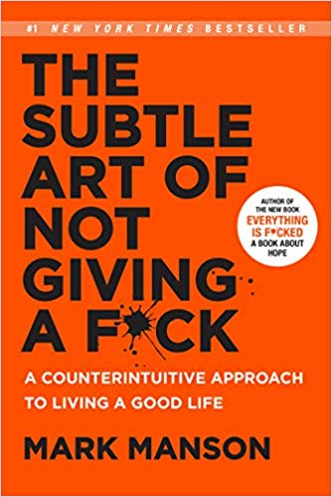
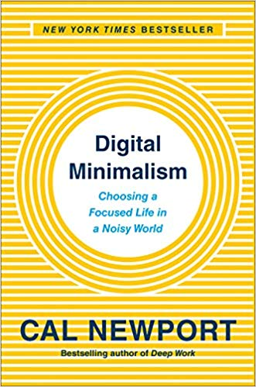
Digital Marketing Essentialism is:
Only a few things matter
Say no to everything except the essential
Removes obstacles to make execution easy
Gets the right things done
“The undisciplined pursuit of more” is the cause of failure
We have to many choices
Focus on the essential by eliminating everything else
Will this activity make the highest contribution to our goals?
We need to create system that encompasses the essentials
Almost everything is noise and very few activities are exceptionally valuable
We must discern the trivial many from the vital few

Slide 27
Important Caveats & Qualifiers
It is about creating a process where a high percentage of effort and attention is given to the truly vital few
We have to ask “What can we go big on?”
Understanding the big picture helps us see what really matters
We have to ignore the loudest voice and not get overwhelmed by all of the information
We must pay attention to the signal in the noise, hear what is NOT being said and find the essence of the information available
We must clarify the question of what is the most important item we can address right now to move us closer to our goals

Slide 28
Pareto Principle
20% of your time
= 80% of your cause
Resources, clients, etc.
Business Growth, Revenue, etc.
20% |  |  |  | 80%
It’s the point where doing less but thinking more produces better outcomes
More effort doesn’t yield more results, less but better does
It’s the 20/80 rule, it’s not a new concept

Slide 29
Digital Marketing Essentialism is not:
How can we do everything?
Chasing the silver bullet
A sprint
Being too busy doing and not enough analyzing, learning and strategizing
Listening to everyone in the digital marketing space
Overwhelming
Vague
A shotgun approach

Slide 30
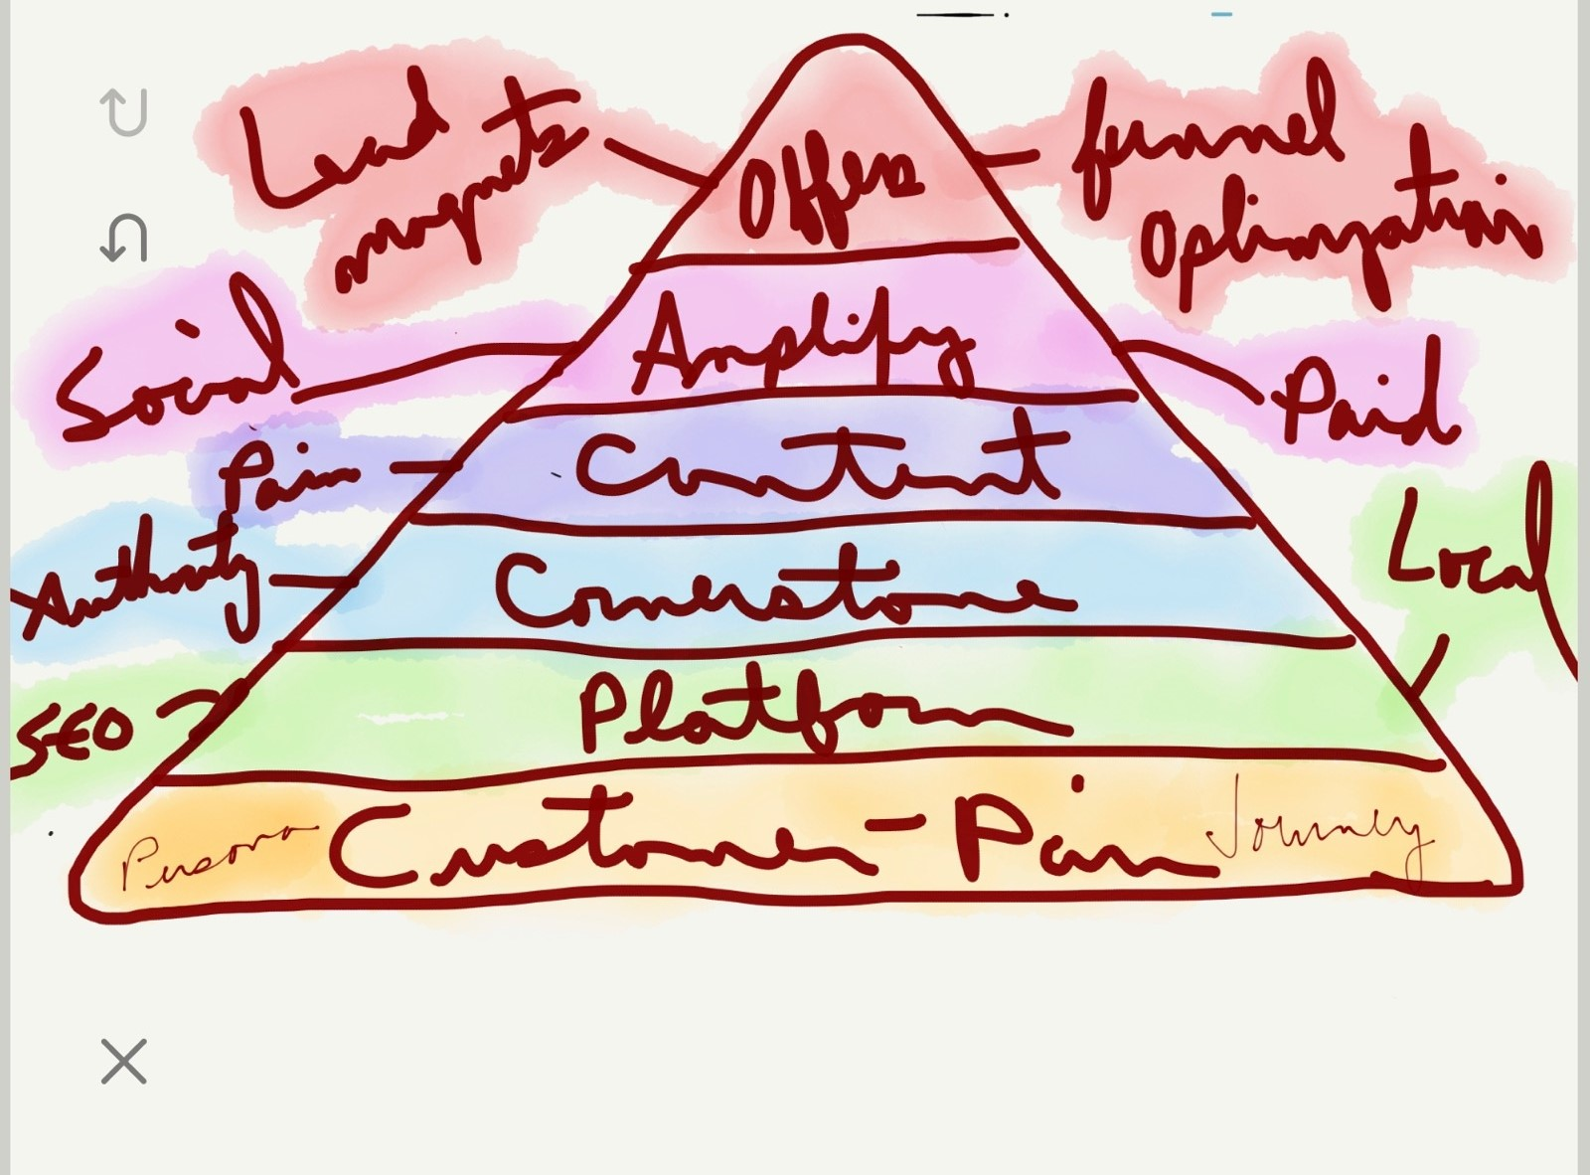
Original Concept
This is the original sketch of the Foundational Marketing Pyramid from a few years ago. The steps are fundamental. The contents within will be context dependent and agile in nature.

Slide 31
Current Format & Process:
OFFERS
PROMOTION/DISTRIBUTION
CONTENT
PLATFORM
CONSUMER

Slide 32

Customer

Slide 33

Platforms

Slide 34

Content

Slide 35

Distribution

Slide 36

Conversion

Slide 37

Emphasis =
Customer & Foundation

Slide 38

The Foundation is Critical

Slide 39

The Results are Exponential

Slide 40
The Message in Summary
Less but better
“Am I investing in the right activities?”
There are more activities than time to invest
This is about how to get the right things done
It’s about making the wisest possible investment by only doing what is essential
It’s a disciplined, systematic approach

Slide 41
A New Approach to Marketing

