Slide 1
Creating a College Internship Program:
Information, Inspiration, and Insights Gained
PRESENTED BY DON GOLINI
Kennebunkport, Maine

Slide 2
MAINE TOURISM WORKFORCE SUMMIT
Innkeeper
General Manager
the
Team
Tina Gordon-Hewett (she/her)
Jean Ginn Marvin
Director Internships & Related Programs
Director of Marketing
Director of Activities Programing
Don Golini (he/him)
Hannah Lamprey (she/her)
01
Esther Montaque

Slide 3
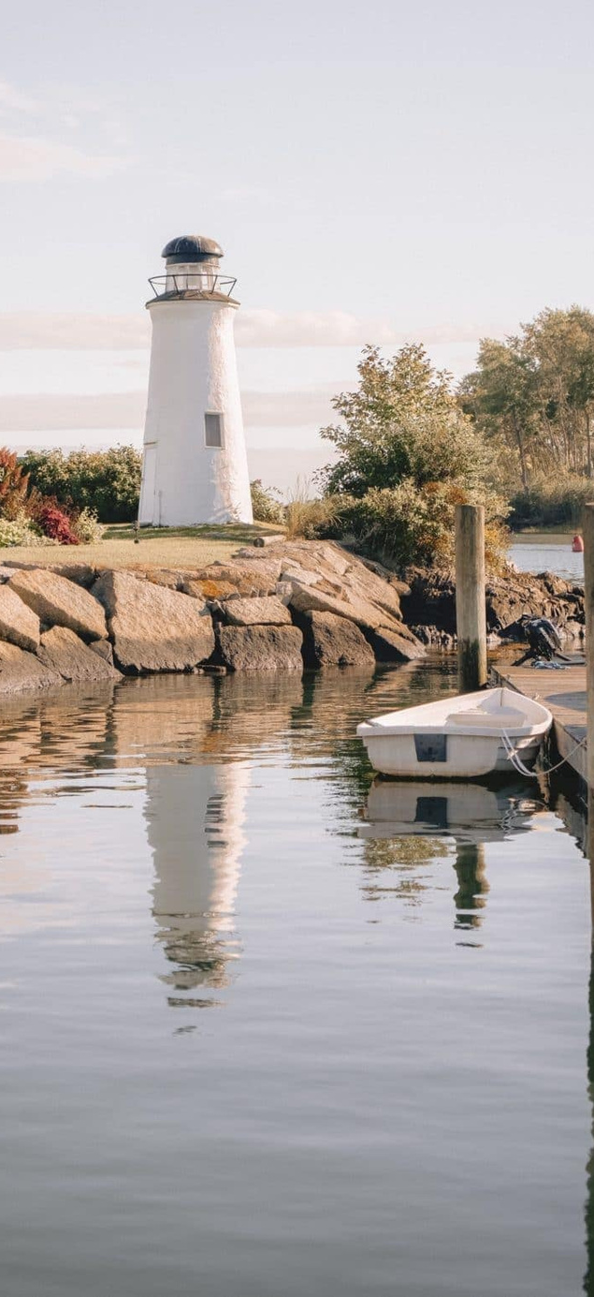
MAINE TOURISM WORKFORCE SUMMIT
Rotations
About
Our Program!
Sales & Marketing
Housekeeping
Front Desk
Full-Time, 10-week program beginning June
PAID!
Real World Experience
All Majors Invited to Apply
Interns will participate in several different positions, based on interest
Attend professional workshops
Create a Final Project
Have Fun!!
Grounds
Activities
Food & Bev
XX
Notes:
We are a flexible program! Interns are invited to discuss career interests/passions with us during the application/interview process. Whatever your major, we're willing to discuss ways to integrate this into your internship.
Here's a few examples we've thought of and had prospects discuss with us.
• Sustainability - work with us to review/develop sustainability programs across the resort.
• Health Care - Develop a wellness program for employees
• Early Childhood Education - Work in our activities program to develop activities for children of all ages
• Ecology/Marine Science - Study the ecology of an onsite river and local beaches
• History/Political Science - explore the history of the resort and surrounding community and prepare documents we can share with our guests.
• Business/Marketing - help us develop social media programs for targeted audiences.
• Photography - create a photo library of the resort property
• Hospitality - explore career opportunities in the hospitality industry.
• Got something else in mind not listed here? Let us know about it during the interview.
ABOUT THE PROGRAM:
• Rotational program: Interns work in several different departments such as Front Desk, Food & Beverage, Event/Sales, Marketing, Activities and Groundskeeping.
• Interns will be invited to attend professional skill building workshops such as working on a team, resume writing and Linked-In profile building.
• Fun activities like group meals, bowling, kayak, paddleboard and bicycle use, hikes, and boat excursions strengthen the team.
• Interns may complete a volunteer project to help them understand The Nonantum commitment to community.
• Each intern will have an assigned mentor to provide advice and ongoing feedback.
• A creative portfolio project on a subject related to your experience at the Nonantum is required to successfully complete our internship.
ABOUT YOU:
• Minimum one year of 2- or 4-year college program completed.
• All majors welcome!
• Desire to learn about a possible career in hospitality while gaining valuable interpersonal and professional skills.
• Ability and desire to be part of a team.
• Desire to develop communication skills.
• Confident asking for help when necessary.
• Success with handling multiple tasks with attention to details and juggling multiple commitments and deadlines.
BENEFITS:
• Staff meals.
• Discounts on rooms, meals, clothing, and gift items.
• Flexible scheduling.
• Opportunities to further education and professional development
• Fun, collaborative work environment

Slide 4
How Do We Attract Candidates?
MAINE TOURISM WORKFORCE DEVELOPMENT
Outreach
Job Fairs
Personal outreach to Local Schools and Intentional Networking
In Person and Virtual with Take Away Materials
Online Platforms
Social Platforms
Leverage services like Handshake, Indeed, Company Website
Facebook, Local Facebook Groups, LinkedIn

Slide 5
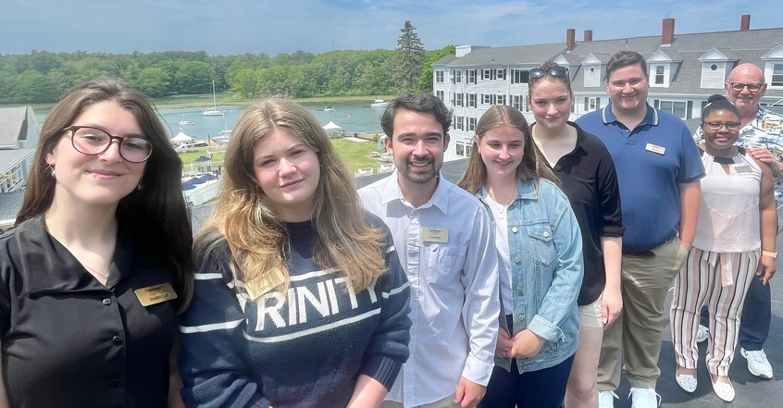
Final Projects:
Where Passion and Experience Combine
MAINE TOURISM WORKFORCE DEVELOPMENT
SUSTAINABILITY
HISTORY
PERSONAL JOURNEY
Kate, a UNH student, completed a Sustainability Audit and made suggestions across her departmental rotations on how to improve our sustainability efforts.
Marilyn, a recent graduate from SMCC, found confidence and a new vision for her life, both professionally and personally, throughout the program.
Carter (UConn) and Charlotte (UNH) created QR codes and media assets to educate our guests about historical items and points on property.
AGRICULTURE
ADA COMPLIANCE
Anthony, a UNE student, created a Business Plan to launch a farmstand at a partner location, Black Rock Farm.
Combining her passion for accessibility and her keen eye for graphic design, Kelly (Trinity College, Dublin) to create a more comprehensive and inclusive check-in process.
06

Slide 6
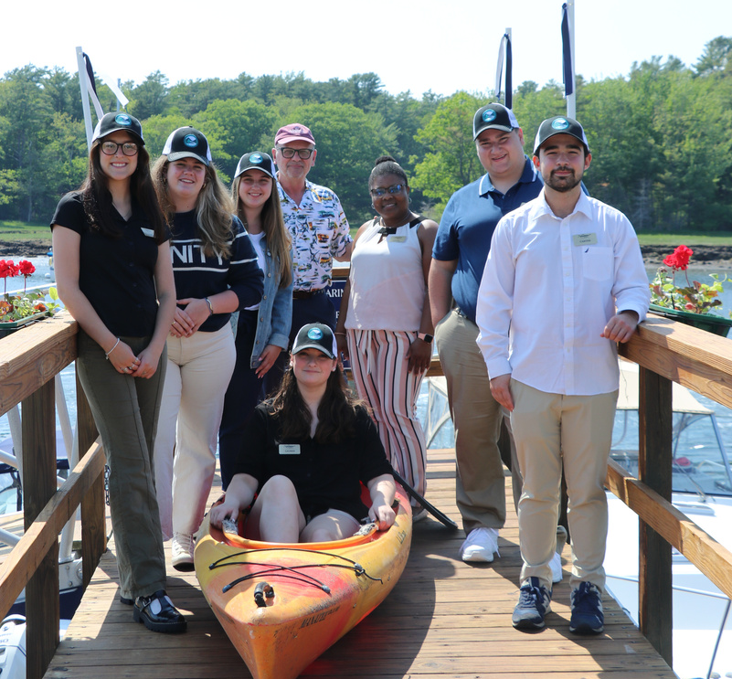
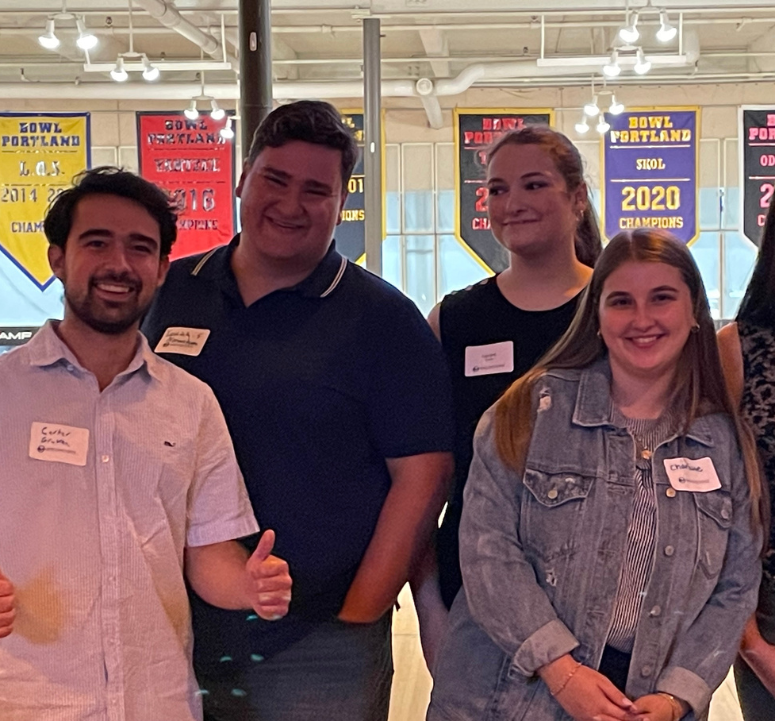
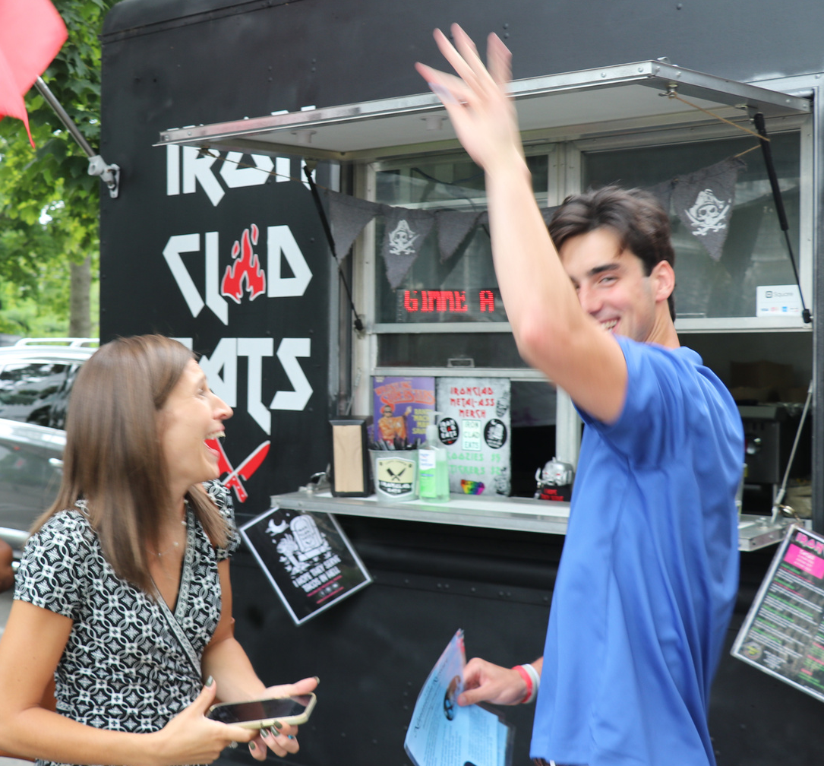
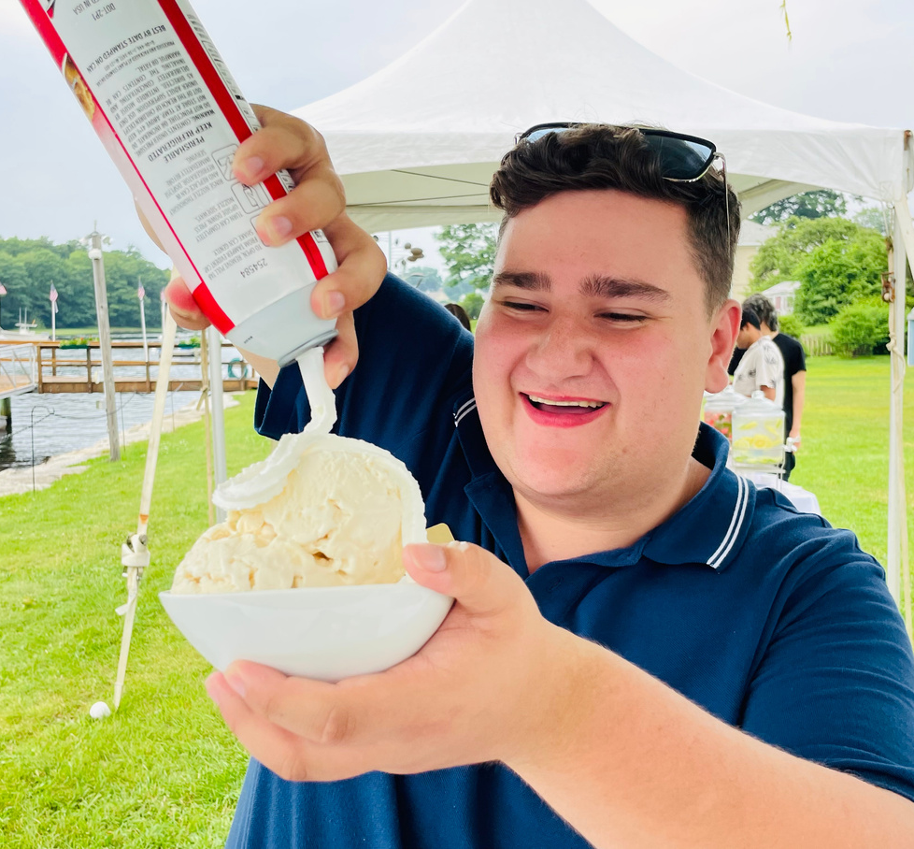
Educate Maine/MCC Partnership
MAINE TOURISM WORKFORCE SUMMIT
A Part of Something Great
Interns Participated in:
Educational Webinars
Teamwork, Networking
Fun!

Slide 7
Planning is Everything!
Hospitality, where the only constant is change
A good foundation will set the tone for the program
Rotation Schedule presented before internship program begins
Organizational tools to keep everyone connected (Notebook, Journal)
A commitment to the program and each other (The “Manifesto”)

Slide 8
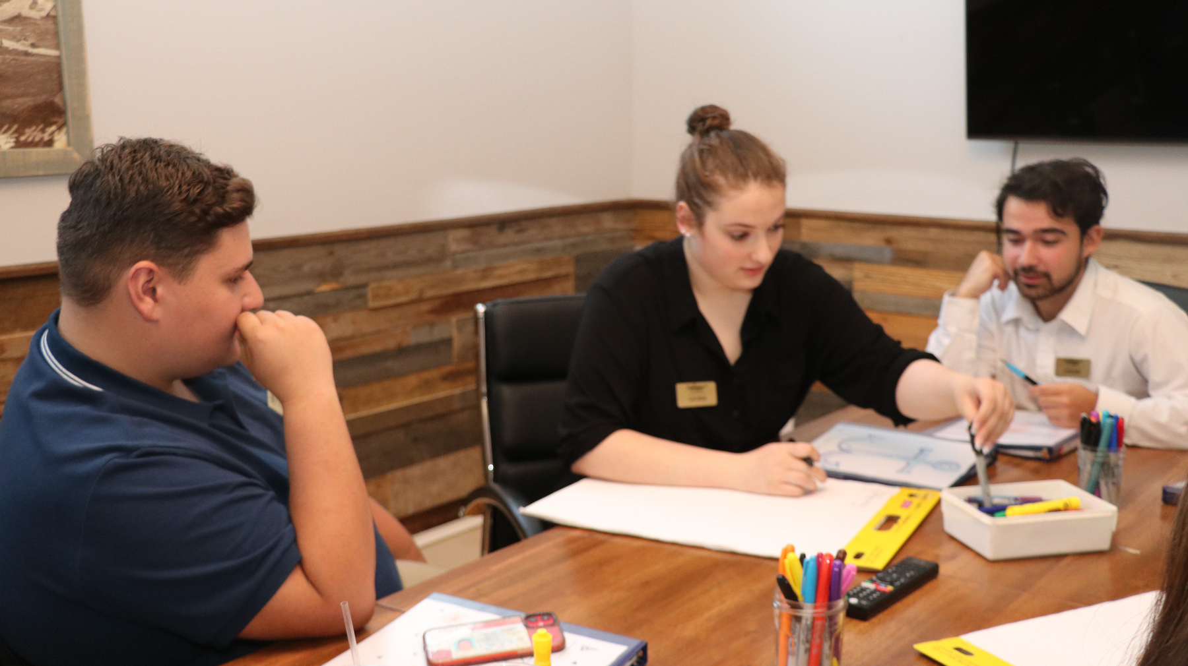
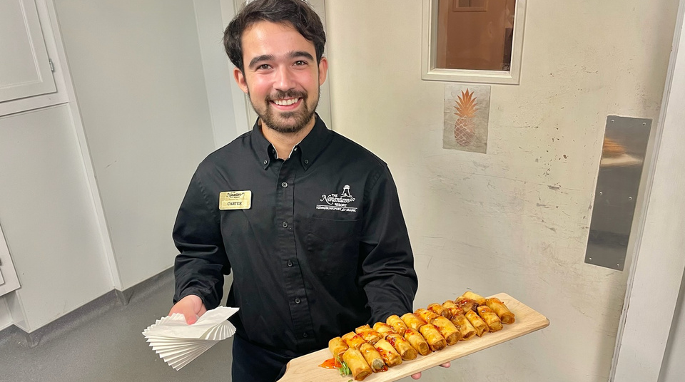
The Nonantum Pivot
Revision is KEY
Revised/Flexible Scheduling
Independence Day
Collaboration Time
Assigned projects by managers

Slide 9
Feedback Loop
MAINE TOURISM WORKFORCE DEVELOPMENT
Journals
“Breakfast With
Hannah”
Performance Reviews
Mentors
Office
Hours
Both formal and informal

Slide 10
Lessons Learned:
There’s Always “Room” to Improve
MAINE TOURISM WORKFORCE DEVELOPMENT
BROADEN STUDENT PROFILE
MODIFY WORKWEEK
Schedule must align with the current process and operations of our organization
From Hospitality majors to Gen Ed majors
DIGITAL COMMUNICATION
PERSONALIZATION
As we learn our interns more, we tailor our projects and opportunities to amplify their experience and takeaways. Play to strengths.
Less email, more text. Enhance participation by speaking “their language”

Slide 11
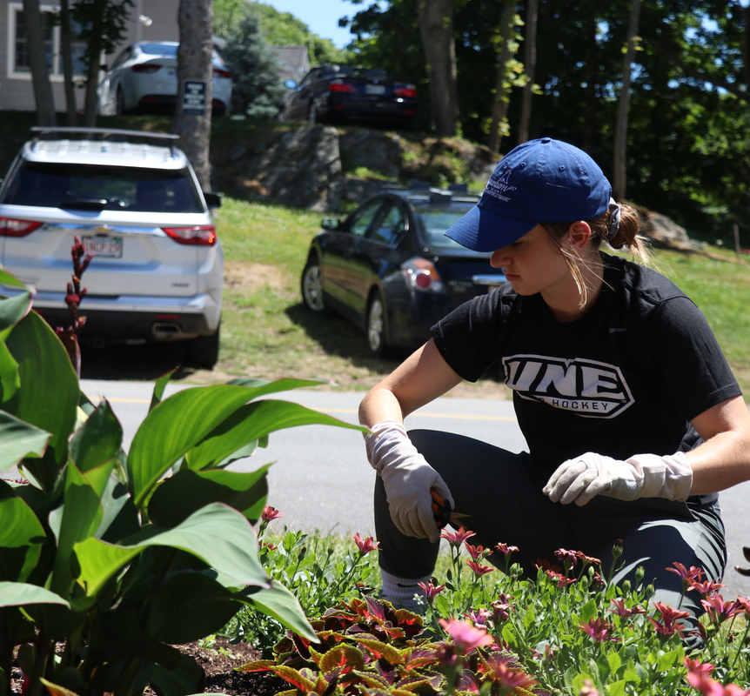
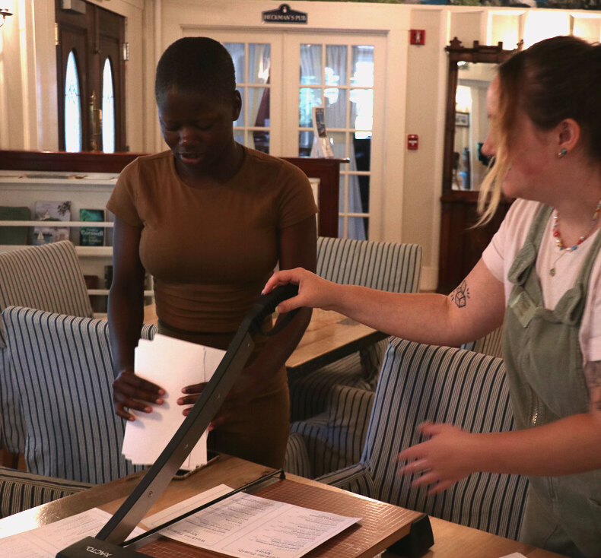
Projects with Passion
MAINE TOURISM WORKFORCE SUMMIT

Slide 12
Slideshow Auto-play Slide

Slide 13
MAINE TOURISM WORKFORCE SUMMIT
www.NonantumResort.com
617.834.7276
Let's Connect/
Any Questions?
don.golini@nonantumresort.com
Director of Student Employment Programs

