Slide 1
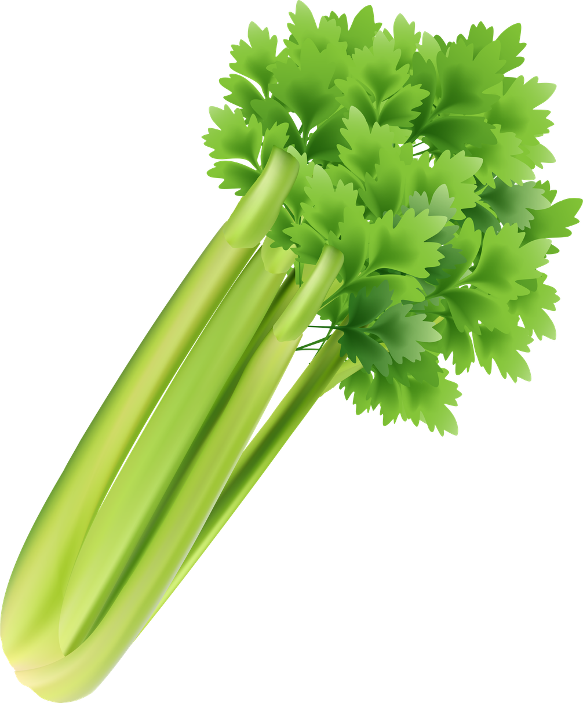
Celery

Slide 2

Cereals
(with gluten)

Slide 3

Crustaceans
(shellfish)

Slide 4

Eggs

Slide 5

Fish

Slide 6

Lupins

Slide 7

Milk

Slide 8

Molluscs
(shellfish)

Slide 9

Mustard

Slide 10



Nuts

Slide 11

Peanuts

Slide 12

Sesame Seeds

Slide 13

Soya

Slide 14
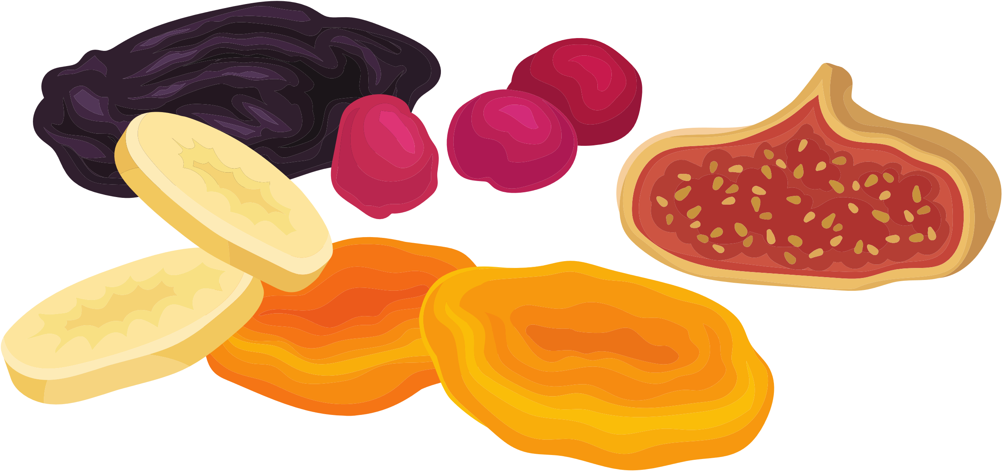
Sulphur Dioxide

Slide 15

No Additives

Slide 16


Alcohol

Slide 17
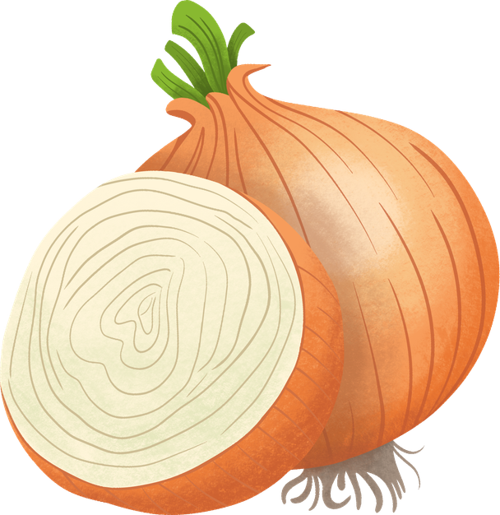
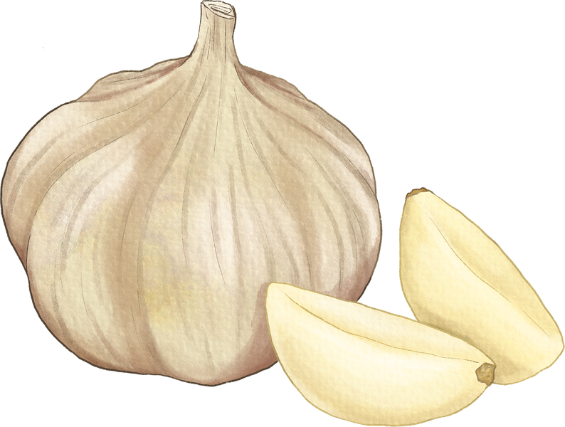
Onion / Garlic

Slide 18




Dairy Free

Slide 19

Lactose Free

Slide 20




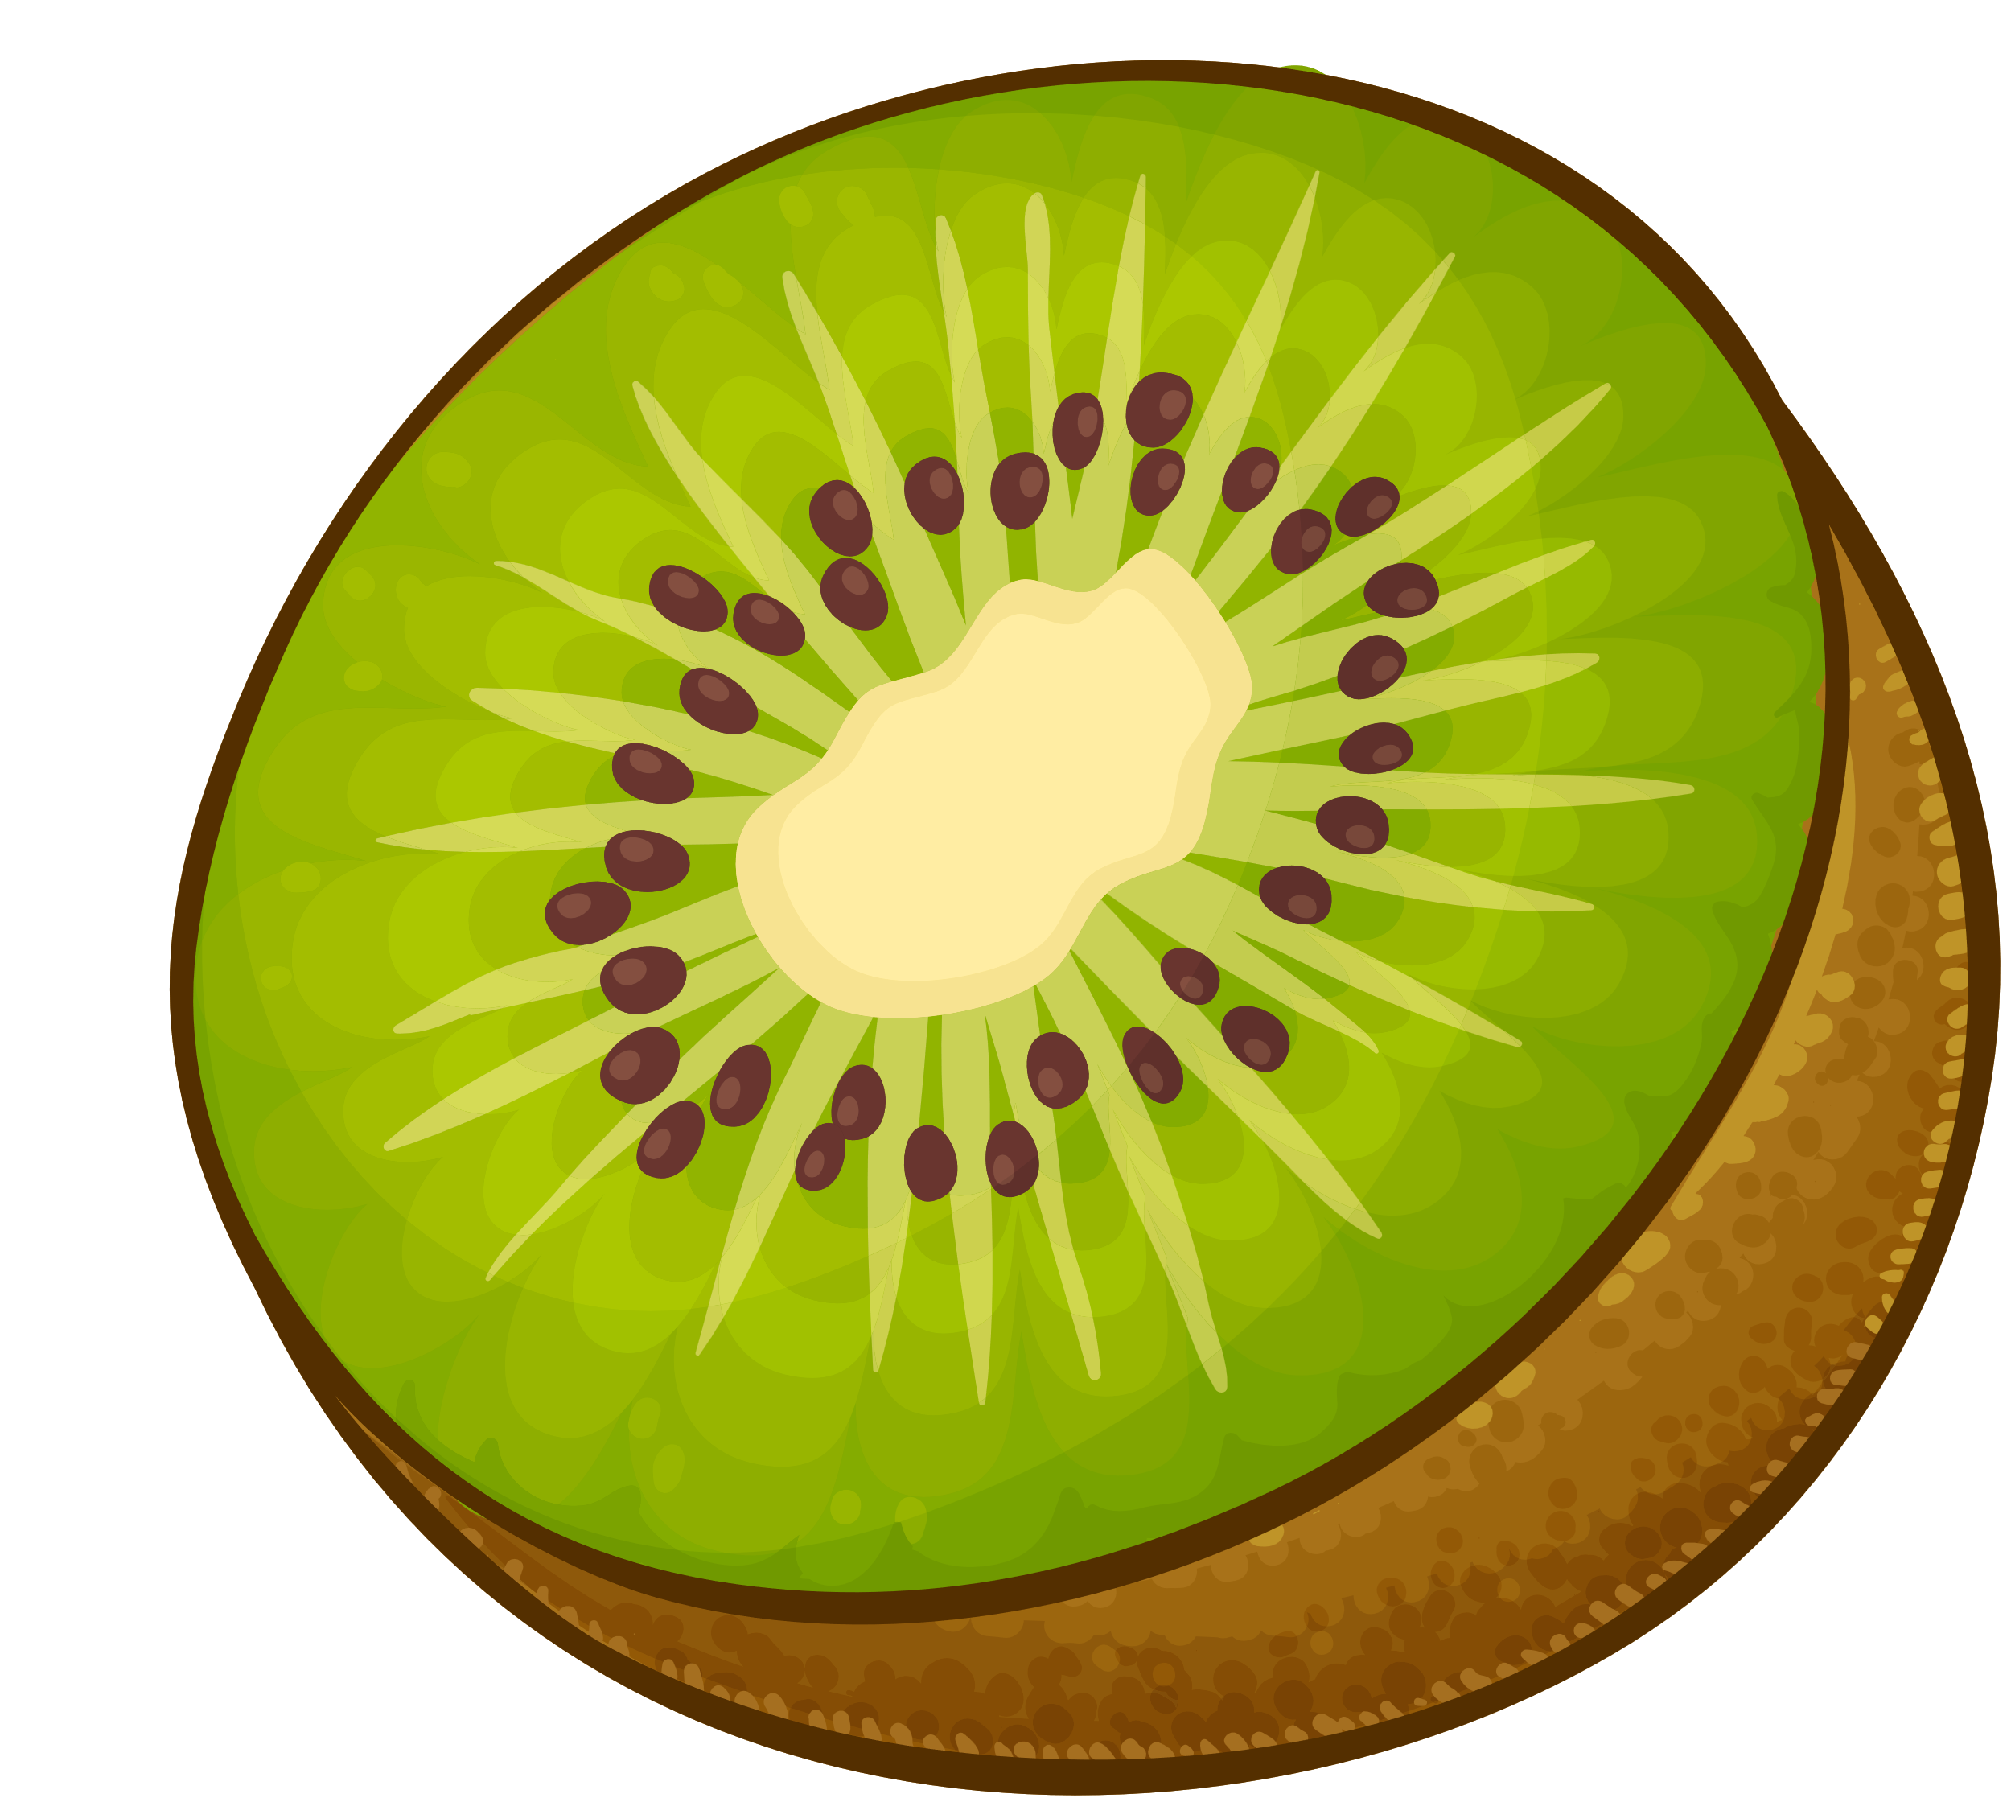

Suitable for FODMAP

Slide 21

Halal

Slide 22

Kosher

Slide 23

Beef & Beef Product Free

Slide 24
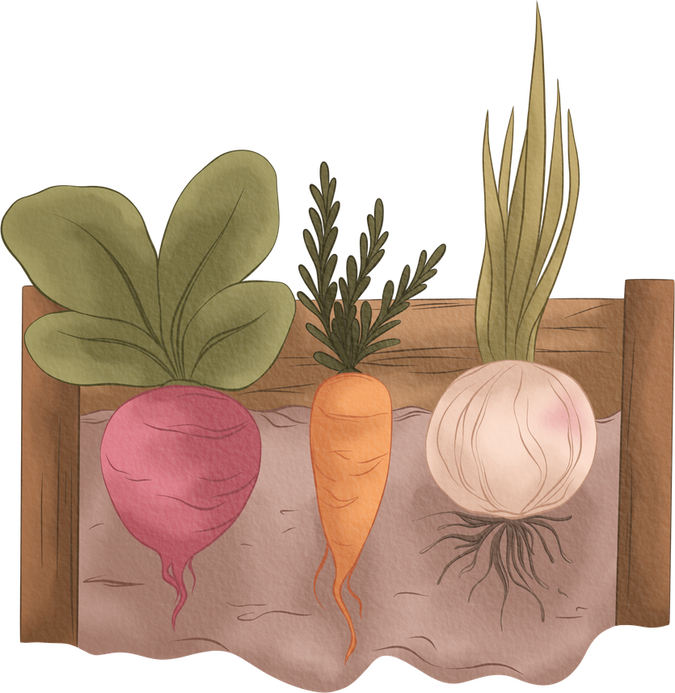
Suitable for Jain Diet

Slide 25
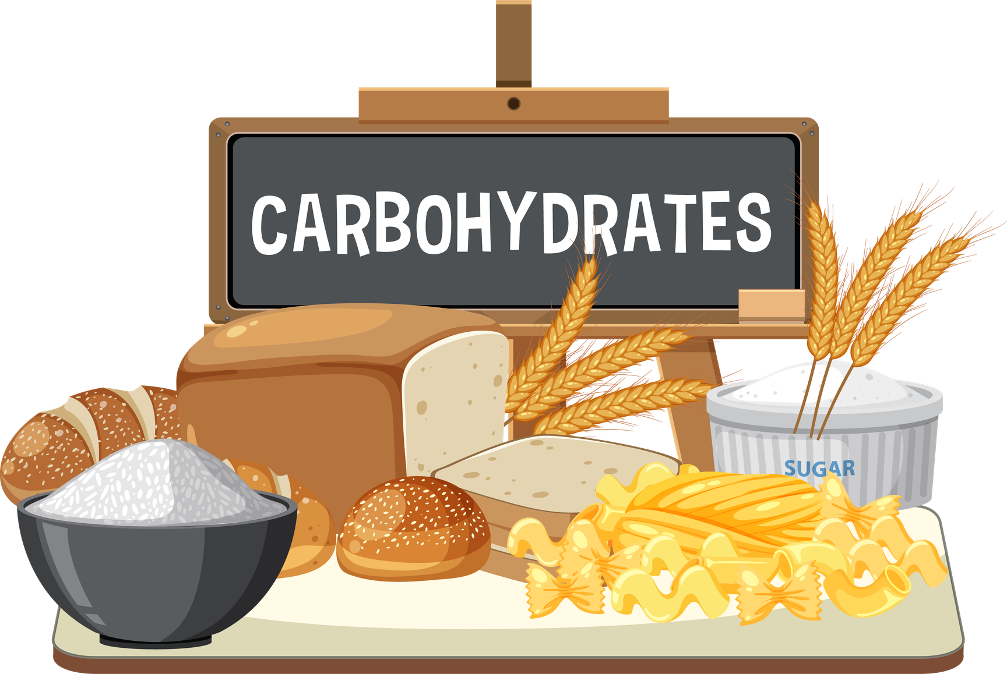
LOW
Low Carbohydrates

Slide 26

Low Cholsterol

Slide 27

Low Sodium / Salt

Slide 28
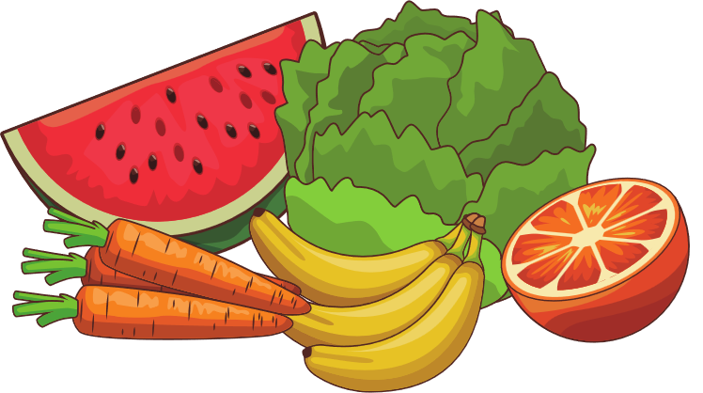
Raw Fruit / Vegetables

Slide 29

Preservative Free

Slide 30
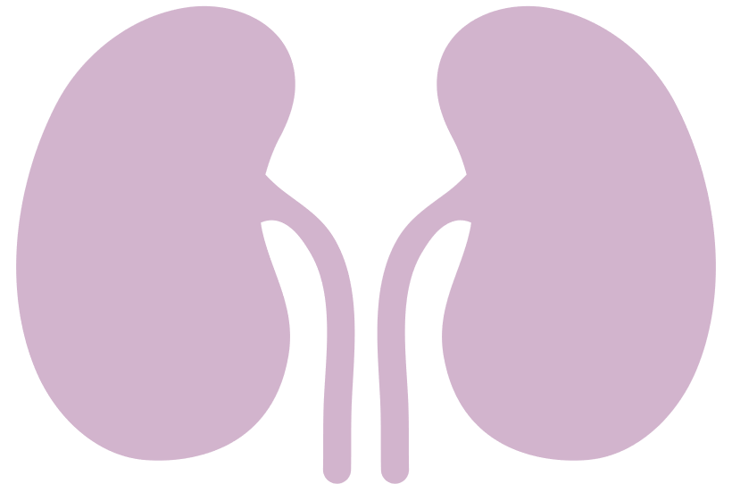
Renal Friendly

Slide 31
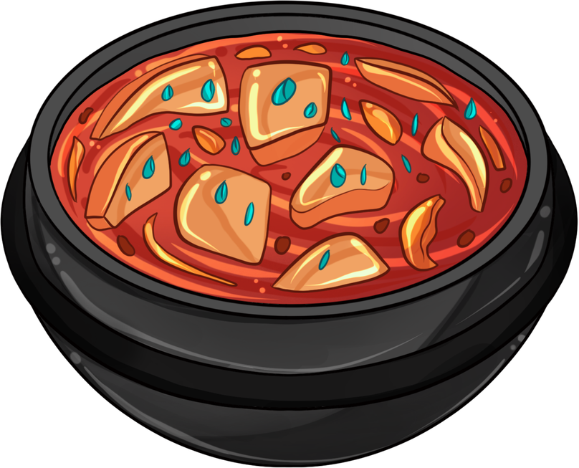
Texture Modified

