Slide 1
Phases of Messaging
Phase 1
Phase 2
Phase 3
Outbreak
Improving Situation
Recovery Commencement
We’re in this together.
Here’s a photo or video that brings us joy during this hard period.
Stories of news, local support and humanity.
Soon, we’ll travel again.
Recovery brand awareness messaging.
Photo, video, contest, or story assets that inspire travel during this time.
Welcome travelers to visit when they feel ready.
Reintroduce brand campaign; tweak as needed.
Invitations to travel including offers/deals.
ORGANIC HAPPENING NOW
ORGANIC/LIGHT PAID IN DEVELOPMENT
PAID
IN DEVELOPMENT

Slide 2
Messaging Funnel Focus
Pushing in-state & drive market travel
California road trips
CALIFORNIA
NAPA VALLEY
Pushing the overarching destination to core drive markets
A respite; to share, savor, discover
INDV. TOWNS
Capitalizing on overarching Napa Valley brand
Unique personalities & offerings
TOURISM BUSINESSES
Capitalizing on overarching Napa Valley brand & towns
Content, offers & deals from hotels, wineries, restaurants, shops, attractions, etc.

Slide 3
Objectives & Strategies
Maintain a foundational layer, reaching prospects through channels where they spend the most time.
Incorporate high reach vehicles to generate broad awareness and interest in the destination.
Incentivize visitation through co-op programs that reach a variety of travel types.
Welcome visitors back
to the Napa Valley,
driving interested audiences to the website to explore more and
book a visit.
Notes:
Considerations for down funnel

Slide 4
Preliminary Media Options
Reviewing options with digital, broadcast and out-of-home opportunities for a robust campaign, targeting both drive markets.
Television
Audio Streaming
Digital
Out-of-home
Timing: 6-weeks
Target: A35+
Markets: San Francisco DMA
Balance of reach and frequency
Timing: 6-weeks
Target: Luxury + Aspirational/value
Markets: San Francisco DMA
Data targeting, cross-device reach
Timing: 8-weeks
Target: Luxury + Aspirational/value
Market: Sacramento area
Units: LED Billboards
Timing: 8-weeks
Target: Luxury + Aspirational/value
Market: San Francisco + Sacramento area
‘Always On’ activity
Notes:
BUDGET DEPENDENT – June - September

Slide 5
Possible Co-op Opportunities
Opportunity to extend campaign reach and provide towns/partners with exposure through co-op program.
Option A
Option B
Co-op within VNV proposed media plan (actual plan TBD)
Partner to choose 1 medium for inclusion
Min. investment levels:
Television: $5K
Audio streaming: $2.5K
Out-of-home: $3K
Digital: $2.5K
VNV branded creative + partner call out/landing page
Additional partner investments will extend campaign exposure
VNV to develop OTA partnership to brand the Napa Valley and drive partner traffic
Details dependent upon participation levels
VNV to match total partner investment
I.e. 5 partners at $25K investment, VNV contribution $25K
Min. investment level: $5K
5 partners minimum
VNV branded creative + partner call out/landing page
Notes:
Landing page of featured partners

Slide 6
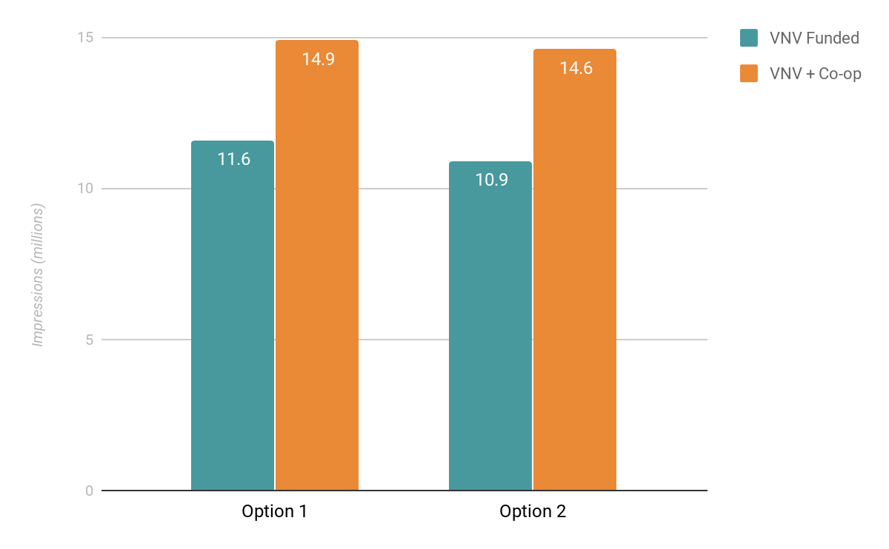
Increased Exposure
$50K in co-op participation results in increased exposure for the Napa Valley.
+28%
+33%
Both scenarios assume an additional $25K in each medium.

