Slide 1
Our Current Moment…
February 2021

Slide 2
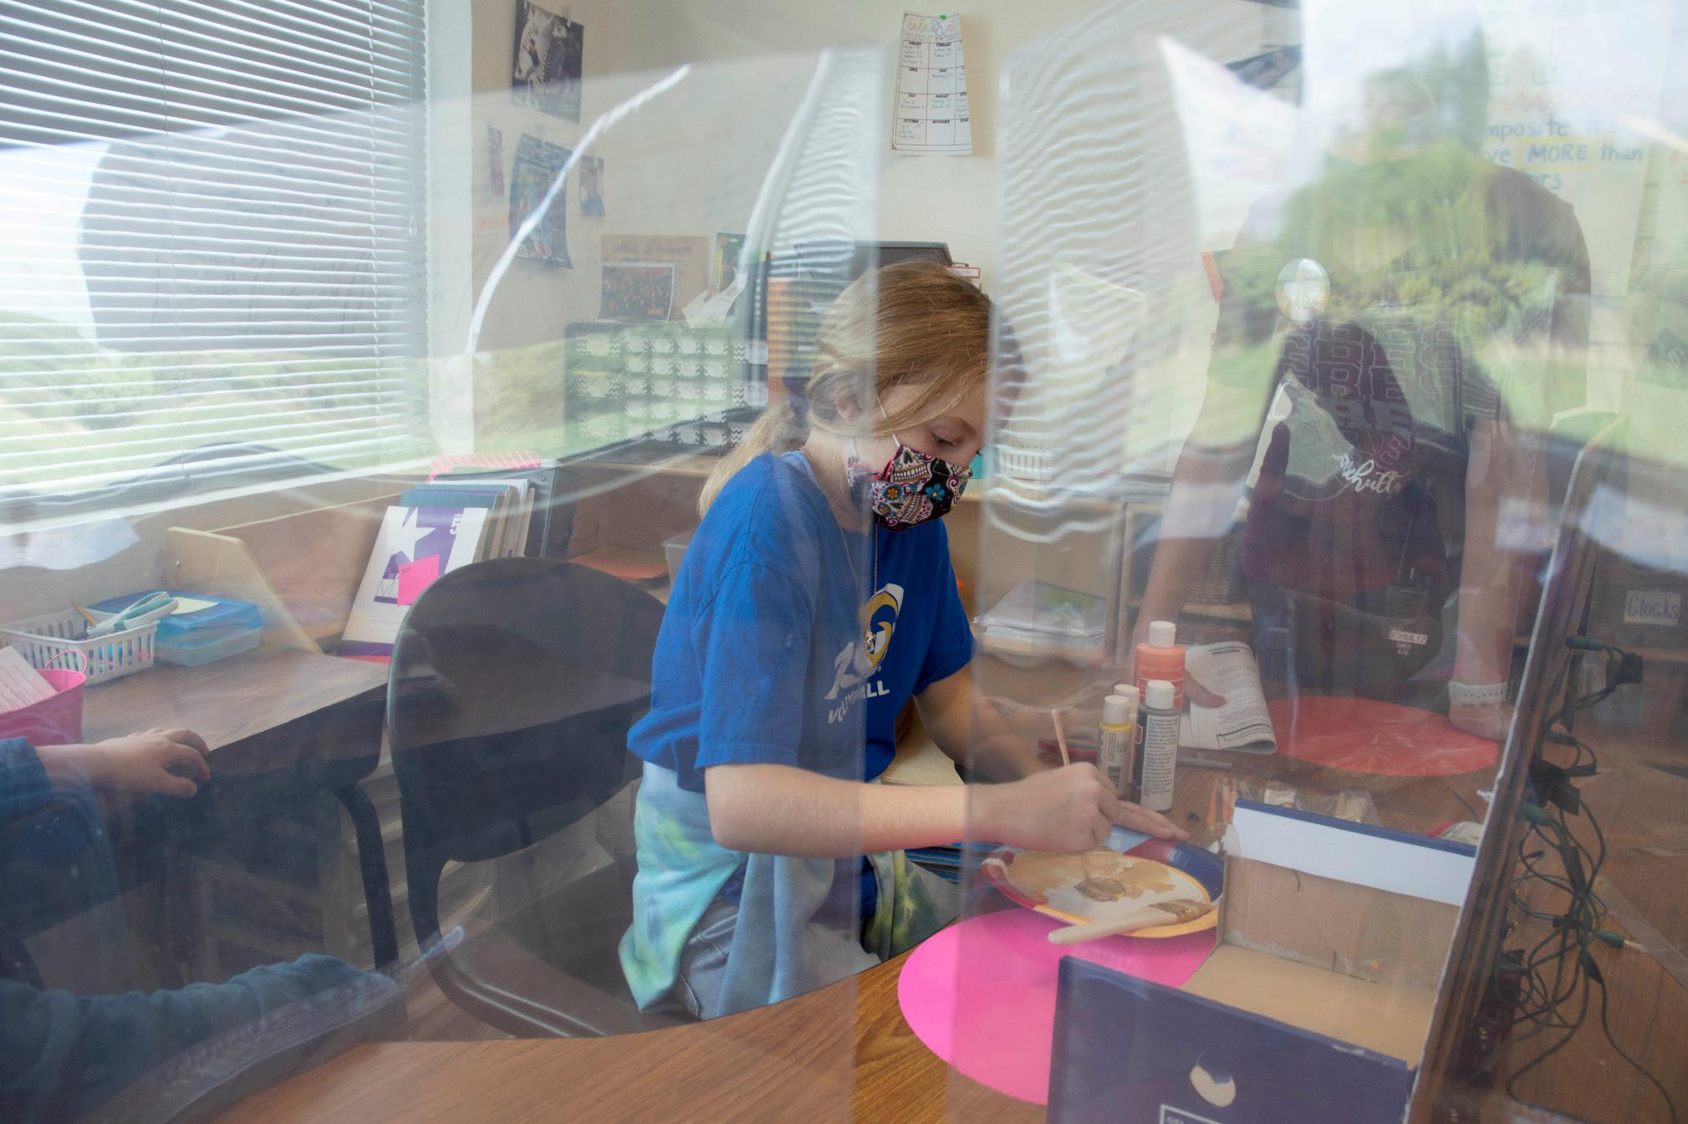
Comal Independent School District
Comal Independent School District
Notes:
Ainsley Edwards, 5th Grade GRES

Slide 3
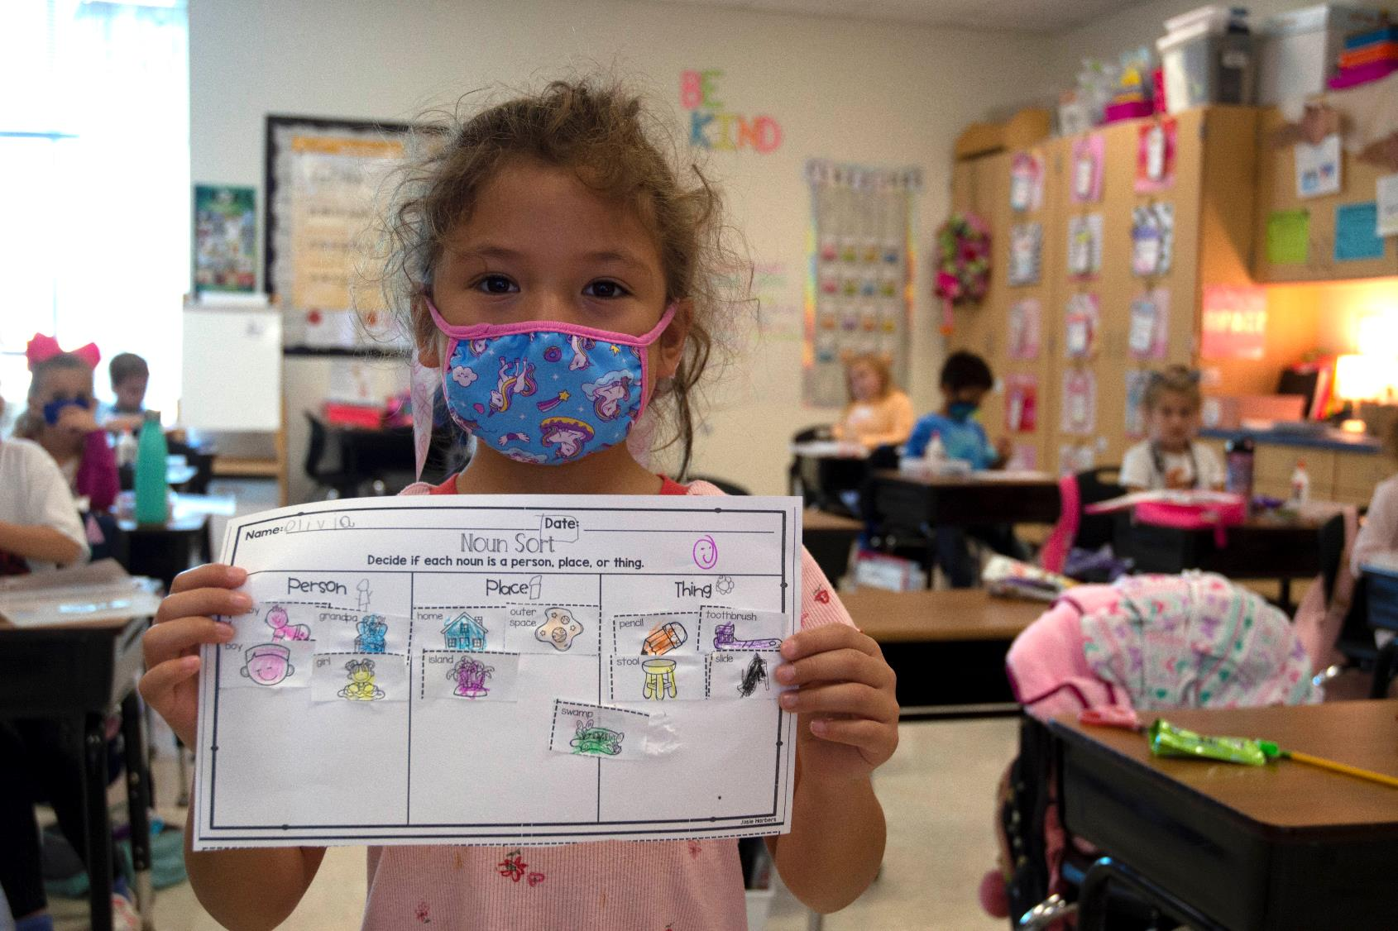
25,843
2020-21 Projected Student Enrollment
Comal Independent School District
Comal Independent School District

Slide 4
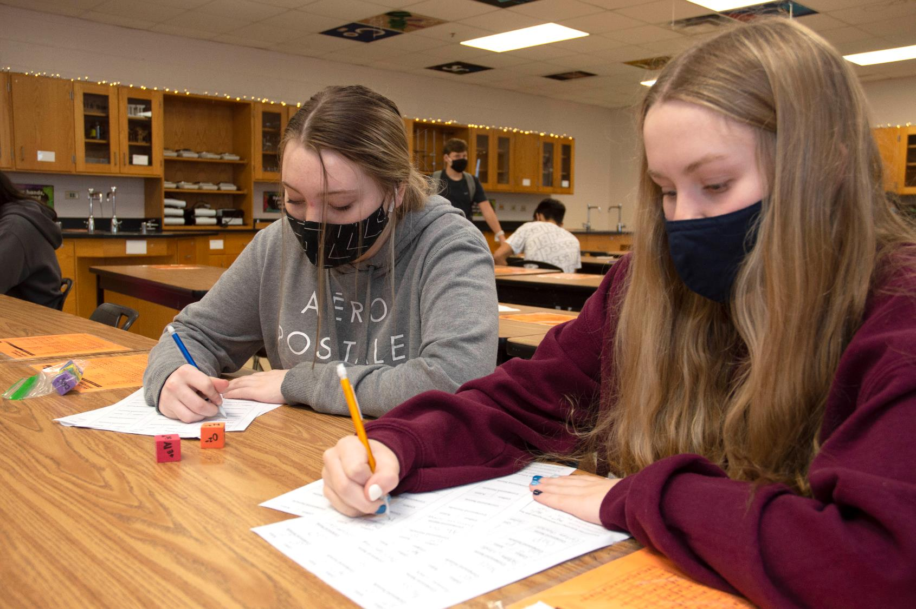
25,807
2020-21 Actual Peak Student Enrollment
Comal Independent School District
Comal Independent School District

Slide 5
95.5%
2020-21 Teacher Attendance
To Compare
94.4%
2019-20 Teacher Attendance
Comal Independent School District
Comal Independent School District

Slide 6
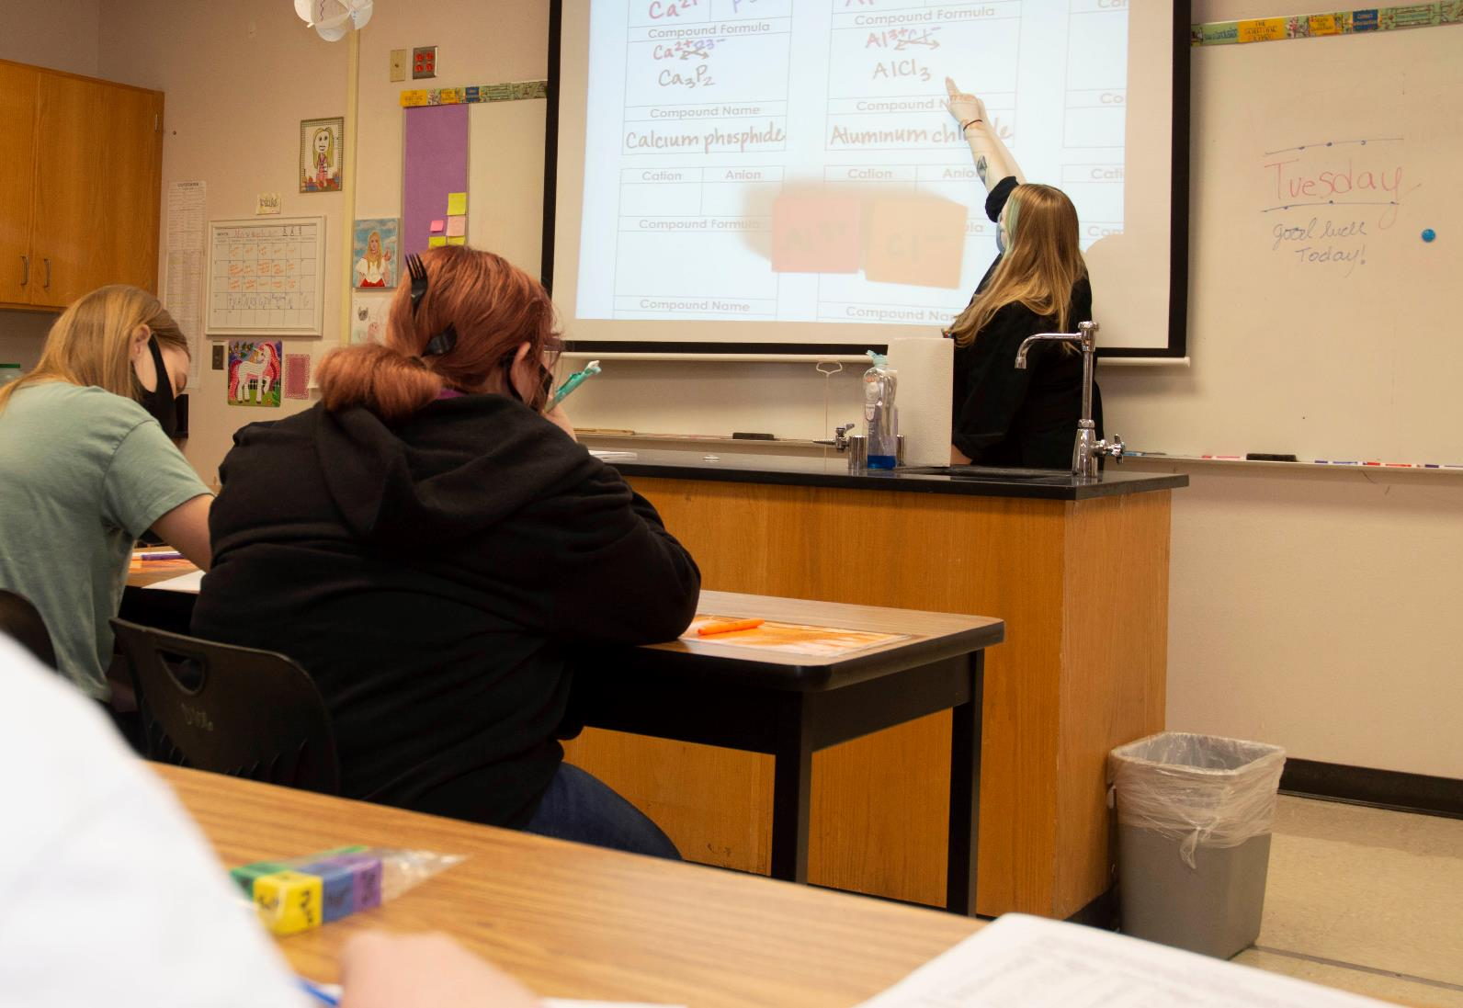
80
Super-Subs
Comal Independent School District
Comal Independent School District

Slide 7
96%
2020-21 Student Attendance
To Compare
96%
2019-20 Student Attendance

Slide 8
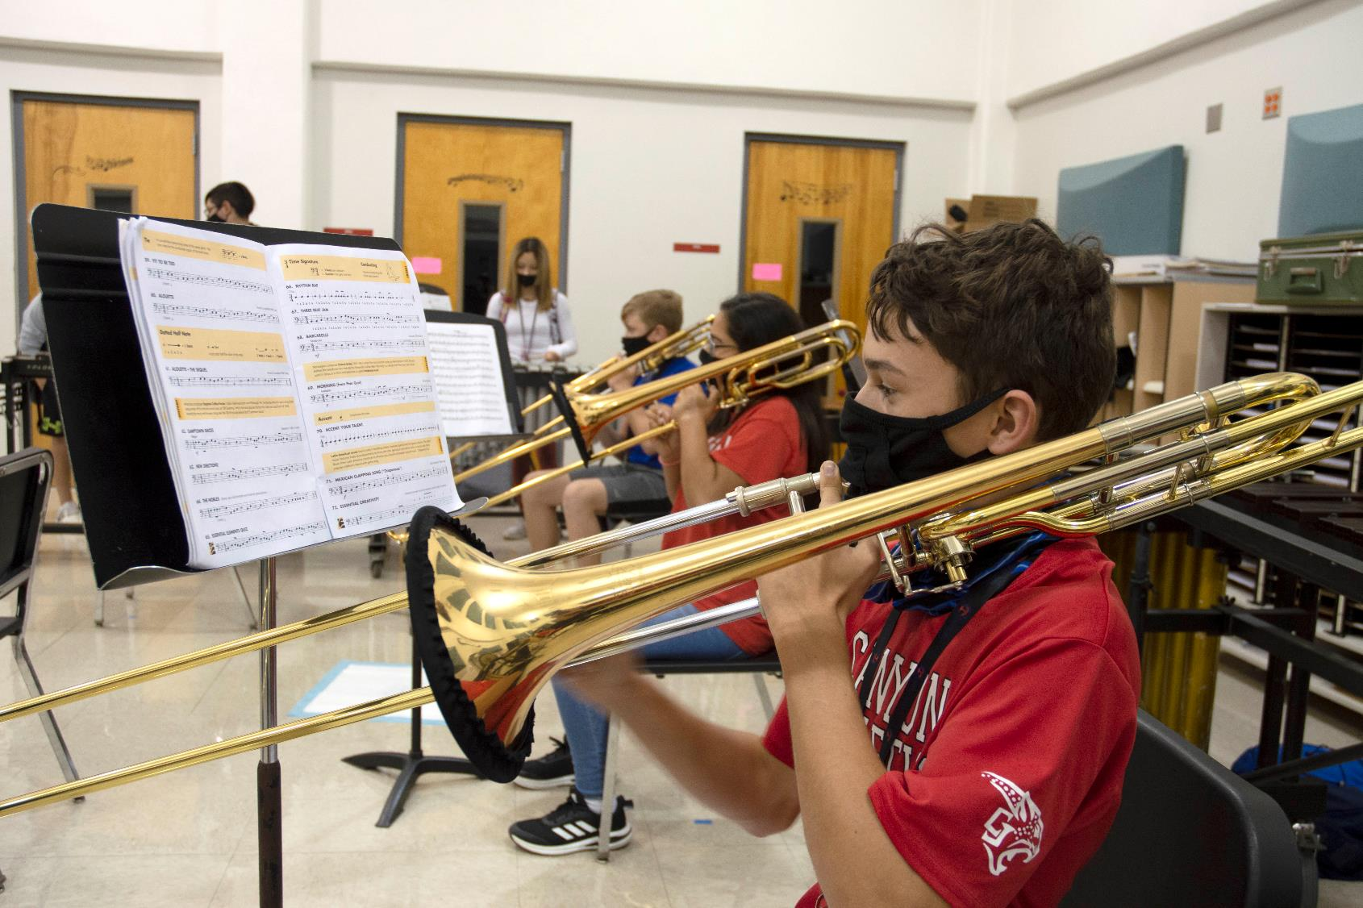
82%
On-Campus Instruction

Slide 9
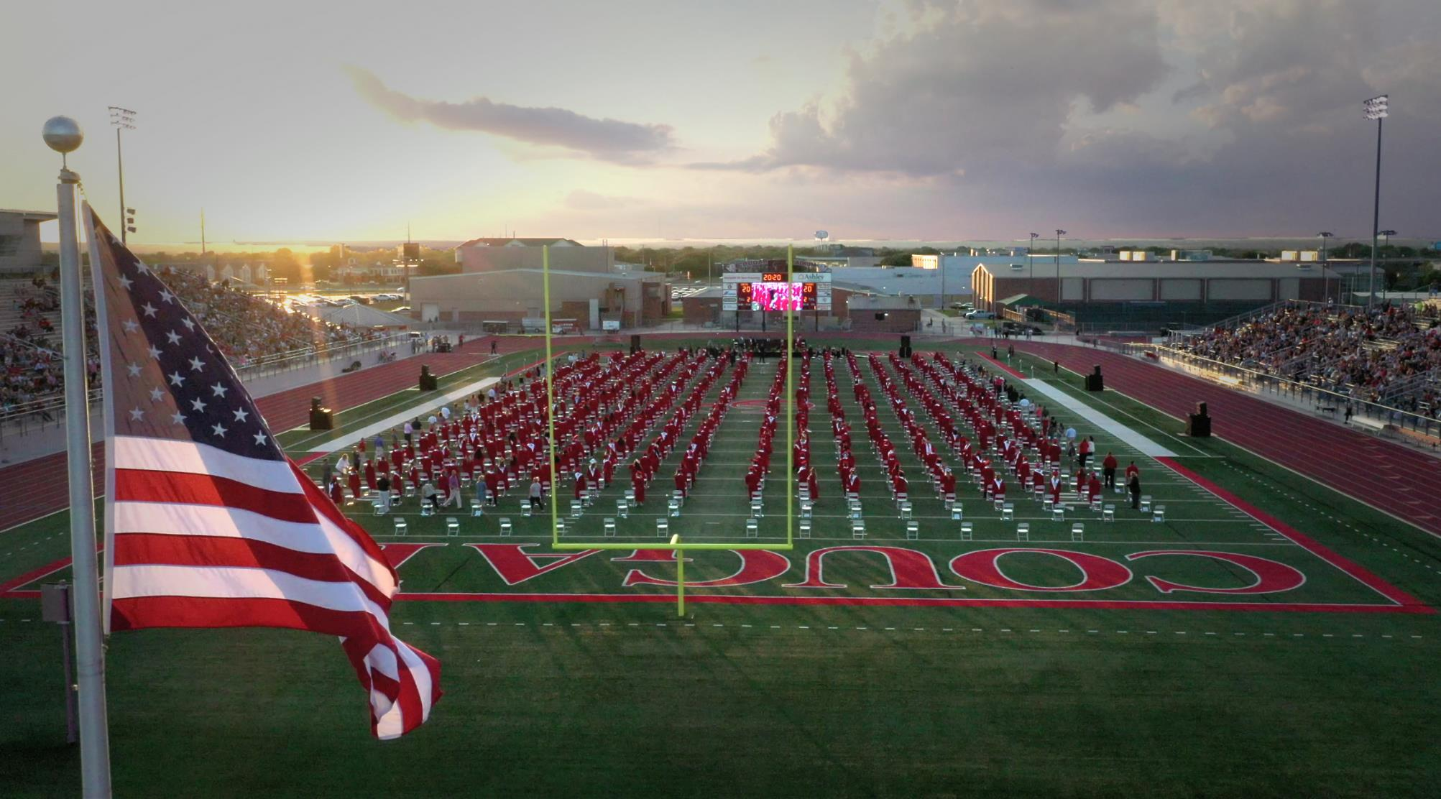
Comal Independent School District
Comal Independent School District

Slide 10
2Q20

Slide 11
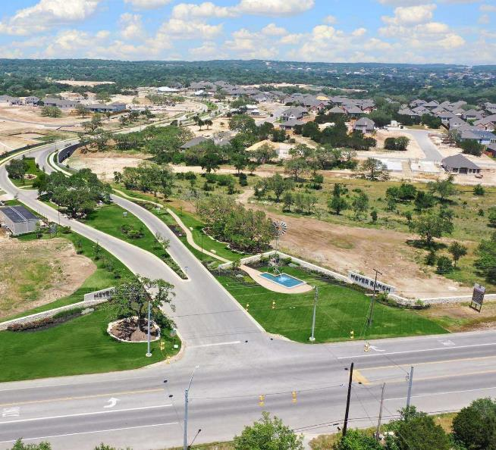
Change in District Housing
 | 2Q19 | 2Q20 | Difference
Annual Starts | 2,053 | 2,281 | +228
Quarterly Starts | 578 | 591 | +13
Annual Closings | 1,924 | 2,151 | +227
Quarterly Closings | 543 | 629 | +86
Inventory | 1,324 | 1,467 | +143
VDL | 2,810 | 3,697 | +887
Futures | 28,716 | 27,765 | -951
Comal Independent School District
Comal Independent School District

Slide 12
Annual Closings
Closings | 2014 | 2015 | 2016 | 2017 | 2018 | 2019 | 2020
1Q | 263 | 334 | 439 | 368 | 448 | 469 | 401
2Q | 318 | 388 | 376 | 479 | 431 | 543 | 629
3Q | 373 | 375 | 429 | 423 | 468 | 570
4Q | 340 | 347 | 362 | 482 | 474 | 523
Total | 1,294 | 1,444 | 1,606 | 1,752 | 1,821 | 2,105 | 1,030
Annual Starts
Starts | 2014 | 2015 | 2016 | 2017 | 2018 | 2019 | 2020
1Q | 362 | 374 | 358 | 444 | 553 | 530 | 567
2Q | 372 | 346 | 447 | 463 | 502 | 578 | 591
3Q | 417 | 415 | 424 | 456 | 493 | 559
4Q | 399 | 406 | 376 | 414 | 455 | 536
Total | 1,550 | 1,541 | 1,605 | 1,777 | 2,003 | 2,203 | 1,158
Comal Independent School District
Comal Independent School District

Slide 13
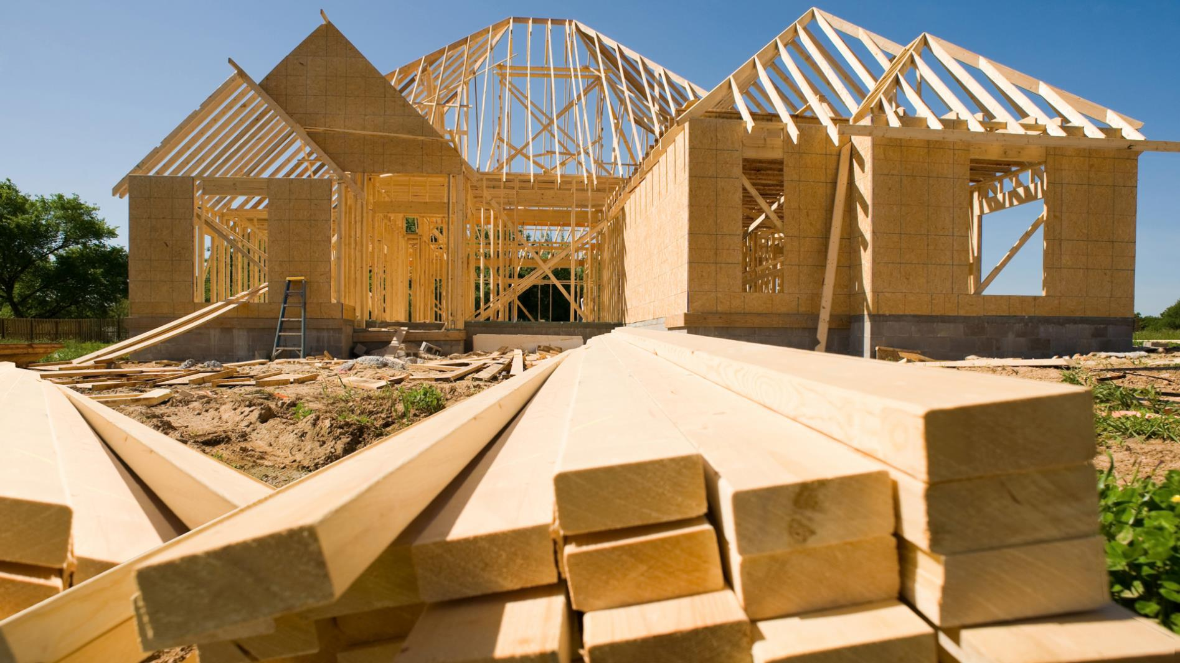
Covid-19 and the New Home Market
12.4%
15.0%
7.7%
STARTS
CLOSINGS
INVENTORY
Comal Independent School District
Notes:
DFW

Slide 14
San Antonio New Homes Ranking Report
Rank | District Name | Annual Starts | Annual Closings | Inventory | VDL | Future
1 | Northside ISD | 3,849 | 4,020 | 2,088 | 4,836 | 31,595
2 | Comal ISD | 2,281 | 2,151 | 1,467 | 3,697 | 27,765*
3 | Judson ISD | 1,488 | 1,253 | 947 | 1,934 | 4,278
4 | Medina Valley ISD | 1,087 | 975 | 555 | 1,610 | 28,114
5 | Boerne ISD | 910 | 837 | 571 | 1,463 | 10,582
6 | Schertz-Cibolo U City ISD | 839 | 833 | 476 | 1,419 | 8,554
7 | New Braunfels ISD | 736 | 806 | 390 | 1,010 | 7,978
8 | East Central ISD | 979 | 758 | 488 | 1,830 | 11,595
9 | North East ISD | 519 | 537 | 331 | 1,001 | 6,406
10 | Southwest ISD | 522 | 491 | 210 | 704 | 7,157
11 | San Antonio ISD | 237 | 250 | 201 | 287 | 1,673
12 | South San Antonio ISD | 191 | 169 | 103 | 179 | 518
13 | Southside ISD | 108 | 120 | 78 | 182 | 6,487
14 | Edgewood ISD | 89 | 61 | 45 | 0 | 32
15 | Harlandale ISD | 18 | 49 | 3 | 32 | 0
16 | Marion ISD | 44 | 47 | 25 | 66 | 217
17 | Seguin ISD | 79 | 44 | 65 | 330 | 4,114
18 | Navarro ISD | 47 | 36 | 44 | 350 | 4,292
19 | Alamo Heights ISD | 33 | 25 | 53 | 73 | 30
20 | Lytle ISD | 0 | 0 | 0 | 0 | 999
* Based on additional Templeton Demographics housing research. ISD Ranked by Annual Closings– 2Q20
Comal Independent School District
Notes:
NOTES:
Subtracted- Ammann Ranch 98 T/F, Chapel Creek 648 T/F, Overlook at Creekside 10 T/F, Oak Creek Estates 6 T/F, Spring Valley 6 F/T, ZCE-Belle Oaks Ranch 18 F/T,
Added- Canyon Springs- added 12 VDL/T; Copper Canyon 77 F/T, Garden Ridge 23 VDL, Gruene/Vineyard 13 VDL, Deer Crest 149 T/F, Meyer Ranch 4 T/F, Wasser Ranch 5F/T, Weltner Farms 24 T/F, ZCE-Havenwood @ Hunter’s Crossing- 31F/T, ZCE-Lantana Ridge 9 F/T, ZCE-Mystic Shores 38 F/T, ZCE-River Chase 55 F/T, ZCE-Timberwood Park 76 T/F

Slide 15
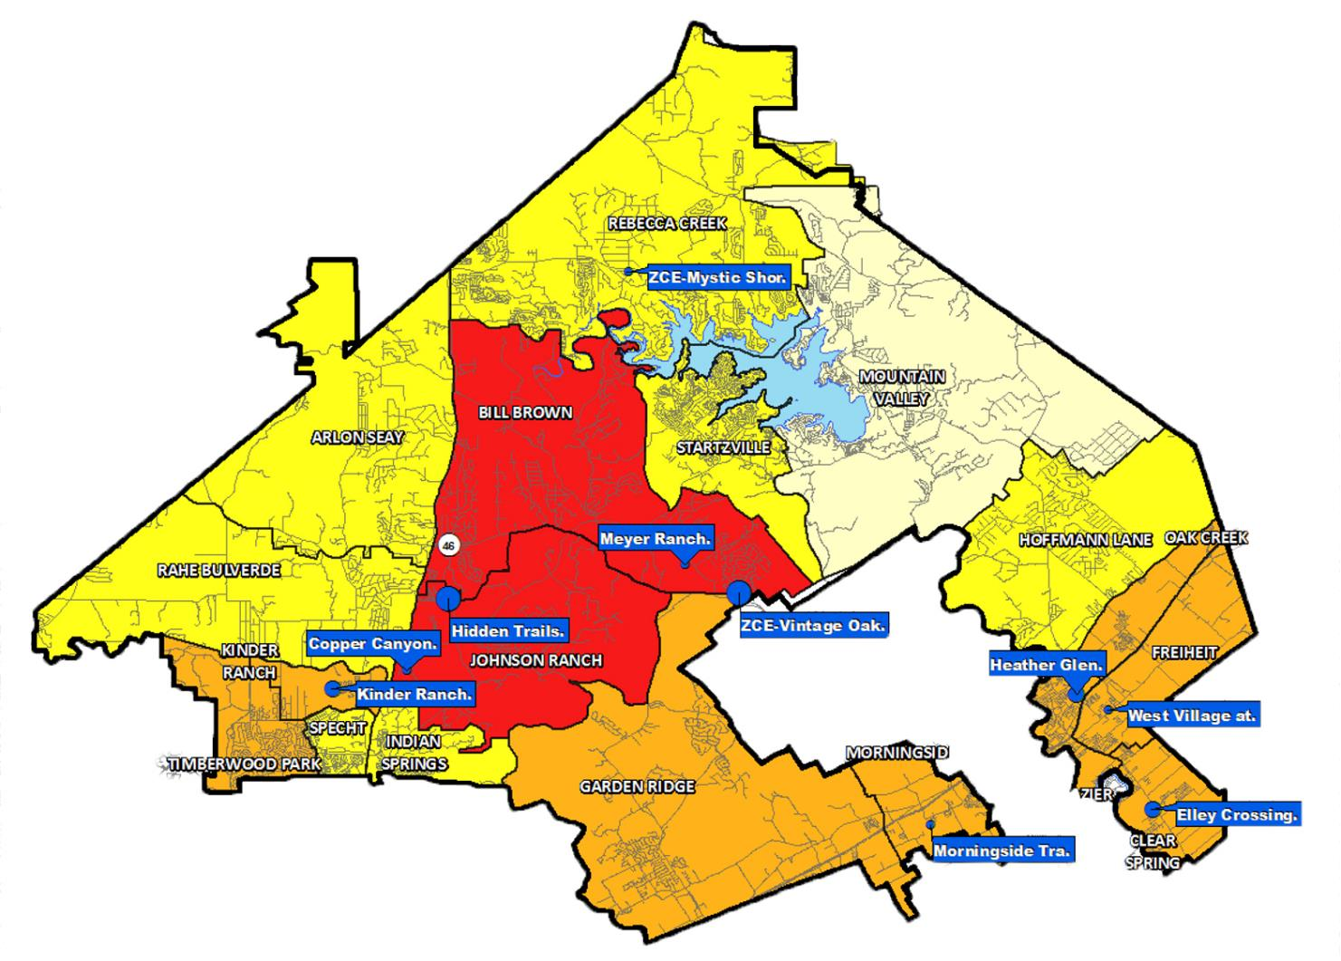
Top 10 Subdivisions-
Annual Closings
Hidden Trails
ZCE-Vintage Oaks at the Vineyard
Heather Glen
Kinder Ranch
Elley Crossing
Meyer Ranch
Copper Canyon
Vest Village at Creekside
ZCE-Mustic Shores
Morningside Trails
Comal Independent School District

Slide 16
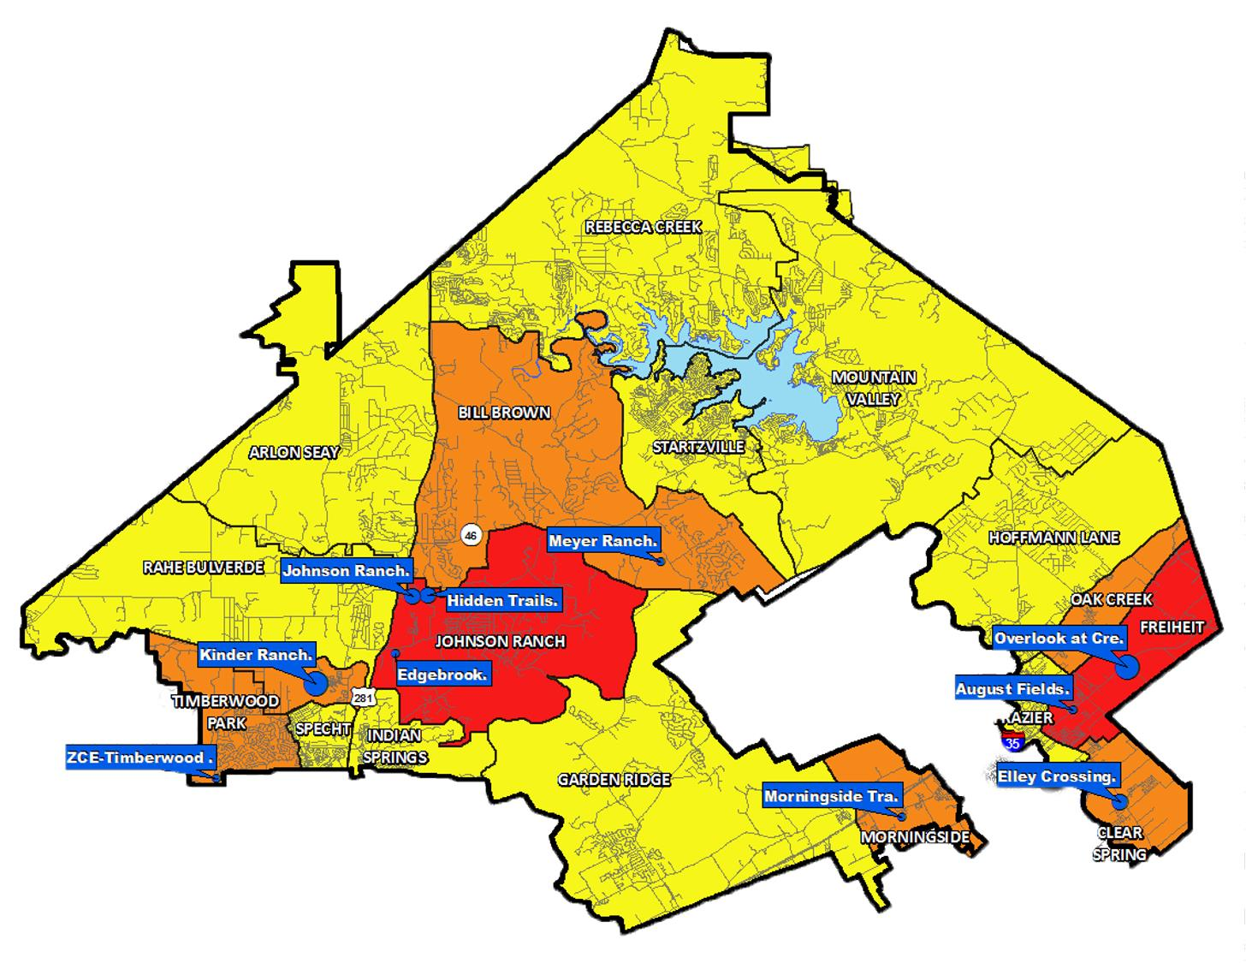
Top 10 Subdivisions-VDL
Kinder Ranch
Overlook at Creekside
Hidden Trails
Johnson Ranch
Elley Crossing
August Fields
ZCE-Timberwood Park
Morningside Trails
Edgebrook
Meyer Ranch
Comal Independent School District

Slide 17
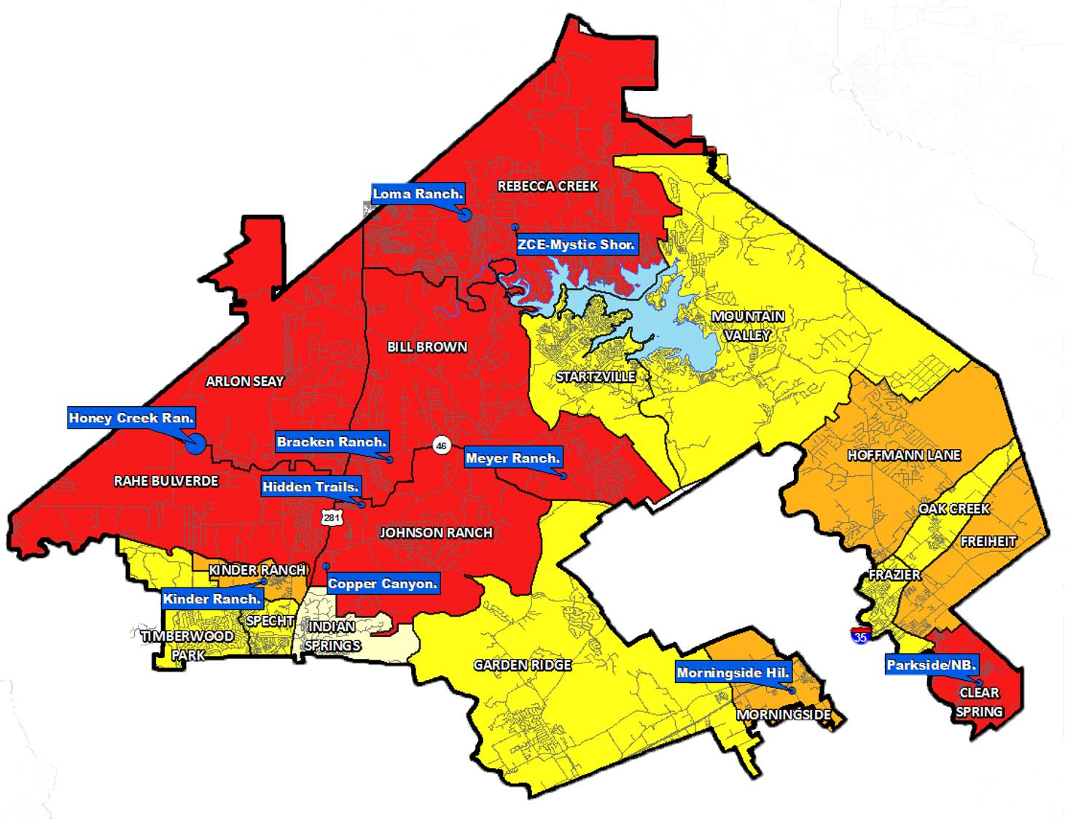
Top 10 Subdivisions-Futures
Honey Creek Ranch
Loma Ranch
Meyer Ranch
Bracken Ranch
ZCE-Mystic Shores
Hidden Trails
Kinder Ranch
Copper Canyon
Morningside Hills
Parkside/NB
Comal Independent School District

Slide 18
Ten Year Forecast by Grade
GRADE LEVEL ENROLLMENT HISTORY AND PROJECTIONS
Year | EE | PK | K | 1st | 2nd | 3rd | 4th | 5th | 6th | 7th | 8th | 9th | 10th | 11th | 12th | Total | Total Growth | % Growth
2016/17 | 131 | 256 | 1,626 | 1,618 | 1,710 | 1,766 | 1,704 | 1,670 | 1,704 | 1,751 | 1,686 | 1,772 | 1,701 | 1,671 | 1,469 | 22,235
2017/18 | 162 | 332 | 1,611 | 1,713 | 1,677 | 1,785 | 1,877 | 1,811 | 1,743 | 1,748 | 1,839 | 1,809 | 1,712 | 1,717 | 1,569 | 23,105 | 870 | 3.9%
2018/19 | 145 | 336 | 1,658 | 1,737 | 1,811 | 1,774 | 1,888 | 1,995 | 1,929 | 1,854 | 1,813 | 1,972 | 1,745 | 1,717 | 1,576 | 23,950 | 845 | 3.7%
2019/20 | 157 | 367 | 1,790 | 1,765 | 1,841 | 1,905 | 1,909 | 1,983 | 2,105 | 2,020 | 1,957 | 2,023 | 1,896 | 1,786 | 1,585 | 25,089 | 1,139 | 4.8%
2020/21 | 223 | 275 | 1,706 | 1,803 | 1,798 | 1,816 | 1,930 | 1,914 | 2,020 | 2,153 | 2,090 | 2,062 | 2,041 | 1,925 | 1,704 | 25,460 | 371 | 1.5%
2021/22 | 223 | 369 | 1,786 | 1,829 | 1,966 | 1,916 | 1,937 | 2,037 | 2,033 | 2,110 | 2,252 | 2,260 | 1,995 | 2,016 | 1,851 | 26,579 | 1,119 | 4.4%
2022/23 | 223 | 369 | 1,785 | 1,900 | 1,988 | 2,090 | 2,037 | 2,054 | 2,168 | 2,149 | 2,218 | 2,532 | 2,205 | 1,988 | 1,960 | 27,666 | 1,087 | 4.1%
2023/24 | 223 | 369 | 1,944 | 1,906 | 2,021 | 2,113 | 2,215 | 2,168 | 2,188 | 2,286 | 2,243 | 2,498 | 2,458 | 2,170 | 1,934 | 28,735 | 1,070 | 3.9%
2024/25 | 223 | 369 | 2,043 | 2,066 | 2,027 | 2,140 | 2,227 | 2,356 | 2,318 | 2,323 | 2,409 | 2,535 | 2,423 | 2,445 | 2,104 | 30,008 | 1,273 | 4.4%
2025/26 | 223 | 369 | 2,133 | 2,165 | 2,183 | 2,141 | 2,268 | 2,356 | 2,494 | 2,458 | 2,460 | 2,709 | 2,454 | 2,411 | 2,362 | 31,187 | 1,179 | 3.9%
2026/27 | 223 | 369 | 2,208 | 2,238 | 2,286 | 2,314 | 2,267 | 2,400 | 2,517 | 2,629 | 2,609 | 2,756 | 2,614 | 2,438 | 2,329 | 32,197 | 1,010 | 3.2%
2027/28 | 223 | 369 | 2,292 | 2,318 | 2,357 | 2,403 | 2,442 | 2,398 | 2,563 | 2,666 | 2,765 | 2,909 | 2,671 | 2,597 | 2,357 | 33,330 | 1,133 | 3.5%
2028/29 | 223 | 369 | 2,371 | 2,412 | 2,443 | 2,481 | 2,542 | 2,591 | 2,549 | 2,709 | 2,812 | 3,063 | 2,818 | 2,655 | 2,506 | 34,544 | 1,214 | 3.6%
2029/30 | 223 | 369 | 2,454 | 2,491 | 2,533 | 2,579 | 2,619 | 2,697 | 2,747 | 2,682 | 2,840 | 3,108 | 2,961 | 2,804 | 2,562 | 35,669 | 1,125 | 3.3%
2030/31 | 223 | 369 | 2,536 | 2,579 | 2,617 | 2,675 | 2,721 | 2,782 | 2,861 | 2,893 | 2,814 | 3,140 | 3,011 | 2,903 | 2,704 | 36,828 | 1,159 | 3.2%
Yellow box = largest grade per year
Green box = second largest grade per year
This forecast model is based upon getting to 2,200 annual single family starts per year.
Five year enrollment growth = 5,727
Comal Independent School District

Slide 19
Ten Year Forecast by Campus
 | Classroom Capacity | 90% Capacity | Fall | ENROLLMENT PROJECTIONS
Campus Name |  |  | 2020/21 | 2021/22 | 2022/23 | 2023/24 | 2024/25 | 2025/26 | 2026/27 | 2027/28 | 2028/29 | 2029/30 | 2030/31
Clear Spring Elementary^{P} | 854 | 769 | 693 | 749 | 787 | 827 | 885 | 940 | 986 | 1,026 | 1,065 | 1,085 | 1,110
Freiheit Elementary^{P} | 854 | 769 | 710 | 752 | 796 | 876 | 945 | 960 | 1,011 | 1,058 | 1,114 | 1,172 | 1,223
Garden Ridge Elementary^{P} | 832 | 749 | 837 | 850 | 847 | 855 | 868 | 897 | 938 | 973 | 1,007 | 1,037 | 1,059
Morningside Elementary | 876 | 788 | 708 | 763 | 847 | 915 | 956 | 1,028 | 1,053 | 1,092 | 1,136 | 1,178 | 1,223
Goodwin Frazier Elementary | 898 | 808 | 613 | 673 | 714 | 747 | 748 | 778 | 791 | 786 | 797 | 814 | 822
Hoffmann Lane Elementary | 876 | 788 | 766 | 782 | 801 | 824 | 840 | 867 | 867 | 882 | 909 | 923 | 940
Oak Creek Elementary | 854 | 769 | 623 | 694 | 724 | 778 | 827 | 829 | 854 | 888 | 917 | 931 | 947
Mountain Valley Elementary | 832 | 749 | 452 | 453 | 477 | 485 | 493 | 474 | 474 | 481 | 492 | 499 | 504
Rebecca Creek Elementary | 898 | 808 | 541 | 564 | 571 | 582 | 610 | 624 | 639 | 659 | 683 | 703 | 725
Startzville Elementary | 876 | 788 | 435 | 449 | 442 | 450 | 449 | 443 | 442 | 437 | 441 | 445 | 447
Bill Brown Elementary | 832 | 749 | 735 | 768 | 794 | 835 | 875 | 921 | 982 | 1,051 | 1,129 | 1,209 | 1,286
Indian Springs Elementary^{P} | 832 | 749 | 770 | 791 | 762 | 745 | 737 | 721 | 713 | 709 | 716 | 720 | 723
Johnson Ranch Elementary | 854 | 769 | 656 | 738 | 809 | 892 | 961 | 1,023 | 1,090 | 1,154 | 1,244 | 1,318 | 1,407
Specht Elementary | 832 | 749 | 804 | 835 | 833 | 840 | 832 | 821 | 836 | 843 | 853 | 862 | 874
Kinder Ranch Elementary | 832 | 749 | 518 | 543 | 549 | 547 | 565 | 578 | 624 | 667 | 705 | 746 | 790
Rahe Bulverde Elementary | 854 | 769 | 456 | 474 | 496 | 524 | 554 | 590 | 633 | 688 | 753 | 801 | 854
Seay Elementary | 876 | 788 | 410 | 437 | 444 | 468 | 502 | 537 | 562 | 586 | 627 | 657 | 687
Timberwood Park Elementary | 832 | 749 | 738 | 748 | 753 | 769 | 804 | 807 | 810 | 822 | 844 | 865 | 881
ELEMENTARY TOTALS | 15,394 | 13,855 | 11,465 | 12,063 | 12,446 | 12,959 | 13,451 | 13,838 | 14,305 | 14,802 | 15,432 | 15,965 | 16,502
Red exceeds 90% capacity
Comal Independent School District

Slide 20
Ten Year Forecast by Campus
 | Classroom Capacity | 90% Capacity | Fall | ENROLLMENT PROJECTIONS
Campus Name |  |  | 2020/21 | 2021/22 | 2022/23 | 2023/24 | 2024/25 | 2025/26 | 2026/27 | 2027/28 | 2028/29 | 2029/30 | 2030/31
Canyon Middle School | 1,075 | 968 | 979 | 1,006 | 1,043 | 1,056 | 1,127 | 1,275 | 1,408 | 1,501 | 1,489 | 1,558 | 1,646
Church Hill Middle School | 1,124 | 1,012 | 821 | 825 | 837 | 861 | 939 | 921 | 956 | 959 | 1,010 | 1,007 | 1,020
Danville Middle School | 1,150 | 1,035 | 896 | 913 | 915 | 937 | 973 | 993 | 1,016 | 1,041 | 1,069 | 1,108 | 1,165
Mountain Valley Middle School | 924 | 832 | 807 | 824 | 790 | 804 | 782 | 837 | 862 | 897 | 860 | 860 | 874
Pieper Ranch Middle School | 1,150 | 1,035 | 1,444 | 1,469 | 1,519 | 1,557 | 1,583 | 1,616 | 1,608 | 1,608 | 1,564 | 1,593 | 1,615
Smithson Valley Middle School^{P} | 1,025 | 923 | 730 | 771 | 829 | 888 | 961 | 1,046 | 1,144 | 1,211 | 1,252 | 1,324 | 1,407
Spring Branch Middle School^{P} | 1,137 | 1,023 | 581 | 582 | 597 | 609 | 680 | 719 | 756 | 772 | 821 | 814 | 836
Comal Discipline Center (6-8) |  |  | 5 | 5 | 5 | 5 | 5 | 5 | 5 | 5 | 5 | 5 | 5
MIDDLE SCHOOL TOTALS | 7,585 | 6,827 | 6,263 | 6,395 | 6,535 | 6,717 | 7,050 | 7,412 | 7,755 | 7,994 | 8,070 | 8,269 | 8,568
Middle School Growth |  |  | 181 | 132 | 140 | 182 | 333 | 362 | 343 | 239 | 76 | 199 | 299
Middle School Percent Growth |  |  | 2.98% | 2.11% | 2.19% | 2.79% | 4.96% | 5.13% | 4.63% | 3.08% | 0.95% | 2.47% | 3.62%
Canyon High School^{P} | 2,450 | 2,205 | 2,469 | 2,309 | 2,300 | 2,320 | 2,410 | 2,576 | 2,620 | 2,733 | 2,946 | 3,096 | 3,210
Canyon Lake High School | 1,375 | 1,238 | 1,087 | 1,117 | 1,174 | 1,125 | 1,190 | 1,203 | 1,178 | 1,179 | 1,222 | 1,260 | 1,283
Memorial Early College H.S. | 400 | 360 | 379 | 374 | 377 | 375 | 376 | 376 | 376 | 376 | 376 | 376 | 376
Smithson Valley High School^{P} | 2,450 | 2,205 | 3,132 | 2,409 | 2,107 | 1,818 | 1,908 | 2,041 | 2,185 | 2,366 | 2,539 | 2,734 | 2,888
Davenport High School | 1,500 | 1,350 | 540 | 837 | 1,078 | 1,256 | 1,342 | 1,383 | 1,398 | 1,440 | 1,456 | 1,488 | 1,516
Pieper High School | 2,500 | 2,250 | 0 | 897 | 1,421 | 1,887 | 2,003 | 2,080 | 2,102 | 2,162 | 2,225 | 2,203 | 2,207
Hill Country College H.S. | 200 | 180 | 47 | 100 | 150 | 200 | 200 | 200 | 200 | 200 | 200 | 200 | 200
Comal Academy | N/A | N/A | 54 | 54 | 54 | 54 | 54 | 54 | 54 | 54 | 54 | 54 | 54
Comal Discipline Center (9-12) | N/A | N/A | 24 | 24 | 24 | 24 | 24 | 24 | 24 | 24 | 24 | 24 | 24
HIGH SCHOOL TOTALS | 6,675 | 6,008 | 7,732 | 8,121 | 8,685 | 9,059 | 9,507 | 9,937 | 10,137 | 10,534 | 11,042 | 11,435 | 11,758
High School Growth |  |  | 442 | 389 | 564 | 375 | 448 | 430 | 200 | 397 | 508 | 393 | 323
High School Percent Growth |  |  | 6.06% | 5.03% | 6.94% | 4.32% | 4.94% | 4.52% | 2.01% | 3.92% | 4.82% | 3.56% | 2.82%
DISTRICT TOTALS | 29,654 | 26,689 | 25,460 | 26,579 | 27,666 | 28,735 | 30,008 | 31,187 | 32,197 | 33,330 | 34,544 | 35,669 | 36,828
District Growth |  |  | 371 | 1,119 | 1,087 | 1,070 | 1,273 | 1,179 | 1,010 | 1,133 | 1,214 | 1,125 | 1,159
District Percent Growth |  |  | 1.5% | 4.4% | 4.1% | 3.9% | 4.4% | 3.9% | 3.2% | 3.5% | 3.6% | 3.3% | 3.2%
Red exceeds 90% capacity
Comal Independent School District
Notes:
Add remaining classroom capacity

Slide 21
Future Moments…
Support
Pay
Teacher/Staff
Need local revenue for compensation
and to hire more teachers & Staff
Comal Independent School District

Slide 22
Comal Independent School District
Notes:
ISES Vanessa Sloan –Music Teacher

Slide 23
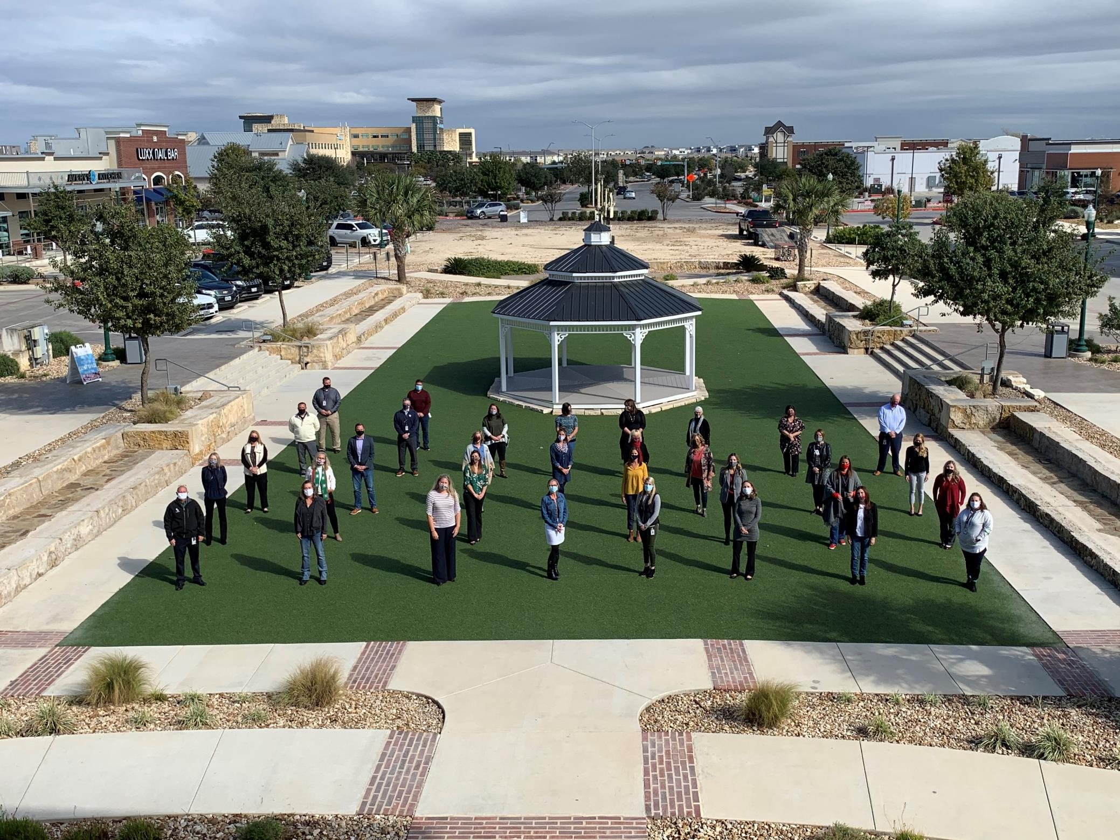
Comal Independent School District
Notes:
ISES Vanessa Sloan –Music Teacher

Slide 24
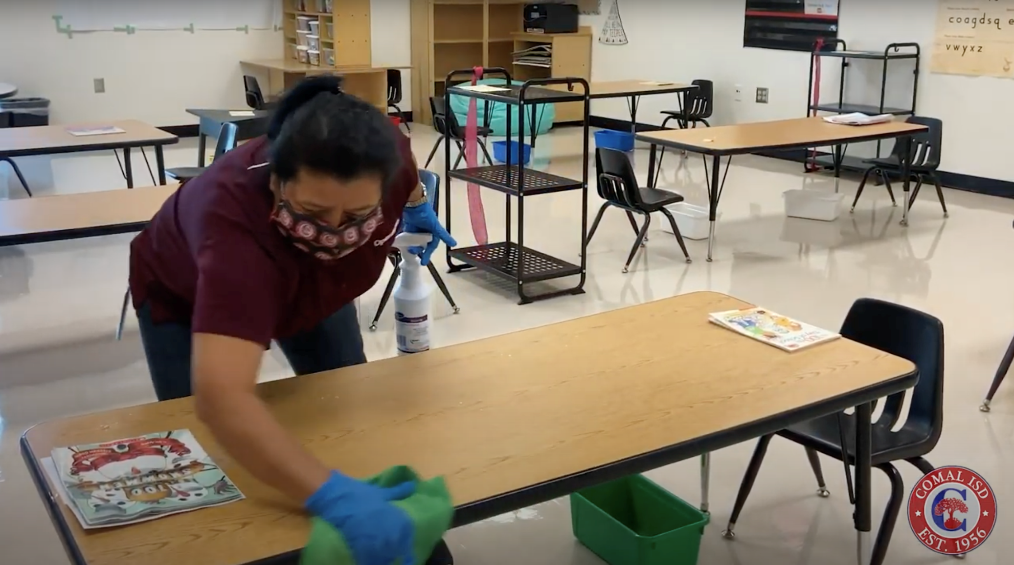
Comal Independent School District
Notes:
Maria Head Custodian at Support Services

Slide 25
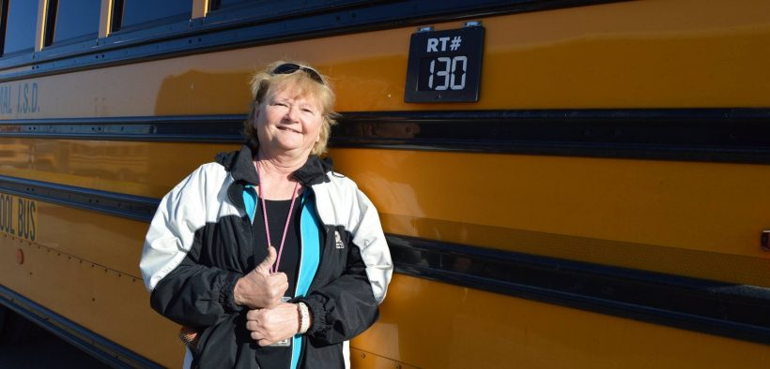
Comal Independent School District
Notes:
Janice Womack, Bus Driver

Slide 26
Comal Independent School District
Notes:
Marisol Lopez the Child Nutrition Manager at CHS

Slide 27
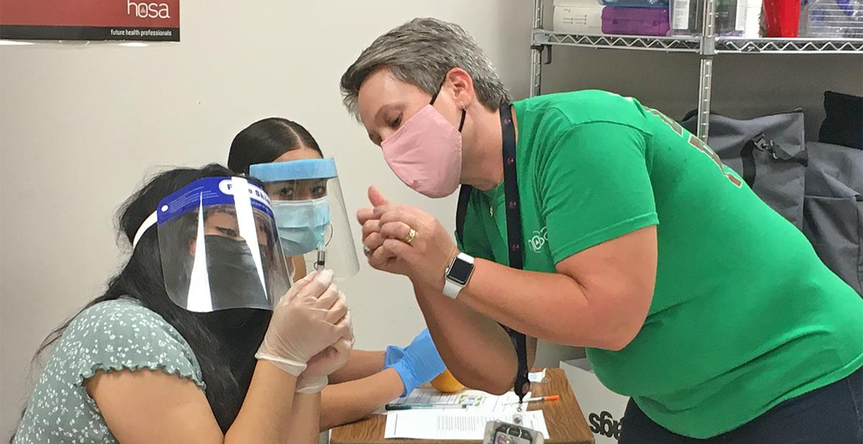
Comal Independent School District
Notes:
Jennifer Booth, Canyon HS, teaches Health Science classes.

Slide 28
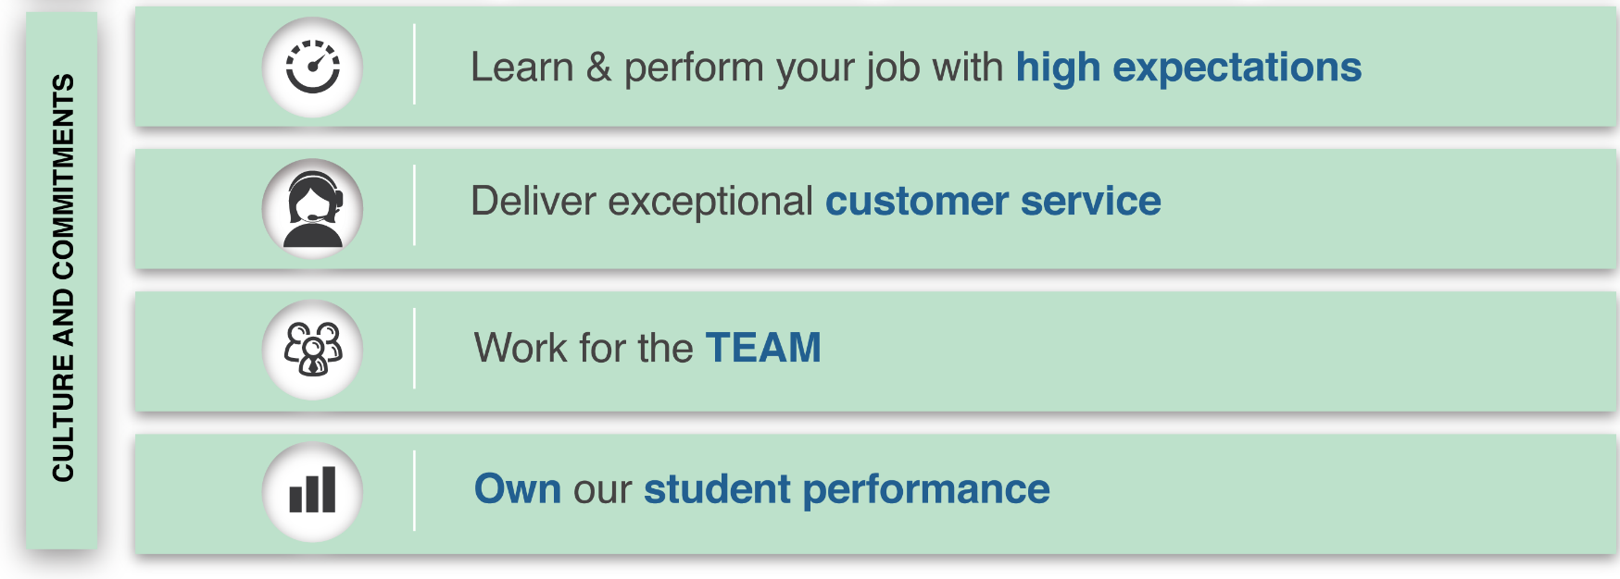
Comal Independent School District

Slide 29
Comal Independent School District
Comal Independent School District
Notes:
Mason McClellan

Slide 30
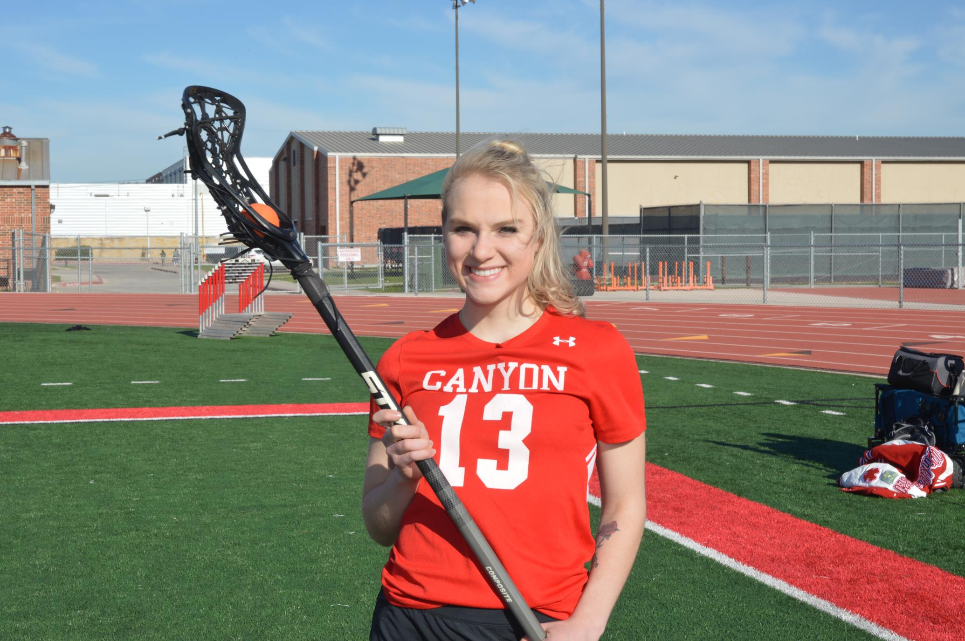
Comal Independent School District
Comal Independent School District

Slide 31
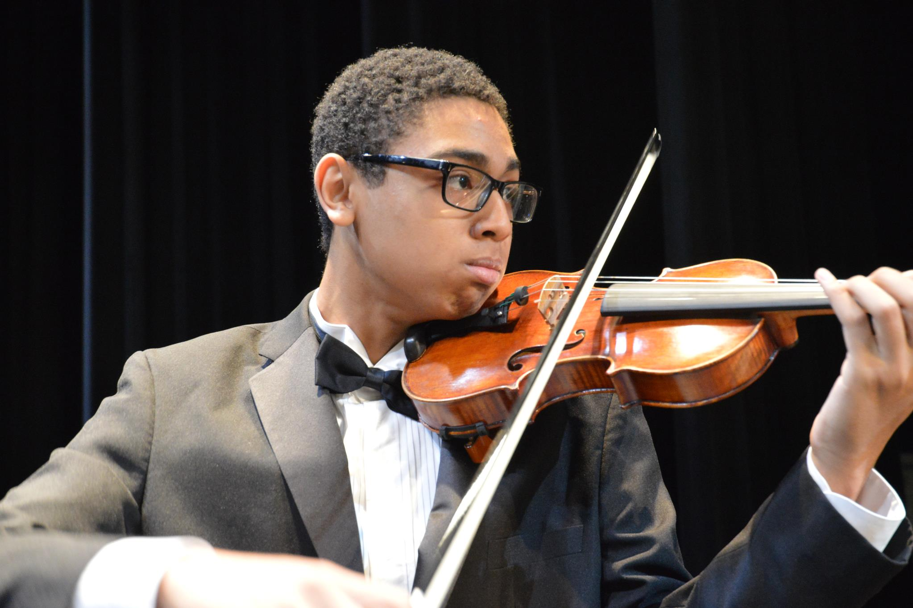
Comal Independent School District
Comal Independent School District

Slide 32
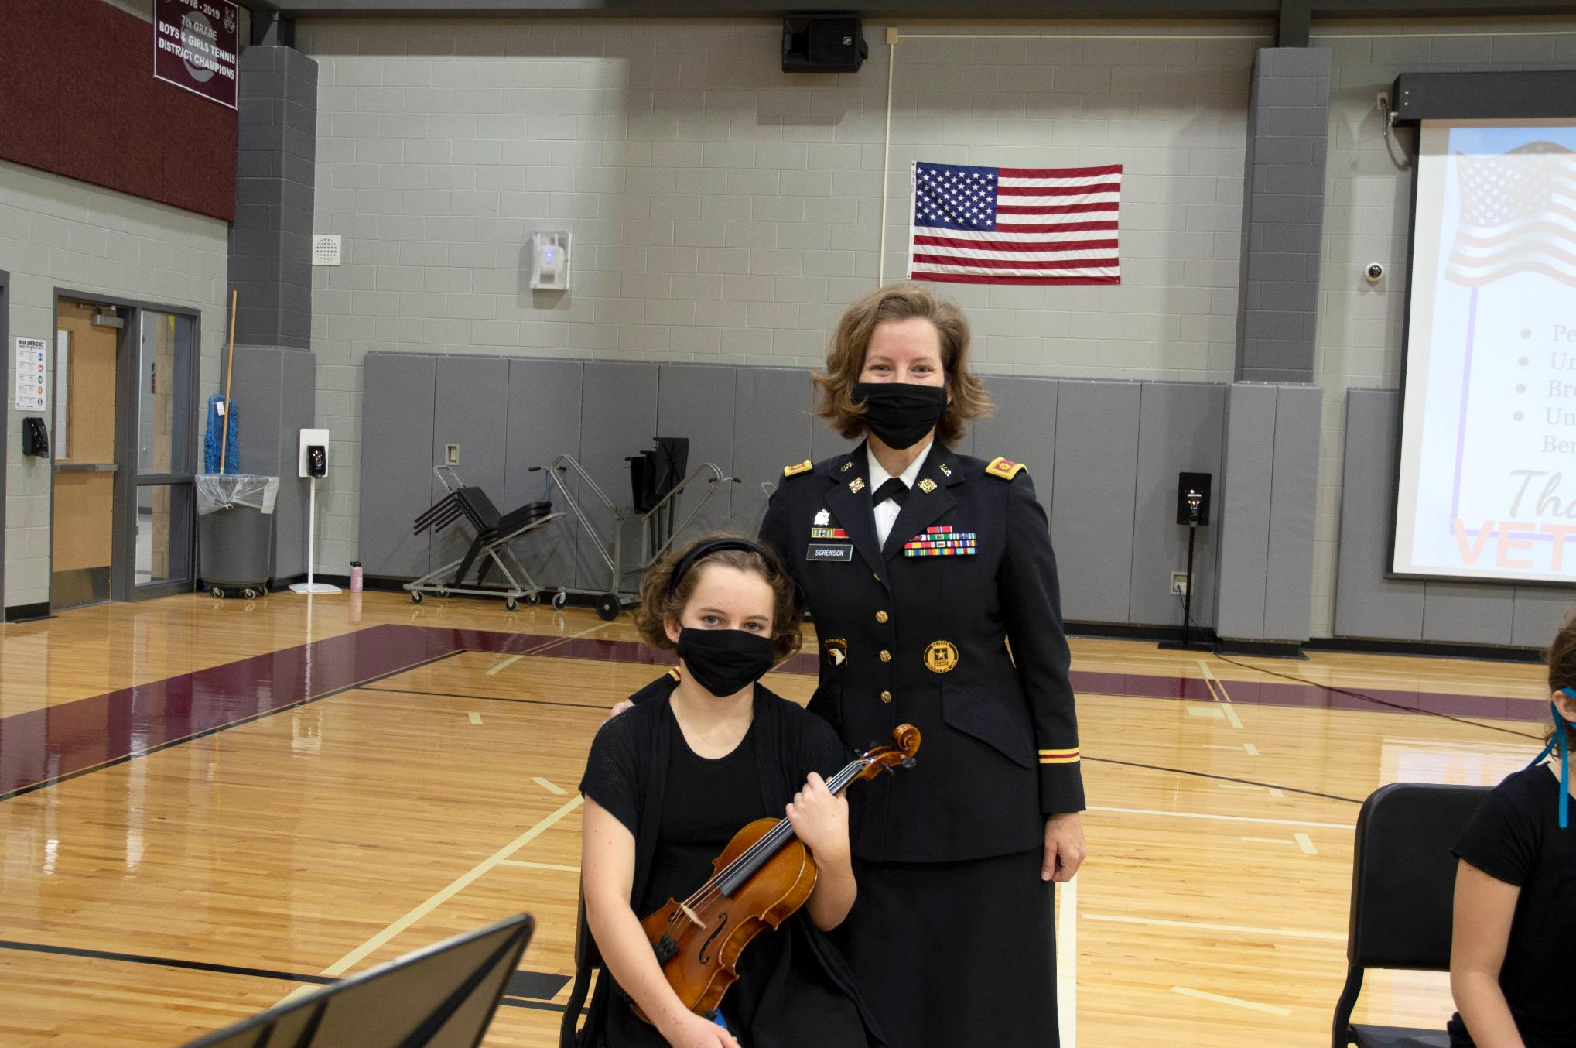
Comal Independent School District
Comal Independent School District

Slide 33
This is our moment…
TOGETHER
Comal Independent School District
Notes:
ISES Vanessa Sloan –Music Teacher

