Slide 1
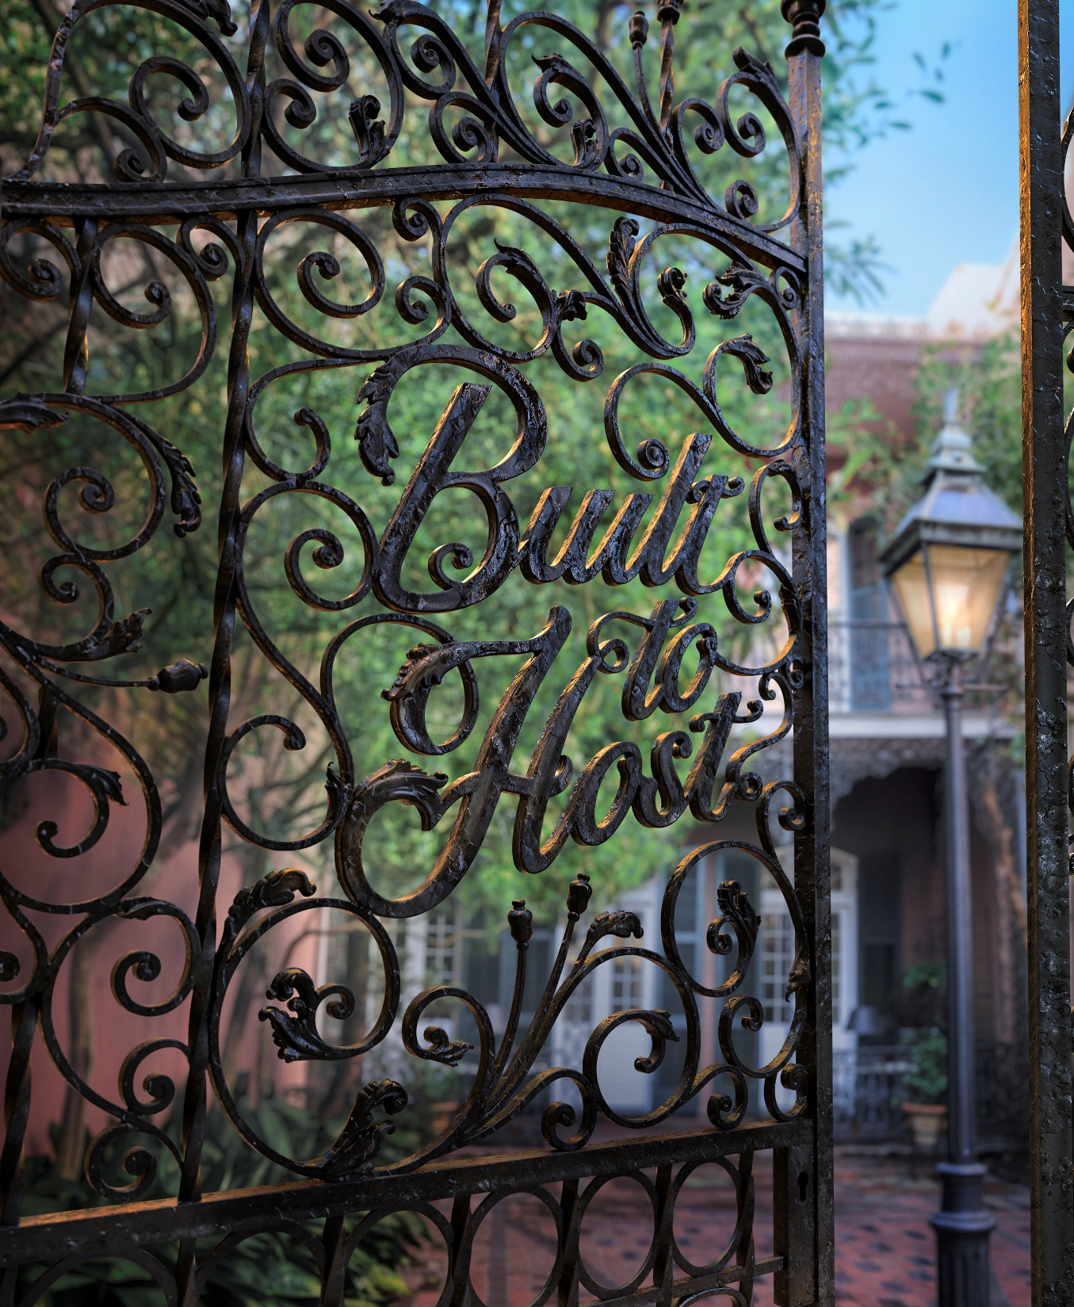

DIRECTORS OF SALES AND MARKETING MEETING
March 16, 2022

Slide 2
Agenda
1) New Orleans & Company Convention Sales
Increased Communication
  DOSM meetings approximately every six weeks
  Meeting content focused on business strategy & team approach
  Focused DOSM email group
  Extranet lead refresher
  Drive Built to Host positioning and content in community
2) Built to Host
  New Orleans first hospitality community application
  One destination, one voice; shared passion with hospitality and customer community
  Talking points
  Execution and integration
  Trade media placements
  Local hospitality launch

Slide 3

Agenda
3) Business Acquisition Strategies Overview –
Stephanie Turner
  Strategic Account Management (SAM)
  Association & Corporate master list strategies
  Vertical segment plans
    Build sales funnel
    Increase opportunities at bat
    Craft customized proposals designed to win the business
      Ensure robust toolbox
    Compete at the grass roots level
4) Strategic Account Discussion & Updates –
Sallee Pavlovich & Donna Glover
  Account specific conversations
  Account updates
5) New Orleans & Company on the Road
  PCMA/DI/IAEE Week
  April/May Trips
  Additional Buy-In Opportunities

Slide 4
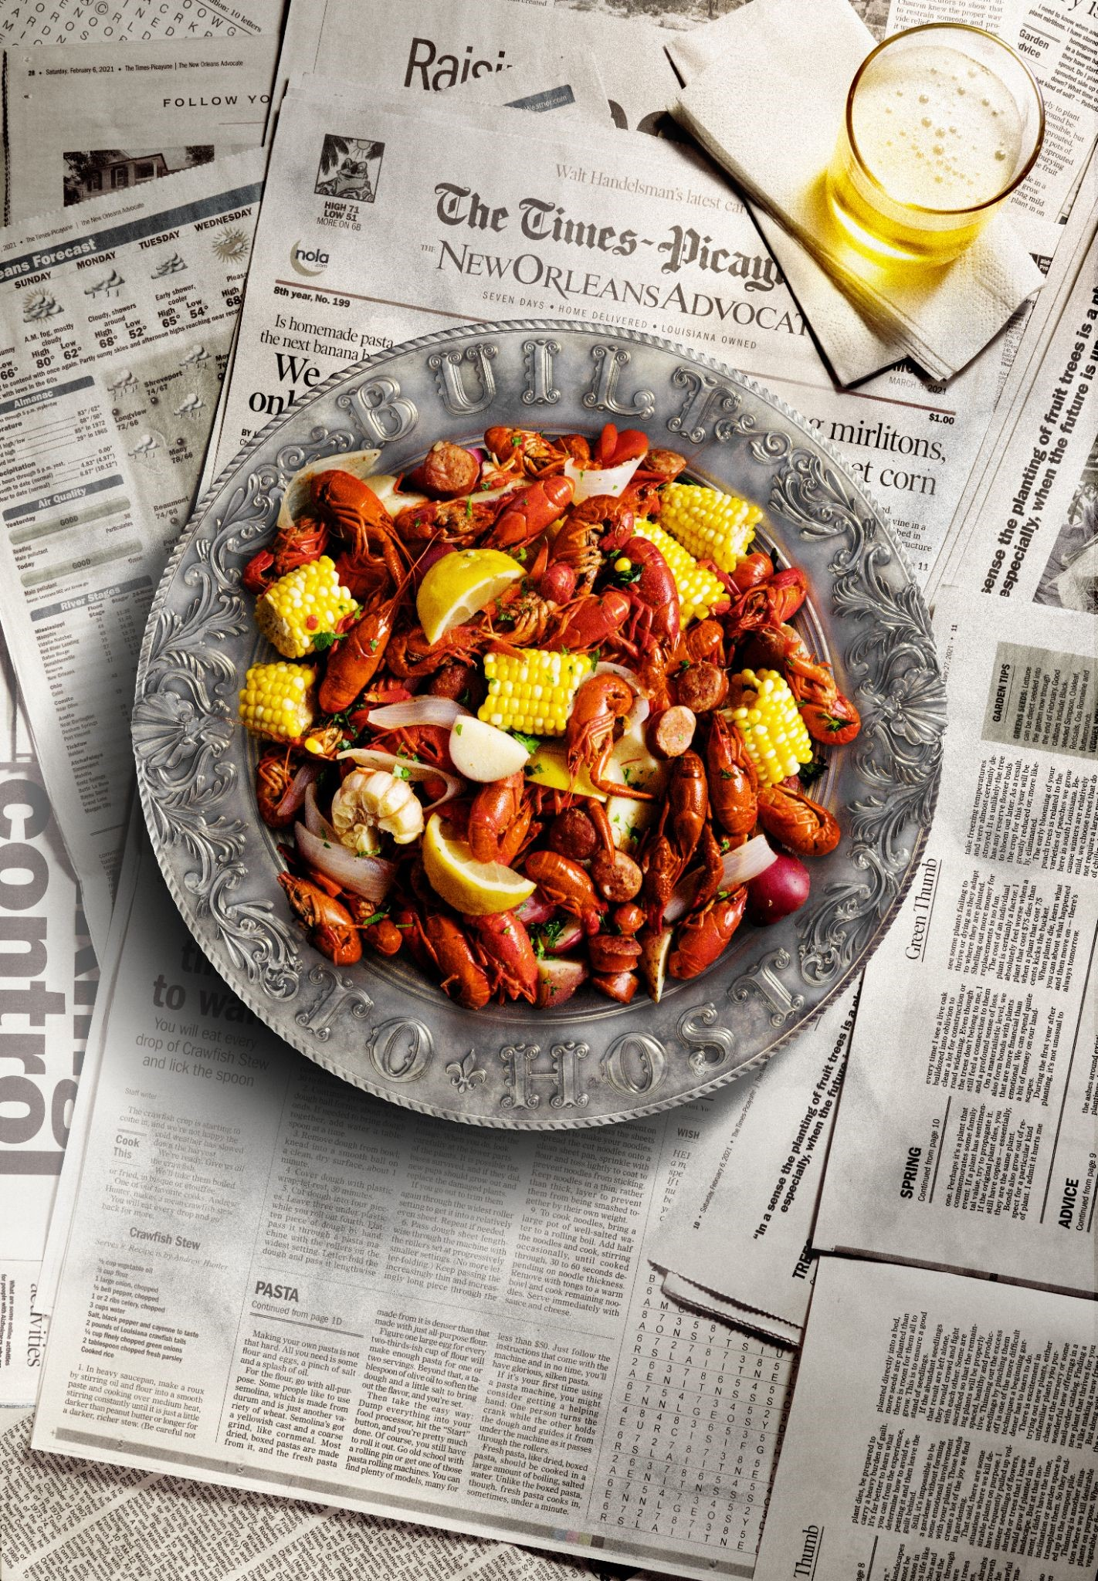
Agenda
6) Built to Host – Planners Experience New Orleans
  PCMA Educon
  Host Board Meetings
  Fall Customer Event – Corporate focus
7) Financial Incentives
  Big Easy Bucks
  Customized financial incentives
8) Hotel Renovations Survey

Slide 5
Agenda Item 1
New Orleans & Company Convention Sales
Increased Communication
  DOSM meetings approximately every six weeks
  Meeting content focused on business strategy & team approach
  Focused DOSM email group
  Extranet lead refresher (watch on own)
  Drive Built to Host positioning and content in community

Slide 6
Agenda Item 2
Built to Host
  New Orleans first hospitality community application
  One destination, one voice; shared passion with hospitality and customer community
  Talking points
  Built to Host positioning statements
  Execution and integration
  Trade media placements
  Local hospitality launch

Slide 7
What is Built to Host?
Built to Host is a fully integrated destination sales and marketing approach
It is designed to promote, position, and sell New Orleans as the premier meetings and destination event in the nation
One destination, one voice

Slide 8
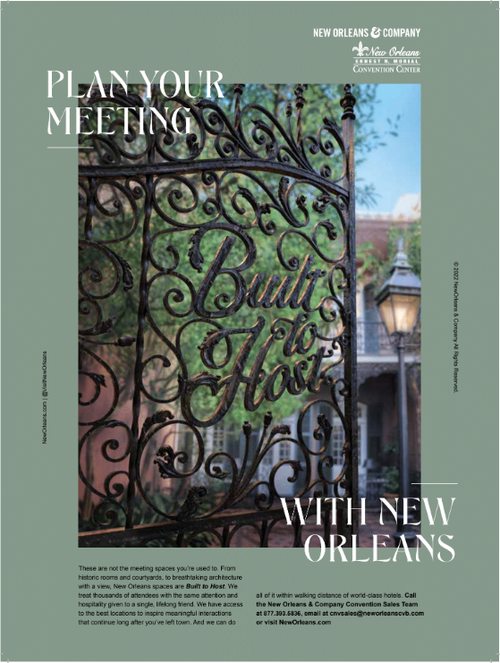
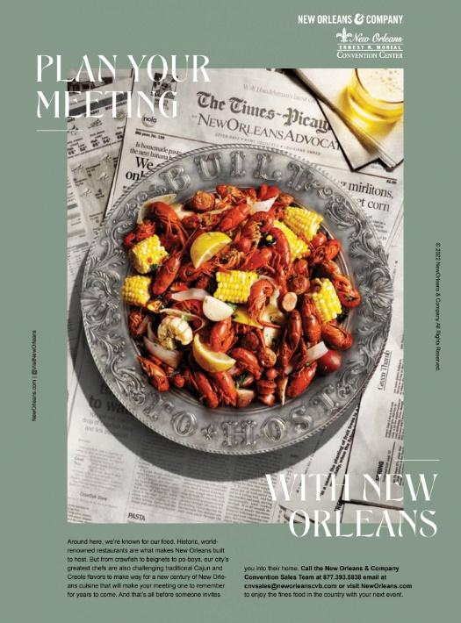
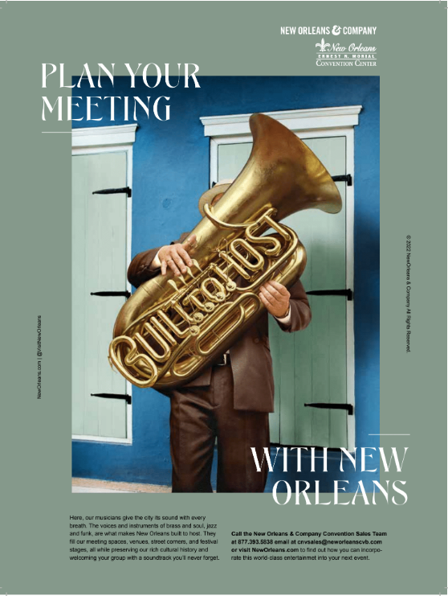
Built to Host Foundational Components
P 8
360i

Slide 9
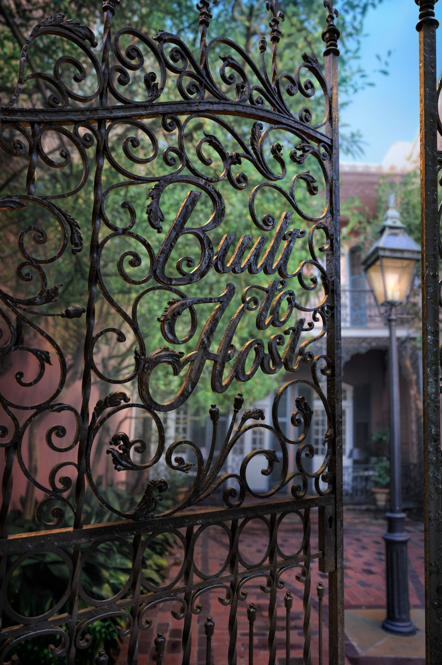
Built to Host Talking Points
Built to Host
Roots itself in the authentic nature of our community
Tells the story of why meet in New Orleans
Speaks to the hospitality extended by our community
Understands the uniquely New Orleans food, music and culture that results in memorable experiences
Illustrates why corporations and associations should link their brand with New Orleans
Shows the serious nature of business taking place in New Orleans
Demonstrates how excellent we are at delivering on major events, conferences, conventions and meetings
Reminds planners how excellent we are at delivering on these types of events from a technical standpoint
Speaks to the walkability of the destination
Demonstrates the continued investments in NOLA by international brands

Slide 10
Growth & Innovation Continue in New Orleans
Global Hospitality Brands Invest in New Orleans
The Four Seasons Hotel + Residences, The Virgin Hotels New Orleans and
The Kimpton Fontenot Hotel opened, adding to the 26,000 downtown hotel rooms.
Caesars Entertainment, Inc. is investing $325 million to renovate and
rebrand Harrah’s Hotel and Casino with additional plans for a 340-room hotel tower by 2024. And the legendary Superdome has been renamed the Caesars Superdome.
Louis Armstrong New Orleans International Airport: New state-of-the-art
airport terminal opened in 2019
Millions of dollars in renovations at hotels across the city
$400 million expansion including the World War II Bollinger
Canopy of Peace
The New Orleans Ernest N. Morial Convention Center (NOENMCC) has
embarked on a $557 million improvement plan including renovations to 140 meeting rooms and a makeover of the exterior experience.

Slide 11
New Orleans & Company is
Built to Host
The New Orleans & Company team is the most trusted resource for all phases of planning and executing meetings and conventions in New Orleans.
Customer Focused
New Orleans is Built To Host. Our sales, services and marketing & attendance building professionals are fully integrated to provide a seamless workflow in a dynamic, fast-paced meeting environment. You can rely on our experienced sales team to provide comprehensive sourcing assistance, convention services offerings and customized marketing and attendance building tools. Our professional experience, new developments in the city and authentic culture make New Orleans the best choice to conduct business.
Expanded Convention Services
Two marketing and attendance building roles in convention sales

Slide 12


Data Analytics
Presence
Solicitation
Proposal
Welcome Program
Convention Services
Marketing & Attendance Building
Site Visits
As shown at State of the Pace October 2021

Slide 13
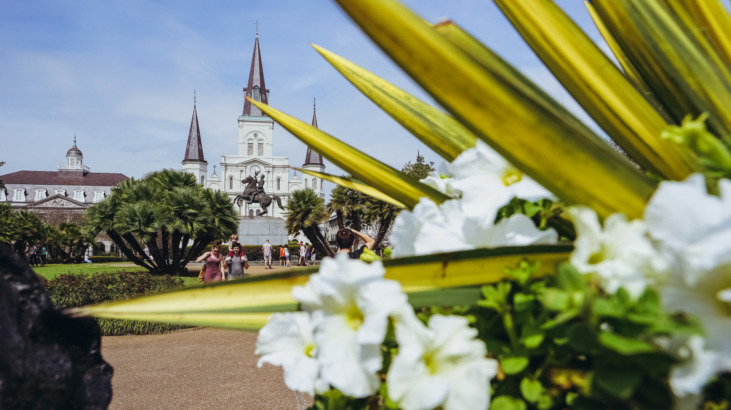
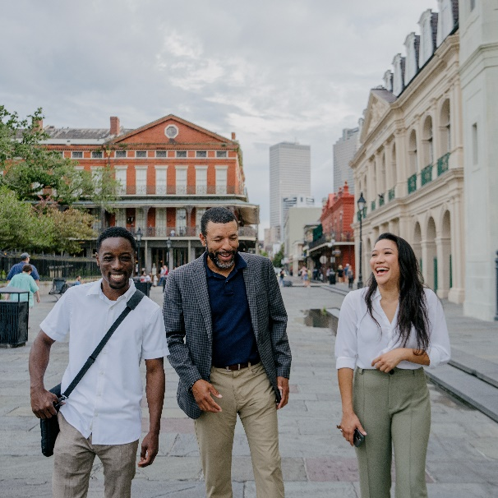
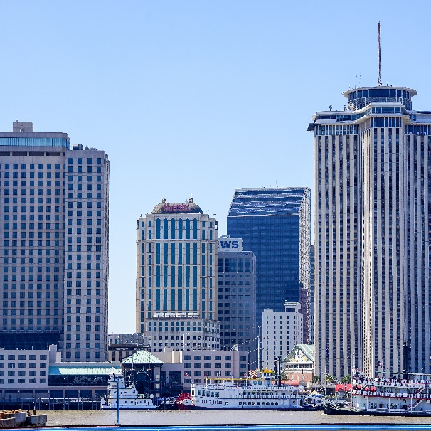
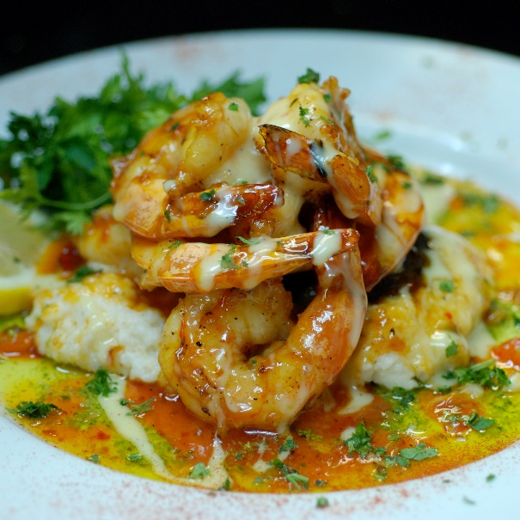
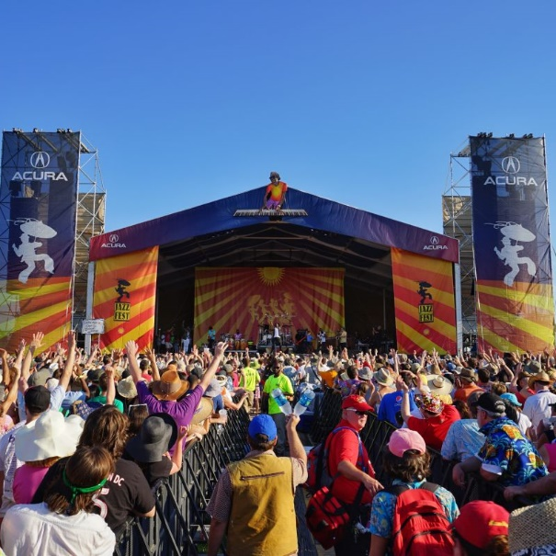
WALKABILITY
HOTELS
DINING
CULTURE
Compact, walkable downtown
26,000 rooms downtown in a 2-mile
walkable area
1,200 restaurant options for every budget + palate
Authentic, unique,
and award-winning
experiences + events
Notes:
FORMATTING NOTE
Slide is locked, do not edit/customize

Slide 14
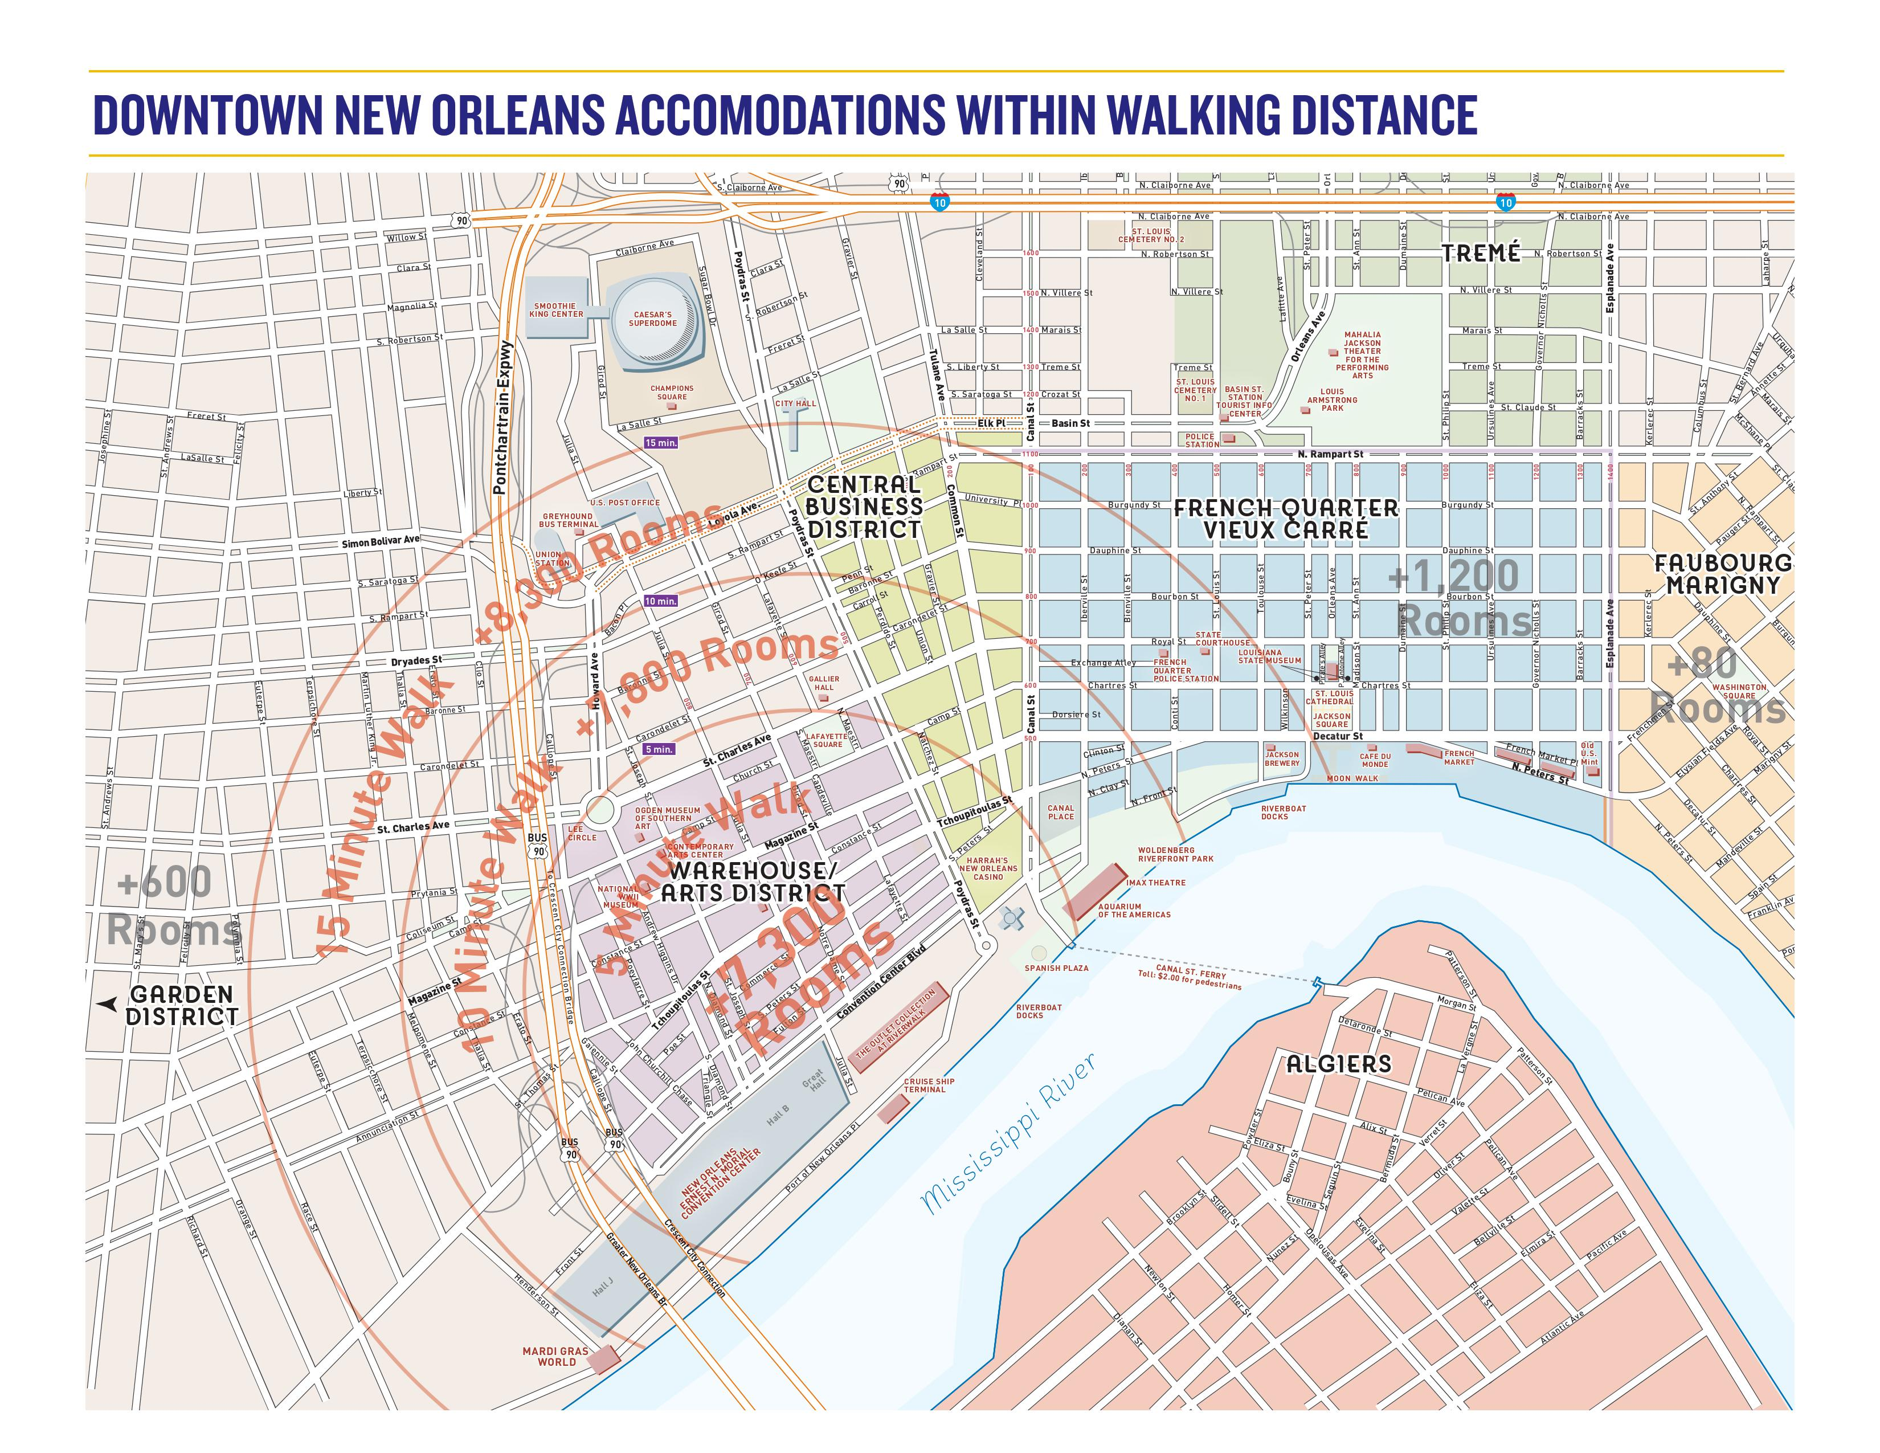
New Orleans walkable city with more than 26,000 hotel rooms
500 restaurants
Convention Facilities
Hundreds of world-class attractions
All in a 2-mile downtown radius
Notes:
FORMATTING NOTE
Slide is locked, do not edit/customize
15 minute: 8,300 rooms
10 minute: 7,800 rooms
5 minute: 7,300 rooms

Slide 15
Presence

Slide 16
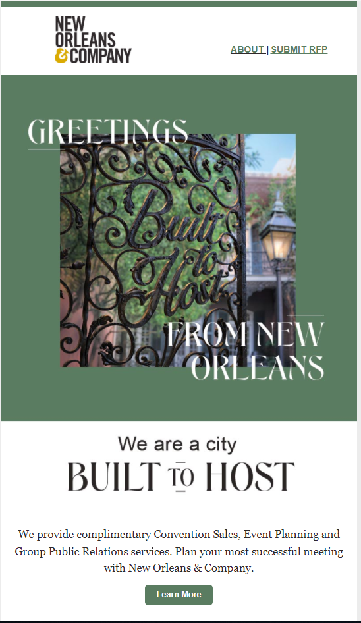
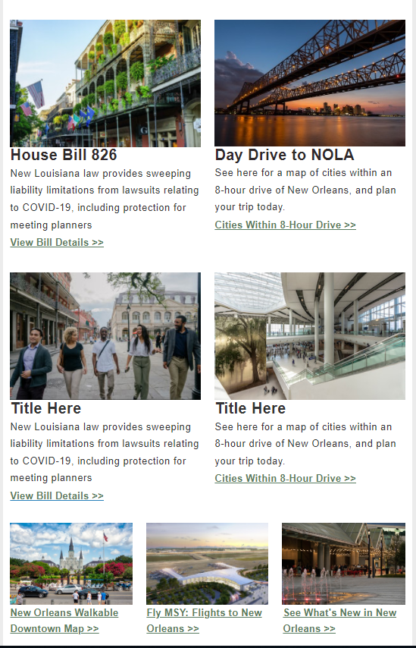
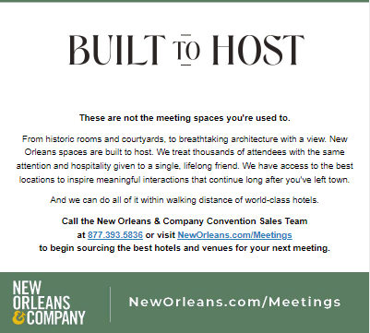
E-BLAST MOCK-UP
P 16

Slide 17
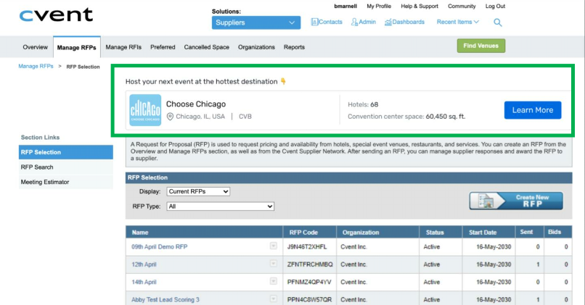
CVENT RFP DASHBOARD AD
P 17
Pilot Opportunity
Meeting Planner RFP Home Page
360i

Slide 18

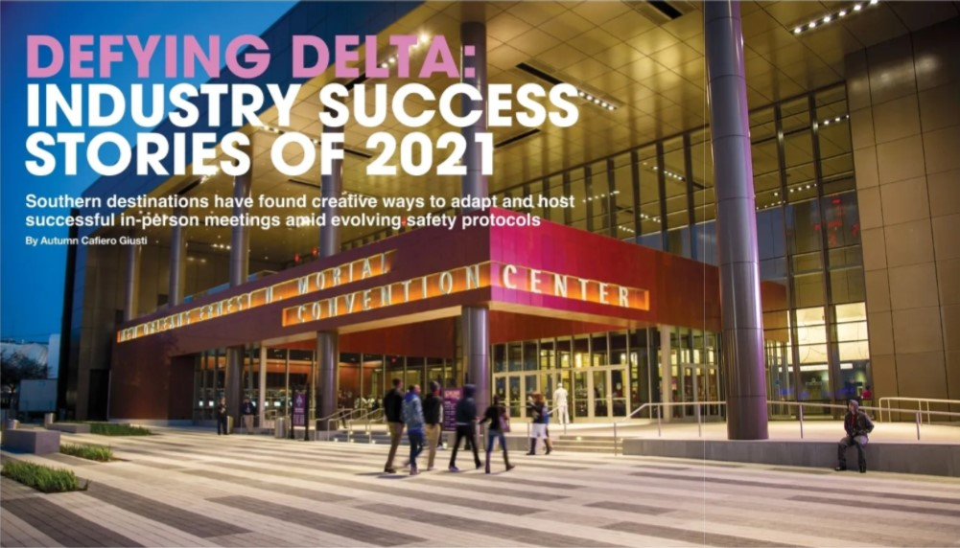
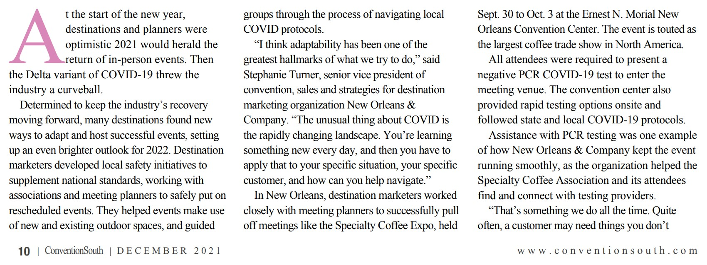
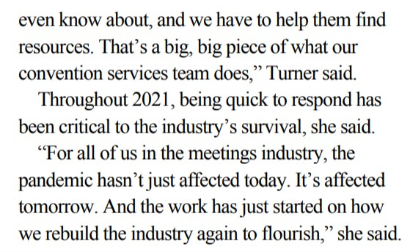
RECENT EARNED TRADE MEDIA

Slide 19



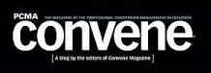
Strategic 12 Month Meetings Trade Placement Plan
Upcoming Placements:
Associations Conventions & Facilities:
March Full Page ad with Matching editorial
Trade Show Executives:
Customized e-blast March 4th and Full-Page Ad- April Issue
Meetings Today:
Full-Page Ad & Full-Page Advertorial- April Issue
PCMA Convene:
April Issue - 10 Reasons to Meet in New Orleans
P 19
360i

Slide 20
Solicitation

Slide 21


Creating Consistent Solicitation Tools

Slide 22



Tradeshow Booth Designs

Slide 23
Proposal

Slide 24
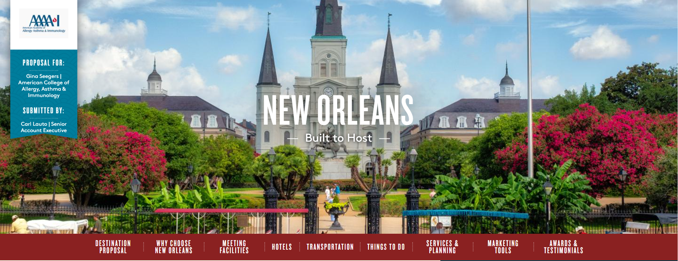

Slide 25
Site Visit

Slide 26
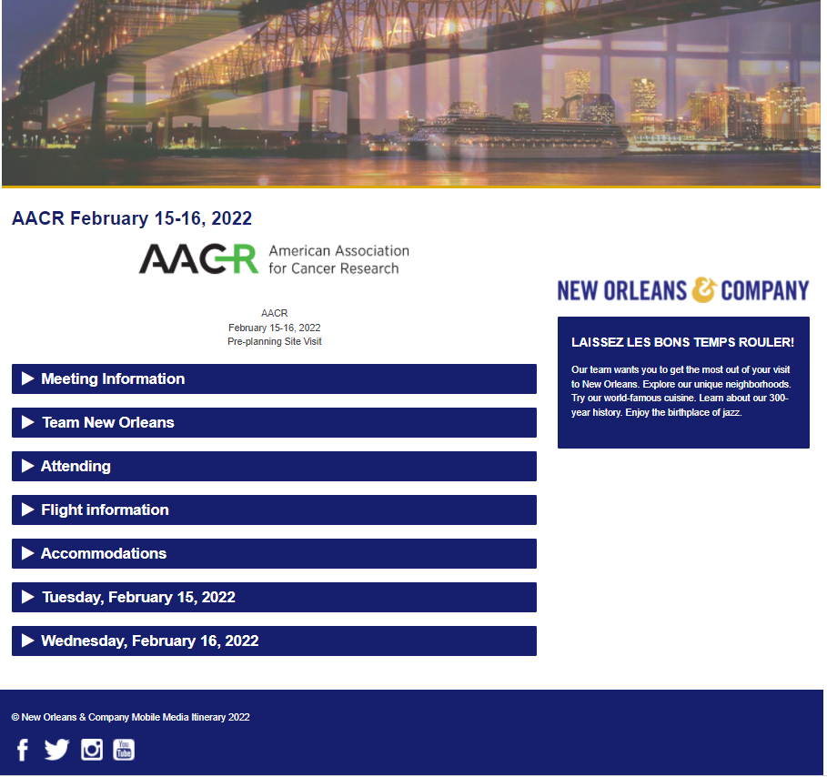
Mobile site itinerary
Adaptation to BTH Forthcoming

Slide 27
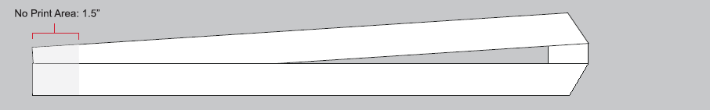
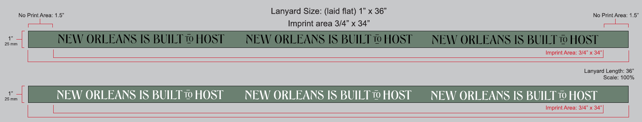



Lanyards & Coasters

Slide 28
Marketing & Attendance Building
Convention Services

Slide 29


Group Welcome Videos

Slide 30
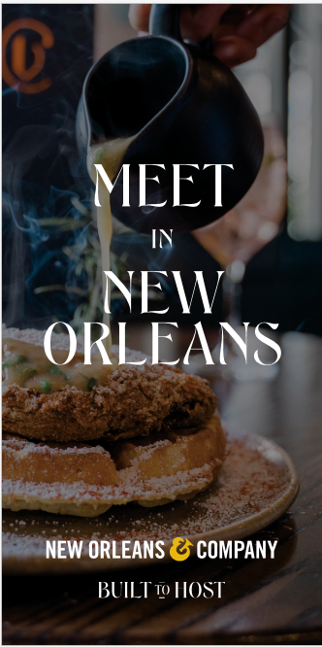
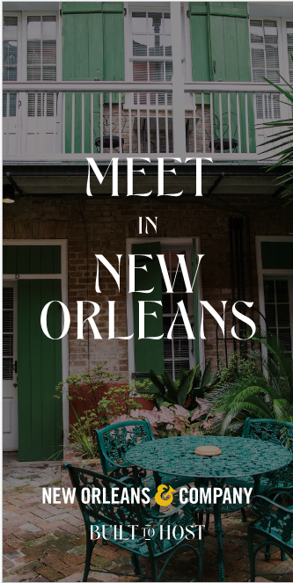
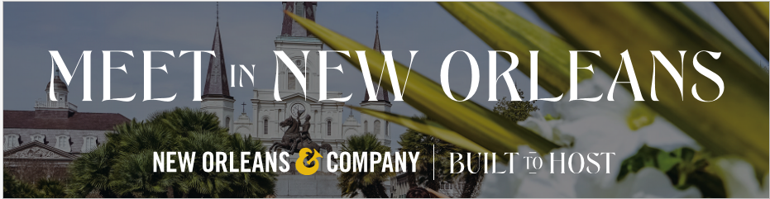
Group PR, Marketing & Attendance Building

Slide 31
Welcome Program

Slide 32
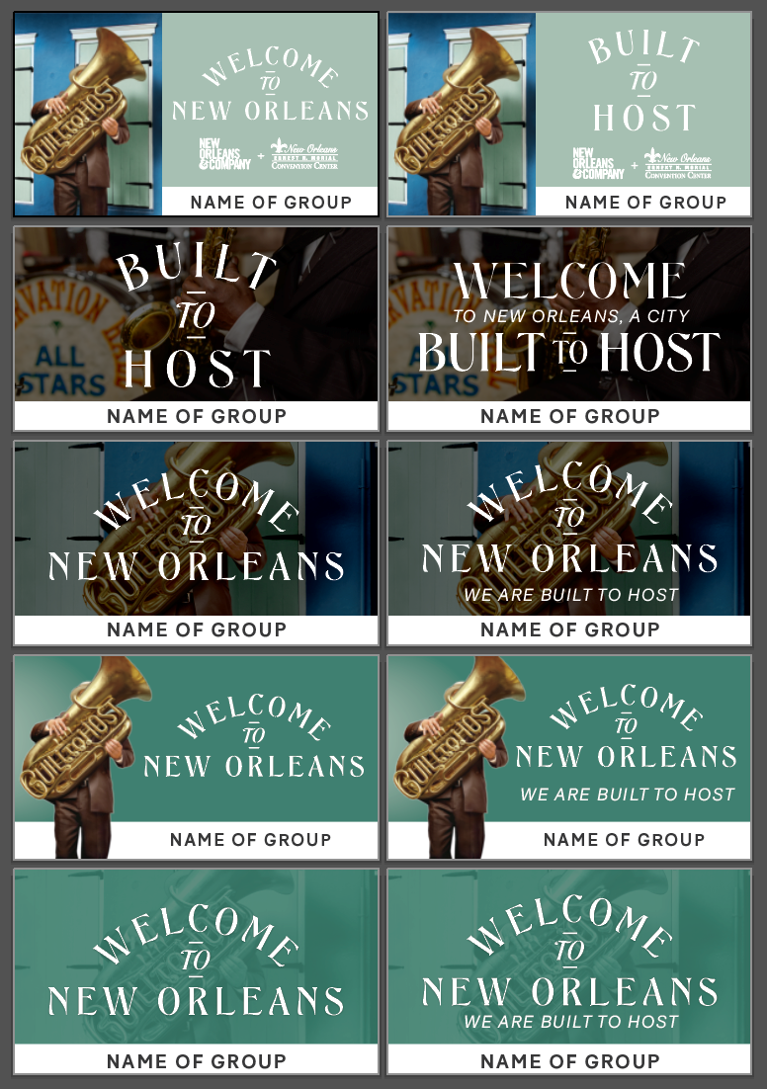
Airport Welcome Graphics
P 32
360i

Slide 33


Built to Host Local Hospitality Community Launch

Slide 34
Agenda Items 3 & 4
Business Acquisition Strategies Overview –
Stephanie Turner
  Strategic Account Management (SAM)
  Association & Corporate master list strategies
  Vertical segment plans
    Build sales funnel
    Increase opportunities at bat
    Craft customized proposals designed to win the business
    Compete at the grass roots level
Account Discussion & Updates –
Sallee Pavlovich & Donna Glover
  Account specific conversations
  Account updates

Slide 35
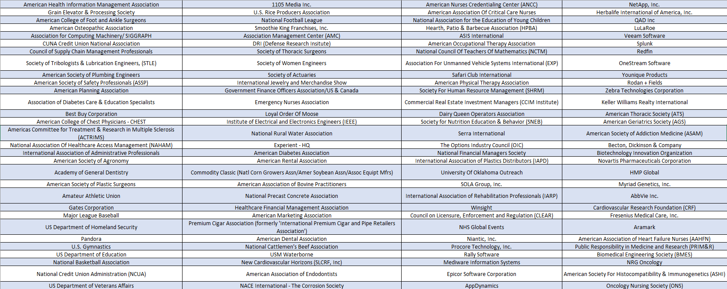
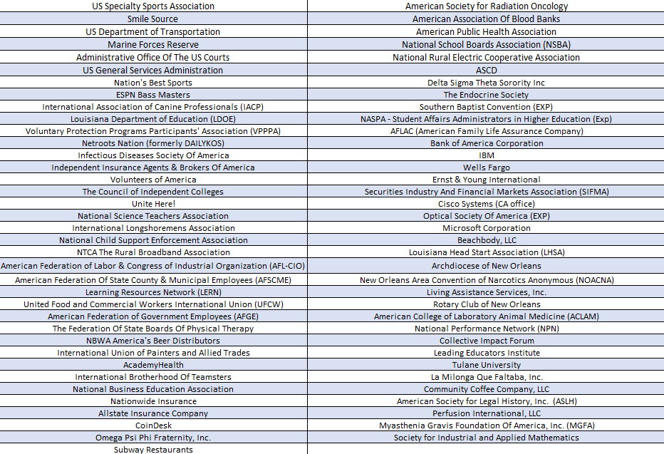
New Orleans & Company Business Acquisition Strategies
Strategic Account Management

Slide 36
New Orleans & Company Business Acquisition Strategies
Account Discussions
Southern Baptist
Nurses Credentialling
NADA
DigitalNow
AGU
HPE
Essence
Final Four
Cancer Research
Future meeting discussions with longer lists and community strategies

Slide 37
Agenda Item 5
New Orleans & Company on the Road
  PCMA/DI/IAEE Week
  April/May Trips
  Additional Buy-In Opportunities

Slide 38

New Orleans & Company On the Road
PCMA / Destinations International / IAEE
Washington D.C.
Includes the following events:
PCMA Functions
  Chapter Leaders and Partner Reception
    Comes from PCMA Partnership
  Visionary Awards
Destinations International
  Convention Sales & Services Summit – Main Stage Sponsor
  Destination Showcase Tradeshow
    Title Sponsor, includes Stage Time
IAEE
  Women’s Leadership Forum
Sales Calls Throughout

Slide 39
New Orleans & Company On the Road
SISO CEO Summit ; March 21st ; St. Petersburg, FL ; Sallee Pavlovich & Tim Hemphill
Brooklyn Bowl & Concert Event – Soul Rebels ; April 2nd ; NYC ; Rocky Dufauchard & Fay Nedd
Building Trade Legislative Conference ; April 3rd ; Washington D.C. ; Janine Raffray
Conference Direct CDX ; April 4th ; Phoenix, AZ ; Erica Lee
MPI Northern California ; April 4th ; San Francisco, CA ; Sallee Pavlovich
SimpleView Summit ; April 10th ; Phoenix, AZ ; Matthew McDaniel
Cvent Connect ; Aprill 11th ; Las Vegas, NV ; Brandee Barrett & Erica Lee

Slide 40
New Orleans & Company On the Road
Texas Sales Calls ; April 18th ; Dallas/Austin, TX ; Ted Pennison
Conference Direct CD Forum ; April 25th ; Las Vegas, NV ; Fay Nedd
Chicago Theater Event ; May 24th ; Chicago, IL ; Allison Comboy, Carl Lauto, & Libby Fein
Sports ETA ; May 2nd ; Fort Worth, TX ; Andy Le Bouef
HelmsBriscoe Annual Business Conference ; May 9th ; Las Vegas, NV ; Ted Pennison & Libby Fein
Observe ACOG 2500 ; May 6th ; San Diego, CA ; Donna Glover & Andy Le Bouef

Slide 41
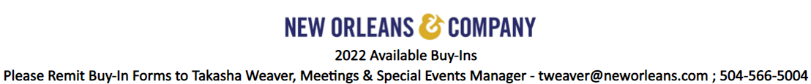
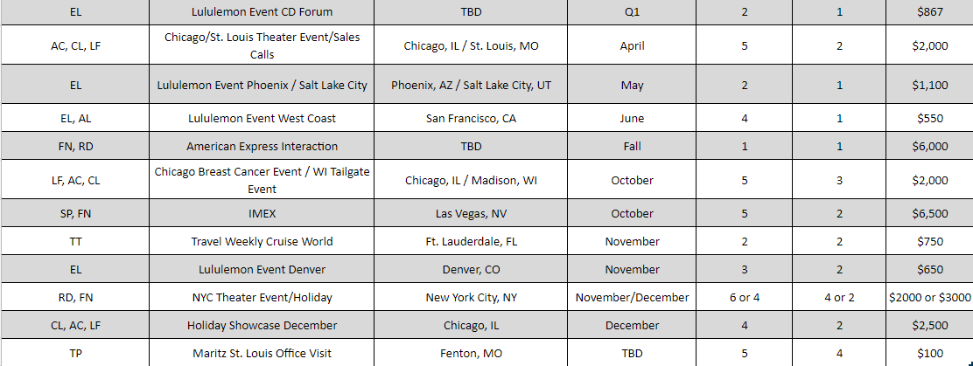

Slide 42
Agenda Item 6
Built to Host – Planners Experience New Orleans
  PCMA Educon
  Host Board Meetings
  Fall Customer Event – Corporate focus
  Other opportunities

Slide 43
Agenda Item 7
Financial Incentives
  Big Easy Bucks
  Customized financial incentives

Slide 44
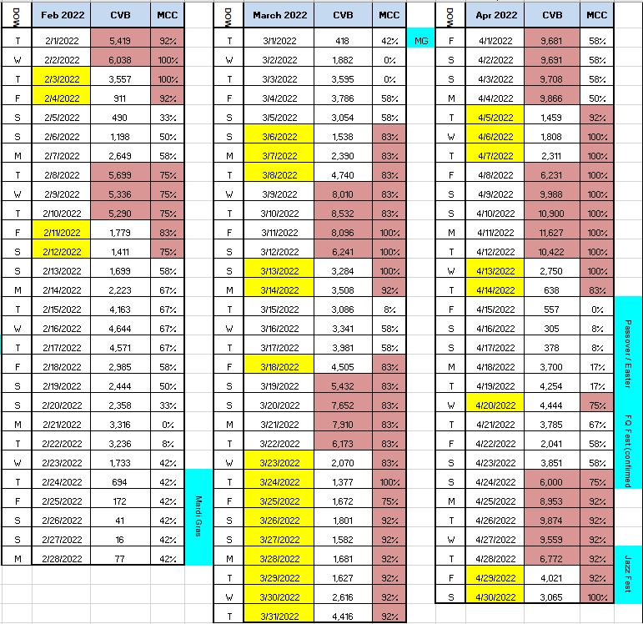
Updated Monthly
Legend:
Less than 5,000 rooms OR​
Less than 69% occupancy at Convention Center
Over 5,000 rooms OR
Over 69% occupancy at Convention Center
Over 69% at Convention Center BUT
Under 5,000 rooms
Room count reflects room nights booked by New Orleans & Company

Slide 45
Current Incentives: Less Than 400 Peak
Big Easy Bucks Overview
400 Peak – rolling 36-month window (expanded from 24)
$5.00 paid on actual pick-up
All dates under 5,000 peak on current month dashboard are eligible – weekends require approval
Availability of incentive and official document must be issued by NO&Co and signed by customer
Hotel contract also required
Pick-up is verified by NO&Co with hotel and payment issued
AAO 2021
Notes:
Note for JSP – do we want to consider asking about GOPPAR, even though we don’t have much affect on that? https://www.hospitalitynet.org/explainer/4102264.html
divide the hotel's gross operating profit by the total number of available rooms.

Slide 46
Big Easy Bucks Potential Enhancements
Big Easy Bucks Ideas & Potential Enhancements
Rebrand Big Easy Bucks in Progress
Create new categories of Big Easy Bucks
Examples
  Lower demand in 2022 and 2023 earn potentially higher payouts
  Increase peak night to 500
AAO 2021
Notes:
Note for JSP – do we want to consider asking about GOPPAR, even though we don’t have much affect on that? https://www.hospitalitynet.org/explainer/4102264.html
divide the hotel's gross operating profit by the total number of available rooms.

Slide 47
Larger Groups Customized Offerings
Build financial incentive package that is customer specific and motivates new definite bookings
  Assist with overall convention costs
  Reduce and/or offset shuttle costs
  New costs arising out of covid guidelines
  Offset exhibitor costs
  Host all or part of New Orleans themes events/food
  Marketing & attendance building resources
    Promotional videos
    LinkedIn & Facebook ad purchases
    Targeted purchases of curated lists
AAO 2021
Notes:
Note for JSP – do we want to consider asking about GOPPAR, even though we don’t have much affect on that? https://www.hospitalitynet.org/explainer/4102264.html
divide the hotel's gross operating profit by the total number of available rooms.

Slide 48
Current Offerings – Large Groups
Welcome Signage at Main Entrance to the Convention Center
  Pole Banners Outside Contracted Halls
  New Orleans Experiences
    Restaurant Gift Cards
    Venue Gift Cards
    Attractions Gift Cards
    Customized VIP amenities
    Airport transfers
    Convention Services staff attend your annual meeting
    to promote New Orleans meeting
AAO 2021
Notes:
Note for JSP – do we want to consider asking about GOPPAR, even though we don’t have much affect on that? https://www.hospitalitynet.org/explainer/4102264.html
divide the hotel's gross operating profit by the total number of available rooms.

Slide 49
Larger Groups Customized Offerings
Special Concessions:
NEW ORLEANS & COMPANY COMPLIMENTARY WELCOME PACKAGE
Custom Welcome Program Commitment: Range from 1000+ Peak
Convention Welcome at MSY:
Group will be listed on a 10-second animated ad that runs on a 4–6-minute loop of various promotions on LED screens at baggage claim
Jazz Band at MSY’s Baggage Claim with Customized Tuba Cover
AAO 2021
Notes:
Note for JSP – do we want to consider asking about GOPPAR, even though we don’t have much affect on that? https://www.hospitalitynet.org/explainer/4102264.html
divide the hotel's gross operating profit by the total number of available rooms.

Slide 50
Agenda Item 8
Hotel Renovations Survey
We would love to hear from you about hotel renovations
This survey will be sent out following this meeting

Slide 51
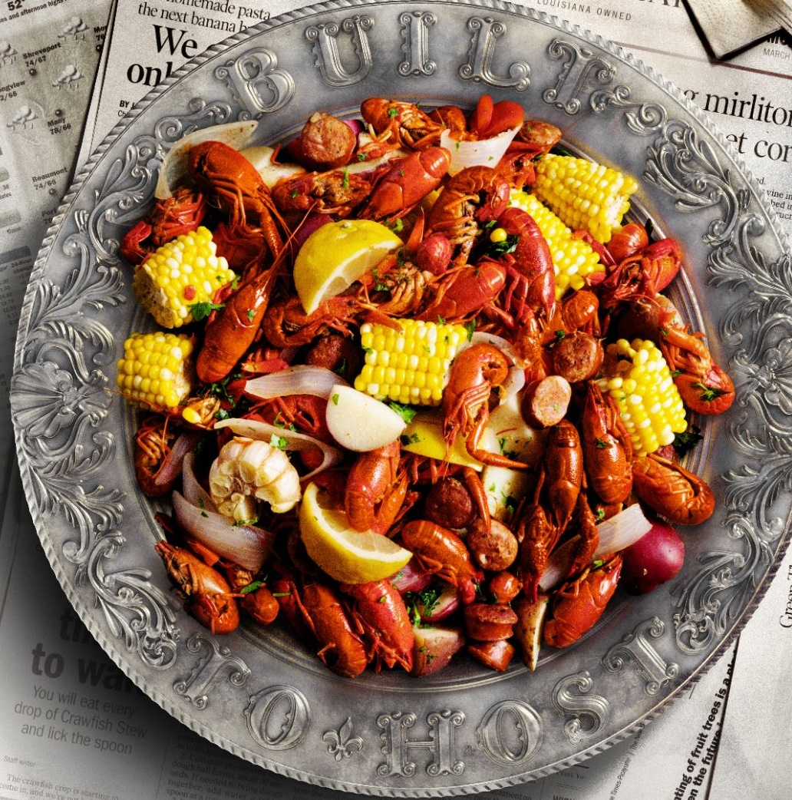
New Orleans
NewOrleans.com/Meetings

