Slide 1


The Soundside Site
Dare County
July 2019

Slide 2


PROCESS
1

Slide 3
✓
1. PROJECT INITIATION
Site Tour | Prior Studies Review | Stakeholder + Community Forums
Phase 1 Report
✓
2. MARKET ANALYSIS
Market Conditions and Characteristics | Comparable Venues
3. RECOMMENDED PROGRAM
Recommended Market-Supportable Land Uses | Alternative Development Concepts | Acquisition Analysis
✓
✓
4. PROJECTED PERFORMANCE
10-year Demand and Operating Projections | Economic and Fiscal Impact Analysis
Phase 2 Report
5. STRATEGY
Funding and Implementation Strategy
Discussion +
Phase 2 Conclusion

Slide 4
MARKET ANALYSIS
3

Slide 5
MARKET OPPORTUNITIES
EVENT VENUE
Existing inventory of venues oriented to smaller, social events not sporting, entertainment or conventions/ tradeshows.
Potential to attract year-round visitors to Outer Banks.
Simple designs offer greatest flexibility and allow for integration with surrounding landscapes.
SUPPLEMENTAL LAND USES
Hotel: New inventory will be necessary to support event venue; Consistent with Comprehensive Plan vision for Soundside Activity Node.
Retail: Locational attributes of site suggest only food-service oriented or neighborhood/ convenience.
Multi-Family Residential: Sound fundamentals and desire of Town to increase diversity of housing; Subject to sufficient land area so may be more appropriate within broader development area.

Slide 6
COMPARABLE VENUES
5

Slide 7
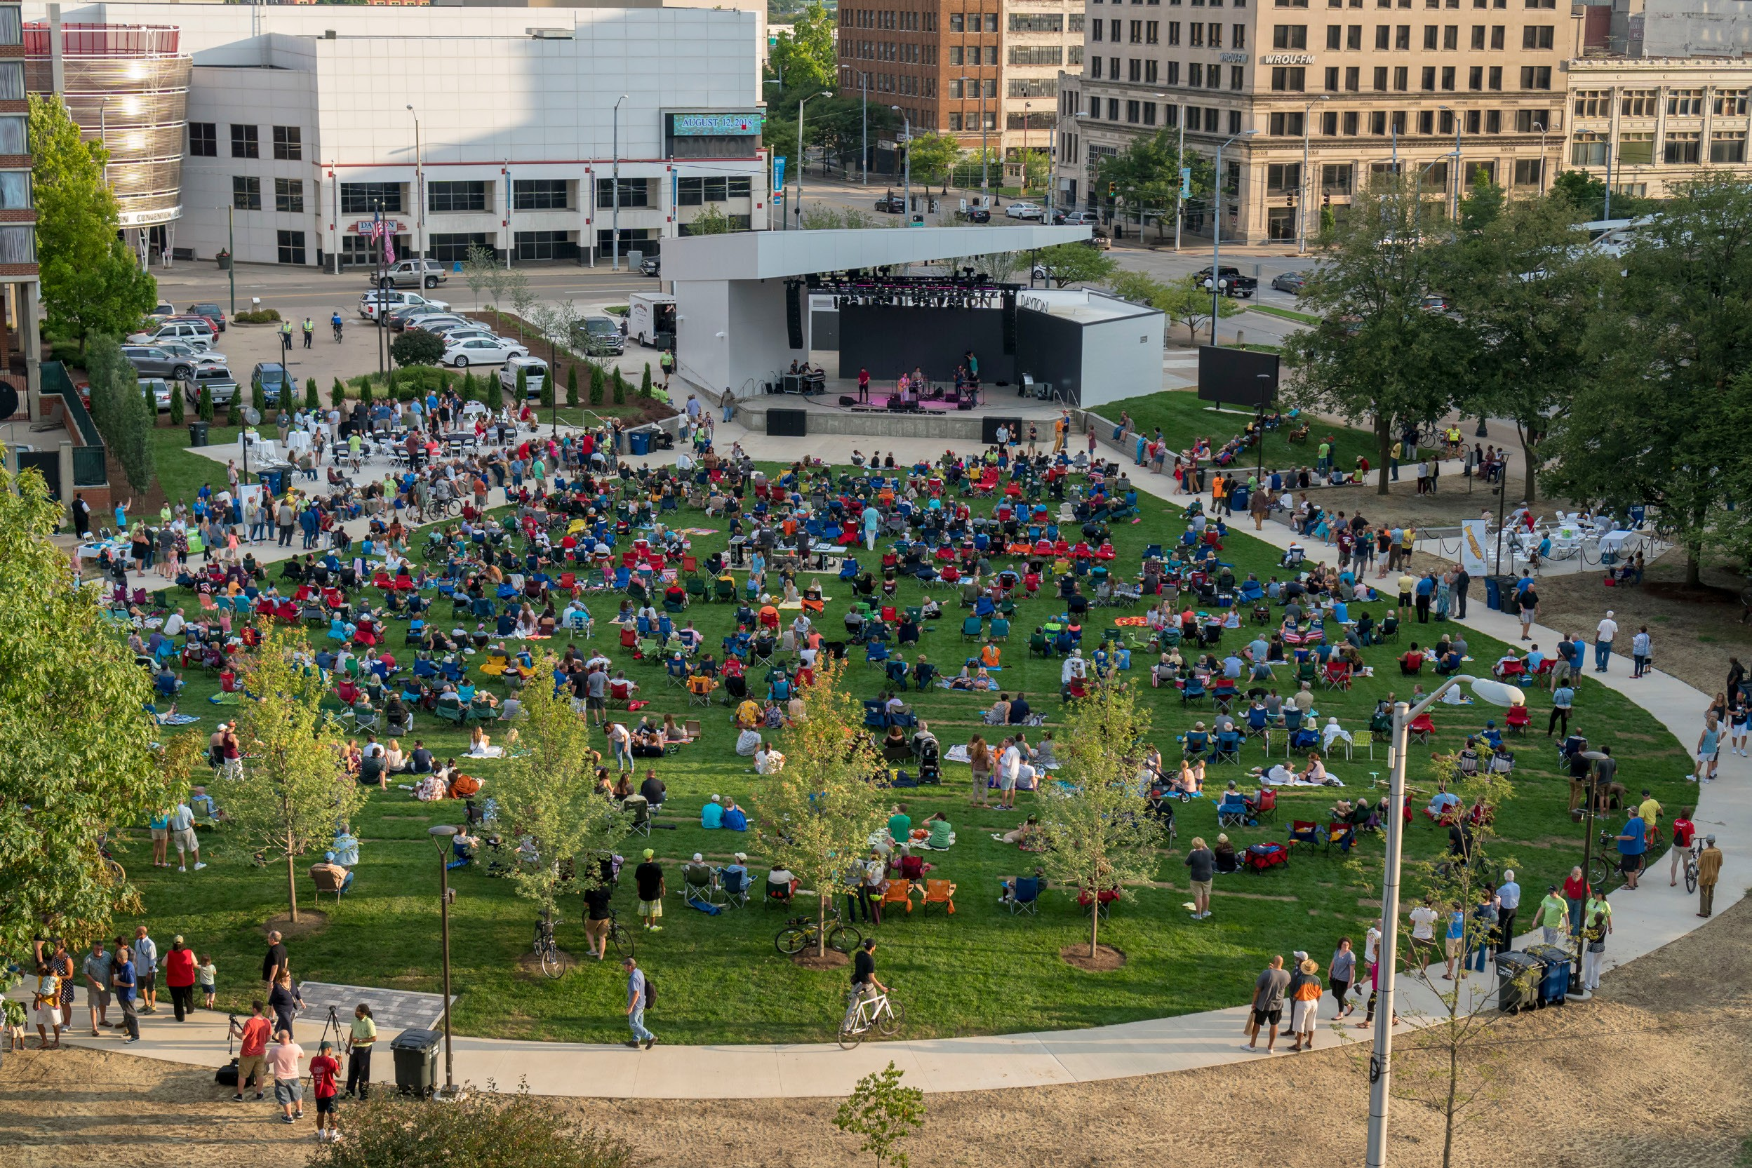
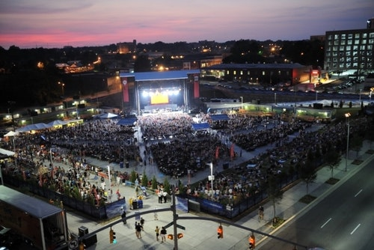
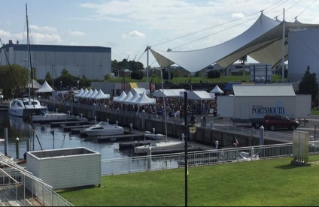
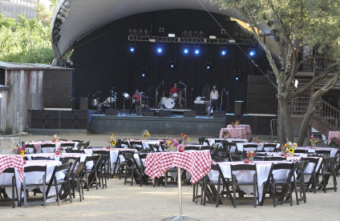
OUTDOOR PAVILIONS
Levitt Pavilion – Dayton, OH
Red Hat Amphitheater – Raleigh, NC
Stubbs Waller Creek Amphitheater – Austin, TX
Union Bank and Trust Pavilion – Portsmouth, VA

Slide 8
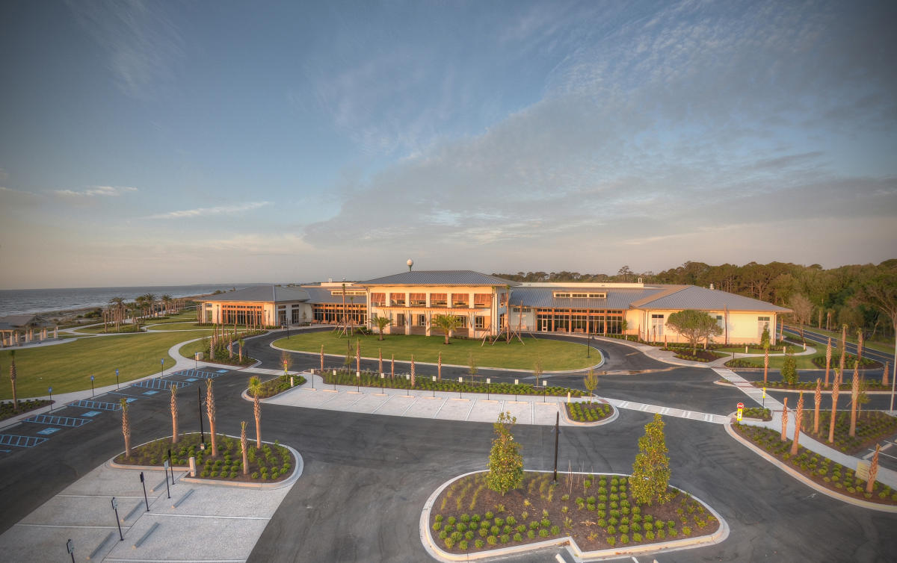
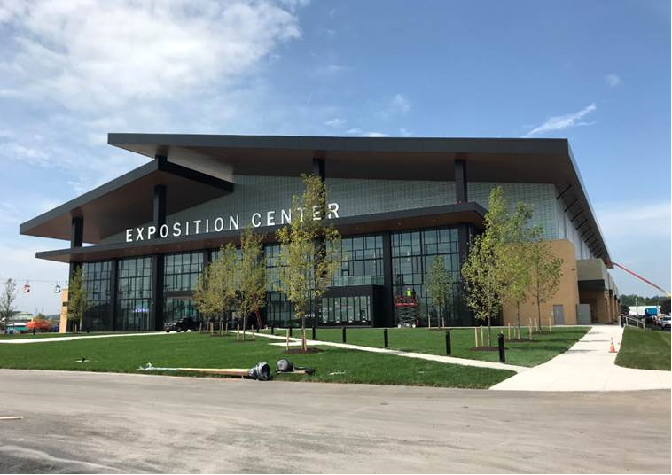
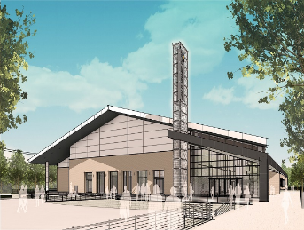
MULTI-PURPOSE EVENT CENTERS
Jekyll Island Convention Center – Jekyll Island, GA
New York State Fairgrounds Expo Center – Syracuse, NY
Jim R. Miller Park and Event Center – Marietta, GA

Slide 9
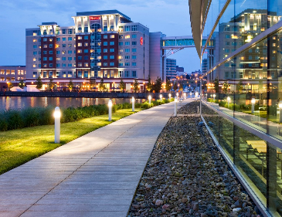
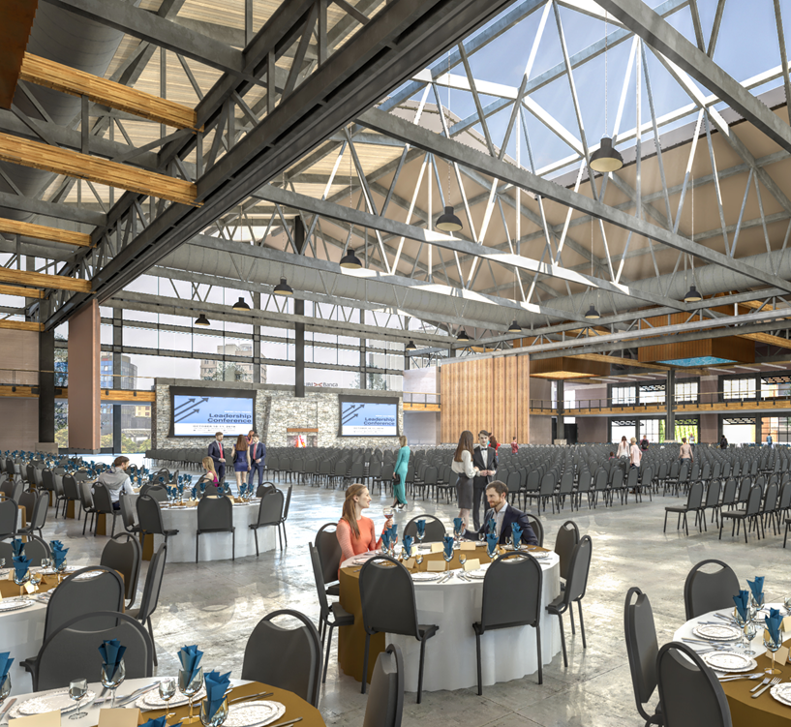
INNOVATIVE DESIGN
Proposed Event Center – Billings, MT
Bayfront Convention Center – Erie, PA
Combination of attributes from various venues have relevance to The Soundside site

Slide 10
RECOMMENDATIONS
9

Slide 11
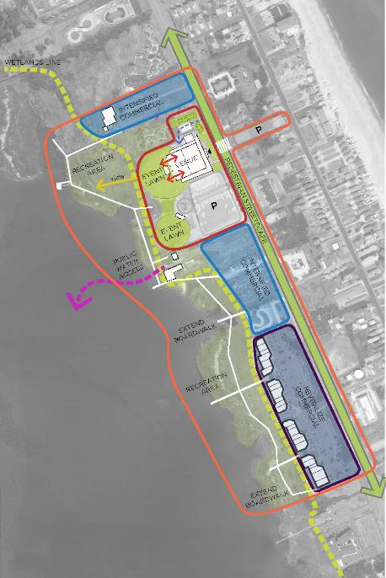

OPTION A:
MULTI-PURPOSE EVENT VENUE
±30,000 SF multi-purpose event venue.
Building itself would have glass walls on 3 sides to maintain a high degree of transparency.
Note: Concepts do not consider Nags Head ordinances (parking, septic, lot coverage etc.)

Slide 12
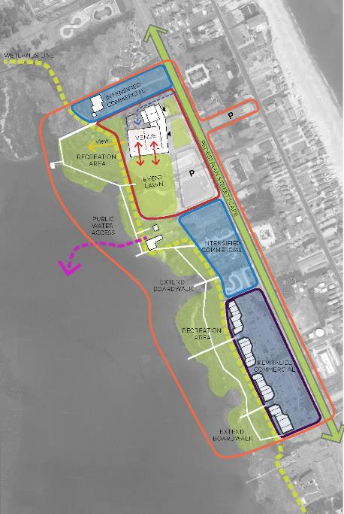
OPTION B:
MULTI-PURPOSE EVENT VENUE WITH HOTEL
±30,000 SF multi-purpose event venue and a ±200 key hotel.
Event space designed to include ±5,400 SF ballroom (capacity for up to 500 guests) and opens directly onto the event lawn, maintaining views to the Sound.
Note: Concepts do not consider Nags Head ordinances (parking, septic, lot coverage etc.)

Slide 13
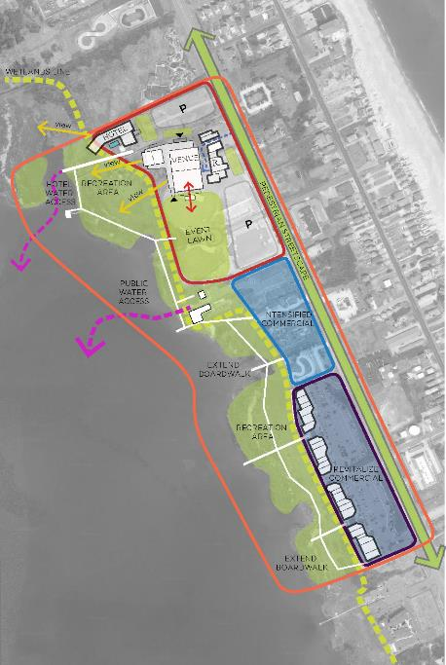
OPTION C:
ALTERNATIVE
CONCEPT WITH HOTEL
±30,000 SF multi-purpose event venue and a ±200 key hotel.
Key variant = Option C assumes acquisition of the Pamlico Jack’s site, to the north of The Soundside site, to accommodate the hotel and associated parking.
Event space designed to include ±5,400 SF ballroom (capacity for up to 500 guests) and opens directly onto the event lawn, maintaining views to the Sound.
Note: Concepts do not consider Nags Head ordinances (parking, septic, lot coverage etc.)

Slide 14
PRELIMINARY COST ESTIMATES

Slide 15
ACQUISITION ANALYSIS
Only Option C assumes acquisition of Pamlico Jack’s site.
Option B requires that some existing outdoor event space be consumed by a hotel property; Option C allows for the retention of all existing outdoor event space (hotel property would be located on the Pamlico Jack’s site).
Option C is the most responsive to current and likely future market opportunities, ultimately it is a policy decision to be made by the DCTB and other stakeholders.

Slide 16
PROJECTIONS
15

Slide 17
OPTION A - EVENTS

Slide 18
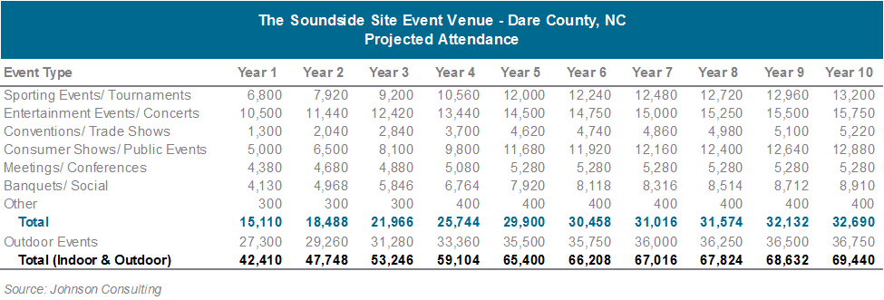
OPTION A - ATTENDANCE

Slide 19
OPTION A - PROFORMA

Slide 20
OPTION B OR C - EVENTS

Slide 21
OPTION B OR C - ATTENDANCE

Slide 22
OPTION B OR C - PROFORMA

Slide 23
COMPARATIVE PERFORMANCE

Slide 24
IMPACTS
23

Slide 25
OPTION A - IMPACT

Slide 26
OPTION B OR C - IMPACT

Slide 27
COMPARATIVE IMPACT

Slide 28
STRATEGY
27

Slide 29
STRATEGY DISCUSSION
FUNDING STRATEGIES
Sales Tax
F&B Tax
Hotel Tax
GO Bonds
TIF
Other funding mechanisms
OPERATING MODELS
Self-Operate
Private Management Company
Authority
501(c)3

Slide 30
COMMENTS, QUESTIONS
+ NEXT STEPS
29

