Slide 1


MONTHLY TDT ANALYSIS
Statistical and Graphical Reports
for month ending:
August 31, 2019
Bay County
Tourist Development Council

Slide 2


Clerk of Court &
Comptroller
Report for Month
Ending
August 31, 2019

Slide 3
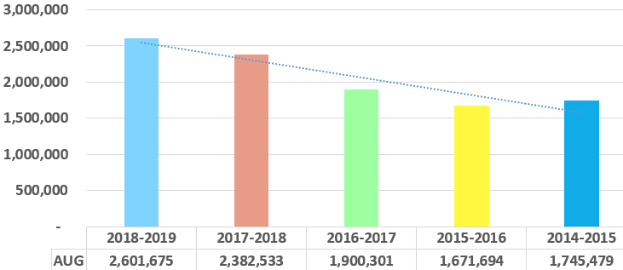
Cash Collection Analysis:
Panama City Beach
For the month ending
August 31, 2019
Note: This report represents collections on a cash basis. The collection period is indicative of all cash receipts generated in the following month (i.e. December period collections are generated January 1st through January 31st).
Bay County
Tourist Development Council

Slide 4
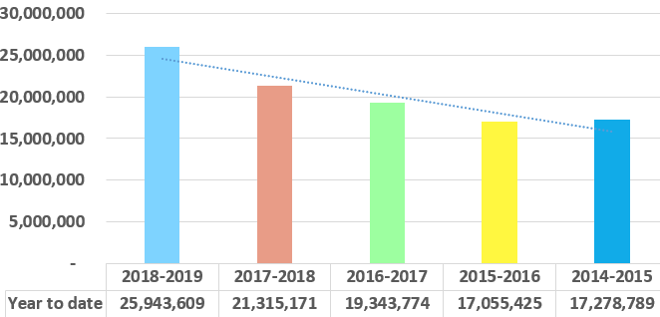
Cash Collection Analysis:
Panama City Beach
Eleven months ending
August 31, 2019
Note: This report represents collections on a cash basis. The collection period is indicative of all cash receipts generated in the following month (i.e. December period collections are generated January 1st through January 31st).
Bay County
Tourist Development Council

Slide 5
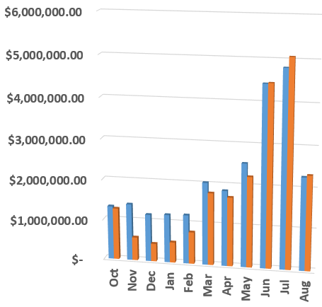
Accrual Attribution Data
Panama City Beach
"On November 1, 2018, The Tourist Development Council met and approved an amendment to its Program of Work to allow tourist development tax collections in excess of FY 2018 levels for the period of October through February to be used for specified purposes to further tourism interests with the impacted communities. The specified purposes are: to pay the costs for public relations and advertising agency fees for the CVB's agencies of record to support Mexico Beach and Panama City; and to fund local match requirements for design, permitting, administrative, and sand search costs for a beach renourishment project for Mexico Beach.“
Bay County Board of County Commissioners 11/06/2018
Bay County
Tourist Development Council

Slide 6
Cash / Accrual Breakdown
Panama City Beach
Attributed period
Note: This report delineates the attribution of collected revenue in a given reporting period.
Bay County
Tourist Development Council

Slide 7
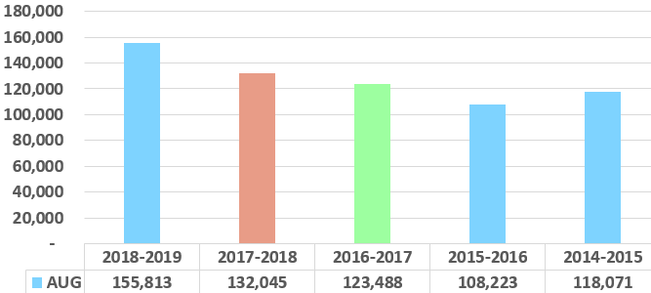
Cash Collection Analysis:
Panama City
For the month ending
August 31, 2019
Note: This report represents collections on a cash basis. The collection period is indicative of all cash receipts generated in the following month (i.e. December period collections are generated January 1st through January 31st).
Bay County
Tourist Development Council

Slide 8
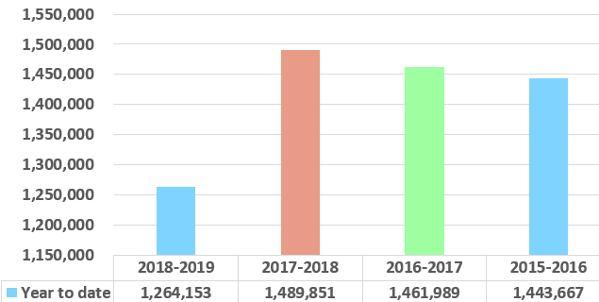
Cash Collection Analysis:
Panama City
Eleven months ending
August 31, 2019
Note: This report represents collections on a cash basis. The collection period is indicative of all cash receipts generated in the following month (i.e. December period collections are generated January 1st through January 31st).
Bay County
Tourist Development Council

Slide 9
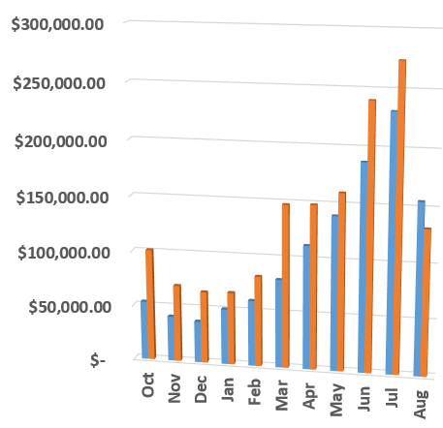
Accrual Attribution Data
Panama City
"On November 1, 2018, The Tourist Development Council met and approved an amendment to its Program of Work to allow tourist development tax collections in excess of FY 2018 levels for the period of October through February to be used for specified purposes to further tourism interests with the impacted communities. The specified purposes are: to pay the costs for public relations and advertising agency fees for the CVB's agencies of record to support Mexico Beach and Panama City; and to fund local match requirements for design, permitting, administrative, and sand search costs for a beach renourishment project for Mexico Beach.“
Bay County Board of County Commissioners 11/06/2018
Bay County
Tourist Development Council

Slide 10
Cash / Accrual Breakdown
Panama City
Attributed period
Note: This report delineates the attribution of collected revenue in a given reporting period.
Bay County
Tourist Development Council

Slide 11
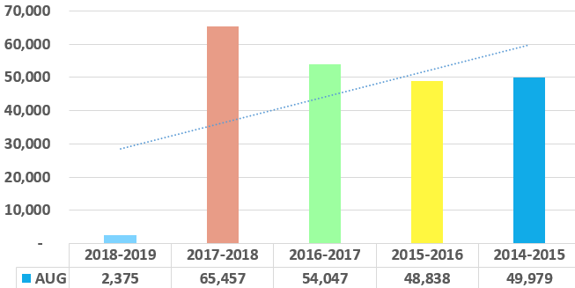
Cash Collection Analysis:
Mexico Beach
For the month ending
August 31, 2019
Note: This report represents collections on a cash basis. The collection period is indicative of all cash receipts generated in the following month (i.e. December period collections are generated January 1st through January 31st).
Bay County
Tourist Development Council

Slide 12
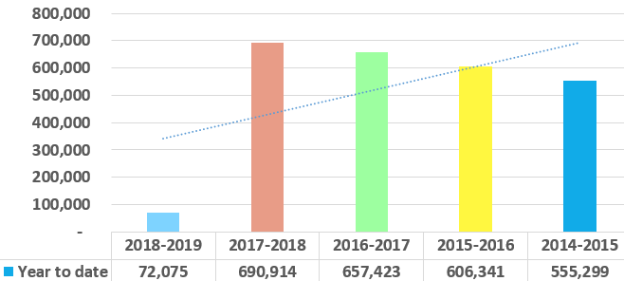
Cash Collection Analysis:
Mexico Beach
Eleven months ending
August 31, 2019
Note: This report represents collections on a cash basis. The collection period is indicative of all cash receipts generated in the following month (i.e. December period collections are generated January 1st through January 31st).
Bay County
Tourist Development Council

Slide 13
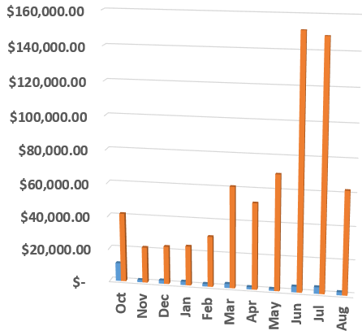
Accrual Attribution Data
Mexico Beach
"On November 1, 2018, The Tourist Development Council met and approved an amendment to its Program of Work to allow tourist development tax collections in excess of FY 2018 levels for the period of October through February to be used for specified purposes to further tourism interests with the impacted communities. The specified purposes are: to pay the costs for public relations and advertising agency fees for the CVB's agencies of record to support Mexico Beach and Panama City; and to fund local match requirements for design, permitting, administrative, and sand search costs for a beach renourishment project for Mexico Beach.“
Bay County Board of County Commissioners 11/06/2018
Bay County
Tourist Development Council

Slide 14
Cash / Accrual Breakdown
Mexico Beach
Attributed period
Note: This report delineates the attribution of collected revenue in a given reporting period.
Bay County
Tourist Development Council

Slide 15
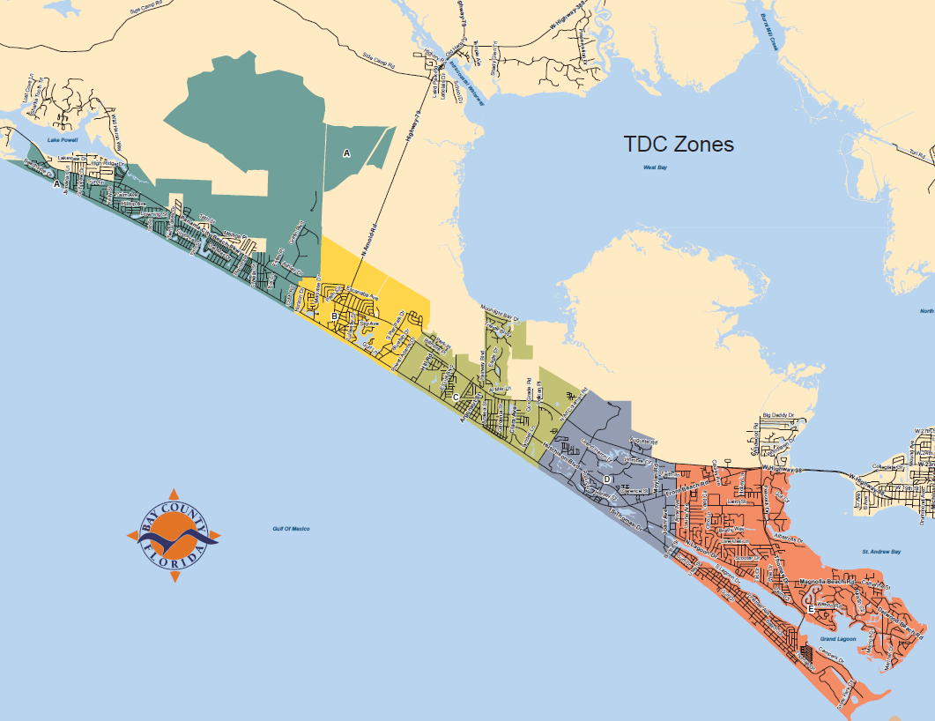
Layout of TDC Zones
A West End
B Pier Park
C Open Sands
D Middle Beach
E Grand Lagoon
Bay County
Tourist Development Council

Slide 16

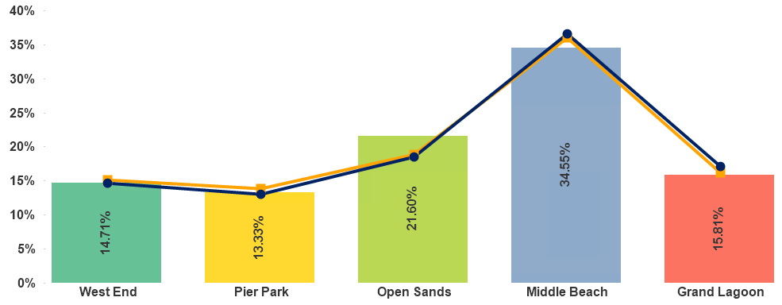

Panama City Beach
Annual % of Gross Receipts by Zones
Three Year August Comparison
Bay County
Tourist Development Council

Slide 17
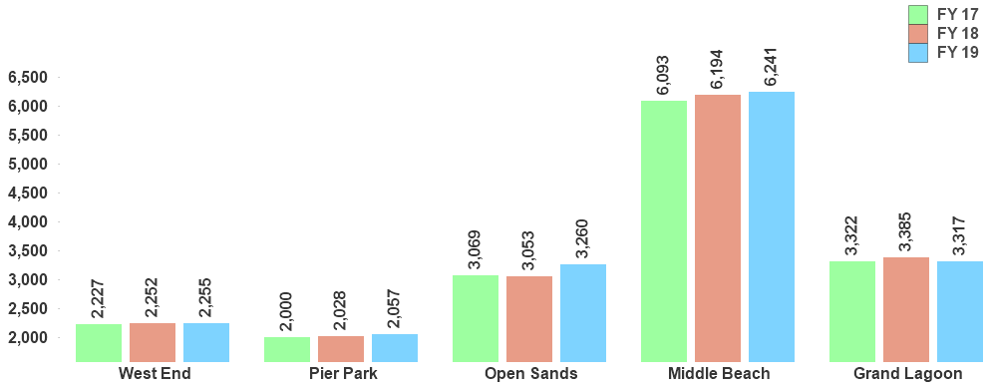

Panama City Beach
Total Unit Count
Three Year August Comparison
Bay County
Tourist Development Council

Slide 18
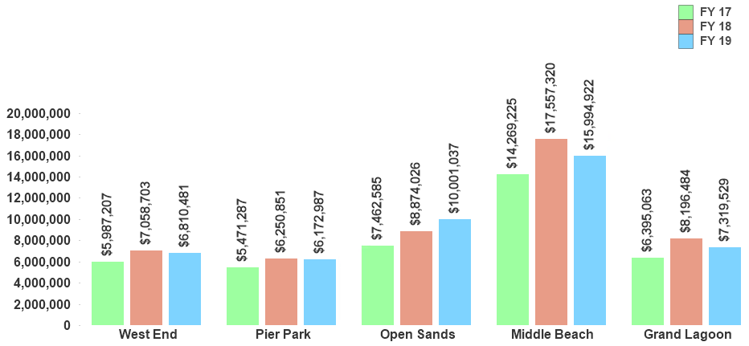
Gross Rental Receipts
Three Year August Comparison
Panama City Beach
*Rounded to nearest whole dollar per each element
Bay County
Tourist Development Council

Slide 19
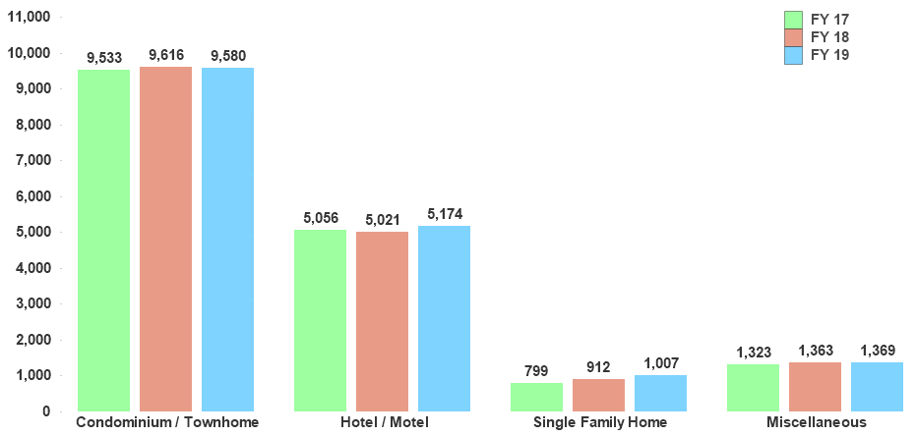
Panama City Beach
Unit Count by Property Type
Three Year August Comparison
Miscellaneous Includes: Campgrounds, Apartments, Duplex / Multi-family and Timeshare properties.
Bay County
Tourist Development Council

Slide 20
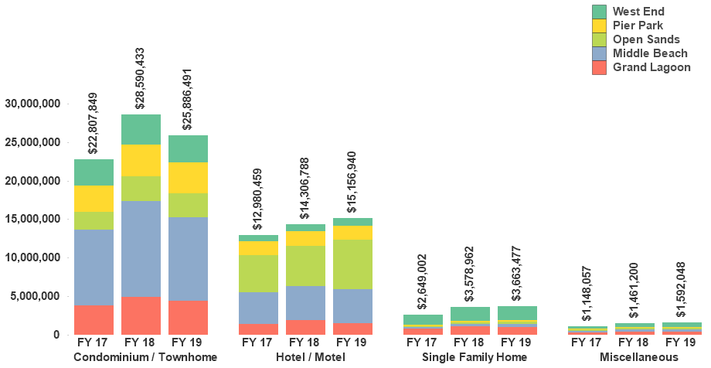
Panama City Beach
Gross Receipts by Property Type
Three Year August Comparison
Miscellaneous Includes: Campgrounds, Apartments, Duplex / Multi-family and Timeshare properties.
*Rounded to nearest whole dollar per each element
Bay County
Tourist Development Council

Slide 21
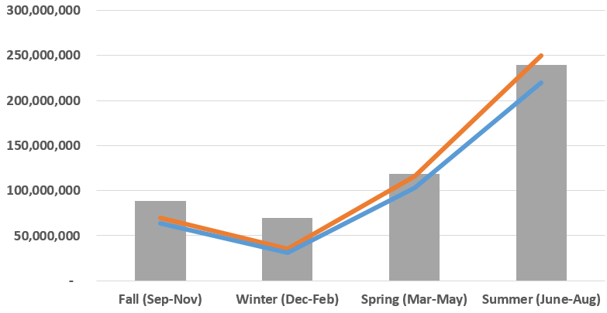
Panama City Beach
Seasonal Gross Receipts
Three Year Comparison
Bay County
Tourist Development Council

Slide 22
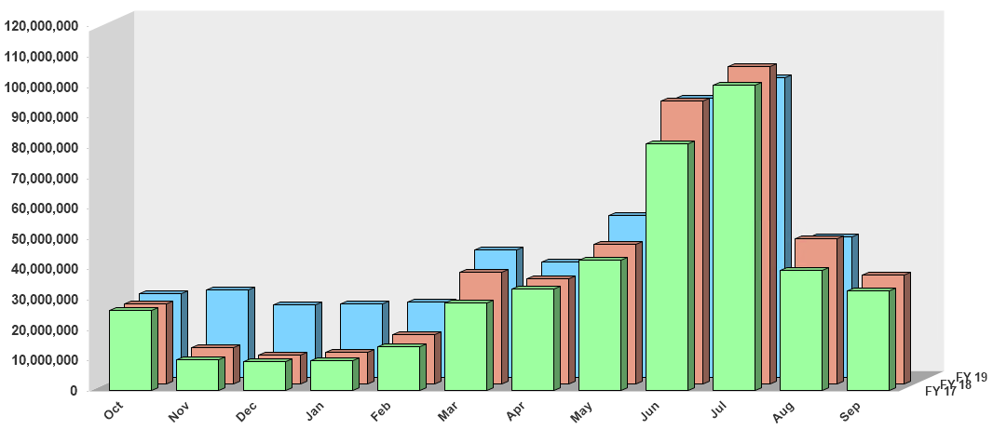

Panama City Beach
Year to Date Monthly Gross
Receipts Comparison
Fiscal Year Ending September 30, 2019
*Rounded to nearest whole dollar per each element
Bay County
Tourist Development Council

Slide 23
MONTHLY TDT DATA DETAIL
Tourist Tax Data and Statistics Report for Panama City Beach Area for month ending:
August 31, 2019
Bay County
Tourist Development Council

Slide 24


Panama City Beach
Reporting Units grouped by
Condominium / Townhome property type
for month ending August 31, 2019
Bay County
Tourist Development Council

Slide 25

Panama City Beach
Reporting Gross Receipts grouped by
Condominium / Townhome property type
for month ending August 31, 2019
Bay County
Tourist Development Council

Slide 26
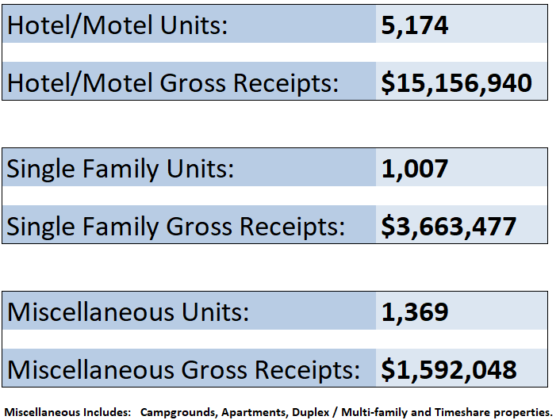
Panama City Beach
Reporting Units and Gross Receipts for
Hotel/Motel, Single Family and Miscellaneous
property types for month ending August 31, 2019
Bay County
Tourist Development Council

Slide 27








Supporting Data and Service Contributors
Robert Snaidman
Support Staff
Jennifer Morgan / Chris Mathers

