Slide 1

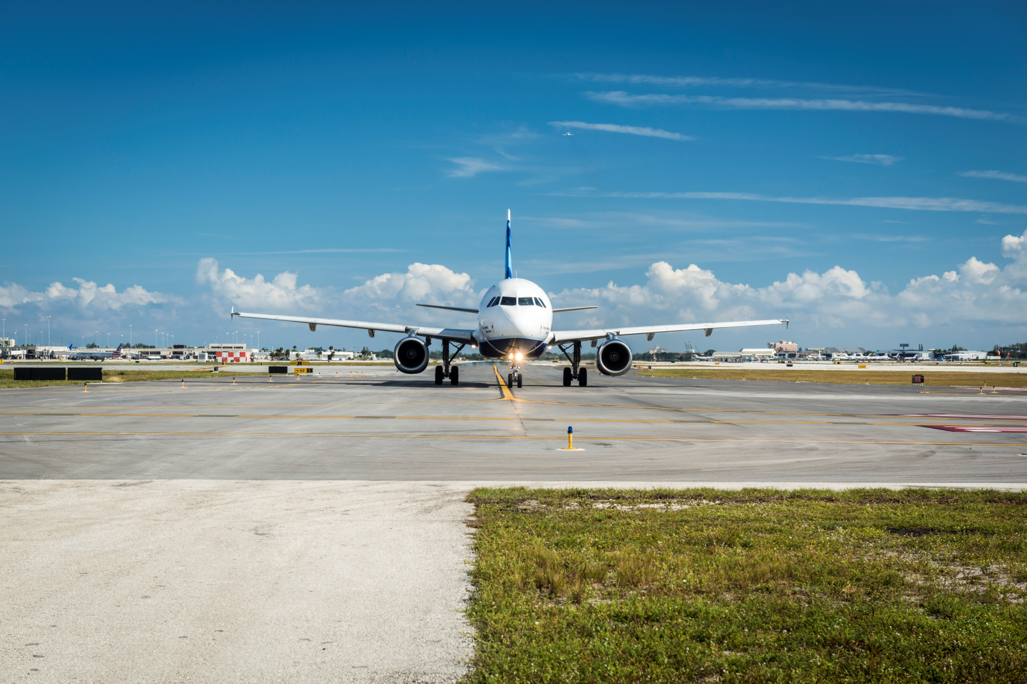
Upcoming Projects & Business Opportunities
Quarterly Workshop
2nd Quarter CY19
April 10, 2019
Palm Beach County Department of Airports

Slide 2
Upcoming Procurement Opportunities/Advertisements
Notes:
Give notes on estimated cost and type/trade of sub and when the project might hit the street.

Slide 3
Upcoming Procurement Opportunities/Advertisements

Slide 4
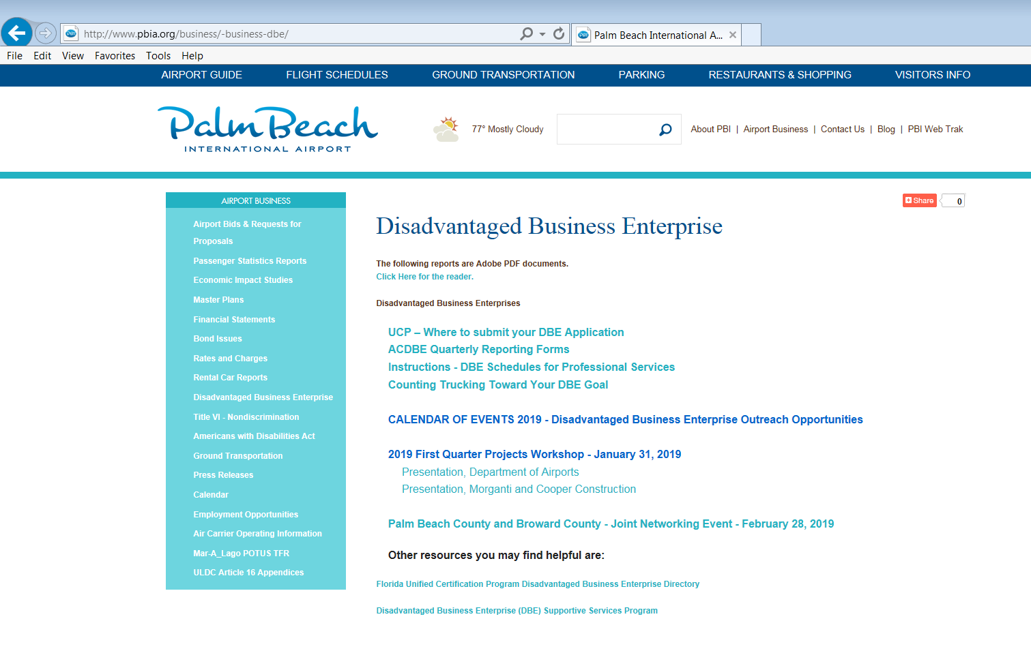
DBE Events and Opportunities

Slide 5
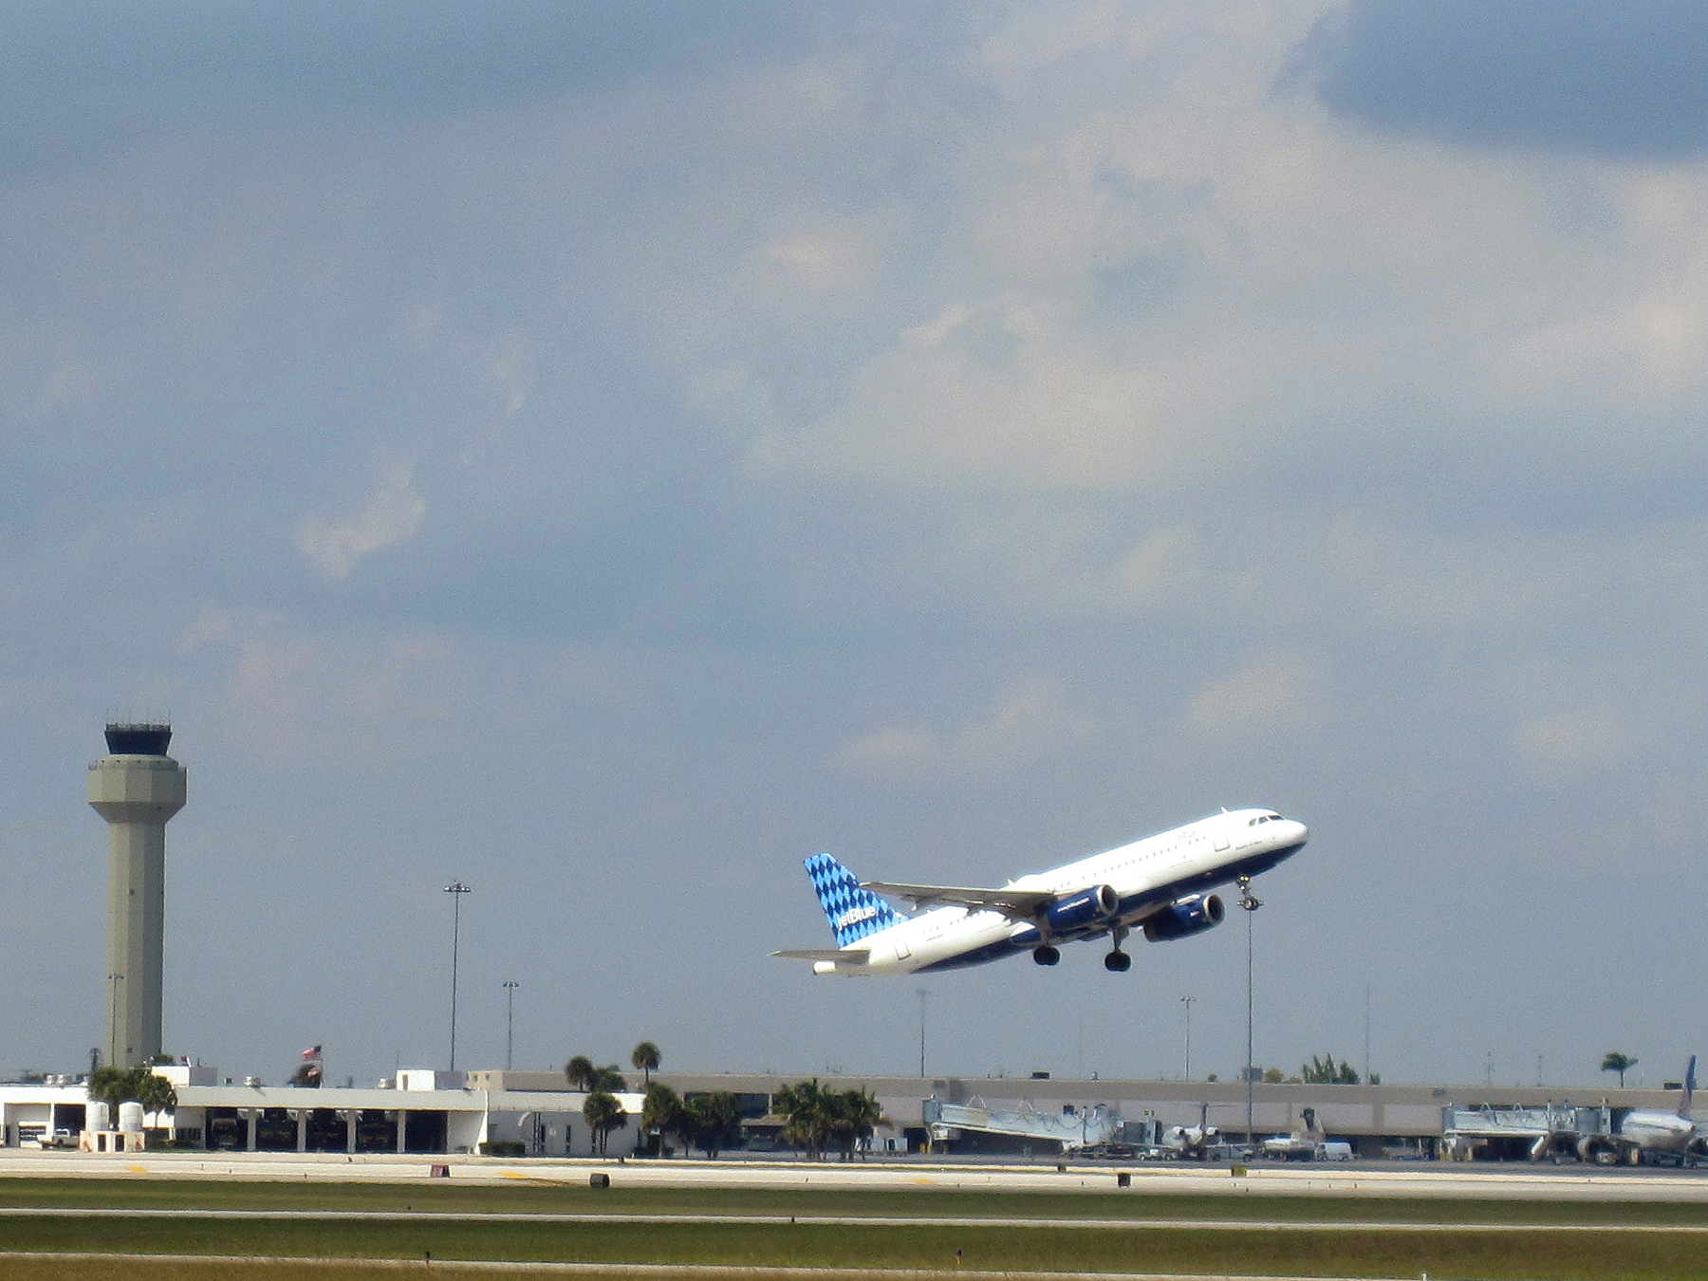
Thank You!
  Gary M. Sypek
  Director of Airport Planning
  Palm Beach County Department of Airports
  561-471-7400
  gsypek@pbia.org
  Martha LaVerghetta
  Airports Compliance Manager
  Palm Beach County Department of Airports
  561-471-7421
  mklaverghetta@pbia.org
  Lorraine Gassett
  Consultant, C.C.D.
  954-854-1894
  lorrainegassett29@gmail.com

