Slide 1
Destination Queenstown
Queenstown 101

Slide 2
Contents
01
Flight Connections & Map
02
Four Seasons
03
Experiences
04
Accommodation
05
Day Trips
06
Travel Trade Resourses

Slide 3
Flight Connections & Map

Slide 4
World Flight Connections
Notes:
Getting to Queenstown is easy whether you decide to fly, drive or catch a coach.
Queenstown International Airport receives daily direct flights from around New Zealand and Australia's main ports, and great road access on major New Zealand highways makes driving into Queenstown an easy and beautiful experience. Exploring the region once you’re in Queenstown is simple with a range of local transport options.
Where is Queenstown?
Queenstown is located in the southwest corner of the South Island of New Zealand and is very accessible with multiple daily direct flights from all of New Zealand’s main centres as well as direct scheduled services from Sydney, Brisbane, Melbourne and Coolangatta in Australia. Queenstown international airport is located just 15 minutes from downtown Queenstown and links to the city centre with shuttles, taxi services, buses and rental cars.
For visitors that chose to drive, experiencing the beautiful Southern Scenic Route through Otago and Southland is a stunning way to arrive in Queenstown or meander down the South Island from the West Coast or Canterbury, taking your time to take in the scenery along the way.

Slide 5
Trans Tasman Flight Connections
Notes:
For many of your clients, they will probably still do the dual destination, visiting both Australia and New Zealand.
Queenstown is located in the southwest corner of the South Island of New Zealand
Prior to covid, Queenstown welcomed direct scheduled services from Sydney, Brisbane, Melbourne and Coolangatta in Australia.
We also hope very soon, that we can welcome back direct scheduled services from Australia in the next short while. With the very much anticipated trans-Tasman bubble.

Slide 6
New Zealand Flight Connections
Notes:
Once arriving into New Zealand, getting to Queenstown is easy whether your clients fly or drive.
Queenstown International Airport receives daily direct flights from around New Zealand – Auckland, Wellington and Christchurch.
Queenstown international airport is located just 15 minutes from downtown Queenstown and links to the city centre with shuttles, taxi services, buses and rental cars.
For you clients that chose to drive, experiencing the beautiful Southern Scenic Route through Otago and Southland is a stunning way to arrive in Queenstown or meander down the South Island from the West Coast or Canterbury, taking their time to take in the scenery along the way.
Only 1h 30 mins from Auckland, 1hr 20 mins from Wellington or 45 minutes from Christchurch

Slide 7
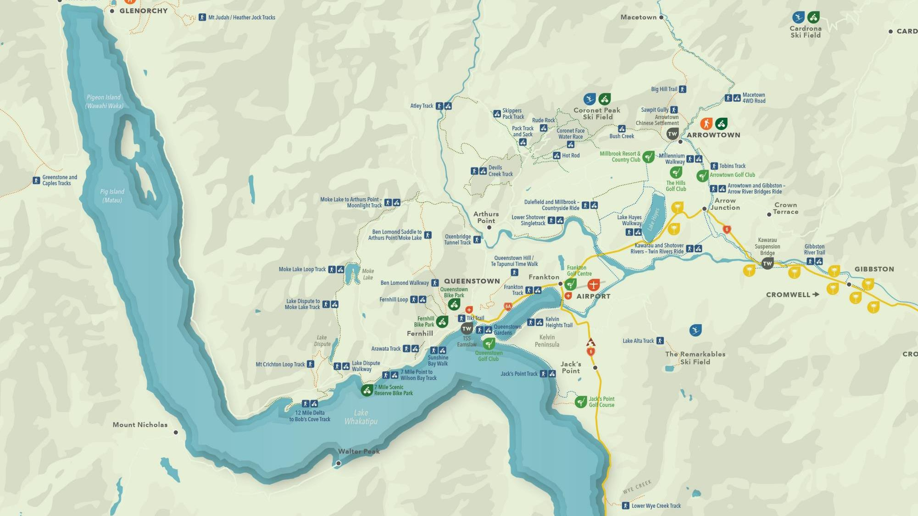
Queenstown Map
Notes:
Queenstown Central & surrounds.
This map provides an orientation for the proximity of the airport to Queenstown.
You can also see Arrowtown, which is about 25 minutes drive from Queenstown.
To the top of the lake Glenorchy, which boarders our World Heritage Area and only 45 minutes from Queenstown.
You can also see out toward Gibbston Valley (the valley of vines) which is also about a 25-minute drive and provides access to our world-renowned wine growing region.

Slide 8
Four Seasons

Slide 9
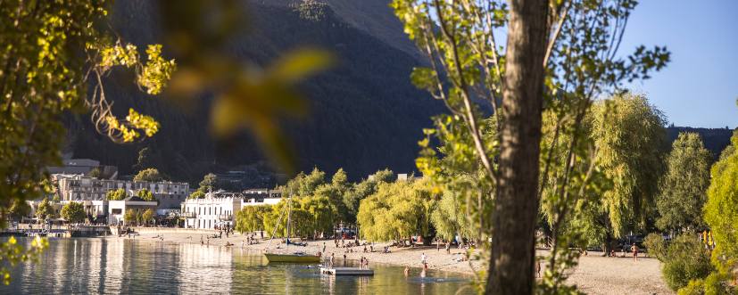
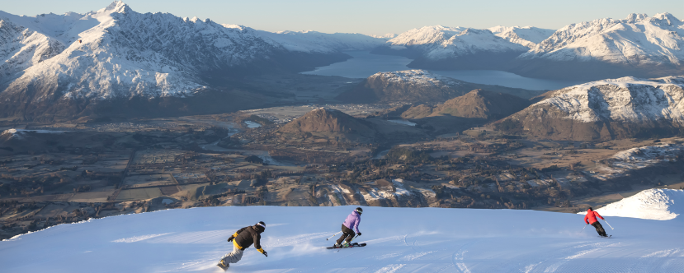
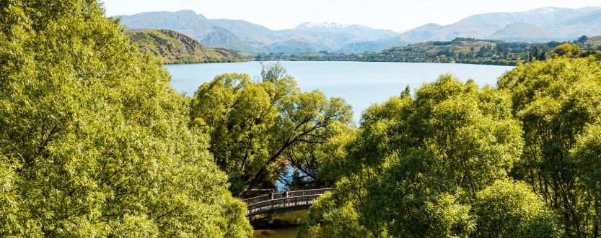
Four Seasons
Notes:
Queenstown is famous for being New Zealand’s favourite four season destination. With four distinct and unique seasons Queenstown has year-round appeal with each season offering a markedly different experience. We enjoy a continental-style climate with long hot summers and cool, crisp winters. Queenstown truly offers something for every season, very few activities aren’t available year-round, and it’s no exaggeration to say you can experience more here in a day than some do in a lifetime.
Summer
20°C to 30°C (68 to 86°F)
Queenstown sits at latitude 45° south against the dramatic backdrop of the Southern Alps. Our location allows for longer days and evenings that are perfect for getting outdoors and enjoying the diversity of landscapes and range of things to do that the region is world-famous for.
It means food, drink, socialising and an irresistible desire for adventure—whether it’s adrenaline-fuelled or leisurely exploration for an unforgettable Queenstown summer holiday.
Summer is peak season in Queenstown and the energy of the downtown area, buzzing with a cosmopolitan mix of people from all around the world, is undeniable.
The epic summer landscapes and inviting outdoors will have your clients heading outside and into nature for their next adventure.
Autumn
5°C to 25°C (41 to 77°F)
Queenstown delivers an unforgettable autumn experience.
The golden and red hues dominate the hills around the region and contrast strikingly with the deep blue of our lakes and rivers—here your clients can truly immerse themselves in the wonder of the season.
Of the four distinct seasons, autumn’s arrival in a blaze of reds and golds is the most dramatic, attracting visitors, artists and photographers from around the world.
The fantastic line-up of regional events and great holiday deals make Queenstown an ideal place to visit in autumn and there are experiences to suit any holiday, whether your clients are looking for adventure, relaxation, luxury or a family break.
The best time to visit Queenstown depends entirely on your interests. It is a true year-round destination with appeal in every month of the year. Explore below to find out more about the seasons.
Winter
-2°C to 8°C (28.4 to 46.4°F)
Set against a stunning backdrop of lakes and mountains, in the heart of the majestic Southern Alps, Queenstown is the Southern Hemisphere’s premier ski destination offering a true alpine experience.
Known as the home of adventure, Queenstown’s fun-loving culture makes for an unforgettable winter holiday.
During the day four world-class ski fields cater for all abilities, off the mountain iconic activities invite you to test your limits and a vibrant, cosmopolitan town centre offers bustling après ski and a sophisticated bar and restaurant scene.
Spring
8°C to 22°C (46.4 to 71.6°F)
Spring in Queenstown is a time for fun and discovery with a sense of energy and playfulness.
The region transforms with bright colours of fresh buds and green pastures yet are surrounded by snow-capped peaks
Spring is a unique season when your clients can literally do everything Queenstown has on offer.
With the ski fields open until early October, but the basin green with fresh growth, your clients can ski in the morning and either golf, mountain bike or hike in the afternoons.

Slide 10
Experiences

Slide 11
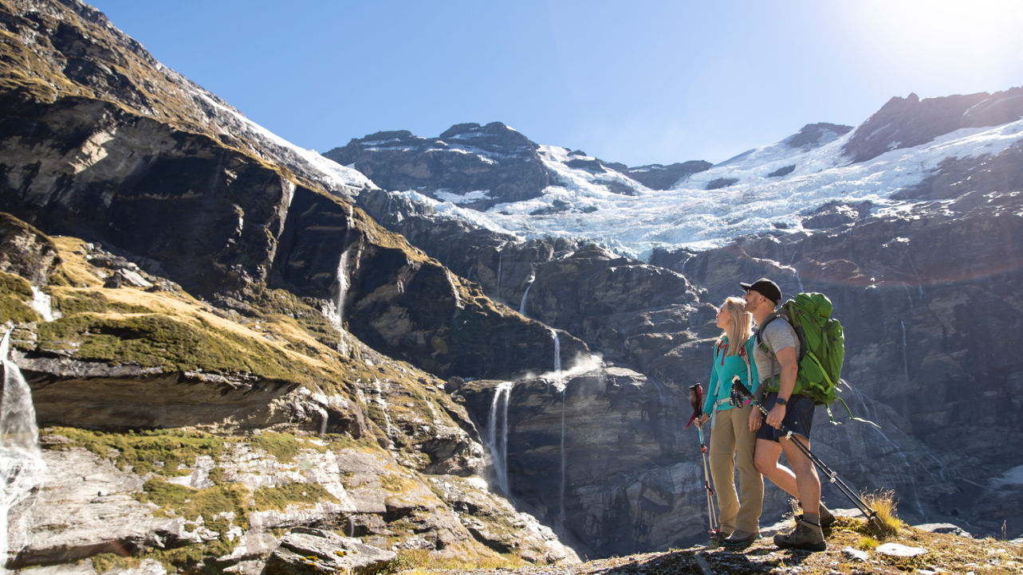
Hiking & Nature
Notes:
Queenstown is renowned for awe-inspiring panoramas and dramatic scenery that invite you to step into nature and explore and centred within a majestic lake and alpine landscape.
Three Great Walks (the Routeburn, Milford Track and the Kepler), are accessible from Queenstown including multiple national parks, conservation areas and a range of outdoor experiences.
The choice for day walks to iconic multi-day hikes, ensures that Queenstown has a variety of easy to access trails that will have your clients experience diverse landscapes and stunning scenery, including native forests, rivers and waterfalls, lakes and mountains.
From the experienced explorer that is planning their own adventure, to those seeking guided or fully catered experiences, Queenstown offers a range of services and information to plan your trip. There is also great support infrastructure that includes track transport, department of conservation office, lodging, guiding and fully inclusive packages.
For any outdoor enthusiast, Queenstown offers an extensive range of ‘other’ outdoor activities, from climbing and rafting to canyoning and kayaking, these all really invite you to step away, pursue your passions and connect with nature.

Slide 12
Mountain Biking
Notes:
Queenstown is an international mountain biking destination. We boast three lift-accessed parks (Skyline, Coronet Peak, Cardrona). But also quality gravity-fed downhill biking all bundled in an iconic, world famous alpine location!
There is a comprehensive range of mountain biking with trails to suit riders of all abilities and styles - from backcountry trails, downhill, single tracks, jump parks, flow trails and heli-biking to short scenic trails and lift-assisted riding – all with excellent trail quality and diversity of terrain.
We welcome the hardiest of bikers to the aspirational progression riders. The varied terrain here coupled with an array of international-standard facilities attract some of the world’s best riders who use this as their training ground!
Our bike culture is really unique. We have very passionate locals who are part of the renowned Queenstown Mountain Bike Club which created and maintain a range of free to access bike trails.
The mountain bike experience is also supported by an extensive range of bike services. As well as a range of world-class amenities and a very vibrant bike social community.
With continual development and our committed local mountain bike community the trails seen here continue to evolve.
The upside to round out the experience is Queenstown’s diverse and cosmopolitan nature which makes it a really social and fun destination, especially with lots of bike-friendly eateries and pubs close to bike tracks.
Our vibrant nightlife and burgeoning après-bike scene, means the fun goes on well after the sun sets!

Slide 13
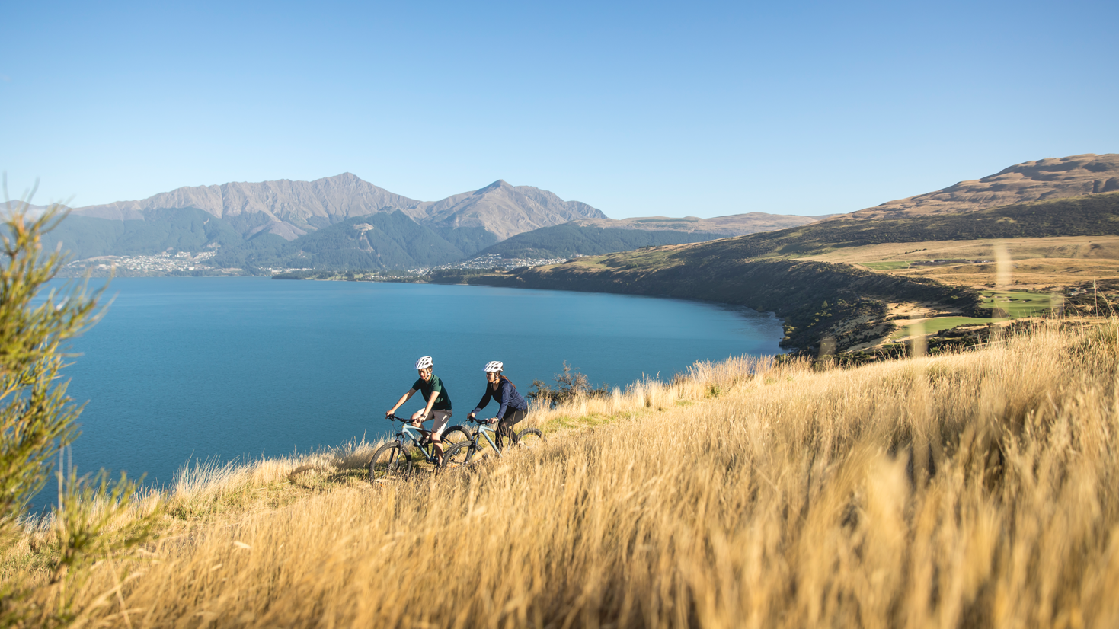
Leisure Biking
Notes:
There is an extensive network of trails, from short scenic rides to multi-day adventures. Biking is a great way to explore the region and experience some of NZ’s most scenic landscapes.
You can choose a guided ride or you can set your own pace as you explore over 130km of biking trails on one NZ’s famed Great Rides – the Queenstown Trail. Where you will experience unparalleled scenery, heritage sites, suspension bridges, forest, rivers and lakes.
And, with trails for all abilities and amenities for both independent adventurers or if supported riding is more your preference, Queenstown is a great place to include biking in your adventure.
Queenstown is not only the gateway to the Queenstown Trail, one of New Zealand’s Great Rides, but also to FIVE others.
Great Rides:
Around The Mountains (Walter Peak to Kingston)
Otago Central Rail Trail
Lake Dunstan
Roxburgh Gorge Trail
Clutha Gold Trail
And, to support all of your biking adventures there are a range of biking services including bike hire, transport and guided trips.
This again is all complemented by an extensive range of visitor experiences, world-class activities and exceptional food and wine to round out any adventure.

Slide 14
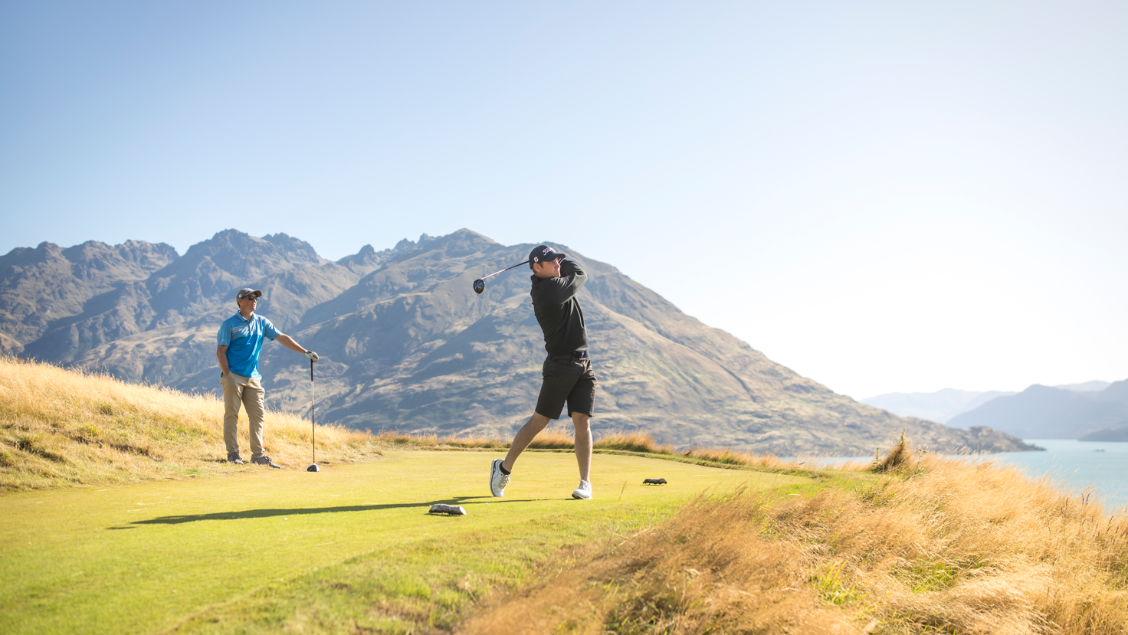
Golfing
Notes:
Queenstown boasts EIGHT spectacular golf courses, including four championship courses and four experience courses. Six of which are located within 25 minutes of downtown. Making Queenstown New Zealand’s premier golf destination.
We have multi award-winning courses, a diverse range of golfing experiences and world-class facilities all set within spectacular alpine landscapes.
There are a variety of golfing experiences that cater to all abilities and challenge levels, and there are experienced local golf operators that offer services and tailored packages to suit golfers of all abilities too.
It is the dramatic natural landscapes and breath-taking scenery of Queenstown that come together, alongside skilful course design, that truly create unique golf experiences.
We are also the host destination to the New Zealand Open, which is played at the prestigious Millbrook Resort, the golf venue that is home to two of our eight courses.

Slide 15
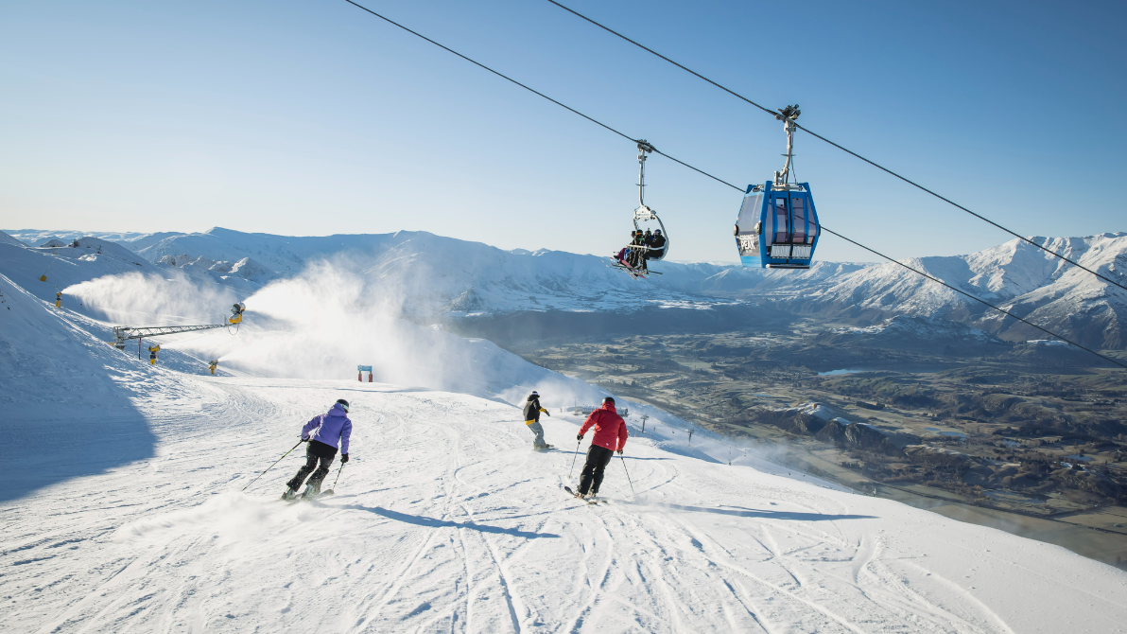
Ski
Notes:
Four ski resorts: Coronet Peak and The Remarkables in Queenstown and Cardrona and Treble Cone in Wanaka. The travel time to access these mountains range from Coronet Peak in 25 minutes to Treble Cone taking about 90 minutes.
Queenstown is a world-class ski destination that offers something for everyone… and great for progression learning with purpose-built beginner slopes, consisting of a wide variety of terrain with lifts and chairs designed for beginner progression as mentioned through to intermediate and advanced skiing abilities.
One of the great specialities is Queenstown’s vibrant nightlife and the après ski scene, sophisticated food and wine culture to match. Which provides a great chance to sit back with a pinot noir, fireside with friends to round of your day on the slopes.

Slide 16
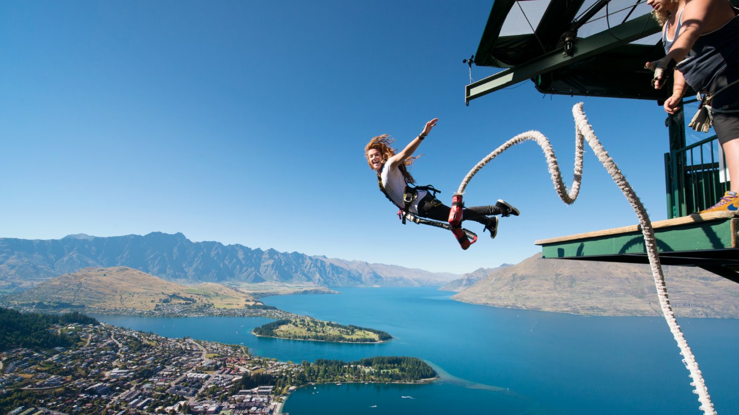
Adventure
Notes:
Queenstown has forged an enduring reputation as a world leader in adventure tourism.
This region has been a magnet for adventurers and entrepreneurs for a long time, making it the home of many firsts!! That includes - the world’s first commercial jet boating and bungy jumping operations and NZ’s first commercial ski field, river surfing, rafting, paragliding and skydiving!!
The diverse natural environment sets the stage for a range of year-round thrills.
Our history and our love of adventure really continues to shape Queenstown’s culture, inspiring innovative new ways to challenge and thrill visitors! That in turn encourages people to challenge themselves and discover not only something new but also to create lifelong memories!
Queenstown’s fun-loving and adventurous culture is definitely tangible in the vibrant and youthful town.

Slide 17
Family
Notes:
Explore Queenstown with the family and discover many new experiences together. There are many activities in Queenstown that are suitable for children and most companies offer kids’ prices or even ‘kids go free’ promotions at certain times of the year.
Some great family activities include visiting farms, jetboating (for those tall enough), paddleboarding or kayaking, or you can go beneath the water’s surface and see the trout and salmon that gather at the Queenstown Pier for regular feeds.
There is some great off the beaten track experiences with an off road adventure or land tours. Hiking or biking is another family-friendly option to get out and explore the wide open trails and taking the views in along the way.
And for downtime or rainy days there’s plenty of indoor fun activities, including the cinema and swimming pools, go karting, indoor skydiving and trampolines to keep everyone occupied and happy.

Slide 18
Food & Drink
Notes:
Food and wine is one of those experiences that unpin all of the previously mentioned segments.
Queenstown offers some of the best restaurants and bars in New Zealand. With delectable food and a great night out practically always on the menu.
There are more than 150 cafes and restaurants innovative and award-winning restaurants and eateries to cater for any occasion from fine dining to fun dining. And, our local chefs are really passionate about using local ingredients, and different seasons, always bring changes to menus to reflect the season’s freshest produce.
In downtown Queenstown you will find stylish bistro food, celebrity chef restaurants, traditional pub meals, designer burgers and a variety of ethnic cuisine. If you have special requirements, in Queenstown you can easily find delicious vegetarian, vegan, halal and gluten-free options.
Gibbston, the 'Valley of Vines', is only a 25 minute drive from Queenstown. This area is home to some of the world’s best Pinot Noir and there are about 200 vineyards to sample wine from when you explore Gibbston and beyond including Bannockburn, Bendigo and Cromwell. Biking/e-biking is also a popular option to explore Gibbston for a half or full-day, with wine tours and shuttles available.
Another experience that is really gaining some traction here also is craft beer with some local brewers, these little spots not only define some great hidden secrets but these craft beers also appear on many of our local bars menu selection, supporting the love and passion from our local brewers.
Food and wine really is an integral part of any holiday experience and Queenstown really does deliver!
Settle in for the evening at a cosy wine bar or friendly pub or explore the town and experience Queenstown’s legendary night life, and discover the vibrant atmosphere, any night of the week.

Slide 19
Accommodation

Slide 20
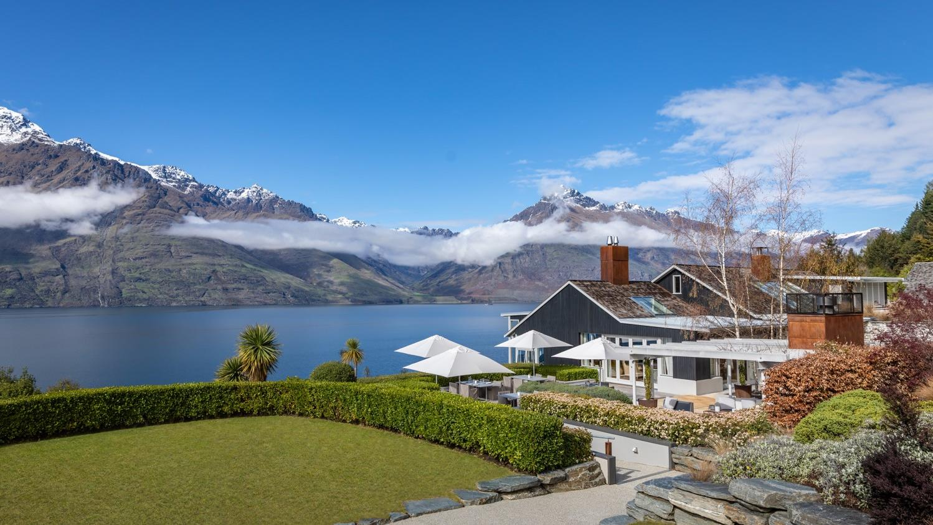
Accommodation
Notes:
Queenstown has a huge range of accommodation styles to suit every age and stage, style and budget. The budget conscious traveller can book into backpacker accommodation, and if you’re travelling with a tent or camper, Queenstown has a number of well-equipped and centrally located holiday parks. If you’re looking for a homely feel try one of Queenstown’s bed and breakfasts in surrounding Arrowtown or Glenorchy. Motels, are well suited for those on a driving holiday, and are dotted around town. There are many hotels and resorts located centrally within walking distance to Queenstown’s vibrant CBD. Queenstown’s award-winning luxury lodges and retreats show off stunning alpine views, and if you’re travelling with family and require shared accommodation, there are serviced apartments and holiday houses so you can self-cater with ease.
There’s a lot of variety when it comes to Queenstown's hotel and resort accommodation. Ranging from boutique hotels to internationally recognised resorts, many offer lake and alpine views of Queenstown's famed scenery.
Many large hotels and resorts are located centrally within walking distance of the town's centre. If you’re after something away from the hustle and bustle, hotels line the shores of Lake Wakatipu, and can be found close to the airport in Frankton or in neighbouring and quaint Arrowtown. With excellent facilities including restaurants that feature winelists rich with Central Otago vintages as well as spa, pool and sauna facilities, Queenstown’s hotel and resort accommodation is second to none.
Self-contained or serviced apartments in Queenstown range from private luxury apartments high in Queenstown’s hills to serviced apartments in the heart of town for those seeking out the nightlife close by. Private apartments offer travellers comfort and style where you can focus on your holiday without worrying about the everyday. Perfect for groups of friends, couples, and families, you can sit back, relax and enjoy the crystal-clear views of Lake Wakatipu.
Queenstown’s lodges and luxury retreats provide the very best in exceptional, private accommodation. From exclusive penthouses, to boutique five-star lodges and retreats, Queenstown is renowned internationally as a world-class destination for luxury accommodation, and bespoke premium experiences. You might find yourself at an exclusive hunting and fishing lake front lodge surrounded by mountains, or at a hidden lodge tucked away from the bustle of central Queenstown, for the ultimate four-season lake and alpine experience, pick one of New Zealand’s top lodges in the heart of the Southern Alps. Helicopter or jet boat transfers can be arranged to a number of luxury accommodation providers, you just have to ask. Pure indulgence is on the menu here in Queenstown.

Slide 21
Day Trips

Slide 22
Day Trips
Notes:
Queenstown is a great base to explore the Sounds, especially if you have clients staying for more than a couple of days. The iconic Milford Sound (as in the photograph) can be reached by self-drive, coach, helicopter or fixed wing plane. Best way to sell this product is by coaching one way and flying the other to get the best of all the landscape. Once there, there are several cruise companies that offer scenic cruises on the fiord for up to 2 hours, and some that offer trips into the Underwater Observatory. Rain, hail or shine - Milford Sound is breathtaking in all weather. Especially, when it rains the waterfalls are sensational!
Glenorchy, is a true slice of New Zealand paradise that sits a spectacular 45-minute drive northwest of Queenstown at the northern end of Lake Wakatipu. The scenic drive along the shores of Lake is breathtaking. And no drive to Glenorchy is complete without a stop at Bennett Bluff for a photo. Surrounded by magnificent snow-capped mountains, pristine lakes and rivers, ancient beech forests and at the edge of Mount Aspiring and Fiordland national parks, the frontier town of Glenorchy has provided the backdrop for many films, including The Hobbit and Lord of the Rings. The nearby settlements of Kinloch and Paradise are also known for their stunning scenery and tranquil setting. The area is also the gateway to several world-famous multi-day hikes including the Routeburn Track, one of New Zealand’s Great Walks. For walks closer to town, there are well-graded walkways that lead to points of interest including the Glenorchy Walkway, Whakaari Conservation Area and Mt Judah, where the remains of scheelite mines can be found. There are a number of exciting ways you can explore the beauty of this pristine area. Take the sites in by horseback and ride through braided rivers, native forests and across open fields. By water you can journey into the heart of glacier country with a jetboat, canoe or kayak. Take a stunning scenic flight into unexplored wilderness or experience the thrill of a skydive over landscapes that have remained untouched for centuries. Or, grab your backpack and hiking boots to enjoy a walk, try your luck at fly-fishing, enjoy a farm tour or 4WD experience.
Arrowtown is a historic former gold mining town, rich in heritage and one of the South Island’s and New Zealand’s, iconic visitor destinations. Located only 20 minutes’ drive from Queenstown, the spectacular scenery, distinct four seasons and charming character make Arrowtown a must do for visitors from all over the world. This delightful town has maintained its rich heritage and historic buildings and is now a vibrant destination with world class food and beverage, shopping and attractions. Arrowtown's history has been well preserved, and a stroll through the main streets or down to the Chinese Village gives you a glimpse into what life would have been like for the early settlers. Some of the ‘must-dos’ in Arrowtown include visiting the historic Chinese miners village, now stone ruins but once a thriving settlement, trying your hand at gold panning in the Arrow river, visiting the Lakes District Museum or browsing through the boutique shopping precinct.

Slide 23
Travel Trade Resources

Slide 24
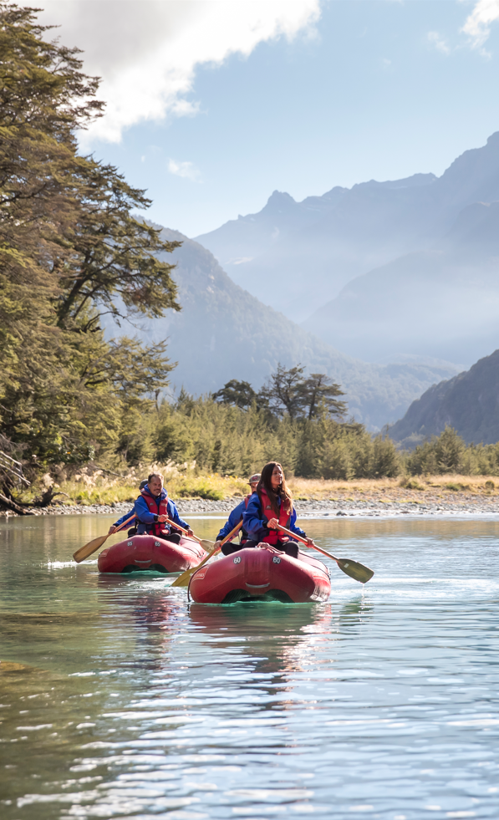
Travel Trade Resources
Scan for Destination Queenstown Travel Trade Website

Slide 25
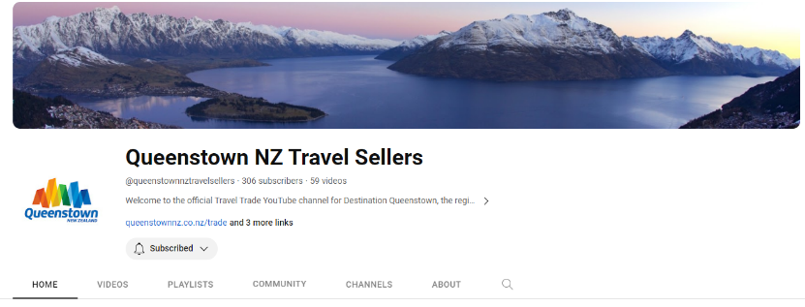
Travel Trade Resources
Travel Trade Website
Trade Newsletter
Facebook Group
YouTube Channel
Notes:
Travel Trade Website – What’s New, The Tools, Itinerary Inspiration
Newsletter – monthly updates
Facebook Group
YouTube Channel

Slide 26
Meet the Travel Trade Team
Linda McIntosh
Trade Marketing Manager
Yangzi Zhang
Rose Wood
Account Manager - Asia
Business Development Executive

Slide 27
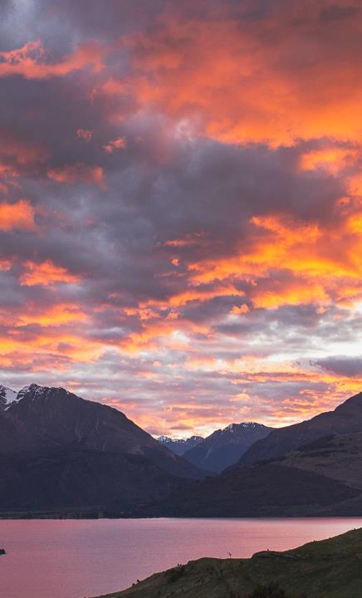
Thank You
Linda McIntosh
E: lindam@queenstownnz.nz
P: +6427 264 7533
Yangzi Zhang
E: yangziz@queenstownnz.nz
P:+6422 455 0973
Rose Wood
E: rosew@queenstownnz.nz
P:+6427 467 6878

