Slide 1
Destination Queenstown
New Product
July 2022

Slide 2
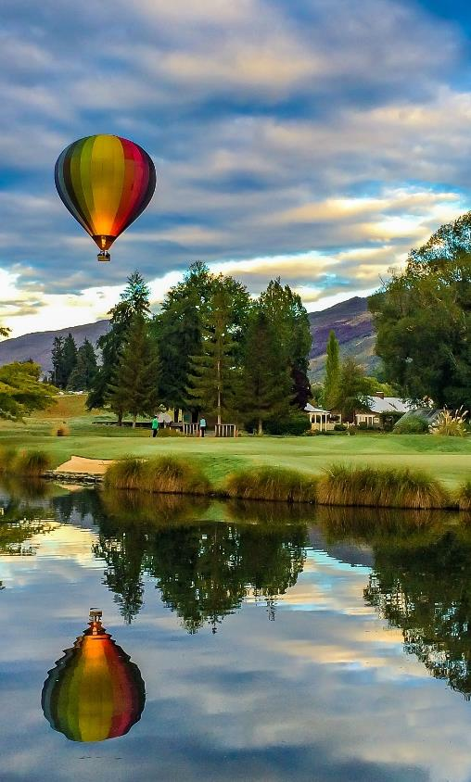
Contents
01
Activities
02
Accommodation
03
Eateries
04
Resources and Meet the Team

Slide 3
Activities

Slide 4
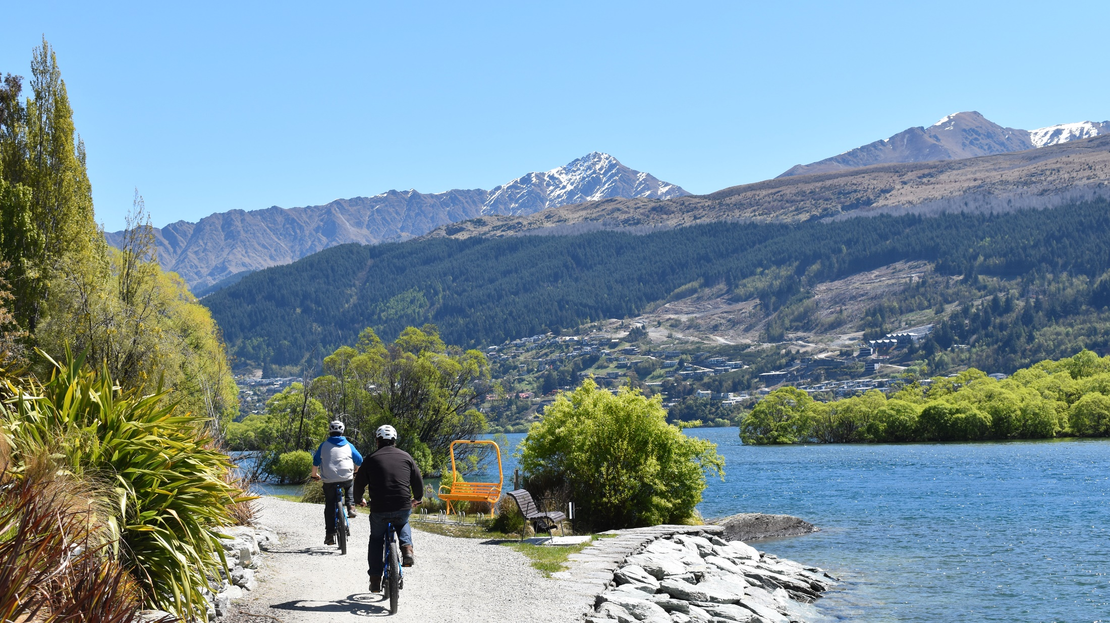

Better by Bike
Notes:
With cycling gaining so much popularity lately, they are very excited to open their newest bike hire location over the Summer period. Now you can find them in both Arrowtown and right on the water's edge of Lake Whakatipu at the Hilton Hotel. With the addition of our new location they now have direct access to connect the entire 130 kms of the Queenstown Bike Trail, connecting Queenstown with Arrowtown and the Gibbston Wine Region. Alongside this they launched their new website, which has details on all the new trail options available.
https://www.queenstownnz.co.nz/listing/better-by-bike/14765/

Slide 5
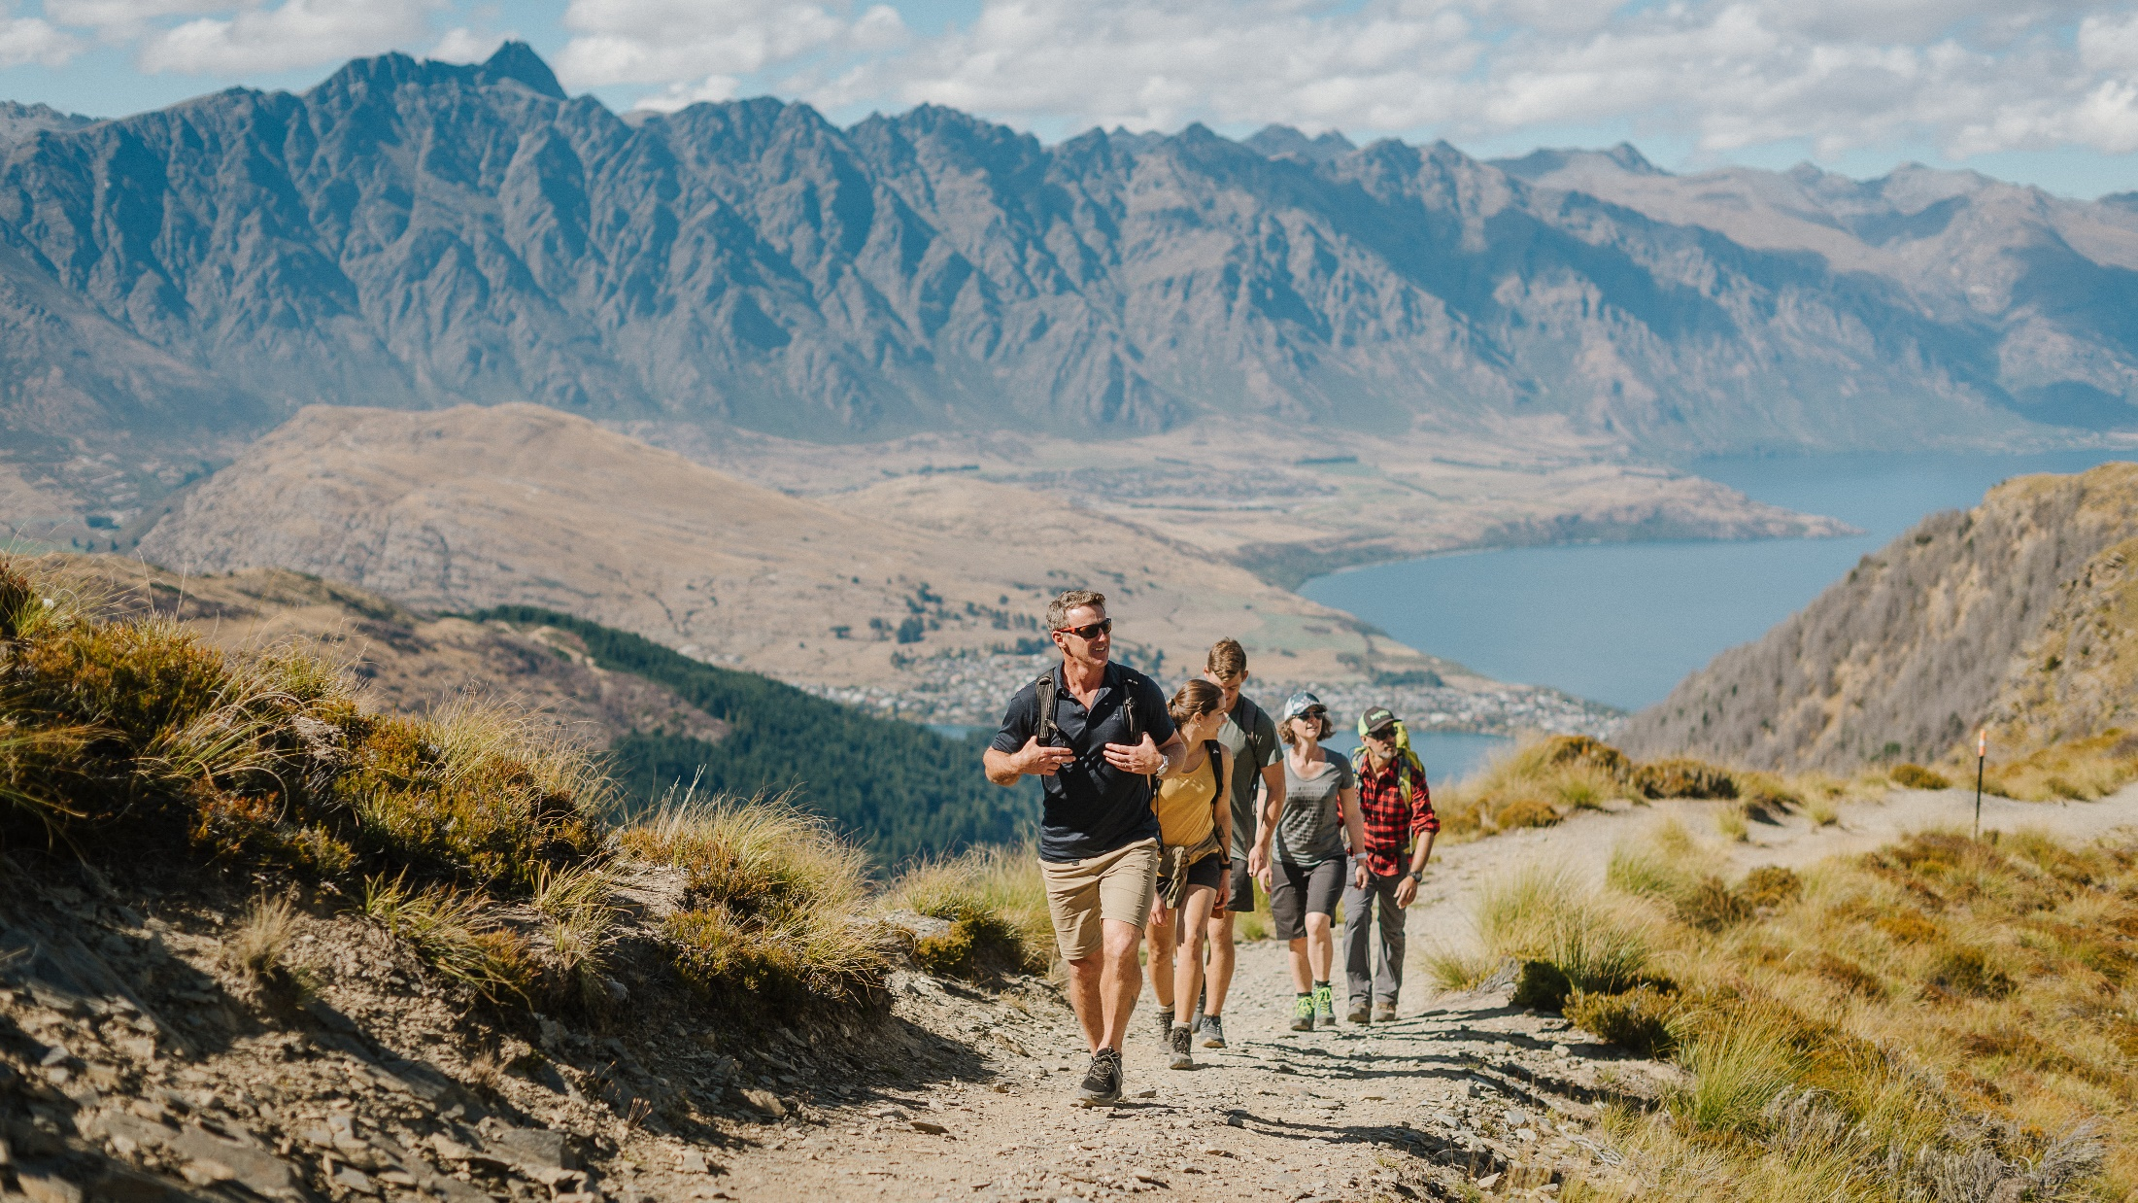
Skyline Queenstown– Guided Walks
Notes:
Introducing Skyline’s newest experience: Guided Walks.
Skyline Guided Walks welcomes guests of all ages and abilities to take a step outside their comfort zone and journey up Ben Lomond's great granite peak. Led by expert local guides, walkers can chose the Ben Lomond Saddle Hike (4 hours) revealing awe-inspiring views across to Mount Aspiring National Park, or conquer the peak on the Ben Lomond Summit Hike (5-6 hours). Both hikes include an all-inclusive packed lunch as their experienced guides take guests on an unforgettable journey discovering our region's history, geography, fauna, and flora.
Guided Walks is a seasonal experience from Oct-April, small group sizes.
FAQ’s is here.

Slide 6
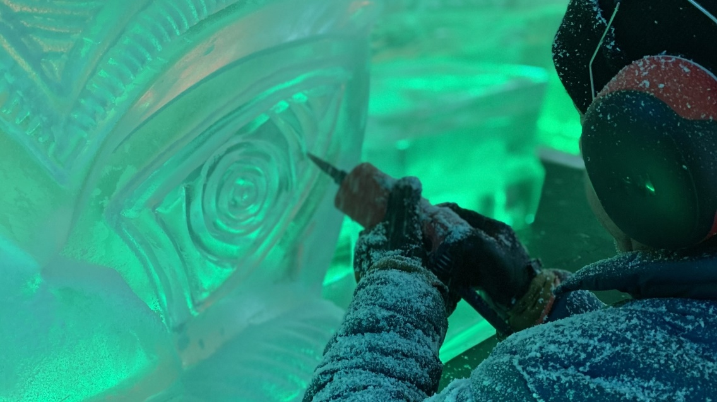
Upper Village – Queenstown Ice Bar
Notes:
An elevated take on the classic Ice Bar experience, offering premium cocktails, a striking lounge bar, and a truly unique night out in one of the most scenic cities in the world. They’re located next to the iconic Queenstown Gondola. Settle in and let them take care of you for your pre-dinner tipple, après ski cocktail, or late-night drinks.
https://www.queenstownicebar.com/

Slide 7
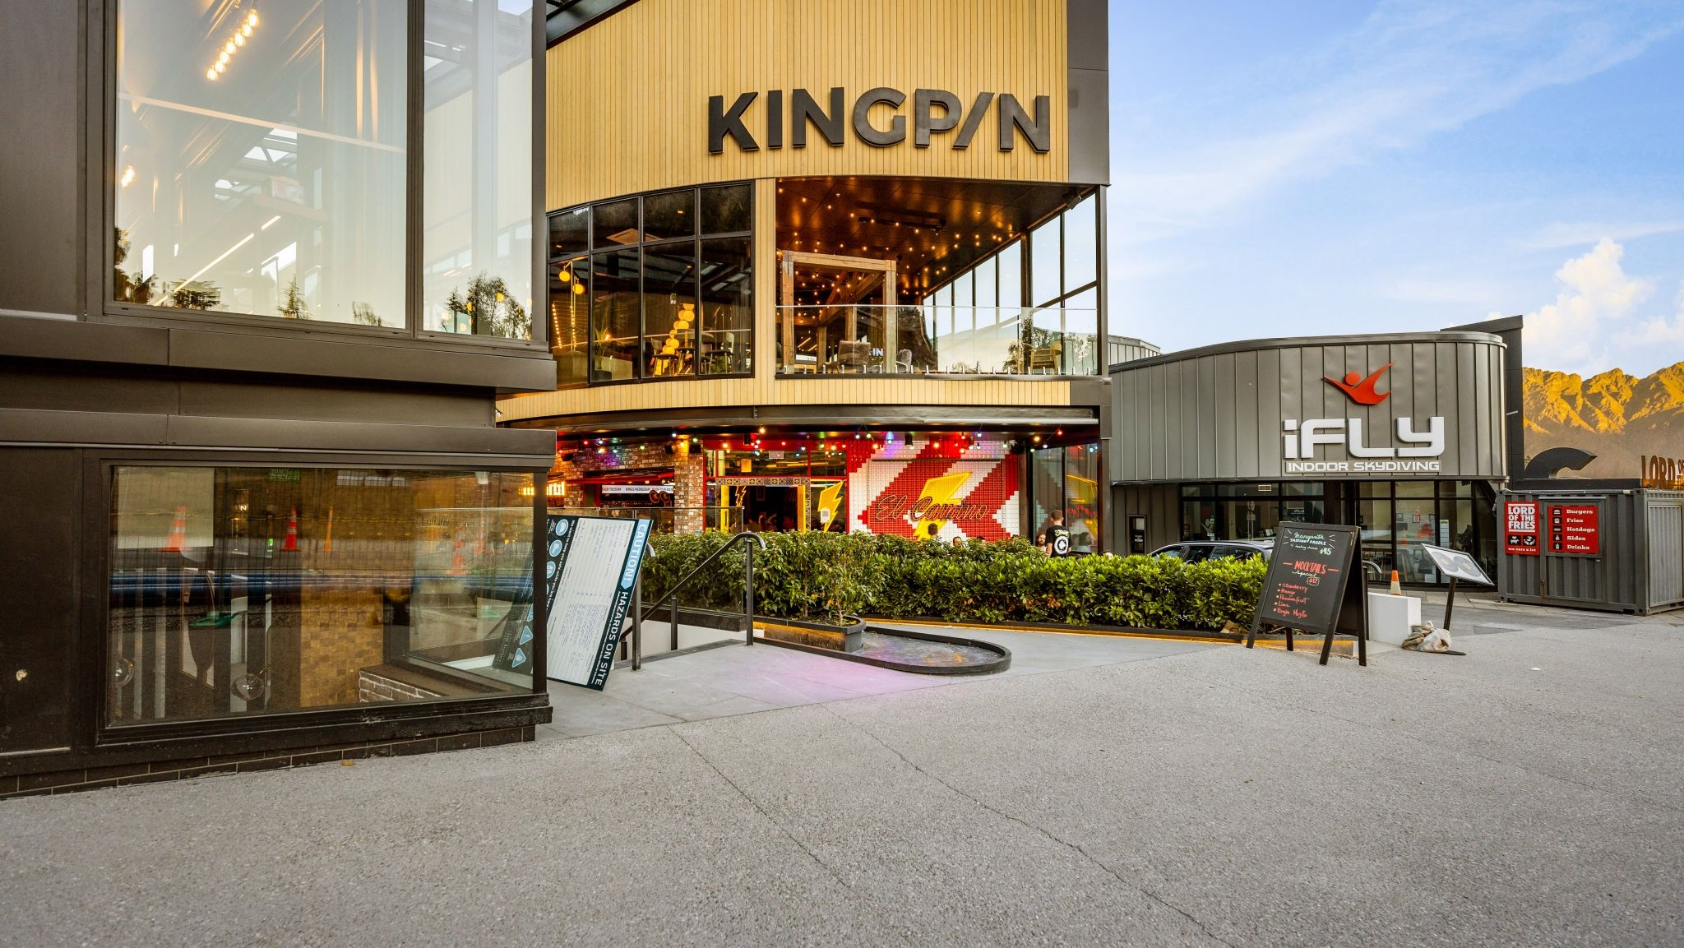
Upper Village - Kingpin
Notes:
Kingpin has recently opened in Queenstown, right beside iFly and below the Skyline Gondola. Have the time of your life with their ten pin bowling lanes, arcade, virtual reality games, escape rooms and private karaoke rooms. Perfect your experience with an exclusive party in our VIP event spaces.
https://www.kingpinplay.com/en-nz/venues/new-zealand/Queenstown

Slide 8
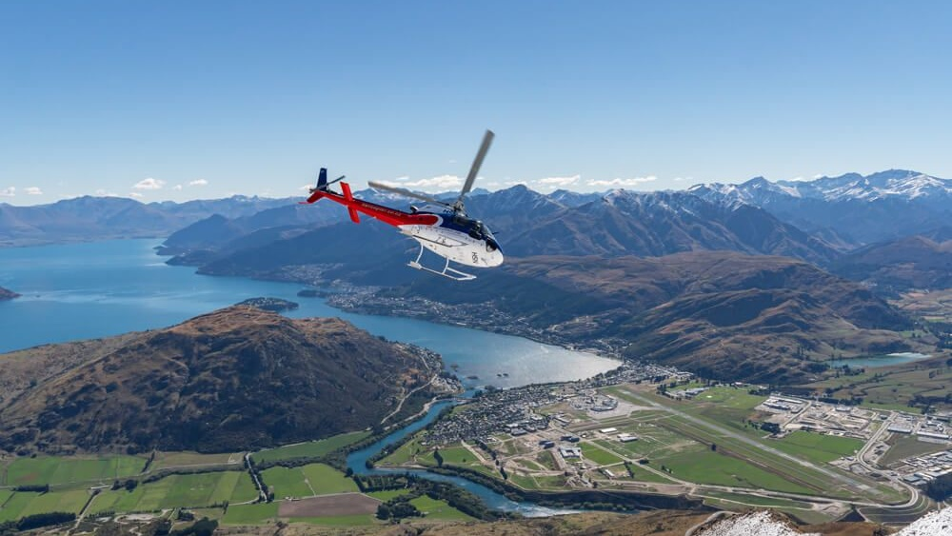
Altitude Tours - Heli Gin Tour
Notes:
Altitude Tours has recently introduced NZ’s first heli gin tour. This 6 hour experience runs daily from 1pm but has a minimum numbers required of 4 people. It includes return transport, a 15-minute scenic flight in the Cardrona Valley, with three gin tastings and a cellar door up Mt Sale, Cardrona Distillery, The Winery and Gin Garden by Broken Heart Gin.
https://www.altitudetours.co.nz/tour/queenstown-heli-gin-tour/

Slide 9
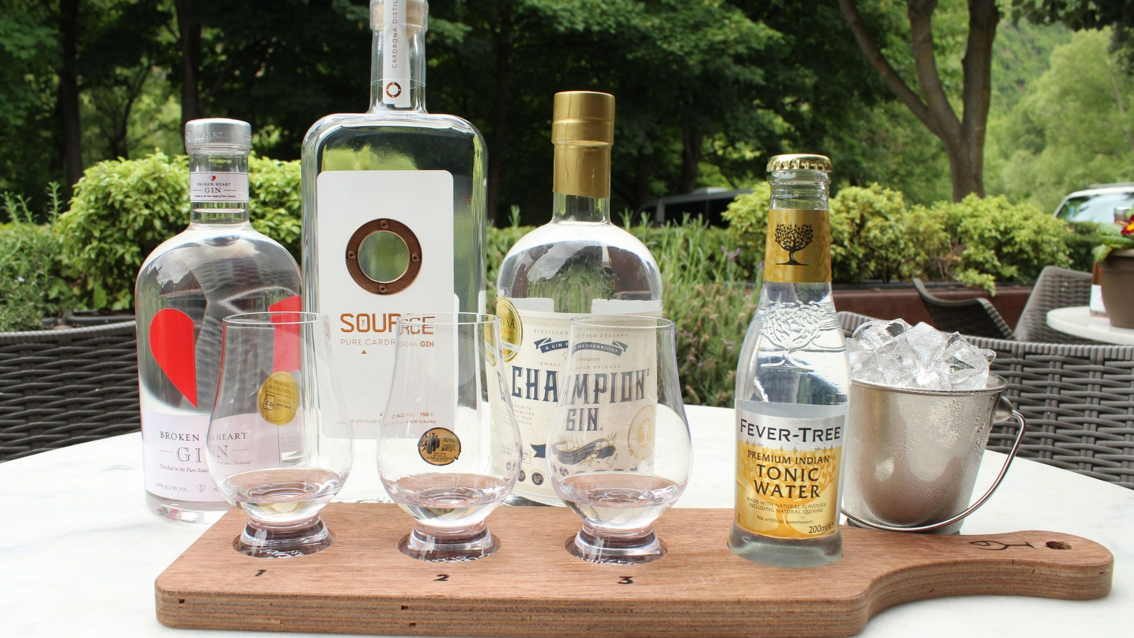
Altitude Tours – Queenstown Gin Tour
Notes:
Altitude Tours has recently introduced NZ’s first gin tour. This 6 hour experience departs daily at 1pm and returns at 7pm. It includes transport, three with three tastings, with a visit to Cardrona Distillery, The Winery in Arrowtown and Gin Garden by Broken Heart Spirits.
https://www.altitudetours.co.nz/tour/queenstown-gin-tour/

Slide 10
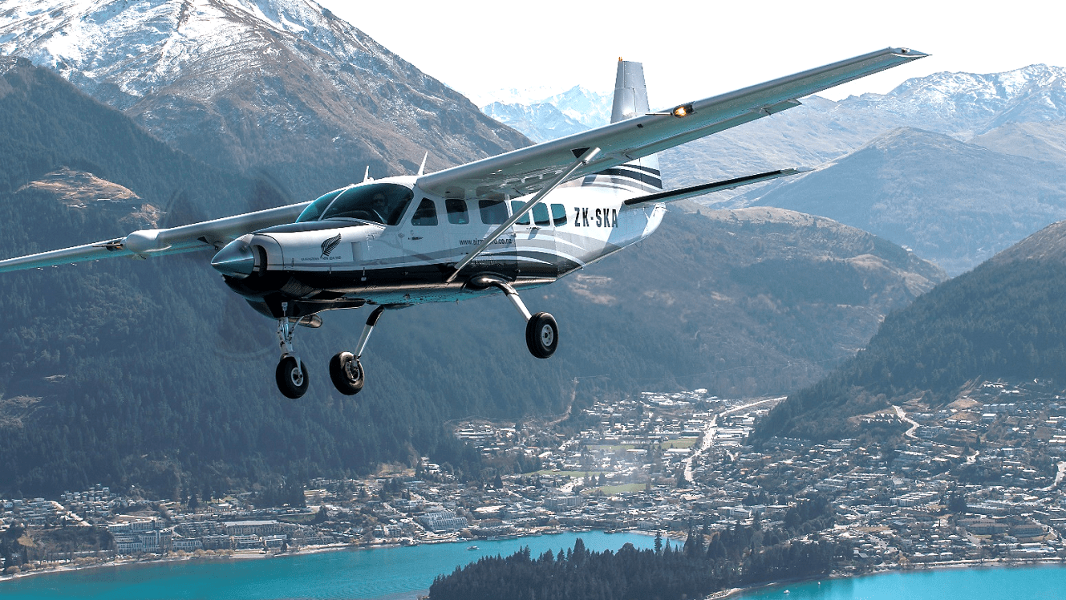
Air Milford - Ride from the Sky
Notes:
Air Milford has recently introduced their Ride from the Sky offering. This includes a scenic flight over Queenstown, Lake Whakatipu & the surrounding mountains, and a 32km trail traversing the rolling hills and shores of Lake Whakatipu past Mt Nicholas Station to the Walter Peak Homestead. Hear you will enjoy a delicious gourmet bbq meal at the homestead with a return over the lake back to Queenstown on the historic TSS Earnslaw.
https://www.airmilford.co.nz/new-zealand-scenic-flight.html

Slide 11
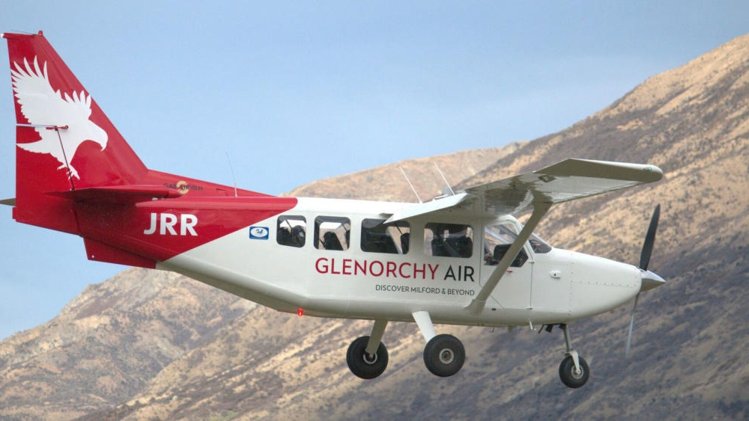
Glenorchy Air – Milford Sound Ultimate Overnight Experience
Notes:
Glenorchy Air is now offering a Milford Sound Ultimate Overnight Experience where guests get to explore all that Milford Sound has to offer.
The Ultimate Overnight Experience includes an unforgettable journey into the heart of Milford Sound by coach, a cruise aboard a spacious, modern catamaran, an overnight stay at Milford Sound Lodge and finishes with a return scenic flight to Queenstown
https://www.glenorchyair.co.nz/destinations/milford-sound-glaciers/milford-sound-ultimate-overnight-experience/

Slide 12
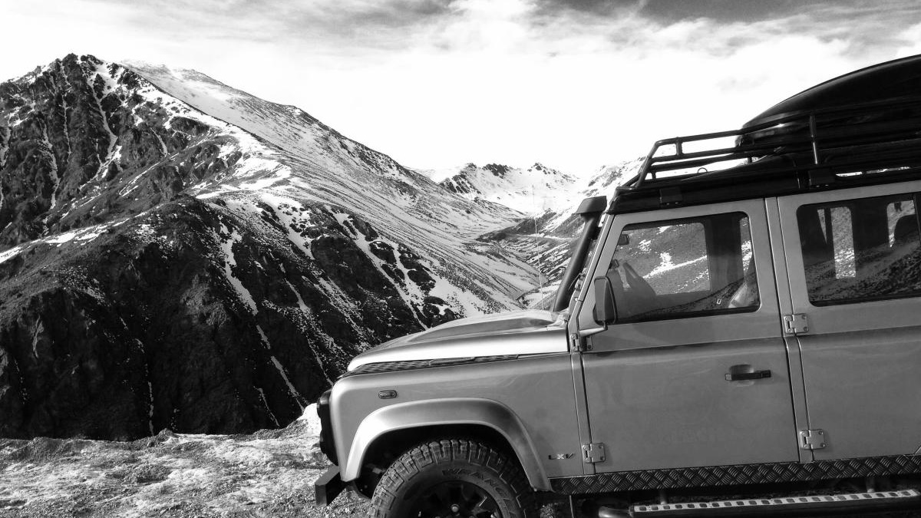
Black – High Country Experience
Notes:
BLACK will be soon offering a new exclusive farm experience right here in Queenstown. Private, guided journeys, with options for heli in both ways or one way, connecting by luxury 4WD. Expect river crossings, off roading and meeting and having lunch with the farmer. There will also be the option to combine with private paddle boarding, kayaking, walks, cycling and jet boating for full day adventure days.
https://www.queenstownnz.co.nz/listing/black-zqn/1904/

Slide 13
Glenorchy Air – Stewart Island Fly – Explore - Fly
Notes:
Glenorchy Air is now offering a Stewart Island Fly – Explore – Fly experience where guests get to experience the island in one day. A Milford Sound Ultimate Overnight experience has also been launched including the best Milford Sound operators.
Glenorchy Air is a family-owned and operated scenic flight company based at Queenstown International Airport on the stunning South Island of New Zealand. Experience awe-inspiring, personalised flights to Milford Sound, Mt. Cook, Mt. Aspiring and beyond. With Glenorchy Air, your window seat awaits. All of our aircraft have expansive windows, allowing every passenger unobstructed views of the stunning locations we fly over.
https://www.queenstownnz.co.nz/listing/glenorchy-air/5482/

Slide 14
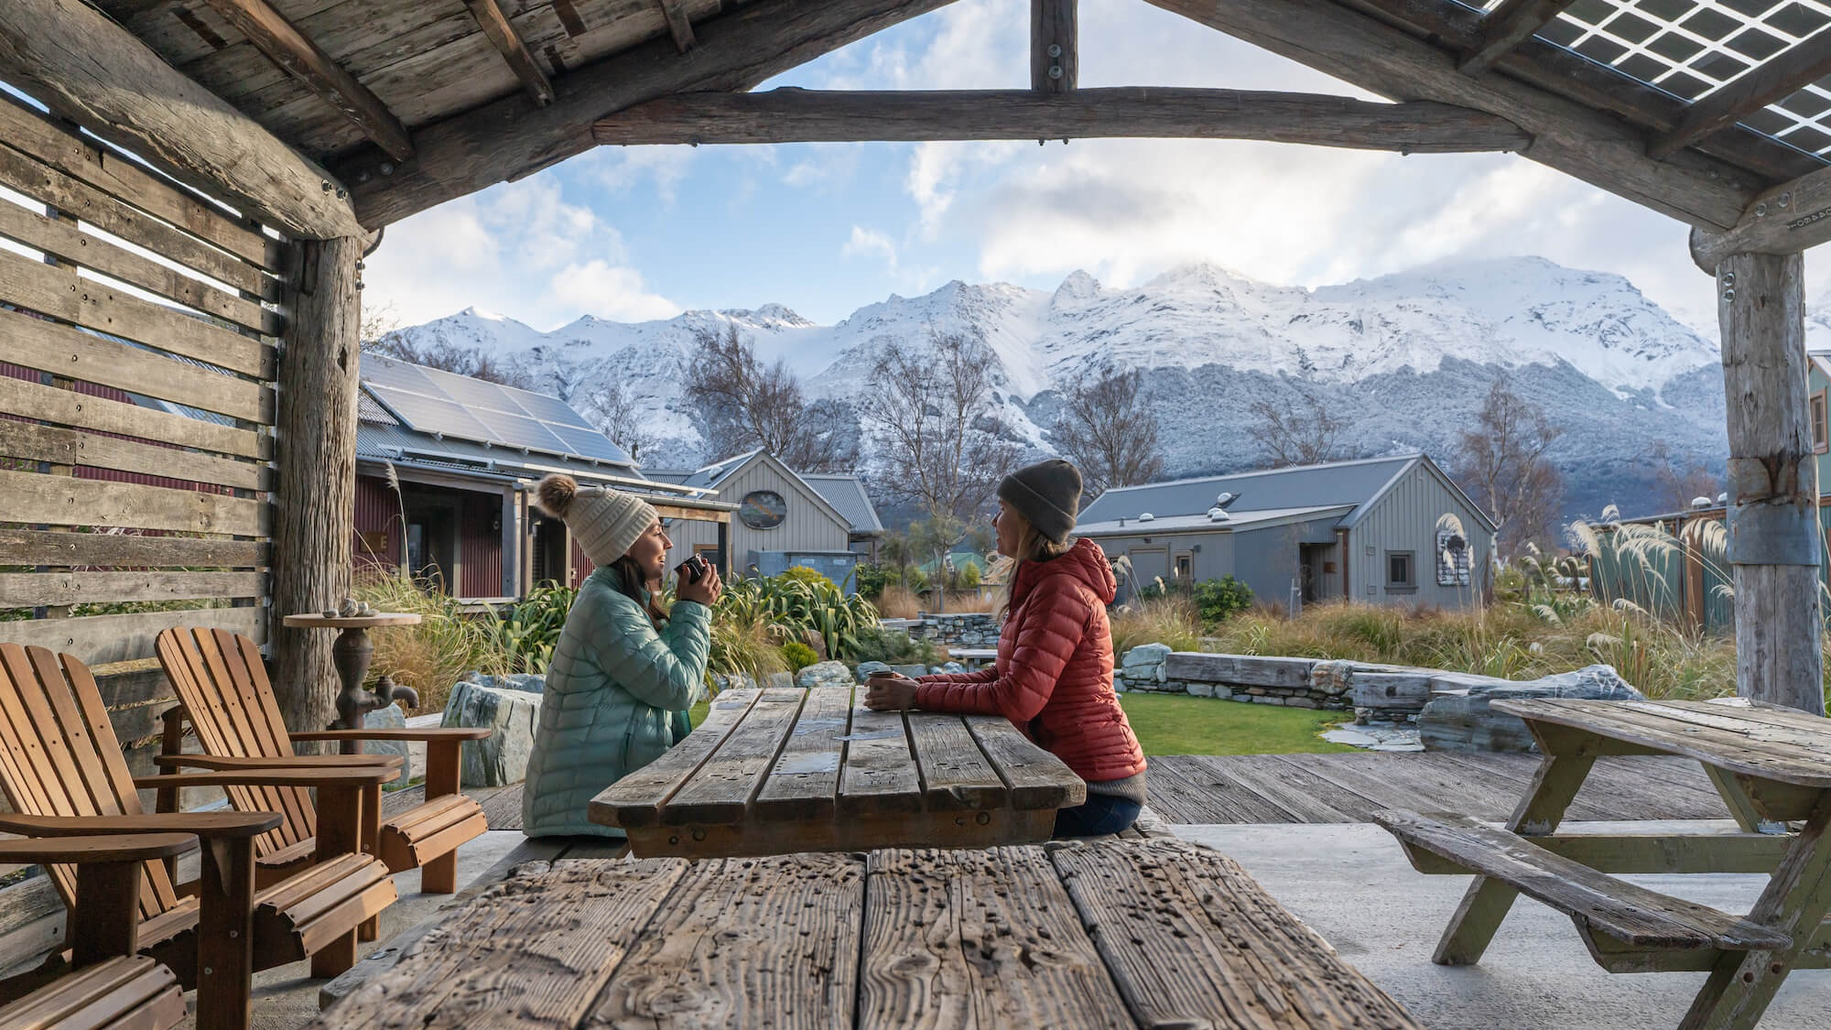
Adventures in Paradise
Notes:
Adventures in Paradise is proudly brought to you by the creators of Camp Glenorchy Eco Retreat. They’ve crafted these all-inclusive, multi-day getaways to explore the very best of our Glenorchy region with Camp Glenorchy Eco Retreat as the home base. With special access to Glenorchy's hidden gems, opportunities to give back to the community and options to customise your experience, this is a whole new way to holiday that gets us one step closer to our goal of supporting the Glenorchy community and natural environment through regenerative tourism.

Slide 15
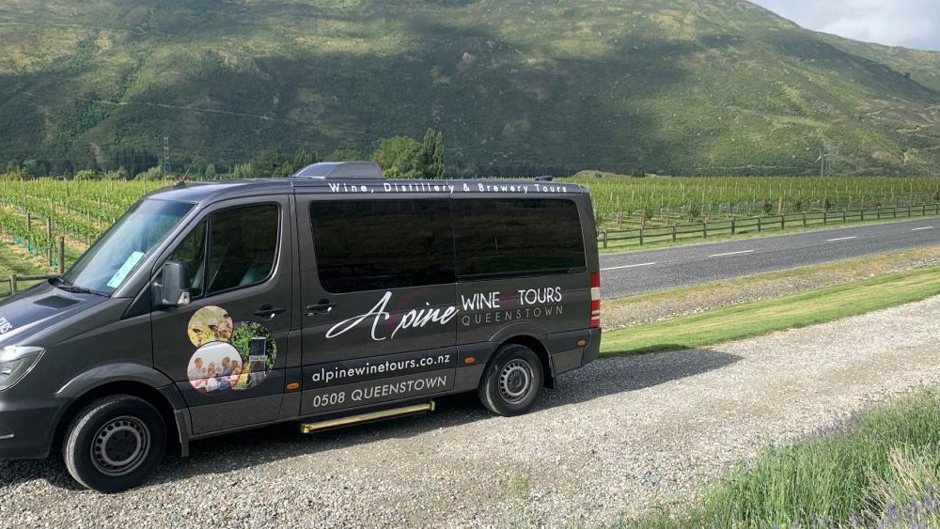
Progressive Lunch Tour
Notes:
Alpine Wine Tours - Progressive Lunch Tour Wine and food lovers are taken on a culinary journey to three of Queenstown’s most iconic winery restaurants. Experience a long lunch like no other, showcasing the very best of Central Otago wines and cuisine. Begin with a stunning entrée and wine tasting at world renowned Amisfield restaurant. Take a short drive along Lake Hayes to Akaura Wines & Kitchen by Artisan to enjoy a delicious main and wine tasting.
Wrap up your long lunch with a scenic drive through the valley of the vines for a decadent dessert and wine tasting at Gibbston Valley Wines. Alpine Wine Tours specialises in boutique and personalised wine tours, all inclusive and exclusively for adults only with a small group of up to 11 wine lovers.

Slide 16
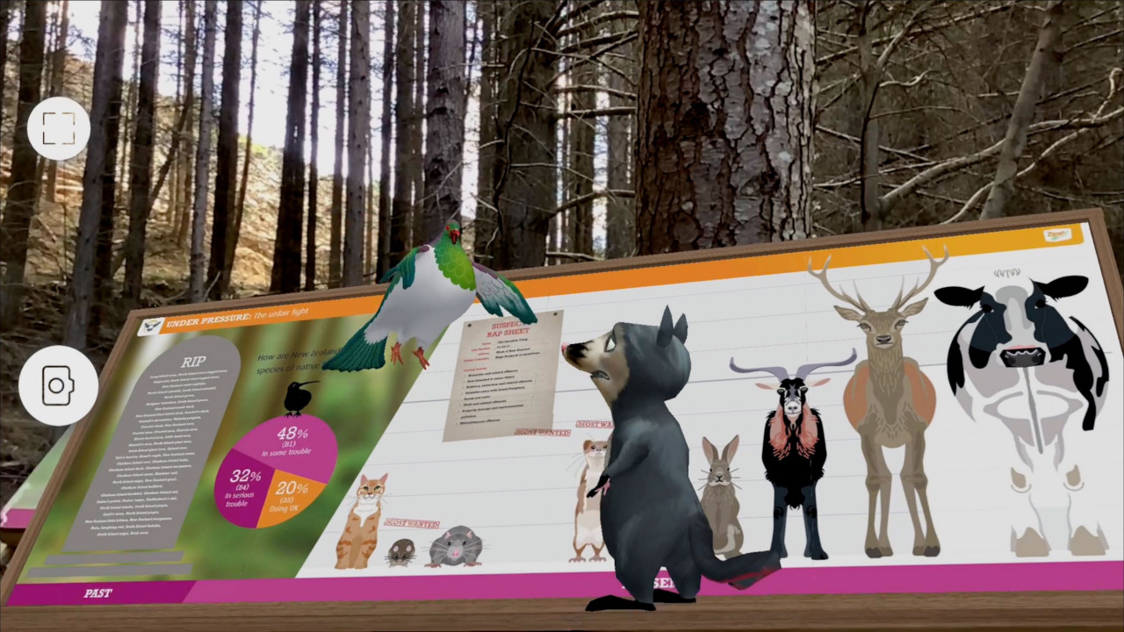
Ziptrek Eco Tours – Kereru Interactive Tour
Notes:
KERERU INTERACTIVE TOUR is Ziptrek Ecotours newest tour and a world first experience that is an integration of digital story-telling in the real world.
The experience is one hour in duration and includes two ziplines in an immersive story-telling experience that utilizes augmented reality.
This new tour will still feature the exciting 21m drop after the two ziplines that the Kereru tour is well known for, however there is the option to return via a small exit zipline, for those that are apprehensive flyers.
https://www.queenstownnz.co.nz/listing/ziptrek-ecotours/11248/

Slide 17
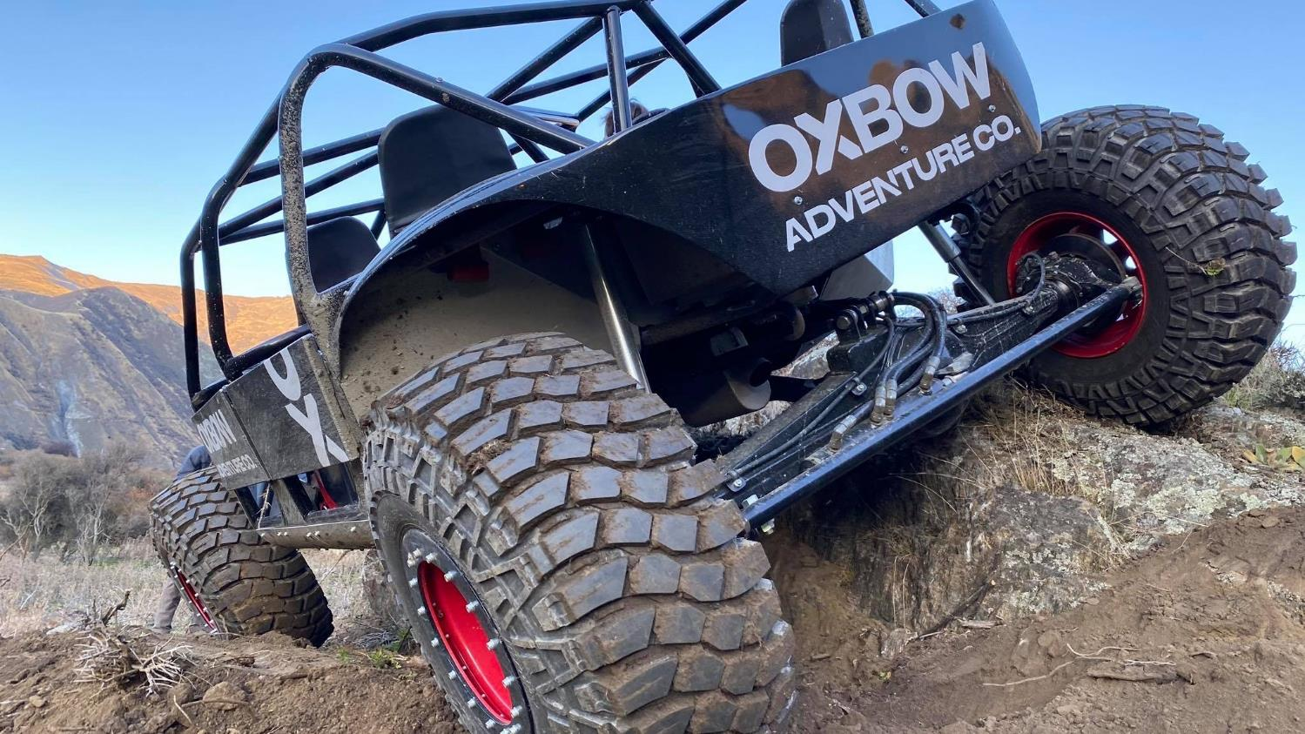
Oxbow Adventure Co.
Notes:
Opened September 2020.
Oxbow Adventure Co is located in the heart of New Zealand’s Southern Alps at the iconic Nevis Bluff and will be proud to exist as a passionate provider of one hundred percent super charged, kiwi fun!
The team at Oxbow are in the business of sending people home with huge grins, a surge of endorphins and a head full of fantastic memories. Whether your clients are planning a boy or girl’s weekend, some Family fun or just craving some adventure...
The friendly and adrenaline hungry folk at Oxbow will provide a personalised service for each individual and group, guarantying an experience your clients guests will never forget. A highly experienced, trained and certified team operate a professional range of activities:
Jet Sprint Boats
4WD Off-Roader
ClayBird Shooting
Jet Boat Sprints (SPEED)
The 4-Seater Jet Sprint boats consist of the professional driver and 3 passengers. They operate on a custom-built Jet Sprint course with a series of islands to navigate around. They accelerate from 0-100km/hr in 2.5 seconds. The trip consists of 3 separate track rotations.
Departures: every 10 minutes, from 8am to 5pm (winter) and 8pm (summer)
Duration: 10 minutes on the water
Eligibility: Minimum height of 1.2metres.
4WD Off-Roader (THRILL)
The Off-Roader is a 4-Seater, which carries the professional driver and 3 passengers. The Off-Roaders are 4WD, 4-wheel steer and have an extremely low centre of gravity which allows them to pretty much go anywhere. They operate on a custom-built course which includes near vertical hill climbs and descents, rock features and many other crazy features.
Departures: every 10 minutes, from 8am to 5pm (winter) and 8pm (summer)
Duration: 15 minutes
Eligibility: Minimum height of 1.2metres. Injuries on a case by case basis. No pregnant woman.
Clay Bird Shooting (SKILL)
Their custom designed compact sporting field is equipped with 8 automatic clay bird throwers to suit all abilities, it also includes the run-away rabbit across the ground (don’t worry it’s not the real thing!) The stand facilitates 6 shooters per session, each shooter is positioned in their own stand with safety barriers to ensure safe operation at all times.
For those more experienced shooters or those wanting an extra challenge, we offer the choice of a 25 or 50 Bird ‘Flurry’.
Departures: every 45 minutes, from 8am to 5pm (winter) and 8pm (summer)
Duration: 45 minutes
Eligibility: Minimum 13 years old
https://www.queenstownnz.co.nz/listing/oxbow-adventure-co/7806/
Combos
Jet Sprints & 4WD Off-Roader $275pp
Jet Sprints OR 4WD Off Roader and Clay Birds $265pp
All 3 products $399pp

Slide 18
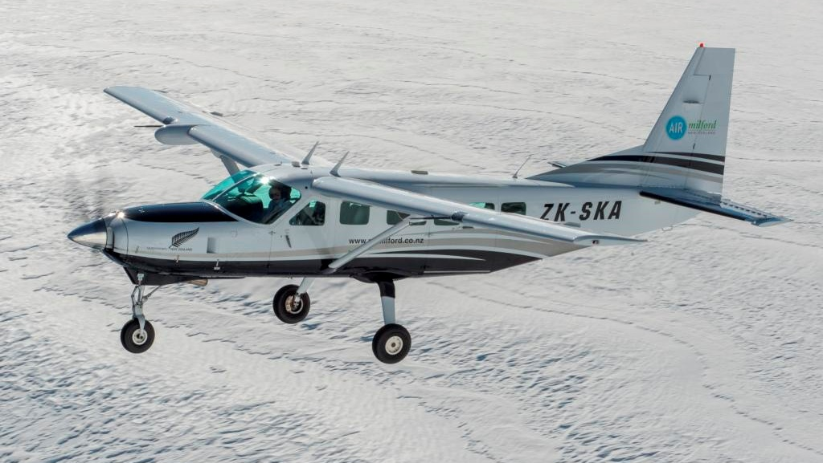
Air Milford – Milford Sound Scenic Flight & Big Five Glaciers
Notes:
Air Milford is now offering New Zealand’s isolated Gem Milford Sound + 5 Big Glaciers Flight.
Board their Cessna aircraft from Queenstown and be transported through a magical wonder of dramatic views including the Rob Roy, Bonar, Jura, Volta, Dart, Olivine and Donne Glaciers as well as the famous Milford Sound.
Expect to see New Zealand fur seals, bottle nose dolphins, penguins and other New Zealand wildlife as you fly over and around the Mt Aspiring and Fiordland national parks largest glaciers.
Air Milford is experienced, established, personalised and thrilled to be able to offer unique and exclusive experiences like this!
https://www.queenstownnz.co.nz/listing/air-milford/9957/

Slide 19
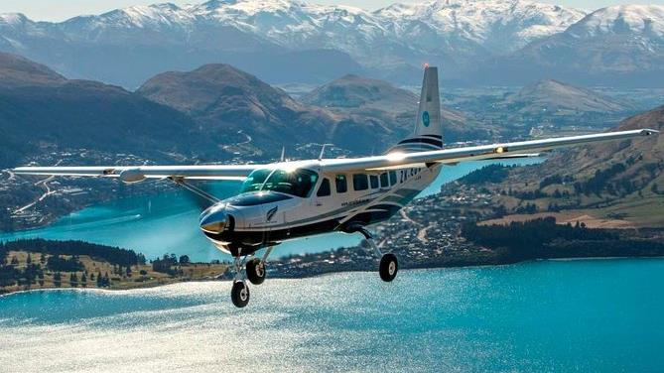
Air Milford & Real Journeys – Walter Peak Flight & Steamship Cruise
Notes:
Air Milford and Real Journeys have teamed up to bring your clients a new experience to the best of Queenstown from the sky and Lake Wakatipu.
Your clients will depart Queenstown with Air Milford to get an aerial view of the Wakatipu Basin, including the world famous gold mining settlement - Arrowtown. Flying past the first founded ski field in New Zealand, Coronet Peak. Overflight Queenstown CBD including a flyby of the Skyline Gondola, before tracking along the northern side of New Zealand's longest lake, Lake Wakatipu.
On the right of the aircraft dominating the horizon is Bob's Peak, at 1748m. Secluded behind this mountain are the alpine lakes, Dispute and Moke. The journey continues to provide a magnificent view of Glenorchy and the Paradise region, including Mt Earnslaw (2830m) and the Earnslaw Glacier.
A descent into Walter Peak station is precluded with an aerial view of the Wakatipu's largest high country station, Mt Nicholas. To finish the flight on a high note, the landing takes place on a non-sealed airstrip, which is an ideal introduction to the relaxed farm life of Walter Peak station.
Your clients will then be able to explore Walter Peak station with the farm tour, including the dog barking demo. They will then board the TSS Earnslaw back to Queenstown.
On board they will be able to enjoy a beverage or food from the café.
Flight duration: 20 minutes
Total trip time is 2.5 hours
https://www.queenstownnz.co.nz/listing/air-milford/9955/

Slide 20
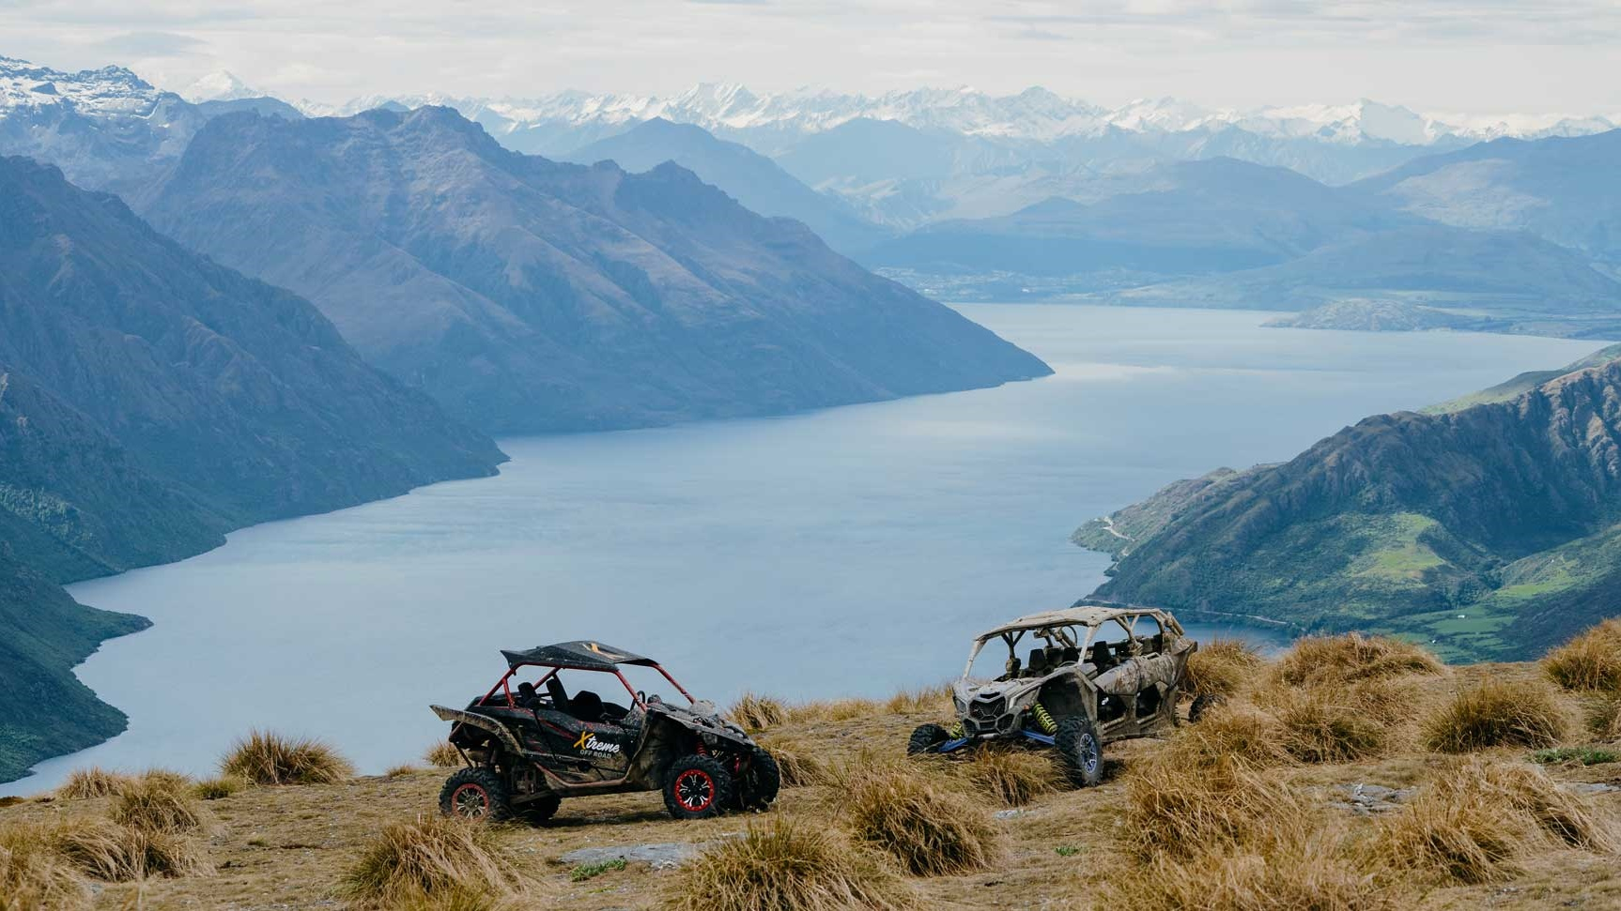
Xtreme Off Road
Notes:
Xtreme Off Road based in Kingston just 30mins from Queenstown Airport.
They offer world-class vehicles with out of this world scenery to give you both thrilling rides and breath taking views.
Our 2.5km X Track gives you the opportunity to release your inner rev head, there’s ample opportunity to give it some jandal, drop the hammer or put the pedal to the metal.
If you want something more scenic their 2-hour tour up Kingston Hill will provide you with some of the most breath taking views of Lake Wakatipu.
https://www.queenstownnz.co.nz/listing/xtreme-off-road-limited/10074/

Slide 21
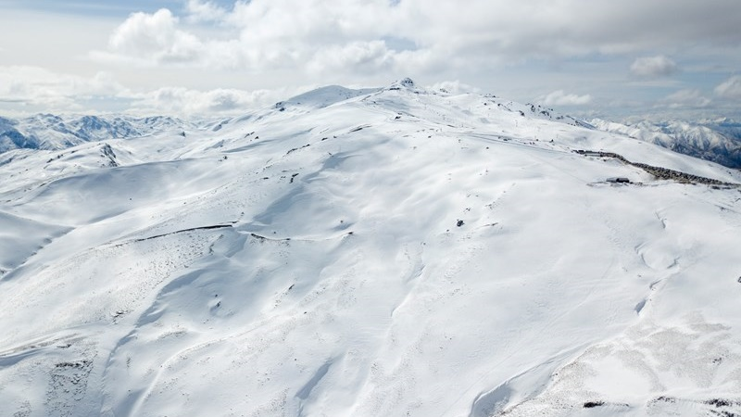
Cardrona Alpine Resort
Notes:
Cardrona Alpine Resort has announced its first move into Soho Ski Area with the installation of Willows Quad Chair for winter 2021.
Willows Basin is the first area to be unlocked within Soho and will open up 65 hectares of new terrain, the first new major section of skiable terrain in New Zealand since Cardrona put in Valley View.
https://www.queenstownnz.co.nz/listing/cardrona-alpine-resort/1008/

Slide 22
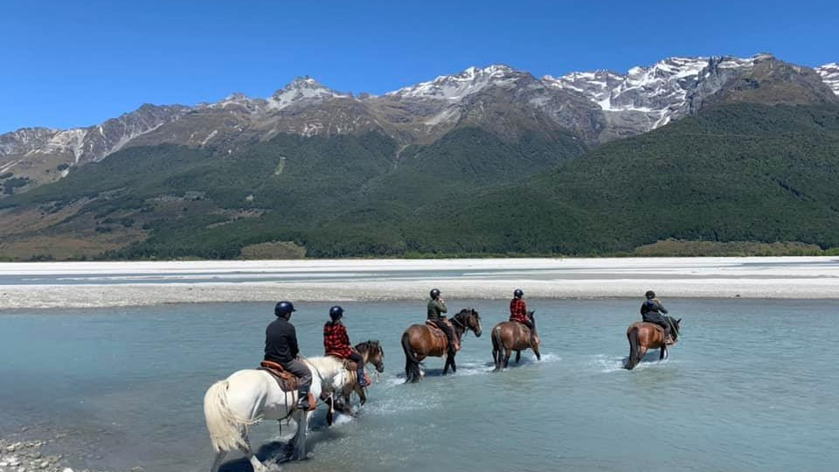
Lighthorse Adventures
Notes:
Lighthorse Adventures located at the head of the lake in the Dart Valley, Glenorchy, offer amazing horse treks for riders of all levels.
From shorter 75 minute rides, to half, full-day and custom trek experiences.
Your clients will enjoy scenic landscapes, gentle rides, quality guides and more importantly a full immersion into the experience of horsemanship.
https://www.queenstownnz.co.nz/listing/lighthorse-adventures/10542/

Slide 23
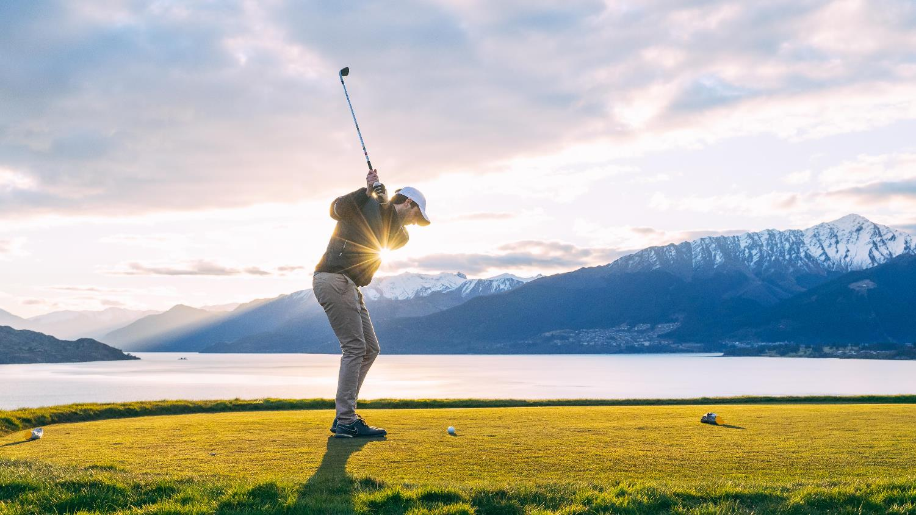
Queenstown Golf Collective Super Pass
Notes:
Queenstown Golf Collective Super Pass allows golfers a round at Arrowtown, Jack’s Point, Millbrook and Queenstown courses on the same pass.
Available to book with:
Remarkable Golf Tours, or
Peak Golf Queenstown
Both companies can arrange other golf services as required – tee-off time reservations, equipment hire & transportation etc
https://www.queenstownnz.co.nz/listing/remarkable-golf-tours/910/
https://www.queenstownnz.co.nz/listing/peak-golf-queenstown/9728/

Slide 24
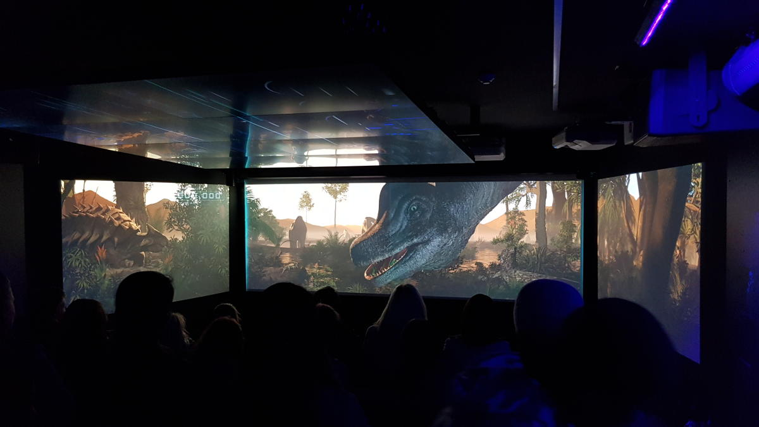
Time Tripper Queenstown
Notes:
QUEENSTOWN’S ONLY UNDERWATER CINEMATIC EXPERIENCE
Time Tripper is a state-of-the-art animated show situated under Lake Wakatipu, that tells the Māori Legend of the Lake and the story of the creation of the Wakatipu region, starting 90 million years ago taking the viewer through to present day Queenstown.
The show is approximately 15 minutes long, with 10-15 minutes of underwater viewing available afterwards where you can see eels, diving ducks and trout that live under Lake Wakatipu.
Price: $10 Adult $5 Child
Every 30 minutes from 9.45am – 3.45pm, 7 days a week
https://www.queenstownnz.co.nz/listing/kjet/5530/

Slide 25
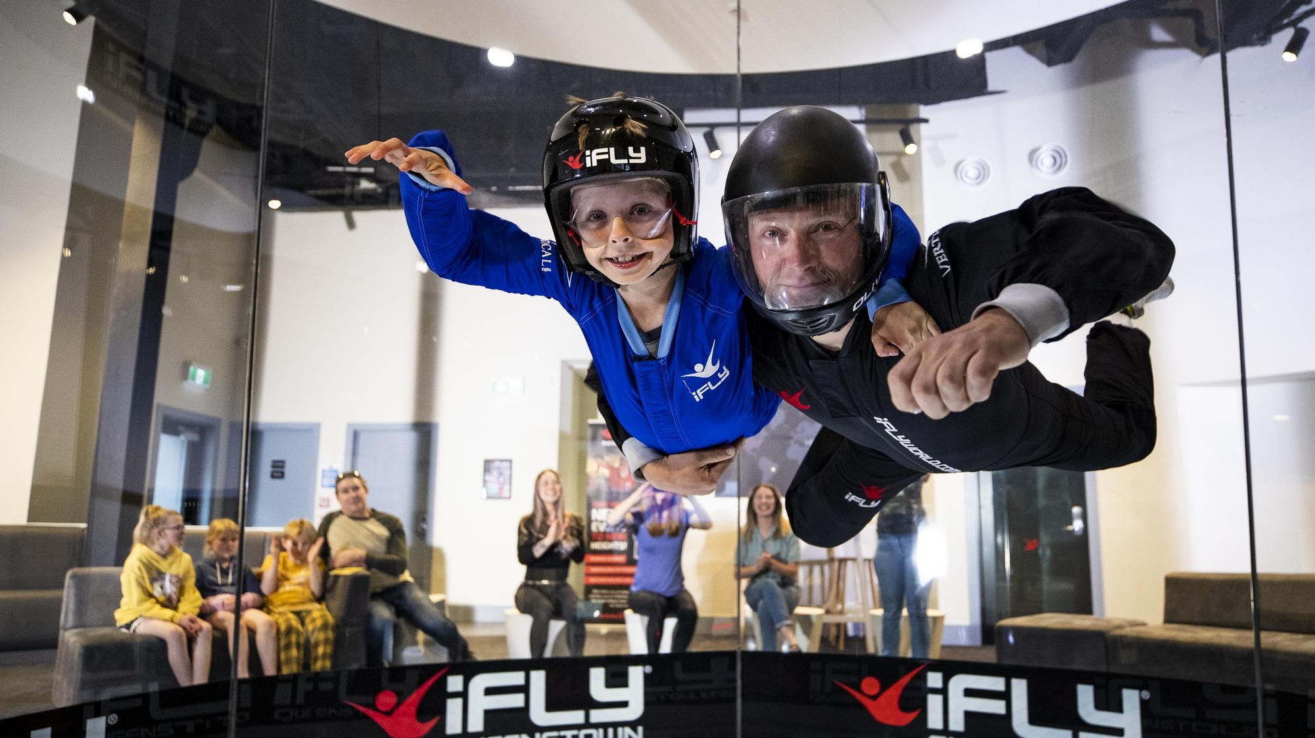
iFly indoor skydiving
Notes:
Ever dream of flying? Now you can!
Experience the rush of 100% pure human flight at iFLY, New Zealand’s only indoor skydiving attraction and Queenstown’s most exhilarating new adrenaline experience!
From the Maori legends of New Zealand’s ancestral people, to our modern-day aviation innovators, there is nothing more quintessentially Kiwi than the dream of flight. It’s in this country’s DNA. It’s in ours, too.
In 1998 iFLY pioneered the technology that made human flight not just a dream, but a reality. Since then we’ve flown over 8 million people from all corners of the world. iFLY creates a smooth, wall-to-wall cushion of air on which anyone can safely float - no experience necessary. Simply lean into the airflow and that’s it - you’re flying! There’s no parachute, no jumping, and nothing attaching you to Planet Earth. It’s just YOU, indoor skydiving in the heart of New Zealand’s adventure capital!
https://www.queenstownnz.co.nz/listing/ifly-indoor-skydiving-queenstown/1481/

Slide 26
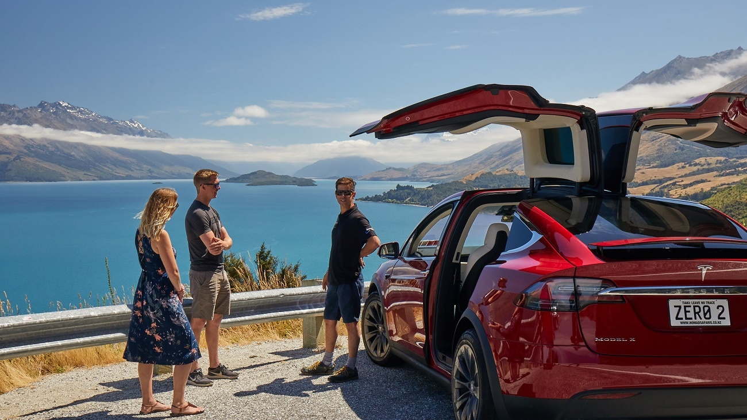
Nomad Safari Tesla Tours
Notes:
Take a scenic tour into the heart of New Zealand high country in a luxury Tesla Model X ESUV unique to Nomad Safaris. These personalized small group tours are woven with fascinating history and legendary stories delivered by true 4WD wizards.
These vehicles offer unrivalled visibility with a vast glass roof and ultra-luxurious seating. Take in the landscapes in this whisper-quiet car driven by your personal guide. With impressive air suspension to deliver an ultra-smooth ride, they really are the ideal vehicle to take you off the beaten path. Take pride in emission free touring through the incredible landscapes of the Southern Lakes region.
Two matching outstanding all wheel drive all electric SUV vehicles from Tesla
Available for all nomad safaris tours (except river wading) e.g. can do Skippers Canyon, Glenorchy, Paradise, Routeburn, Wanaka
best wedding car in the world due to falcon wing rear doors
biggest glass roof of any production vehicle
quietest of any luxury vehicle
no carbon footprint – what bragging rights
licenced for 5 passengers in each vehicle
2 available
Airport, dinner, wine tours etc. all in the portfolio
Still the best most homely guides in town
Delivering the tiaki promise, “leave no trace”
https://www.queenstownnz.co.nz/listing/nomad-safaris/5688/

Slide 27
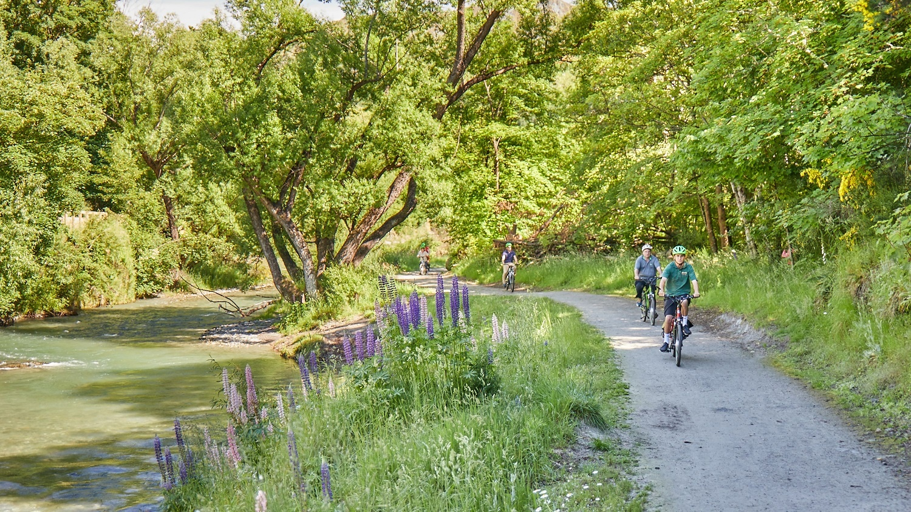
Nomad Safaris - E-biking
Notes:
This is the complete half day wine tour; with a fully- kitted ebike, guide, support vehicle, and wine tasting, we have covered all of the bases.
Beginning in Arrowtown, the gentle trail winds its way to the Gibbston Valley and guests finish the day sipping boutique wines.
Our purpose-built ebikes are easy to use and keep the trip scenic, fun and comfortable. Perfect for those who would like to get active (but not too active), it is a one of a kind afternoon not to be forgotten.
https://www.queenstownnz.co.nz/listing/nomad-safaris/3519/

Slide 28
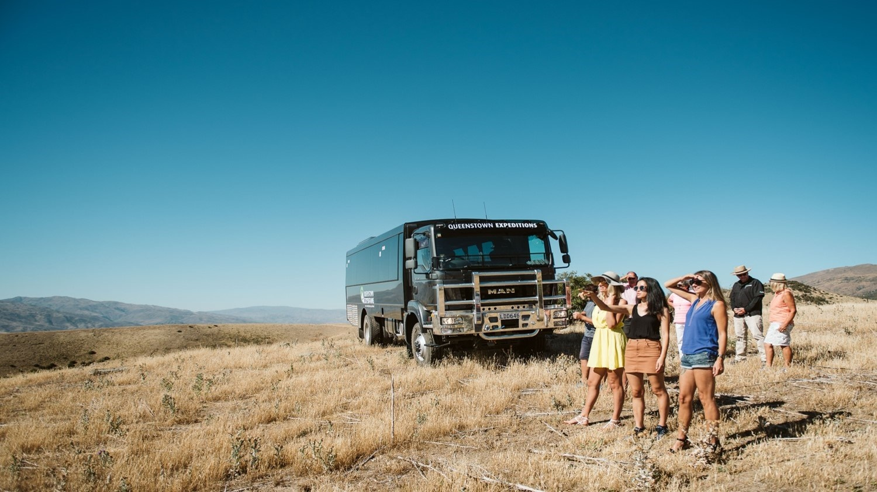
Queenstown Expeditions
Notes:
Offering two half-day trips, Queenstown Expeditions is a recent player in the sightseeing tour scene.
Explore the historic gold trails from Queenstown, Arrowtown and the Kawarau Gorge through to old Cromwell and a working high country station, or head to Glenorchy and soak up farmland, see a sheep-shearing demonstration and have your picture taken with a llama.
The accompanying commentary took nearly a year to develop, and features interactive and GPS-activated narratives so guests can really immerse themselves in the region’s history.
https://www.queenstownnz.co.nz/listing/queenstown-expeditions/1683/

Slide 29
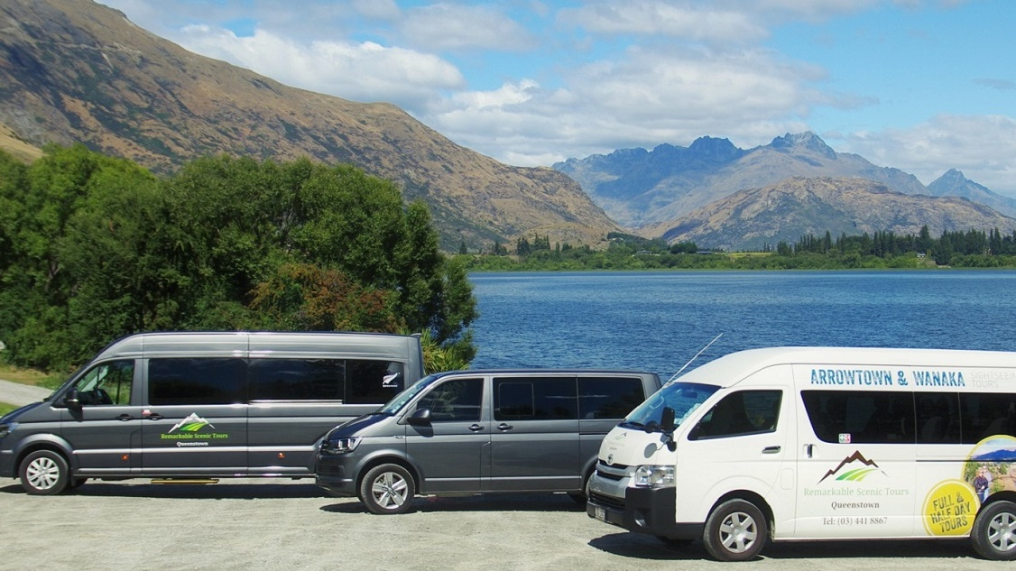
Remarkables Scenic Tours
Notes:
Discover Queenstown’s amazing scenery with Remarkable Scenic Tours a locally owned and operated small group tour specialists run by Kathy & Wayne Hansen
Remarkable Scenic Tours understands the importance of using local knowledge to experience the finest a region has to offer. Offering relaxed small group half and full day tours with full commentary and specialising in finding secluded locations for amazing photo opportunities without the crowds.
Modern comfortable fleet catering up to 13 guests per tour combined with easy access and microphones these tours are perfect for all ages.
https://www.queenstownnz.co.nz/listing/remarkable-scenic-tours/1987/

Slide 30
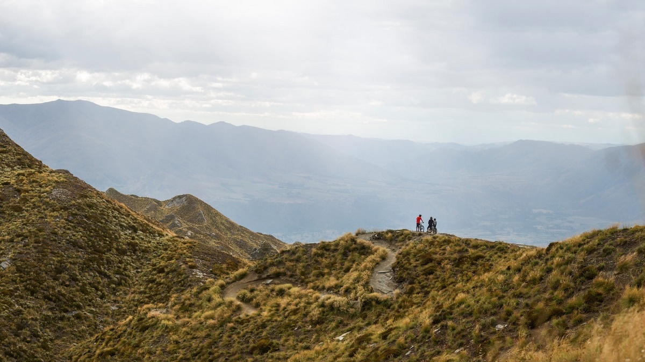
Coronet Peak Bike Park
Notes:
Opened in the summer of 2019, and just a 20 minutes easy drive from Queenstown on a sealed road with the Wakatipu Basin is laid out below you. Enjoy a Tele mix cabin ride to 1649m, high above the valley below.
World famous views over the Wakatipu basin and back to the divide of the Southern Alps.
While you are up on top of the world take a guided hike out towards Skippers along the ridgeline. Or go at your own pace and take a picnic hamper and enjoy some time out with the world below your feet.
Bring your own Mountain Bike or rent one of ours on mountain.
There are three trails ranging from International Downhill to Enduro with a fourth opening in 2022.
Our mountain bike workshop will do its best to keep your wheels rolling when the unexpected happens.
https://www.queenstownnz.co.nz/listing/coronet-peak/9306

Slide 31
Accommodation

Slide 32
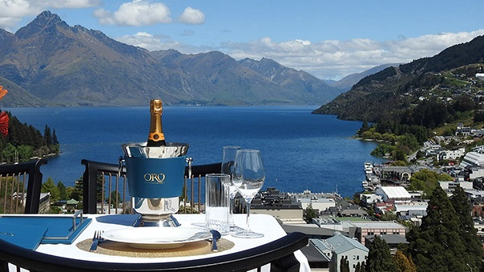
The Carlin Boutique Hotel
Notes:
The Carlin is for discerning travellers attracted to a one-of-a-kind, local boutique Hotel experience. Offering a range of spacious suites in 1, 2, 3 and 4-bedroom configurations with 50 to 288 square meters of indoor and outdoor living space.
The Hotel includes outdoor terraces with private spas and gas fires, and exceptional Lake and Mountain views
Relax in 6 Star Luxury, enjoy world class amenities and personalised service provided by an experienced team of Hotel Ambassadors, Concierge, Butlers, Massage Therapists and Chefs.
https://www.kevincarlin.com.au/portfolios/the-carlin-hotel/
ORO Restaurant is a sophisticated modern Queenstown Restaurant celebrating the best seasonal produce what the beautiful land and sea Aotearoa has to offer.

Slide 33
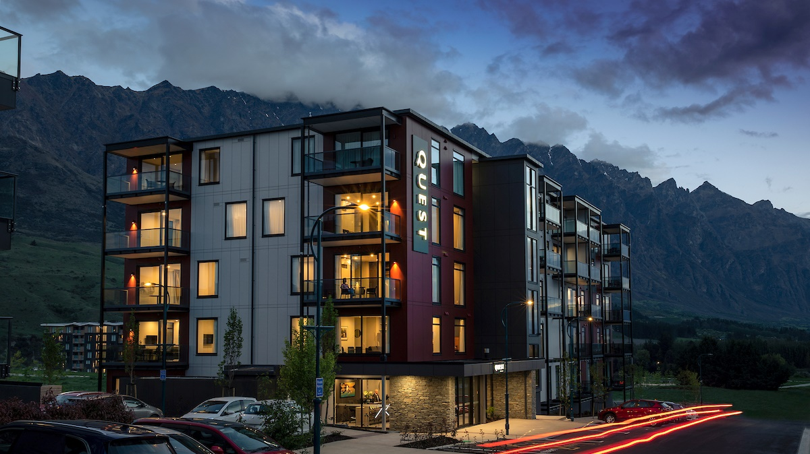
Quest Apartments
Notes:
The Brand New Quest Queenstown serviced apartment style hotel rooms offer guests a relaxed and comfortable accommodation experience perfect for short or long stays.
Quest Queenstown is very close to Queenstown International Airport and a short drive into central Queenstown and all the amenities the town has to offer, Quest Queenstown is ideally situated for easy access to the Remarkables Ski Area, Arrowtown, Wanaka and all the adventure tourism hotspots Queenstown is famous for.
The Quest features 41 rooms, including Studios, One and Two Bedroom Apartments. Our Studio Apartments are the perfect alternative to a hotel room each with a fully equipped kitchenette. The One and Two Bedroom Apartments are ideal for families, colleagues or larger groups looking for a home away from home experience. They are fully equipped with full kitchen and laundry facilities.
https://www.questapartments.co.nz/properties/south-island/queenstown/quest-queenstown/overview

Slide 34
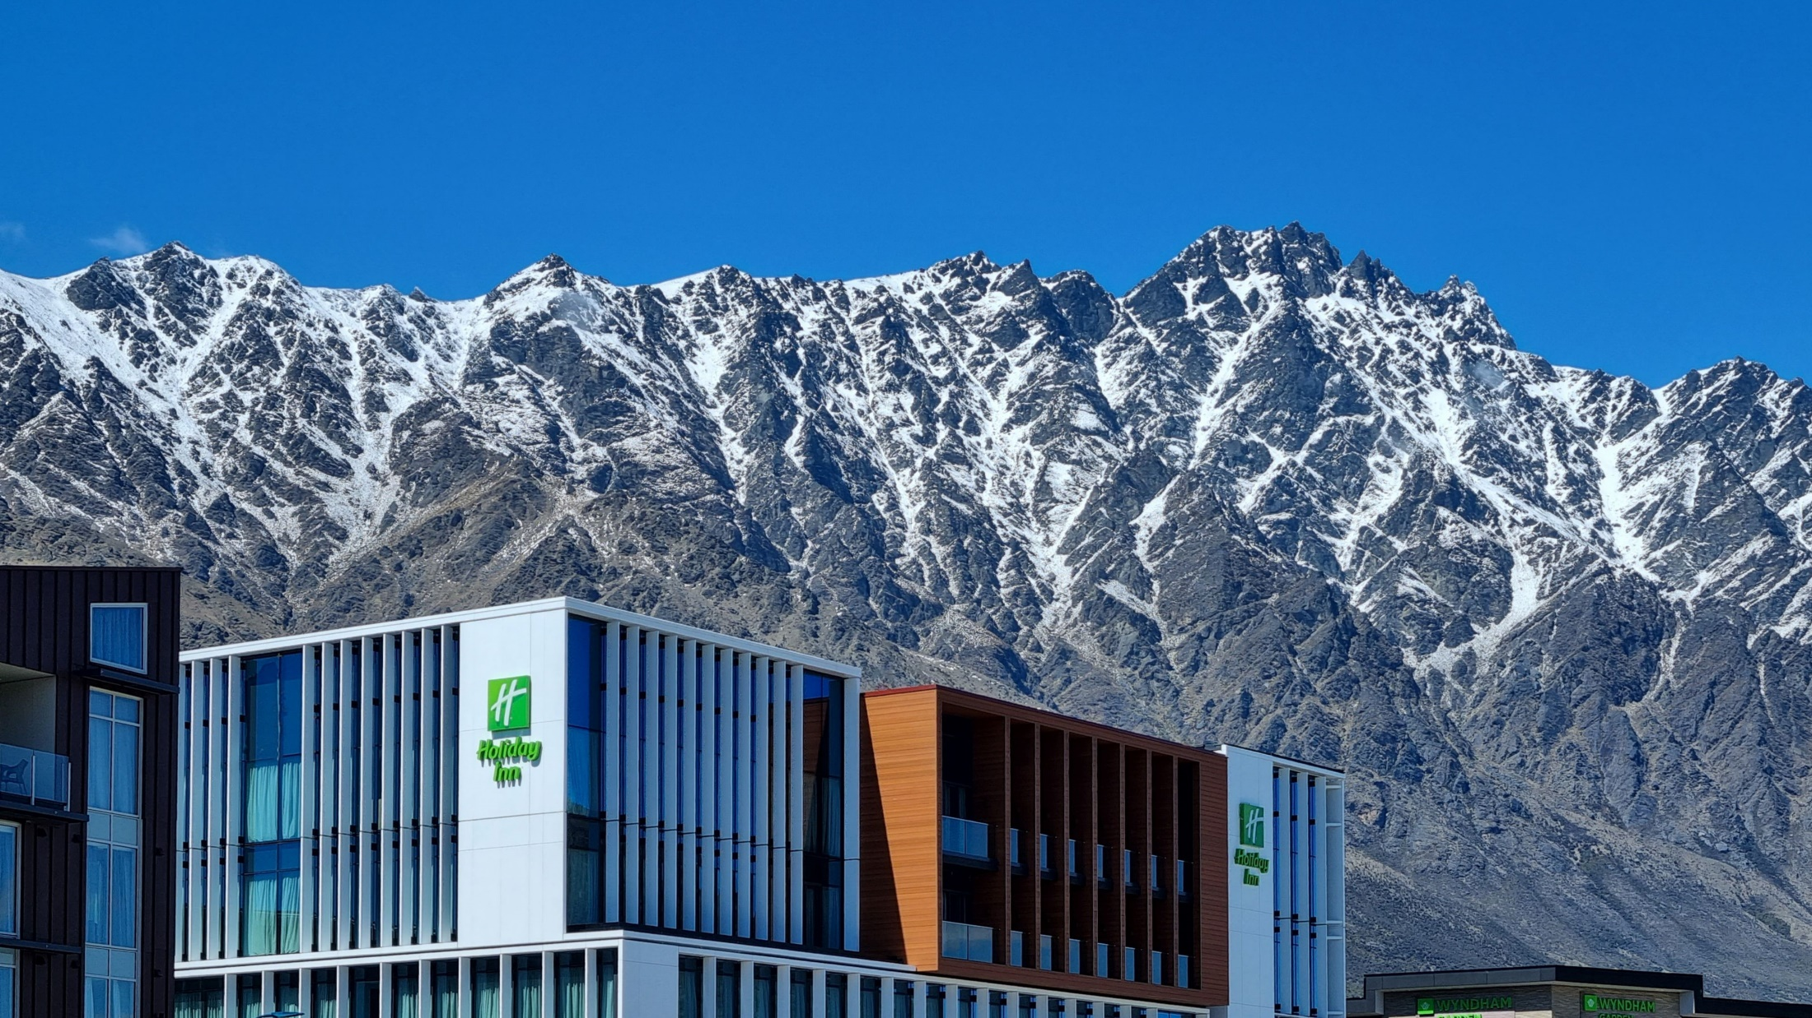
Holiday Inn Remarkables Park
Notes:
Ever wanted to wake up with a view of snow-capped mountain ranges, just minutes away from some of the best skiing and outdoor adventure New Zealand has to offer?
Holiday Inn Queenstown Remarkables Park is a new hub for South Island exploration. With a convenient location in the Remarkables Park precinct, their full-service hotel has a range of modern facilities to make your stay extra comfortable while you create memories in the heart of New Zealand’s world famous alpine playground.
Views of The Remarkables and nearby mountain peaks set the scene for our restaurant, café and bar all available within our Open Lobby area – designed so you can relax and feel at home in comfy and convenient modern surroundings. You will be in the perfect spot to connect with friends, family and colleagues, enjoying great food and drink while you catch up on the day’s highlights.
Hotel rooms and suites.
4 star.
https://www.queenstownnz.co.nz/listing/holiday-inn-queenstown-remarkables-park/12549/

Slide 35
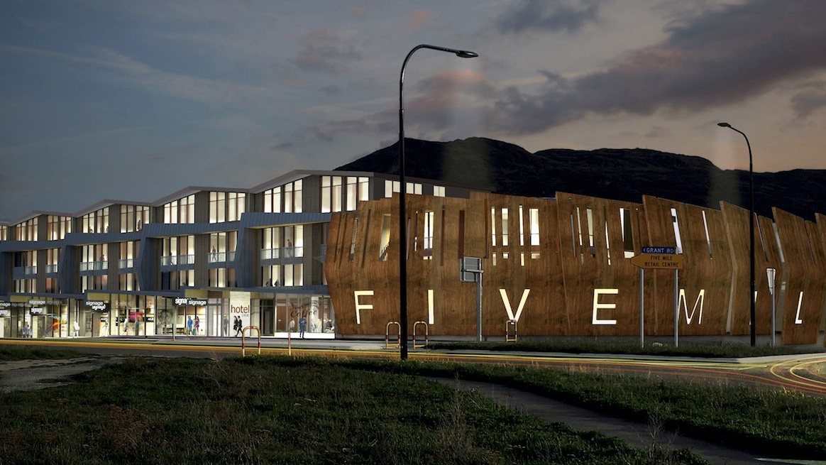
Sudima Hotel
Notes:
Sudima Queenstown Five Mile is a new 4.5-star hotel in the bustling Frankton area conveniently located in the Five Mile retail precinct close to the Airport and on the main road to the surrounding ski fields and routes north and south.
With views of the surrounding landscapes, high quality fit-out, well-appointed rooms, restaurant, bar, bike and ski storage and free parking, it represents 4.5-star style, comfort and value. Sudima Queenstown Five Mile is a great option for both leisure and business travellers.
https://www.sudimahotels.com/en/our-hotels/queenstown-5-mile/

Slide 36
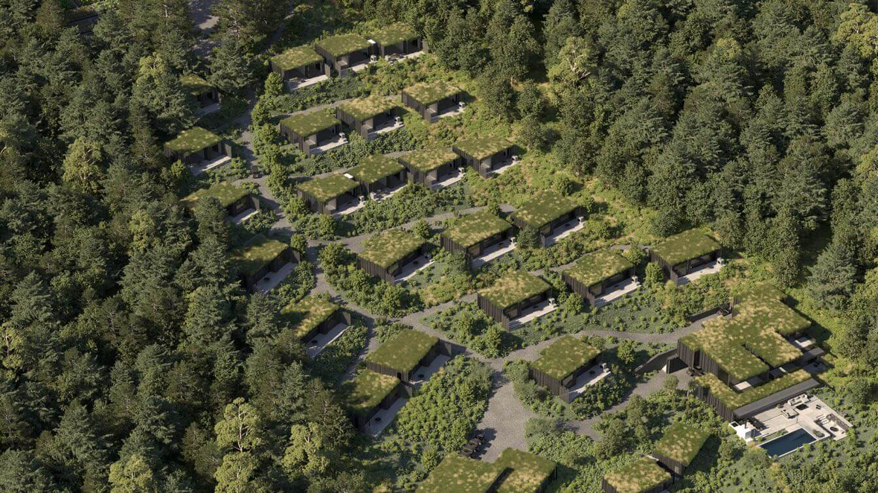
Waimarino Luxury Lodge – opening 2023
Notes:
Waimarino Luxury is being sustainably developed to set a new standard in eco-lodges in New Zealand. Located just a short 12-minute drive from Queenstown, the lodge will have its own onsite kitchen garden and orchard. The single level villas are nestled into the landscape and surrounded by regenerated native vegetation. It is expected to open in Bob’s Cove in 2023.
This will consist of a range of luxury villas, premium villas and an owner’s residence.
https://waimarinolodge.co.nz/
https://www.waimarinolodge.com/

Slide 37
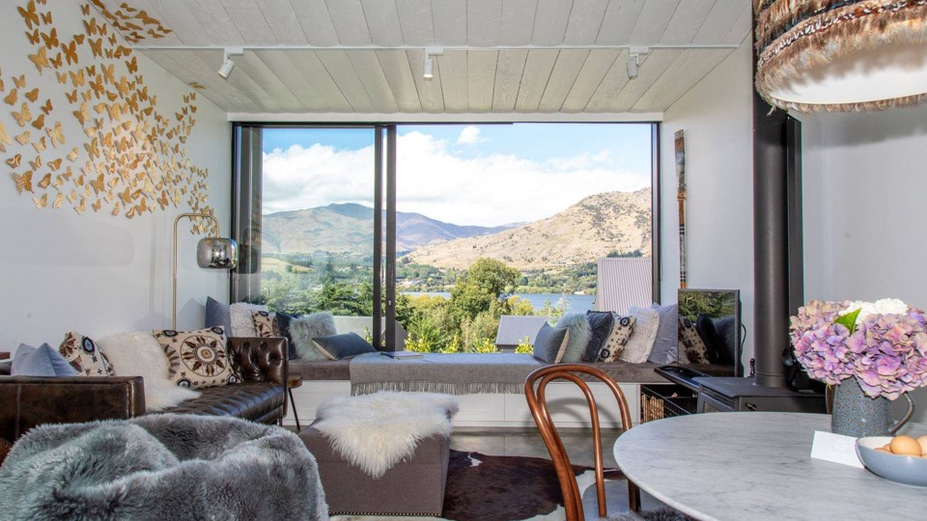
The Cottages at Lake Hayes
Notes:
The Cottages are on the shores of Lake Hayes, one of New Zealand’s most iconic settings, and close to all of the outdoor activities, with ski fields, golf courses and vineyards on your doorstep, and only 10 minutes from bustling Queenstown and historic Arrowtown for world class shops, bars and restaurants.
The Cottages were launched in 2020 and the stunning views, luxurious interiors, a curated art collection and exquisite attention to detail have already welcomed back many returning guests. Each of the 5 cottages sleep up to 4 adults with 2 en-suite bedrooms with private terraces, a fully-equipped kitchen, dining, bar, and lounge with wood-burner.
Each cottage has their own parking, plus secure storage for skis, golf clubs, bikes, and a laundry and drying room. There is also a communal Pinot Pit, and you can treat yourself to a cottage with a hot tub. The Cottages are perfect for a private escape or an extended group get-together.
https://www.queenstownnz.co.nz/listing/the-cottages-at-lake-hayes/12055/

Slide 38
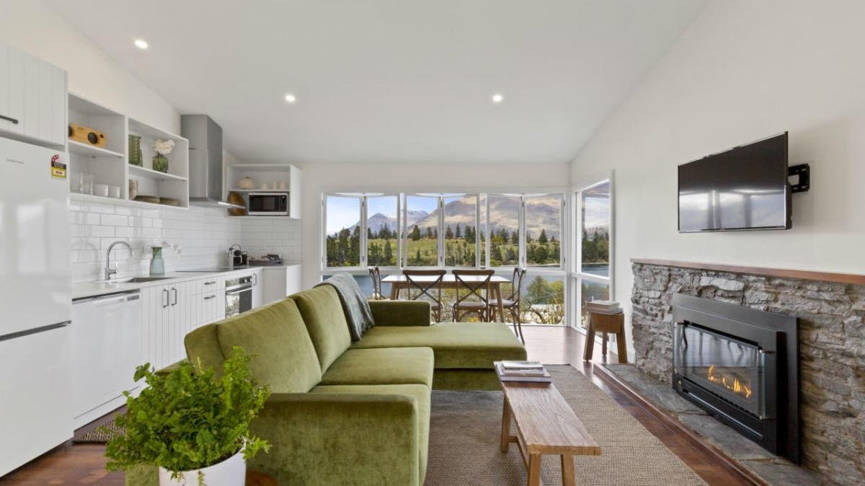
Stay of Queenstown
Notes:
At STAY your clients will be located in the heart of Queenstown's most established residential area.
STAY is boutique accommodation made up of eight, self-contained private suites located strolling distance from the town centre and the beaches of Lake Wakatipu. Every suite looks out from its garden setting onto magnificent lake and mountain landscapes.
Each one or two bedroom suite has been meticulously designed with your comfort in mind. Every suite is fitted out with a luxurious Bellagio bed, the highest quality linen, a Nespresso machine, a private living area with wifi, a smart TV, a microwave, electric fry pan, tea and coffee, a dining table, a bluetooth speaker, a private bathroom complete with heated towel rails and complimentary Natural Earth body products.
STAY suites are designed to enjoy the best of every season, cosy and warm in the winter with heat pumps or fireplaces, and with windows and doors to throw open to the view in the warmer months.
Each suite has its own private outdoor sitting area, and there are gorgeous communal outdoor areas perfect for sharing the region's bounty of superb wines and cheeses.
Each morning fresh local bread, jams, and cereal will be delivered for you to create your breakfast and in summer, these deliveries will include seasonal fresh herbs, fruit and vegetables from our onsite garden.
https://www.queenstownnz.co.nz/listing/stay-of-queenstown/5500/

Slide 39
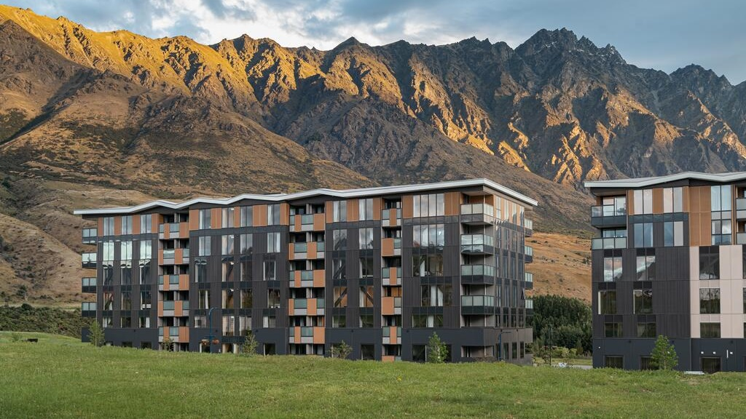
LQ Hotel by Ramada
Notes:
LQ Hotel by Ramada opened December 2020 and is located in Remarkables Park, Frankton, 15 minutes from downtown Queenstown.
With unparalleled views of the Remarkables mountain range, Kawarau River to the south and Coronet Peak to the north.
LQ Queenstown offers a combination of hotel rooms and self-contained apartments in a range of sizes and configurations.
Made up of 91 guest rooms featuring king size beds, air conditioning and 40" flat screen TV's with Sky TV. Studio and 1 bedroom apartments are fully self-contained, providing kitchenette with stovetop, microwave, and full laundry facilities.
https://www.queenstownnz.co.nz/listing/lq-queenstown-hotel/10299/

Slide 40
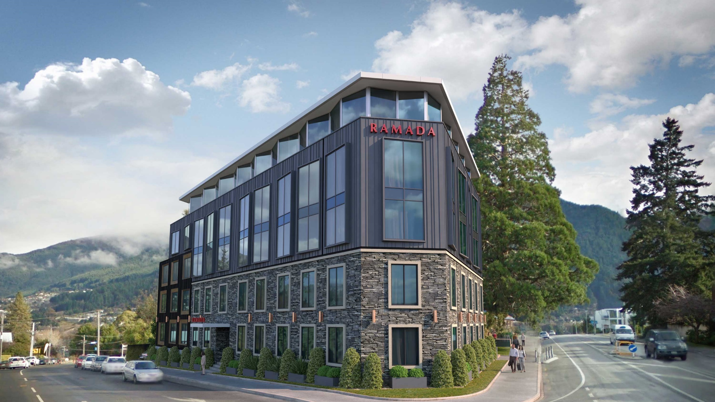
Ramada Central Queenstown
Notes:
As the company’s flagship property in New Zealand, Ramada Queenstown Central hotel is perfectly positioned in the heart of Queenstown on a wonderfully elevated position allowing spectacular views that include Lake Wakatipu, The Remarkables Mountain Range, the Queenstown Golf Course, Walter Peak and many other parts of the iconic Central Otago landscape Queenstown is famous for.
Experience tranquility all year round overlooking the beautiful shores of Lake Wakatipu and within easy walking distance of Queenstown’s central shopping, entertainment and restaurant precinct. The property is just 15 minutes’ drive from Queenstown Airport and has popular ski areas close by, such as Coronet Peak just a 20-minute drive, The Remarkables a 30-minute drive away and Cardrona Mountain a 60-minute drive.
https://www.queenstownnz.co.nz/listing/ramada-queenstown-central/6301/

Slide 41
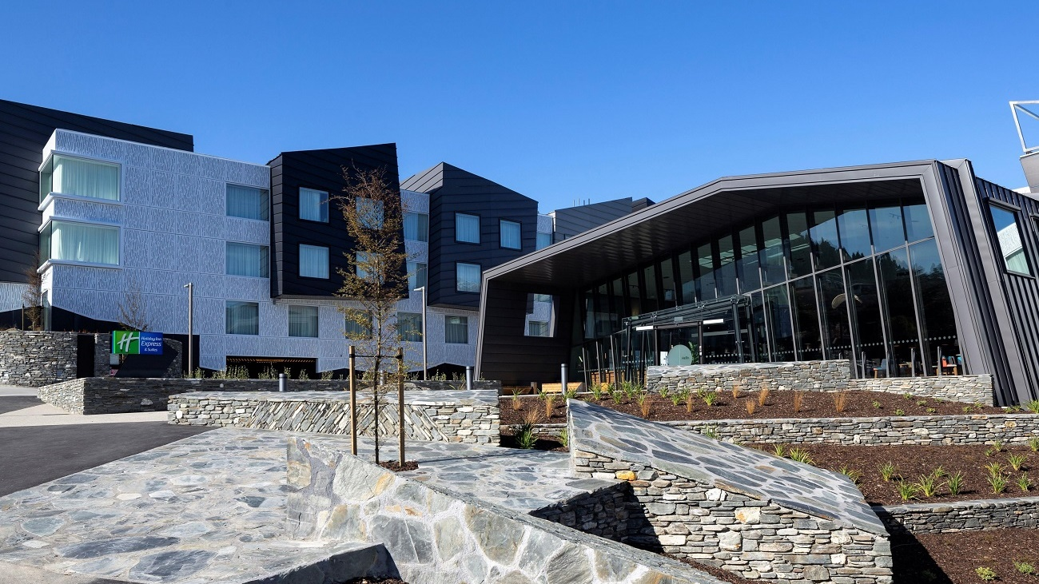
Holiday Inn Express & Suites
Notes:
Opened July 2020.
At Holiday Inn Express they keep it simple and smart by providing their guests with more where it matters most.
They believe in smart, hassle free travel. They also believe travel should have more to offer, such as fast check-in, free Express Start Breakfast included, free high-speed Wi-Fi, comfy beds and a choice of pillows in your clients room and everything else needed for a great stay within arm’s reach.
The hotel features spacious suites with king size beds, separate lounge with double sofa and kitchenettes, perfect for families or a group of friends to spread out. At the centre of the outdoor alfresco terrace is an inviting fire pit, a perfect place for après ski drinks.
Guests can also relax in the hotel’s sauna. With views over the crystal clear Lake Wakatipu and out to the majestic Remarkables Mountain Range, the brand new Holiday Inn Express and Suites Queenstown is located in the prime position to downtown Queenstown.
227 rooms and suites (5 room type categories)
Suites featuring king size bed, separate lounge with double sofa, kitchenette and two 55” smart TVs
FOOD:
Breakfast, lunch and dinner daily
• Free Express Start available: Monday to Sunday - 6am to 9:30am
• Grab & Go breakfast option
• Snacks, beverages and barista made coffee available from Reception 24-hours
• On-site restaurant with healthy and classic meals prepared to order: Monday to Sunday - 5pm to 10pm
• 24-hour menu with Call & Collect option
• Bar with selection of local and international wine, craft beer and bar snacks
https://www.queenstownnz.co.nz/listing/holiday-inn-express-%26-suites-queenstown/5334/

Slide 42
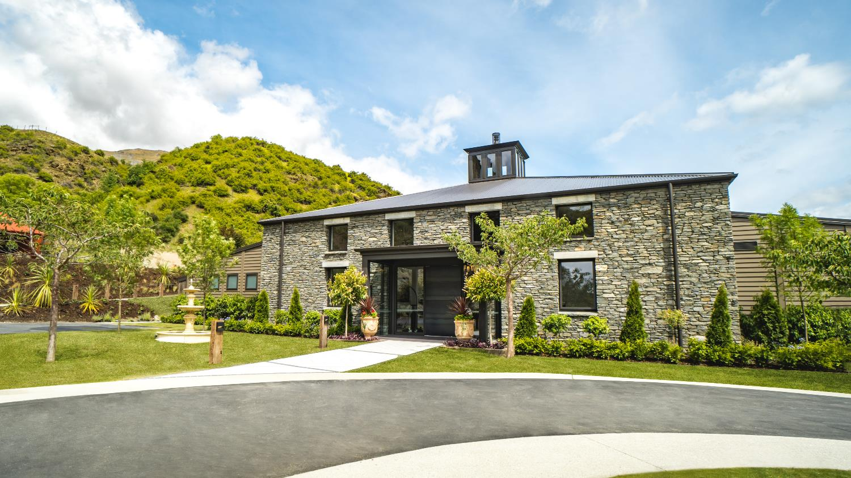
Gibbston Valley Lodge & Spa
Notes:
Opened in December 2019
Gibbston Valley Lodge and Spa is set within Central Otago’s oldest founding vineyard, and nestled between rugged schist mountains. This property offers the ultimate in relaxed luxury, fine wine, gastronomic food and five-star concierge service.
There are 24 private villas featuring views over organic and historic vineyards. Each villa offers spacious and luxurious indoor living areas that open onto a secluded, covered deck and courtyard.
Inspired by the Central Otago landscape, the lodge’s high ceilings and schist finishing echoes the natural beauty and the inspiring elements of the region.
Located inside the lodge, is an exclusive wine cellar, the conservatory and a media room that are perfect venue options for the most important and intimate events.
Clients can also indulge in their onsite Spa experience and a host of other activities on offer that include exclusive wine tastings, vineyard tours, wine cave dinner, private picnics and luxury cycle tours.
The concierge team at Gibbston Valley is committed to making every moment of your time here a seamless, enjoyable, and unforgettable experience.
https://www.queenstownnz.co.nz/listing/gibbston-valley/5410/

Slide 43
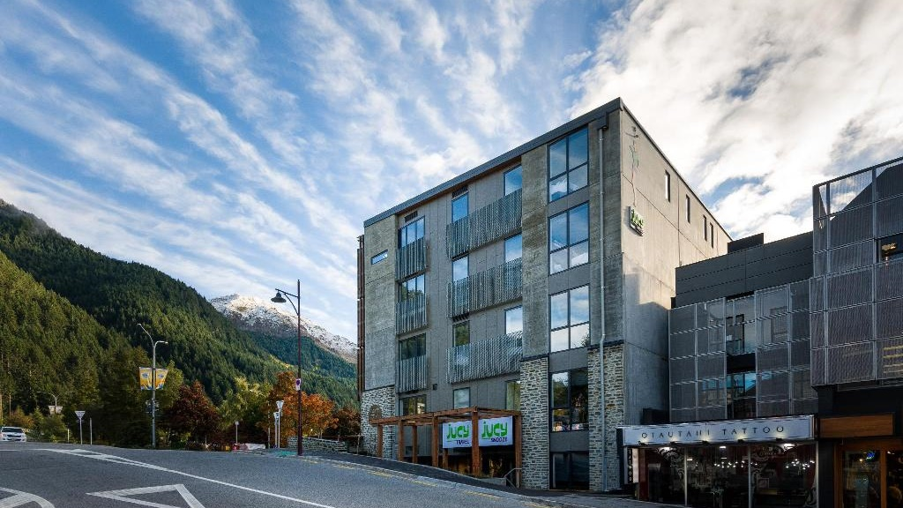
Jucy Snooze
Notes:
Centrally located and only walking distance from Lake Wakatipu, JUCY Snooze opened its doors in April 2018.
Choose from private ensuite rooms complete with Smart televisions, or nestle into one of the JUCY Pods - a private space in a shared room that's able to be completely enclosed. Free WiFi throughout allows you to post your travel snaps and Skype the crew back home!
With a unique pizzeria & bar - Miss Lucy's, you can look out to epic views of Lake Wakatipu, with a slice of woodfired pizza in one hand and a local beverage in the other!
https://www.queenstownnz.co.nz/listing/jucy-snooze/2261/

Slide 44
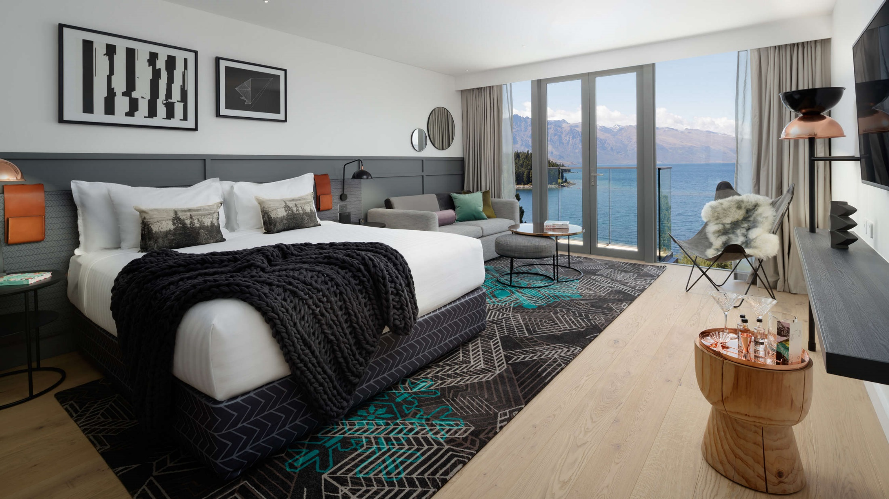
The QT and Rydges
Notes:
69 rooms of The QT opened in late 2017, with further wings of the Rydges redeveloped and converted into more of The QT. The designer hub, primly positioned overlooking the world-renowned New Zealand Southern Alps and majestic Lake Wakatipu. QT Queenstown’s eclectic spaces dare guests to adventure into the wild or enjoy the beautiful tranquillity of Queenstown. The hotel also opened Bazaar Interactive Marketplace restaurant, and Reds Cocktail Bar in late 2017.
https://www.queenstownnz.co.nz/listing/qt-queenstown/8600/
https://www.queenstownnz.co.nz/listing/rydges-lakeland-resort/1561/

Slide 45
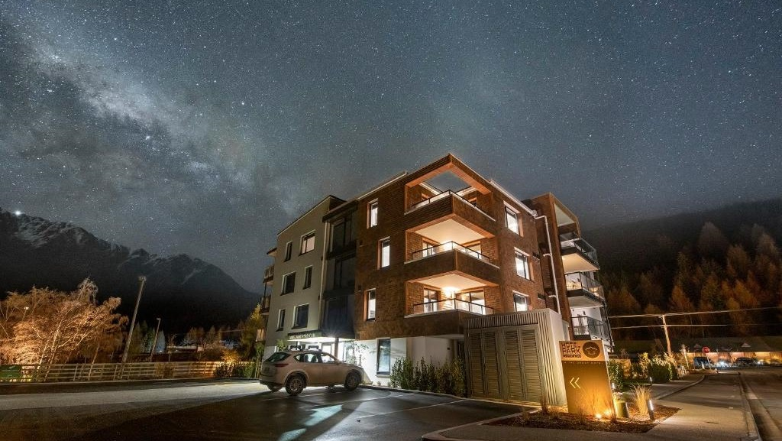
THC Hotel Park Residence
Notes:
Opened in late 2019 and seated at the foot of the Coronet Peak ski field and at less than 5 minutes driving distance from Queenstown, the brand-new apartments at Park Residence offer absolute luxury and comfort and are an ideal place to spend your holiday.
Complete with modern amenities and deluxe furnishings, our apartments have everything you’ll need for a luxurious getaway or family vacation. And with views of the historic Shotover River and Queenstown ranges from every window, balcony or patio, there’s no better place to enjoy the rugged and beautiful landscapes of southern New Zealand.
https://www.queenstownnz.co.nz/listing/hotel-park-residence/5630/

Slide 46
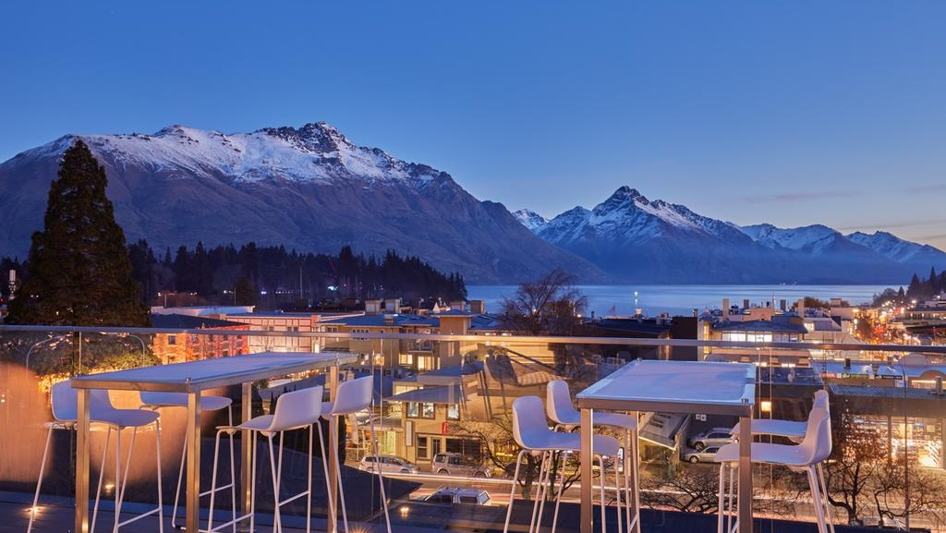
mi-pad
Notes:
mi-pad Queenstown is situated in the heart of Queenstown, less than a two-minute walk from the vibrant center with its hundreds of bars, restaurants and activity operators set on the shores of stunning Lake Wakatipu.
The six-storey hotel features 55 stylish and well-appointed rooms which are fitted with the latest in-room tech, purposefully designed to include everything you need and nothing you don’t.
https://www.queenstownnz.co.nz/listing/mi-pad-hotel/2660/

Slide 47
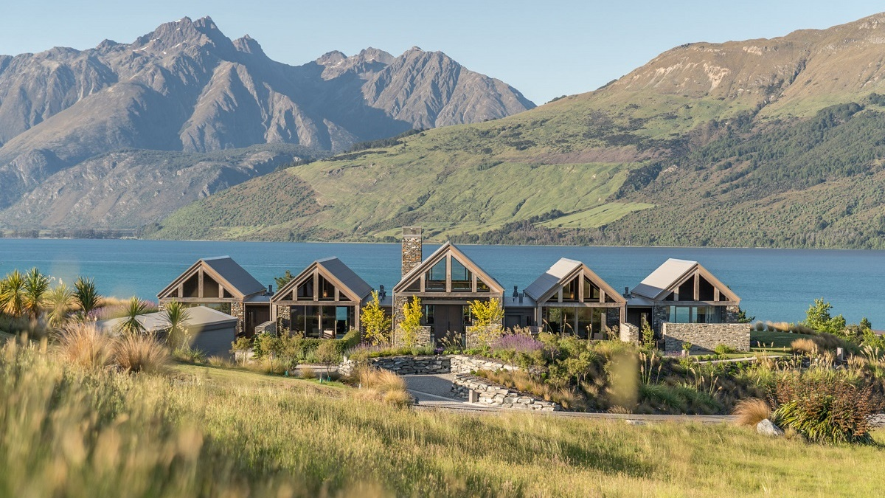
The Villa at Blanket Bay
Notes:
AWARD WINNING UNPARALLELED LEVEL OF LUXURY, CONVENIENCE AND SECLUSION. Completed in December 2017, this multiple award winning architecturally designed masterpiece adds an impressive fully serviced Villa option to Blanket Bay. Positioned above the Lodge and Chalets, the Villa reveals spectacular views across Lake Wakatipu to the Humboldt and Thomson mountain ranges.
Four king suites comprising bedroom, bathroom and sitting area feature individual fireplaces with shared spaces centered around the grand lounge, bar and commercial kitchen, outdoor lounge areas with fire pit and hot tubs.
https://www.queenstownnz.co.nz/listing/blanket-bay-luxury-lodge/836/

Slide 48
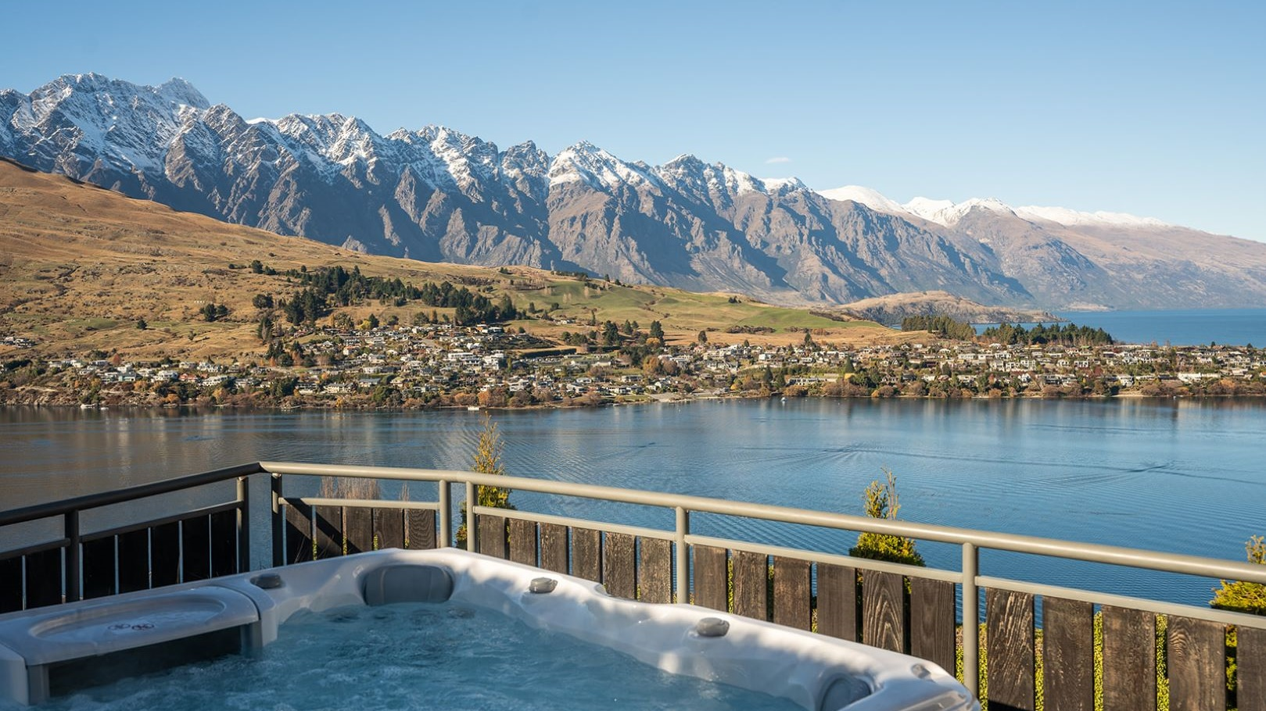
Castle Cliff Lodge
Notes:
Stay in ultimate style and luxury at Castle Cliff Lodge. Come and experience this amazing holiday home brand new to the luxury rental market and renovated to incredible standards, newly completed in May 2021.
Key features include:
Sleeps 12
Spa Pool
Weber BBQ and outdoor dining
Sauna room
Outdoor fireplace
2 indoor fireplaces
Billiards table
Ping pong
Dartboard
Boardroom table
3 Smart TVs including a 90“
Castle Cliff Lodge has been built on a large section positioned perfectly with the most incredible 270-degree views. The panorama encompasses the famous Remarkable mountain range, Bayonet Peak, Cecil Peak, Walter Peak and Bob’s Peak. This is a brilliant, elevated location looking down Lake Wakatipu towards Kingston and up towards Glenorchy.
Conveniences include unlimited fibre WiFi, SKY Sport channels, a chef's kitchen, coffee machine, ski storage and a drying room.
This is a stand-out home packed with amenities for the ultimate holiday.

Slide 49
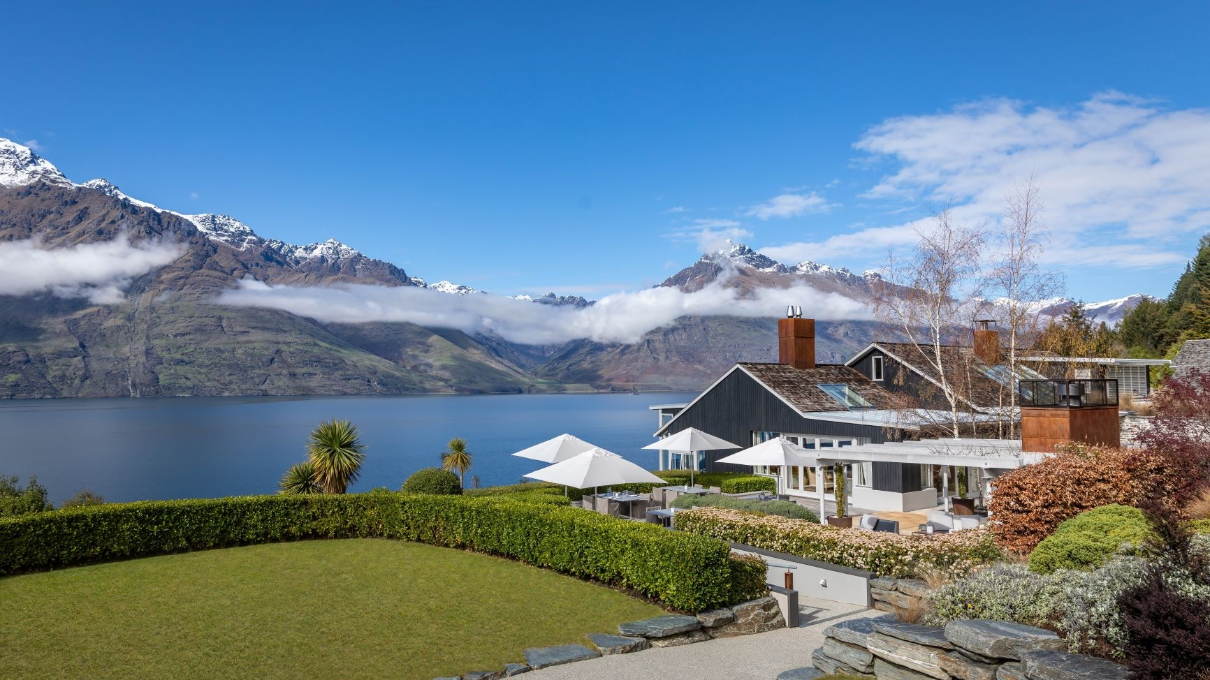
Matakauri Lodge
Notes:
Matakauri Lodge reopens its doors on 1 July 2021
The main lodge consists of a spacious lounge and dining and living areas, all with views of Lake Wakatipu. The lodge also offers a range of indoor and outdoor dining locations for guests, including superb private dining options, and an elegant meeting space with a business centre offering abundant natural light and views of the mountain ranges beyond.
Facilities include a full service spa, infinity swimming pool, and fully-equipped fitness centre, including sauna and a jacuzzi.
Accommodation is offered in twelve luxurious guest suites and rooms. Each suite offers a private porch, bedroom with sitting area and open fireplace, walk-in wardrobe and bathroom. The suites are nestled in to the landscape overlooking Lake Wakatipu and the mountain panorama.
The Owner’s Cottage at Matakauri features four suites in a freestanding residence with private Jacuzzi, kitchen and grand courtyard making it ideal for families, couples or friends travelling together, as well as special celebrations.
Matakauri Lodge is a member of Relais & Châteaux and is a sister property to Kauri Cliffs and Cape Kidnappers.

Slide 50
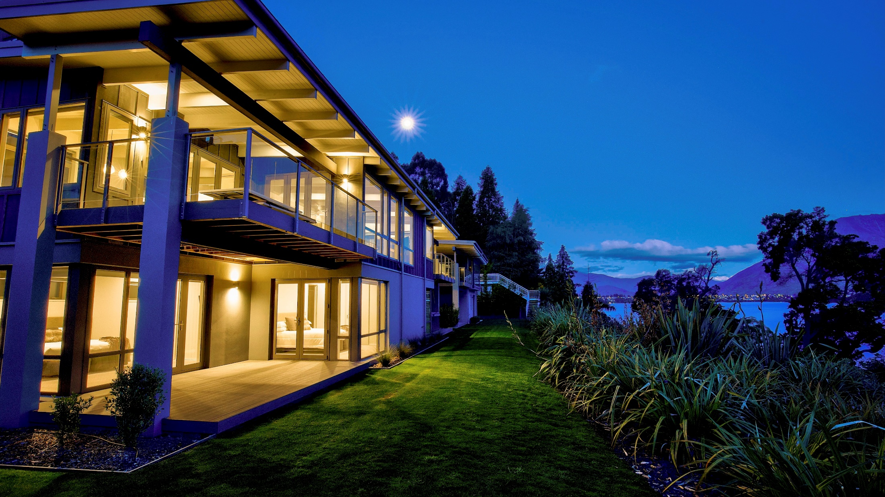
The Rees Residences
Notes:
Showcasing breath taking panoramic lake and alpine views, The Rees Hotel Queenstown is a sophisticated Five Star hotel situated right on the shores of Lake Wakatipu, with its own beach and private wharf.
The Rees Hotel offers a variety of spacious and luxurious accommodation options. This includes 5 lakeside private Residences which opened in 2018 which each consists of three bedrooms and 3.5 bathrooms.
https://www.queenstownnz.co.nz/listing/the-rees-hotel-luxury-apartments-%26-lakeside-residences/1896/

Slide 51
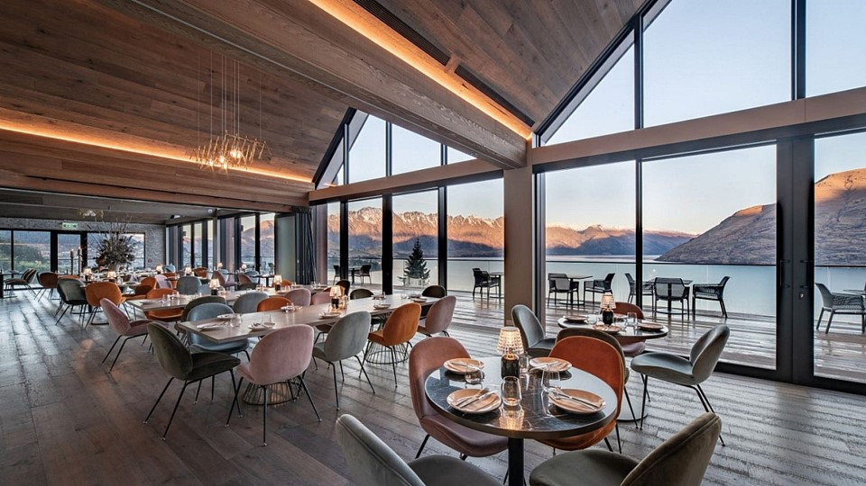
Kamana Lakehouse
Notes:
A multi-million-dollar rebuild and rebrand have transformed Queenstown’s Aspen Hotel into Kamana Lakehouse. ‘Kāmana’ is the Māori name for the Australasian Crested Grebe, which breeds on NZ’s southern lakes. Situated ontop of Fernhill Queenstown it is the highest hotel in Queenstown.
The ultimate private hot tubs experience in Queenstown, Kamana Soak Tubs offers our guests the perfect way to relax and take in the best views of Lake Wakatipu.
Available exclusively to Kamana Lakehouse in-house guests.
https://www.queenstownnz.co.nz/listing/kamana-lakehouse/1547/

Slide 52
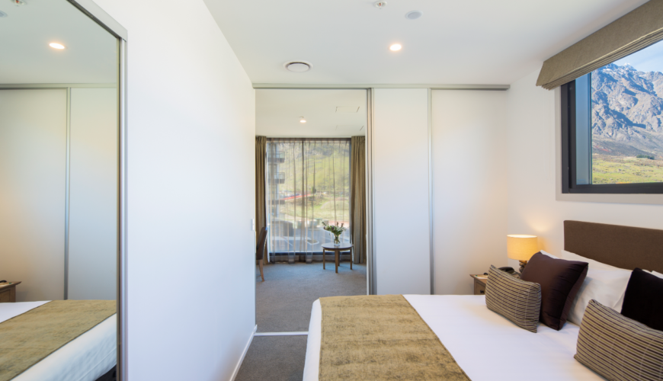
Wyndham Gardens Remarkables Park
Notes:
Wyndham Garden Queenstown opened in April 2018 at the foot of the spectacular Remarkables and a short walk to Remarkables shopping centre. It offers guests free WiFi, access to a 24-hour fitness centre and a secure heated ski gear storage room.
https://www.queenstownnz.co.nz/listing/wyndham-garden-remarkables-park/3433/

Slide 53
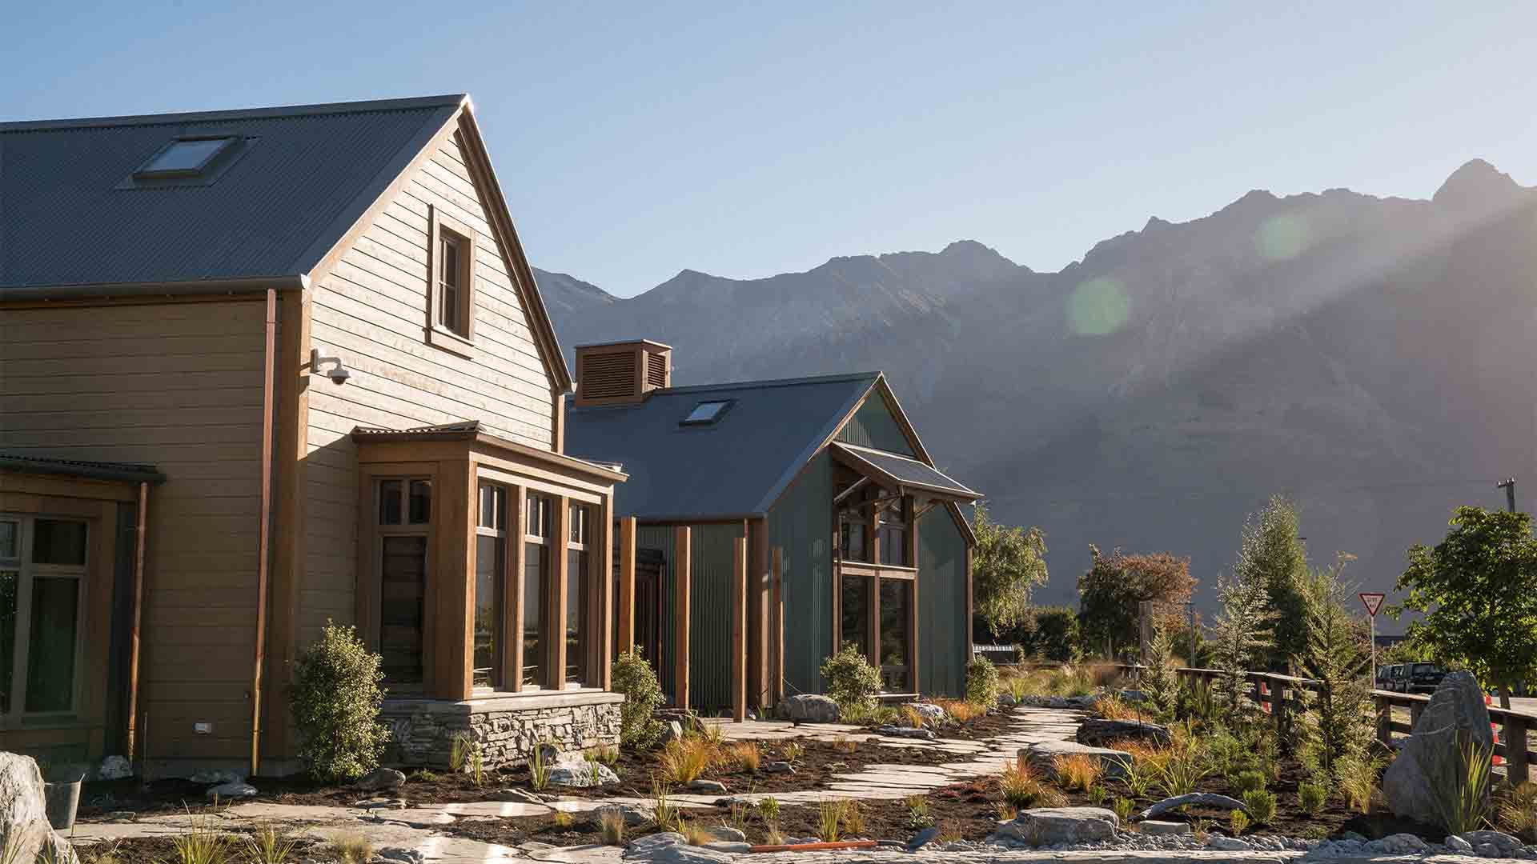
The Headwaters Eco Lodge
Notes:
Camp Glenorchy is said to be the first ever guest accommodation designed according to the Living Building Challenge, built to the most rigorous sustainability standards in the world.
7 cabins, 2 bunkhouses, 7 powered RV/campervan sites, shared kitchen, dining, relaxing and meeting spaces.
There is a solar garden to produce power on-site, state-of-the-art composting toilets to save water, an innovative heating system to increase efficiencies, all housed in smartly designed buildings and grounds.
https://www.queenstownnz.co.nz/listing/camp-glenorchy-eco-retreat/2011/

Slide 54
Food & Drink

Slide 55
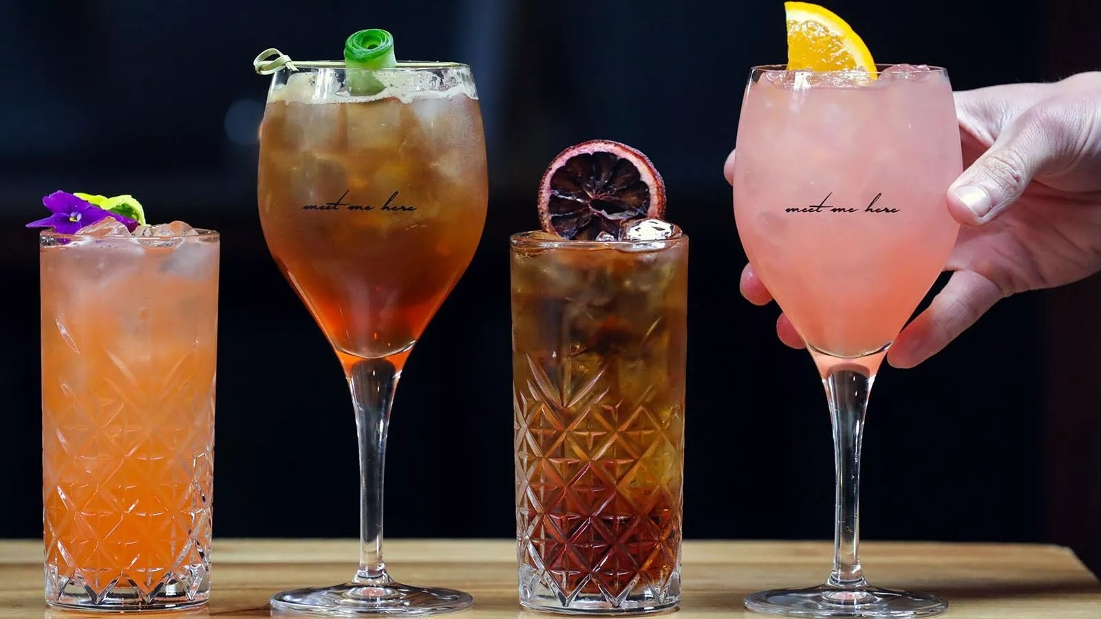
Little Mez
Notes:
Hidden away in a basement off Queenstown Mall, the team behind Margo’s are bringing Queenstown’s first dedicated Agaveria to life. Little Mez opened in July 2022. Situated below Margo’s, Little Mez offers incredible twists on classic cocktails curated from it’s large portfolio of mezcal, raicilla and tequila (Agave-based Mexican spirits). If margaritas aren’t your thing, get comfy at the bar and sip neat from a shallow Queenstown crafted clay cup.
https://www.future.co.nz/

Slide 56

Rhino’s Ski Shack
Notes:
Now located on Searle Lane, Rhino’s Ski Shack is back in a brand-new location for Winter 2022. Be transported into an authentic European après lifestyle with a kiwi twist. Featuring a handcrafted fit out, sourcing local materials and talent, this alpine themed bar is typical après in style, with chopped logs and vintage skis versus cutting edge photography, street art, and funky music.
They’ve always got something fun happening but our soft-spot is for winter, where they are host to Queenstown’s best Après Ski sessions. Come in straight from the ski fields, enjoy a game of pool... or Jenga, and try their signature drinks with some Après Ski style food - and of course... BEER!
By night, watch Rhino’s Ski Shack transform into Queenstown’s only hip-hop bar, featuring DJs spinning the best beats in town. The dance floor is unbeatable on a night out.
https://www.queenstownnz.co.nz/listing/rhinos-ski-shack/2263/

Slide 57

Max Brenner
Notes:
Max Brenner has opened in the Upper Village next to Kingpin, The Bavarian, Kiwi Park & Skyline, and it’s their first ever Chocolate Cafe in New Zealand.
Whether it’s a solo escape from life’s hustle or an endearing moment with loved ones, there’s no better inspiration for their master chocolatiers than seeing a lover of chocolate melt into their Max Brenner moment. Your happiness is the driving force behind their special chocolate recipe and unique dessert creations, all lovingly made in their very own patisserie.
https://maxbrenner.co.nz

Slide 58

Matakauri Lodge Day Guests
Notes:
Matakauri Lodge welcomes Queenstown locals and visitors alike to enjoy dining with full breakfasts, delicious three-course lunches and exquisite fine dining options for dinner. You may like to take time to combine a delicious breakfast or lunch with a relaxing treatment in the Spa. Reservations are essential and their team will be delighted to help you plan your perfect visit to Matakauri with bookings for the dining room and spa.
https://www.queenstownnz.co.nz/listing/matakauri-lodge/15306/
https://www.robertsonlodges.com/matakauri/day-guests

Slide 59

Oro Restaurant
Notes:
Pure culinary artistry from world-class chefs, this dining experience opened in March 2022. ORO is a sophisticated modern Queenstown Restaurant celebrating the best seasonal produce what the beautiful land and sea Aotearoa has to offer. Explore the Cuisine of our Executive Chef Thomas Barta who has earned Michelin Star experience working in the kitchen of Gordon Ramsay. Chef Barta aims to showcase the extraordinary produce of New Zealand in a golden explosion of flavours.
https://thecarlinhotel.com/oro-dining/

Slide 60

Little Aosta
Notes:
Arrowtown’s favourite restaurant Aosta welcomed a little bambino into its family with ‘Little Aosta’ opening next door to the flagship venue. The menu is designed to bring the magic of an authentic multi-generational Italian home into the heart of Arrowtown, capturing the essence of northern Italian food that is pared back and designed for sharing.
Little Aosta is a family-friendly, fast-paced trattoria offering dine-in and takeaway options for locals and visitors to Arrowtown. The cuisine of both Aosta and Little Aosta is inspired by the cooking techniques of Northern Italy paired with ingredients of the South of New Zealand. The namesake city of Aosta is in an alpine valley near the meeting point of the Italian, French and Swiss Alps.
https://www.littleaosta.co.nz/
.

Slide 61

Upper Village – The Bavarian
Notes:
The Bavarian brings a German-inspired, Aussie-embraced dining experience to Queenstown. Iconic credentials are built on three key attributes: great food, unbeatable German beers and bucket loads of fun
https://www.thebavarians.com/venue/the-bavarian-queenstown/

Slide 62

Upper Village – El Camino
Notes:
Located on Brecon Street, next to the Skyline Gondola, El Camino Cantina is a large & loud Tex-Mex bar filled with classic and frozen margaritas and delicious Tex-Mex feast
https://www.elcaminocantina.com.au/location/el-camino-queenstown/

Slide 63

Upper Village – Kingpin
Notes:
Kingpin is a social and entertainment hub where our goal is to make you feel like royalty regardless of how you choose to build your experience. Kingpin is a venue that not only has everything but the best of everything. This includes a restaurant and bar (including cocktails), coffee cart, and a crepe car.
https://www.queenstownnz.co.nz/listing/kingpin/14592/

Slide 64

Yia Yia’s Queenstown
Notes:
Yiayia's Queenstown pronounced [YA-YA] means grandmother in Greek, the matriarch who brings the family together for comfort food feasts of traditional recipes passed down through generations. Now open in central Queenstown on Beach Street.
This exciting new venue is the southernmost Greek restaurant in the world. Open everyday from 12pm.
https://yiayias.co.nz/

Slide 65

Gin Garden by Broken Heart
Notes:
Gin Garden by Broken Heart welcomes you to Queenstown’s first boutique gin tasting room.
They are located in Arthurs Point, just a 10-minute drive from Queenstown and Arrowtown and only a 3 minute drive from the base of Coronet Peak ski field.
Owned and operated by Broken Heart, the Gin Garden prides itself on serving award winning, locally distilled Broken Heart Spirits along with a locally brewed Oktoberfest lager. Recently winning Best New Zealand London Dry at the World Gin Awards 2021, a Double Gold at the 2021 New York Fifty Best, and the Double Gold at the NZ Spirit Awards 2020.
https://www.queenstownnz.co.nz/listing/gin-garden/12203/

Slide 66

Lil Red at QT
Notes:
Lil Red at QT
Taking sassy cues from brazen big sis Reds Bar, Lil Red is a culinary whiz kid. Cuisine as bold as the décor, she packs pops of quirk and a flavourful punch.
With a momentous menu designed for mingling, QT Chef Ryan Henley has gone straight to the source. Seasonal Central Otago produce, locally farmed meats and caught fresh seafood are gathered here for a foraged feast in a homegrown hideaway.
Cocooned in cosy, the scene is set for après ski revelry. Over delectable delights, we toast to tiny triumphs and dream up big adventures. Our cheeks rosy from the flare of the fire, crimson-lit evenings spark cheerful chatter that glows to deep conversation by dessert.
https://www.queenstownnz.co.nz/listing/reds-bar/12196

Slide 67

Coco Cabana
Notes:
Coco Cabana has opened at Remarkables Queenstown Central
Coco Cabana by Frank's is a fun cafe with a tropical Tiki bar theme, pizza hut and colourful restaurant. Find us at the top of the hill!
https://www.cococabana.co.nz/

Slide 68

Hustl. Cafe
Notes:
Hustl. Café is located in Queenstown Central, Frankton which is close to the new accommodation developments at Remarkables Park.
Hustl. Cafe is a contemporary cafe with a large focus on sustainability. We serve delicious, strong coffee all day long and have a carefully curated menu to suit all. With house plants galore & a warm ambience it is a lovely place to enjoy your coffee, breakfast or lunch.
https://queenstowncentral.co.nz/tenant/hustl-cafe/

Slide 69

The Crown Pub and Beer Garden
Notes:
The Crown Pub and Beer Garden has recently opened in Five Mile in a prime location with uninterrupted views of the Remarkables. It’s a perfect stop off on your way back from your day skiing at Remarkables, golfing or biking.
Open from 11am-late on weekdays and 9am-late on weekends.
The Crown has an extensive menu with pub classics including Fish & Chips and a Sunday Roast, a wide range of local and international beers on tap and an indoor play area for kids.
https://www.queenstownnz.co.nz/listing/the-crown-pub-and-beer-garden/11359/
https://www.thecrownpub.nz/

Slide 70

Canyon Brewing
Notes:
Canyon Brewing has reopened under new ownership, now operating daily from 11am-8pm.
The brewery and restaurant sold to The Boatshed Café and Bistro’s owners James Nicholson and Jane, James and Jack Paterson in December 2020.
Gather with friends or family for a Sunday sesh, visit after a day skiing, sit outside and watch the iconic Shotover Jet go past, enjoy a quick bite, long lunch, early dinner or local craft beer brewed in-house.
https://www.canyonfoodandbrew.co.nz/brewery

Slide 71

Fumé
Notes:
Open during summer.
Gibbston Valley offers a Wood-Fired Kitchen: Fumé (pronounced foo-may).
Fumé is a casual style restaurant and offers a 100% wood-fired selection of BBQ meats, home-made pizzas, seasonal salads and craft beer on tap.
Located in the old cheesery building, Fumé offers covered, courtyard style dining amongst the vines.
https://www.gibbstonvalley.com/nz/eat/fume-wood-fired-kitchen/

Slide 72

Gibbston Valley Cheesery & Deli
Notes:
Gibbston Valley Cheese Tours run 7 days a week from 10am - 5pm.
We are redeveloping our dynamic world of wine and cheese.
We are immersing our wines, food, people and experiences with a new range of cheese from producers whom we treasure and respect, and from the land we love.
The Gibbston Valley Cheesery & Deli in located in the Old Winery and is open 7 days a week from 10am - 5pm.
OUR CHEESES
We offer a range of artisan cheeses and are proud to be partnering with Whitestone Cheese to produce some unique, collaborative cheeses using Gibbston Valley ingredients.
Our selection of cheeses are aged and matured in the Gibbston Valley Cheesery & Deli, and in our famous Gibbston Valley Wine Cave. You will also find our cheese range served across all of our onsite eateries.
Choose from one of our carefully curated cheese boards (designed to pair perfectly with our handcrafted wines) or make your own.
THE EXPERIENCE
The cheese offering at Gibbston Valley is part of a 360 degree experience, stemming from our new Cheesery & Deli, where our cheeses are cut to order.
We will run a full daily schedule of tours and tastings that explore the incredible intricacies of wine and cheese pairing. In doing so, we will illustrate how our land is indispensable to our products, and what our craft does to bring the best out of land and place.
Our cheese is expertly paired with wines from across our property. Gibbston Valley Wine & Cheese tastings and tours are investigatory and educational. They offer you the opportunity to explore and discuss combinations.
OUR WHITESTONE PARTNERSHIP
Gibbston Valley and Whitestone Cheese share a common history, collaborating as early as the late 80s. Founders Bob Berry (Whitestone) and Alan Brady (Gibbston Valley) were quick to recognize the potential of Otago’s landscapes and each chose a hallowed craft as a medium of exploration. As Alan was drawn to Central Otago’s schist, so Bob was to North Otago’s limestone. Standing side by side at tradeshows and country fairs some thirty years ago, they each set their sights on creating authentic Central Otago products that would live on in our regional history.
Gibbston Valley Winery are now working in close unity with Whitestone Cheese Co to continue this legacy and bring the dual pioneering heritage into the present. We have reconnected to continue bringing local, handmade products and experiences that are, as Bob Berry announced in the early 90s, ‘as unique as the land that created them’.
This is a marriage of diversity and quality, imagination and talent, crafted by patience, history and care.
https://www.gibbstonvalley.com/nz/eat/gibbstonvalleycheese/

Slide 73

Flame Bar & Grill
Notes:
New location, now upstairs on Queenstown Steamer Wharf
World Famous in Queenstown
Ribs are their hero, succulent, juicy and addictive but of course our steaks are where they stand apart. Their cocktails and wine list are extensive with many local award winning wines and hand crafted signature cocktails. Flame has a casual, intimate ambience with an open kitchen and balcony overlooking Lake Wakatipu and the Remarkables Mountain Range, a perfect place to unwind and enjoy the magic of Queenstown.
Bookings are definitely recommended.
https://www.queenstownnz.co.nz/listing/flame-bar-and-grill/1773/

Slide 74

Pedro’s By The Lake
Notes:
Pedro’s By The Lake is a modern take on the original Pedro’s Restaurant, that was lost due to the 2011 Christchurch earthquake.
It’s taken nearly 10 years to re-open a full restaurant again. Occupying a central position down on the Queenstown lakefront you'll enjoy Spanish food a comprehensive drinks selection and an incredible view.
https://www.pedrosbythelake.co.nz/

Slide 75

The Dishery
Notes:
The Dishery
There's a new hub in Arrowtown called the Dudley's Cottage Precinct near the Chinese Village with Honey & Cocoa, Better By Bike, Jenny Mehrtens Artists, and The Dishery.
The latest addition to the precinct is The Dishery a new café which focuses on locally sourced produce paired with great wine, all in a garden setting adjacent to the Arrow River Reserve.
Their menu offers breakfast, lunch and early dinner or grazing inbetween.
https://www.queenstownnz.co.nz/listing/the-dishery-restaurant/10891/

Slide 76

Ferg’s Bar
Notes:
Newest addition to the famous Ferg family. Ferg’s Bar.
Brand New Cocktail Bar that has opened in the heart of beautiful Queenstown right next door to Fergburger. Designed with the Bartender in mind with wood, brass, leather fittings.
Their feelings are Queenstown is where fun and adventure exist all year round. Fergburger started as a hole in a wall down an alleyway in 2001.19 years on Fergburger has become famous around the world and has expanded with Fergbaker and Mrs Ferg (Gelato).
They are now excited to have opened their new bar with a focus on high quality cocktails and food offerings, with a fast and friendly service. It will have an international feel open from 7am – 2am.
https://fergsbar.com/

Slide 77

The Winery
Notes:
The world’s largest specialist New Zealand’s wine store.
At The Winery your clients can taste over 80 award-winning local, single vineyard and reserve wines from boutique wineries from across New Zealand - many of which don’t have cellar doors.
TASTE 80+ WINES
YOUR clients choose their wines they taste. With the simple push of a button their can serve themselves either a taste, half or full glass.
NEW ZEALAND WHISKY
They also are stockists of an extensive range of NZ’s rare single malt whiskies – with 8 for tasting.
CHEESE BOARDS & TAPAS MENU
Your clients can relax outside in the sun or inside in the cosy leather chairs of the wine lounge as they enjoy award-winning local cheeses with delicious platters to accompany their time at The Winery.
https://www.queenstownnz.co.nz/listing/the-winery/1521/

Slide 78

Cargo at Gantley’s
Notes:
Pub, Cafe & Takeaway at Gantley's
A little background about Cargo Brewing Company
Cargo is a unique and innovative brewing company based in Queenstown and their Brewery and cellar door are located in Gibbston Valley, named Cargo at Waitiri. There they have created an interactive and versatile space where they not only create their award-winning beer but share their beer making process with visitors. It’s a great place to gor for lunch and a drink.
The newest addition to the Cargo family is their Tap Room which can be found in Arthurs Point.
Cargo at Gantley's is only a 5 minute drive from central Queenstown and is a great place to visit any time of the year. This amazing building has a rich history dating back to the early settlement of Queenstown. Built over 150 years ago it provided hospitality for both travellers and locals, and they have brough it’s history back to life.
Open from 7am – 10pm for breakfast, lunch, dinner and drinks and have a delicious menu. There’s a roaring fire in winter, and an awesome beer garden to enjoy live music in summer.
https://www.queenstownnz.co.nz/listing/cargo-at-gantleys/6214/

Slide 79

Margo’s
Notes:
Margo’s is a new Mexican restaurant located on Ballarat Street, right in Queenstown Mall.
The atmosphere is fun, bold and high-energy, with colourful street art filled walls, and fun colourful food and cocktails that draw inspiration from the many different flavours of Mexico.
Open: Wednesday – Sunday 5pm to late.
https://www.queenstownnz.co.nz/listing/margos/8932/

Slide 80








DQ Travel Trade Marketing
Notes:
For further resource you can check out our website www.queenstownNZ.nz and our trade pages www.queenstownNZ.nz/trade and if you need any suggestions for product operators for selling to your clients please contact either Linda or myself and we can share the appropriate sales and marketing contact for you.
You can also join our Queenstown Travel Sellers Facebook Group and subscribe to our YouTube channel where you can receive regular updates on Queenstown.
Trade Team email: trade@queenstownNZ.nz

