Slide 1
Destination Queenstown
Food & Wine
Notes:
Queenstown offers some of the best restaurants and bars in New Zealand. Delectable food and a great night out are always on the menu. Food is an integral part of your holiday experience, and Queenstown is renowned globally for its great food, wine and legendary nightlife.
Whether you want to taste the flavours of the region and savour the local produce, or you’re after something virtuous with healthy eating top of mind, the Queenstown food scene has you covered. There are over 150 bars and cafes in the Queenstown region, with everything from fine dining, restaurants owned by celebrity chefs, family-friendly eateries to boutique dessert diners. Not to mention award-winning cafes and iconic burger joints that command a serious following. If you have special requirements, in Queenstown you can easily find delicious vegetarian, vegan, halal and gluten-free options. Start your day off right at one of Queenstown’s many cafes, where expert baristas craft coffee to fuel you. Or perhaps have a lazy brunch or lunch lake side.
If it’s takeaways you’re after, grab a giant gourmet burger and meander down to the lakefront, or pick up sushi, a pie or some pastry and pack a picnic basket for the day’s adventures. Settle in for the evening at a cosy wine bar or friendly pub or hot the town and experience Queenstown’s legendary night life, and discover the vibrant atmosphere, any night of the week. Learn more about Queenstown's food offerings, but be warned, there’s so much to choose from you’ll have to return to Queenstown for another taste.

Slide 2
Central Otago Wine region
Wine tours
Wineries & Cellar doors
Restaurants & Bars and more

Slide 3
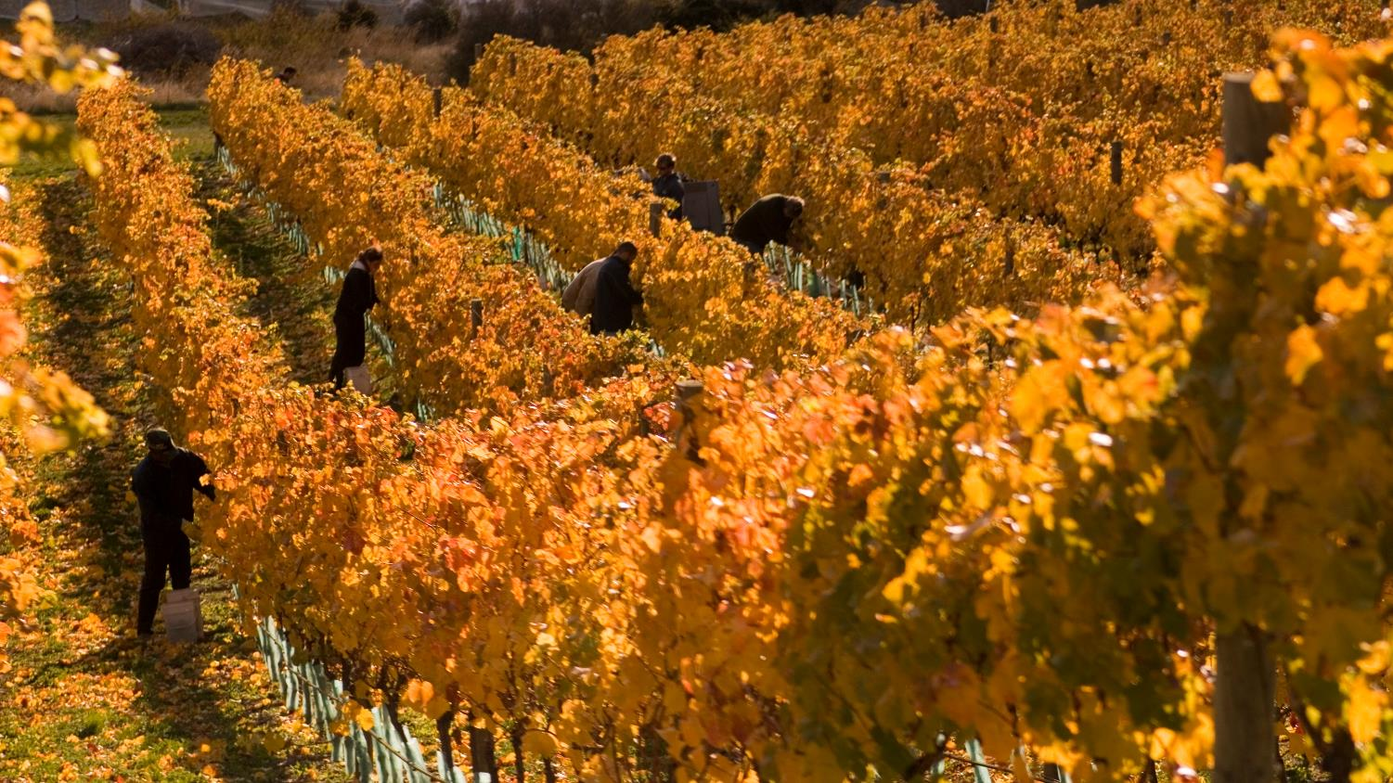

Central Otago Wine Region
Notes:
The wineries in Queenstown and nearby Gibbston, the 'Valley of Vines', have a reputation for producing some of the world’s best Pinot Noir, and it’s easy to while away a day exploring cellar doors and restaurants to find your favourite vintage. Queenstown is the gateway to the Central Otago region where you’ll find 200 vineyards within a 40 minute drive of the town centre. The Central Otago wine region is made up of six sub-regions; Gibbston, Cromwell/Pisa/ Lowburn, Bannockburn, Bendigo, Wanaka and Alexandra, all producing world-class wines.
What makes the region’s wine so special is the landscape its grapes are grown in. At a latitude of 45° south, Central Otago is the southernmost wine growing region in the world, with unique shaly soil and climate providing excellent grape growing conditions. Local winemakers produce award-winning wines of exceptional elegance and longevity.
Central Otago features New Zealand's highest and the world's most southerly wine region. The climate, temperatures and terroir (earth) all combine to create the unique flavours of Central Otago Pinot Noir and the other varietals that the talented winemakers create here. Find out more on the climate, temperatures and soil that makes Central Otago so special.
To help you experience our wines for yourself, many Queenstown wineries have cellar door tasting, and several have excellent winery restaurants on site, so you can drop in for a taste, a chat to the staff or a delicious meal with a glass of your favourite variety.
In Queenstown you can choose from tour companies to ferry you around Gibbston and further afield Central Otago wineries, leaving you to indulge in as many tastings as you wish before being whisked to the next destination. You can join an organised group tour, enlist the services of a chauffeur-driven private vehicle or even fly high on a helicopter charter flight across the region.

Slide 4
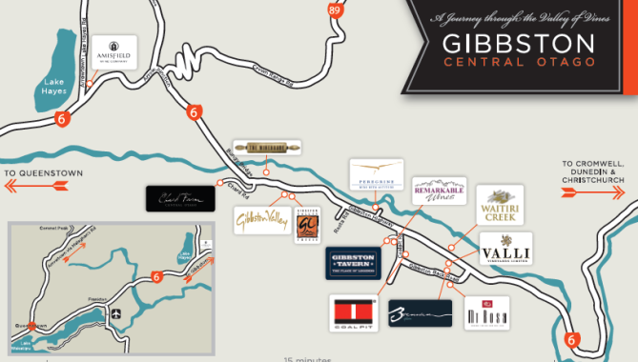
Notes:
Explore the region

Slide 5
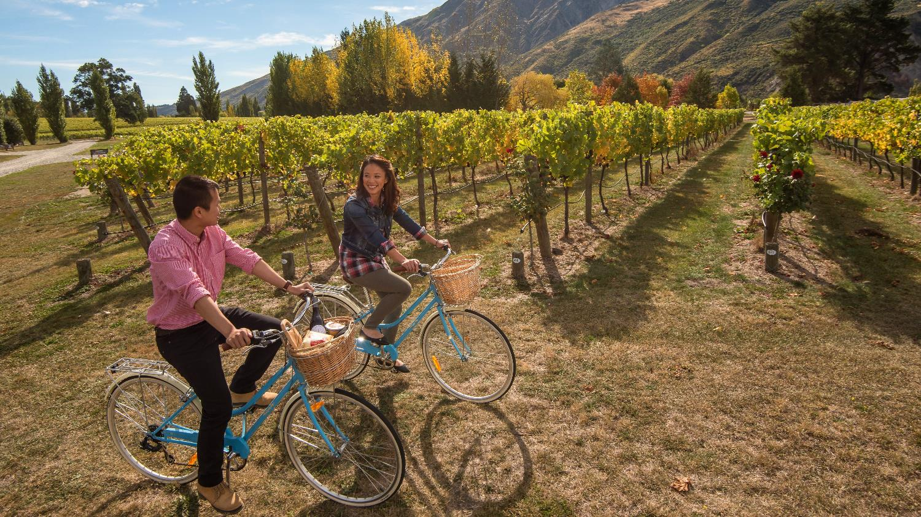
Wine Tours
Notes:
Information of wine tour operators

Slide 6
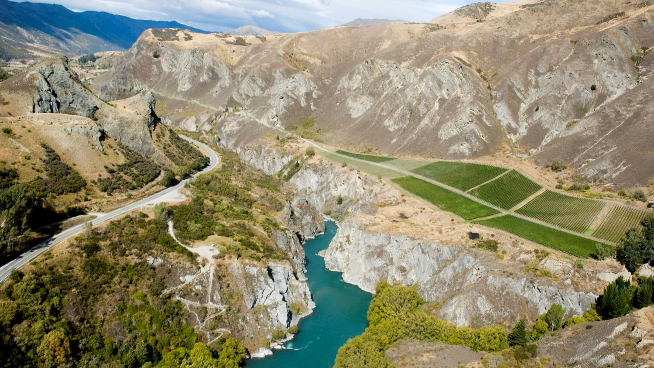
Explore the area

Slide 7
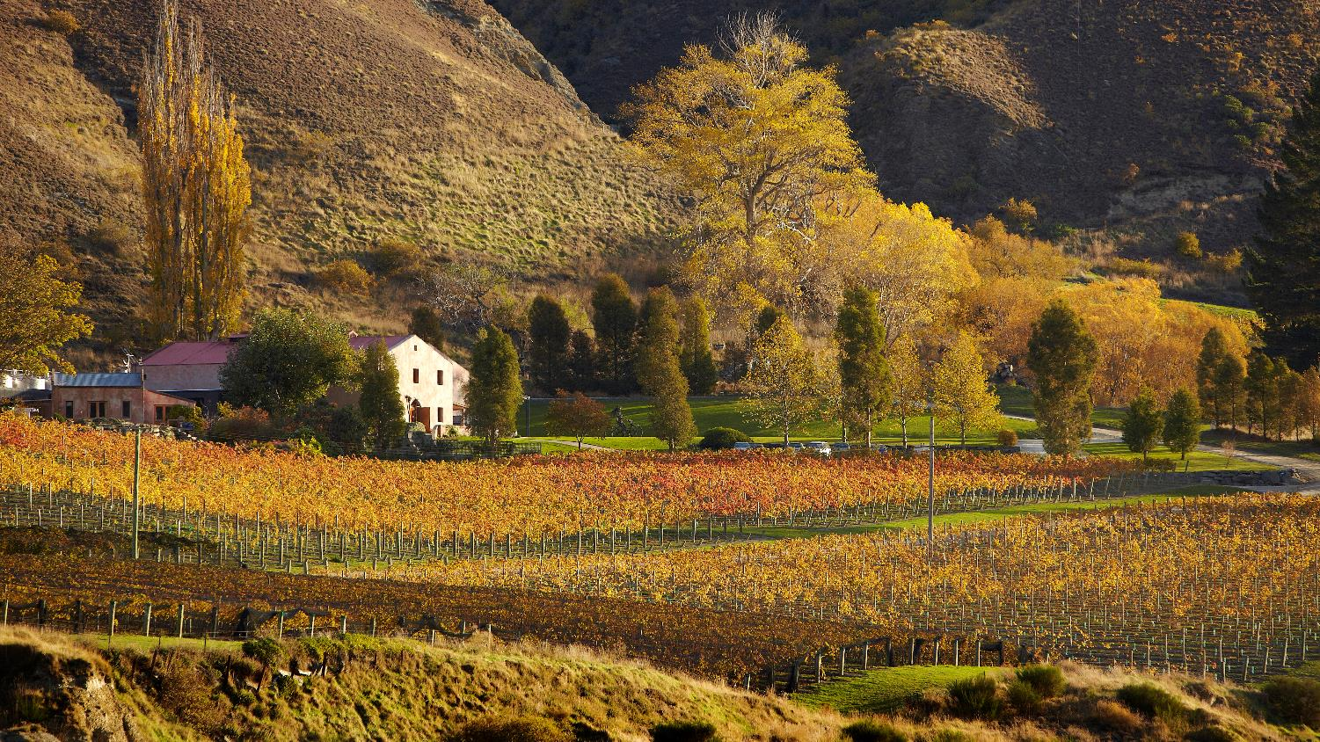
Gibbston Valley Winery
Notes:
1.About Gibbston Valley Winery- As one of the region’s founding wineries, their focus is always on handcrafting premium wines and honoring the traditions that have made them a world-renowned destination, since releasing Central Otago's first commercial vintage in 1987. Their wine is unfined, unfiltered and sustainably produced. Not only in their wine, but in their dining and other experiences they offer, they create unique and pure reflections of their ruggedly-beautiful and incredibly diverse surrounds. They’re inspired by the pursuit of good wine, good food and what they like to call good living. Their winemakers pour their passion for wine and the alluring and unique characteristics of their vineyards into every bottle of Gibbston Valley Wine. From handpicking whole bunches of grapes to macerating fruit by foot, they use traditional and time-tested techniques to craft their award-winning range of premium varietals. They value and respect our vineyards most of all. They have seven vineyards, two in Gibbston and five in Bendigo. Their intricate and diverse landscapes allow them to create wines that reflect the site they grow in. Everything from the soil type to altitude and temperatures during growing season impacts the flavors and aromas of their wine. Their wines have been recognised worldwide for creating and redefining the measure of New Zealand wines. They offer four distinct ranges, each showcasing a different aspect of our unique Central Otago vineyards.
Tours and tastings: They offer daily wine cave and tasting tours where you can visit Home Block, the region's oldest vineyard, do a tasting in their wine cave and catch a glimpse of their winemakers in action. For a more exclusive experience, upgrade to one of their private tour options.
Bike Tours: Their bike center gives you access to some of the top trails in Queenstown including the Arrow River Trail and the Gibbston River Trail. They offer bike hire and various packages including return transport from Queenstown.
Dining: Renowned as one of the finest dining experiences in the Queenstown region, Gibbston Valley restaurant offers a fine Central Otago wine and food experience featuring seasonal selections that match the freshest ingredients with their range of award-winning wines. Led by their Head Chef Anthony Gradiska, they create a harmonious blend of wine, food and place.
Cellar Door Menu-An assortment of platters and other light bites perfect if you are just in the mood for wine and some nibbles. Their Cellar Door Menu features a selection of gourmet meat and cheese platters and other light bites to pair with your Gibbston Valley wine experience. They also offer barista coffees and a selection of handmade pastries and cakes to enjoy with them at the winery or for takeaway.
Gibbston Valley Cheesery: Open for cheese tasting and light bites, the Cheesery is a delicious pairing to your Gibbston Valley Wine experience. The cheesery is located next to the winery gift shop and showcases the best of New Zealand sheep, cow and goat milk cheeses crafted in the European style.
Groups: The wine cave is also available for private functions including weddings, corporate dinners and other special events.
2.Location: Gibbston Valley Winery,1820 State Highway 6,Queenstown, New Zealand 9371
3.Distance from Queenstown: 20 minutes drive from Queenstown
4.Opening Hours: Cellar Door: 10 a.m. – 5p.m, Restaurant 12pm-3pm Daily, Cave Tour 10a.m-4pm on the hour daily.
Closed only on the following: Good Friday, ANZAC day, Queens Birthday, Christmas Day.
5.Bookings: Restaurant Bookings: restaurant@gibbstonvalley.com Group Bookings: groupevents@gibbstonvalley.com Wine Club: wineclub@gibbstonvalley.com
6.Contact: Tel:+64 (0) 3 442 6910, Email: General Enquiries: info@gibbstonvalley.com

Slide 8
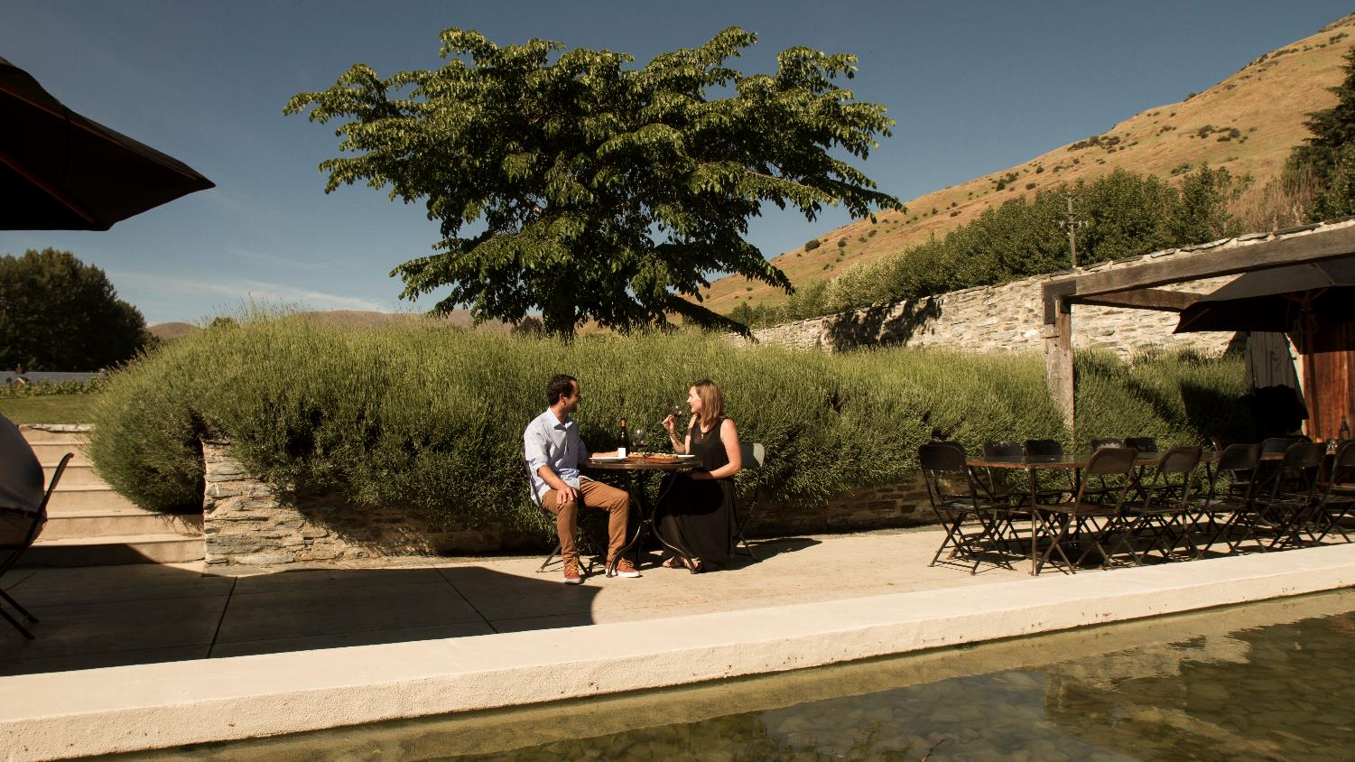
Amisfield Winery

Slide 9
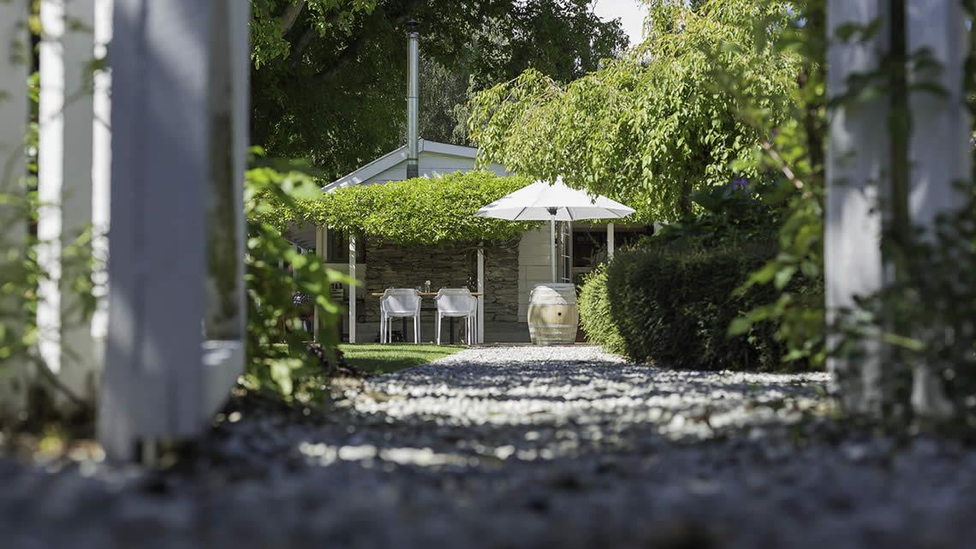
Akarua Wines and Kitchen

Slide 10
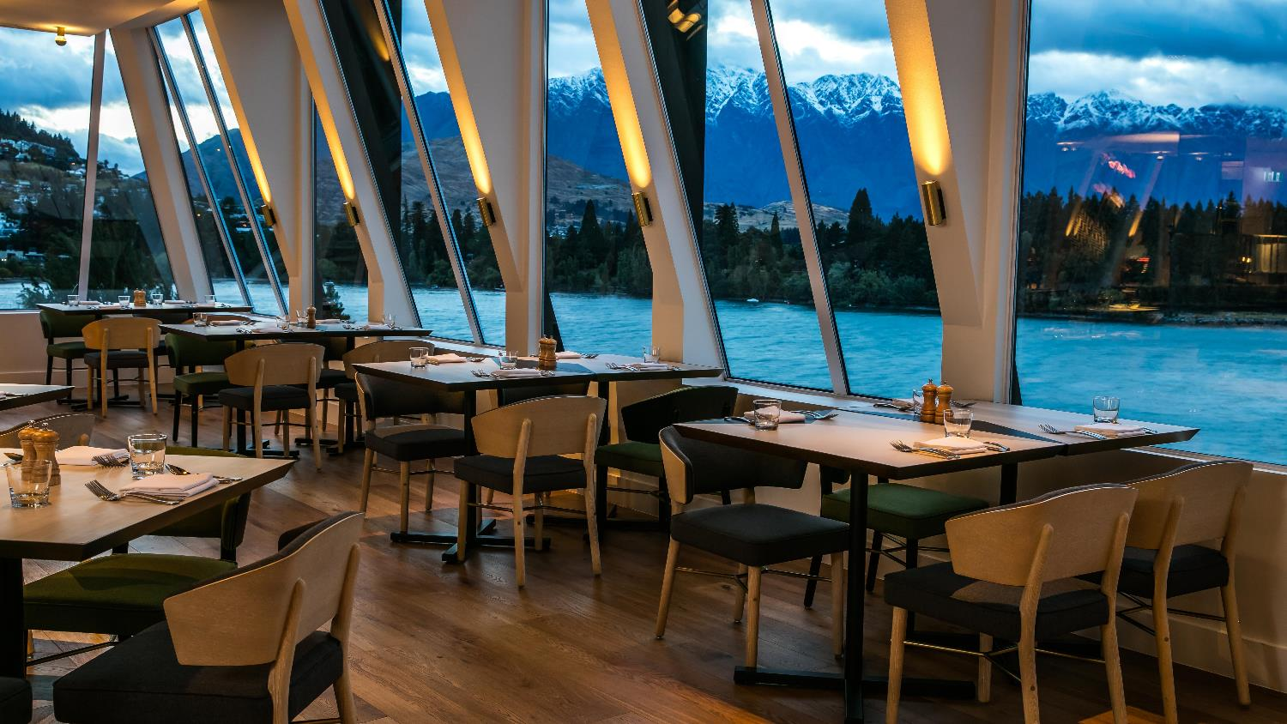
Restaurants

Slide 11
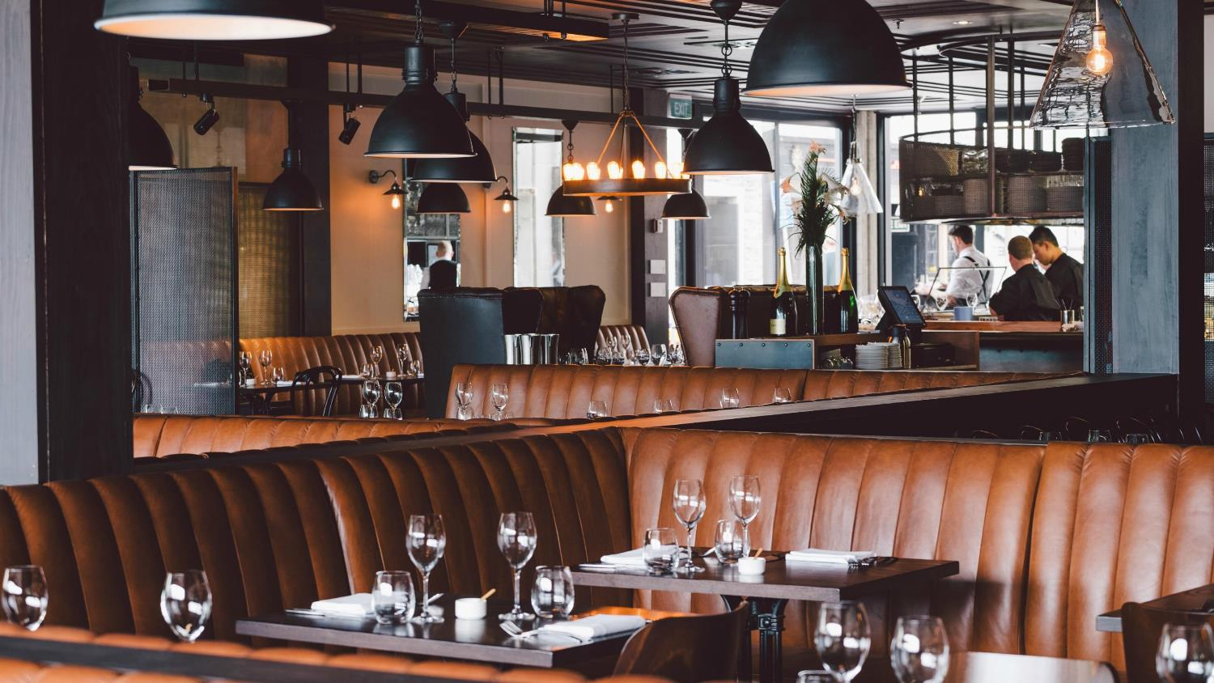
Restaurants
Notes:
1.About- The Grille by Eichardt's offers a fresh take on quality dining in Queenstown. Approachable enough to be comfortable yet stylish enough to stand out from the crowd. A continuation of the renowned icon of the 1860s, The Grille is a considered testament to the enduring history of Eichardt's. Serving sincerely memorable experiences mere footsteps from the shores of Lake Wakatipu, this outstanding dining hub encapsulates the spirit of Queenstown and Central Otago. The sophisticated interior, reminiscent of New York City bistros and genial French brasseries, warmly welcomes both locals and visitors alike. Once comfortably enveloped by the charm and character, the bounty of Central Otago and Southland awaits; home-grown, free-range, and locally sourced produce is at the forefront of an authentic dining experience. Savour each hand-crafted dish thoughtfully designed by Executive Chef Will Eaglesfield to showcase the unique tastes of the region. A state of the art kitchen fully equipped for curing, smoking, and grilling dishes to perfection, makes each course unrivalled in its flare and flavour. Your new favourite local dining experience awaits.
Breakfast, lunch & dinner.
2.Location: Marine Parade, Central Queenstown
3.Opening Hours: Monday-Sunday 7.30am –Late
4.Groups:
5.Contact: Tel +64 3 441 0444, Email: thegrille@eichardts.com
6.Website: http://www.eichardtsdining.com/thegrille/menu/

Slide 12
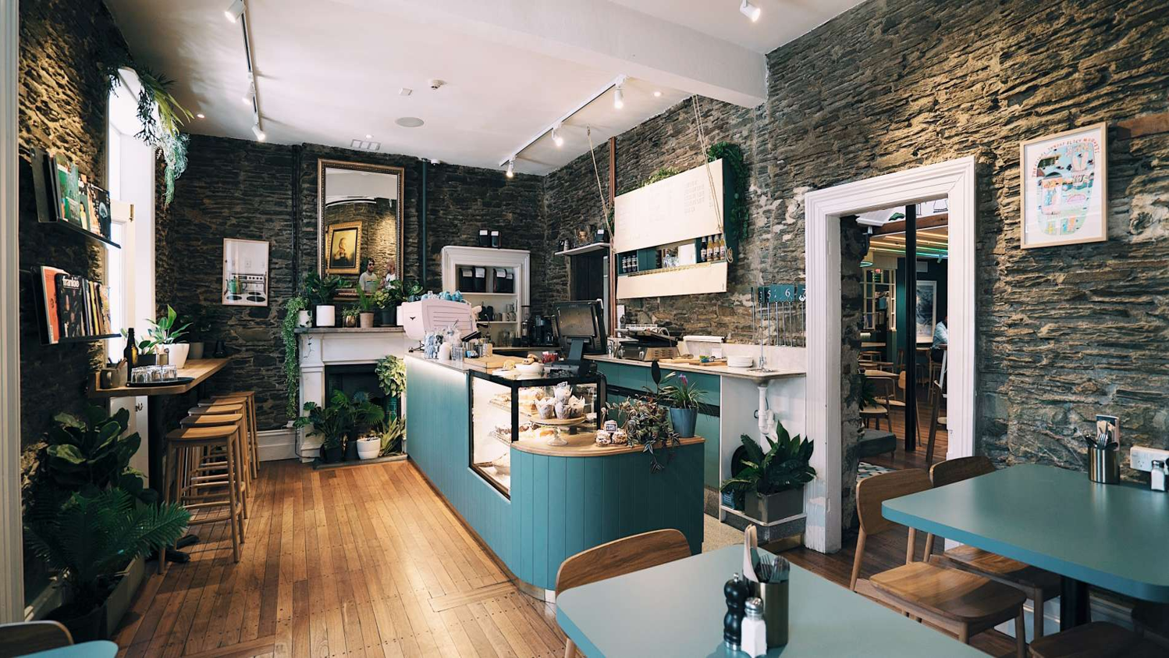
Cafes

Slide 13
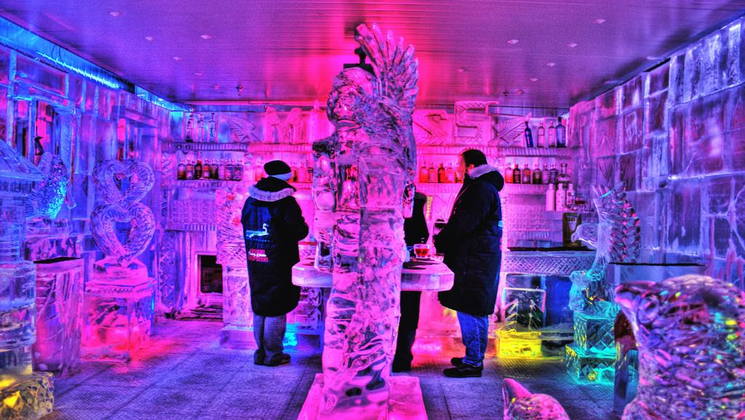
Pubs & Bars
Notes:
1.About- Eichardt's Bar; a Queenstown icon since 1867 has an atmosphere, history and ambience unlike anywhere else in the world, offering a welcoming environment for comfortable interaction between guests of the hotel and some of Queenstowns most colorful characters. Here, cocktails are created by top New Zealand bartenders who incorporate years of experience and passion into every drink. Eichardt's' attentive bar team is always ready to serve with a welcoming smile, good humor and utterly professional and knowledgeable manner. Eichardt's signature breakfast, lunch and tapas menus feature fresh and organic produce sourced from the very best local growers and all can be paired with a wine from their extensive hand selected list. Eichardt's' chefs have built a loyal following for consistent delicious and always inspiring dishes. The Bar oozes the warmth, comfort and style of this beautiful hotel with breathtaking views of the lake and mountains. A Queenstown must do.
2.Location: Marine Parade , Central Queenstown
3.Opening Hours: 7.30am-Late
4.Groups:
5.Contact: Tel: +64 3 441 0450, Email: bar@eichardts.com
6.Website: http://www.eichardtsdining.com/eichardtsbar/#footer-widgets

Slide 14
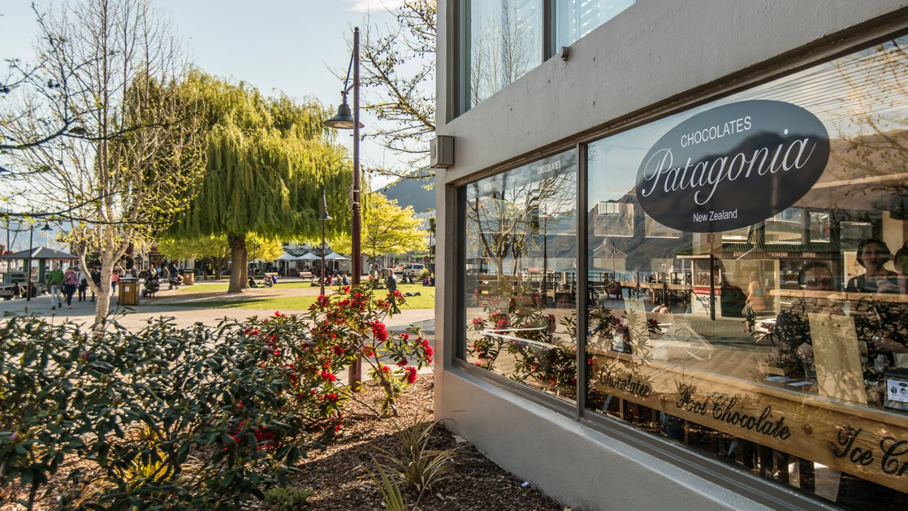
Dessert & Icecream

Slide 15
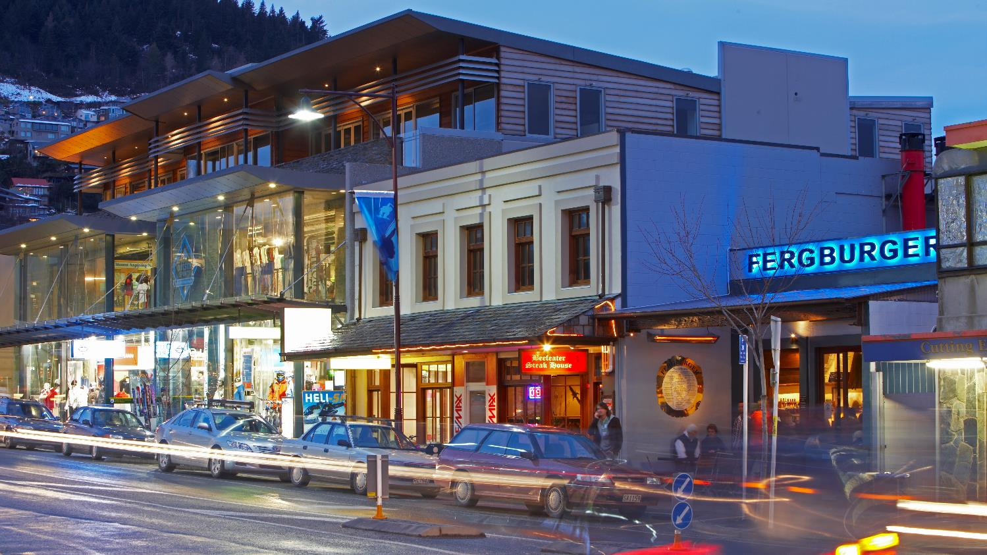

Fergburger
Notes:
1.About- Fergburger is a Queenstown 'Must Do'! Operating since 2001 it has been a favourite by locals and visitors alike. Try the classic Ferg with Cheese, Tropical Swine, the Chief Wiggam or the Cockadoodle Oink… you can’t go wrong!
2.Location- 42 Shotover Street Queenstown
3.Opening Hours: 21 hours a day 7 days a week.
4.Contact: Tel: +64 3-441 1232, Email: admin@fergburger.com
5.Website: https://www.fergburger.com

Slide 16
