Slide 1
Destination Queenstown
Home of Adventure – Food & Wine
Food & Wine Training

Slide 2
Contents
01
Central Otago Wine Region
02
Explore the area
03
Wine Tours
04
Restaurants
05
Cafes
06
Pubs & Bars
07
Desserts & Ice-cream
08
Trade Resources

Slide 3
Central Otago Wine Region
Notes:
The wineries in Queenstown and nearby Gibbston, the 'Valley of Vines', have a reputation for producing some of the world’s best Pinot Noir, and it’s easy to while away a day exploring cellar doors and restaurants to find your favourite vintage. Queenstown is the gateway to the Central Otago region where you’ll find 200 vineyards within a 40 minute drive of the town centre. The Central Otago wine region is made up of six sub-regions; Gibbston, Cromwell/Pisa/ Lowburn, Bannockburn, Bendigo, Wanaka and Alexandra, all producing world-class wines.
What makes the region’s wine so special is the landscape its grapes are grown in. At a latitude of 45° south, Central Otago is the southernmost wine growing region in the world, with unique shaly soil and climate providing excellent grape growing conditions. Local winemakers produce award-winning wines of exceptional elegance and longevity.
Central Otago features New Zealand's highest and the world's most southerly wine region. The climate, temperatures and terroir (earth) all combine to create the unique flavours of Central Otago Pinot Noir and the other varietals that the talented winemakers create here. Find out more on the climate, temperatures and soil that makes Central Otago so special.
To help you experience our wines for yourself, many Queenstown wineries have cellar door tasting, and several have excellent winery restaurants on site, so you can drop in for a taste, a chat to the staff or a delicious meal with a glass of your favourite variety.
In Queenstown you can choose from tour companies to ferry you around Gibbston and further afield Central Otago wineries, leaving you to indulge in as many tastings as you wish before being whisked to the next destination. You can join an organised group tour, enlist the services of a chauffeur-driven private vehicle or even fly high on a helicopter charter flight across the region.

Slide 4
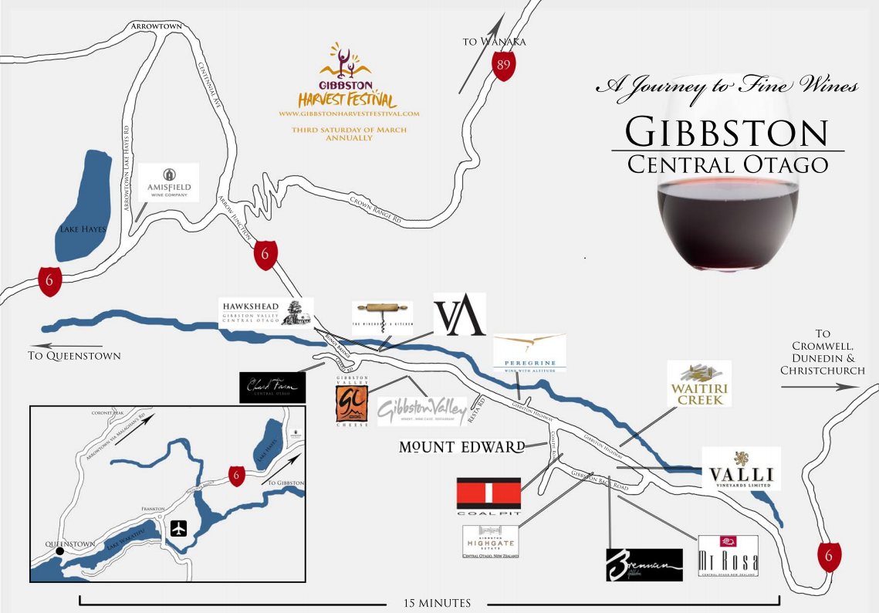

Slide 5
Explore the area
Notes:
Gibbston, the Valley of the Vines, is home to some of the region's oldest vineyards nestled between ruggedly beautiful schist mountains.
Located a 30 minute drive from downtown Queenstown you'll find Gibbston, the heart of Central Otago wine country and home to a number of wineries, restaurants, pubs, boutique accommodation – lodges, an historic cottage or charming B&B’s, and the historic Kawarau Suspension Bridge.
Famous for producing award-winning pinot noir wines, you'll find a collection of cellar doors lined up along the valley offering tastings of a wide variety of wines from throughout Central Otago’s six sub-regions. There’s also delicious food to savour at several restaurants and pubs serving up atmospheric, al fresco dining.
Hop on a shuttle, bike around the vines, or go on a guided wine tour – there’s all sorts of ways to taste the terroir, and plenty more to eat, see and do along the way.
The Queenstown Trail
A fantastic option for cyclists, the Queenstown Trail connects Gibbston with the rest of the region, and is arguably one of the most scenic ways to explore Gibbston. The Gibbston River Trail starts at the Kawarau Bridge, home of the world's first commercial bungy jumping operation, and then meanders past the dozen or so cellar doors and other attractions lining Gibbston. You can ride from Queenstown (6-8 hours/40kms), Arrowtown (2-3 hours/13kms), or start your journey at Gibbston Valley Winery and ride to the other end of the valley. Bike tour operators will collect you at the end of the day so you don't have to do the full there-and-back.
Gibbston Valley Shuttle
An easy transport option from downtown Queenstown, this shuttle bus runs 2–3 times daily to Gibbston Valley Winery, one of Central Otago’s pioneer producers. Located at the gateway to Gibbston, the winery is the valley’s major hub with bike hire, a cheesery and gift shop alongside an impressive cellar door.
Hop-on Hop Off shuttle options
Hop-on Hop-off shuttles are a fun and flexible way to get around the wineries without expending too much energy. Get top tasting tips on the journey out to Gibbston, then hop-off to start your self-guided tour. Hop On Hop Off and Wine Hopper Bus both offer services departing several times a day from downtown Queenstown.
Self-drive
Pick up a wine map, designate your driver, and create your own wine tour of Gibbston and beyond. Highlights between Queenstown and Gibbston include historic Arrowtown, Amisfield Bistro & Cellar Door near pretty Lake Hayes, and Chard Farm winery perched high on the river terraces at the entrance to the valley.

Slide 6
Wine Tours
Notes:
Discover just why Queenstown and Central Otago is home to some of the world’s best Pinot Noir on a tasting tour of our wineries and cellar doors.
You’re spoilt for choice when it comes to guided wine tours around Queenstown, with a range of different tour operators offering everything from popular group trips to private tours customised to specific interests and tastes.
Many wineries now bottle a number of varieties, so there’s something to pique the taste buds of all wine lovers on an organised car tour, or hop on a bike to ride through Gibbston’s vines (with a much-welcomed shuttle at the end of the day). For something truly special there are even helicopter tours.
Or, you might find yourself in Queenstown’s very own wine cave at one of the wineries where it all began in the 1980s.
A number of tour operators depart central Queenstown and tour a selection of Arrowtown, Queenstown and Gibbston wineries.
If you’re having trouble deciding what to buy on tour, no worries! There are food and wine stores in both Queenstown and Arrowtown with a wide selection of vintages from here and around New Zealand.

Slide 7
Gibbston Valley Winery
Notes:
Gibbston Valley Winery- As one of the region’s founding wineries, their focus is always on handcrafting premium wines and honoring the traditions that have made them a world-renowned destination, since releasing Central Otago's first commercial vintage in 1987. Their wine is unfined, unfiltered and sustainably produced. Not only in their wine, but in their dining and other experiences they offer, they create unique and pure reflections of their ruggedly-beautiful and incredibly diverse surrounds. They’re inspired by the pursuit of good wine, good food and what they like to call good living. Their winemakers pour their passion for wine and the alluring and unique characteristics of their vineyards into every bottle of Gibbston Valley Wine. From handpicking whole bunches of grapes to macerating fruit by foot, they use traditional and time-tested techniques to craft their award-winning range of premium varietals. They value and respect our vineyards most of all. They have seven vineyards, two in Gibbston and five in Bendigo. Their intricate and diverse landscapes allow them to create wines that reflect the site they grow in. Everything from the soil type to altitude and temperatures during growing season impacts the flavors and aromas of their wine. Their wines have been recognised worldwide for creating and redefining the measure of New Zealand wines. They offer four distinct ranges, each showcasing a different aspect of our unique Central Otago vineyards.
Tours and tastings: They offer daily wine cave and tasting tours where you can visit Home Block, the region's oldest vineyard, do a tasting in their wine cave and catch a glimpse of their winemakers in action. For a more exclusive experience, upgrade to one of their private tour options.
Bike Tours: Their bike center gives you access to some of the top trails in Queenstown including the Arrow River Trail and the Gibbston River Trail. They offer bike hire and various packages including return transport from Queenstown.
Dining: Gibbston Valley restaurant offers a fine Central Otago wine and food experience featuring seasonal selections that match the freshest ingredients with their range of award-winning wines.
Their Cellar Door Menu – offers an assortment of platters with a selection of meat and cheese and other light bites perfect if you are just in the mood for wine and some nibbles. They also offer barista coffees and a selection of handmade pastries and cakes to enjoy with them at the winery or for takeaway. Open daily 12noon – 3pm.
Gibbston Valley Cheesery: Offer a full daily schedule of tours and tastings that explore the incredible intricacies of wine and cheese pairing. In doing so, they illustrate how our land is indispensable to our products, and what their craft does to bring the best out of land and place. Their cheese is expertly paired with wines from across our property. Gibbston Valley Wine & Cheese tastings and tours are investigatory and educational. They offer you the opportunity to explore and discuss combinations. Gibbston Valley Cheese Tours run 7 days a week from 10am - 5pm.
Groups: The wine cave is also available for private functions including weddings, corporate dinners and other special events.
Location: Gibbston Valley Winery,1820 State Highway 6,Queenstown, New Zealand 9371
Distance from Queenstown: 25 minutes drive from Queenstown

Slide 8
Amisfield Winery
Notes:
Amisfield Bistro offers four distinct dining experiences, all of which showcase the finest local, in-season produce.
Lunch and dinner offer a multi-course degustation menu that promise an exciting sensorial exploration of the region’s flavours.
Indulge your love of fine wine as our passionate staff introduce your palate to the intricate flavours of Central Otago.
Open 7 days 10am-6pm
10 Lake Hayes Road, Queenstown

Slide 9
Chard Farm
Notes:
Chard Farm is a small family owned winery located 25 minutes from Queenstown.
Established in 1987, they are one of the pioneers of wine in Central Otago.
Chard Farm have 5 Estate owned vineyards in the Cromwell and Gibbston regions. They specialize in Single Vineyard pinot noirs (the Tiger, the Viper and MkII) and sub-regional specific pinots, including the signature Mata-Au pinot noir from the Lowburn subregion.
The winemaking philosophy is driven by the premise that people enjoy drinking interesting wines rather than tasting special wines. Chard Farm make wines to be enjoyed with food, conversation and contemplation. They do not enter competitions; so the wines tend to demand some interaction with the drinker, they do not deliver everything on offer in the first mouthful.
Chard Farm's wines are complex and interesting, textural and elegant, that shows good fruit/acid balance and genuine flavour length.
Cellar door open 7 days
Monday-Friday 10am-5pm
Satruday-Sunday 11am – 5pm

Slide 10
Akarua Wines & Kitchen
Notes:
Akarua Wines and the team from Artisan share similar principles….put simply to deliver the best wine and food experience to our customers that we can.
Wine is made in the vineyard and Akarua’s belief is that our land plays an integral part in producing the premium Central Otago wines that we bring to market each year. Likewise Artisan views the ingredients as the key to delivering food that is their signature.
A passion for hand crafted cuisine that’s made from scratch is a philosophy that makes the Artisan kitchen tick, using some of New Zealand’s finest sustainable ingredients sourced in and around the four coasts of our South Island.
The food coming from our kitchen is honest, comforting and social with a focus on quality, taste and seasonality helped from Central Otago’s local growers. Our food matched carefully with the purity of Akarua wines combine to create a memorable dining experience.
Enjoy the beautiful garden setting and the historic cottage which we have lovingly restored – whether it’s for a coffee and breakfast or for a shared lunch over wine with friends, we look forward to welcoming you soon.
Executive chef John Pickens.
Open 7 days – 9am-5pm and Friday nights for dinner.

Slide 11
Restaurants
Notes:
You're spoilt for choice when dining out in Queenstown, with a wide selection of restaurants to choose from.
Queenstown restaurants offer a range of cuisine, from contemporary New Zealand fare using the freshest local produce, to delicious ethnic food, quick bites for those on the go as well as vegetarian and vegan-friendly menu items with a focus on flavour.
Early diners can stake out a spot at a lake-front bistro for platters of seafood, cruise over Lake Wakatipu on a vintage steamship for a BBQ feast, or find a fine-dining experience tucked away from the bustle of the main streets.
For families there are fast and friendly options as well as hearty meals after a day on the mountain or out adventuring.
There is something for everyone, and every mood, in cosmopolitan Queenstown.

Slide 12
Cafes
Notes:
Nothing beats a lazy breakfast or brunch when you’re on holiday, and Queenstown is host to many stylish cafes.
Queenstown’s cafés offer a selection of expertly crafted coffee, drinks, beautifully presented cabinet food and light meals. In winter, cafes offer a cosy respite from the cold, while summer lets you dine al fresco in sun drenched courtyards, or at beachfront haunts.
Pack a picnic basket with treats from a local bakery, grab an award-winning pie to fuel up for the day’s adventure, or just take a break from shopping and sightseeing.

Slide 13
Pubs & Bars
Notes:
Experience Queenstown’s legendary nightlife with a night out at any, or all, of the local bars and nightclubs.
Cosy up next to a roaring fire for some après ski, or gear up and go bar hopping in central Queenstown to discover hidden laneways with the best and busiest clubs. Queenstown’s bars and clubs often have live music with talented cover bands, or visiting DJ’s for those wanting to carry on into the night.
There’s also a number of destination bars, with extensive cocktail and wine lists.
Many pubs, bars and clubs have happy hours and drink specials, no matter what day of the week.

Slide 14
Dessert & Icecream
Notes:
A stroll on the lakefront in Queenstown and through the historic buildings around Arrowtown can be made even sweeter with the treats on offer at our dessert shops and candy stores.
Chocolatiers, gelaterias, specialty sweet shops, dessert shops and ice cream parlours in Queenstown will satisfy your sweet tooth when the mood strikes.
Admire the chocolate fountains, and salivate over the wide range of gelato flavours, taste test specialty fudge, or build your own ice cream on a stick before choosing some to take home.
Queenstown’s dessert shops will leave your mouth watering.

Slide 15
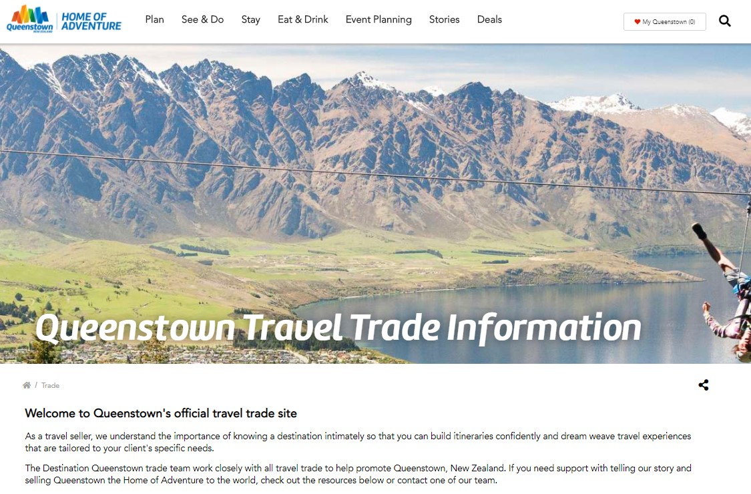
www.queenstownNZ.nz/trade
Notes:
For further resource you can check out our website www.queenstownNZ.nz and our trade pages www.queenstownNZ.nz/trade
If you need suggestion for product operators for selling to your clients, please contact our team on trade@queenstownnz.nz and we can share the appropriate sales and marketing contact for you.

Slide 16
Thank you
Destination Queenstown
50 Stanley Street,
Queenstown, 9300
New Zealand
Trade Team
E: trade@queenstownNZ.nz
P: +64 3 441 0700

