Slide 1
Destination Queenstown
New Product
July 2021

Slide 2
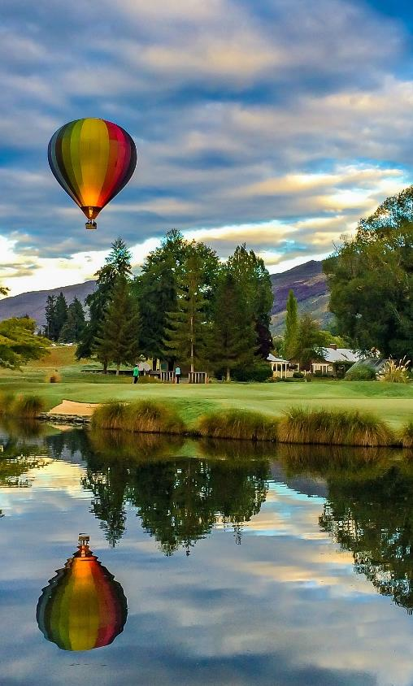
Contents
01
Activities
02
Accommodation
03
Eateries
04
Resources
05
Contact details

Slide 3
Activities

Slide 4
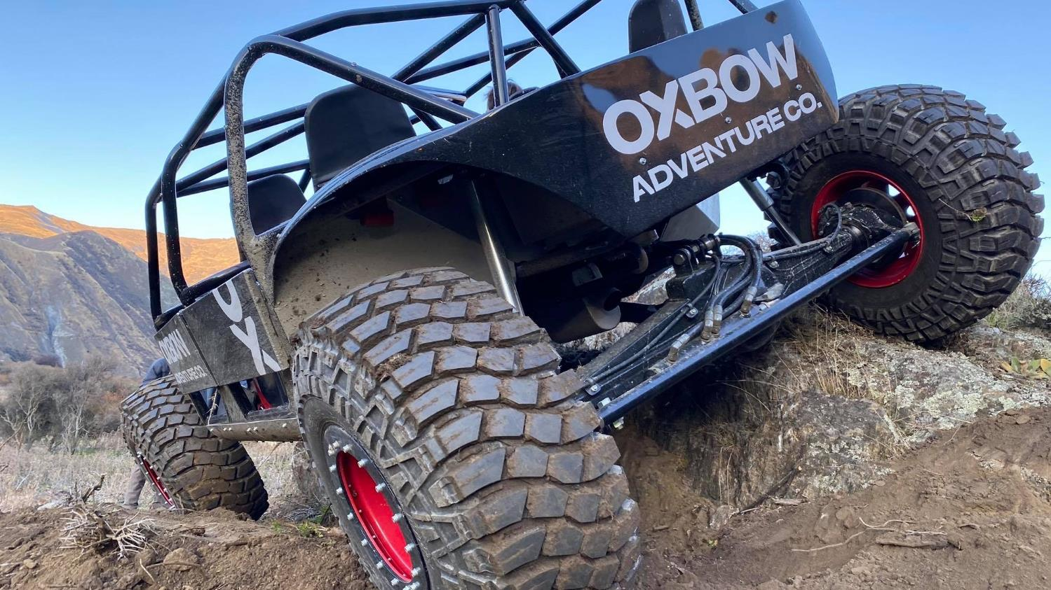

Oxbow Adventure Co.
Notes:
Opened September 2020.
Oxbow Adventure Co is located in the heart of New Zealand’s Southern Alps at the iconic Nevis Bluff and will be proud to exist as a passionate provider of one hundred percent super charged, kiwi fun!
The team at Oxbow are in the business of sending people home with huge grins, a surge of endorphins and a head full of fantastic memories. Whether your clients are planning a boy or girl’s weekend, some Family fun or just craving some adventure...
The friendly and adrenaline hungry folk at Oxbow will provide a personalised service for each individual and group, guarantying an experience your clients guests will never forget. A highly experienced, trained and certified team operate a professional range of activities:
Jet Sprint Boats
4WD Off-Roader
ClayBird Shooting
Jet Boat Sprints (SPEED)
The 4-Seater Jet Sprint boats consist of the professional driver and 3 passengers. They operate on a custom-built Jet Sprint course with a series of islands to navigate around. They accelerate from 0-100km/hr in 2.5 seconds. The trip consists of 3 separate track rotations.
Departures: every 10 minutes, from 8am to 5pm (winter) and 8pm (summer)
Duration: 10 minutes on the water
Eligibility: Minimum height of 1.2metres.
4WD Off-Roader (THRILL)
The Off-Roader is a 4-Seater, which carries the professional driver and 3 passengers. The Off-Roaders are 4WD, 4-wheel steer and have an extremely low centre of gravity which allows them to pretty much go anywhere. They operate on a custom-built course which includes near vertical hill climbs and descents, rock features and many other crazy features.
Departures: every 10 minutes, from 8am to 5pm (winter) and 8pm (summer)
Duration: 15 minutes
Eligibility: Minimum height of 1.2metres. Injuries on a case by case basis. No pregnant woman.
Clay Bird Shooting (SKILL)
Their custom designed compact sporting field is equipped with 8 automatic clay bird throwers to suit all abilities, it also includes the run-away rabbit across the ground (don’t worry it’s not the real thing!) The stand facilitates 6 shooters per session, each shooter is positioned in their own stand with safety barriers to ensure safe operation at all times.
For those more experienced shooters or those wanting an extra challenge, we offer the choice of a 25 or 50 Bird ‘Flurry’.
Departures: every 45 minutes, from 8am to 5pm (winter) and 8pm (summer)
Duration: 45 minutes
Eligibility: Minimum 13 years old
https://www.queenstownnz.co.nz/listing/oxbow-adventure-co/7806/
Combos
Jet Sprints & 4WD Off-Roader $275pp
Jet Sprints OR 4WD Off Roader and Clay Birds $265pp
All 3 products $399pp

Slide 5
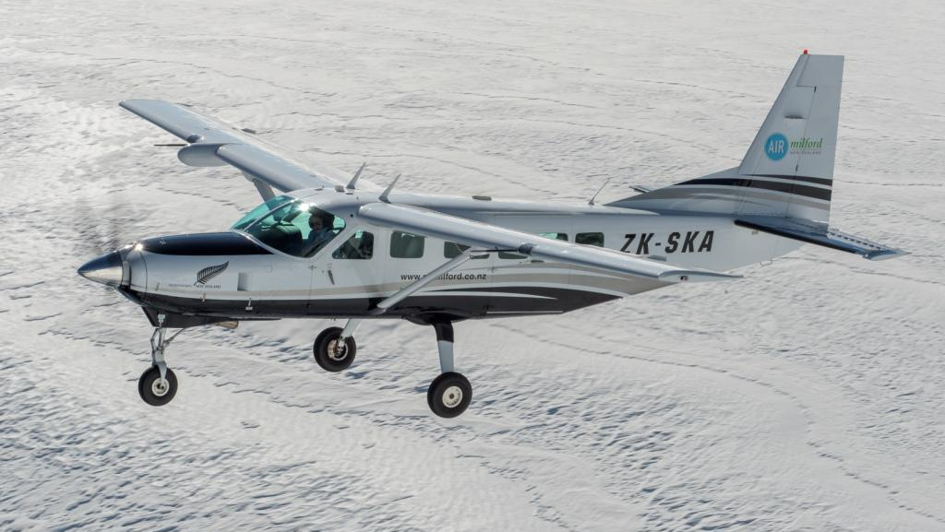
Air Milford – Milford Sound Scenic Flight & Big Five Glaciers
Notes:
Air Milford is now offering New Zealand’s isolated Gem Milford Sound + 5 Big Glaciers Flight.
Board their Cessna aircraft from Queenstown and be transported through a magical wonder of dramatic views including the Rob Roy, Bonar, Jura, Volta, Dart, Olivine and Donne Glaciers as well as the famous Milford Sound.
Expect to see New Zealand fur seals, bottle nose dolphins, penguins and other New Zealand wildlife as you fly over and around the Mt Aspiring and Fiordland national parks largest glaciers.
Air Milford is experienced, established, personalised and thrilled to be able to offer unique and exclusive experiences like this!
https://www.queenstownnz.co.nz/listing/air-milford/9957/

Slide 6
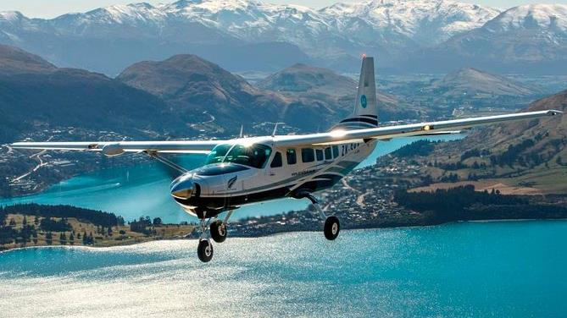
Air Milford & Real Journeys – Walter Peak Flight & Steamship Cruise
Notes:
Air Milford and Real Journeys have teamed up to bring your clients a new experience to the best of Queenstown from the sky and Lake Wakatipu.
Your clients will depart Queenstown with Air Milford to get an aerial view of the Wakatipu Basin, including the world famous gold mining settlement - Arrowtown. Flying past the first founded ski field in New Zealand, Coronet Peak. Overflight Queenstown CBD including a flyby of the Skyline Gondola, before tracking along the northern side of New Zealand's longest lake, Lake Wakatipu.
On the right of the aircraft dominating the horizon is Bob's Peak, at 1748m. Secluded behind this mountain are the alpine lakes, Dispute and Moke. The journey continues to provide a magnificent view of Glenorchy and the Paradise region, including Mt Earnslaw (2830m) and the Earnslaw Glacier.
A descent into Walter Peak station is precluded with an aerial view of the Wakatipu's largest high country station, Mt Nicholas. To finish the flight on a high note, the landing takes place on a non-sealed airstrip, which is an ideal introduction to the relaxed farm life of Walter Peak station.
Your clients will then be able to explore Walter Peak station with the farm tour, including the dog barking demo. They will then board the TSS Earnslaw back to Queenstown.
On board they will be able to enjoy a beverage or food from the café.
Flight duration: 20 minutes
Total trip time is 2.5 hours
https://www.queenstownnz.co.nz/listing/air-milford/9955/

Slide 7
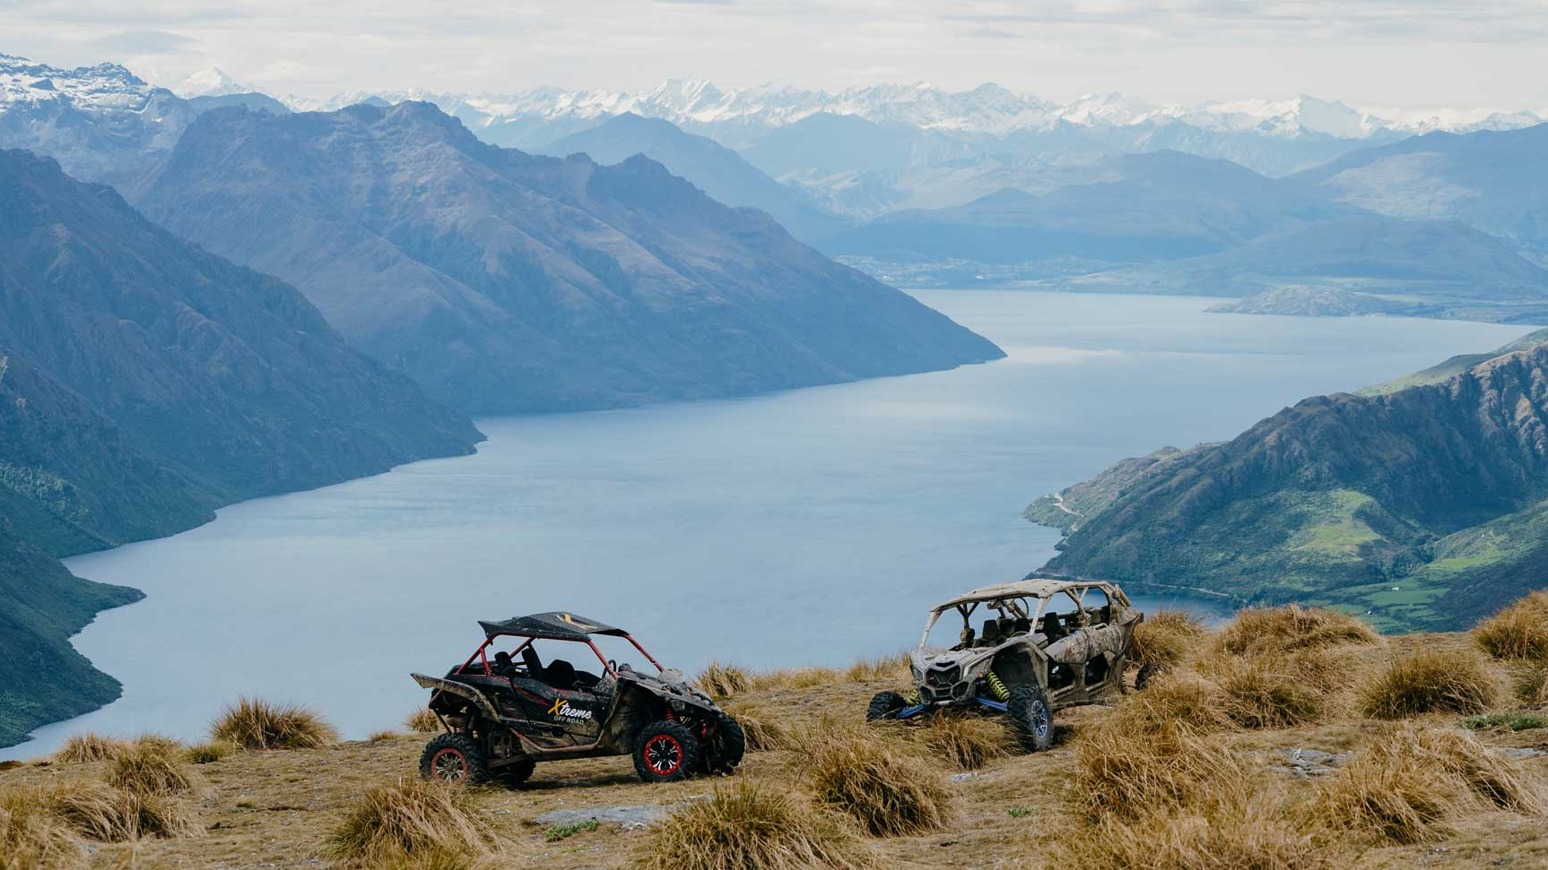
Xtreme Off Road
Notes:
Xtreme Off Road based in Kingston just 30mins from Queenstown Airport.
They offer world-class vehicles with out of this world scenery to give you both thrilling rides and breath taking views.
Our 2.5km X Track gives you the opportunity to release your inner rev head, there’s ample opportunity to give it some jandal, drop the hammer or put the pedal to the metal.
If you want something more scenic their 2-hour tour up Kingston Hill will provide you with some of the most breath taking views of Lake Wakatipu.
https://www.queenstownnz.co.nz/listing/xtreme-off-road-limited/10074/

Slide 8
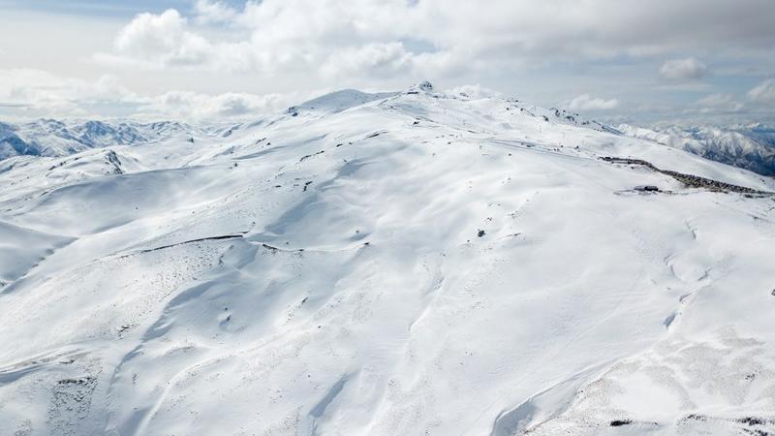
Cardrona Alpine Resort
Notes:
Cardrona Alpine Resort has announced its first move into Soho Ski Area with the installation of Willows Quad Chair for winter 2021.
Willows Basin is the first area to be unlocked within Soho and will open up 65 hectares of new terrain, the first new major section of skiable terrain in New Zealand since Cardrona put in Valley View.
https://www.queenstownnz.co.nz/listing/cardrona-alpine-resort/1008/

Slide 9
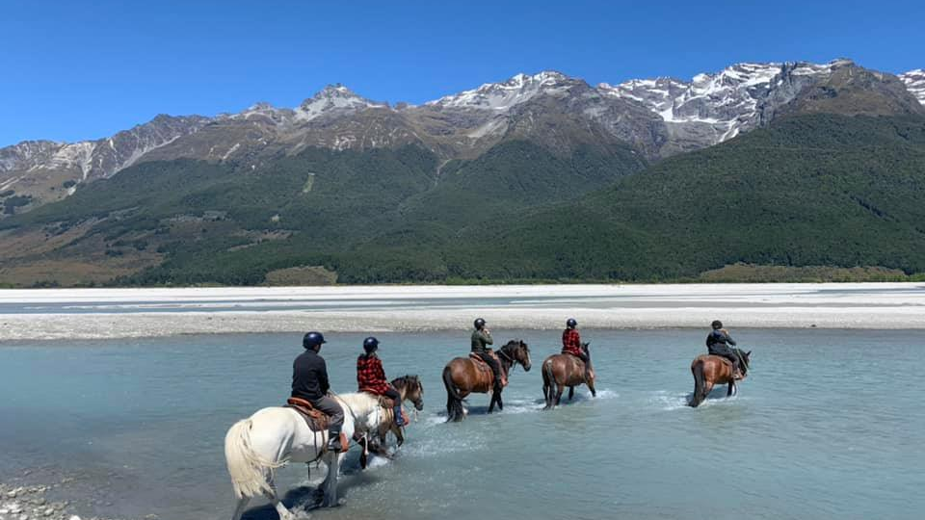
Lighthorse Adventures
Notes:
Lighthorse Adventures located at the head of the lake in the Dart Valley, Glenorchy, offer amazing horse treks for riders of all levels.
From shorter 75 minute rides, to half, full-day and custom trek experiences.
Your clients will enjoy scenic landscapes, gentle rides, quality guides and more importantly a full immersion into the experience of horsemanship.
https://www.queenstownnz.co.nz/listing/lighthorse-adventures/10542/

Slide 10
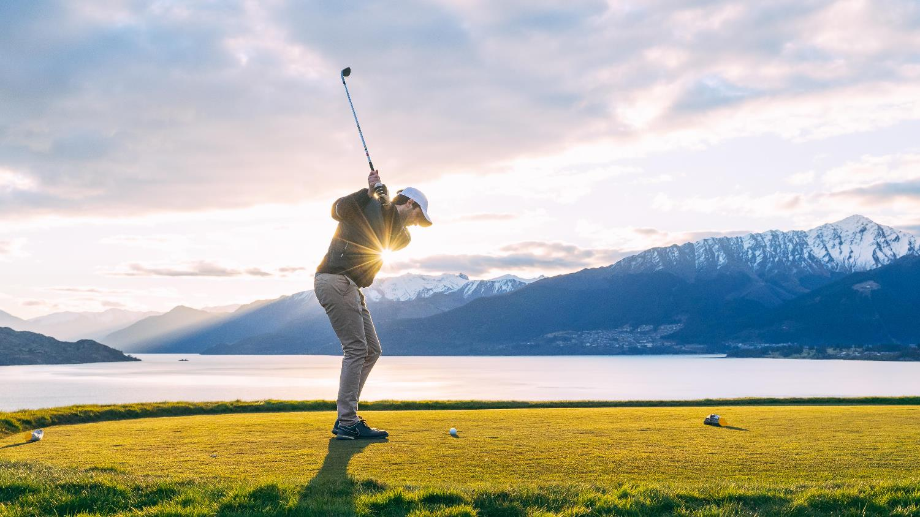
Queenstown Golf Collective Super Pass
Notes:
Queenstown Golf Collective Super Pass allows golfers a round at Arrowtown, Jack’s Point, Millbrook and Queenstown courses on the same pass.
Available to book with:
Remarkable Golf Tours, or
Peak Golf Queenstown
Both companies can arrange other golf services as required – tee-off time reservations, equipment hire & transportation etc
https://www.queenstownnz.co.nz/listing/remarkable-golf-tours/910/
https://www.queenstownnz.co.nz/listing/peak-golf-queenstown/9728/

Slide 11
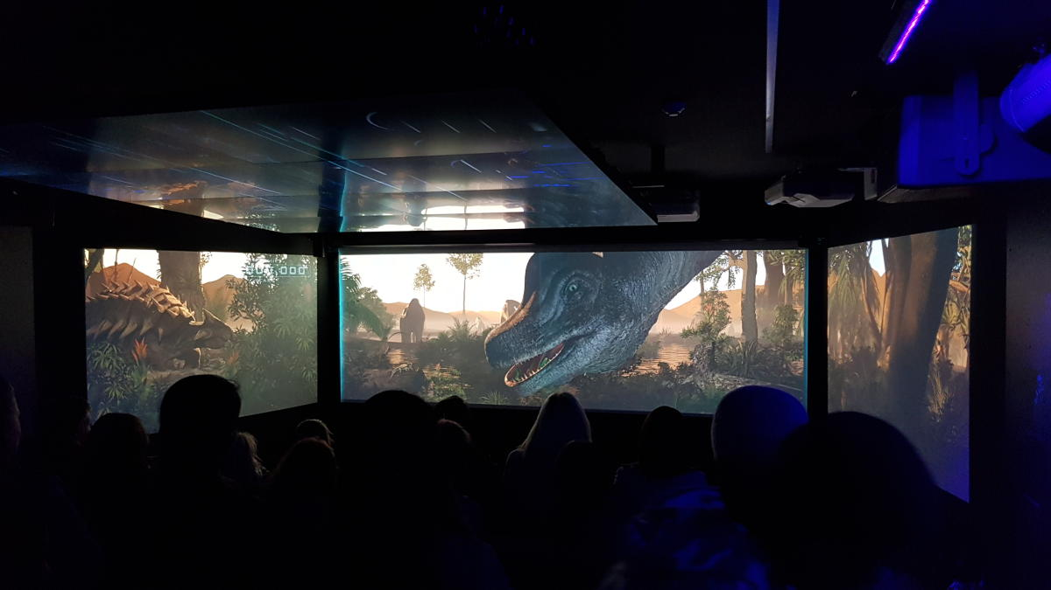
Time Tripper Queenstown
Notes:
QUEENSTOWN’S ONLY UNDERWATER CINEMATIC EXPERIENCE
Time Tripper is a state-of-the-art animated show situated under Lake Wakatipu, that tells the Māori Legend of the Lake and the story of the creation of the Wakatipu region, starting 90 million years ago taking the viewer through to present day Queenstown.
The show is approximately 15 minutes long, with 10-15 minutes of underwater viewing available afterwards where you can see eels, diving ducks and trout that live under Lake Wakatipu.
Price: $10 Adult $5 Child
Every 30 minutes from 9.45am – 3.45pm, 7 days a week
https://www.queenstownnz.co.nz/listing/kjet/5530/

Slide 12
Accommodation

Slide 13
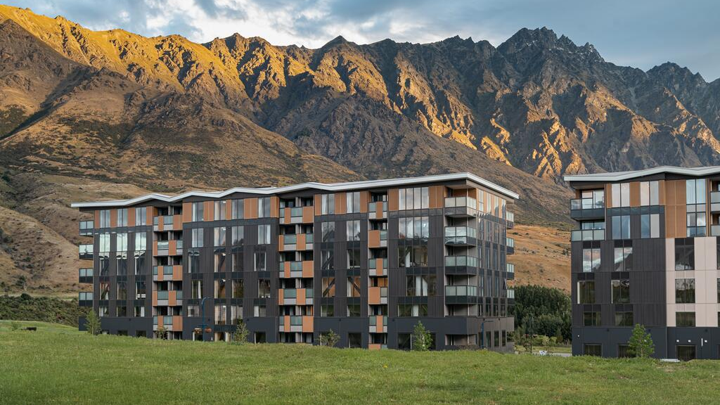
LQ Hotel by Ramada
Notes:
LQ Hotel by Ramada opened December 2020 and is located in Remarkables Park, Frankton, 15 minutes from downtown Queenstown.
With unparalleled views of the Remarkables mountain range, Kawarau River to the south and Coronet Peak to the north.
LQ Queenstown offers a combination of hotel rooms and self-contained apartments in a range of sizes and configurations.
Made up of 91 guest rooms featuring king size beds, air conditioning and 40" flat screen TV's with Sky TV. Studio and 1 bedroom apartments are fully self-contained, providing kitchenette with stovetop, microwave, and full laundry facilities.
https://www.queenstownnz.co.nz/listing/lq-queenstown-hotel/10299/

Slide 14
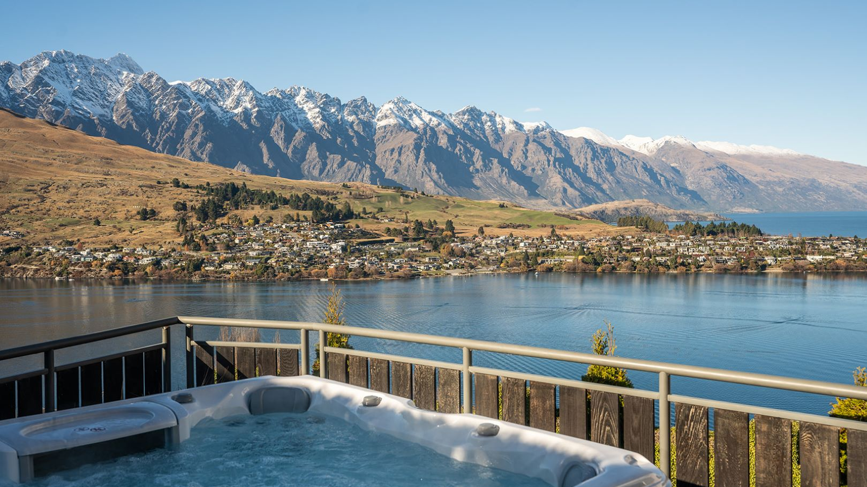
Relax It’s Done – Castle Cliff Lodge
Notes:
Stay in ultimate style and luxury at Castle Cliff Lodge. Come and experience this amazing holiday home brand new to the luxury rental market and renovated to incredible standards, newly completed in May 2021.
Key features include:
Sleeps 12
Spa Pool
Weber BBQ and outdoor dining
Sauna room
Outdoor fireplace
2 indoor fireplaces
Billiards table
Ping pong
Dartboard
Boardroom table
3 Smart TVs including a 90“
Castle Cliff Lodge has been built on a large section positioned perfectly with the most incredible 270-degree views. The panorama encompasses the famous Remarkable mountain range, Bayonet Peak, Cecil Peak, Walter Peak and Bob’s Peak. This is a brilliant, elevated location looking down Lake Wakatipu towards Kingston and up towards Glenorchy.
Conveniences include unlimited fibre WiFi, SKY Sport channels, a chef's kitchen, coffee machine, ski storage and a drying room.
This is a stand-out home packed with amenities for the ultimate holiday.

Slide 15
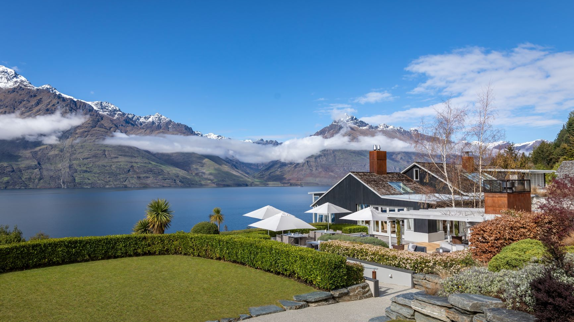
Matakauri Lodge
Notes:
Matakauri Lodge reopens its doors on 1 July 2021.
This will be for a limited winter and spring season offering lakeside luxe bed & breakfast until 14 December.
The main lodge consists of a spacious lounge and dining and living areas, all with views of Lake Wakatipu. The lodge also offers a range of indoor and outdoor dining locations for guests, including superb private dining options, and an elegant meeting space with a business centre offering abundant natural light and views of the mountain ranges beyond.
Facilities include a full service spa, infinity swimming pool, and fully-equipped fitness centre, including sauna and a jacuzzi.
Accommodation is offered in twelve luxurious guest suites and rooms. Each suite offers a private porch, bedroom with sitting area and open fireplace, walk-in wardrobe and bathroom. The suites are nestled in to the landscape overlooking Lake Wakatipu and the mountain panorama.
The Owner’s Cottage at Matakauri features four suites in a freestanding residence with private Jacuzzi, kitchen and grand courtyard making it ideal for families, couples or friends travelling together, as well as special celebrations.
Matakauri Lodge is a member of Relais & Châteaux and is a sister property to Kauri Cliffs and Cape Kidnappers.

Slide 16
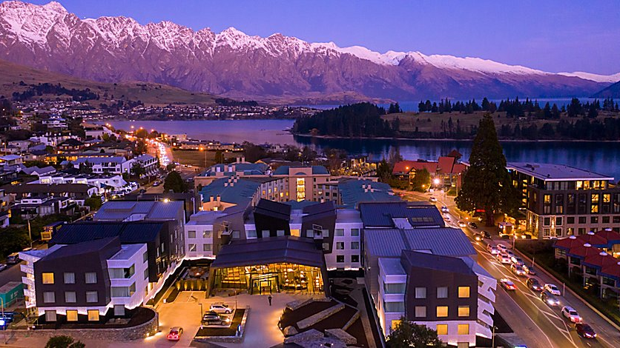
Holiday Inn Express & Suites
Notes:
Opened July 2020.
At Holiday Inn Express they keep it simple and smart by providing their guests / your cilents with more where it matters most.
They believe in smart, hassle free travel. They also believe travel should have more to offer, such as fast check-in, free Express Start Breakfast included, free high-speed Wi-Fi, comfy beds and a choice of pillows in your clients room and everything else needed for a great stay within arm’s reach.
The hotel features spacious suites with king size beds, separate lounge with double sofa and kitchenettes, perfect for families or a group of friends to spread out. At the centre of the outdoor alfresco terrace is an inviting fire pit, a perfect place for après ski drinks.
Guests can also relax in the hotel’s sauna. With views over the crystal clear Lake Wakatipu and out to the majestic Remarkables Mountain Range, the brand new Holiday Inn Express and Suites Queenstown is located in the prime position to downtown Queenstown.
227 rooms and suites (5 room type categories)
Suites featuring king size bed, separate lounge with double sofa, kitchenette and two 55” smart TVs
FOOD:
Breakfast, lunch and dinner daily
• Free Express Start available: Monday to Sunday - 6am to 9:30am
• Grab & Go breakfast option
• Snacks, beverages and barista made coffee available from Reception 24-hours
• On-site restaurant with healthy and classic meals prepared to order: Monday to Sunday - 5pm to 10pm
• 24-hour menu with Call & Collect option
• Bar with selection of local and international wine, craft beer and bar snacks
https://www.queenstownnz.co.nz/listing/holiday-inn-express-%26-suites-queenstown/5334/

Slide 17
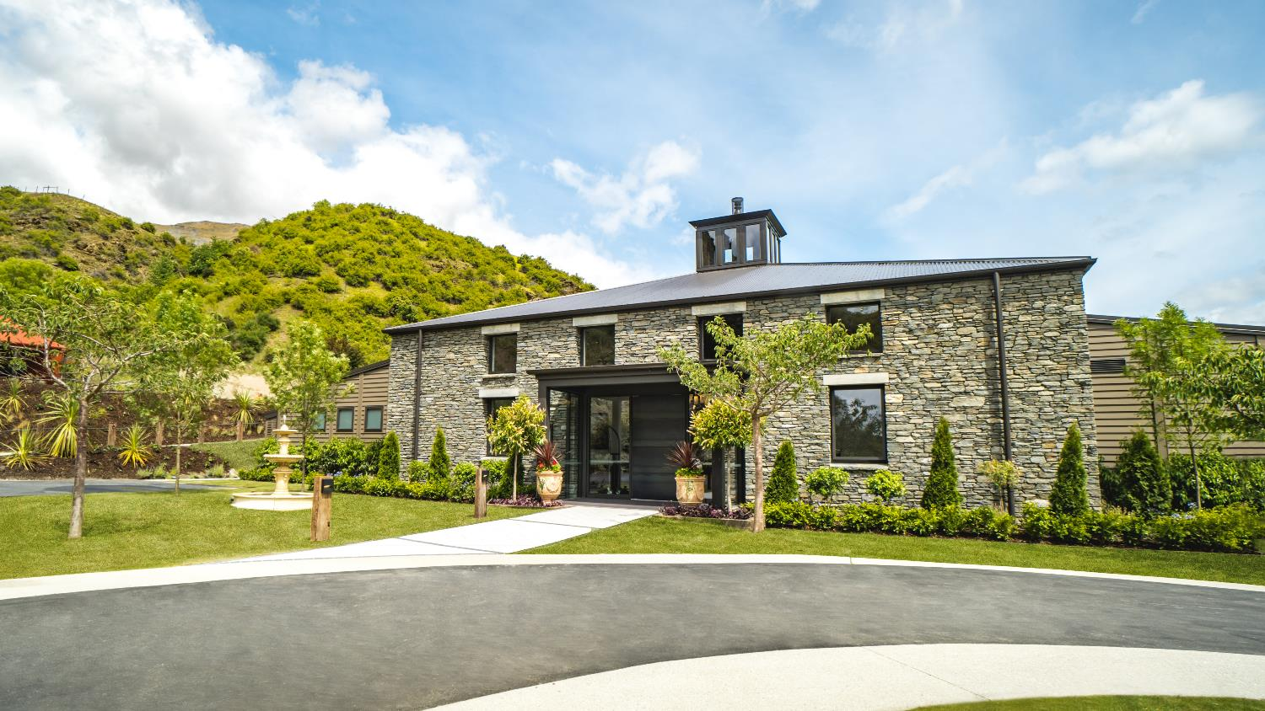
Gibbston Valley Lodge & Spa
Notes:
Opened December 2019
Gibbston Valley Lodge and Spa is set within Central Otago’s oldest founding vineyard, and nestled between rugged schist mountains. This property offers the ultimate in relaxed luxury, fine wine, gastronomic food and five-star concierge service.
There are 24 private villas featuring views over organic and historic vineyards. Each villa offers spacious and luxurious indoor living areas that open onto a secluded, covered deck and courtyard.
Inspired by the Central Otago landscape, the lodge’s high ceilings and schist finishing echoes the natural beauty and the inspiring elements of the region.
Located inside the lodge, is an exclusive wine cellar, the conservatory and a media room that are perfect venue options for the most important and intimate events.
Clients can also indulge in their onsite Spa experience and a host of other activities on offer that include exclusive wine tastings, vineyard tours, wine cave dinner, private picnics and luxury cycle tours.
The concierge team at Gibbston Valley is committed to making every moment of your time here a seamless, enjoyable, and unforgettable experience.
https://www.queenstownnz.co.nz/listing/gibbston-valley/5410/

Slide 18
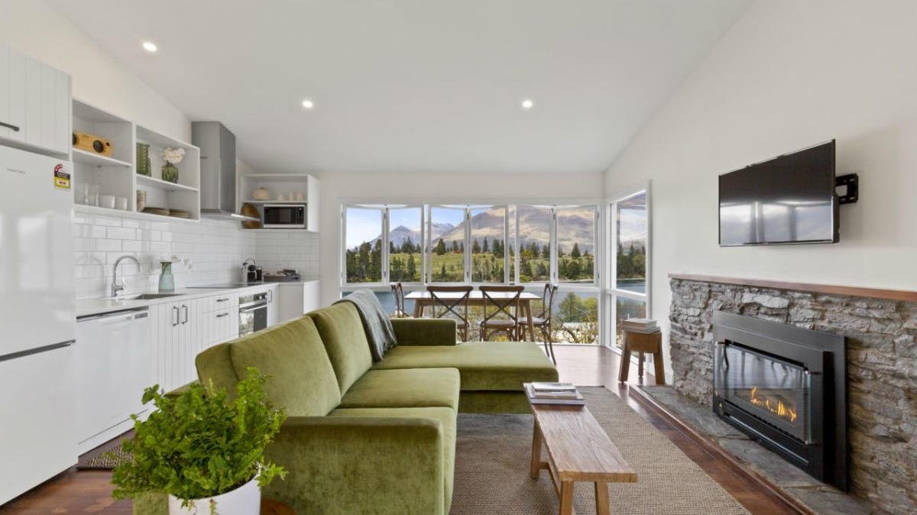
Stay of Queenstown
Notes:
At STAY your clients will be located in the heart of Queenstown's most established residential area.
STAY is boutique accommodation made up of eight, self-contained private suites located strolling distance from the town centre and the beaches of Lake Wakatipu. Every suite looks out from its garden setting onto magnificent lake and mountain landscapes.
Each one or two bedroom suite has been meticulously designed with your comfort in mind. Every suite is fitted out with a luxurious Bellagio bed, the highest quality linen, a Nespresso machine, a private living area with wifi, a smart TV, a microwave, electric fry pan, tea and coffee, a dining table, a bluetooth speaker, a private bathroom complete with heated towel rails and complimentary Natural Earth body products.
STAY suites are designed to enjoy the best of every season, cosy and warm in the winter with heat pumps or fireplaces, and with windows and doors to throw open to the view in the warmer months.
Each suite has its own private outdoor sitting area, and there are gorgeous communal outdoor areas perfect for sharing the region's bounty of superb wines and cheeses.
Each morning fresh local bread, jams, and cereal will be delivered for you to create your breakfast and in summer, these deliveries will include seasonal fresh herbs, fruit and vegetables from our onsite garden.
https://www.queenstownnz.co.nz/listing/stay-of-queenstown/5500/

Slide 19
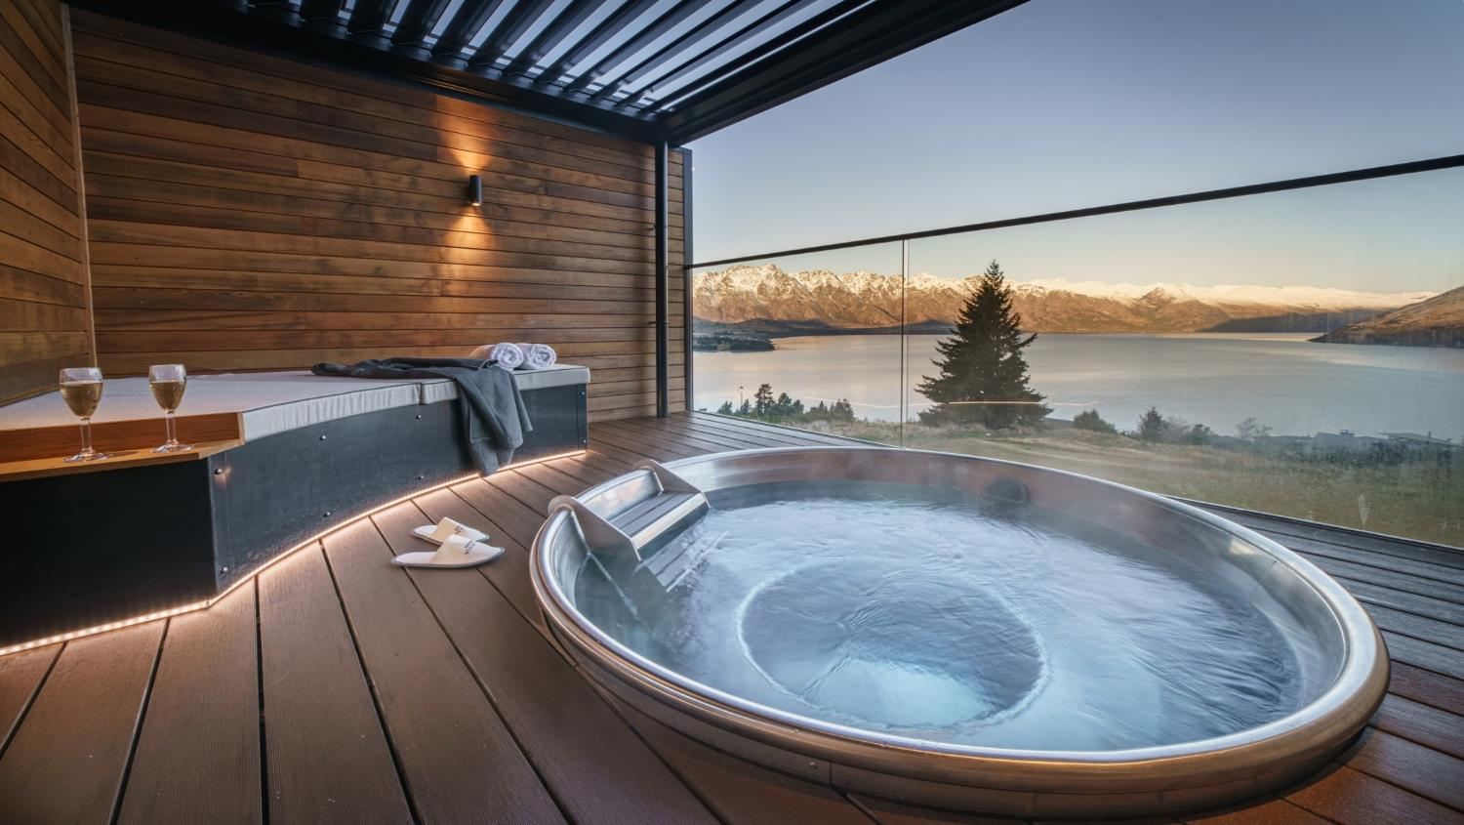
Kamana Lakehouse – Hot Tubs
Notes:
The ultimate private hot tubs experience in Queenstown, Kamana Soak Tubs offers our guests the perfect way to relax and take in the best views of Lake Wakatipu.
Available exclusively to Kamana Lakehouse in-house guests.
https://www.queenstownnz.co.nz/listing/kamana-lakehouse/1547/

Slide 20
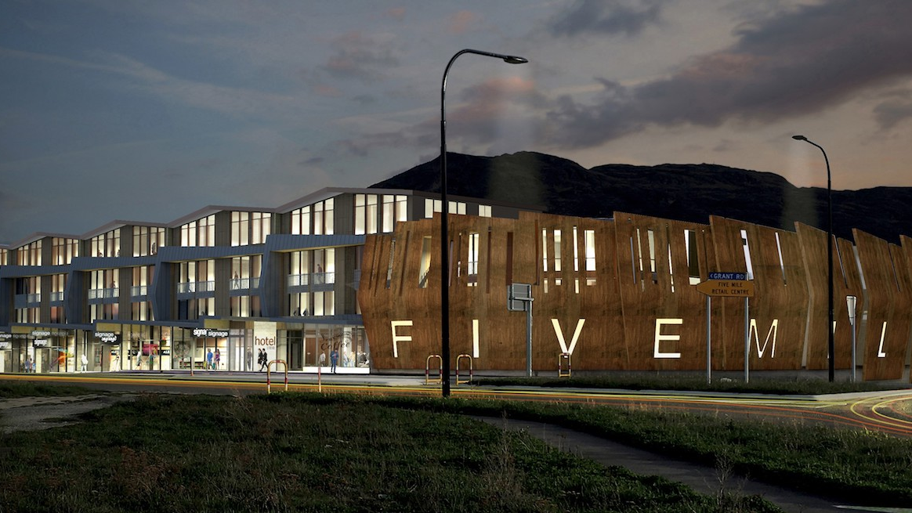
Sudima Hotel – opening 2022
Notes:
22 Grant Road, Frankton – Five Mile retail centre.
Available for booking from February 2022.
4.5 star – superior king, superior twin and famil rooms. Bookings available from February 2022.

Slide 21
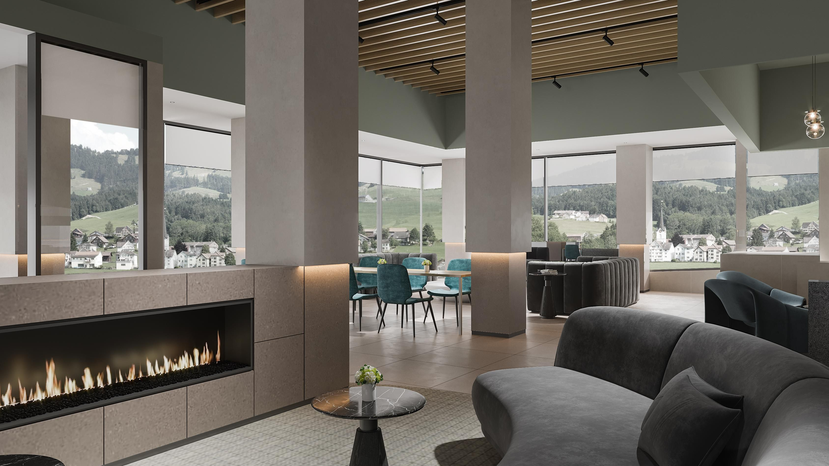
Holiday Inn Remarkables Park – Opening 2022
Notes:
182 rooms, bookings available from November 2021.
Restaurant and bar onsite.
Hotel rooms and suites.
4 star.

Slide 22
Eateries

Slide 23
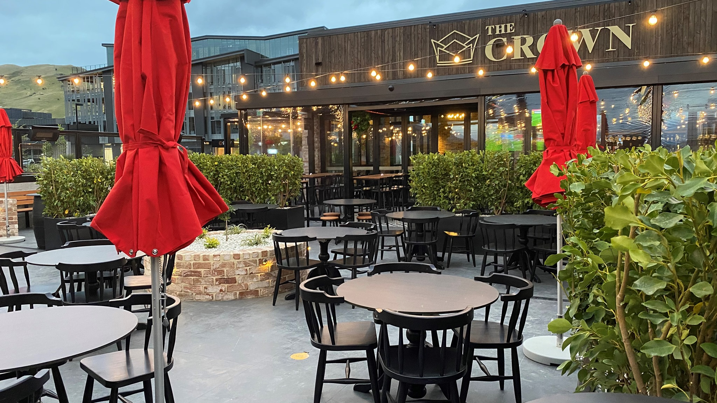
The Crown Pub and Beer Garden
Notes:
The Crown Pub and Beer Garden has recently opened in Five Mile in a prime location with uninterrupted views of the Remarkables.
Open from 11am-late on weekdays and 9am-late on weekends.
The Crown has an extensive menu with pub classics including Fish & Chips and a Sunday Roast, a wide range of local and international beers on tap and an indoor play area for kids.
https://www.thecrownpub.nz/

Slide 24
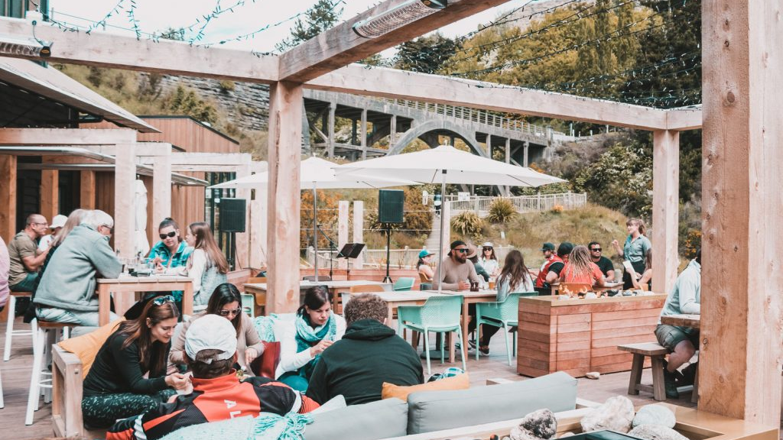
Canyon Brewing
Notes:
Canyon Brewing has reopened under new ownership, now operating daily from 11am-8pm.
The brewery and restaurant sold to The Boatshed Café and Bistro’s owners James Nicholson and Jane, James and Jack Paterson in December 2020.
Gather with friends or family for a Sunday sesh, sit outside and watch the iconic Shotover Jet go past, enjoy a quick bite, long lunch, early dinner or local craft beer brewed in-house.
https://www.canyonfoodandbrew.co.nz/brewery

Slide 25
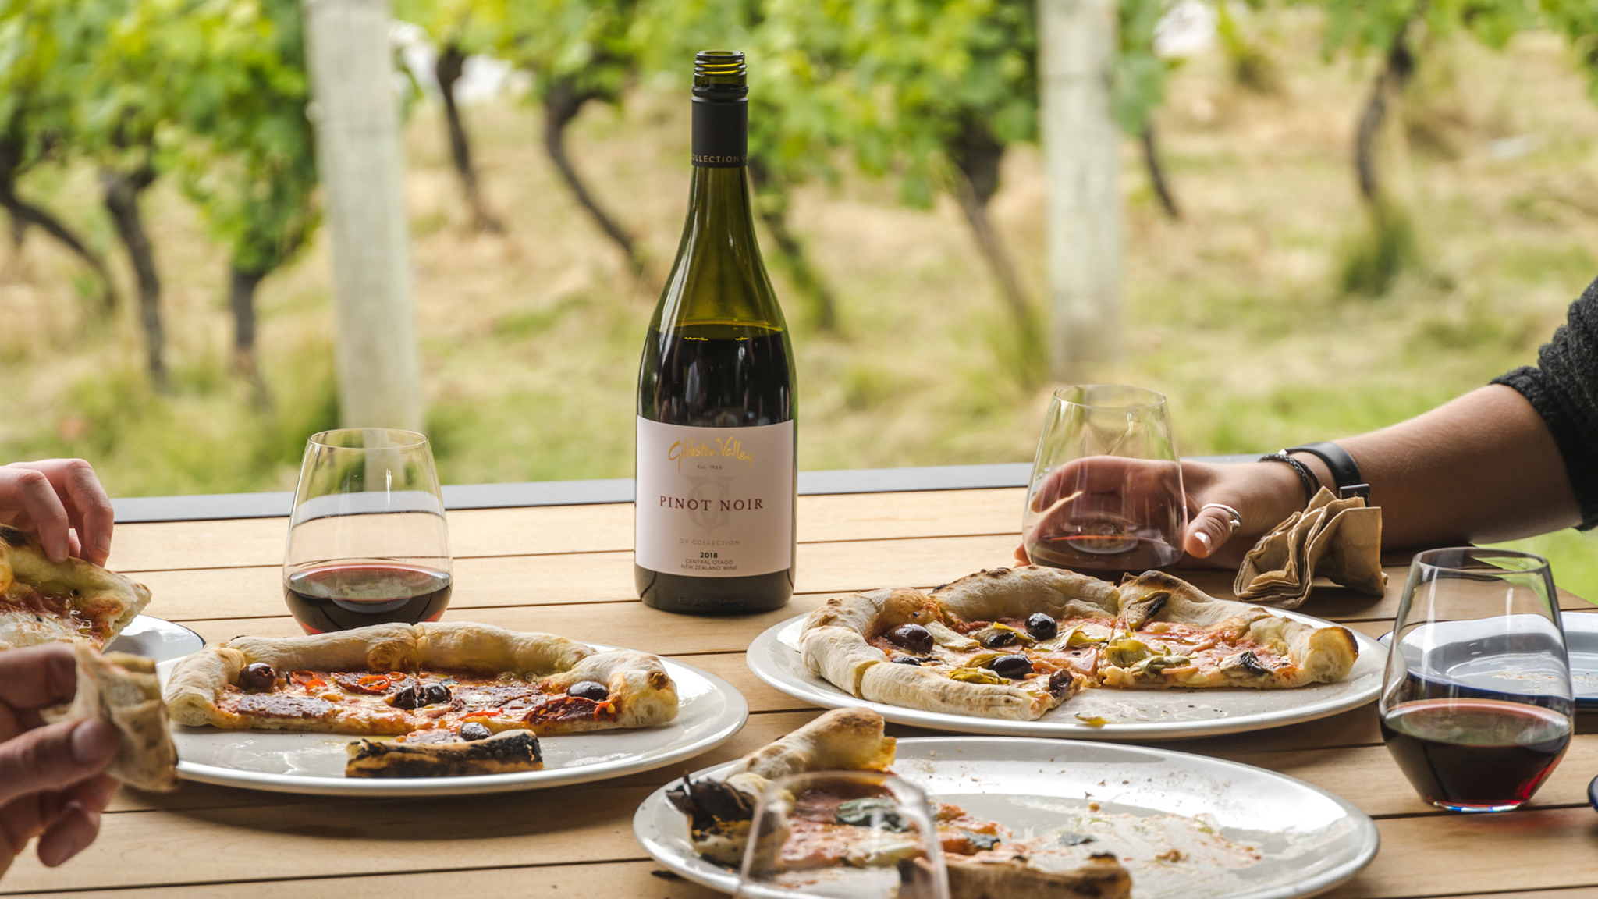
Fumé
Notes:
Open during summer.
Gibbston Valley offers a Wood-Fired Kitchen: Fumé (pronounced foo-may).
Fumé is a casual style restaurant and offers a 100% wood-fired selection of BBQ meats, home-made pizzas, seasonal salads and craft beer on tap.
Located in the old cheesery building, Fumé offers covered, courtyard style dining amongst the vines.
https://www.gibbstonvalley.com/nz/eat/fume-wood-fired-kitchen/

Slide 26
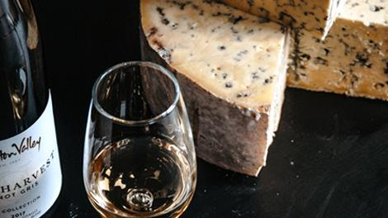
Gibbston Valley Cheesery & Deli
Notes:
Gibbston Valley Cheese Tours run 7 days a week from 10am - 5pm.
We are redeveloping our dynamic world of wine and cheese.
We are immersing our wines, food, people and experiences with a new range of cheese from producers whom we treasure and respect, and from the land we love.
The Gibbston Valley Cheesery & Deli in located in the Old Winery and is open 7 days a week from 10am - 5pm.
OUR CHEESES
We offer a range of artisan cheeses and are proud to be partnering with Whitestone Cheese to produce some unique, collaborative cheeses using Gibbston Valley ingredients.
Our selection of cheeses are aged and matured in the Gibbston Valley Cheesery & Deli, and in our famous Gibbston Valley Wine Cave. You will also find our cheese range served across all of our onsite eateries.
Choose from one of our carefully curated cheese boards (designed to pair perfectly with our handcrafted wines) or make your own.
THE EXPERIENCE
The cheese offering at Gibbston Valley is part of a 360 degree experience, stemming from our new Cheesery & Deli, where our cheeses are cut to order.
We will run a full daily schedule of tours and tastings that explore the incredible intricacies of wine and cheese pairing. In doing so, we will illustrate how our land is indispensable to our products, and what our craft does to bring the best out of land and place.
Our cheese is expertly paired with wines from across our property. Gibbston Valley Wine & Cheese tastings and tours are investigatory and educational. They offer you the opportunity to explore and discuss combinations.
OUR WHITESTONE PARTNERSHIP
Gibbston Valley and Whitestone Cheese share a common history, collaborating as early as the late 80s. Founders Bob Berry (Whitestone) and Alan Brady (Gibbston Valley) were quick to recognize the potential of Otago’s landscapes and each chose a hallowed craft as a medium of exploration. As Alan was drawn to Central Otago’s schist, so Bob was to North Otago’s limestone. Standing side by side at tradeshows and country fairs some thirty years ago, they each set their sights on creating authentic Central Otago products that would live on in our regional history.
Gibbston Valley Winery are now working in close unity with Whitestone Cheese Co to continue this legacy and bring the dual pioneering heritage into the present. We have reconnected to continue bringing local, handmade products and experiences that are, as Bob Berry announced in the early 90s, ‘as unique as the land that created them’.
This is a marriage of diversity and quality, imagination and talent, crafted by patience, history and care.
https://www.gibbstonvalley.com/nz/eat/gibbstonvalleycheese/

Slide 27
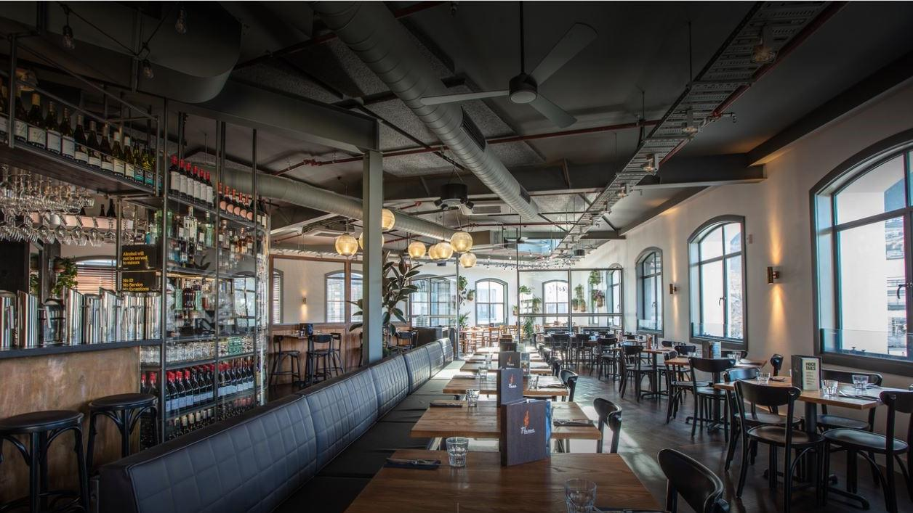
Flame Bar & Grill
Notes:
New location, now upstairs on Queenstown Steamer Wharf
World Famous in Queenstown
Ribs are their hero, succulent, juicy and addictive but of course our steaks are where they stand apart. Their cocktails and wine list are extensive with many local award winning wines and hand crafted signature cocktails. Flame has a casual, intimate ambience with an open kitchen and balcony overlooking Lake Wakatipu and the Remarkables Mountain Range, a perfect place to unwind and enjoy the magic of Queenstown.
Bookings are definitely recommended.
https://www.queenstownnz.co.nz/listing/flame-bar-and-grill/1773/

Slide 28
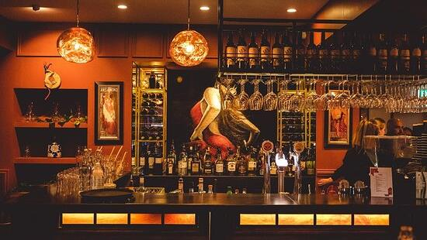
Pedro’s By The Lake
Notes:
Pedro’s By The Lake is a modern take on the original Pedro’s Restaurant, that was lost due to the 2011 Christchurch earthquake.
It’s taken nearly 10 years to re-open a full restaurant again. Occupying a central position down on the Queenstown lakefront you'll enjoy Spanish food a comprehensive drinks selection and an incredible view.
https://www.pedrosbythelake.co.nz/

Slide 29
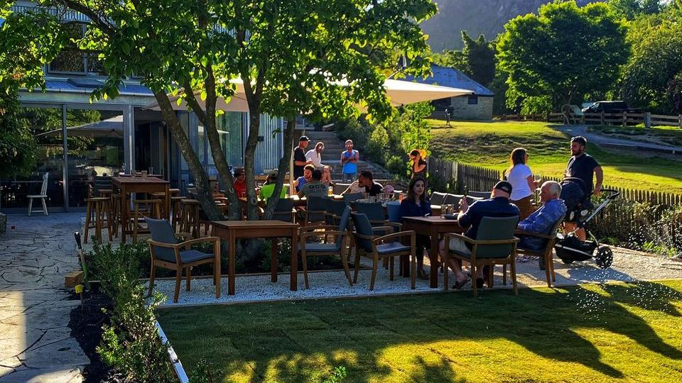
The Dishery
Notes:
The Dishery
There's a new hub in Arrowtown called the Dudley's Cottage Precinct near the Chinese Village with Honey & Cocoa, Better By Bike, Jenny Mehrtens Artists, and The Dishery.
The latest addition to the precinct is The Dishery a new café which focuses on locally sourced produce paired with great wine, all in a garden setting adjacent to the Arrow River Reserve.
Their menu offers breakfast, lunch and early dinner or grazing inbetween.
https://www.queenstownnz.co.nz/listing/the-dishery-restaurant/10891/

Slide 30
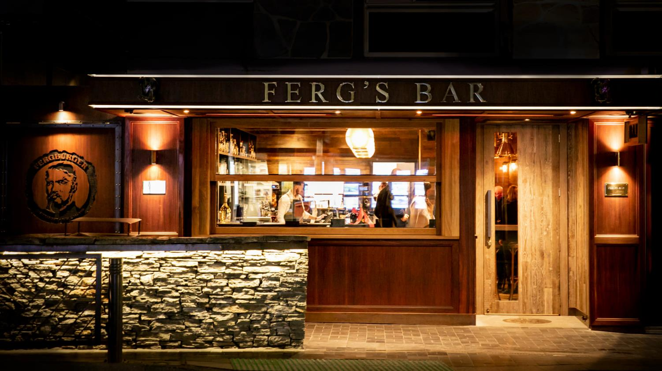
Ferg’s Bar
Notes:
Newest addition to the famous Ferg family. Ferg’s Bar.
Brand New Cocktail Bar that has opened in the heart of beautiful Queenstown right next door to Fergburger. Designed with the Bartender in mind with wood, brass, leather fittings.
Their feelings are Queenstown is where fun and adventure exist all year round. Fergburger started as a hole in a wall down an alleyway in 2001.19 years on Fergburger has become famous around the world and has expanded with Fergbaker and Mrs Ferg (Gelato).
They are now excited to have opened their new bar with a focus on high quality cocktails and food offerings, with a fast and friendly service. It will have an international feel open from 7am – 2am.
https://fergsbar.com/

Slide 31
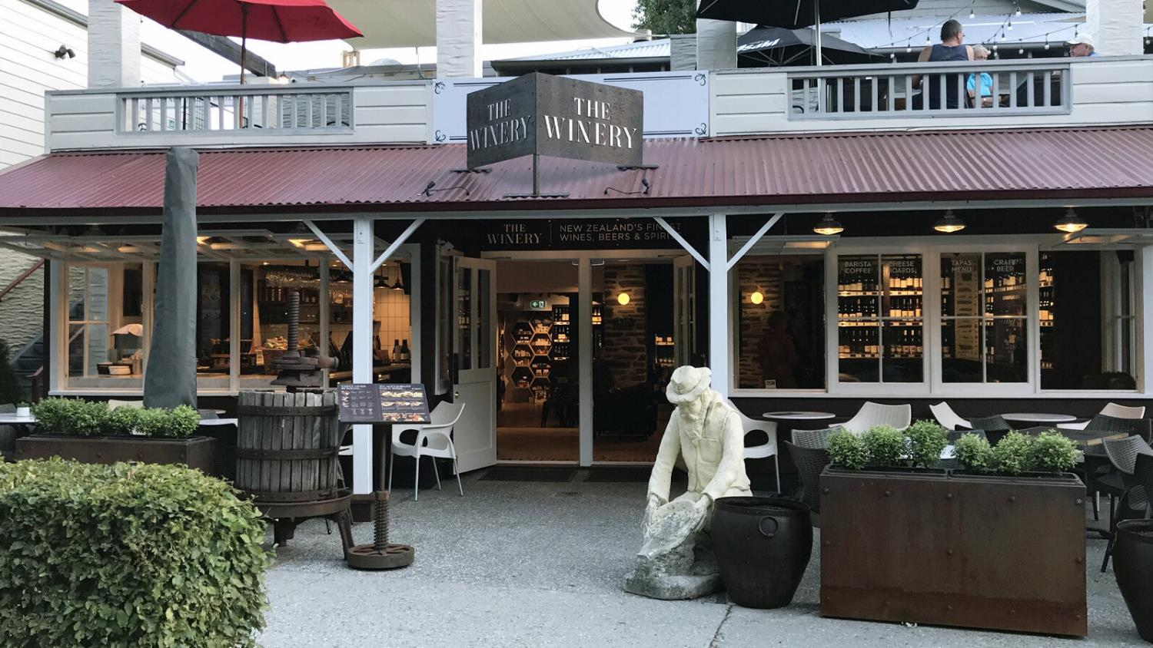
The Winery
Notes:
The world’s largest specialist New Zealand’s wine store.
At The Winery your clients can taste over 80 award-winning local, single vineyard and reserve wines from boutique wineries from across New Zealand - many of which don’t have cellar doors.
TASTE 80+ WINES
YOUR clients choose their wines they taste. With the simple push of a button their can serve themselves either a taste, half or full glass.
NEW ZEALAND WHISKY
They also are stockists of an extensive range of NZ’s rare single malt whiskies – with 8 for tasting.
CHEESE BOARDS & TAPAS MENU
Your clients can relax outside in the sun or inside in the cosy leather chairs of the wine lounge as they enjoy award-winning local cheeses with delicious platters to accompany their time at The Winery.
https://www.queenstownnz.co.nz/listing/the-winery/1521/

Slide 32
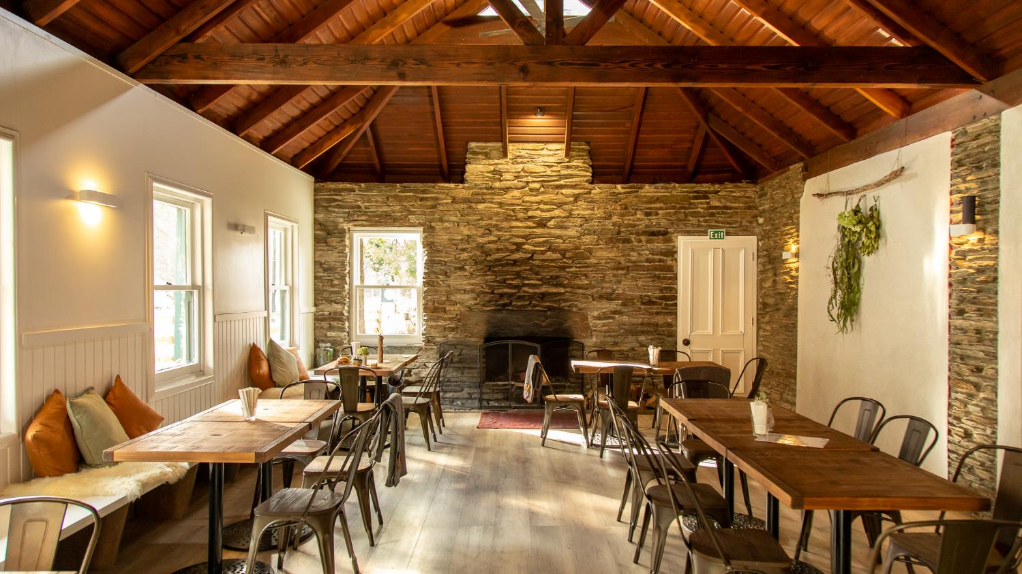
Cargo at Gantley’s
Notes:
Pub, Cafe & Takeaway at Gantleys
A little background about Cargo Brewing Company
Cargo is a unique and innovative brewing company based in Queenstown and their Brewery and cellar door are located in Gibbston Valley, named Cargo at Waitiri. There they have created an interactive and versatile space where they not only create their award-winning beer but share their beer making process with visitors. It’s a great place to gor for lunch and a drink.
The newest addition to the Cargo family is their Tap Room which can be found in Arthurs Point.
Cargo at Gantleys is only a 5 minute drive from central Queenstown and is a great place to visit any time of the year. This amazing building has a rich history dating back to the early settlement of Queenstown. Built over 150 years ago it provided hospitality for both travelers and locals, and they have brough it’s history back to life.
Open from 7am – 10pm for breakfast, lunch, dinner and drinks and have a delicious menu. There’s a roaring fire in winter, and an awesome beer garden to enjoy live music in summer.
https://www.queenstownnz.co.nz/listing/cargo-at-gantleys/6214/

Slide 33

Margo’s
Notes:
Margo’s is a new Mexican restaurant located on Ballarat Street, right in Queenstown Mall.
The atmosphere is fun, bold and high-energy, with colourful street art filled walls, and fun colourful food and cocktails that draw inspiration from the many different flavours of Mexico.
Open: Wednesday – Sunday 5pm to late.
https://www.queenstownnz.co.nz/listing/margos/8932/

Slide 34
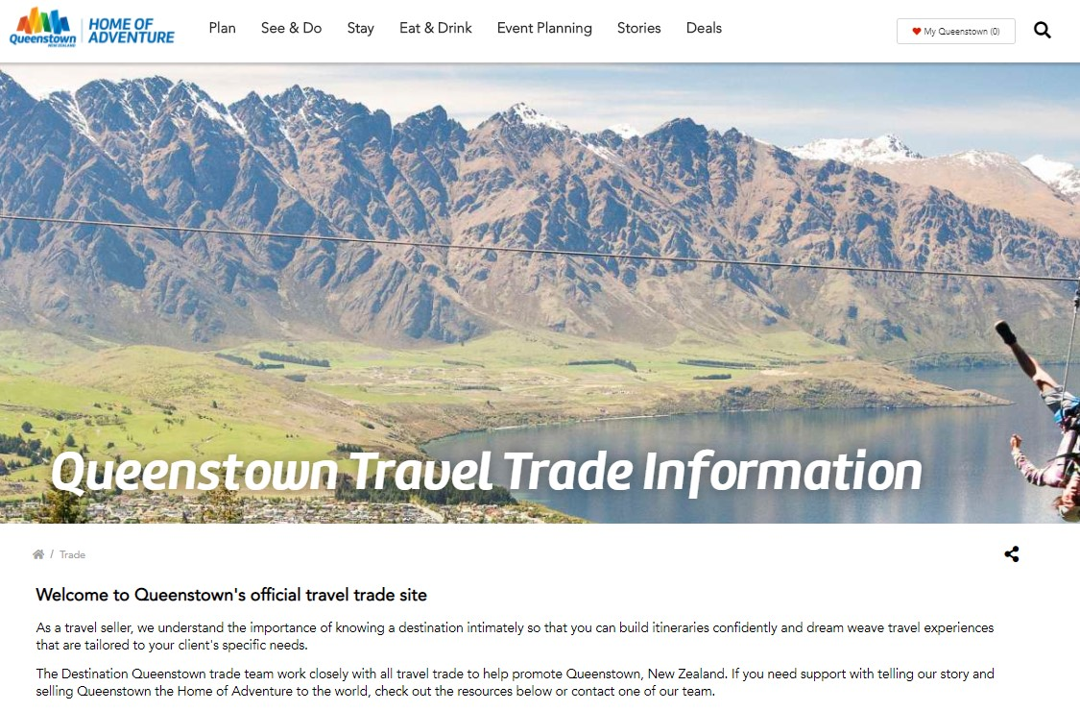
www.queenstownNZ.nz/trade
Notes:
For further resource you can check out our website www.queenstownNZ.nz and our trade pages www.queenstownNZ.nz/trade
If you need suggestion for product operators for selling to your clients, please contact our team on trade@queenstownnz.nz and we can share the appropriate sales and marketing contact for you.

Slide 35
Thank you
Destination Queenstown
50 Stanley Street,
Queenstown, 9300
New Zealand
Trade Team
E: trade@queenstownNZ.nz
P: +64 3 441 0700

