Slide 1
Destination Queenstown
Adventure
Travel Trade Training

Slide 2
Contents
01
Adventures
02
Air Adventures
03
Bungy, Zip, Swing
04
Land Adventures
05
Water Adventures
06
Indoor Thrills
07
Travel Trade Resources

Slide 3
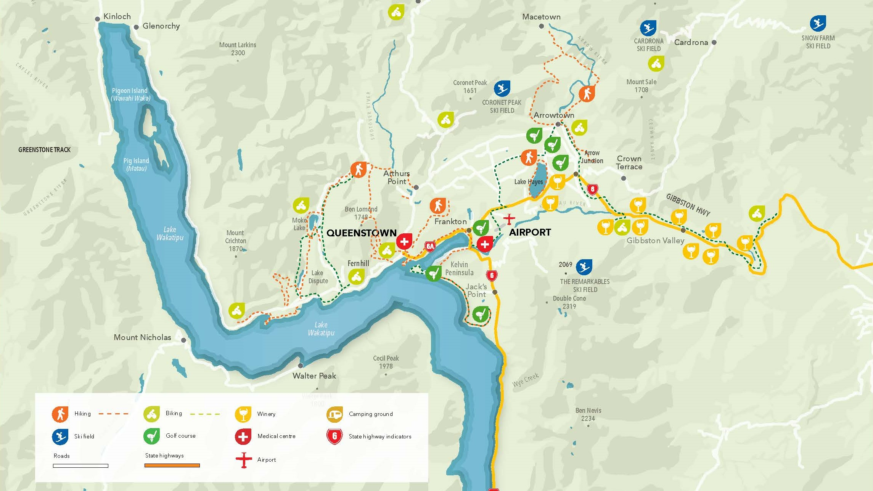
Notes:
Queenstown Central & surrounds.
This map provides an orientation for the proximity of the airport to Queenstown. Starting from the top of the lake with Glenorchy, which boarders our World Heritage Area is only 45 minutes from Queenstown.
The drive has been names one of the top 10 scenic drives in New Zealand and no drive is complete without a stop at Bennett's Bluff for the icon photo of Pig and Pigeon Islands in the foreground.
Coming back to Queenstown, you can also see Arrowtown, which is about 25 minutes drive from Queenstown. Here you will find the Chinese Village which is great for exploring. You could spend an entire day exploring Arrowtown.
If you were driving east off this map, you can also see out toward Gibbston Valley, which is also about a 25-minute drive and provides access to our world-renowned wine growing region.
You can also identify on this map Coronet Peak, The Remarkables, Cardona ski fields. With Treble Cone being a little further north than this map shows.

Slide 4
Adventure Activities
Notes:
Queenstown is the adventure capital of the world. Home of many firsts, our love of thrills and spirit of innovation is an invitation to share in our passions and embark on an adventure.
Queenstown has been shaped by many different people, cultures and lifestyles from its earliest days—but it’s Queenstown’s pioneering spirit and sense of adventure that leaves a lasting impression on those who visit.
Known as the adventure capital of the world and home to the latest and greatest adventures, there is no shortage of Queenstown adrenaline activities for anyone looking to test their limits. From Queenstown bungy jumping and tandem skydiving, to river surfing, canyon swinging and speeding through our surrounds by jet boat, many of these iconic experiences were pioneered right here in Queenstown.
From indoor thrills to adventures high above the clouds, in the water or on the land, there are many ways to explore Queenstown. Get the heart pumping and immerse yourself in our natural surrounds with outdoor adventures from mountaineering and climbing, hiking, mountain biking, rafting and kayaking.
If living life full-speed isn't quite your thing, the cruisier side of Queenstown is not hard to find, and it’s full of leisurely experiences with wow-factor. Embark on a beautiful lake cruise, a sightseeing expedition by air or a breath-taking scenic tour on land.
Choose your Queenstown adventure and experience something new.

Slide 5
Air Adventures
Notes:
Take to the skies above Queenstown and try out skydiving, hang gliding, paragliding or an exhilarating scenic flight over our lakes and mountains.
Queenstown is known for its extreme adventure activities and stunning scenery, so what better place to try something unforgettable like jumping out of a plane at 15,000ft? Or leaping from a cliff attached to a hang glider? Skydiving, hang gliding and paragliding in Queenstown offer a thrilling experience you'll truly never forget.
These adventures all start in Queenstown, but take you high above the town for the most spectacular views and thrilling experiences.
Queenstown skydiving, paragliding and hang gliding operators are all fully qualified and have top safety records, so you can relax and enjoy the ride.
There is also plenty of opportunity for scenic helicopter or plane flights for those who want to get into the air but aren’t so keen on the adrenalin part. Take a short flight over mountains, or a longer trip to Fiordland to land on a dramatic West Coast beach, a remote farm or even on a glacier to explore the ice.
You'll enjoy incredible aerial views of the lakes, mountains and town as you soar, fly, float or fall from the sky above Queenstown.

Slide 6
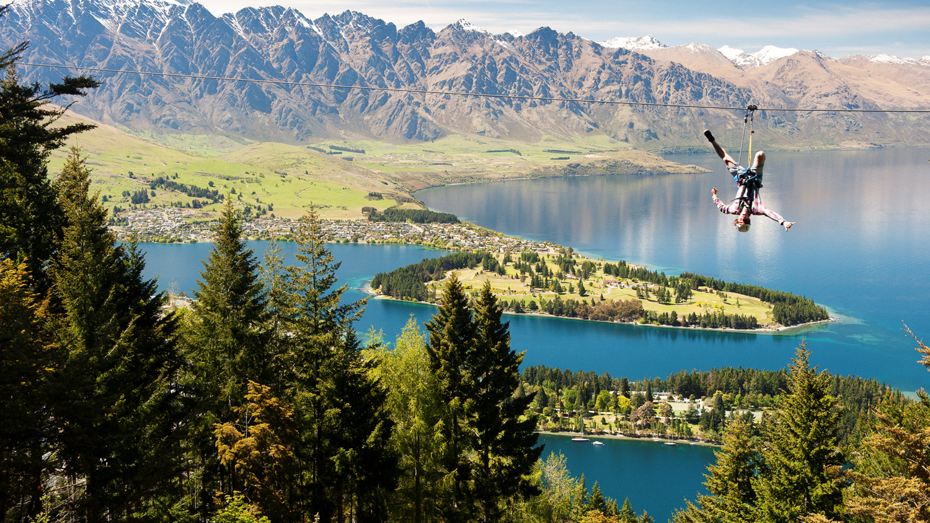
Bungy, Zip, Swing
Notes:
Take a leap of faith with a Queenstown bungy jump, flying fox or giant swing!
A bungy jump is the essential Queenstown adventure experience. Not only is Queenstown ground-zero for commercial bungy jumping, it’s home to the best bungy jumps and swings in New Zealand and around the world.
After making international headlines by bungy jumping from the Eiffel Tower in 1987, AJ Hackett and business partner Henry van Asch launched the world’s first bungy business here in Queenstown on the historic Kawarau Bridge.
Since then, Queenstown has become home to some of the world's most thrilling bungy jumps, swings, and ziplines.
Fancy the world’s highest cliff jump? How about New Zealand’s highest bungy? Zip through the forest at high speed on the world’s steepest zipline? Or try out one of the biggest giant swings in the world?

Slide 7
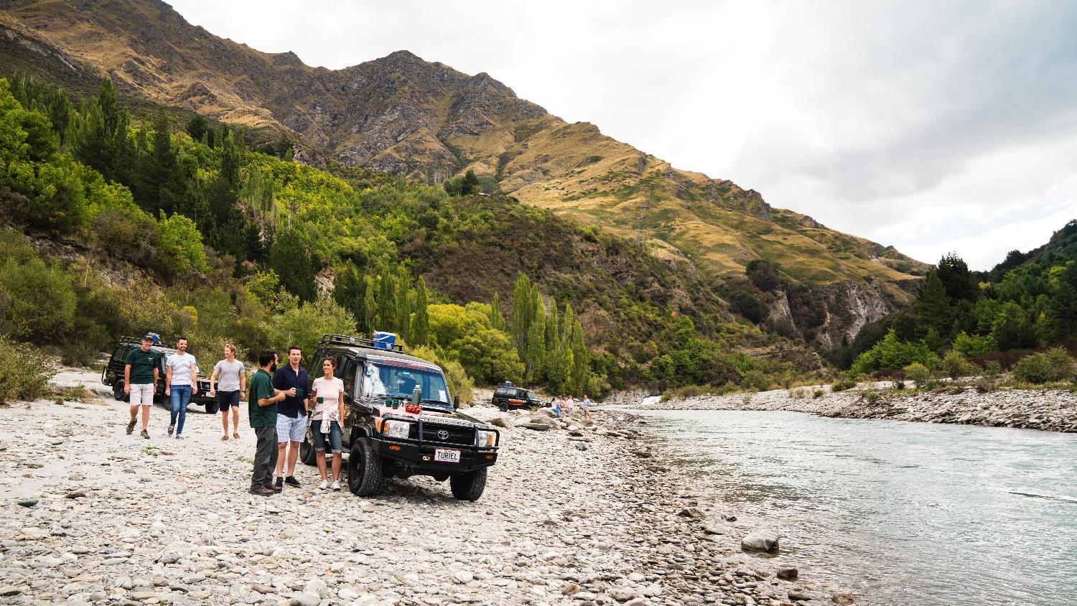
Land Adventures
Notes:
Get off the beaten track with an off road adventure or land tour in Queenstown!
Queenstown 4WD and off road tours take you deep into the back country, where few people have ventured before. You'll experience some of the most remote and stunning scenery in New Zealand from the comfort of your specialised vehicle, get to enjoy the thrill of four-wheel-driving, quad biking or in an off road buggy.
If a slower pace is what you’re looking for there’s horse riding operators who can take you on a journey through Lord of the Rings film locations, or into Queenstown’s frontier history on farm land and foothills.
Road hogs, you’re not left out either, there’s motorcycle tours that explore some of our most incredible roads. Drive out to Glenorchy, or to Kingston on the winding highways that follow the lake’s edge.

Slide 8
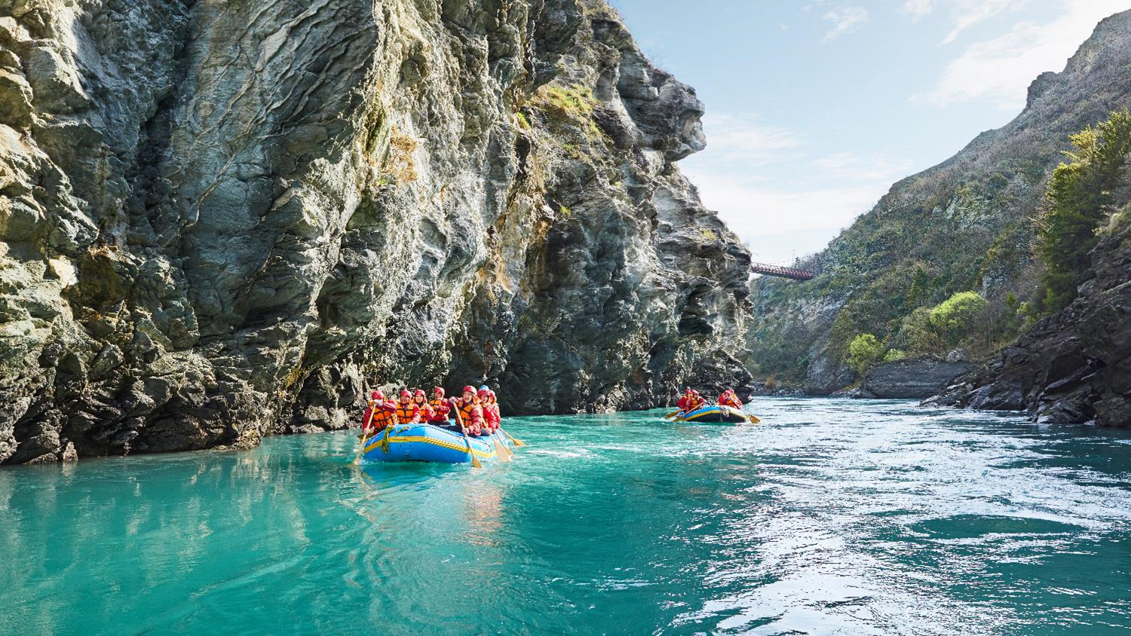
Water Adventures
Notes:
Surrounded by beautiful lakes, rivers and fiords, Queenstown is an ideal destination for all your favourite water and lake activities, and some you may not have discovered yet.
You can embark on a leisurely boat cruise, a thrilling jet boat ride through steep ravines or across the open waters of Lake Wakatipu, or explore deep canyons around the region on a canyoning escapade.
Meanwhile, parasailing lifts you high above the lake as you sail along behind a boat, enjoying the thrill of the ride and the beautiful scenery from above.
With a few hours to spare you could enjoy a relaxing canoeing or kayaking trip down a pristine river, across a sparkling lake or on a remote fiord.
Kayaking and canoeing excursions in Queenstown are great for the whole family, and for travellers looking to join a social group activity.
The ultimate in water adventures in Queenstown will take you back to the rivers, where you can go whitewater rafting or river surfing. Take your pick from heli-rafting, family rafting, river boarding, river surfing, Queenstown offers a grade of rapids for everyone, from beginners to advanced whitewater enthusiasts. So whether you’re an expert or a complete novice, get out there and get wet!

Slide 9
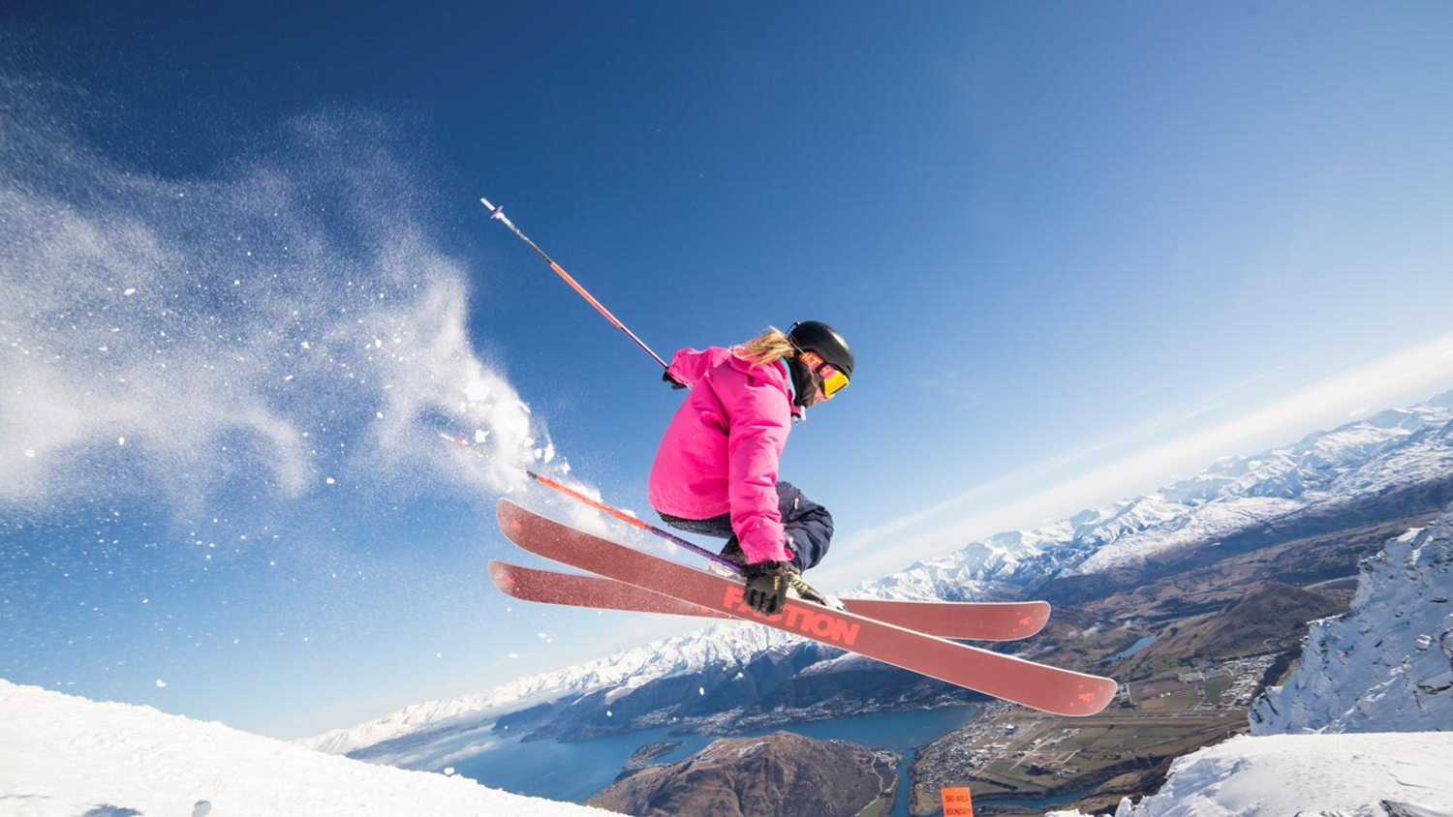
Skiing & Snowboarding
Choose from four ski area
Notes:
Predominately June to September
Temperatures between -2°C and 8°C
Set against a stunning backdrop of lakes and mountains, in the heart of the majestic Southern Alps, Queenstown is the Southern Hemisphere’s premier ski destination offering a true alpine experience.
Queenstown is a world-class ski destination with a range of accommodation options, quality services including rentals and transport and variety of off-mountain activities.
Vibrant nightlife and après ski scene, sophisticated food and wine culture with a choice of more than 150 bars and restaurants, boutique shopping and an extensive range of activities and attractions. Great for progression learning with purpose-built beginner slopes, consisting of a wide variety of terrain with lifts and chairs designed for beginner progression.
Known as the home of adventure, Queenstown’s fun-loving culture makes for an unforgettable winter holiday. Four ski resorts: Cardrona, Coronet Peak, Remarkables and Treble Cone.

Slide 10
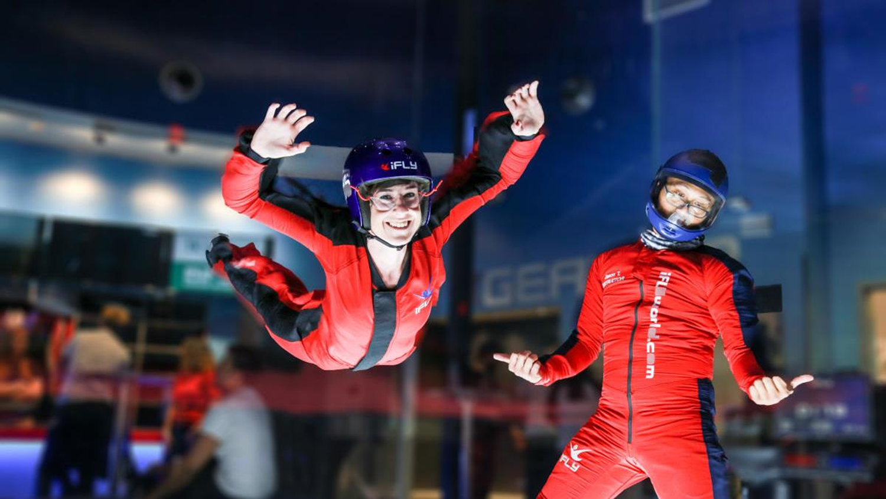
Indoor Thrills
Notes:
Thrills in Queenstown aren’t limited to the outdoors…
Wind your way through a live action haunted house, try indoor skydiving, a trampoline park, ice-skating and ice-bumper cars, go back in time, enjoy indoor climbing action or take the ultimate motion ride and stimulate your senses by battling zombies, riding roller-coasters and experiencing white knuckle adventure without stepping outside.
Queenstown's indoor activities are perfect if you want something different or as wet weather option for rainy days!

Slide 11
Adventures on our website
Notes:
https://www.queenstownnz.co.nz/things-to-do/biking/

Slide 12
Travel Trade Resources
Notes:
For further resource you can check out our website www.queenstownNZ.nz and our trade pages www.queenstownNZ.nz/travel-trade
If you need suggestion for product operators for selling to your clients, please contact our team on trade@queenstownnz.nz and we can share the appropriate sales and marketing contact for you.

Slide 13
Thank You
Destination Queenstown Travel Trade
50 Stanley Street,
Queenstown, 9300
New Zealand
Trade Team
E: trade@queenstownNZ.nz
P: +64 3 441 0700

