Slide 1
Destination Queenstown
Leisure & Mountain Biking
Travel Trade Training

Slide 2
Contents
01
Biking in Queenstown
02
Terrain & Trails
03
Accessibility
04
Travel Trade Resources

Slide 3
Biking in Queenstown
Notes:
Queenstown is New Zealand's ultimate mountain biking and cycling destination.
Queenstown is a magnet for bikers. The quality and variety of the Queenstown bike offering, from cruisy lakeside trails to gnarly downhill tracks, means there’s a biking experience for everyone, whatever your age, ability or biking style.
Queenstown’s prestigious mountain bike scene, with three lift-assisted MTB parks, world-famous trails, and one of the most legendary dirt jump parks on the planet, attracts keen bikers from around the world. Queenstown is the place pros come to ride and train, so don’t be surprised to bump into industry giants on our trails. A range of trails suited to all abilities ensures there is plenty of terrain for beginners and those keen to develop their skills too. Our biking culture is unique and much of the trail building in Queenstown is due to the legends at the Queenstown Mountain Bike Club and passionate local volunteers who ensure there’s always something new to enjoy.
For those looking for a gentler pace, there are plenty of stunning scenic cycling trails to explore. With an extensive trail network, Queenstown is the perfect base for your next biking adventure. From short scenic rides to multi-day rides including access to five of New Zealand’s Great Rides spanning Queenstown, Central Otago and Southland, biking is a great way to discover the region’s scenic landscapes.
The Queenstown Trail, managed by the Queenstown Trails Trust, offers over 130kms of trails beside Lake Wakatipu and our rivers, climbing to Arrowtown and winding through vineyards. Discover historic sites, suspension bridges and hidden gems, ride a small section or discover the whole trail at your leisure.
Biking is one of the best ways to experience Queenstown. Explore our stunning landscape and when you’re not in the saddle, you’re in the home of adventure, with food and wine to try and an après bike scene second to none.

Slide 4
Terrain & Trails

Slide 5
Leisure Biking
Notes:
With respect of being a leisure biking destination, and part of the Queenstown Trails 130kms of network, you will find easy scenic tracks that will take you along lakeside or backcountry trails and past picturesque locations, including Lake Wakatipu, Lake Hayes, Arrowtown and Gibbston Valley. There are stunning river gorges, hidden ruins, access to unspoilt private land, and suspension bridge crossings over three iconic rivers.
Visitors can use the trail for an hours leisurely ride, a half or full-day or for multi-day enjoyment – guided or unguided. All trails range from easy to intermediate making it even more accessible for all ages, stages and levels of fitness.
Biking in Queenstown is fun and also very family-friendly. We also have a very enviable climate during spring and summer, especially against the scenic backdrops that will make a biking adventure one to remember.

Slide 6
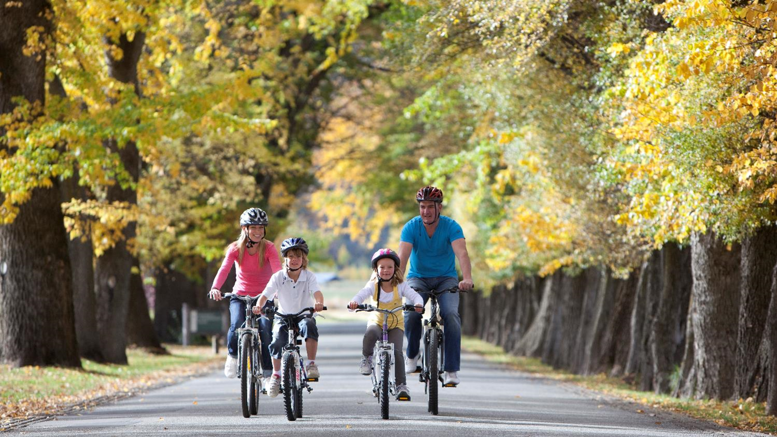
Family Biking
Notes:
Explore Queenstown by bike with the kids. Queenstown has endless options to choose from, ranging from flat, wide open trails to beginner mountain bike runs and advanced terrain to keep even the most aspiring young kids on their toes! There is something for all ages and interests to enjoy.
Queenstown is packed with family-friendly bike rides. With more than 130 kms of off-road cycle trails, you and the kids have plenty of opportunities to explore our beautiful scenery, have fun, and fuel up with food and drink.
There are heaps of things to see and do along the way. Stop off for frisbee golf, lakefront playgrounds, BMX pump tracks, swimming, sculptures, wildlife, historic bridges, and wineries for the parents.
If you have little rippers in the family, the Queenstown Mountain Bike Park - accessible via Skyline Gondola in the heart of Queenstown, has kid’s passes and trails like Hammy’s Track, suitable for capable beginners aged 8 and older. Cardrona has mountain bike lessons, gear hire, and a free learners’ zone. Both bike parks have gondolas for bonus fun and tired legs.
For the more experienced and adventurous riders in your family, explore 7 Mile Bike Park, a network of single track mountain biking routes and great training ground for beginner and intermediate riders, offering a handful of green trails. It's free to access and there are bike transport operators available, offering pick up and drop off. Refuel after the ride with a family picnic by the lake when you're finished!
Our friendly bike hire shops can kit your family out with bikes and all the gear you need for your Queenstown biking adventure, including bikes for the kids and bike seats and trailers for your littlest riders. They’re also a great source of handy tips for parents and intel on kid friendly trails. And bike shuttles can drop you wherever you want to go.
Beginning with the easiest and moving through to the slightly more challenging, here’s a top 5 list of stress-free family bike trails for getting outdoors, having adventures and seeing the sights with the little ones.
Kelvin Heights Sculpture Trail
Distance: 3.5km
Time: 1 hour
This flat and pleasant family bike trail circumnavigates the Kelvin Heights golf course at the end of the peninsula and can be taken in either direction. It’s easy enough for even young ones to manage, with interesting stops along the way at the many unusual and interactive sculptures and gently lapping, hidden coves and bays. Parking can be found at either end of Grove Lane. End at the beach for a picnic.
If you want to go further, try a section of the Kelvin Heights-Jack’s Point track, which connects from the sculpture trail, or head along the Kelvin Peninsula track towards Frankton.
Arrowtown Millennium Trail
Distance: 3.25km
Time: 1 hour or less
This popular track begins at the historic Dudley’s Cottage and journeys along the shaded edge of the Arrow River as it undulates and flows through bluffs and into cool pools and shallow rapids.
In the summer, stop for dips in swimming holes or try out the rope swings, popular with local kids. Arrowtown is known for its autumn splendor, a time when the trees are alive with colour. Winter brings strong flows and bare, moody trees, great for taking in some fresh alpine air. And in the spring, the riverbanks are dotted with wild lupins of every colour.
Cross at Tobin’s Bridge and take the left side of the river until the next bridge, then head back to town. The historic Chinese mining settlement makes an interesting picnic and exploring spot, or head to the shops for an ice cream, pick a cafe or pub for lunch. The popular Fork and Tap offers a great play area complete with sandpit, treehut and slide.
Old Kawarau-Falls Bridge to Kelvin Heights
Distance: 1-5km
Time: 1-2 hour
This family bike ride can be as long or as short as the smallest people in your family allow! Start at the Bridge Street car park on the Frankton side of the old Kawarau-Falls Bridge. This is now a pedestrian bridge so take your time cycling across it and taking in breathtaking views towards The Remarkables in one direction and the sparkling lake in the other.
Drop down and carry on to the Kelvin Heights trail. From here you can stop along the way for lunch at the Hilton Resort or keep going as far as you please. The trail dips down to little bays which are perfect for paddling and exploring, and there is also a playground around the halfway point along the peninsula. Or carry on to the golf course and meet up with the fabulous sculpture trail.
Tucker Beach Trail
Distance: 3.34km
Time: 1.5 hours return
Beginning at the Rotary car park on the western side of the old Shotover Bridge, this trail journeys over the bridge - a photo opportunity in itself - then follows the aquamarine waters of Shotover River from on high, with views across to Coronet Peak and back to The Remarkables.
The trail dips into the Tucker Beach Wildlife Management Reserve, home to rare dotterels and black fronted tern, before ending at Tucker Beach, a great picnic spot on the bend of the river. Kids will love the variety this family bike trail provides and the bridge is always a winner!
Queenstown Gardens to Frankton Marina
Distance: 12km
Time required: 2 hours
For this great family bike ride, begin in the Queenstown Gardens and head towards Frankton beach on the Queenstown Trail. Stop along the way for paddles or tree climbs, and take a break for a delicious treat at the quaint Boat Shed at Frankton Marina.
Head back, journeying around the periphery of the beautifully landscaped gardens and take in spectacular views across the lake to The Remarkables and across Queenstown Bay towards Walter Peak.
In the gardens, stop off to feed the ducks at the ponds with the bags of seed for sale from the Lions Rotary Club stand near the rotunda, and end at the million-dollar, destination playground in Queenstown Bay for a well deserved coffee, play and picnic!

Slide 7
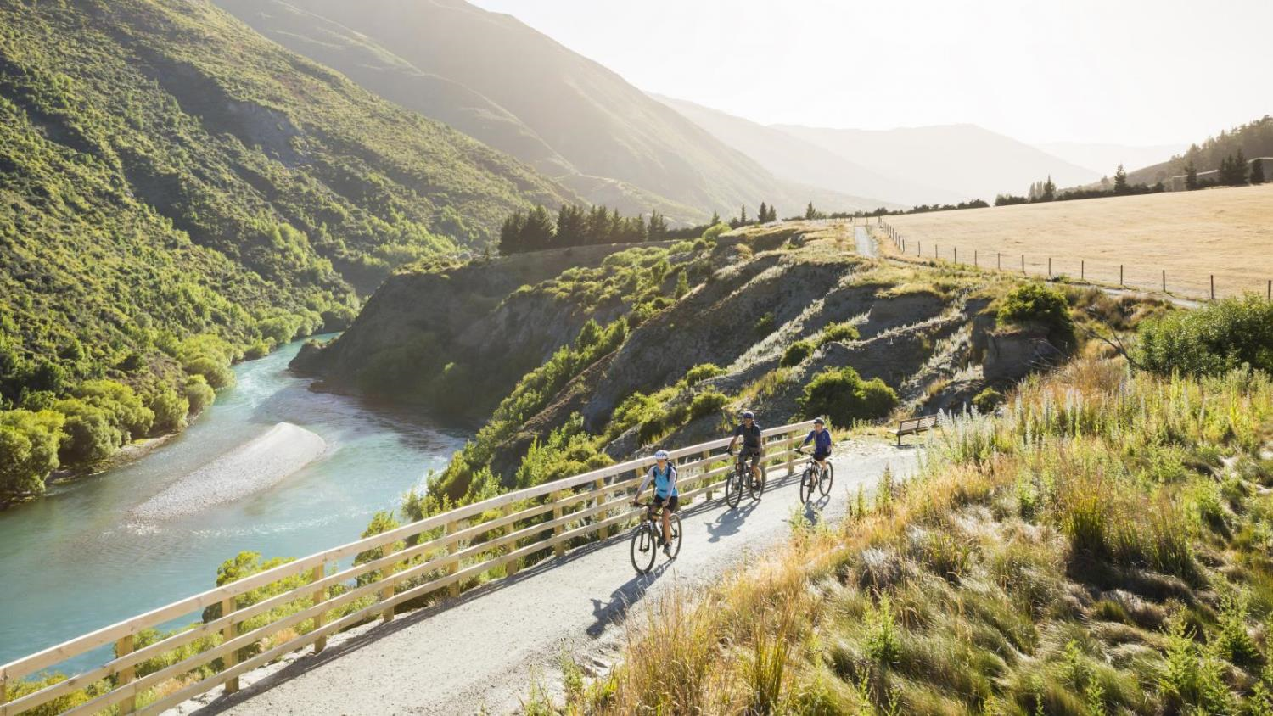
Queenstown Trails
Notes:
The Queenstown Trail is made up of 130kms of trails alongside awe-inspiring alpine vistas, crystal clear lakes, stunning river gorges and hidden ruins, running through Queenstown, Arrowtown and Gibbston. The Queenstown Trail now allows public access to unspoilt private land, traversing two mighty suspension bridges, crossing three iconic rivers and circumnavigating two lakes... all set in dramatic Lord of the Rings landscapes.
Accessible all year round and suitable for all abilities with trails ranging from easy to intermediate; the Queenstown Trail can be enjoyed by everyone. Visitors can use the trail for an hour, a day or stay for four – bring your friends and family and discover a whole new side to Queenstown.
The Queenstown Trail also gives visitors and locals alike great access to our region, enabling them to explore by foot or cycle, or commute, with a small environmental footprint.

Slide 8
Notes:
https://queenstowntrail.co.nz/maps-and-trails/

Slide 9
Wine Trail
Notes:
Bike the wineries with a wine tour from Queenstown or Arrowtown. Ride beside the turquoise waters of the Arrow and the Kawarau Rivers, past the Kawarau bridge bungy and into Gibbston Valley wine country. The Gibbston River Trail passes several wineries, so you’ll have plenty of opportunities to rest your legs and sample local vintages.

Slide 10
Mountain Biking
Notes:
Queenstown welcomes the hardiest of bikers to the aspirational progression riders. Our varied terrain and array of international-standard facilities attract some of the world’s best riders to come and train here!
This truly makes Queenstown an international mountain biking destination!
We not only boast three lift-accessed parks (Coronet Peak, Cardrona, and Skyline – which is also the only Gondola accessed downhill mountain biking park in the Southern Hemisphere). But it is these quality gravity-fed downhill biking tracks that are all housed in an iconic and world-famous alpine location that set the stage for making it all possible.

Slide 11
Mountain Biking
Notes:
There is a comprehensive range of mountain biking with trails to suit riders of all abilities and styles - from backcountry trails, downhill, single tracks, jump parks, flow trails and heli-biking to short scenic trails and lift-assisted riding – with excellent trail quality and diversity of terrain.
Queenstown’s bike culture is really unique. We have many very passionate locals who are part of the renowned Queenstown Mountain Bike Club which created and maintain a range of free to access bike trails.
With continual development from our committed local mountain bike community, you will find the epic trails seen here continue to evolve.
The mountain bike experience is also supported by an extensive range of bike services. As well as a range of world-class amenities and a very vibrant bike social community.
The upside to rounding out the experience is Queenstown’s diverse and cosmopolitan nature which makes it a really social and fun destination, plus there are also lots of bike-friendly eateries and pubs close to bike tracks. Our renowned vibrant nightlife and burgeoning après-bike scene, means the fun goes on well after the sun sets!

Slide 12
Mountain Bike Parks
Cardrona Alpine Resort
Skyline Mountain Bike Park
Features a variety of lift-accessed downhill mountain bike trails for all levels of rider to enjoy. With some of the longest vertical descents in the country.
New Zealand’s first ever Gondola-assisted Mountain Bike lift. Over 30 world-class trails totaling over 30 kilometres in length and dropping 450 metres. There’s something for all abilities.
Notes:
Cardrona
With activities for the mountain explorer to the hardcore downhiller, there’s something for everyone at Cardrona this season. There are lift-accessed mountain bike trails at Cardrona for first-time riders all the way through to seasoned downhillers. Lifts operate 10am-4pm daily (10am-8pm Fridays). Offer rental fleet of trail, full-suspension & downhill bikes in our rental locations in Queenstown & on the mountain. Helmets & knee pads are included with all rentals. Kids under 6yrs use lifts for free!
Cardrona's also offer Mountain Carts. These three-wheeled, purpose-built carts are all you need to tackle the trails with no previous experience needed. Cardrona is just a 58km drive from Queenstown over the spectacular Crown Range.
Season – December to April
Skyline Offering over 30 world class mountain trails in the Queenstown Bike Park. Ranging from beginner, green trails right through to advanced double black, the Queenstown Bike Park has something to offer every Mountain Biker, including a huge 6km run.
Open 10am daily. Closing times vary due to daylight hours. The mountain bike season runs September through to May.

Slide 13
Mountain Bike Parks
Coronet Peak
Make the most of the natural terrain riding the Coronet Express chairlift to the top and then enjoy trails that are fun, flowy and technical.
Notes:
Coronet Peak
Open daily, 10am to 6.30pm (Friday’s open until 8.30pm).
Season – December to March
Enjoy all-day riding with the Coronet Express chairlift.
Half Day (4 hours), Full-Day pass, season passes, sunset passes, 10 run pass and single run passes available.
The Coronet XC trail is rated an intermediate grade 3, while the Coronet DH trail is for the more confident rated at expert grade 5. You can also access Slip Saddle (grade 6) and Rude Rock (grade 4).
Café 1200 open and located just next to the chairlift will keep you fuelled and hydrated for an epic day on the mountain.

Slide 14
Mountain Biking
Notes:
Heli-biking is also another great option for keen mountain bikers to access absolute untouched, remote backcountry wilderness. All accessible right from Queenstown Airport. It doesn’t get much easier than that!
The rugged ranges around Queenstown are riddled with farm roads, old pack tracks and other historic byways, custom-made for heli-biking. With some start points hovering around 2000m above sea level, there are plenty of opportunities for epic descents. Highlights include a double-descent down from The Remarkables involving two heli rides and almost 3000m of downhill; and Advance Peak, a sweet piece of downhill along an old gold miners’ track to Macetown followed by a riverside ride to Arrowtown.

Slide 15
Accessibility

Slide 16
How to get around
Guided
Take the hassle out of biking and join an organised tour. Private and public options available.
Supported
If you have a group of people with varying fitness levels. Have a van check in with you at different points.
Taxi or Shuttle Service
Don’t double back. Get dropped off at point A and picked up from point B.
Bike Hire
Choose from many of our reputable bike hire businesses. Everything from e-bikes, hard tails, cross country, trail and downhill bikes available.
Notes:
https://www.queenstownnz.co.nz/things-to-do/biking/

Slide 17
Biking on our website
Notes:
https://www.queenstownnz.co.nz/things-to-do/biking/

Slide 18
Travel Trade Resources
Notes:
For further resource you can check out our website www.queenstownNZ.nz and our trade pages www.queenstownNZ.nz/travel-trade
If you need suggestion for product operators for selling to your clients, please contact our team on trade@queenstownnz.nz and we can share the appropriate sales and marketing contact for you.

Slide 19
Thank You
Destination Queenstown Travel Trade
50 Stanley Street,
Queenstown, 9300
New Zealand
Trade Team
E: trade@queenstownNZ.nz
P: +64 3 441 0700

