Slide 1
Destination Queenstown
Golf
Travel Trade Training

Slide 2
Contents
01
Golf in Queenstown
02
Jack’s Point
03
Millbrook Resort
04
Queenstown Gold Club
05
Arrowtown Golf Club
06
Frankton Golf Centre
07
The Hills
08
Golf Services
99
Experiences, Food & Drink
Travel Trade Resources

Slide 3
Golf in Queenstown
Notes:
Queenstown is New Zealand's premier golfing destination.
Home of New Zealand's most stunning fairways, Queenstown boasts seven spectacular golf courses, including three championship courses and four experience courses. Host destination to the New Zealand Open, Queenstown offers an unparalleled golf holiday destination for players of all abilities.
Jack’s Point, The Hills and Millbrook Resort feature exceptional course design incorporating our majestic natural landscapes and spectacular scenery to create a stunning golf experience. These three award-winning Marquee courses are ‘must-plays’ on avid golfers’ bucket lists. Queenstown’s temperate climate and long days provide the ideal setting to perfect your swing as you explore the diversity of unique courses and variety of terrain.
With direct flights from New Zealand’s main centres, getting here is easy, and there are six courses within a 20-minute drive of Queenstown. Experienced local golf operators offer services for visiting golfers including Queenstown golf tours, transport, quality facilities, and world-class amenities.
Off the greens, enjoy some quality après-golf R&R with Queenstown’s celebrated local food scene, award-winning Central Otago wine, and quality accommodation. And with plenty of world-famous activities and attractions off the golf-course, partners, family and non-golfing friends will have a great time too.

Slide 4
Jack’s Point
Notes:
With a backdrop of 2300 vertical metres of the Remarkables mountain range and an armchair view of an outstanding lake panoramas, Jack's Point Golf course is one of the most visually spectacular in the world.
As an 18 hole par 72 championship course it offers golfers an exciting challenge with five tee positions to choose from, providing all golfers an unforgettable golf experience.
The course has been designed around the natural landscape, with minimal excavation. The course measures 6388 metres (6986 yards) from the championship tees and is built on the most spectacular of Jack's Point terrain, weaving through native tussock grasslands, dramatic rock outcrops, steep bluffs and swathes of native bush to the edge of Lake Wakatipu.
Located beneath the Remarkables mountain range, Jack's Point is only 20 minutes from downtown Queenstown.

Slide 5
Millbrook Resort
Notes:
Home of the New Zealand Open, this is one of the most scenic golf courses in the world. Millbrook is simply an unforgettable Queenstown golfing experience.
With extraordinary photo opportunities at every turn, this 36-hole championship course located in Queenstown offers two 18-hole courses – the Coronet 18 and the Remarkables 18. Millbrook is set in a natural amphitheatre and utilises the superb physical terrain to provide an outstanding golf experience for players of all levels.
GOLF AWARDS
1. Awarded New Zealand’s Best Golf Hotel at the 2016 World Golf Awards.
2. Named Oceania's Best Golf Hotel in New Zealand at the World Golf Awards 2014 & 2016.
3. Voted Leading Golf Resort in New Zealand at the World Travel Awards in 2011, 2012 and 2013.
4. Voted Australasia’s Leading Golf Resort in 2010, 2011 & 2012 at the World Travel Awards.
5. Best Asia Pacific Golf Course in the Shanghai Travelers’ Club 2013 Luxury Travel Awards.

Slide 6
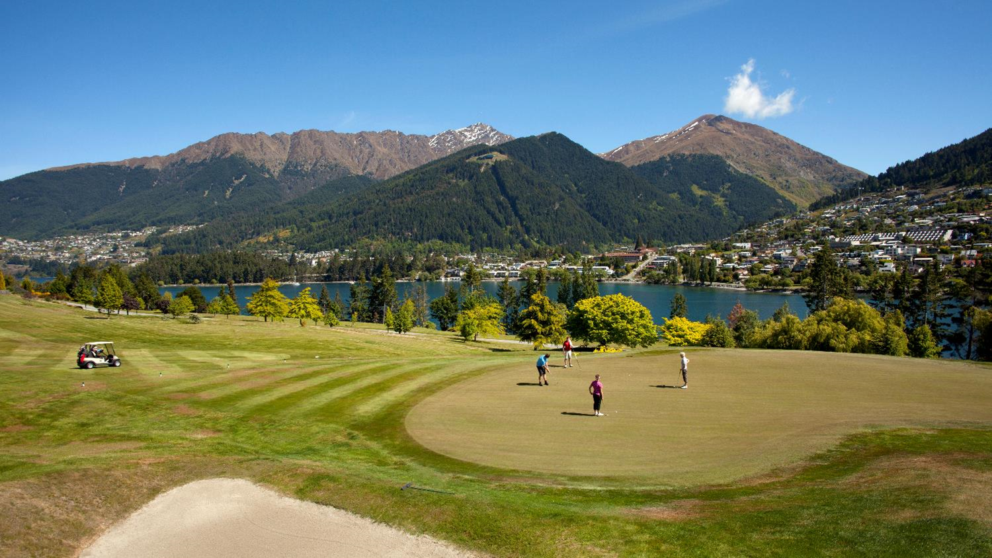
Queenstown Gold Club
Notes:
Queenstown Golf Club is internationally renowned as the most scenic golf course in New Zealand. Located on the sunny Peninsula it is surrounded on three sides by pristine alpine waters with the rugged Remarkables in the background. The 'must play' golf course in Queenstown and acclaimed as one of the most picturesque golf courses in the World. The 18-hole course is the closest to Queenstown and offers the best golfing conditions all year round (providing summer and winter sun and little frost). Clubs and a modern fleet of motorised carts are available to hire. Practice facilities include a driving range, chipping green and practice putting greens. Lessons are available from our resident PGA Professionals. A fully stocked pro shop is available offering a full range of clothing as well as all of the necessities to start your round.

Slide 7
Arrowtown Golf Club
Notes:
The picturesque Arrowtown Golf Club is set in Central Otago, one of New Zealand's most historic and scenic regions. This Golf Course is a must when playing Queenstown Golf, surrounded by mountains the 18 hole course has superb views from every fairway.
Take time to play golf in this inspiring setting - it's unique! Each hole has its own attraction and the diverse and challenging course attracts players from all over the world. Historic stone cottage ruins nestle amongst towering trees, a legacy of Arrowtown's pioneers.
Golf clubs, trundlers and electric carts are available for hire.
The Arrowtown Golf Club is open all year round and welcomes green fee players.

Slide 8
Frankton Golf Centre
Notes:
Situated beneath a stunning backdrop of the Remarkables, our gentle 9-hole golf course is perfect for novices and experienced players alike. Conveniently located adjacent to the Queenstown Events Centre and Queenstown International Airport, Frankton Golf Centre provides residents and visitors to Queenstown with an opportunity to play and learn golf at an affordable and well-maintained facility. If you're looking for a casual game of golf or an activity to fill in spare time, Frankton Golf Centre is the destination for you.
Our facilities include a: 9-hole golf course Driving range FootGolf course large putting/chipping green NZPGA qualified coaching. Fully stocked Pro Shop.

Slide 9
The Hills
Notes:
Sir Michael Hill's private golf course in Arrowtown was designed by Darby Partners and opened in 2007 to host The New Zealand Open. Set over 500 acres of land across a glacial valley. The Hills is home to an incredible array of flora including native brown top grasses and wild native mountain tussocks. Sculptures crafted by New Zealand artists compliment the natural beauty of the courses lakes, waterways and wetland areas. The 6596 meter par 72 championship course features numerous elevated tees offering players an excellent view of the challenge ahead and 360 degree views of spectacular snow capped mountain scenery. There are no parallel fairways and no two holes alike. While primarily a private club, The Hills accepts a limited number of visitor bookings daily. Players visiting have access to the clubhouse, locker room facilities, and driving range for the day of their booking. The clubhouse restaurant is open to players for both breakfast and lunch, and food and beverages can be delivered on course by request.

Slide 10
Golf Services
Notes:
Queenstown Golf Collective Superpass
The Queenstown Golf Collective Superpass offers players a round at Arrowtown, Jack’s Point, Millbrook and Queenstown golf courses for $399. Commissionable for travel trade and bookable through Peak Golf Queenstown or Remarkables Golf Tours.
Over the Top Golf – Fly / Drive / Putt
Over The Top Golf is possibly the worlds most picturesque golf hole situated at 4500 feet overlooking Queenstown. This par 3 golf experience has three tee boxes the altitude golfer can use to attempt their hole in one. With Over The Top helicopter access only, players will fly in, play the hole, putt out on top before flying out. Meet your pilot who will fly you up to our Over The Top exclusive Golf course 4,500ft above Queenstown, with 180 degree views overlooking the magnificent Wakatipu Basin. Enjoy our Par 3 course, attempt the highest hole in one and when you are finished putting on the green, the helicopter will relocate to pick you up and fly you back to our heli base. Return transportation into Queenstown is included. We take care of providing all required gear.
Peak Golf Queenstown
PGQ cater for all golfers and their varying skill levels. For comprehensive information and guidance on local golf courses, green, fees, tournaments, escorted & self drive tours.
Remarkables Golf Tours
Remarkable Golf Tours offer a range of golf services from transport, tee-time reservations and green fee packages, accommodation, equipment hire and more. Locally owned and operated since 2007, Remarkable Golf Tours ensure you have a memorable golfing experience in Queenstown. Our service is perfect for golf groups of all sizes and every level of golfer. We have small, luxury vehicles through to coaches available to transport you to our local golf courses and we're also available for conference or private golf group transfers.

Slide 11
Restaurants – Food & Drink
Notes:
Queenstown offers some of the best restaurants and bars in New Zealand. With delectable food and a great night out practically always on the menu.
There are more than 150 cafes and restaurants innovative and award-winning restaurants and eateries to cater for any occasion from fine dining to fun dining. And, our local chefs are really passionate about using local ingredients, and different seasons, always bring changes to menus to reflect the season’s freshest produce.
In downtown Queenstown you will find stylish bistro food, celebrity chef restaurants, traditional pub meals, designer burgers and a variety of ethnic cuisine. If you have special requirements, in Queenstown you can easily find delicious vegetarian, vegan, halal and gluten-free options.
Gibbston Valley in the picture is our wine growing region, and only 25 minutes drive from Queenstown. This area hosts some of the world’s best Pinot Noir and there are about 200 vineyards to sample wine from when you explore Gibbston Valley and beyond including Bannockburn, Bendigo and Cromwell. Biking/e-biking is also a popular option to explore Gibbston Valley for a half or full-day.
Another experience that is really gaining some traction here also is craft beer with some local brewers, these little spots not only define some great hidden secrets but these craft beers also appear on many of our local bars menu selection, supporting the love and passion from our local brewers.
Food and wine really is an integral part of any holiday experience and Queenstown really does deliver!
Settle in for the evening at a cosy wine bar or friendly pub or explore the town and experience Queenstown’s legendary night life, and discover the vibrant atmosphere, any night of the week.

Slide 12
Supporting Experiences
Notes:
Off the greens, enjoy some quality après-golf R&R with Queenstown’s celebrated local food scene, award-winning Central Otago wine, and quality accommodation. And with plenty of world-famous activities and attractions off the golf-course, partners, family and non-golfing friends will have a great time too.
Queenstown is a natural playground providing an incredible backdrop for a range of sights to see and things to do for adventurers of all persuasions.
Each of the seasons has its own special vibe in Queenstown, and the great thing is that most activities can be accessed all year round. World-renowned for its adventure, Queenstown is home to a huge choice of adrenaline activities including jet boating, bungy jumping, white water rafting, skydiving and even indoor thrills – all guaranteed to get your blood pumping!
When the cooler months arrive Queenstown transforms into a world class winter resort, with four ski areas and a range of activities, bars, restaurants and ways to relax and unwind.
You can even combine a round of golf at one of Queenstown’s gorgeous clubs one morning with a tour of some of our wineries and cellar doors in Gibbston and further afield to discover why Central Otago Pinot Noir is famous on the world stage.
If you’re looking for a slightly slower pace there’s plenty of recreational activities including hiking and biking trails to explore, guided tours, boat cruises, scenic flights or spa and wellness options to help you get away.

Slide 13
Golf on our website
Notes:
https://www.queenstownnz.co.nz/things-to-do/biking/

Slide 14
Travel Trade Resources
Notes:
For further resource you can check out our website www.queenstownNZ.nz and our trade pages www.queenstownNZ.nz/travel-trade
If you need suggestion for product operators for selling to your clients, please contact our team on trade@queenstownnz.nz and we can share the appropriate sales and marketing contact for you.

Slide 15
Thank You
Destination Queenstown Travel Trade
50 Stanley Street,
Queenstown, 9300
New Zealand
Trade Team
E: trade@queenstownNZ.nz
P: +64 3 441 0700

