Slide 1
Destination Queenstown
Hiking & Nature
Travel Trade Training

Slide 2
Contents
01
Hiking & Nature in Queenstown
02
Short & Half Day Walks
03
Full Day Walks
04
Multi-Day Walks
05
Great Walks
06
Walking & Hiking Services
07
Accommodation
08
Restaurants – Food & Drink
99
Travel Trade Resources

Slide 3
Hiking & Nature in Queenstown
Notes:
Hiking in New Zealand’s South Island is unlike anywhere else in the world. Complete freedom and reconnection with nature await just a stone’s throw from Queenstown, and even in the centre of town you can feel the presence of the wild. This is a special place, one that stops you in your tracks at every turn, and it’s no surprise that hikers of all ages and stages come to find, lose and immerse themselves in the surroundings.
Centred within dramatic lake and alpine landscapes, Queenstown’s breath-taking scenery has inspired outdoor exploration for decades.
The stunning and easily accessible natural environment sets the stage for a range of outdoor pursuits, inviting outdoor enthusiasts to step away and explore.
In Queenstown you will find the natural world on your doorstep and nature within your reach. There are three Great Walks accessible from Queenstown, multiple national parks and conservation areas and a range of experiences. Queenstown is the home of outdoor adventure, that really invites you to step away, pursue your passions and connect with nature.
From day walks to iconic multi-day hikes, Queenstown has a variety of trails through diverse scenery.
Your adventure is supported by world class amenities, quality services and easy access right into the heart of NZ’s great outdoors.

Slide 4
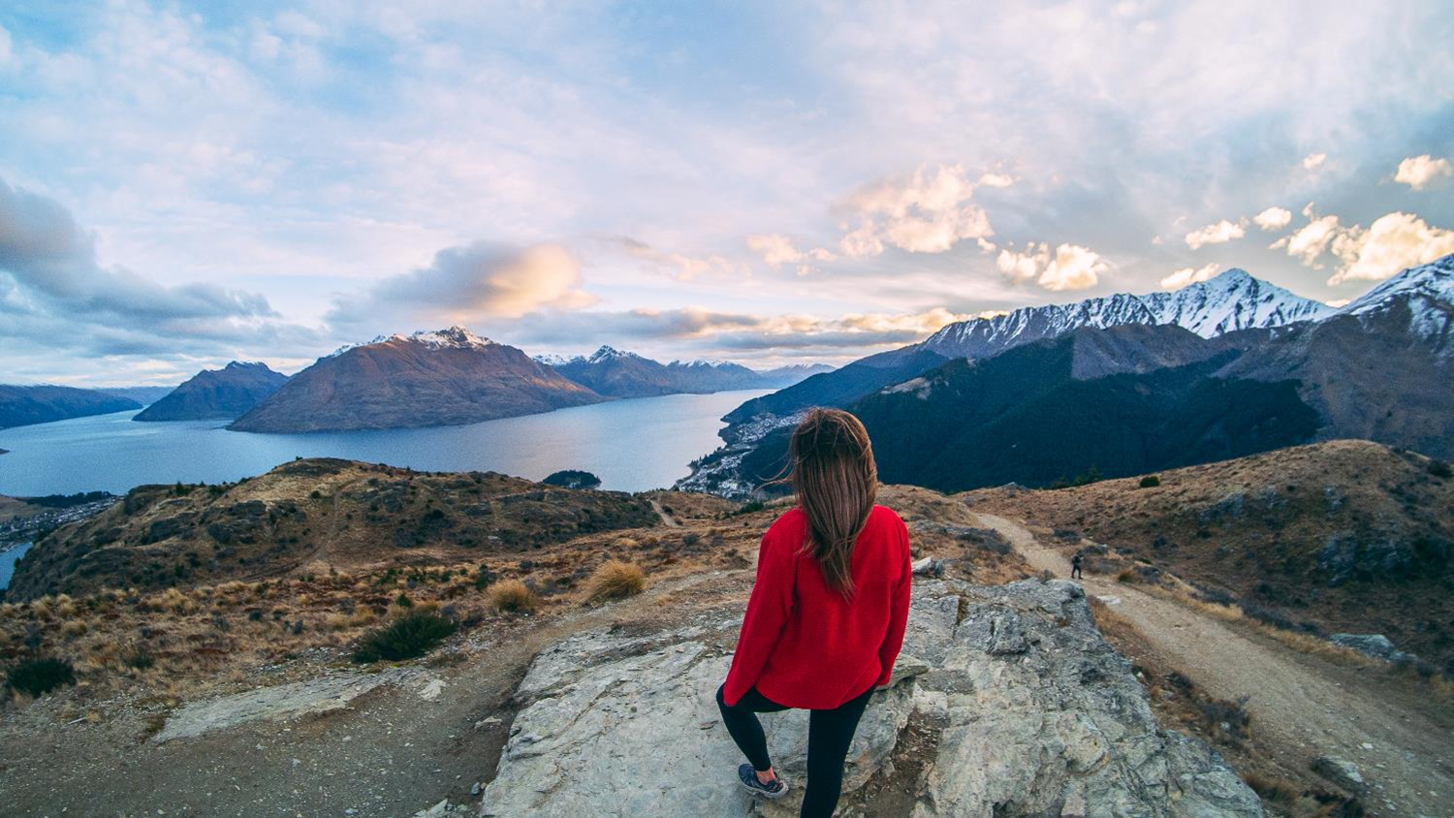
Short & Half Day Walks
Notes:
Short walks are a great opportunity to stretch your legs between adventures, even if you only have a hour or two to spare.
Because of our spectacular mountain scenery, do note that when you walk in the mountains, short doesn’t always mean easy.
But do be rest assured that you will always find a selection of relaxed lakeside ambles and short but sometimes quite steep hillside ascents. The best part is that many trails can be very easily accessed from downtown which is great for clients that haven’t the transport for walking further afield. However, for those that do venture and explore and that maybe visiting Arrowtown or Glenorchy, there is also many easy access trails for multiple short walks.
Some favourites include:
Queenstown Hill Time Walk – 2 hours return that provides 360-degree views and at the top is the infamous ‘basket of dreams sculpture’.
Arrowtown River Trail – a leisurely 1 hour loop track that’s nice and easy and perfect for families.
Tiki Trail – straight up the side of Bob’s Peak (where the Skyline Gondola complex is), it’s a quick 1-hour ascent, you can also extend this walk if you have a full-day to take in the Ben Lomond Track.
Glenorchy Lagoon Walkway – again another easy and leisurely 1 hour loop track that is located right behind the Glenorchy township.
For those with a little more time on their hands you can begin to explore a little further afield into some more off-the beaten track experiences. This also then encompasses the option for half day guided walking options, which is really supportive for those clients who don’t wish to walk alone and want to understand more about the region, nature, our flora and fauna.

Slide 5
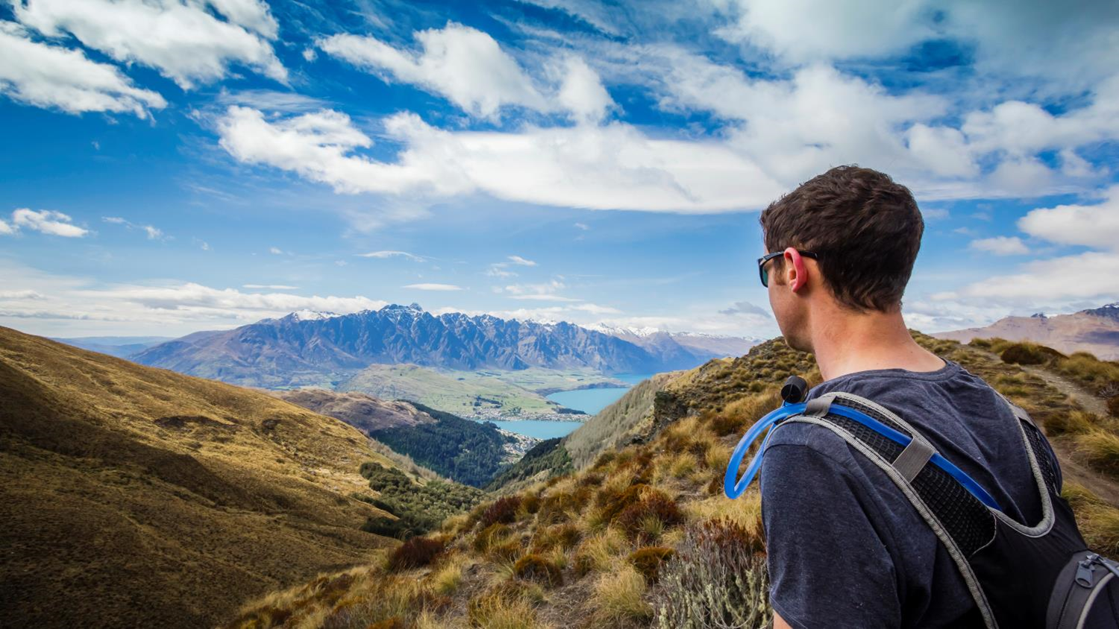
Full Day Walks
Notes:
Full Day Walks offer up an experience to again enjoy walking independently, OR to be part of a fully-guided experience. A guided experience is ideal if you enjoy exploring with a knowledgeable local expert, or if you want the security of knowing that you’re hiking with a guide who knows how to navigate challenging alpine terrain and changeable weather safely.
Options for exploring full-day on foot, include getting up Ben Lomond, one of Queenstown’s iconic backdrops, 6-8 hours return. To the Gibbston River Trail 3-5 hours depending on detours and possible winery stops, to Glenorchy, a 45-minute drive from Queenstown to the head of the lake, where you can enjoy an experience on one of the Great Walks the Routeburn if a multi-day walk isn’t an option. These are just a couple of examples.
One thing guaranteed when walking a full-day is that you will enjoy trails that offer a diverse landscape, stunning scenery, and include native forests, rivers, waterfalls, lakes and mountains. Full-day walks can be done both independently or guided with local companies.

Slide 6
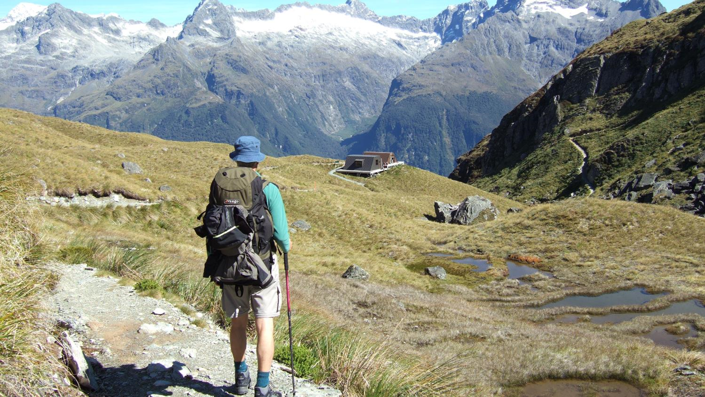
Multi-Day Walks
Notes:
In the heart of the south, there’s a place where the landscape really takes charge.
Lakes, mountains, rivers and national parks have absolute sovereignty here! Queenstown is not only the access to three of the Great Walks (the Milford Sound, Kepler and Routeburn tracks – I’ll talk about these next), but also an abundance of other awe-inspiring multi-day hikes.
Multi-day walks, allow you to escape the hustle, leave your phone at home and truly be given the opportunity to drop into Queenstown’s unspoiled wilderness.
There are three other iconic multi-day walk:
The Greenstone Track and Caples Track
Distance: 51kms
Hiking time: 4 days
These two tracks run up parallel valleys to form a loop linked by the McKellar Saddle. Whilst the Greenstone Valley is an expansive open valley with tussock flats and beech forest, the Caples Valley is narrower, with dense forest and grassy clearings.
Bookings aren’t required for most of the huts, but you’ll need to buy a hut pass from DOC office.
The Rees-Dart Track
Distance: 63km
Hiking time: 4-5 days
These tracks pierce straight into the breathtaking Mt Aspiring National park, running through the Rees and Dart Valleys and linking the two. There are three huts, which are first-come-first-serve (though you’ll need to buy a backcountry hut pass at a DOC office).
Hollyford Track – a 3 day all-inclusive multi-day wilderness experience. This particular walk can also be booked with the Department of Conservation (DOC).

Slide 7
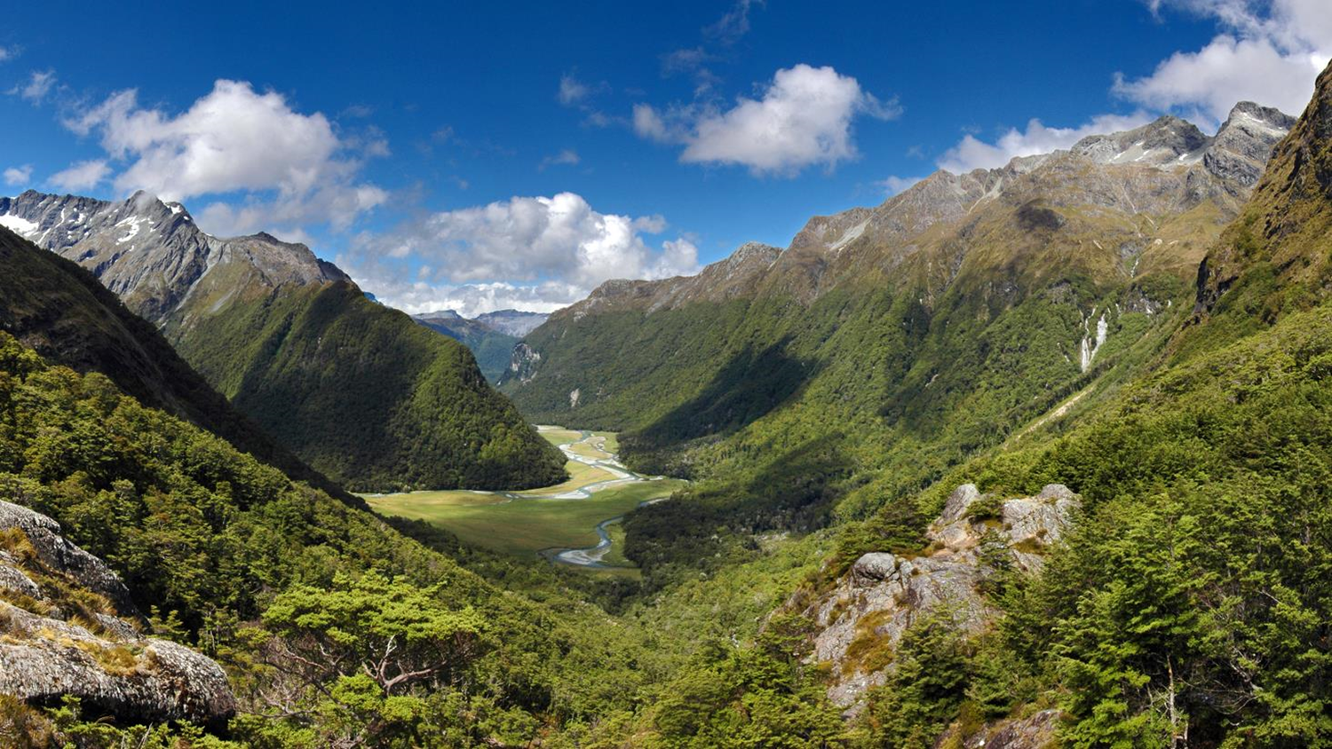
Great Walks
Notes:
The walking season usually runs from the end of October to the end of April, with the peak season being January and February. These are an experience that need to be booked in advance. If you want to avoid the main summer crowds, book in for March/April as you’ll still get nice long days for hiking.
The Milford Track
Distance: 54 kms
Hiking time: 4 days
The Milford Sound Track has been dubbed ‘the finest walk in the world’, and for good reason. It’s a stunning exploration of the Fiordland National Park, through glacier-carved valleys, waterfalls and NZ’s iconic native rainforest. The track follows the Clinton River before ascending Mackinnon Pass, where the views from the top leave your jaw on the floor and take the words from your lips.
From here descend into Milford Sound, where a side trip to Sutherland Falls is not to be missed. The Milford Sound hike is the most popular Great Walk, and we recommend booking in advance. A great way to round out your experience on this track is to also add on a Milford Sound cruise at the end of your hiking trip so that you can enjoy a whole different angle.
Bookings through DOC, but Ultimate Hikes still have availability for this summer season.
The Routeburn Track
Distance: 32 kms
Hiking time: 2-4 days
Named one of the ‘best hikes in the world’ by Lonely Planet, the Routeburn offers remote wilderness at its finest. It’s a bridge between two very special places, linking the Mt Aspiring National Park with Fiordland National Park, and will take you wandering through native forest, past waterfalls and high into the surrounding mountain peaks.
The Routeburn can also be joined with either the Greenstone or Caples Tracks to make a near-loop back to Lake Wakatipu, this extends the trip up 4-6 days.
Bookings through DOC, but Ultimate Hikes still have availability for this summer season.
The Kepler Track – departs from Te Anau (which is 2 hours from Queenstown – Queenstown is more the gateway).
Distance: 60 kms
Hiking time: 3-4 days
Traversing impressive ridgelines and saddles, the Kepler Track keeps you moving high above the bush line, looking down over Lake Te Anau and Fiordland National Park. The loop track includes many amazing side trips to caves, waterfalls, moss-covered forest, wetlands and a rocky valley scarred by an old rockslide.
Kepler Track day walks are also popular.
Again, bookings through DOC.

Slide 8
Hiking Services
Notes:
Track Transport - If you’re planning a multi-day hike or you’re tackling a Great Walk while you’re in Queenstown, it’s a great idea to organise track transport to drop you at the start and pick you up at the track’s end. Then you can enjoy your hiking adventure without worrying about parking your car safely or being stranded at the end of your walk.
Hiking Equipment Hire – if you don’t have your own hiking gear? No problem. Queenstown offers a selection of outdoor equipment rental options for visitors who don’t have hiking or camping equipment. Boots, poles, clothing, tents etc. Most outdoor shops also sell hiking essentials, like cooking equipment, gas canisters, insect repellent, hydration packs, and water bottles etc.
The Department of Conservation – have an office right in the centre of town. Your clients can visit DOC and access all sorts of additional information and support of track transport and suggestions for equipment hire and so forth which will really support any person wanting to book Queenstown for their next walking and hiking adventure.

Slide 9
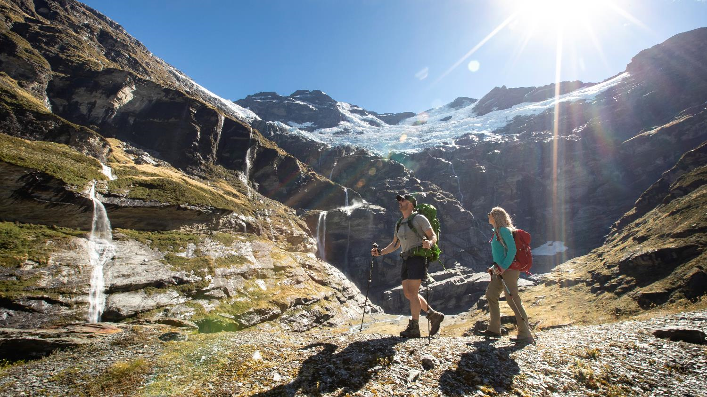
Heli Hiking
Notes:
Another option for accessing complete back-country and off-the-beaten-track remote wilderness is to enjoy a heli-hike. This will have you explore further afield and can truly be the trip of a lifetime adventure. A true bucket list experience. Heli-hike experiences can include glacier hikes, backcountry mountain peaks, and overnight wilderness camping adventures.

Slide 10
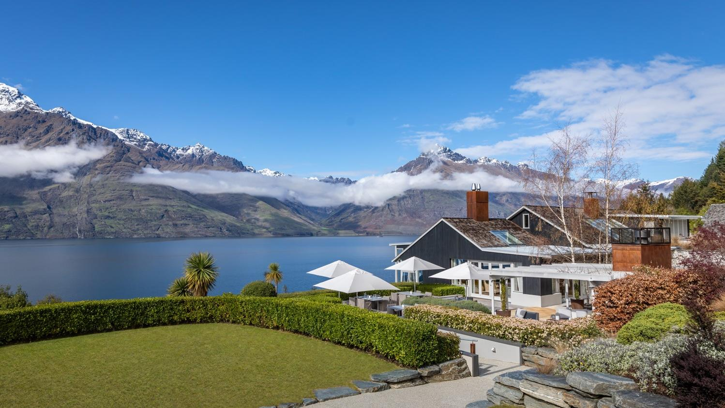
Accommodation
Notes:
Queenstown has a huge range of accommodation styles to suit every age and stage, style and budget that are perfect for adding on a couple of nights at the beginning and end of your hiking experience.
The budget conscious traveller can book into backpacker accommodation, and if you’re travelling with a tent or camper, Queenstown has a number of well-equipped and centrally located holiday parks. If you’re looking for a homely feel try one of Queenstown’s bed and breakfasts in surrounding Arrowtown or Glenorchy. Motels, are well suited for those on a driving holiday, and are dotted around town. There are many hotels and resorts located centrally within walking distance to Queenstown’s vibrant CBD. Queenstown’s award-winning luxury lodges and retreats show off stunning alpine views, and if you’re travelling with family and require shared accommodation, there are serviced apartments and holiday houses so you can self-cater with ease.
There’s a lot of variety when it comes to Queenstown's hotel and resort accommodation. Ranging from boutique hotels to internationally recognised resorts, many offer lake and alpine views of Queenstown's famed scenery.
Many large hotels and resorts are located centrally within walking distance of the town's centre. If you’re after something away from the hustle and bustle, hotels line the shores of Lake Wakatipu, and can be found close to the airport in Frankton or in neighbouring and quaint Arrowtown. With excellent facilities including restaurants that feature winelists rich with Central Otago vintages as well as spa, pool and sauna facilities, Queenstown’s hotel and resort accommodation is second to none.
Self-contained or serviced apartments in Queenstown range from private luxury apartments high in Queenstown’s hills to serviced apartments in the heart of town for those seeking out the nightlife close by. Private apartments offer travellers comfort and style where you can focus on your holiday without worrying about the everyday. Perfect for groups of friends, couples, and families, you can sit back, relax and enjoy the crystal-clear views of Lake Wakatipu.
Queenstown’s lodges and luxury retreats provide the very best in exceptional, private accommodation. From exclusive penthouses, to boutique five-star lodges and retreats, Queenstown is renowned internationally as a world-class destination for luxury accommodation, and bespoke premium experiences. You might find yourself at an exclusive hunting and fishing lake front lodge surrounded by mountains, or at a hidden lodge tucked away from the bustle of central Queenstown, for the ultimate four-season lake and alpine experience, pick one of New Zealand’s top lodges in the heart of the Southern Alps. Helicopter or jet boat transfers can be arranged to a number of luxury accommodation providers, you just have to ask. Pure indulgence is on the menu here in Queenstown.

Slide 11
Restaurants - Food & Drink
Notes:
Food and drink is one of those experiences that rounds out any day on the slopes.
Queenstown offers some of the best restaurants and bars in New Zealand. With delectable food and a great night out practically always on the menu.
There are more than 150 cafes and restaurants innovative and award-winning restaurants and eateries to cater for any occasion from fine dining to fun dining. And, our local chefs are really passionate about using local ingredients, and different seasons, always bring changes to menus to reflect the season’s freshest produce.
In downtown Queenstown you will find stylish bistro food, celebrity chef restaurants, traditional pub meals, designer burgers and a variety of ethnic cuisine. If you have special requirements, in Queenstown you can easily find delicious vegetarian, vegan, halal and gluten-free options.
Gibbston Valley is our wine growing region, and only 25 minutes drive from Queenstown. This area hosts some of the world’s best Pinot Noir and there are about 200 vineyards to sample wine from when you explore Gibbston Valley and beyond including Bannockburn, Bendigo and Cromwell. Biking/e-biking is also a popular option to explore Gibbston Valley for a half or full-day (even in winter).
Another experience that is really gaining some traction here also is craft beer with some local brewers, these little spots not only define some great hidden secrets but these craft beers also appear on many of our local bars menu selection, supporting the love and passion from our local brewers.
Food and wine really is an integral part of any holiday experience and Queenstown really does deliver!

Slide 12
Nature & Hiking on our website
Notes:
https://www.queenstownnz.co.nz/things-to-do/biking/

Slide 13
Travel Trade Resources
Notes:
For further resource you can check out our website www.queenstownNZ.nz and our trade pages www.queenstownNZ.nz/travel-trade
If you need suggestion for product operators for selling to your clients, please contact our team on trade@queenstownnz.nz and we can share the appropriate sales and marketing contact for you.

Slide 14
Thank You
Destination Queenstown Travel Trade
50 Stanley Street,
Queenstown, 9300
New Zealand
Trade Team
E: trade@queenstownNZ.nz
P: +64 3 441 0700

