Slide 1
Destination Queenstown
Premium & Luxury
Travel Trade Training

Slide 2
Contents
01
Whakatipu Basin Map
02
Accommodation
03
Activity
04
Restaurants & Bars
05
Transport
06
Travel Trade Resources

Slide 3
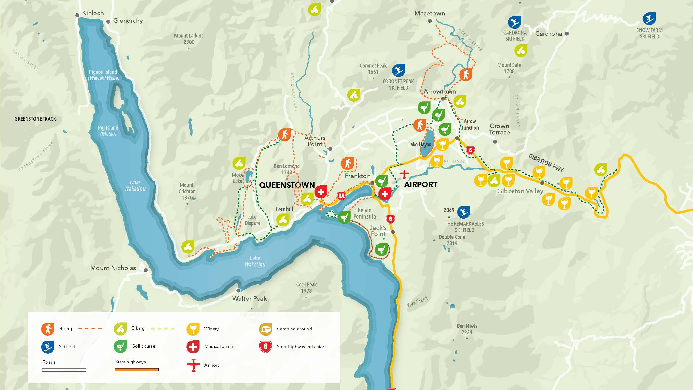
Notes:
Queenstown Central & surrounds.
This map provides an orientation for the proximity of the airport to Queenstown. Starting from the top of the lake with Glenorchy, which boarders our World Heritage Area is only 45 minutes from Queenstown.
The drive has been names one of the top 10 scenic drives in New Zealand and no drive is complete without a stop at Bennett's Bluff for the icon photo of Pig and Pigeon Islands in the foreground.
Coming back to Queenstown, you can also see Arrowtown, which is about 25 minutes drive from Queenstown. Here you will find the Chinese Village which is great for exploring. You could spend an entire day exploring Arrowtown.
If you were driving east off this map, you can also see out toward Gibbston Valley, which is also about a 25-minute drive and provides access to our world-renowned wine growing region.
You can also identify on this map Coronet Peak, The Remarkables, Cardona ski fields. With Treble Cone being a little further north than this map shows.

Slide 4
Accommodation

Slide 5
Luxury Lodges & Private Residences
Notes:
Queenstown’s lodges and luxury retreats provide the very best in exceptional, private accommodation.
From exclusive penthouses, to boutique five star lodges and retreats, Queenstown is renowned internationally as a world-class destination for luxury accommodation, and bespoke premium experiences.
You might find yourself at an exclusive hunting and fishing lake front lodge surrounded by mountains, or at a hidden lodge tucked away from the bustle of central Queenstown, for the ultimate four season lake and alpine experience, pick one of New Zealand’s top lodges in the heart of the Southern Alps.
Helicopter or jet boat transfers can be arranged to a number of luxury accommodation providers, you just have to ask.
Pure indulgence is on the menu here in Queenstown.
Blanket Bay – Glenorchy
Matakauri Lodge
Eichardt’s Private Hotel
Hulbert House
Gibbston Valley Lodge & Spa
Millbrook Resort
Touch of Spice
Major Domo
Azur Lodge
Queenstown Park Boutique Hotel
Aroha Wellness Retreat

Slide 6
Room with a view
Notes:
Mountain Views
There’s no escaping mountains on a visit to Queenstown, which lies at the bottom of the Southern Alps, and they dramatically dominate the landscape in almost every direction. The mountains are spectacular at any time of year but most of the time you’ll see at least a dusting of snow on their jagged tips. As well as The Remarkables along the southeastern side of Lake Wakatipu, during a visit to the area you can enjoy views of Cecil Peak, Walter Peak, Ben Lomond and many others.
If you're looking for accommodation with mountain views located amongst the hustle and bustle of Queenstown's CBD, Sofitel Queenstown Hotel and Spa has a nice perspective over Cecil Peak and The Remarkables. Slightly further afield but still within walking distance of Queenstown's CBD is St Moritz and Queenstown Park Boutique Hotel which overlooks Queenstown Hill and Bobs Peak.
Vineyard Views
Central Otago is particularly famous for its pinot noir, and the Queenstown and neighboring Gibbston regions have more than 75 wineries. This, of course, means acres and acres of beautiful grapevines, so if vineyards are your vista du jour, head for one of the area’s wine-growing regions to find a place to rest your head, with a number of boutique accommodation options to choose from.
Stoneridge Estate, located an easy 20 minute drive from Queenstown's town centre, offers five star luxury bed and breakfast accommodation and fine dining overlooking Lake Hayes. Peer down a valley of vines with a beautiful lake in the background.
Slightly further afield, in Gibbston and newly opened in December 2019, guests can stay at the original Gibbston winery at Gibbston Valley Luxury Lodge and Spa, and experience luxury accommodation in the valley of vines.
Lake Views
The distinctive snake-shaped Lake Wakatipu, the longest lake in New Zealand at 80km, offers plenty of accommodation providers with fresh-water views, and many will have big picture windows facing towards it. Other lakes in the region include Lake Hayes, which lies at the southern end of the Wakatipu Basin. These alpine lakes may be incredibly pretty but swimming in them is not for the faint-hearted: the average temperature is about 12C.
Being the third largest lake in New Zealand, it's no surprise that a fair amount of Queenstown's accommodation offers beautiful Lake views. For luxury stays, Matakauri Lodge, Blanket Bay and Eichardt's Private Hotel boast some pretty incredible lake views. Slightly further afield but within a quick drive of town, Kamana Lakehouse, Heritage Queenstown and The Rees also have a great perspective over the lake.
River Views
If you like your water views fast flowing and changeable, the tributaries that feed into Lake Wakatipu in particular are destinations in themselves, and where many of the region’s adventure activities take place. The closest rivers to town are the Shotover (home to the world-famous Shotover Jet) and the Kawarau (think bungy jumping), while north is the Dart River, near Glenorchy.
THC Nugget Point Hotel is build on the hillside in Arthurs Point and offers beautiful views over the Shotover River.
City Views
If you’re after more of an urban experience, the vibrant city centre has plenty to offer. Everything is within walking distance, so you can take your pick of world class eateries and shopping, or wander down to the lakefront to catch a boat. On Saturdays be sure to stop by the weekly art and craft market at Earnslaw Park. Most of the tourist attractions run transport services from town, so it’s not essential to have a car.
The Spire Hotel Queenstown is located in the heart of Queenstown's CBD on Church Street and offers a contemporary luxury experience.

Slide 7
Activity

Slide 8
Air Activity
Notes:
Queenstown scenic flights offer an exceptional way to see the beautiful region.
View the stunning alpine and lake scenery from the air with a scenic helicopter, fixed-wing flight, hot air balloon or flight charter.
Fly from Queenstown over to Fiordland or enjoy the thrill of a snow landing high in the alps, complete with a picnic!
Choose from a short scenic flight, take to the air on a balloon as the sun rises, or a full day excursion incorporating other adventure activities with your flying experience, from rafting to snowboarding, skiing and downhill mountain biking.

Slide 9
Land Activity
Notes:
Get off the beaten track with an off-road adventure or land tour in Queenstown!
Queenstown 4WD and off-road tours take you deep into the back country, where few people have ventured before. You'll experience some of the most remote and stunning scenery in New Zealand from the comfort of your specialised vehicle, get to enjoy the thrill of four-wheel-driving, quad biking or in an off-road buggy.
If a slower pace is what you’re looking for there’s horse riding operators who can take you on a journey through Lord of the Rings film locations, or into Queenstown’s frontier history on farm land and foothills.
With respect of being a leisure biking destination, and part of the Queenstown Trails 130kms of network, you will find easy scenic tracks that will take you along lakeside or backcountry trails and past picturesque locations, including Lake Wakatipu, Lake Hayes, Arrowtown and Gibbston Valley. There are stunning river gorges, hidden ruins, access to unspoilt private land, and suspension bridge crossings over three iconic rivers.
Visitors can use the trail for an hours leisurely ride, a half or full-day or for multi-day enjoyment – guided or unguided. All trails range from easy to intermediate making it even more accessible for all ages, stages and levels of fitness.
We also have a very enviable climate during spring and summer, especially against the scenic backdrops that will make a biking adventure one to remember

Slide 10
Water Activity
Notes:
Take to the region's lakes and fiords with a boat cruise in Queenstown and beyond!
The Southern Lakes region is home to some of New Zealand's most beautiful waterways, including Lake Wakatipu in Queenstown, as well as Lake Wanaka, Lake Te Anau and Milford Sound in the wider region.
Fiordland is one of the most popular areas of New Zealand—and for good reason, cruising through the soaring mountains, deep waters and witnessing the abundant wildlife in their element is an incredible experience.
There are several companies that offer transfers to Milford and Doubtful Sounds from Queenstown, and there are even overnight cruise options!
Select a leisurely lake cruise to experience the tranquility and beauty of boating in New Zealand.

Slide 11
Sightseeing
Notes:
Queenstown sightseeing tours and activities are an ideal way to take in the region’s breathtaking natural beauty.
Take to the air on a scenic flight, cruise across Lake Wakatipu and see the mountains from a new perspective or be carried high over Queenstown in a gondola and take in the views, there are activities for all travellers.
Let your knowledgeable guide inform and inspire as you drive, walk, taste or fly your way around the Queenstown area.
Join a Queenstown scenic tour to experience the natural beauty of New Zealand's Southern Lakes and landscapes. Embark on a city tour, a buggy tour, farm tour by foot or on a horse trekking journey. Or take an off-road tour to discover some of Queenstown’s gold mining history, go quad biking high over Queenstown or indulge in wine tours and tastings. Regardless of whether you travel on foot, by car, motorcycle, or horseback, a scenic tour around Queenstown showcases the area's famous mountain peaks, tranquil lakes and rivers, striking canyons and beautiful national parks.

Slide 12
Day Trips
Notes:
Queenstown is a great base to explore the Sounds, especially if you have clients staying for more than a couple of days. The iconic Milford Sound (as in the photograph) can be reached by self-drive, coach, helicopter or fixed wing plane. Best way to sell this product is by coaching one way and flying the other to get the best of all the landscape. Once there, there are several cruise companies that offer scenic cruises on the fiord for up to 2 hours, and some that offer trips into the Underwater Observatory. Rain, hail or shine - Milford Sound is breathtaking in all weather. Especially, when it rains the waterfalls are sensational!
Glenorchy, is a true slice of New Zealand paradise that sits a spectacular 45-minute drive northwest of Queenstown at the northern end of Lake Wakatipu. The scenic drive along the shores of Lake is breathtaking. And no drive to Glenorchy is complete without a stop at Bennett Bluff for a photo. Surrounded by magnificent snow-capped mountains, pristine lakes and rivers, ancient beech forests and at the edge of Mount Aspiring and Fiordland national parks, the frontier town of Glenorchy has provided the backdrop for many films, including The Hobbit and Lord of the Rings. The nearby settlements of Kinloch and Paradise are also known for their stunning scenery and tranquil setting. The area is also the gateway to several world-famous multi-day hikes including the Routeburn Track, one of New Zealand’s Great Walks. For walks closer to town, there are well-graded walkways that lead to points of interest including the Glenorchy Walkway, Whakaari Conservation Area and Mt Judah, where the remains of scheelite mines can be found. There are a number of exciting ways you can explore the beauty of this pristine area. Take the sites in by horseback and ride through braided rivers, native forests and across open fields. By water you can journey into the heart of glacier country with a jetboat, canoe or kayak. Take a stunning scenic flight into unexplored wilderness or experience the thrill of a skydive over landscapes that have remained untouched for centuries. Or, grab your backpack and hiking boots to enjoy a walk, try your luck at fly-fishing, enjoy a farm tour or 4WD experience.
Arrowtown is a historic former gold mining town, rich in heritage and one of the South Island’s and New Zealand’s, iconic visitor destinations. Located only 20 minutes’ drive from Queenstown, the spectacular scenery, distinct four seasons and charming character make Arrowtown a must do for visitors from all over the world. This delightful town has maintained its rich heritage and historic buildings and is now a vibrant destination with world class food and beverage, shopping and attractions. Arrowtown's history has been well preserved, and a stroll through the main streets or down to the Chinese Village gives you a glimpse into what life would have been like for the early settlers. Some of the ‘must-dos’ in Arrowtown include visiting the historic Chinese miners village, now stone ruins but once a thriving settlement, trying your hand at gold panning in the Arrow river, visiting the Lakes District Museum or browsing through the boutique shopping precinct.

Slide 13
Beauty & Wellness
Notes:
The picturesque lake and alpine resort of Queenstown is the ultimate place for relaxation and rejuvenation.
Queenstown is renowned as the perfect destination to escape to for rejuvenation and revitalisation and there are a wide range of health, beauty and wellness services for visitors and locals alike. There are world class day spas and beauty services with a range of pampering treatments as well as specialists in the field of appearance medicine, women’s health, naturopathy and physiotherapy.
For true relaxation, enjoy a spa where you can enjoy your choice of facials, body scrubs, manicures, pedicures, foot treatments or any type of beauty procedure you desire. Ease those aching muscles after a day of adventure, or just treat yourself to some relaxation with a massage!
Hot pools in Queenstown are an excellent way to soothe the muscles and relax after a day on the slopes or the trails. Enjoy a daytime soak to warm and unwind, or make a night time visit and marvel at the clear night sky as your worries and aches are gently soothed by the warm waters.

Slide 14
Shopping & Art Galleries
Notes:
Well beyond souvenirs, Queenstown’s shopping precinct caters for fashionistas young and old alike. If it’s a luxurious something special that you’re after, make a beeline to Louis Vuitton’s new store – one word of warning: you won’t want to leave. Perched by the edge of Lake Wakatipu with views of Cecil Peak, the boutique is truly one of a kind. Local furniture designer Ed Cruikshank was enlisted to instil the space with the spirit of the South Island and the result is unforgettable. Your next stop needs to be WORLD’s recently opened boutique, which is just footsteps around the corner. On offer are a covetable array of luxurious fragrance and beauty brands – Amouage, Cire Trudon candles and Santa Maria Novella skincare – as well as its eponymous seasonal fashion collections.
Stroll up Searle Lane to discover go-to fashion destination, Angel Divine, inside you’ll find a carefully curated selection of some of New Zealand’s best labels: Zambesi, NOM*d, Kate Sylvester and Deadly Ponies. Decode – home to an eclectic array array of out-of-the-box fashion and accessories alongside an impressive assortment of homeware, furnishings, lighting, and jewellery – is just moments away on Camp Street.
Unique, 100 per cent New Zealand-made trinkets can be discovered at the Creative Queenstown Arts and Crafts Market. The outdoor market runs each Saturday and is the perfect spot to pick up a gift for someone special. When your belly starts to rumble head to Remarkables Market. Snow-capped mountains form the backdrop, and each Saturday the Red Barn is transformed into a hive of artisanal activity. Alongside locally produced arts and crafts you’ll be able to devour tasty local produce.
Queenstown and Arrowtown are home to a number of excellent art galleries and craft workshops that are open to the public.
Paintings, drawings, contemporary scultpure, watercolours and photography are all on display in various public galleries and workshop spaces. Often you can meet the artist and purchase their work as a memento of your visit to Queenstown.

Slide 15
Restaurants & Bars

Slide 16
Restaurants
Notes:
Queenstown offers some of the best restaurants and bars in New Zealand. With delectable food and a great night out practically always on the menu.
There are more than 150 cafes and restaurants innovative and award-winning restaurants and eateries to cater for any occasion from fine dining to fun dining. And, our local chefs are really passionate about using local ingredients, and different seasons, always bring changes to menus to reflect the season’s freshest produce.
In downtown Queenstown you will find stylish bistro food, celebrity chef restaurants, traditional pub meals, designer burgers and a variety of ethnic cuisine. If you have special requirements, in Queenstown you can easily find delicious vegetarian, vegan, halal and gluten-free options.
Food and wine really is an integral part of any holiday experience and Queenstown really does deliver!
Queenstown offers a range of intimate dining options and extra special dinner venues. The Bunker, Amisfield Winery, Botswana Butchery, Jervois Steakhouse, The Grille by Eichardt’s just some of the options you might like to look into.

Slide 17
Bars
Notes:
Queenstown is known far and wide for its excellent restaurant and bar scene. Whether you're in search for a place to have a pre-dinner drink, a decadent restaurant, a night spot with a chilled vibe, or somewhere to dance the night away, our compact town centre makes it easy to experience our vibrant nightlife scene.
From house-made gin cocktails with a lake view to champagne from a sky-high lookout across the mountain silhouettes. Whether it’s Kiwi craft beer, Otago wine, mixologists’ libations or mulled wine by an outdoor fire, you will find something here with your name on it.

Slide 18
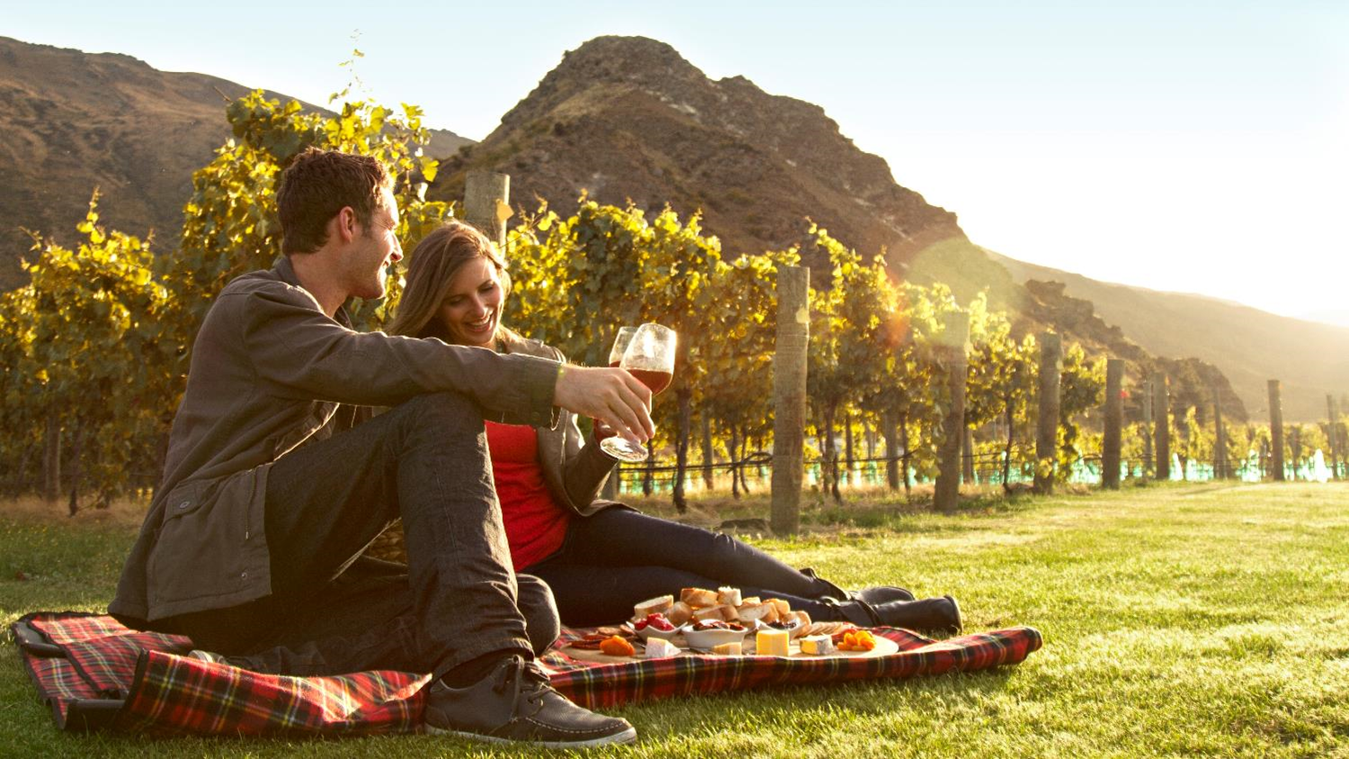
Wineries
Notes:
The wineries in Queenstown and nearby Gibbston, the 'Valley of Vines', have a reputation for producing some of the world’s best Pinot Noir, and it’s easy to while away a day exploring cellar doors and restaurants to find your favourite vintage.
Queenstown is the gateway to the Central Otago region where you’ll find 200 vineyards within a 40 minute drive of the town centre. The Central Otago wine region is made up of six sub-regions; Gibbston, Cromwell/Pisa/Lowburn, Bannockburn, Bendigo, Wanaka and Alexandra, all producing world-class wines.
What makes the region’s wine so special is the landscape its grapes are grown in. At a latitude of 45° south, Central Otago is the southernmost wine growing region in the world, with unique shaly soil and climate providing excellent grape growing conditions. Local winemakers produce award-winning wines of exceptional elegance and longevity.
Central Otago features New Zealand's highest and the world's most southerly wine region. The climate, temperatures and terroir (earth) all combine to create the unique flavours of Central Otago Pinot Noir and the other varietals that the talented winemakers create here. Find out more on the climate, temperatures and soil that makes Central Otago so special.
To help you experience our wines for yourself, many Queenstown wineries have cellar door tasting, and several have excellent winery restaurants on site, so you can drop in for a taste, a chat to the staff or a delicious meal with a glass of your favourite variety.
In Queenstown you can choose from tour companies to ferry you around Gibbston and further afield Central Otago wineries, leaving you to indulge in as many tastings as you wish before being whisked to the next destination. You can join an organised group tour, enlist the services of a chauffeur-driven private vehicle or even fly high on a helicopter charter flight across the region.

Slide 19
Transport

Slide 20
Private Transfers
Notes:
Helicopter, luxury sedans and vans, boat?
Private transfers from the airport to your accommodation to privately guided day tours for sightseeing, wine, hiking and biking. There are plenty of discreet and luxurious options to choose from.

Slide 21
Travel Trade Resources
Notes:
For further resource you can check out our website www.queenstownNZ.nz and our trade pages www.queenstownNZ.nz/travel-trade
If you need suggestion for product operators for selling to your clients, please contact our team on trade@queenstownnz.nz and we can share the appropriate sales and marketing contact for you.

Slide 22
Thank You
Destination Queenstown Travel Trade
50 Stanley Street,
Queenstown, 9300
New Zealand
Trade Team
E: trade@queenstownNZ.nz
P: +64 3 441 0700

