Slide 1
Destination Queenstown
Winter & Ski
Travel Trade Training

Slide 2
Contents
01
Winter & Ski in Queenstown
02
Ski Areas
03
Heli Skiing/Boarding
04
Accommodation Options
05
Off-Mountain Adventures
06
Après Ski
07
Food & Drink
08
Bars & Nightlife
99
Travel Trade Resources

Slide 3
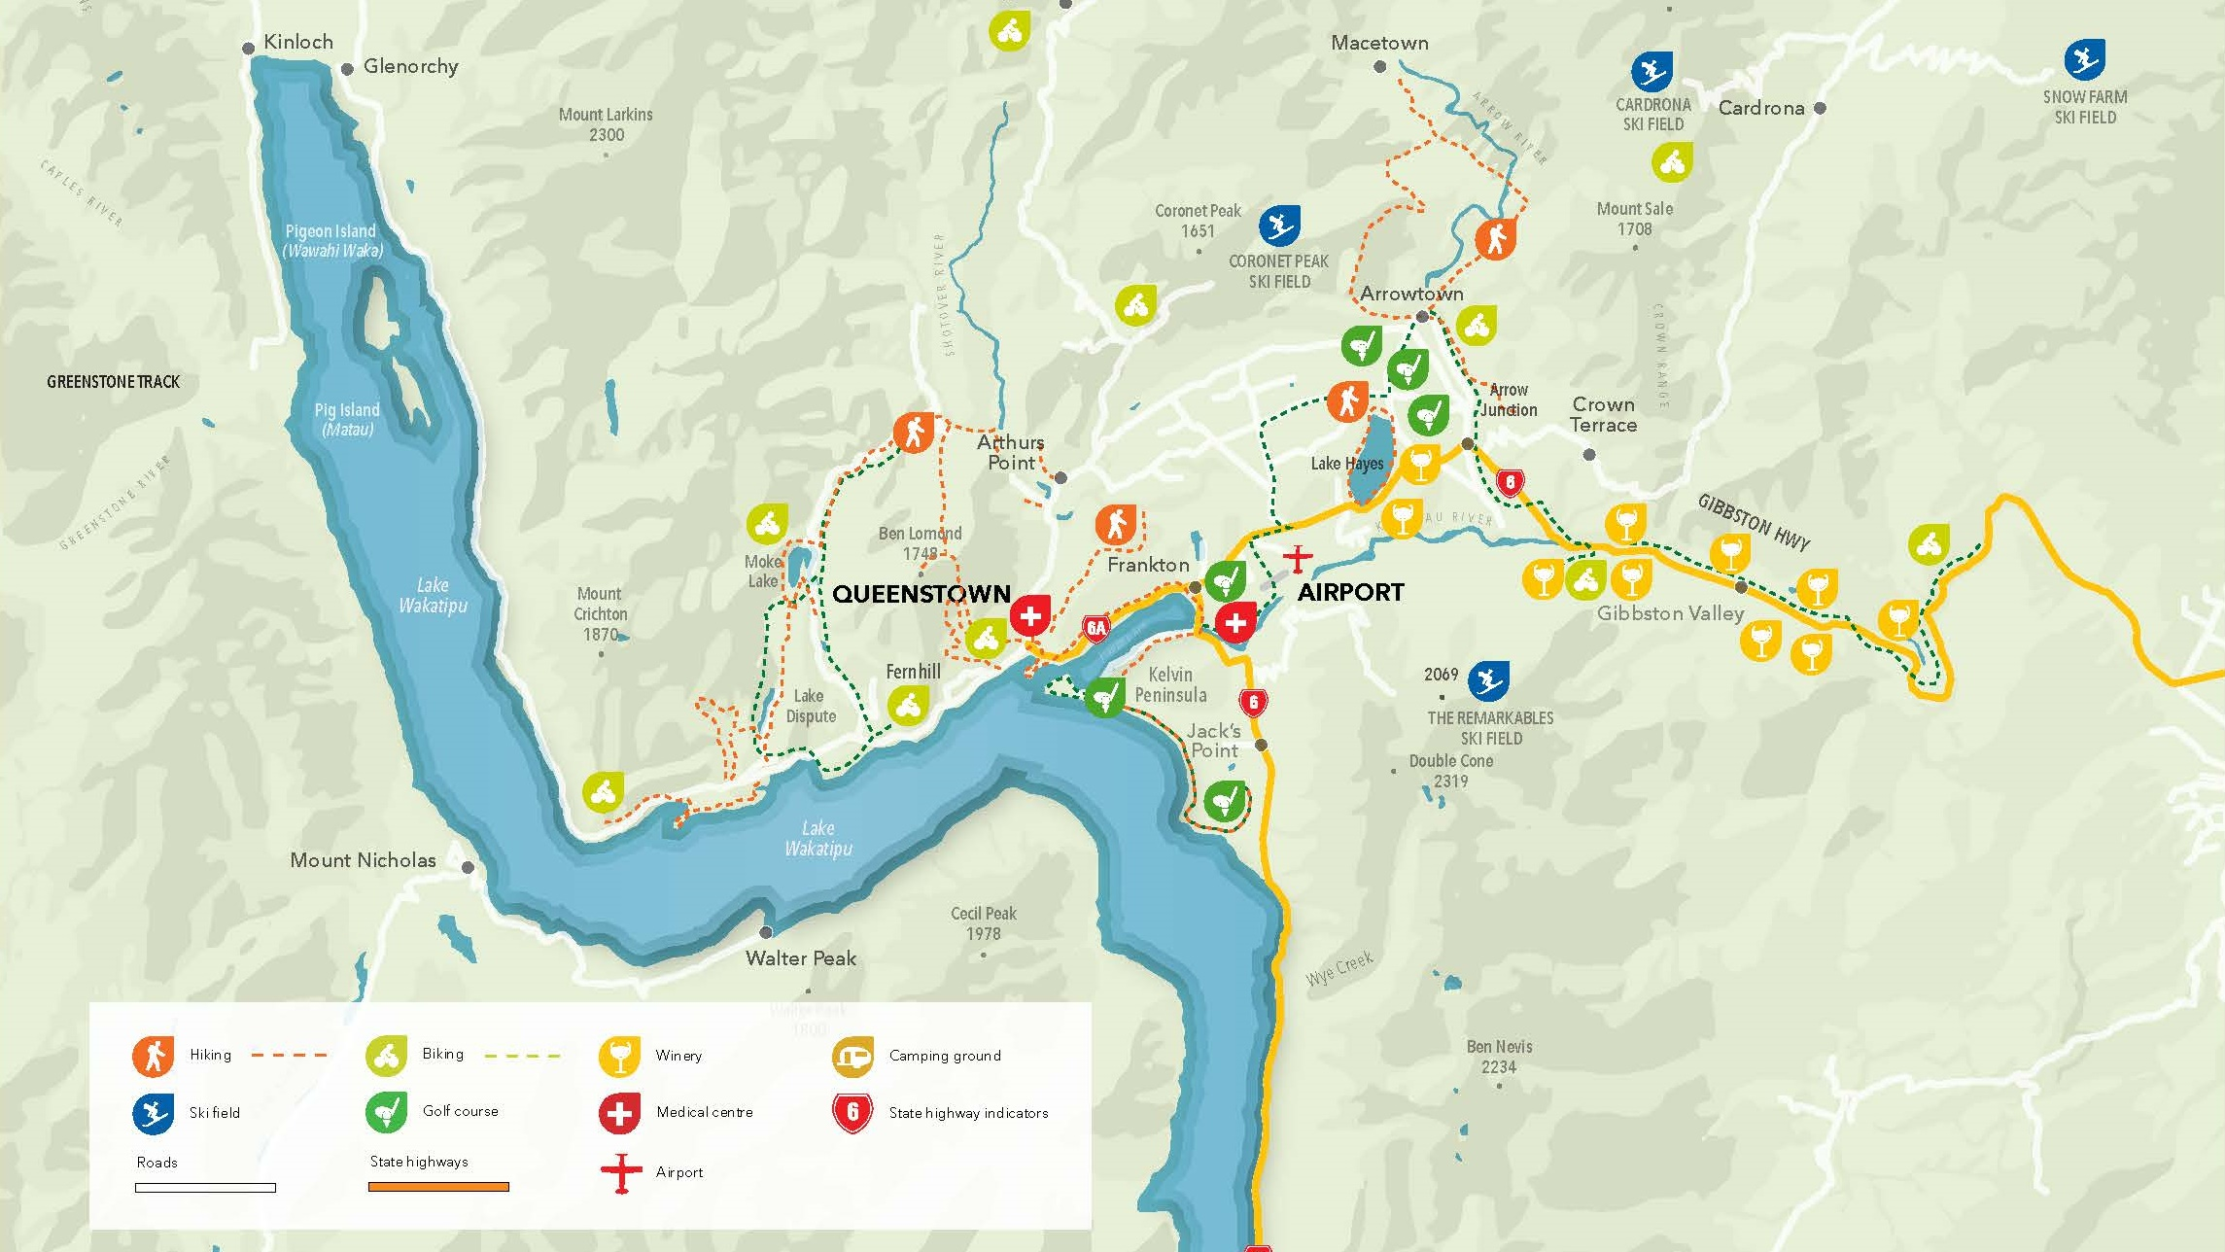
Notes:
Queenstown Central & surrounds.
This map provides an orientation for the proximity of the airport to Queenstown. Starting from the top of the lake with Glenorchy, which boarders our World Heritage Area is only 45 minutes from Queenstown.
The drive has been names one of the top 10 scenic drives in New Zealand and no drive is complete without a stop at Bennett's Bluff for the icon photo of Pig and Pigeon Islands in the foreground.
Coming back to Queenstown, you can also see Arrowtown, which is about 25 minutes drive from Queenstown. Here you will find the Chinese Village which is great for exploring. You could spend an entire day exploring Arrowtown.
If you were driving east off this map, you can also see out toward Gibbston Valley, which is also about a 25-minute drive and provides access to our world-renowned wine growing region.
You can also identify on this map Coronet Peak, The Remarkables, Cardona ski fields. With Treble Cone being a little further north than this map shows.

Slide 4
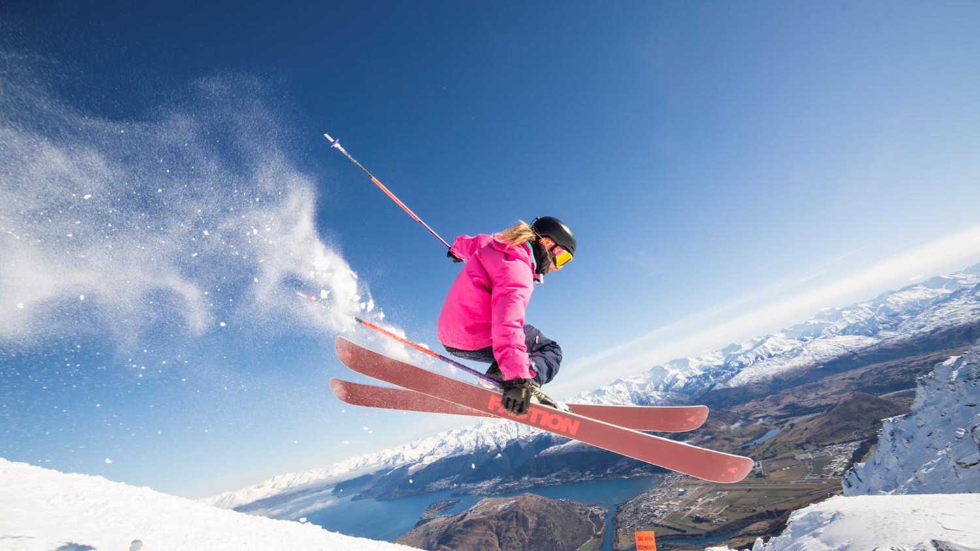
Ski & Snowboard
Choose from four ski area
Notes:
Predominately June to September
Temperatures between -2°C and 8°C
Set against a stunning backdrop of lakes and mountains, in the heart of the majestic Southern Alps, Queenstown is the Southern Hemisphere’s premier ski destination offering a true alpine experience.
Queenstown is a world-class ski destination with a range of accommodation options, quality services including rentals and transport and variety of off-mountain activities.
Vibrant nightlife and après ski scene, sophisticated food and wine culture with a choice of more than 150 bars and restaurants, boutique shopping and an extensive range of activities and attractions. Great for progression learning with purpose-built beginner slopes, consisting of a wide variety of terrain with lifts and chairs designed for beginner progression.
Known as the home of adventure, Queenstown’s fun-loving culture makes for an unforgettable winter holiday. Four ski resorts: Cardrona, Coronet Peak, Remarkables and Treble Cone.

Slide 5
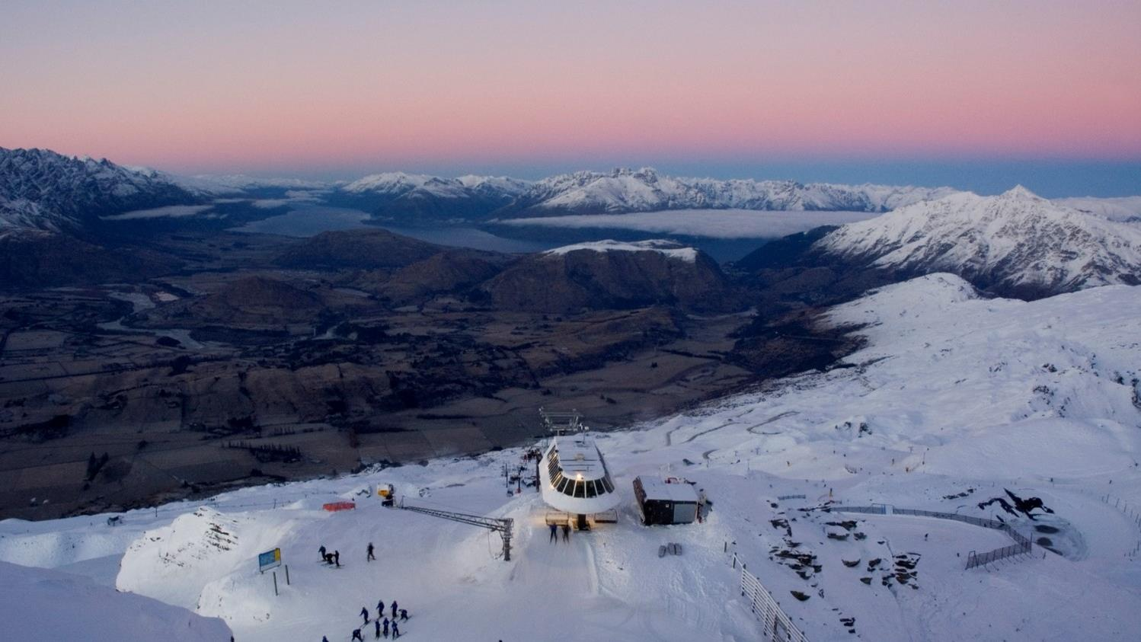
Coronet Peak
Notes:
25mins from Queenstown on a sealed access road
Elevation: 1649m (4947ft)
Vertical: 462m (1386ft)
Skiable Area: 280 Hectares (692 acres)
Terrain : Beginners 25%, Intermediates 45%, Advanced 30% (includes Back Bowls)
Only mountain that offers night skiing in New Zealand
Coronet Peak, the home of Good Times! Just 25 minutes from central Queenstown, the modern facilities, amazing views, roller coaster terrain make it the premier winter playground in New Zealand’s adventure capital.
Coronet Peak features ski terrain for all abilities from June to early October, the wide-open slopes and varied terrain make it a playground for skiers in winter and mountain bikers over summer. Coronet caters for all levels of skiers and snowboarders; experienced and friendly coaches help first-timers through to seasoned pros progress their skills on snow. Book your lesson, lift pass and rental equipment online and in advanced for an easy day on the snow!
You can hire your equipment on the mountain from the rentals department, with modern skis, snowboards and clothing for kids and adults. Easily accessible, you can drive the scenic alpine road or catch the Ski Bus from central Queenstown.
Coronet Peak is also the Home of Night Ski in New Zealand. Enjoy Après Ski, Queenstown style with epic sunsets, great vibes and laps of the mountain after dark. Keep an eye on the events page for our Night Ski parties. A bucket list activity for Queenstown in winter. Enjoy the alpine atmosphere in the cafes, restaurants, bars or in the locals favourite Heidi's Hut. Epic views and a wide variety in food available.
An extensive state -of-the-art, fully automated snowmaking system boosts Mother Nature’s snow helping coverage during the season, from the beginning of June to early October.
Learner and novice areas away from the main trails make learning fun and easy, while higher up, choose your slopes as you go – explore the contours and take in spectacular views.

Slide 6
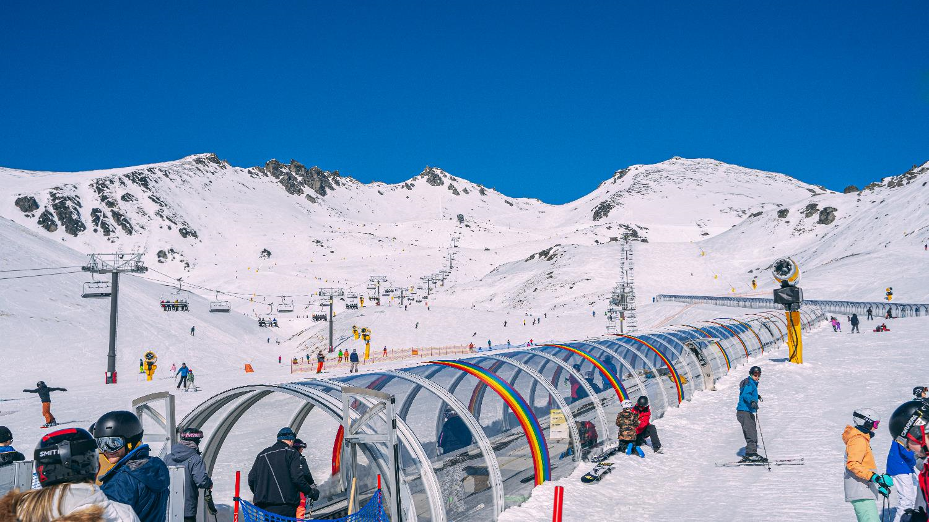
The Remarkables
Notes:
Average snowfall: 3.67 m/yr
Back country
Elevation: 1943m (5829ft)
Vertical: 357m (1071ft)
Skiable Area: 220 Hectares (544 acres)
Drive from town: 45 minutes (23.7kms)
Terrain: Beginners 30%, Intermediates 40%, Advanced 30%
2 x terrain parks and The Stash.
The famous Remarkables mountain range is all about fun, families freestyle and you finding your freedom! A scenic 40-minute drive from downtown Queenstown. What’s not to love about three sun-drenched, north-facing snow-filled bowls perfectly formed to cater for everyone from absolute beginners to powderhounds.
With over 350 hectares of terrain to explore, modern facilities and a new high-speed six-seater chairlift to Sugar Bowl, as well as 2.5km of new trails that were introduced for 2020. Explore the mountain at your own pace and enjoy kiwi hospitality from our cafes, restaurant or bar.
Equipment can be hired on the mountain for kids and adults of all abilities. Experienced and fun coaches are available for ski and snowboard lessons for everyone. A ski bus is available from central Queenstown and can be booked online or you can drive the scenic alpine road. Please check the website for weather and road conditions before heading up.
Sun-drenched slopes with terrain to keep all ability levels entertained, The Remarkables really is fun for everyone.

Slide 7
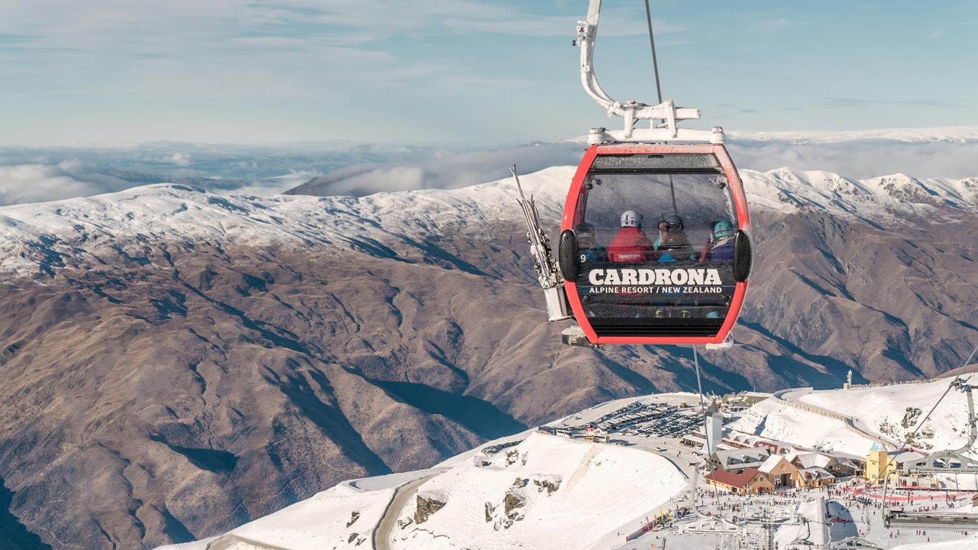
Cardrona Alpine Resort
Notes:
Average snowfall: 2.9 m/yr
Accommodation on mountain
Elevation: 1860m (5580ft)
Vertical: 600m (1800ft)
Skiable Area: 345 Hectares (852 acres)
Drive from town: 60 minutes (43.3kms)
Terrain: Beginners 25%, Intermediates 50%, Advanced 25%
2 halfpipes (including a 22ft Olympic superpipe), Big Air and a Gravity-Cross course
Only 60 minutes from Queenstown, Cardrona is a fun and family-friendly ski resort and a perfect place for beginners and intermediates.
Cardrona is New Zealand's fun and family-friendly ski resort with the most reliable snow conditions in the region. Only 60 minutes' drive from Queenstown and with its high elevation and southerly aspect it means dry natural snow is plentiful, which is further enhanced by snowmaking facilities.
Cardrona is the perfect place for beginners and intermediates, with NZ's only combined gondola chairlift, easy-to-use surface lifts, specialized beginner packages and plenty of wide-open trails spread over three basins. If you're up for a challenge, you'll find it in Arcadia, with secret powder stashes, chutes and cliff drops.
Cardrona is home to the NZ Park & Pipe Team & offers the most extensive terrain park facilities in the Southern Hemisphere with four terrain parks, two half pipes and a gravity-cross course. Boasting eight distinctly different cafes, fully licensed kids' centres, on-mountain accommodation, retail; ski & snowboard lessons; and a fully equipped rental department.

Slide 8
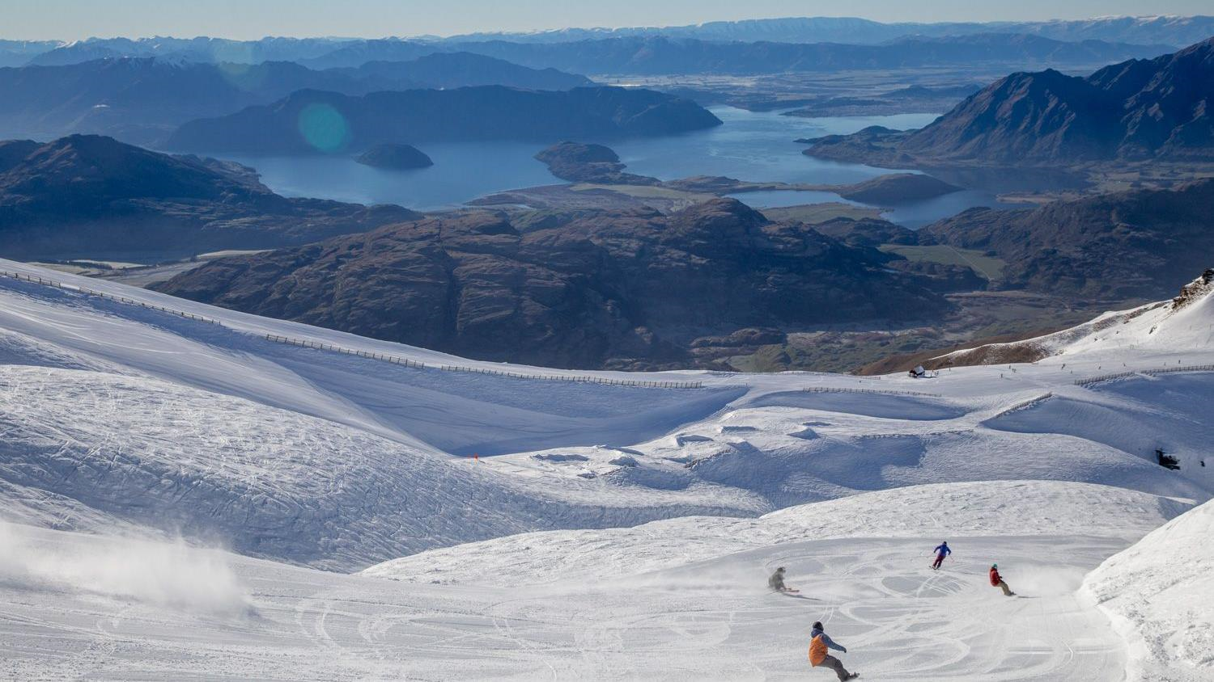
Treble Cone
Notes:
Elevation: 1960m (6,430ft)
Vertical Drop: 700m (2,321ft)
Ski Area: 550 hectares (1,359 acres)
Drive from Queenstown: 1.5 hours (90.5km)
Treble Cone, the largest ski area in NZ’s South Island, is famous for its long, uncrowded groomed runs, legendary off-piste terrain and unrivalled views over Lake Wanaka and the Southern Alps.
Located just a 35 minute scenic drive from Wanaka and a 90 minute drive from Queenstown via the Crown Range road.
Treble Cone is a must-do experience for skiers and snowboarders with a massive 700m of vertical, which also allows for some of New Zealand’s longest groomed trails and best free riding terrain.
If you're not quite ready to explore too far from the groomers just yet, Treble Cone's snow sports school can help you get up to speed- whatever your level. Treble Cone's learner area is located alongside the comforts of the Base lodge and café with the convenience of a fully kitted ski and snowboard rental shop.
Save time on the mountain and get prepared early. Visit our Wanaka (20 Helwick Street) or Queenstown (37 Camp Street) offices for a full range of ticketing and rental needs.

Slide 9
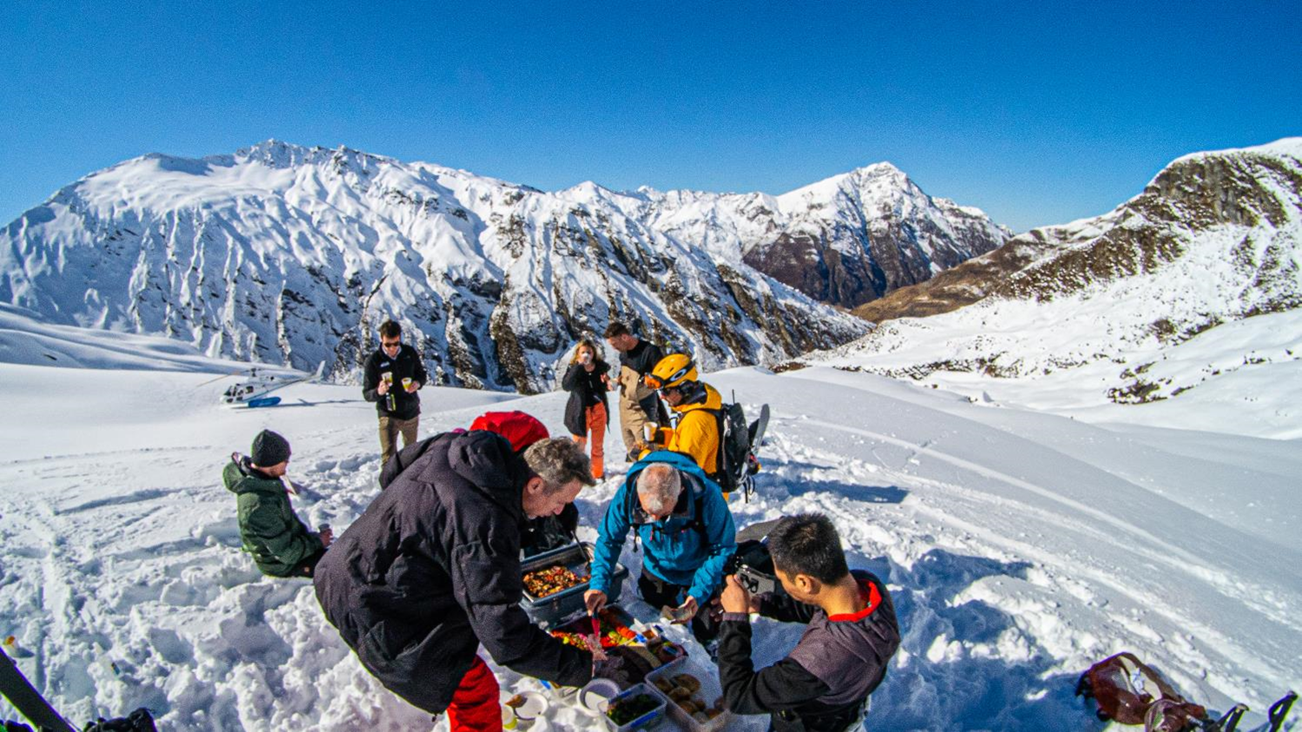
Heli-Skiing
Notes:
Heli Skiing & Heli Boarding is a great option if you're looking for the backcountry terrain and untouched fresh powder.
For the ultimate snow experience, choose a heli skiing and snowboarding trip and make the Southern Alps your very own winter playground.
Fully-guided experience. Big mountain experience. Variety of terrain. Different package/run options.

Slide 10
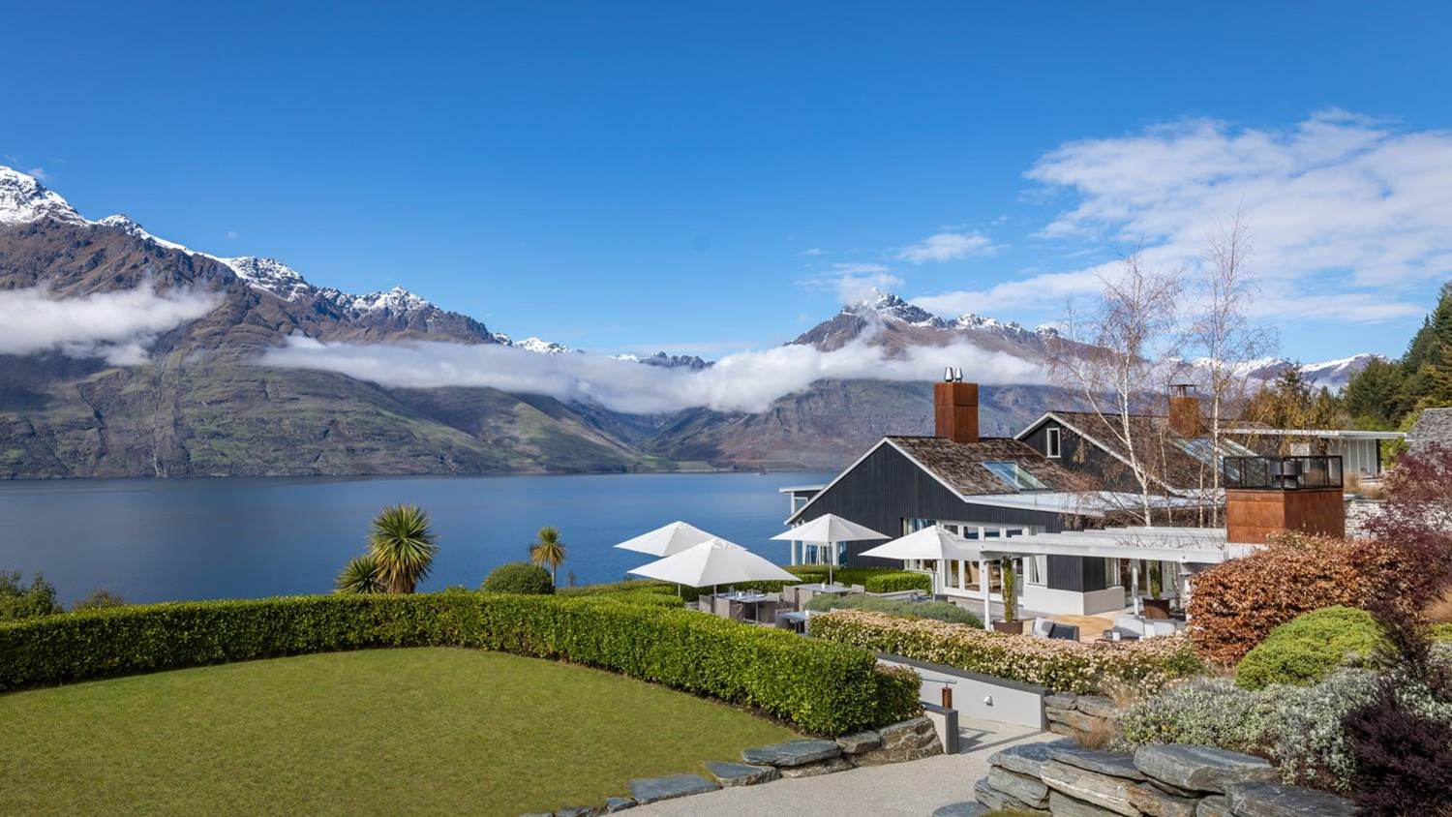
Accommodation
Notes:
Queenstown has a huge range of accommodation styles to suit every age and stage, style and budget when coming for a winter/ski holiday.
The budget conscious traveller can book into backpacker accommodation, and if you’re travelling with a tent or camper, Queenstown has a number of well-equipped and centrally located holiday parks. If you’re looking for a homely feel try one of Queenstown’s bed and breakfasts in surrounding Arrowtown or Glenorchy. Motels, are well suited for those on a driving holiday, and are dotted around town. There are many hotels and resorts located centrally within walking distance to Queenstown’s vibrant CBD. Queenstown’s award-winning luxury lodges and retreats show off stunning alpine views, and if you’re travelling with family and require shared accommodation, there are serviced apartments and holiday houses so you can self-cater with ease.
There’s a lot of variety when it comes to Queenstown's hotel and resort accommodation. Ranging from boutique hotels to internationally recognised resorts, many offer lake and alpine views of Queenstown's famed scenery.
Many large hotels and resorts are located centrally within walking distance of the town's centre. If you’re after something away from the hustle and bustle, hotels line the shores of Lake Wakatipu, and can be found close to the airport in Frankton or in neighbouring and quaint Arrowtown. With excellent facilities including restaurants that feature winelists rich with Central Otago vintages as well as spa, pool and sauna facilities, Queenstown’s hotel and resort accommodation is second to none.
Self-contained or serviced apartments in Queenstown range from private luxury apartments high in Queenstown’s hills to serviced apartments in the heart of town for those seeking out the nightlife close by. Private apartments offer travellers comfort and style where you can focus on your holiday without worrying about the everyday. Perfect for groups of friends, couples, and families, you can sit back, relax and enjoy the crystal-clear views of Lake Wakatipu.
Queenstown’s lodges and luxury retreats provide the very best in exceptional, private accommodation. From exclusive penthouses, to boutique five-star lodges and retreats, Queenstown is renowned internationally as a world-class destination for luxury accommodation, and bespoke premium experiences. You might find yourself at an exclusive hunting and fishing lake front lodge surrounded by mountains, or at a hidden lodge tucked away from the bustle of central Queenstown, for the ultimate four-season lake and alpine experience, pick one of New Zealand’s top lodges in the heart of the Southern Alps. Helicopter or jet boat transfers can be arranged to a number of luxury accommodation providers, you just have to ask. Pure indulgence is on the menu here in Queenstown.

Slide 11
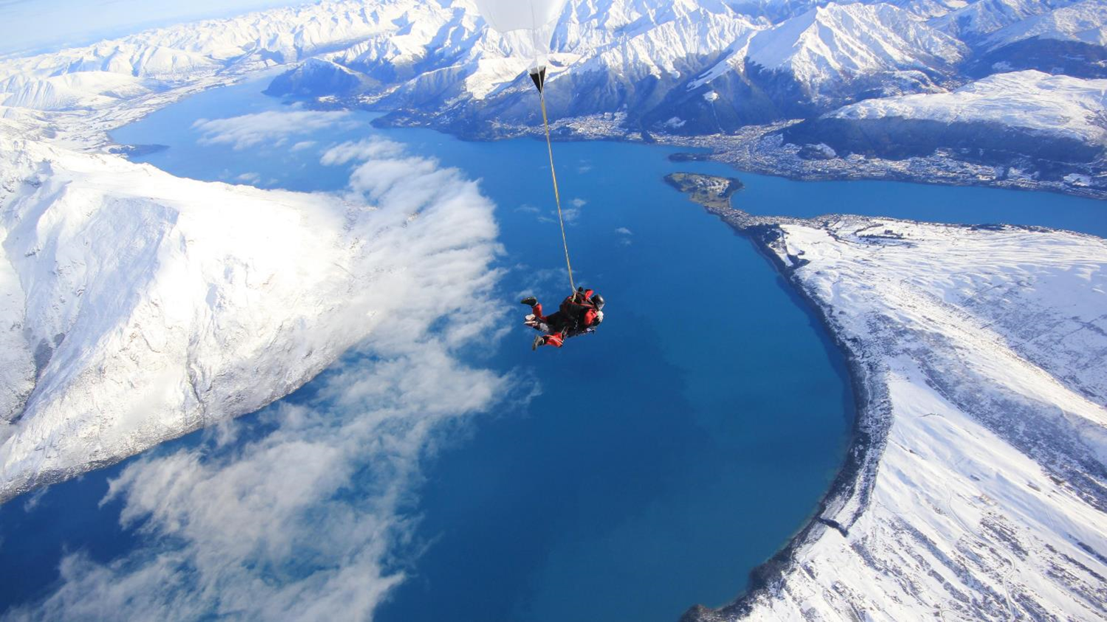
Off-Mountain Adventures
Notes:
Queenstown is a natural playground providing an incredible backdrop for a range of sights to see and things to do for adventurers of all persuasions.
Each of the seasons has its own special vibe in Queenstown, and the great thing is that most activities can be accessed all year round, even in winter!
Adventures
Queenstown is famous for its high-octane thrills so if you’re looking for an adrenaline rush or want to push your boundaries, there’s activities like bungy jumping, jet boating, skydiving, zip lining, paragliding, quad biking, supercar or four-wheel-driving—all guaranteed to get your blood pumping! If thrills and spills aren’t your thing, there’s lots more to see and do well beyond the mountains. Queenstown’s seven golf courses and renowned wineries are just a short drive away. Plus, there’s over 130km of walking and cycling trails which all link to popular scenic spots.
Relax and Rejuvenate
Ease those aching muscles after a day of adventure, or just treat yourself to some relaxation, Queenstown is the ultimate place for rejuvenation and revitalisation. Sit back, relax and soothe those muscles after a day on the slopes at one of Queenstown’s many luxurious hot pools. Indulge in some ‘me time’ on a wellness retreat which your body and soul will thank you for, or if you’d simply prefer an hour or two of quiet time, treat yourself at one of our luxury day spas.

Slide 12
Après Ski
Notes:
Winter in Queenstown is just as much about skiing and snowboarding as it is about the après ski.
The compact and vibrant town centre comes alive after dark with options for all styles and budgets.
When it comes to eating out, Queenstown’s innovative and award-winning cafés and restaurants offer cuisine to suit every palate.
Along with nearby Arrowtown, Queenstown is home to more than 150 eateries ranging from fine dining to fun dining.
Stylish bars, sophisticated clubs, Kiwi pubs and late-night hot spots also make Queenstown’s après ski atmosphere second to none.

Slide 13
Restaurants - Food & Drink
Notes:
Food and drink is one of those experiences that rounds out any day on the slopes.
Queenstown offers some of the best restaurants and bars in New Zealand. With delectable food and a great night out practically always on the menu.
There are more than 150 cafes and restaurants innovative and award-winning restaurants and eateries to cater for any occasion from fine dining to fun dining. And, our local chefs are really passionate about using local ingredients, and different seasons, always bring changes to menus to reflect the season’s freshest produce.
In downtown Queenstown you will find stylish bistro food, celebrity chef restaurants, traditional pub meals, designer burgers and a variety of ethnic cuisine. If you have special requirements, in Queenstown you can easily find delicious vegetarian, vegan, halal and gluten-free options.
Gibbston Valley is our wine growing region, and only 25 minutes drive from Queenstown. This area hosts some of the world’s best Pinot Noir and there are about 200 vineyards to sample wine from when you explore Gibbston Valley and beyond including Bannockburn, Bendigo and Cromwell. Biking/e-biking is also a popular option to explore Gibbston Valley for a half or full-day (even in winter).
Another experience that is really gaining some traction here also is craft beer with some local brewers, these little spots not only define some great hidden secrets but these craft beers also appear on many of our local bars menu selection, supporting the love and passion from our local brewers.
Food and wine really is an integral part of any holiday experience and Queenstown really does deliver!

Slide 14
Bars & Nightlife
Notes:
Food and drink is one of those experiences that rounds out any day on the slopes.
Queenstown offers some of the best restaurants and bars in New Zealand. With delectable food and a great night out practically always on the menu.
There are more than 150 cafes and restaurants innovative and award-winning restaurants and eateries to cater for any occasion from fine dining to fun dining. And, our local chefs are really passionate about using local ingredients, and different seasons, always bring changes to menus to reflect the season’s freshest produce.
In downtown Queenstown you will find stylish bistro food, celebrity chef restaurants, traditional pub meals, designer burgers and a variety of ethnic cuisine. If you have special requirements, in Queenstown you can easily find delicious vegetarian, vegan, halal and gluten-free options.
Gibbston Valley is our wine growing region, and only 25 minutes drive from Queenstown. This area hosts some of the world’s best Pinot Noir and there are about 200 vineyards to sample wine from when you explore Gibbston Valley and beyond including Bannockburn, Bendigo and Cromwell. Biking/e-biking is also a popular option to explore Gibbston Valley for a half or full-day (even in winter).
Another experience that is really gaining some traction here also is craft beer with some local brewers, these little spots not only define some great hidden secrets but these craft beers also appear on many of our local bars menu selection, supporting the love and passion from our local brewers.
Food and wine really is an integral part of any holiday experience and Queenstown really does deliver!

Slide 15
Travel Trade Resources
Notes:
For further resource you can check out our website www.queenstownNZ.nz and our trade pages www.queenstownNZ.nz/travel-trade
If you need suggestion for product operators for selling to your clients, please contact our team on trade@queenstownnz.nz and we can share the appropriate sales and marketing contact for you.

Slide 16
Thank You
Destination Queenstown Travel Trade
50 Stanley Street,
Queenstown, 9300
New Zealand
Trade Team
E: trade@queenstownNZ.nz
P: +64 3 441 0700

