Slide 1
Destination Queenstown
Romance & Honeymoon

Slide 2
Notes:
Getting to Queenstown is easy whether you decide to fly, drive or catch a coach.
Queenstown International Airport receives daily direct flights from around New Zealand and Australia's main ports, and great road access on major New Zealand highways makes driving into Queenstown an easy and beautiful experience. Exploring the region once you’re in Queenstown is simple with a range of local transport options.
Where is Queenstown?
Queenstown is located in the southwest corner of the South Island of New Zealand and is very accessible with multiple daily direct flights from all of New Zealand’s main centres as well as direct scheduled services from Sydney, Brisbane, Melbourne and Coolangatta in Australia. Queenstown international airport is located just 15 minutes from downtown Queenstown and links to the city centre with shuttles, taxi services, buses and rental cars.
For visitors that chose to drive, experiencing the beautiful Southern Scenic Route through Otago and Southland is a stunning way to arrive in Queenstown or meander down the South Island from the West Coast or Canterbury, taking your time to take in the scenery along the way.

Slide 3
Notes:
Fly to Queenstown
Queenstown airport is the gateway to the lower South Island. Located 15 minutes from downtown Queenstown, the Queenstown international Airport services the region with daily domestic flights and regular direct trans-Tasman flights. It receives direct scheduled services from New Zealand’s main metropolitan ports of Auckland, Wellington and Christchurch which provide strong regional links throughout the country, as well as from the Australian cities of Brisbane, Coolangatta, Sydney and Melbourne. Auckland and Sydney airports are the major international hub airports for long haul visitors and some international airlines also fly to Christchurch Airport.
Four major airlines provide scheduled services in and out of Queenstown Airport. Air New Zealand and Jetstar offer both domestic and international flights to and from Queenstown and Qantas and Virgin Australia fly internationally between Queenstown and east coast Australia.
In 2016 after dark flights were introduced to Queenstown, opening up even more convenient travel options, with evening flights to and from both Auckland and Australia now available.
Queenstown Airport is also New Zealand’s busiest helicopter base and is heavily used for ‘flightseeing’ on fixed-wing and rotary-wing aircraft. There are many great products available for visitors to explore the region by air.

Slide 4
Notes:
Getting Around
Once you arrive in Queenstown getting around is easy, whether you hire your own car, use the $2 public bus network which links Queenstown’s main suburbs and outlying areas or explore the region by foot or cycle on the Queenstown Trail.
Many local activity operators also offer free transport from the town centre and hotels making it easy to get out and about and experience what the region has to offer. The compact downtown area of Queenstown means many restaurants, attractions and accommodation are within walking distance of each other and can be reached easily on foot so you can leave the car behind.
If you prefer to self-drive, Queenstown is home to the best known rental car brands from around New Zealand and the world. With car rental outlets at Queenstown International Airport, and in downtown Queenstown, picking up or dropping off your rental vehicle is easy and convenient.
Campervans and motorhomes are a great way to explore the Queenstown region and hiring a campervan or motorhome in Queenstown is easy, with both internationally recognised and local vehicle hire companies operating in the town centre or airport.
For the ultimate convenience there are multiple taxi and limousine services available in and around Queenstown.
For information on real time transport options while in Queenstown, download the Choice App.

Slide 6
Notes:
Queenstown region map to show Glenorchy, Arrowntown, Gibbston valley, golf courses etc – email sent to feast

Slide 7
Accommodation
Notes:
Queenstown is a natural playground providing an incredible backdrop for a range of sights to see and things to do for adventurers of all persuasions.
Each of the seasons has its own special vibe in Queenstown, and the great thing is that most activities can be accessed all year round. World-renowned for its adventure, Queenstown is home to a huge choice of adrenaline activities including jet boating, bungy jumping, white water rafting, skydiving and even indoor thrills – all guaranteed to get your blood pumping!
When the cooler months arrive Queenstown transforms into a world class winter resort, with four ski areas and a range of activities, bars, restaurants and relaxation to make sure your winter holiday is as epic as possible.
You can even combine a round of golf at one of Queenstown’s gorgeous clubs one morning with a tour of some of our wineries and cellar doors in Gibbston and further afield to discover just why Central Otago Pinot Noir is famous on the world stage.
If you’re looking for a slightly slower pace there’s plenty of recreational activities including hiking and biking trails to explore, guided tours, boat cruises, scenic flights or spa and wellness options to help you get away.

Slide 8
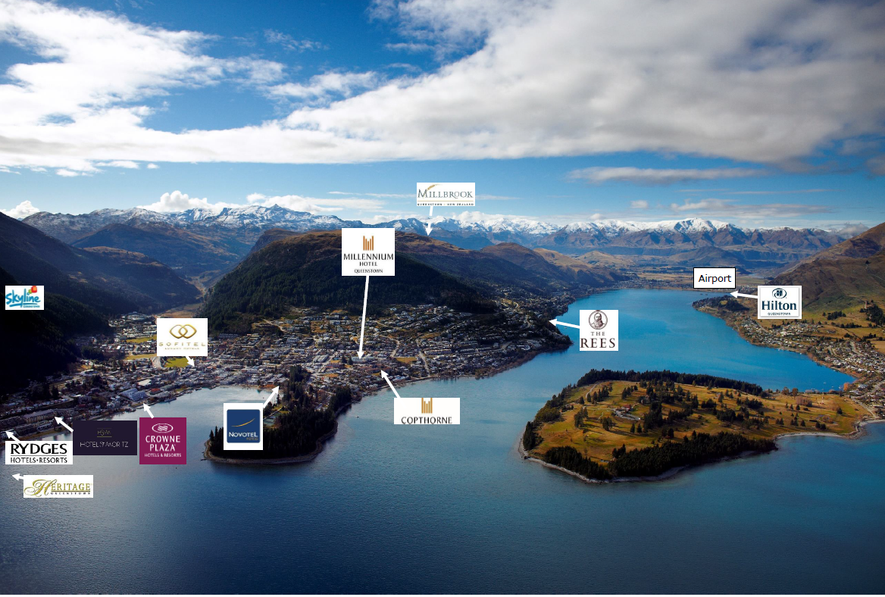
Notes:
Talk about different types of accommodation and distance to downtown and airport. There will be 1200 hotel rooms coming online in next 2 years.

Slide 9
Luxury lodges

Slide 10
Room with view
Notes:
The Rees, Azur, St Moritz and Hilton., Crowne Plaza.

Slide 11
Unique accommdation

Slide 12
Activity
Notes:
Queenstown is a natural playground providing an incredible backdrop for a range of sights to see and things to do for adventurers of all persuasions.
Each of the seasons has its own special vibe in Queenstown, and the great thing is that most activities can be accessed all year round. World-renowned for its adventure, Queenstown is home to a huge choice of adrenaline activities including jet boating, bungy jumping, white water rafting, skydiving and even indoor thrills – all guaranteed to get your blood pumping!
When the cooler months arrive Queenstown transforms into a world class winter resort, with four ski areas and a range of activities, bars, restaurants and relaxation to make sure your winter holiday is as epic as possible.
You can even combine a round of golf at one of Queenstown’s gorgeous clubs one morning with a tour of some of our wineries and cellar doors in Gibbston and further afield to discover just why Central Otago Pinot Noir is famous on the world stage.
If you’re looking for a slightly slower pace there’s plenty of recreational activities including hiking and biking trails to explore, guided tours, boat cruises, scenic flights or spa and wellness options to help you get away.

Slide 13
Air activity
Notes:
Queenstown has been shaped by many different cultures and lifestyles from its earliest days—but it’s adventure that has the most lasting mark on those who visit or choose to live here. Queenstown is the adventure capital of the world! Home to the latest and greatest adventures, there are Queenstown adrenaline activities for every thrill-seeker, from iconic Queenstown bungy jumping to whitewater rafting, river surfing, canyon swinging and thrills on a jet boat. From indoor thrills and spills to adventures high above the clouds, in the water or on the land, there are so many innovative ways to explore Queenstown and it surrounds it might be hard to choose how to go about it. Find weird and wacky trips to satisfy your curiosity, speeding beneath the lake’s surface in a shark-like submersible, or why not add a chair or hang upside down on your swing trip?
There are also companies in Queenstown that specialise in creating adventure combos, or you can enquire with your preferred adventure activity provider to see what combos they offer.
Air Adventures in Queenstown-Take to the skies above Queenstown and try out skydiving, hang gliding, paragliding or an exhilarating scenic flight over our lakes and mountains.
Queenstown is known for its extreme adventure activities and stunning scenery, so what better place to try something unforgettable like jumping out of a plane at 15,000ft? Or leaping from a cliff attached to a hang glider? Skydiving, hang gliding and paragliding in Queenstown offer a thrilling experience you'll truly never forget. These adventures all start in Queenstown, but take you high above the town for the most spectacular views and thrilling experiences. Queenstown skydiving, paragliding and hang gliding operators are all fully qualified and have top safety records, so you can relax and enjoy the ride. There is also plenty of opportunity for scenic helicopter or plane flights for those who want to get into the air but aren’t so keen on the adrenalin part. Take a short flight over mountains, or a longer trip to Fiordland to land on a dramatic West Coast beach, a remote farm or even on a glacier to explore the ice. You'll enjoy incredible aerial views of the lakes, mountains and town as you soar, fly, float or fall from the sky above Queenstown.
Queenstown-Bungy, Swing& Zip- Take a leap of faith with a Queenstown bungy jump, flying fox or bungy swing! Not only is Queenstown the bungy capital of New Zealand’s adventure industry, it’s ground-zero for commercial bungy jumping anywhere in the world. After making international headlines by bungy jumping from the Eiffel Tower in 1987, AJ Hackett and business partner Henry van Ache launched the world’s first bungy business here in Queenstown, on the historic Kawarau Bridge. Since then, Queenstown has become home to some of the world's most thrilling swinging and flying adventures. Zip through the forest at high speed on a flying fox, on the highest flying fox in the Southern Hemisphere, or try out the world's highest swing hundreds of metres above the valley floor.
Water Adventures in Queenstown- Surrounded by beautiful lakes, rivers and fiords, Queenstown is an ideal destination for all your favourite water activities, and some you may not have discovered yet.
You can embark on a leisurely boat cruise, a thrilling jet boat ride through steep ravines or across the open waters of Lake Wakatipu, or explore deep canyons around the region on a canyoning escapade. Meanwhile, parasailing lifts you high above the lake as you sail along behind a boat, enjoying the thrill of the ride and the beautiful scenery from above. With a few hours to spare you could enjoy a relaxing canoeing or kayaking trip down a pristine river, across a sparkling lake or on a remote fiord. Kayaking and canoeing excursions in Queenstown are great for the whole family, and for travellers looking to join a social group activity. The ultimate in water adventures in Queenstown will take you back to the rivers, where you can go whitewater rafting or river surfing. Take your pick from heli-rafting, family rafting, river boarding, river surfing, Queenstown offers a grade of rapids for everyone, from beginners to advanced whitewater enthusiasts. So whether you’re an expert or a complete novice, get out there and get wet! Queenstown is well known for its iconic jet boating! Experience the thrill of a high speed Queenstown jet boat ride: skim across the water, whizz round corners and shoot through narrow rocky gorges! In Queenstown you can choose from a number of world famous jet boat operators.
Land Adventures in Queenstown- Get off the beaten track with an off road adventure or land tour in Queenstown!
Queenstown 4WD and off road tours take you deep into the back country, where few people have ventured before. You'll experience some of the most remote and stunning scenery in New Zealand from the comfort of your specialised vehicle, get to enjoy the thrill of four-wheel-driving, quad biking or in an off road buggy. If a slower pace is what you’re looking for there’s horse riding operators who can take you on a journey through Lord of the Rings film locations, or into Queenstown’s frontier history on farm land and foothills. Road hogs, you’re not left out either, there’s motorcycle tours that explore some of our most incredible roads. Drive out to Glenorchy, or to Kingston on the winding highways that follow the lake’s edge.

Slide 14
Air activity

Slide 15
Land activity

Slide 16
Sightseeing
Notes:
Queenstown sightseeing tours and activities are an ideal way to take in the region’s breathtaking natural beauty.
Take to the air on a scenic flight, cruise across Lake Wakatipu and see the mountains from a new perspective, or be carried high over Queenstown in a gondola and take in the views, there are activities for all travellers.
Let your knowledgeable guide inform and inspire as you drive, walk, taste or fly your way around the Queenstown area.
Queenstown scenic flights offer an exceptional way to see the beautiful region.
View the stunning alpine and lake scenery from the air with a scenic helicopter, fixed-wing flight, hot air balloon or flight charter. Fly from Queenstown over to Fiordland, or enjoy the thrill of a snow landing high in the alps, complete with a picnic! Choose from a short scenic flight, take to the air on a balloon as the sun rises, or a full day excursion incorporating other adventure activities with your flying experience, from rafting to snowboarding, skiing and downhill mountain biking.
Join a Queenstown scenic tour to experience the natural beauty of New Zealand's Southern Lakes and landscapes.
Embark on a city tour, a buggy tour, farm tour by foot or on a horse trekking journey. Or, take an off road tour to discover some of Queenstown’s gold mining history, go quad biking high over Queenstown or indulge in wine tours and tastings.
Regardless of whether you travel on foot, by car, motorcycle, or horseback, a scenic tour around Queenstown showcases the area's famous mountain peaks, tranquil lakes and rivers, striking canyons and beautiful national parks.
Take to the region's lakes and fiords with a boat cruise in Queenstown and beyond!
The Southern Lakes region is home to some of New Zealand's most beautiful waterways, including Lake Wakatipu in Queenstown, as well as Lake Wanaka, Lake Te Anau and Milford Sound in the wider region.Fiordland is one of the most popular areas of New Zealand—and for good reason, cruising through the soaring mountains, deep waters and witnessing the abundant wildlife in their element is an incredible experience. There are a number of companies that offer transfers to Milford and Doubtful Sounds from Queenstown, and there are even overnight cruise options!
Select a leisurely lake cruise to experience the tranquility and beauty of boating in New Zealand.
Step into Middle-earth and beyond. Walk where hobbits walked, or drive the same road as Wolverine.
The Queenstown region is home to some of New Zealand’s most dramatic scenery and its towering mountains, ancient beech forests and glacial fed rivers have provided inspirational backdrops for many productions, with filmmakers and Hollywood stars alike falling under its spell.Feature films shot here include The Hobbit: An Unexpected Journey, The Lord of the Rings trilogy, The Lion, the Witch and the Wardrobe, Vertical Limit, 10,000 BC, The Water Horse, 30 Days of Night, Wolverine, Prince Caspian, Any Questions for Ben?, and the Bollywood super-hit I Hate Luv Storys.
Take specialised tours to New Zealand film locations located in the Queenstown region that are even more stunning in real life and put yourself in a film set for the day.
Discover just why Queenstown and Central Otago is home to some of the world’s best Pinot Noir on a tasting tour of our wineries and cellar doors.
Many wineries now bottle a number of varieties, so there’s something to pique the taste buds of all wine lovers on an organised car tour, or hop on a bike to ride through Gibbston’s vines (with a much-welcomed shuttle at the end of the day). For something truly special there are even helicopter tours.
Or, you might find yourself in Queenstown’s very own wine cave at one of the wineries where it all began in the 1980s.
A number of tour operators depart central Queenstown and tour a selection of Arrowtown, Queenstown and Gibbston wineries.
If you’re having trouble deciding what to buy on tour, no worries! There are food and wine stores in both Queenstown and Arrowtown with a wide selection of vintages from here and around New Zealand.

Slide 17
Day trips
Notes:
Day trip to MF, DS, Wanaka, Glenorchy, and Central Otago……

Slide 18
Spas & Massages

Slide 19
Shopping & Art Gallery

Slide 20
Notes:
more than 200 wineries in Central Otago region. Many wineries have restaurants and cellar doors for FITs and group dining options are also available.

Slide 21
Winery

Slide 22
Restaurants & Bars
Notes:
Queenstown offers some of the best restaurants and bars in New Zealand. Delectable food and a great night out are always on the menu. Food is an integral part of your holiday experience, and Queenstown is renowned globally for its great food, wine and legendary nightlife. Whether you want to taste the flavours of the region and savour the local produce, or you’re after something virtuous with healthy eating top of mind, the Queenstown food scene has you covered. There are over 150 bars and cafes in the Queenstown region, with everything from fine dining, restaurants owned by celebrity chefs, family-friendly eateries to boutique dessert diners. Not to mention award-winning cafes and iconic burger joints that command a serious following.
If you have special requirements, in Queenstown you can easily find delicious vegetarian, vegan, halal and gluten-free options. The perfect foodie day-Start your day off right at one of Queenstown’s many cafes, where expert baristas craft coffee to fuel you. Or perhaps have a lazy brunch or lunch lake side. If it’s takeaways you’re after, grab a giant gourmet burger and meander down to the lakefront, or pick up sushi, a pie or some pastry and pack a picnic basket for the day’s adventures. Settle in for the evening at a cosy wine bar or friendly pub or hot the town and experience Queenstown’s legendary night life, and discover the vibrant atmosphere, any night of the week. Learn more about Queenstown's food offerings, but be warned, there’s so much to choose from you’ll have to return to Queenstown for another taste.
Add wineries !!!

Slide 23
Restaurants
Notes:
More than 150 restaurants and bars in downtown Queenstown. Many options s available. Fine dining, family dining, restaurants with views, group dining options and more.

Slide 24
Bars

Slide 25
Winery restaurant

Slide 26
www.queenstownNZ.nz/trade

