Slide 1
Winter And Ski

Slide 2
Winter in Queenstown
Nestled in the heart of the Southern Alps, Queenstown is the ultimate ski holiday destination.
Queenstown offers a choice of four world-class ski resorts within a short 20-90-minute drive of the vibrant town centre. The perfect winter base to hit the slopes of Coronet Peak, The Remarkables, Cardrona and Treble Cone, there’s something suitable for all abilities and styles.
The range of iconic off-mountain activities and an endlessly epic après-ski scene, rounded off by sophisticated accommodation options and high-quality services including ski hire and transport on and off the mountains make Queenstown a top winter destination.
Notes:
- Four mountains four ways – Queenstown is the ultimate ski holiday destination in NZ (Coronet Peak, The Remarkables, Cardrona and Treble Cone)
- Long ski season from June to October
- Ski passes range from single day, to multi-day and season passes, allowing access to multiple Queenstown ski fields
- It’s easy to hire gear in town or on the mountain. Book lessons with seasoned pros that cater for all levels and abilities.
- Each ski area offers mountain transport – book your seat on the bus, departing regularly from downtown Queenstown
- The fun doesn’t stop when the chairlifts do – wine bars, pubs, nightclubs – Queenstown’s apres-ski offering is the perfect end to a day on the slopes

Slide 3
Coronet Peak
New Zealand’s first commercial ski field, Coronet Peak features wide-open slopes and rollercoaster terrain making it the ultimate playground for skiers and snowboarders.
Queenstown’s local mountain offers a variety of terrain for all levels and on-mountain facilities including restaurants, cafes, bars and gear hire, set against the grand backdrop of the Whakatipu basin.
As the home of Night Ski, Coronet Peak lights up for skiing after dark with epic sunsets and great vibes – it’s après-ski, Queenstown style.
Notes:
- Just a 20-minute drive from downtown Queenstown
- Three lifts and a t-bar – 280 hectares of skiable terrain for all abilities and styles
- Mountain transport and on-mountain gear hire
- Home of night ski and countless winter events and on the slopes – also offers first tracks
Coronet Peak, the home of Good Times! Just 25 minutes from central Queenstown, the modern facilities, amazing views, roller coaster terrain make it the premier winter playground in New Zealand’s adventure capital.
Coronet Peak features ski terrain for all abilities from June to early October, the wide-open slopes and varied terrain make it a playground for skiers in winter and mountain bikers over summer. Coronet caters for all levels of skiers and snowboarders; experienced and friendly coaches help first-timers through to seasoned pros progress their skills on snow. Book your lesson, lift pass and rental equipment online and in advanced for an easy day on the snow!
You can hire your equipment on the mountain from the rentals department, with modern skis, snowboards and clothing for kids and adults. Easily accessible, you can drive the scenic alpine road or catch the Ski Bus from central Queenstown.
Coronet Peak is also the Home of Night Ski in New Zealand. Enjoy Après Ski, Queenstown style with epic sunsets, great vibes and laps of the mountain after dark. Keep an eye on the events page for our Night Ski parties. A bucket list activity for Queenstown in winter. Enjoy the alpine atmosphere in the cafes, restaurants, bars or in the locals favourite Heidi's Hut. Epic views and a wide variety in food available.
An extensive state -of-the-art, fully automated snowmaking system boosts Mother Nature’s snow helping coverage during the season, from the beginning of June to early October.
Learner and novice areas away from the main trails make learning fun and easy, while higher up, choose your slopes as you go – explore the contours and take in spectacular views.

Slide 4
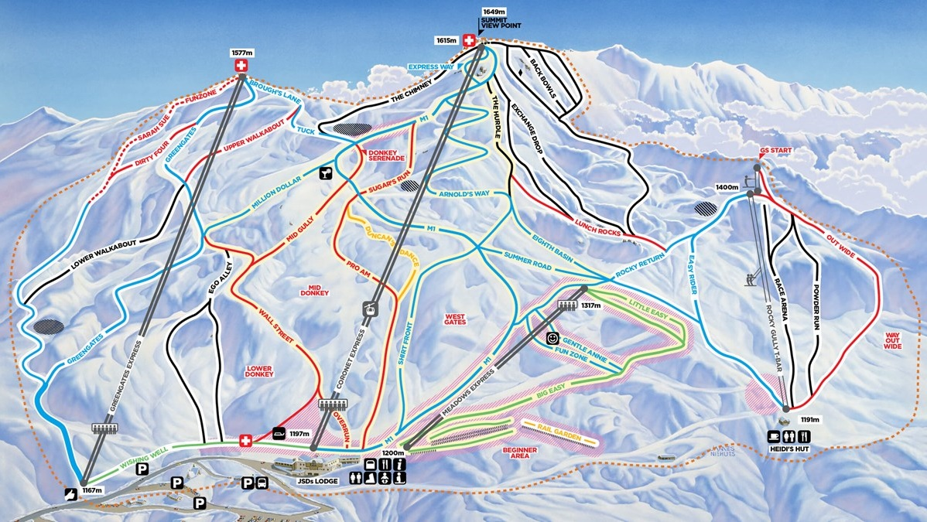
Coronet Peak
Elevation
1649m (4947ft)
Vertical
462m (1386ft)
Skiable Area
280 Hectares (692 acres)
Terrain
Beginners 25%
Intermediates 45%
Advanced 30%
Notes:
25mins from Queenstown on a sealed access road
Elevation: 1649m (4947ft)
Vertical: 462m (1386ft)
Skiable Area: 280 Hectares (692 acres)
Terrain : Beginners 25%, Intermediates 45%, Advanced 30% (includes Back Bowls)
Only mountain that offers night skiing in New Zealand – Weds & Fri nights 4-9pm (mid-June to end Aug)

Slide 5
The Remarkables
Experience big mountain terrain, sun-soaked chutes and untouched snow at The Remarkables.
Just 45-minutes from Queenstown, The Remarkables offers terrain and facilities to suit first-timers to seasoned skiers and snowboarders, with over 350ha of terrain to explore, sun-soaked slopes, modern facilities, cafes, restaurants and an Ice Bar.
Boasting seven terrain parks, a large learner's area and a new chairlift for the 2025 season, The Remarkables is all about fun, families, freestyle and finding your freedom.
Notes:
The famous Remarkables mountain range is all about fun, families freestyle and you finding your freedom! A scenic 40-minute drive from downtown Queenstown. What’s not to love about three sun-drenched, north-facing snow-filled bowls perfectly formed to cater for everyone from absolute beginners to powderhounds.
With over 350 hectares of terrain to explore, modern facilities and a new high-speed six-seater chairlift to Sugar Bowl, as well as 2.5km of new trails that were introduced for 2020. Explore the mountain at your own pace and enjoy kiwi hospitality from our cafes, restaurant or bar.
Equipment can be hired on the mountain for kids and adults of all abilities. Experienced and fun coaches are available for ski and snowboard lessons for everyone. A ski bus is available from central Queenstown and can be booked online or you can drive the scenic alpine road. Please check the website for weather and road conditions before heading up.
Sun-drenched slopes with terrain to keep all ability levels entertained, The Remarkables really is fun for everyone.

Slide 6
The Remarkables
Elevation
1943m (5829ft)
Vertical
357m (1071ft)
Skiable Area
220 Hectares (544 acres)
Terrain
Beginners 30%
Intermediates 40%
Advanced 30%with two terrain parks and The Stash
Notes:
Average snowfall: 3.67 m/yr
Back country
Elevation: 1943m (5829ft)
Vertical: 357m (1071ft)
Skiable Area: 220 Hectares (544 acres)
Drive from town: 45 minutes (23.7kms)
Terrain: Beginners 30%, Intermediates 40%, Advanced 30%
2 x terrain parks and The Stash.

Slide 7
New Shadow Basin Chairlift
Opening June 2024
The new higher chairlift alignment increases lift-accessible terrain in Shadow Basin by 47ha, which is nearly 50% more than the existing chairlift.
From 8 minutes to 4 minutes travel time
6-seater express chairlift
Increases lift capacity from 1500 riders to 2400 per hour
Suitable for intermediate, advanced and expert skiers and riders
Notes:
The new higher chairlift alignment increases lift-accessible terrain in Shadow Basin by 47 hectares, which is nearly 50% more than the existing chairlift. Some of The Remarkables best advanced and expert freeride runs will now be accessible directly from the lift, without the need to hike, including Alta Chute, Boulder Basin, East-Face, The Nose, Front Face and Sunrise Face, while Elevator and Escalator chutes will be just a short bootpack away. The groomed, intermediate-level Calypso Trail will also be extended by 363m, providing even more fun and flowy on-piste terrain.
Opening June 2024
Key Points:
50% More Terrain
From 8minutes to 4 minutes travel time
Detachable chairs and padded seats
Easier and more comfortable to ride
6 people chair instead of 4
Increases lift capacity from 1500 riders to 2400 per hour
Suitable for intermediate, advanced and expert skiers & riders
Facilities – the bottom station will be rebuilt at the similar site- and a covered chair parking will be built to house the chairs during bad weather overnight. This helps ensure the chairlift will open on time in the AM and reduce wear

Slide 8
Cardrona
Cardrona is New Zealand's fun and family-friendly ski resort only 60 minutes' drive from Queenstown.
Cardrona is the perfect place for beginners and intermediates with 465ha of wide-open trails spread over three basins and a new chairlift into Soho Basin opening up another 150ha in 2025. Boasting eight distinctly different cafes, fully licensed kids' centre, on-mountain accommodation, lessons and packages, as well as a fully equipped rental department.
Cardrona also features four terrain parks, two half pipes and a gravity-cross course.
Notes:
Cardrona is New Zealand's fun and family-friendly ski resort with the most reliable snow conditions in the region. Only 60 minutes' drive from Queenstown and with its high elevation and southerly aspect it means dry natural snow is plentiful, which is further enhanced by snowmaking facilities.
Cardrona is the perfect place for beginners and intermediates, with NZ's only combined gondola chairlift, easy-to-use surface lifts, specialized beginner packages and plenty of wide-open trails spread over three basins. If you're up for a challenge, you'll find it in Arcadia, with secret powder stashes, chutes and cliff drops.
Eight distinctly different cafes, fully licensed kids' centres, on-mountain accommodation, retail; ski & snowboard lessons; and a fully equipped rental department.

Slide 9
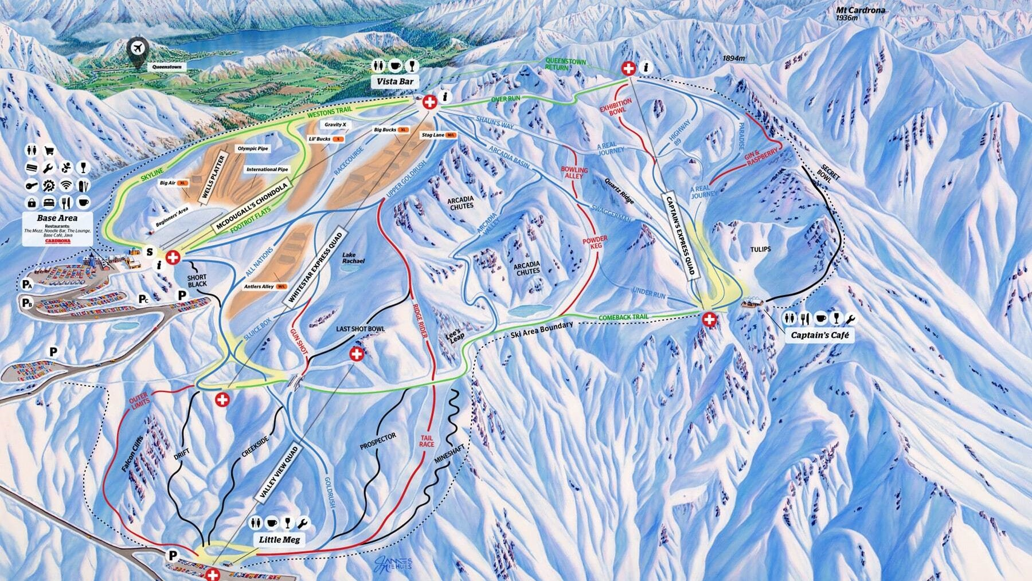
Cardrona
Elevation
1860m (5580ft)
Vertical
600m (1800ft)
Skiable Area
345 Hectares (852 acres)
Terrain
Beginner 25%
Intermediates 25%
Advanced 30%
Expert 20%
Notes:
Average snowfall: 2.9 m/yr
Accommodation on mountain – 15 apartments (studio / 2-bedroom / 3-bedroom / 4 bedroom)
Elevation: 1860m (5580ft)
Vertical: 600m (1800ft)
Skiable Area: 345 Hectares (852 acres)
Drive from town: 60 minutes (43.3kms)
Terrain: Beginners 25%, Intermediates 25%, Advanced 30%, 20% Expert
5 chairlifts and Conveyor Lifts (beginners area)
Offers the most extensive terrain park facilities in the Southern Hemisphere with four terrain parks, two half pipes and a gravity-cross course.

Slide 10
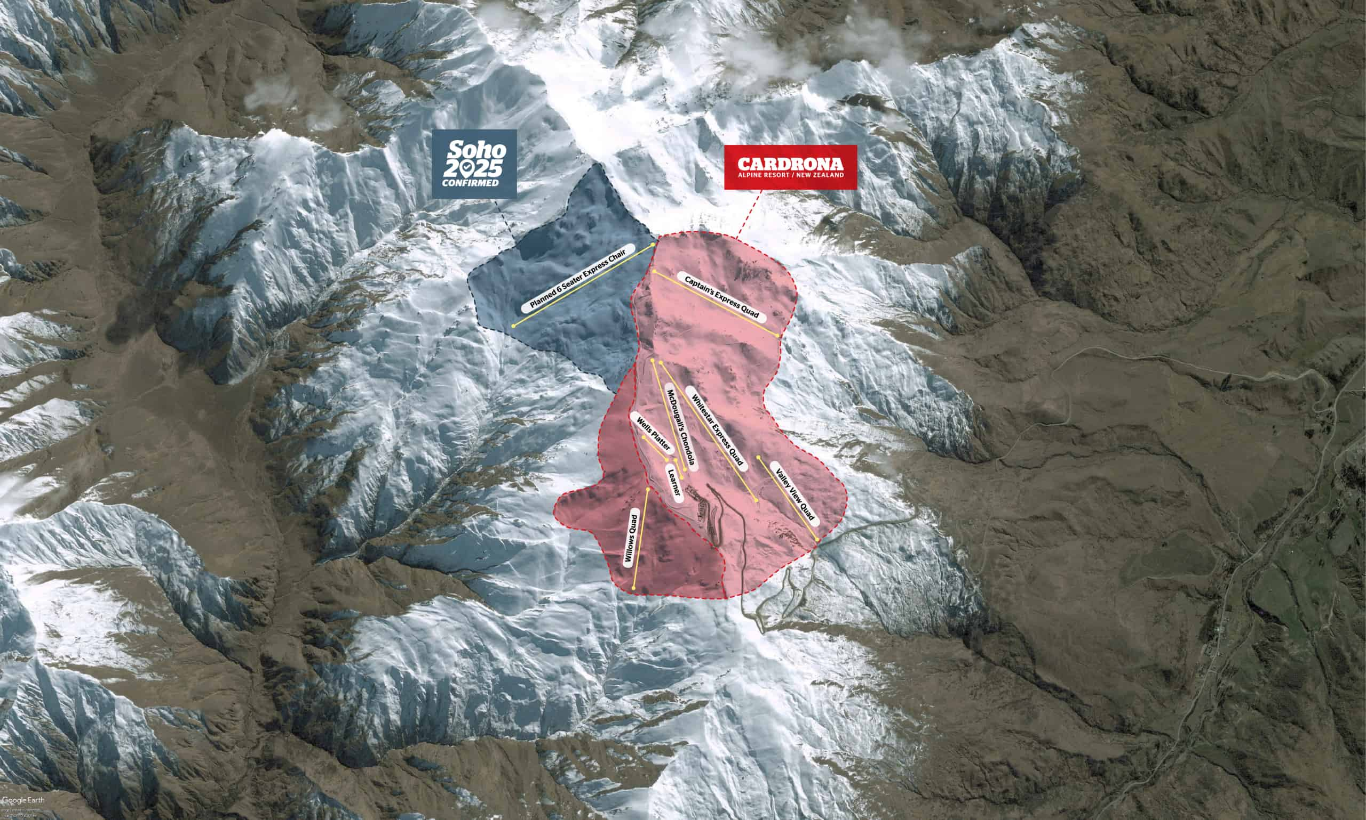
New Cardrona Soho Basin
Opening winter 2025
A brand-new 6-seater detachable Doppelmayr chairlift will be installed over the next two summers, ready to open for Winter 2025
Cardrona to be the biggest commercial ski area in New Zealand
Adding 24% of skiable terrain overall to Cardrona Ski Field
Increasing from 465ha to 615ha
Notes:
Soho Basin development, will take the resort from 465ha to 615ha – which will make it the biggest commercial ski area in New Zealand.
Adding 24% of skiable terrain overall to the resort.

Slide 11
Treble Cone
Treble Cone, the largest ski area in the South Island, famous for its long, groomed runs and legendary off-piste terrain.
Located a 30 minutes' drive from Wanaka and a 90-minute drive from Queenstown, Treble Cone is a must-do for ski enthusiasts. Boasting 700m of vertical, four basins and 550ha to explore with unrivalled views over Lake Wānaka and the Southern Alps.
With on-mountain retail and gear hire stores available, and a range of fresh, delicious dining options available, Treble Cone is equipped to deliver a world-class ski and snowboard experience.
Notes:
Treble Cone, the largest ski area in NZ’s South Island, is famous for its long, uncrowded groomed runs, legendary off-piste terrain and unrivalled views over Lake Wanaka and the Southern Alps.
Located just a 35-minute scenic drive from Wanaka and a 90-minute drive from Queenstown via the Crown Range road.
Treble Cone is a must-do experience for skiers and snowboarders with a massive 700m of vertical, which also allows for some of New Zealand’s longest groomed trails and best free riding terrain.
If you're not quite ready to explore too far from the groomers just yet, Treble Cone's snow sports school can help you get up to speed- whatever your level. Treble Cone's learner area is located alongside the comforts of the Base lodge and café with the convenience of a fully kitted ski and snowboard rental shop.
Save time on the mountain and get prepared early. Visit our Wanaka (20 Helwick Street) or Queenstown (37 Camp Street) offices for a full range of ticketing and rental needs.

Slide 12
Treble Cone
Elevation
1960m (6430ft)
Vertical
700m (2321ft)
Skiable Area
550 Hectares (1359 acres)
Terrain
Beginners 10%
Intermediate 30%
Advanced 40%
Expert 20%
Notes:
Elevation: 1960m (6,430ft)
Vertical Drop: 700m (2,321ft)
Ski Area: 550 hectares (1,359 acres)
Drive from Queenstown: 1.5 hours (90.5km)
45% Intermediate / 45% Advanced
1x 6-seater and 1x quad lift and platter for beginners

Slide 13
Heli Skiing
Heli-skiing in Queenstown is your ticket to an adventure beyond the ordinary.
Explore back-country terrain and untouched fresh powder with one of Queenstown’s heli-ski adventures.
Venture into the heart of the Southern Alps with 17 mountain ranges and terrain to suit intermediate to advanced skiers and snowboarders. Choose from 3-10 run packages on a fully guided experience.
Notes:
Fully-guided experience. Big mountain experience. Variety of terrain. Different package/run options.
Heli Skiing & Heli Boarding is a great option if you're looking for the backcountry terrain and untouched fresh powder.
For the ultimate snow experience, choose a heli skiing and snowboarding trip and make the Southern Alps your very own winter playground.
Fully-guided experience. Big mountain experience. Variety of terrain. Different package/run options.

Slide 14
Where to stay
Queenstown has a huge range of accommodation options to suit every age, travel style, group size and budget.
If you’re travelling to Queenstown in winter, there are a number of accommodation options that come with drying rooms and lockers for your snow gear and are situated along the pick-up route for mountain bus transport. From backpacker accommodation to hotels or serviced apartments, many are located centrally within walking distance to Queenstown’s vibrant town centre.

Slide 15
Après ski
Winter in Queenstown is just as much about skiing and snowboarding as it is about the après-ski.
The après-ski scene in Queenstown is unmissable whether you ski or not, with snug firelit bars pouring local wines, craft beers, and cocktails, and home to more than 150 eateries serving up everything from tapas to three-hat fine dining.
Stylish bars, sophisticated clubs, Kiwi pubs and late-night hot spots also make Queenstown’s après-ski atmosphere second to none.

Slide 16
Off the slopes
Queenstown is a winter lovers paradise with an array of activities on and off the snow.
Queenstown offers winter sports beyond skiing and snowboarding, from ice skating and snow shoeing, to backcountry snowmobiling and dog sledding.
Warm up and relax at one of Queenstown’s boutique spas or hot pools, enjoy a leisurely walk or bike ride along the Queenstown Trail, or choose from the many indoor activities to keep the whole family entertained.

Slide 17
Stay in the know with Trade
Trade Newsletter
Sign up and stay up to date with seasonal updates on the latest news in Queenstown, New Zealand to share with your clients.
Travel Trade Website
Here you will find a range of trade-ready resources that will support you to sell Queenstown, New Zealand to your clients.
Facebook Sellers group
Keep in touch and learn all about the latest product and destination updates for Queenstown, New Zealand travel.
Travel Trade YouTube
Find a range of Queenstown travel trade training videos to broaden your knowledge base and understanding of what’s on offer.

Slide 18
Your Queenstown Trade team
When it comes to selling Queenstown, NZ to the world, the DQ Travel Trade team know the importance of understanding the destination so that you can build itineraries confidently and dream weave travel experiences that are tailored to your business and client's specific needs.

