Slide 1
Revised TDA Logos - External
Horizontal
Vertical

Slide 2
Revised TDA Logos - Internal
Horizontal
Vertical

Slide 3
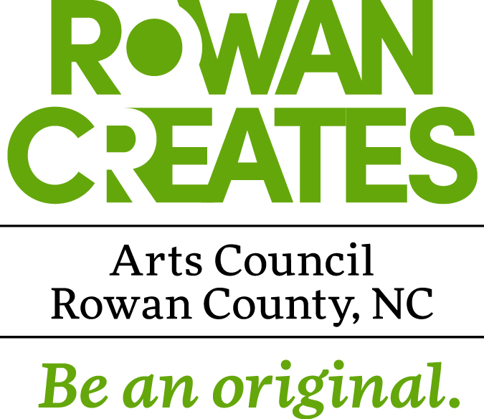
Rowan Arts Council Logos
Horizontal
Vertical

Slide 4
NEW EDC Logos
Horizontal
Vertical

Slide 5
Rowan Chamber of Commerce Logo

Slide 6
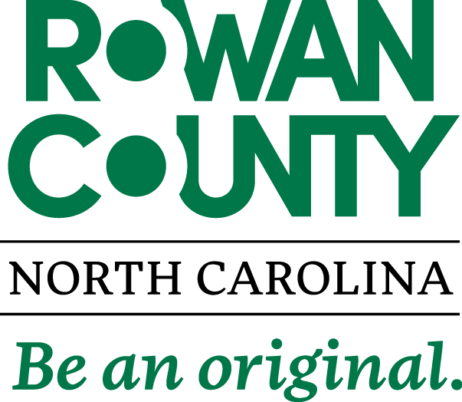
Rowan County Logo

Slide 7
Mid Carolina Regional Airport Logos

Slide 8
Rowan Library Logos

Slide 9
Rowan Library Logos

Slide 10
Rowan Library Logos

Slide 11
Rowan Parks & Recreation Logos

Slide 12
Rowan Parks & Recreation Logos

Slide 13
Rowan Parks & Recreation Logos

Slide 14
Rowan Parks & Recreation Logos

Slide 15
Rowan Wild Logo

Slide 16
Emergency Services Logos

Slide 17
Emergency Services Logos

Slide 18
911 Communications Logo

Slide 19
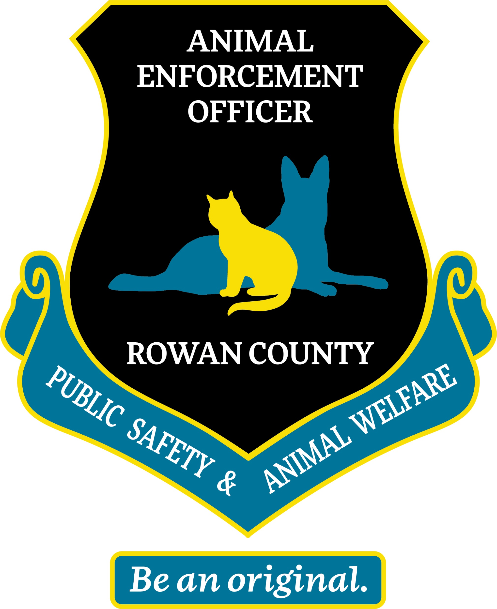
Animal Services & Enforcement Logos

Slide 20
Soil & Water Conservation District Logo

Slide 21
Public Health Department Logo

Slide 22
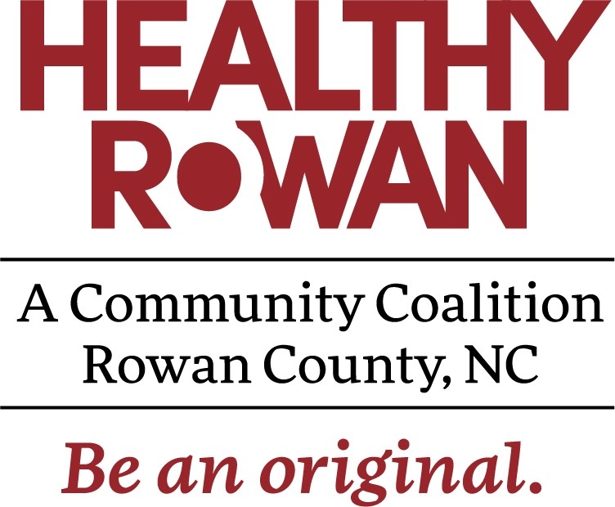
Healthy Rowan Logo

Slide 23
Dental Center Logo

Slide 24
Department of Social Services Logo

Slide 25
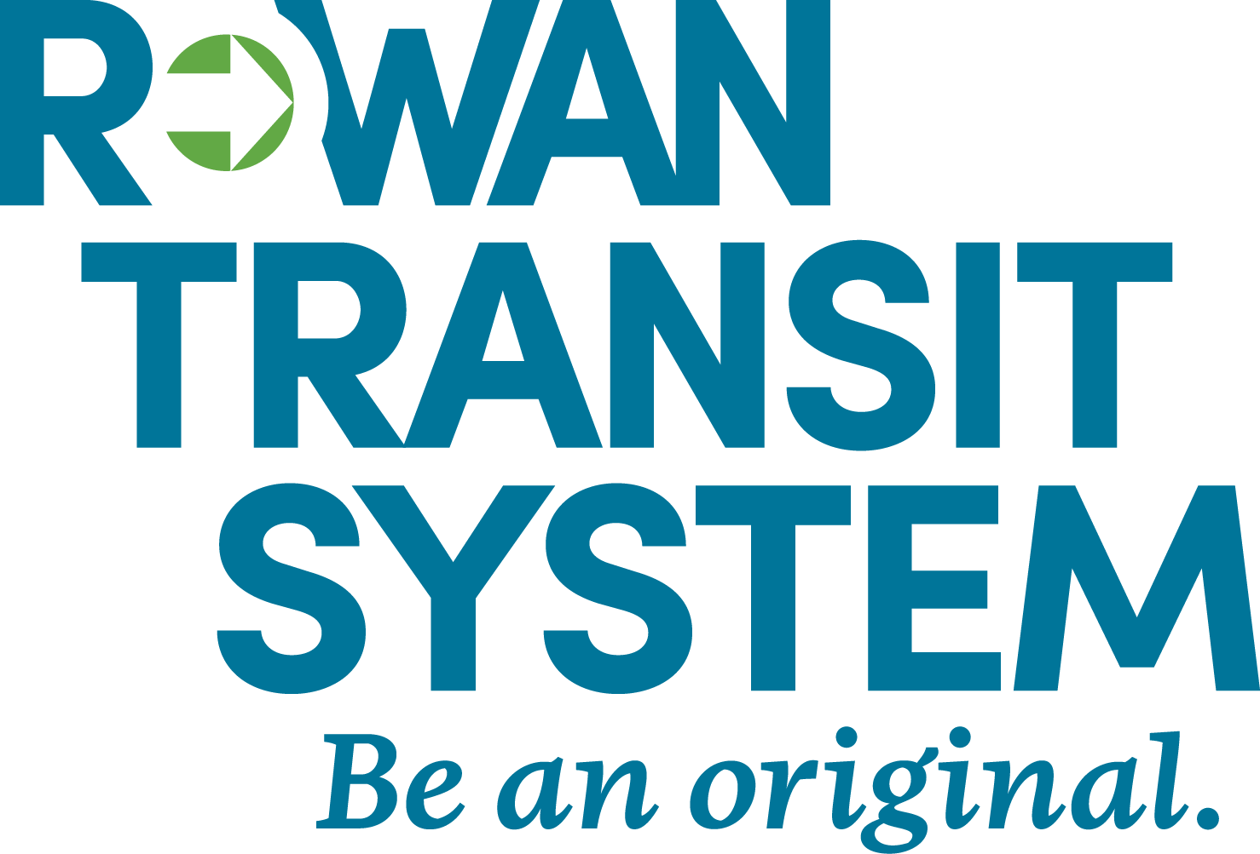
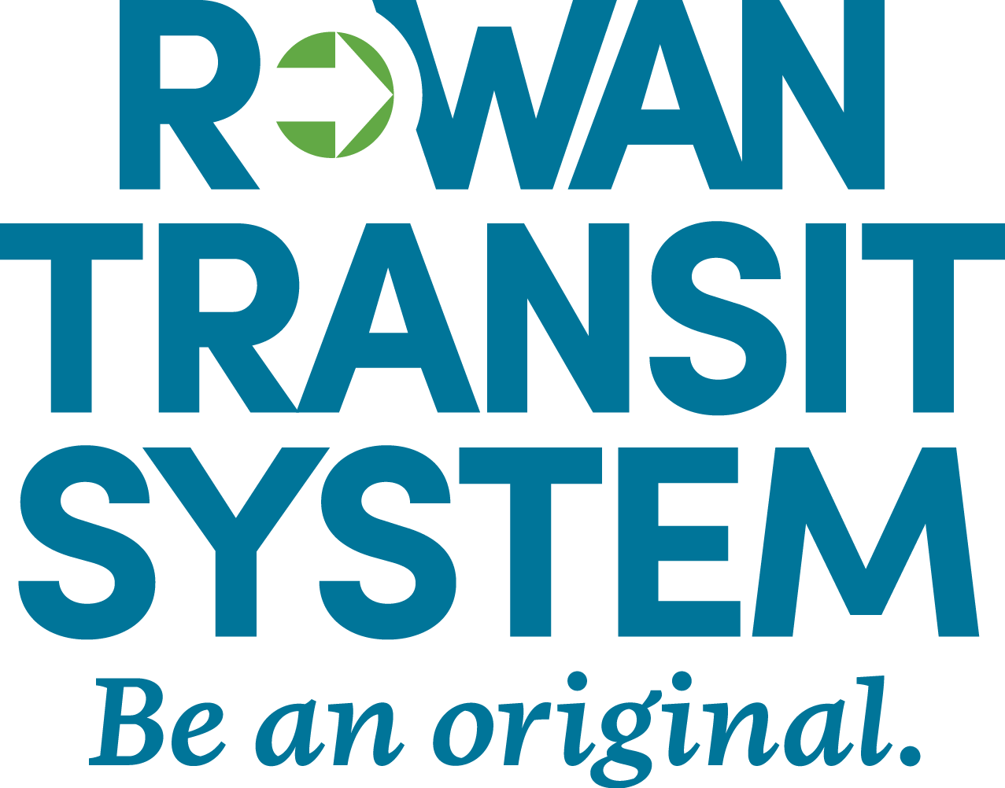
Rowan Transit Logos

Slide 26
Town of China Grove Logo

Slide 27
Town of East Spencer Logo

Slide 28
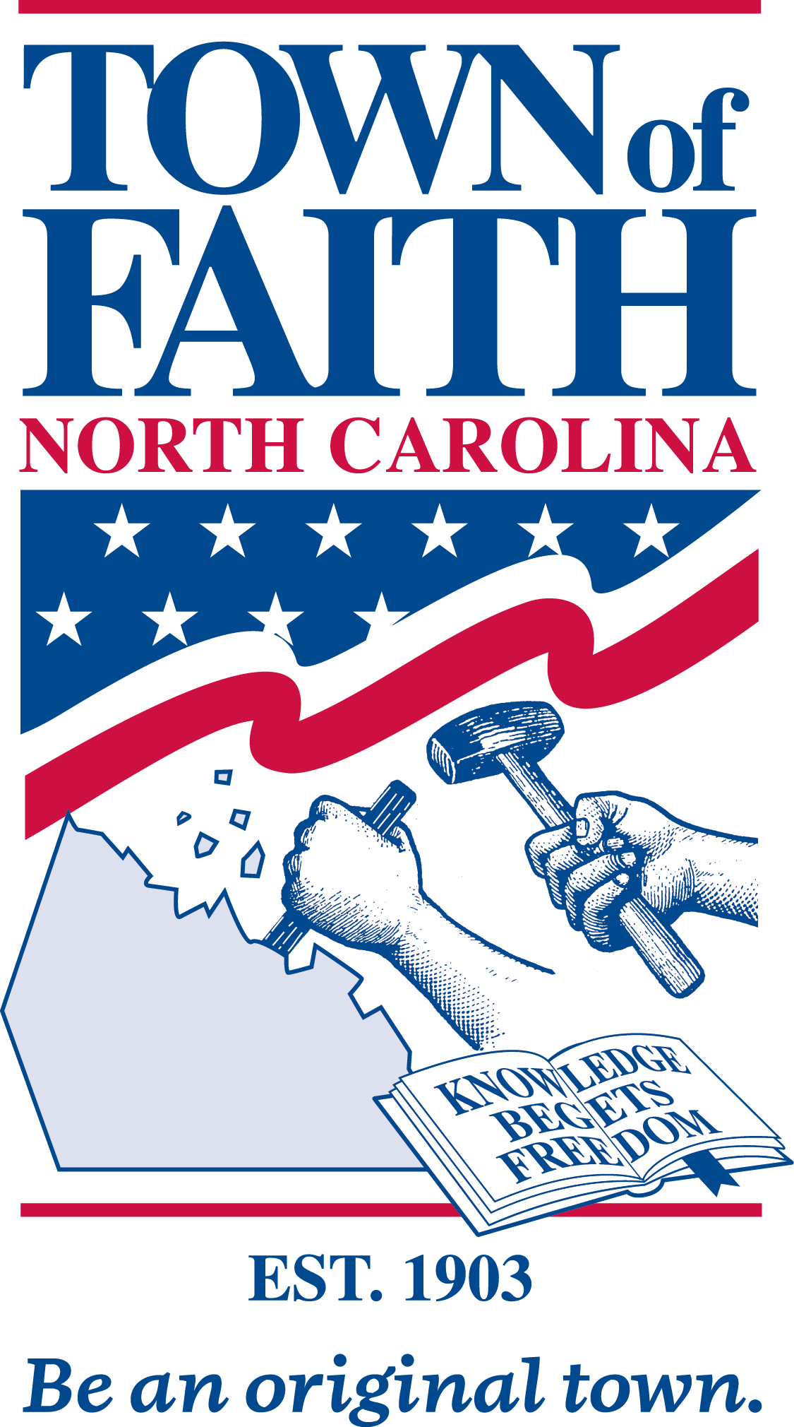
Town of Faith Logo

Slide 29
Gold Hill Logos
Gold Hill, NC
Gold Hill Mines Historic Park

Slide 30
Town of Granite Quarry Logos
Horizontal
Vertical

Slide 31
Internal Branding Campaign Logos: Your Rowan

