Slide 1
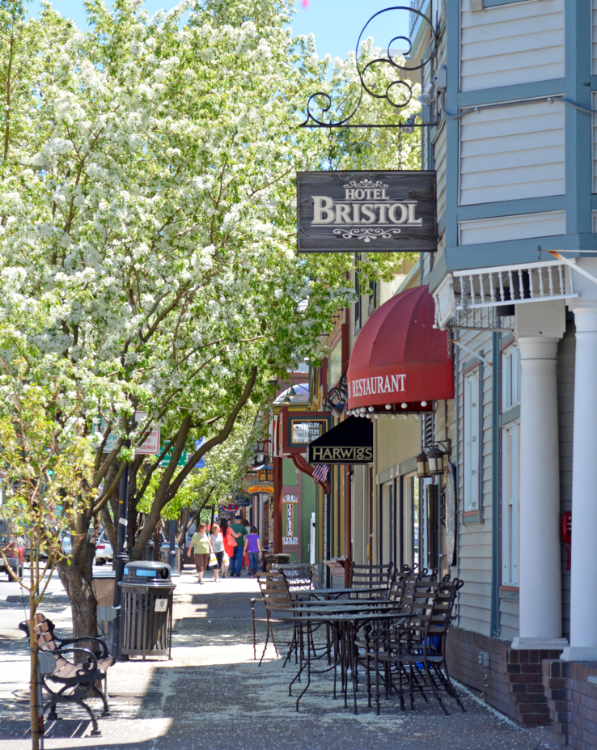

September 2025 Data
Summary
September 2025 saw modest growth over the previous year in several metrics, while down in others. Average occupancy was just above 34%, a 5% YOY increase. ADR isup slightly over last year, and the average length of stay continues to lag behind 2024.
Owner, or unpaid, stays continue to be consistent with previous months when compared with total occupancy, which is reflected in total (paid & owner) occupancy, but doesn’t contribute to accommodations tax or STR collections.
The data in the following tabs reflects the most current data as of October 5, 2025. Some data takes two-three months to populate.

Slide 2
September 2025 Data
Lodging Occupancy and Metrics
Note: Total Occupancy = Paid & Owner
*ADR= Average Daily Rate
Source: Key Data Dashboard 10/04/2025

Slide 3
September 2025 Data
Sales and Accommodation Tax Collections
Source: City of Steamboat Springs

Slide 4
September 2025 Data
Visitor Origin
Source: Key Data Dashboard 10/04/2025

Slide 5
September 2025 Data
2024 Economic Visitor Impact % YOY Change
Direct Travel Spending | $678.1Million | 2.50%
Direct Employment | 5,100 | 1.70%
Direct Earnings | $315.6Million | 3.20%
Direct Tax Receipts | $54.3Million | 5.00%
Source: Dean Runyan and Associates

Slide 6

Contact laura@steamboatchamber.com with any questions on this or other data requests.

