Slide 1
MONTHLY SUMMARY
FRANCE
TRENDS FOR THE MONTH: The French travel market continues to evolve following geopolitical tensions in the Middle East and softer consumer confidence. Summer 2026 bookings are showing a slower pace, particularly for long-haul destinations, with the U.S. among the markets experiencing the most noticeable adjustments.
Travel agencies are observing more cautious booking behaviors, including shorter booking windows and greater interest in last-minute travel opportunities. While destinations such as Canada and Albania are performing positively, many international markets are seeing more moderate demand overall. The industry remains attentive as agencies continue to monitor booking trends heading into the peak summer season.
 | Goal | February | March | April | Total
Trade Engagement | 100 | 12 | 7 | 4 | 109
Trade FAM | 5-6 | 0 | 0 | 0 | 3
Travel Trade Training | 7 | 1 | 0 | 0 | 6
Trade Newsletter | 4 | 0 | 0 | 0 | 3
Press Release | 12 | 1 | 1 | 1 | 12
Media Fam | 2 | 0 | 0 | 1 | 1
Media Engagement (In-person or virtual) | 100 | 6 | 35 | 4 | 71
Sales Mission | 1 | 0 | 0 | 0 | 1
Media Mission | 1 | 0 | 0 | 0 | 1
Social Media | 60 | 5 | 5 | 5 | 55
Notes:
1

Slide 2
FRENCH SALES CALLS
Evasions Forever 273, Route 4 chansons F- 34200 Sète Nicolas Abbate – Product Manager contact@evasion-forever.com | Nicolas has returned to his full-time role as Product Manager and is looking to further develop travel products focused on the Eastern and Southern United States. He is a true US enthusiast and regularly accompanies small groups on trips. He will be joining the June fam trip and is very excited to discover Virginia, a state he has not yet visited. This experience will allow him to design a new tailor-made, 100% Virginia product offering.
Visiteurs 43, Rue de la Chaussée D’Antin F – 75009 Paris Roxane Vergught - Marketing Manager rvergught@visiteurs.com | As part of the FY26 approved co-op marketing initiatives, activities will be implemented between late May and mid-June 2026. A training session is scheduled for May 28, with 87 travel agents currently registered. In addition to this training, a new 100% Virginia program (currently under development) will be launched by mid-May. A newsletter will also be sent to both B2B and B2C databases to support the campaign.
Cercle des Voyages 31, Avenue de l’Opéra F – 75001 Paris Anthony Enault– Product Manager antony@cercledesvoyages.com | After a slight increase in quotations and bookings in March and early April, the conflict in the Middle East led to a global drop in demand, not limited to the United States. Many initiatives are currently being implemented, including offers designed to provide greater flexibility for clients, such as free cancellation up to 10 days prior to departure. Anthony and his teams are actively negotiating with all partners to secure more flexible conditions, with the aim of encouraging bookings in the current context. Anthony had initially hoped to participate in the May fam trip but has already confirmed his attendance at Rendez-vous Canada this year. He remains very interested in joining a future fam trip in the near future.

Slide 3
FRENCH SALES CALLS
Les Ateliers Du Voyage 54/56, Avenue Bosquet F – 75007 Paris Bertrand Juilliard– Product Manager Bertrand.Juilliard@atlv.fr | In addition to his role as USA/Canada Product Manager, Bertrand Juilliard has recently been appointed Latin America Product Manager, marking a new professional challenge for him. He will continue overseeing USA/Canada sales and product development, while gradually delegating more responsibilities to his colleague Cyrille. Bertrand is currently working on a new itinerary he aims to launch by the fall, themed “In the Footsteps of the Presidents,” designed to highlight the 250th anniversary of the United States.

Slide 4
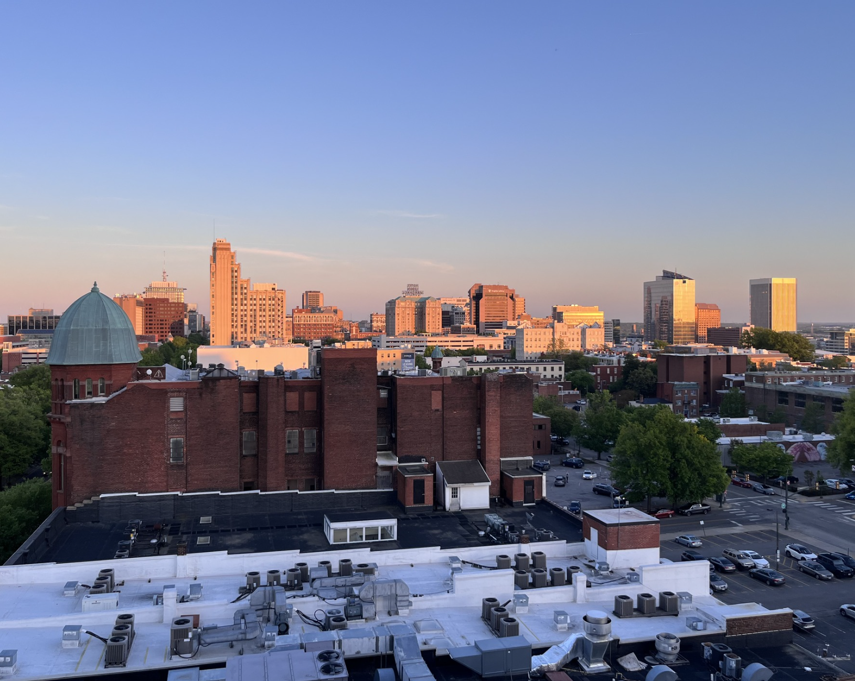
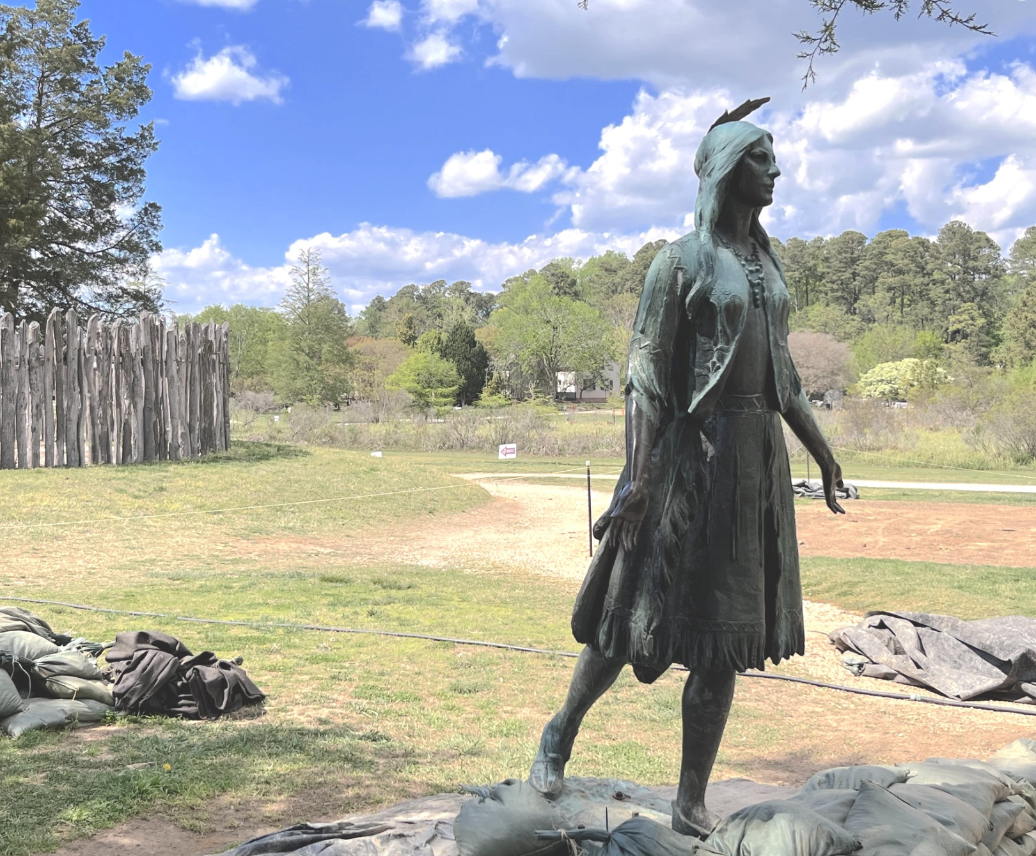
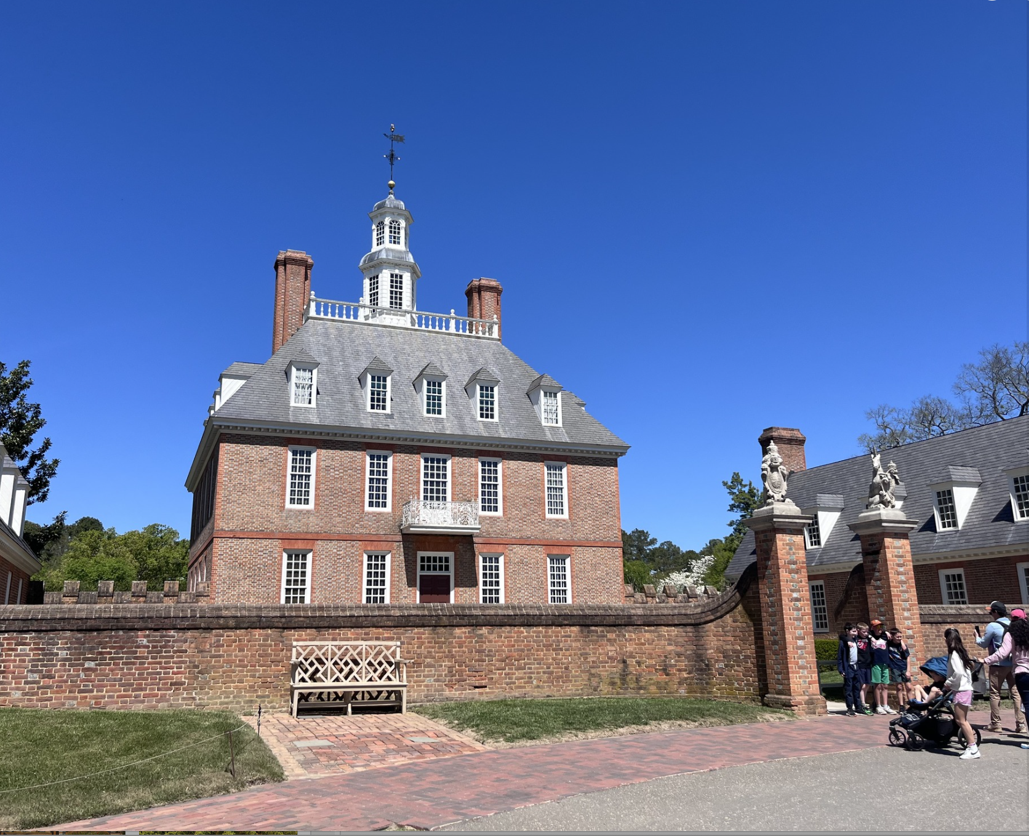
Indicidual Media Trip
Carnets d’Ailleurs
Emmanuel Tellier and Olivia Marcus traveled through Virginia from April 7 to 13 to prepare an article for Carnets d’Ailleurs, highlighting the state’s rich history and marking the 250th anniversary of the United States.
Their itinerary included Alexandria, Richmond, and the Historic Triangle. Both were highly impressed by the destination.
The feature is expected to be published before the summer.

Slide 5
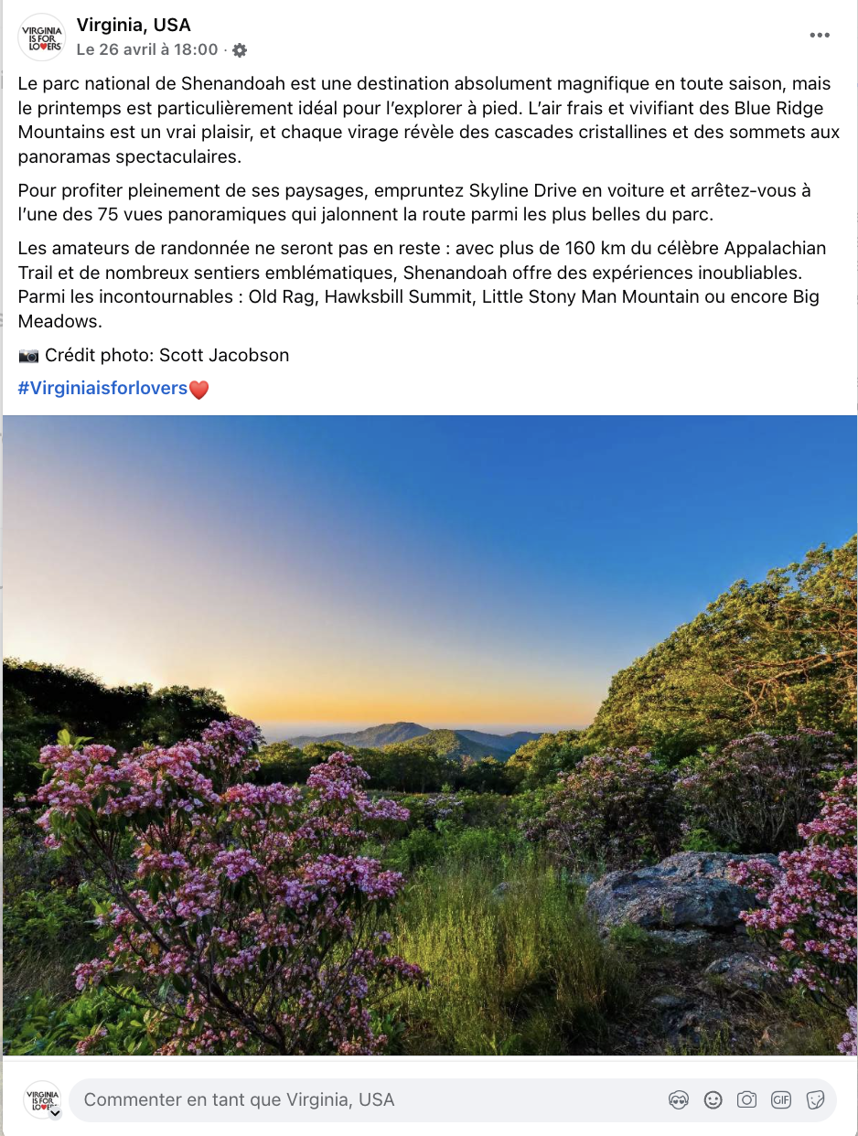
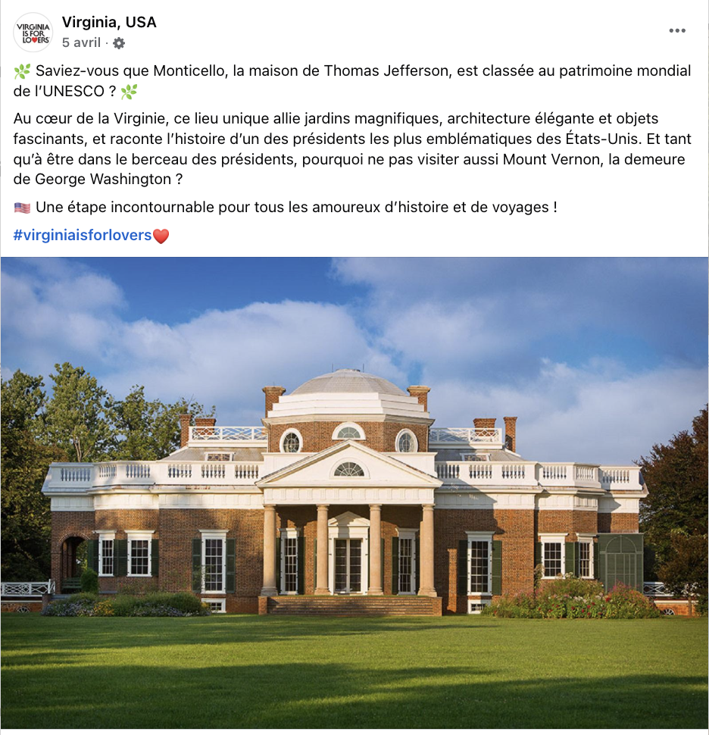
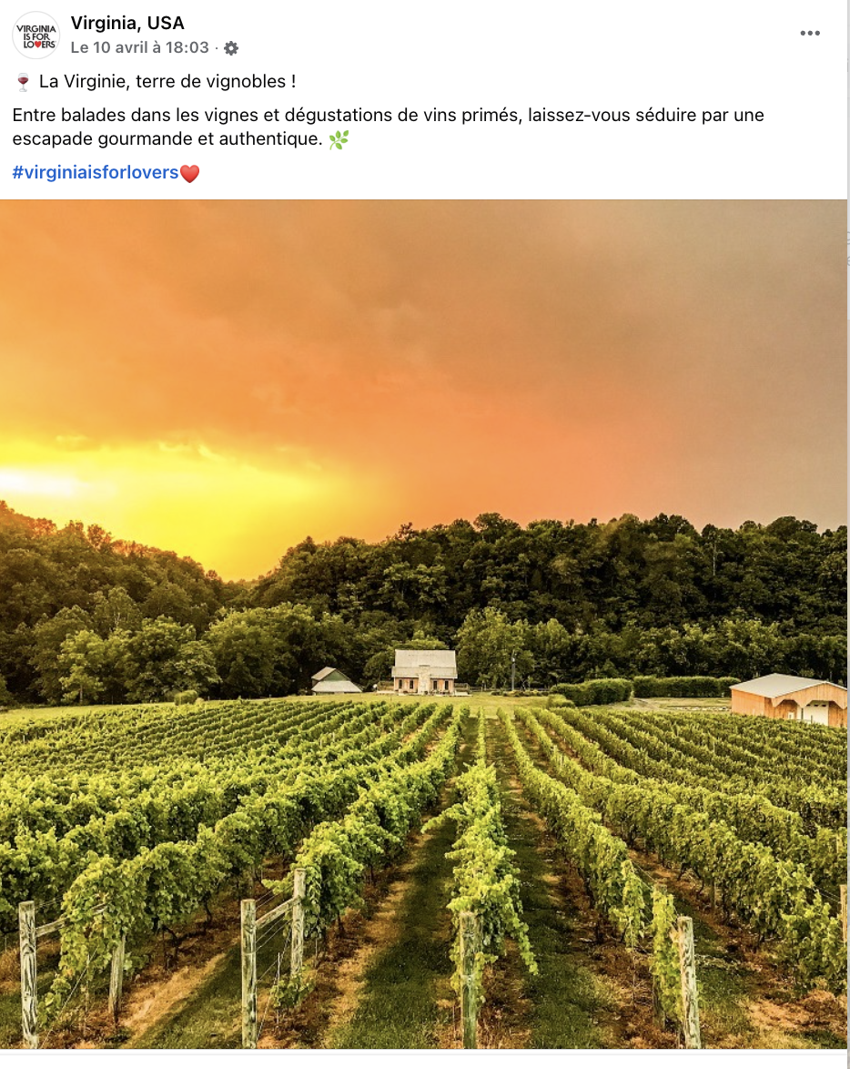
META ORGANIC POSTS
FRANCE
Fans: 173
This month, no promotional budget was allocated to social media activities. All published content was entirely organic, focusing on maintaining visibility and engagement without paid amplification.
The 3 posts that generated the most interactions are:

Slide 6
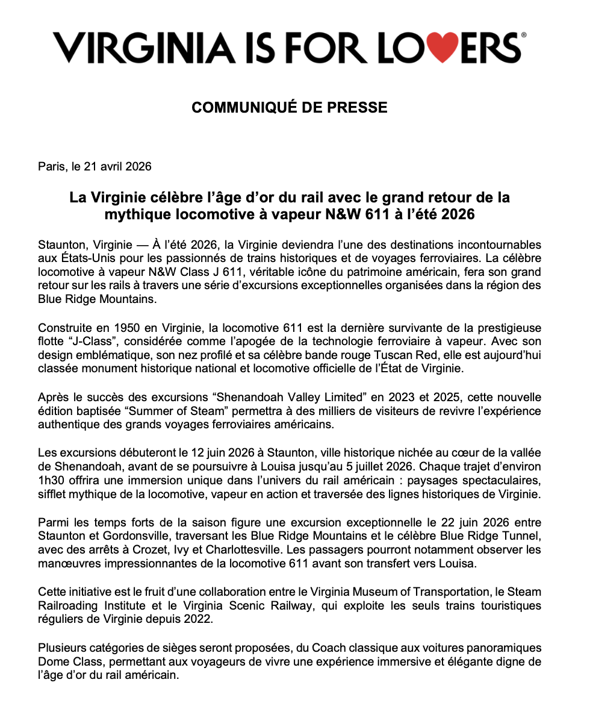
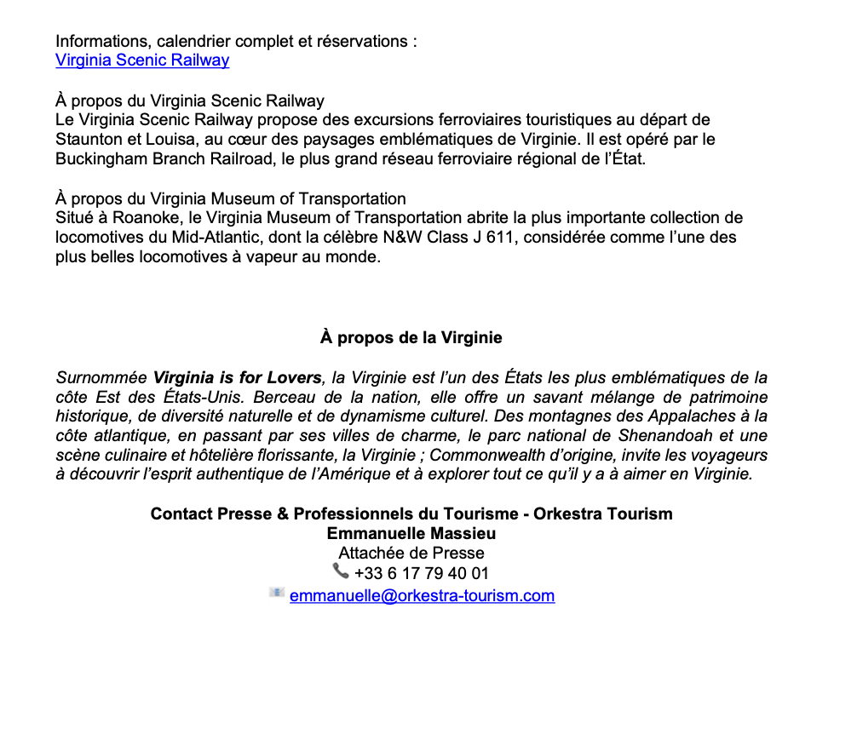
PRESS RELEASE
Summer of Steam Railroading

