Slide 1
Workforce Development & Transportation
Prepared for: Hospitality Workforce Summit
Amanda Wanke, Chief External Affairs Officer
September 6, 2019

Slide 2
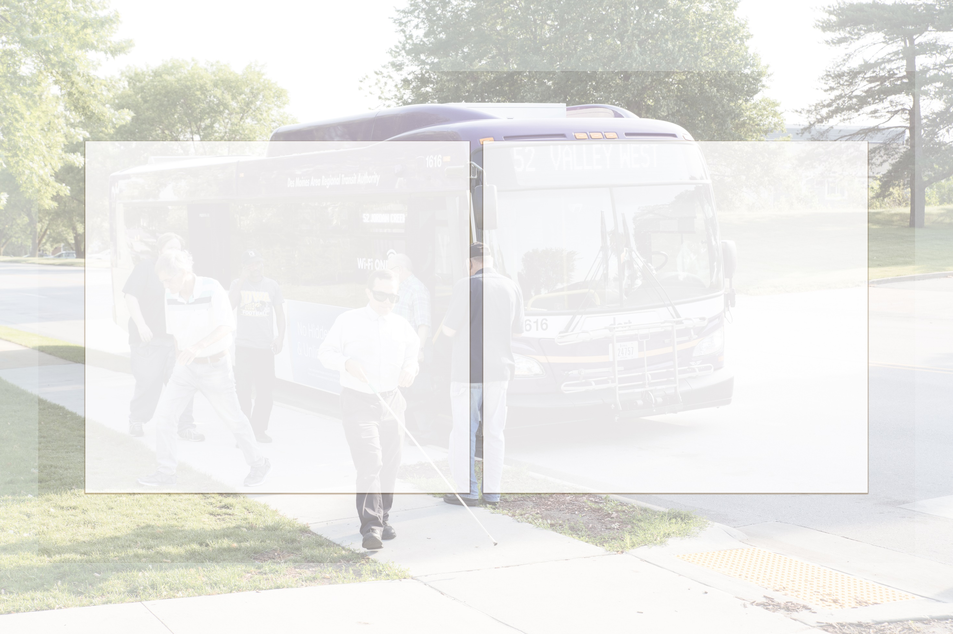
Mission / Vision
Mission
Vision
  Enriching Lives,
  Connecting Communities,
  Expanding Opportunities
  Facilitate affordable, seamless mobility options that support economic prosperity for all

Slide 3
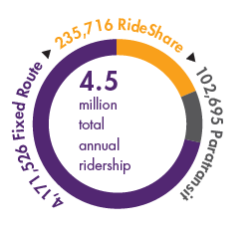

DART
Formed in 2006
Regional transit agency
Serve 13 cities and Polk County
14-member Board of Commissioners
1,700+ bus stops

Slide 4

DART services

Slide 5
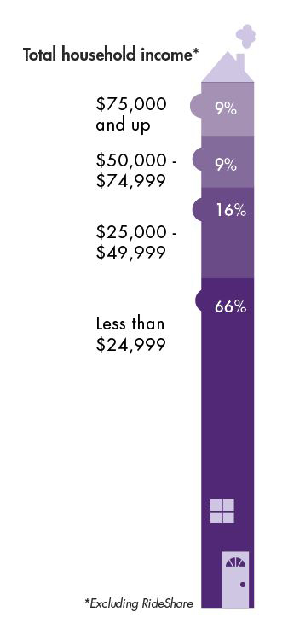
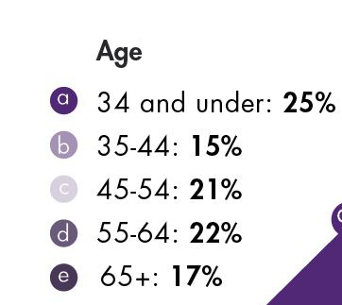
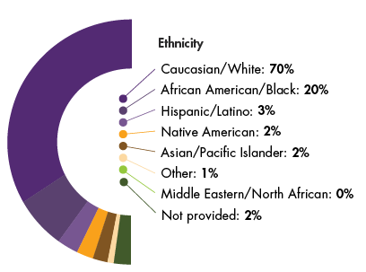
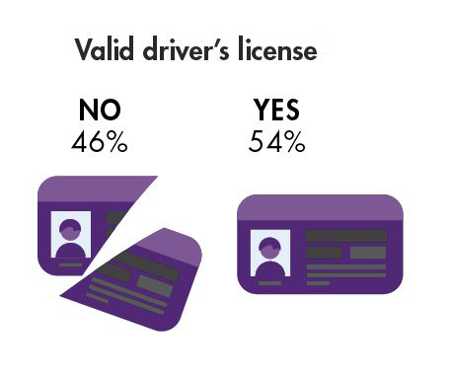
Who uses DART?

Slide 6
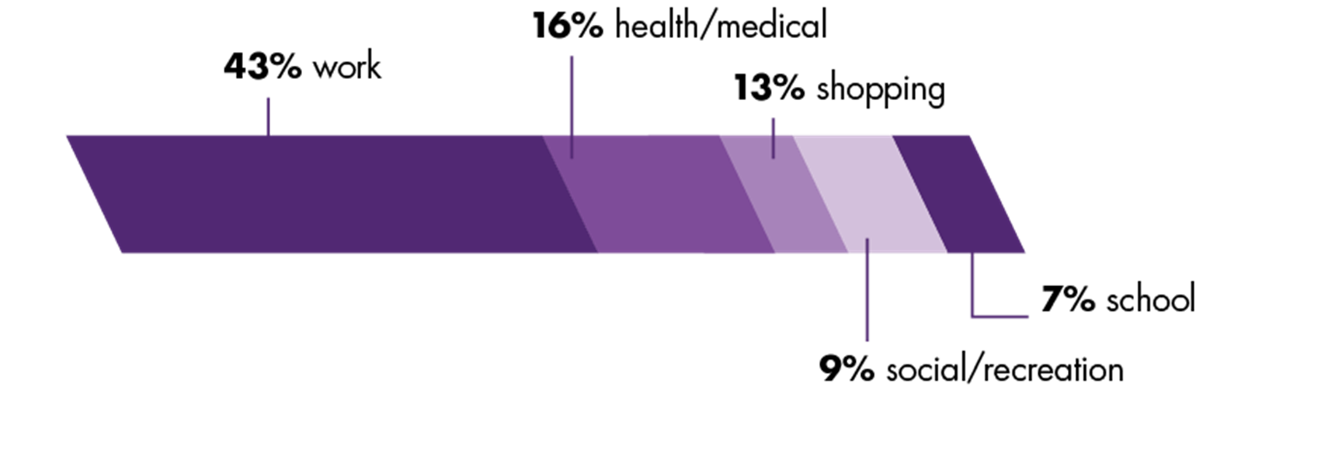
Why do they ride?

Slide 7



DART service priorities
Employment
Healthcare
Education

Slide 8
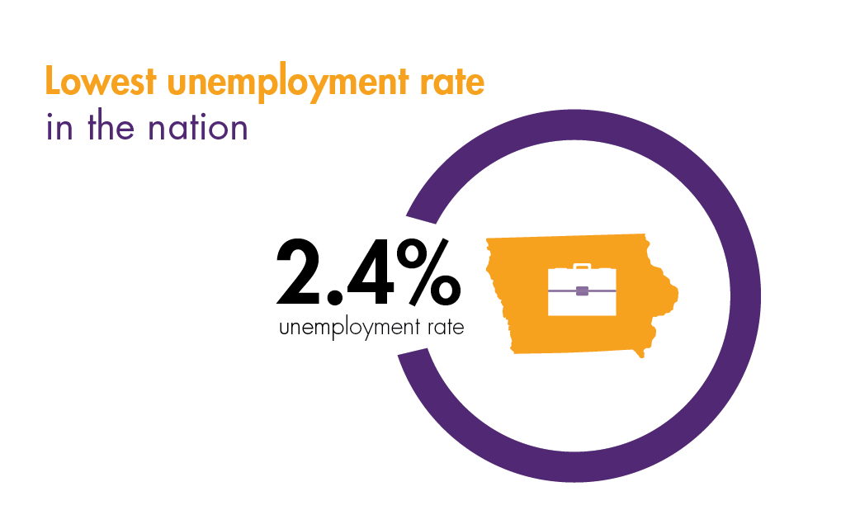

Slide 9



Economic impact through transit
Fosters economic activity
Workforce recruitment and retention
Supports job creation

Slide 10


Slide 11

Transportation Makes a Difference
Access = opportunity
Reduce barriers
Workforce attraction/retention
Quality of life

Slide 12

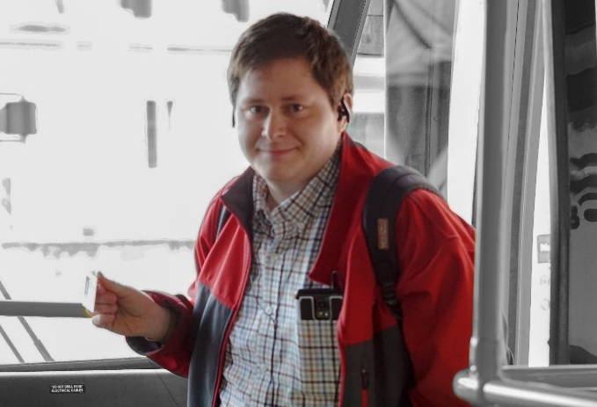
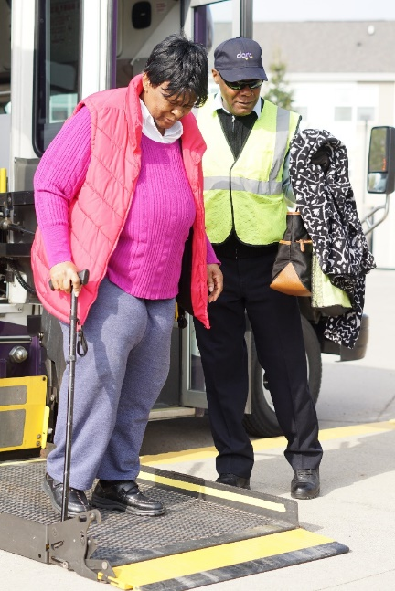

DART Resources
Business partnership opportunities
Bulk pass purchases
Unlimited Access program
RideShare vanpooling
Mobility training and employee education

Slide 13

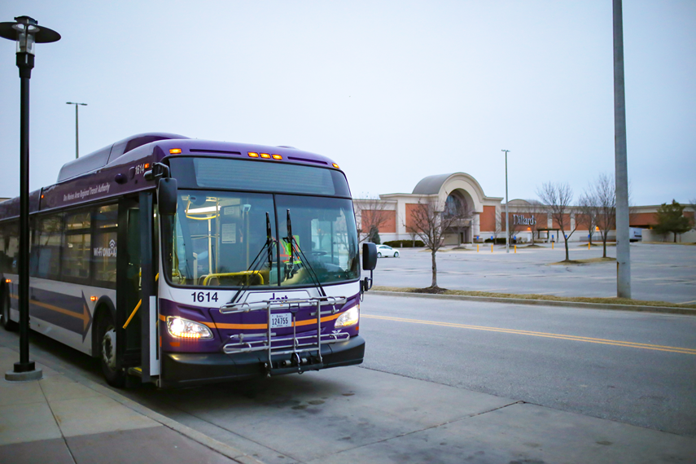
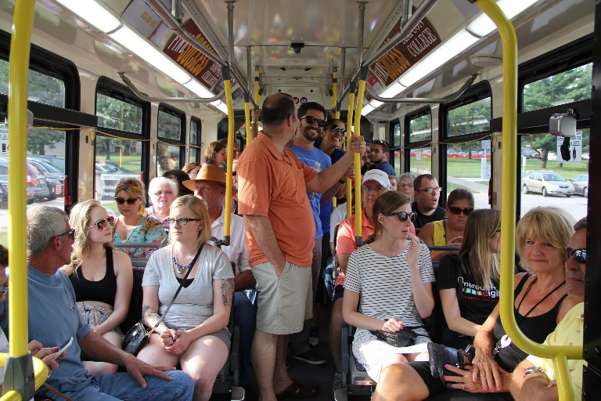
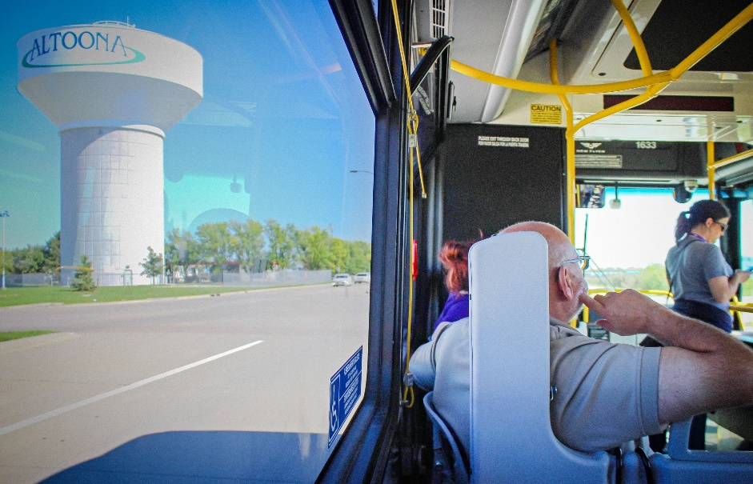
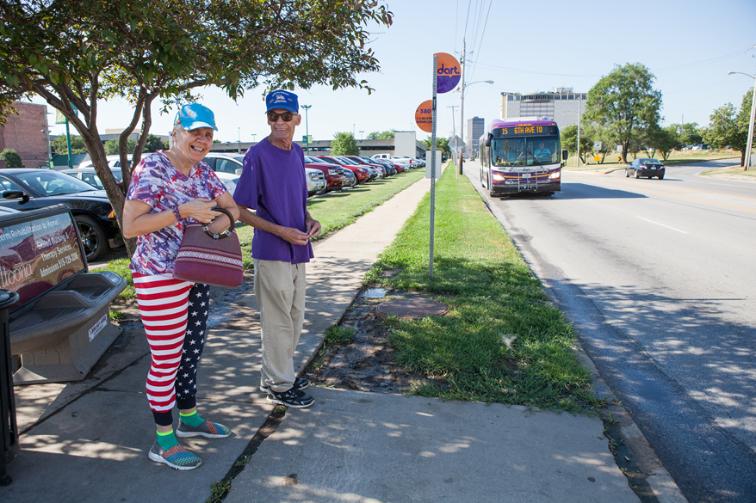
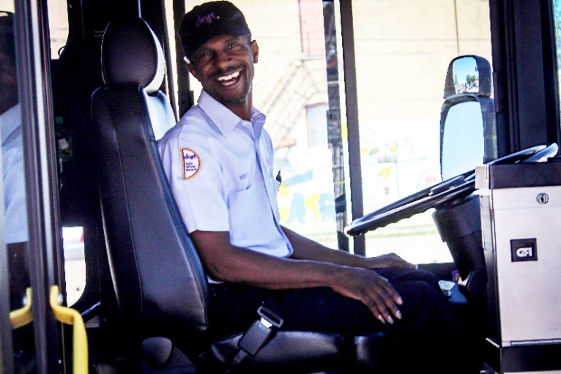
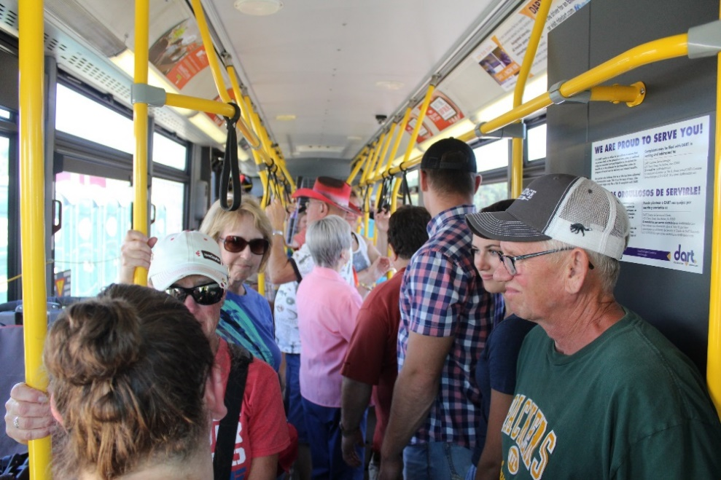
Thank you!

