Slide 1
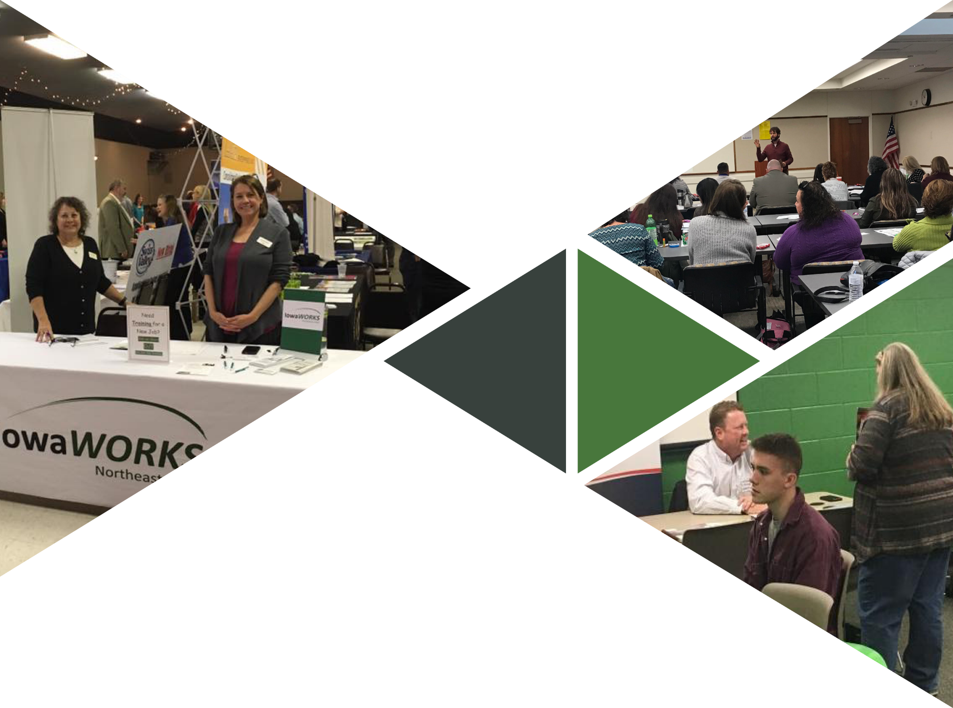

Connect with your
Local one-STOP

Slide 2
The regional one-stop centers provide a variety of services to meet the workforce and workplace needs of job seekers and Iowa businesses through state and local partnerships.
Adult Training
Youth Training
Career Counseling
Job Development
Dislocated Worker Programs
Unemployment Insurance Assistance
Business Services
Rapid Response Assistance

Slide 3
CAREER
Readiness
Local one-stop centers offer career preparation resources to ensure job seekers meet the needs of local businesses:
Resume Preparation
Career Planning
Understanding Labor Market Information
Social Media Strategies
**Maximize Your Potential workshops
Mock Interviews
OPAC/NCRC Testing
**Work Ethic Development (Bring Your A-Game)
**Certificate upon completion

Slide 4
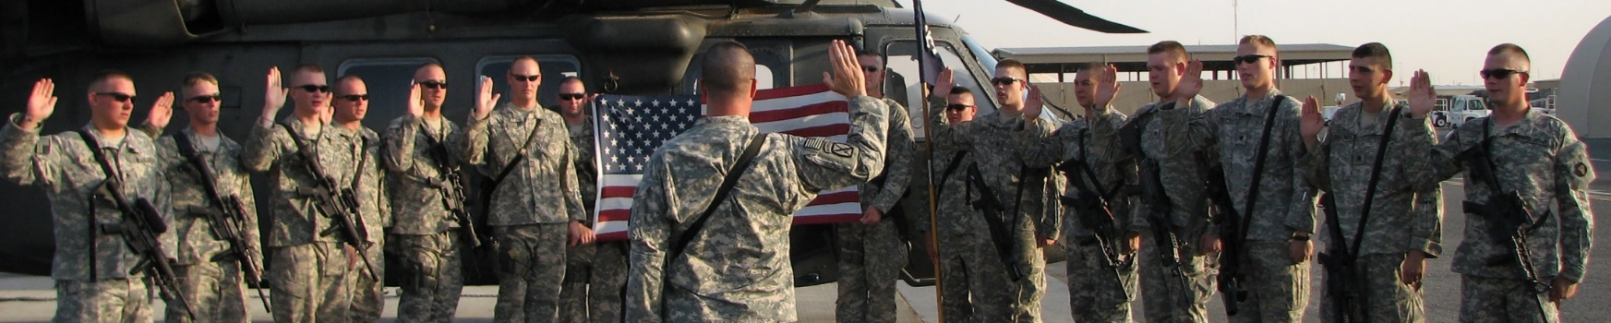
Priority of Service
Case management/ DVOP
Home Base Iowa
homebaseiowa.gov
Vet2Work hiring events
Federal Job Search/ Federal Resumes
Assisting Justice Involved Veterans
Local Veteran Employer Representative (LVER)
edgardo.ortizhernandez@iwd.iowa.gov
VETERAN
Services

Slide 5
With over 90% of all offenders eventually being released, understanding this valuable workforce pipeline is essential.
Full Time Reentry Advisors: Newton Correctional Facility, Iowa Correctional Institution for Women in Mitchellville, North Central Correctional Facility in Rockwell City, Mt. Pleasant Correctional Facility in Mt. Pleasant
Part Time Reentry Advisors at transitional housing facilities throughout the state
EMERGE (Empowering, Motivating, Ex-Offenders to Reach Gainful Employment) Training
Offender Workforce Development Specialists (OWDS)
D.O.C. Registered Apprenticeship Program
Federal Bonding Program Coordinator
State and Federal tax credits and other incentives
REENTRY
Services

Slide 6
One-Stop Centers provide a variety of services to meet the workforce and workplace needs of job seekers with disabilities.
Iowa Vocational Rehabilitation Services counselor on-site
Ticket to Work Program through DMACC/IES counselors
Interpretive Services and accommodations available for jobseekers
Disability Task Force
WIOA Core Partner Business Engagement meetings
Disability
Services

Slide 7
One-stop centers connect foreign-born jobseekers to gainful employment.
EMBARC Career Navigators on-site
IowaWORKS Title 1 participation in the SIIP grant along with Greater Des Moines Partnership, Lutheran Services of Iowa, DMACC ESL and Goodwill
Bilingual Workforce Advisors
Collaborating with community partners on outreach events (World Refugee Day and Multicultural career fairs and resource events)
Migrant Seasonal Farm Worker outreach program
Refugee and Immigrant
Services

Slide 8

Programs provided to individuals receiving unemployment insurance:
Employment plans including, guidance for completing online applications, resume and cover letter writing assistance and interview preparation
Help develop effective networking skills
Skills assessments and testing
Review Labor Market Information to identify employment needs in the community and career possibilities
Referrals to additional training and educational programs
* IWD believes (and studies have found) individuals receiving reemployment services return to work earlier than people who do not receive services.
REEMPLOYMENT
Services

Slide 9
IowaWORKS offers a variety of services to benefit employers:
IowaWORKS.gov
Recruitment Assistance
Career Fairs, Hiring Events and Networking
Labor Market Information
Tax Credits – WOTC
Employers’ Council of Iowa
Unemployment Insurance Assistance
Registered Apprenticeships
BUSINESS
Services

Slide 10

Registered
Apprenticeship
Visit the Registered Apprenticeship website at
www.earnandlearniowa.gov to learn more about the process and to connect with your local IowaWORKS Center.
Program set up
Connect to existing programs
Testimonials
Filling pipeline with quality workers
Increase employee longevity
Connection with Future Ready Iowa
Futurereadyiowa.gov

Slide 11
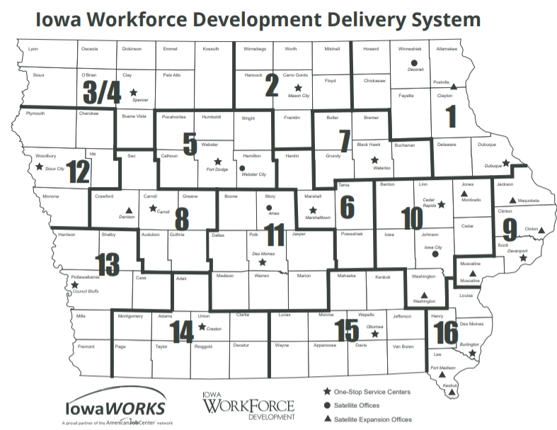
Questions?

Slide 12
Thank You!
Rachel.falahpour@iwd.iowa.gov
515-725-3606

