Slide 1

FY27 TRIPP Program
Tourism Reinvestment In Promotion & Product
Tourism Advertising Awards
& Development Grants

Slide 2

“TRIPP” Tourism Reinvestment in Promotion & Product
A program through which Visit Frederick partners with nonprofit attractions and government agencies to encourage potential visitors to experience Frederick County.
TRIPP Award $500,000

Slide 3
Goals of the TRIPP Program
Increase
Visitation
Increase the number of people visiting Frederick County and the amount of money spent while visiting.
Encourage
Hotel Stays
Increase overnight stays in Frederick County hotels, thereby replenishing and increasing the hotel tax revenue that is used to fund this program.
Enhance
Visitor Experience
Enhance the overall attractiveness and marketability of Frederick County as a destination.

Slide 4
TRIPP Categories
Tourism Advertising Award
Placement of advertisements promoting local nonprofit attractions and their events to non-local audiences.
Tourism Development Grant
Development of tourism product through nonprofit attractions, events, and activities.

Slide 5

Other TRIPP Components
Group Overnight Incentive Program
Reimbursement of $10 per room night to organizations generating a quantity of overnight hotel stays.
Unanticipated Opportunity Fund
Advertising or development opportunities which could not have been anticipated prior to March 31.

Slide 6
TRIPP Funds Available
$500,000 for FY27 to be allocated as follows: $288,000 for the Advertising Awards $192,000 for Development Grants
$20,000 for Unanticipated and Group Overnight Incentive Program

Slide 7
Advertising and Development Funding
TRIPP Advertising Award: $40,000 maximum ($57,000 media schedule) and $2,000 minimum ($2,857 media schedule).
The cash match requirement is 30%.
All TRIPP funded advertisements are to be placed with non-local media outlets that demonstrate at least half of their audience is outside of Frederick County.
Development Grants: $25,000 maximum grant request, and $1,500 minimum grant request.
25% Match
$3 grant funds to $1 organization funds

Slide 8
Successful Applicants…
Provide details when completing the application.
Identify attributes of their attraction or event that would motivate residents from outside of Frederick County to visit/attend.
Demonstrate the ability to attract and measure the number of visitors from outside of Frederick County.
Ask for ZIP Codes of attendees as they enter attraction/event.
Count out-of-state license plates at your site or event.
Have participants fill out a survey.
Post a map and have participants mark their hometown.

Slide 9
Tips for Success
The applicant should be able to measure successes tied to the funding and information about visitors.
Compared to last year, sales during the festival increased __%
__% of attendees were from outside of Frederick County
__% of survey respondents spent over $__ at the event

Slide 10
Tips for Success
Ask
Ask someone to read your application to ensure it will be clear to the committee.
Complement
Complement Visit Frederick’s goals of increasing the number of visitors, visitor spending, and length-of-stay.
Partner
Partner with other entities to achieve goals
Partners do not need to be nonprofits
Partners cannot include hotel, motel, or other lodging businesses located outside of Frederick County.

Slide 11
Application Deadline
Tuesday, March 31, 2026, at 5:00 PM
FY27 TRIPP Applications are due electronically no later than 5pm.
Applications must be submitted through Submittable.

Slide 12
Award Limits: Advertising
Cash match is 30%.
Minimum request is $2,000.
Media schedule maximum request is $40,000.

Slide 13
Award Limits: Development
Cash match is 25%.
Minimum request is $1,500.
Maximum request is $25,000.

Slide 14
Project Time Frame
Advertising must run in FY27
(July 1, 2026 – June 30, 2027).
Development Grant projects must begin in FY27. It is recognized that some projects may require more than a year to complete. Up to 24 months will be allowed, after which no TRIPP funds will be released for the project without prior approval of a written request for a project extension.

Slide 15
FY27 Application
One application to apply for Advertising Award and Development Grant.
You may submit 2 separate applications (one Advertising and one Development) if your proposed projects are not closely related.

Slide 16
Advertising Media Selection
FY27 All non-local media (Maximum request of $40,000)
The media schedule budget must be placed with only non-local media outlets that can demonstrate at least half of their audience resides outside Frederick County.

Slide 17

Digital and Online Advertising
Ads placed on websites, native / sponsored content on relevant web channels, mobile advertising, etc.
Pay at Placement Advertising, such as direct social media ads, does NOT qualify for the TRIPP Advertising program.
Social media advertising through a third-party media outlet that provides invoicing is permitted. The name of the media outlet being utilized must be included in the digital media schedule.

Slide 18

Digital and Online Advertising
All paid digital content and online advertising funded through TRIPP must include a link to a page with related content on the awardee’s website.
That landing page on the awardee’s website must include the TRIPP “Visit Frederick City & County” logo graphic with a live link to the VisitFrederick.org website

Slide 19
TRIPP Advertising
Visit Frederick must directly pay the media outlet.
The awardee will submit:
Request for Payment form, media outlet invoice(s)
proof of performance (original tear-sheet, radio spot audio file, screenshot, etc.)
30% of total invoice amount* as cash match payable “Tourism Council of Frederick County.”
Request for payment must be submitted at least 10 days prior to the due date on the invoice
* Until TRIPP award is expended, then awardee pays match plus remainder.

Slide 20
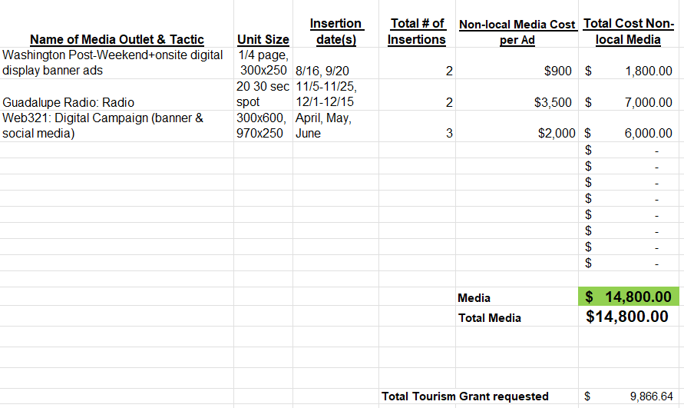

Media Schedule
File is formula driven, no need to enter data in Total Cost Column.

Slide 21
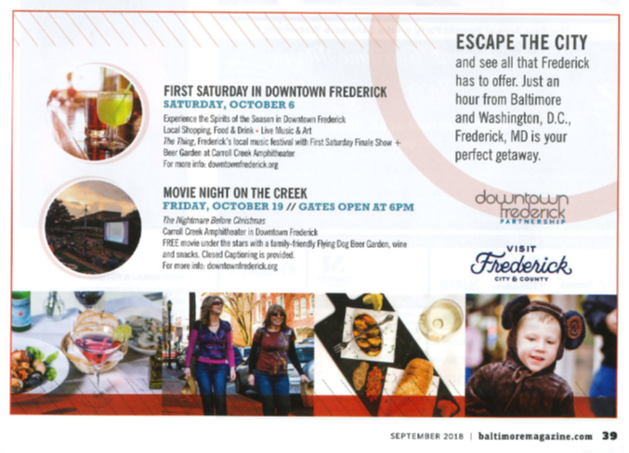
Logo Requirements in Advertising
Don’t forget to include Maryland or MD.

Slide 22
Logo/Copy Requirement in Broadcast Advertisements
Television spots must include the TRIPP logo. This logo should appear on the screen at least 3-5 seconds.
Radio spots must include the words “Visit Frederick, Maryland.”
Tear sheets, audio or video recordings, or similar proof of performance will be required before invoices are paid.

Slide 23
Advertising Award Note
Advertising awardee will open a separate account for TRIPP with vendor setting up as Visit Frederick / (awardee name and address).
The awardee will provide vendor’s W-9 form with first payment request. This form verifies the vendor’s taxpayer identification number. Payment will be held until W-9 is received.

Slide 24
TRIPP Development Grant
Development Grants are available to nonprofit organizations (potentially in partnership with for-profit organizations) to assist with up to 75% of the cost of tourism projects in Frederick County, to include:
Exhibits
Events
Activities
Festivals
Conferences
Programs

Slide 25
TRIPP Development Grant
The preferred use of funds is for one-time or start-up project costs. Applicants proposing ongoing activities are encouraged to work toward becoming self-sustaining.
Create new reasons for residents of other areas to want to visit Frederick County. A new or enhanced attraction, exhibit, or a major event (those attracting at least 500 attendees).
Capital projects (construction, acquisition or renovation of fixed assets), particularly those that directly improve the visitor experience, will also be considered.

Slide 26


TRIPP Development Grant Proof of Performance
All printed materials printed with TRIPP Program funds must include the Visit Frederick logo that is included in TRIPP agreements AND the phrase “For information about the other great things to see and do in Frederick County: 1-800-999-3613 or www.visitfrederick.org”.
Samples of printed materials must be submitted as proof of performance with final report. The TRIPP logo for FY27 will be sent by email after contract has been executed.

Slide 27
TRIPP Development Grant
Previous grants - Applicants must close out all projects awarded prior to FY25 by the application deadline.
No applicant can have more than two Product Development Grants open at one time.

Slide 28
TRIPP Group Overnight Incentive Program
Provides a cash incentive for local nonprofit organizations and events that generate a quantity of overnight hotel stays in Frederick County during FY27.
At least 10 hotel room nights per hotel must be sold within a single month as a result of the applicant’s efforts on behalf of visitors to their attraction or event.

Slide 29
TRIPP Group Overnight Incentive Program
Maximum cash payment to a single organization is $4,000 in a single calendar month, beginning with July 2026. (May apply for additional funds in future months if funding remains in the incentive pool.)
First-come basis until the pool is depleted. If multiple organizations involved with the same tour group or room block submit for the same hotel room nights, the incentive will be shared among the organizations.
The General Manager or Sales Manager of the hotel(s) where the group stayed will need to sign documentation to certify that the room nights were sold and used as a result of applicant’s efforts, prior to the organization receiving the incentive payment.

Slide 30
TRIPP Unanticipated Opportunities
Funds to be awarded in FY27 for marketing or development opportunities that could not have been anticipated at the time of the TRIPP application deadline.
Use FY27 Grant application.
Explain in a cover letter why the opportunity could not have been anticipated prior to the regular TRIPP program deadline.
Applications may be submitted after the regular TRIPP application deadline for opportunities in FY27.

Slide 31
For the person implementing the grant, if not you…
Ensure the person implementing the grant understands how the grant process works, especially for advertising awards.
If an organization does not follow the grant process, the organization will be liable for advertising and development expenses.

Slide 32
TRIPP Timeline
31 Mar.
Deadline for applications to be submitted to TCFC
April
First week in April - Applications with scoring sheets distributed to Selection Committee
May
First week in May - Committee meets for Selection Day
May
Visit Frederick Board consideration of recommendations
May
Mid-May - Announcement of TRIPP awards

Slide 33
Visit Frederick + Submittable
TRIPP Grant Program FY27

Slide 34
Introduction to Submittable
Message
Communicate through messaging
Save
Save your drafts as you go
Track
Track the status of your application
Receive
Receive updates about your funding

Slide 35
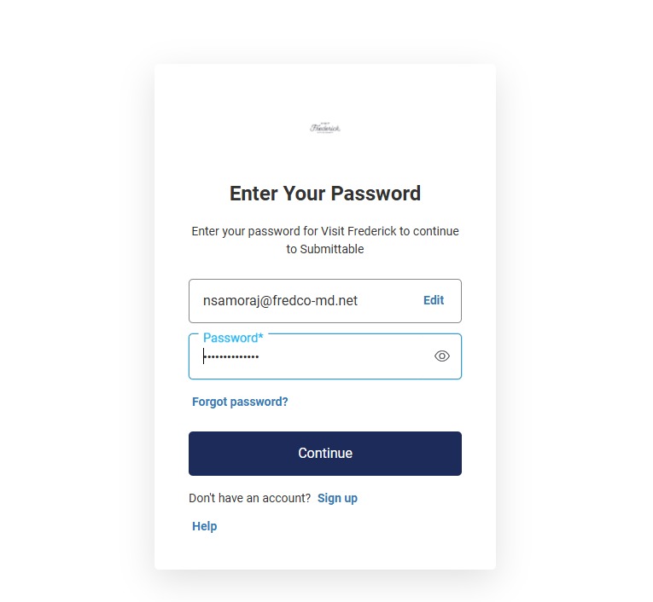
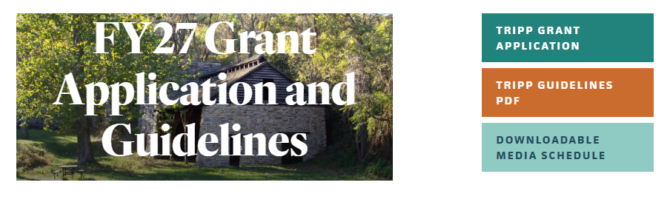
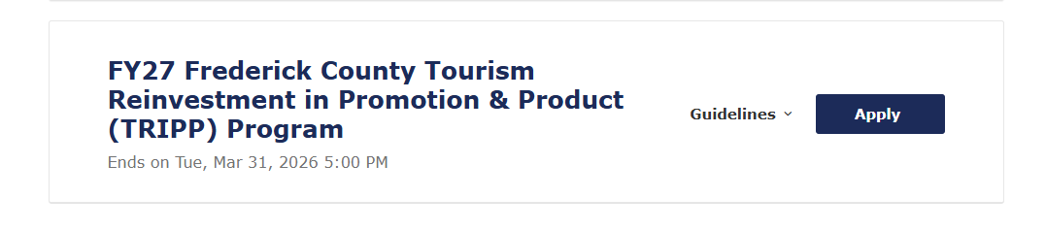
Create Your Account/Login to an Existing Account visitfrederick.org/TRIPP

Slide 36
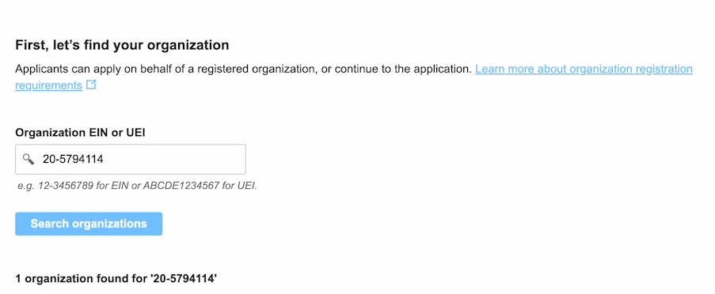
Organization Eligibility
Eligibility requirement
EIN or UEI required
Connected to Candid

Slide 37
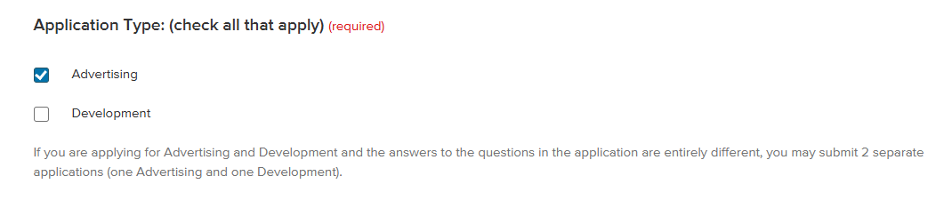
Getting Started – TRIPP Grant Application
Read through the Guidelines carefully
Fill out all (required) fields
Check box for type of grant. Checking the box opens branching for questions related to that grant type.
Contact & Applicant Information
Organization information, including website
Be aware of Character limits
Save Draft at any point (does autosave)

Slide 38
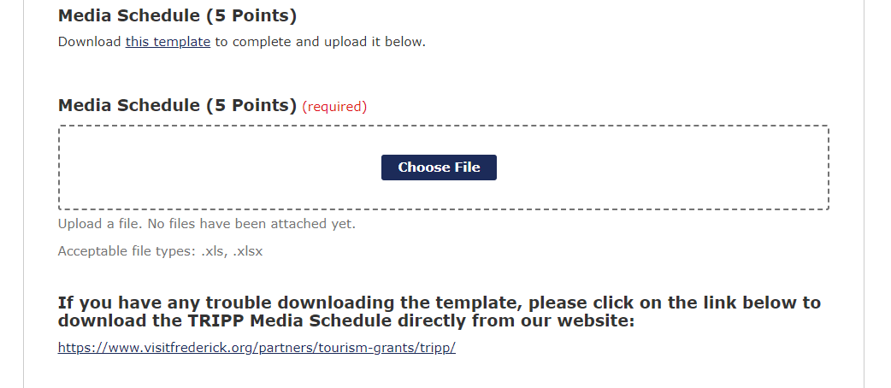
Advertising
Click “Download this template” to download Media Schedule template
Click Choose File to upload completed Media Schedule
Click link under “trouble downloading template”:
https://www.visitfrederick.org/partners/tourism-grants/tripp/

Slide 39
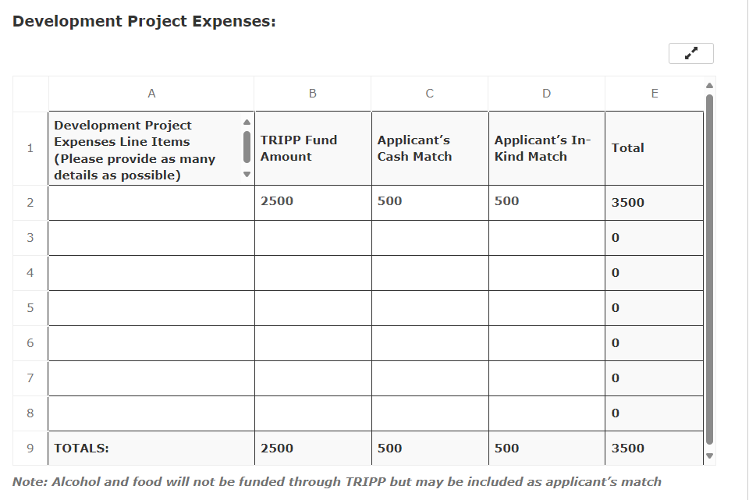
Development
Budget Summary
Development Project Expenses:
Fill out embedded spreadsheet
Click arrows to expand window
Totals will auto-populate

Slide 40
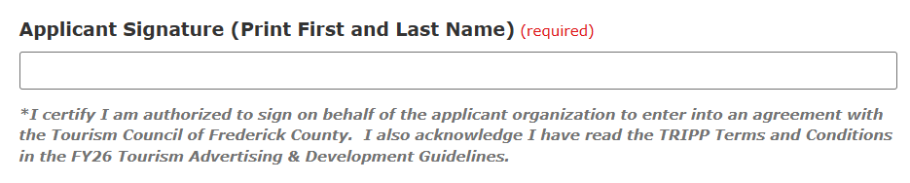
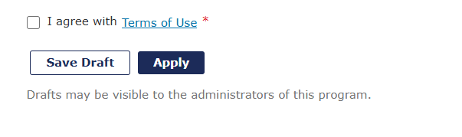
Submitting Your Application
Authorized Signature required
Check box to agree with Terms of Use
Click “Apply”
Once you click Apply, your application is submitted.

Slide 41
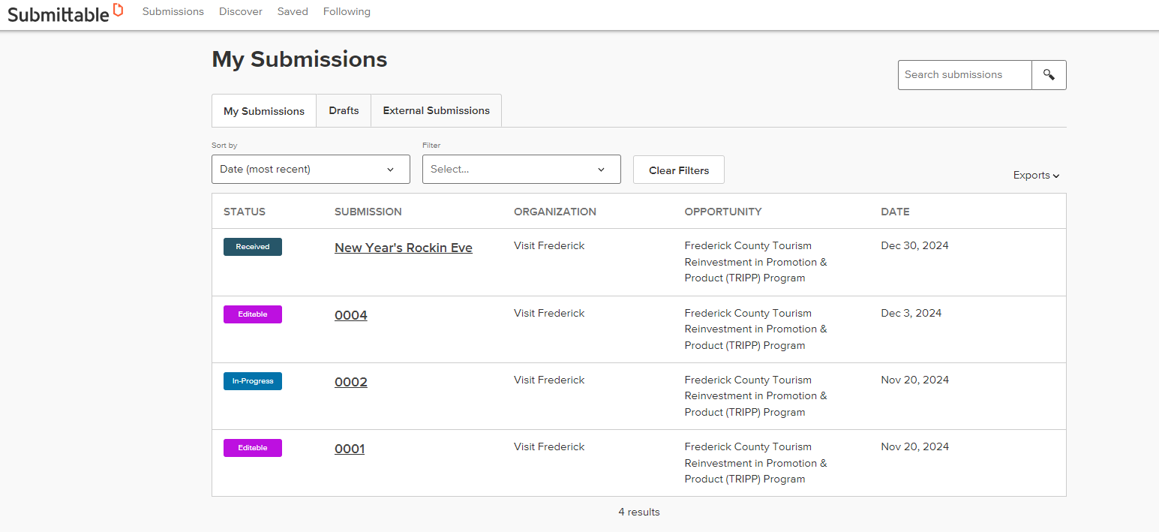
Your Submittable Account
My Submissions tab
Status
Submission (Project Name)
Organization
Opportunity (TRIPP Grant)
Date

Slide 42
Status of Submission
Statuses:
Received
In-Progress
Editable
Declined
Accepted
Completed
Withdrawn

Slide 43
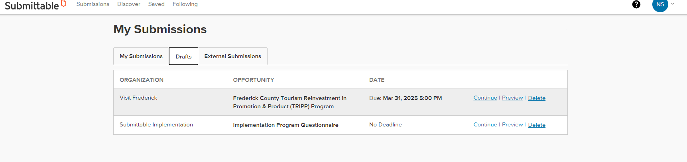
Your Submittable Account
Drafts tab
Continue
Preview
Delete

Slide 44
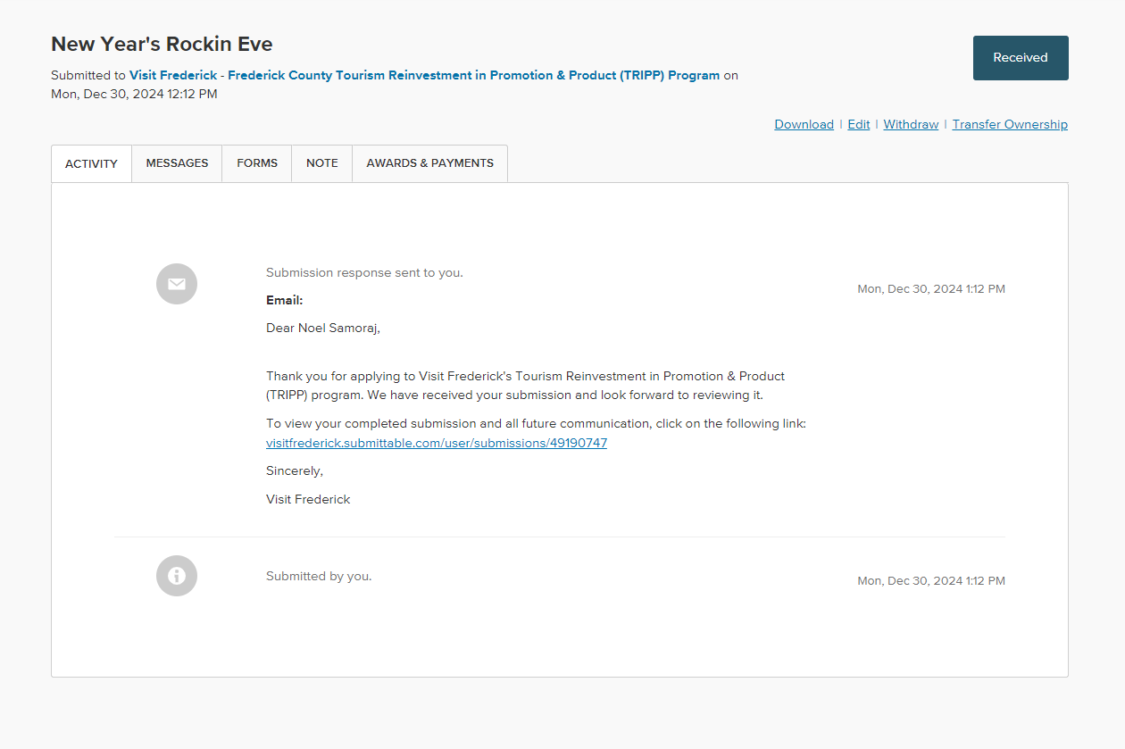
Your Submittable Account
Submission
Activity log
Messages
Forms
Notes
Awards & Payments
Download
Withdraw Submission
Edit

Slide 45
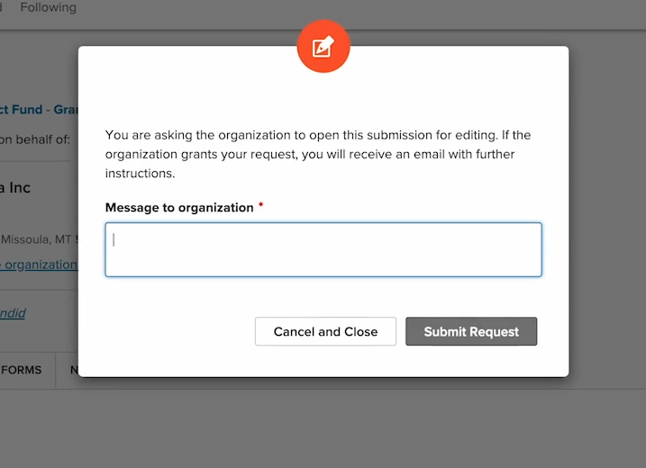
Edit Submission
Click on Submission (project name)
Click Edit in top right
Write a Message to organization and click Submit request
Notification when submission is editable
Click on submission name to reopen and make edits

Slide 46

Questions?
visitfrederick.org/TRIPP
Katie Reichard
kreichard@fredco-md.net
301-600-4043
Dave Ziedelis
dziedelis@fredco-md.net
301-600-4041
Submittable Help Center:
Question mark top right corner

