Slide 1

Irving’s Visibility (The marketing, advertising and selling of Irving by the ICVB)
+
Irving’s Visit-Ability (The ownership of the destination’s development)
=
Irving’s VIABILITY
ICVB Board & Committee
ConventionCenter24$

Slide 2
Board & Business Development Committee
Feb. 18, 2025
2021-26 STRATEGIC PLAN – COMMITTEE CHARGES
Maximize Organizational Stability & Growth
Advocate for Destination-Enhancing Development
2025 Committee Chair: Michael Basoco
2025 Committee Vice Chair: Karen Berlin Cooperstein

Slide 3
Vision & Mission
Destination Vision:
  Irving will be a uniquely vibrant destination welcoming the world for unforgettable experiences.
Organization Mission:
  The Irving Convention & Visitors Bureau enhances Irving’s economy and quality of life by marketing and advocating for the development of Irving as a premier destination.
Board Mission:
  The Irving CVB Board will take ownership of the opportunities on its horizon, doing everything in its power to move the visitor vision of the destination forward by proactively putting the ideas, desires and priorities on every table it can.
    The Irving CVB Board takes seriously its responsibilities, including its fiduciary and operational oversight of the Convention and Visitors Bureau and the Convention Center, as outlined in the City’s Charter and the City Ordinance.

Slide 4
Agenda
Citizen Comments
Approval of December 6, 2024 Meeting Minutes
New Board Orientation Recap

Slide 5
4. Board Development Topics
Survey Results
  Effective Networking & Relationship Building - II
  Social Media Metrics - IIII
  Best Practices for Volunteer Board Members - II
  Strategic Planning Frameworks - II
  Advocacy with Local Politics/Politicians - II
  Principles of Risk Management in DMOs/CVBs - III
  Understanding Leadership Styles - II
  Ethical Judgment & Integrity/Defining Conflicts of Interest - I
  Government Finance for Non-Finance Professionals – II
  Best Practices in Destination Marketing – II
  Fostering Effective Communication – I
  Persuasive Communications/Advocacy - I
Portal “Reading Room”
  Build up portal use
  Put only agenda-related materials in packets

Slide 6
5. Strategic Plan Review & Committee Next Steps
5a. Maximize organizational sustainability & growth
Financial Stability
  FY 2025-26 Budget will see the sunset of the Arts Excess funding ($1.6 million/annually)
    Bring forward recommended revised allocation ordinance to Council as part of the May 14 Budget and Strategic Planning Retreat
    Requires Board Action at April 28 meeting
  Revise allocation ordinance to percentages within the 7% for clarity

Slide 7
Current Irving Hotel Tax Allocations
9% Collected
2% (Brimer*) to Entertainment Venue Debt
REMAINING 7%
  2% to Convention Center Debt
    Plus IAC percentage previously allocated to IAC debt service ($628,000)
  REMAINING 5%
      CC Hotel revenue adjustment and then:
        Museum – 2.5%
        Historic Preservation – 1%
        Arts – @39.5% (15% plus $1.6 million)
          Minus IAC percentage previously allocated to IAC debt service ($628,000)
        Convention and Visitors Bureau – 57%
State Law allows:
Up to 15% for Arts as it relates to tourism promotion
Up to 15% for Historic Preservation & Museums as it relates to tourism promotion
*The 2% Brimer (of the 9%) dedicated to the Entertainment Venue debt does not get counted when tallying the percentage allocations.

Slide 8
Irving Hotel Tax Allocation –
7%* converted to 100
7%* | CURRENT Allocations | FY 2024-25 $$
33% | Convention Center Debt | $8,001,522 (24-25 Payment $7,043,700)
40.7% | Irving Convention & Visitors Bureau | $9,868,543
23.8% | Irving Arts Center (15% plus $1.6 million) | $5,770,794
2.5% | Irving Museum, Preservation | $ 606,176
*The CC HQ Hotel Payment comes off the top of the 7% before it is allocated.

Slide 9
Irving Hotel Tax Allocation – Proposed Reallocation
7% converted to 100
7% | PROPOSED ALLOCATIONS | FY 2024-25 Reallocated | FY 2024-25 Actual
33% | Convention Center Debt | $8,001,522 | $8,001,522
47% | Irving Convention & Visitors Bureau & Convention Center Operations | $11,396,107 | $9,868,543
15%* | Irving Arts Center | *$3,637,055 | $5,770,794
5% | Irving Museums, Preservation Museum feasibility study showed operating subsidy of $450,000 required annually – this would provide an excess of that. | $1,212,352 | $606,176
* The change to the Arts Center’s operating budget for 15% (of the 7%) will occur regardless of how the funds are reallocated.

Slide 10
5. Strategic Plan Review &
Committee Next Steps
5a. Maximize organizational sustainability & growth
  Diversification of revenue streams
    Reallocation of the $1.6 million
    Tourism Public Improvement District – 2026-27 fiscal year re-start
    New HOT revenues potentially generated by PUD 6 project
    On-demand Irving merchandise shop
  World Cup financial expectations and budget impact
    Potential impact of Travel Bans
  Jittery marketplace
  PUD 6 potential beyond HOT

Slide 11
5a. Maximize organizational sustainability & growth
Preliminary placemaking options study (handout)
The Irving Convention & Visitors Bureau recently engaged Clarity of Place to provide a high-level economic impact assessment of five potential place-making development uses, as well as case studies showing the benefits of the different uses from a community/societal perspective. Specific attention was given the current discussions surrounding PUD 6.
Clarity of Place is part of Longwoods International, a market research consultancy whose research methodologies have been peer-reviewed, intensely scrutinized by legislators and the media, and critically evaluated by academics and economists. Clarity of Place focuses on optimizing community alignment, helping destinations align with their community’s needs. Their approach allows community leaders to make sound, data-based decisions on how to manage their destination and grow their visitor economy.

Slide 12
Placemaking Options Study
High level economic impact assessment of 5 potential place-making development uses/components, chosen for their “fit” within Irving’s urban landscape and ability to generate positive economic benefit for the city
  Corporate office
  Integrated resort
  High-end residential
  Theater/concert venue
  Professional sports venue
Methodology:
  Identify examples of mixed-use development components
  Compare the impact of the components on their community
  Provide research/examples of the social impact of each component
  Provide case studies exemplifying combinations of the different uses/components

Slide 13
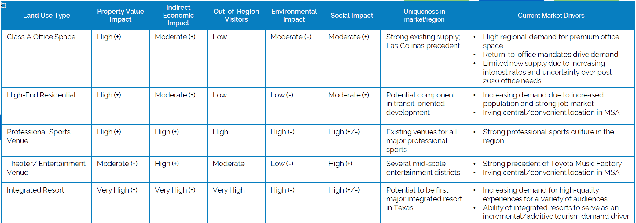
Placemaking Component Comparison

Slide 14
Placemaking Component Snapshots

Slide 15
Placemaking Component Snapshots

Slide 16
Placemaking Component Snapshots

Slide 17
PUD 6 – Potential Fit
CLARITY OF PLACE: The City of Irving is currently considering amendments to uses for PUD 6 Tract A Sectors 1 and 2 as a “High Intensity Mixed Use District.” All (and combinations of) the placemaking options described could fit onto the tract. The uses would create a signature development that would extend Irving’s high-quality brand and generate positive economic value within a transit-oriented, walkable environment that is accessible to residents and guests across the region and internationally.

Slide 18
Case Studies

Slide 19
5a. Maximize organizational sustainability & growth
City Manager has asked ICVB to put together a second more comprehensive & extensive study that would detail:
  Public Engagement Strategy
  Analysis of the potential project components to include: revenue projections, financing structures, costs and mitigation assessments (fiscal, societal, public safety), neighborhood impacts and community investment opportunities
  Likely a 4-6 month process
  Cost – and who will pay - TBD

Slide 20
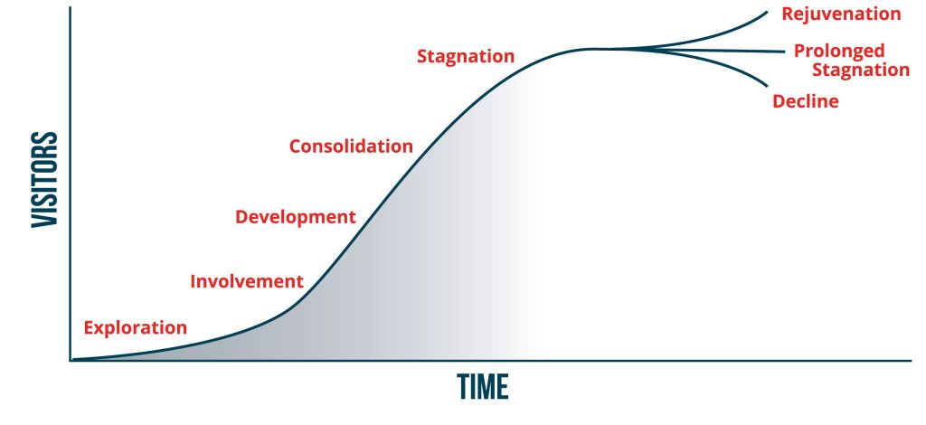
5. Strategic Plan Review & Committee Next Steps, cont’d.
5b. Advocate for Destination-Enhancing Development
  Support legislative initiatives that would serve to enhance development options at the former Texas Stadium site
  Research the financing and operating structures that have made possible competing projects in other destinations, particularly in the DFW area
Destination Life Cycle

Slide 21
Existing Irving Tools
Naming Rights
Ticket & Parking Taxes
  2006 Irving Brimer Election authorized these as well as redevelopment at the stadium site; not sure if that would apply to the Village Walk II property
  If not, another Brimer election could potentially be held
PUD 6 TIF Revenues
Economic Development Bond Authority within Charter
Qualified Hotel Project - potential caveats
2% HOT from ICC Debt
  Debt service currently pays off in 2039
  Refi to support venue? Or kept in place post pay-off to fund new venue?
2% HOT from TMF/Brimer
  Can this be refi’d?
  Would it require another Brimer election?
Incremental HOT funding – only when the 7% exceeds $70 million
  7000+ rooms at the assumed ADR should see this happen quickly
  All HOT-funded entities would benefit GREATLY

Slide 22
New Legislative Tools
Project Financing Zone – 3-mile radius currently
  SB 748 - 83rd Lege; Tax Code 351.1065/351.1015; Govt Code 334
    Legislation currently allows CC expansions (Dallas, Fort Worth, Houston, San Antonio, Austin and Corpus)
    Funded Dickies Arena (new build) – may have done so as an “expansion” of Will Rogers
    Could it be considered as an existing zone from the old stadium site?
  Can legislation be expanded to allow new project/s?
  If able to change/use legislation for new project, could it be used for Westin ICC expansion?
  Requires voter approval

Slide 23
5. Strategic Plan Review & Committee Next Steps, cont’d.
5c. Relationship-building Discussion
  District 4 Councilman Luis Canosa
  District 1 Councilmember
    Incumbent John Bloch
    Candidate Tony Grimes
  New District 7 Councilmember
5d. Board Succession Planning – Terms Expiring
    2025: Herbert Gears
    2026: Yasir Arafat, Michael Basoco, Richard Stewart Jr.
    2027: Colvin Gibson, Sam Reed
    2028: Michael Basoco

Slide 24
Agenda, continued.
City Council Report
Committee Chair Report and Staff Comments
  Legislative Updates
Next meeting – June 13, 2025

Slide 25

Build a place where people want to VISIT, and you’ll build a place where people want to LIVE.
Build a place where people want to WORK, and you’ll build a place where BUSINESS has to be.
Build a place where people want to LIVE, and you’ll build a place where people want to WORK.
Build a place where BUSINESS has to be, and you’ll build a place where people have to VISIT.
It all starts
with
the VISIT.
And the Visit starts
with US.

