Slide 1
IRVING VISITOR INFORMATION CENTER
VOLUNTEER PROGRAM

Slide 2
PROGRAM INTRODUCTION
Maura Gast
THE HOW’S AND WHY’S OF SERVING OUR GUESTS

Slide 3
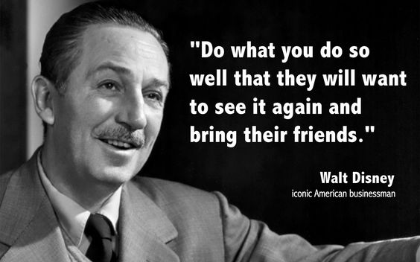

Slide 4
WHY VOLUNTEER?
Serve the community for which you are so passionate about and share your enthusiasm for Irving
Use your abilities, skills and knowledge in a fun and upbeat environment
Learn new skills
Flexible work schedule
Develop an increased sense and global view of society and help others by giving back
Work with friends, family and meet new people
Have fun!!
Being a Visitor Information Center Volunteer is a great way to connect with visitors to our City and learn about all the things happening around and about town.

Slide 5
PROGRAM GOALS
Welcome visitors to the Irving Convention Center and Urban Center area and provide them with accurate and timely information.
Provide a service that meets and exceeds the visitor’s needs, including physical, cultural and language needs.
Promote the City of Irving offering information and welcoming all visitors with a friendly and kind spirit.
Be up-to-date on the events and specials happening at the Convention Center and Toyota Music Factory, along with the surrounding area attractions.
Answer inquiries with information and assistance ranging from local attractions to lodging and transportation.

Slide 6
VOLUNTEER QUALIFICATIONS
Commit to a minimum of two weekend, four-hour shifts a month
A desire to meet and interact with people
Friendly and courteous
Neat appearance
Enjoy meeting people of all cultures and ethnic groups
Familiar with the city of Irving and immediate surround area
Willing to learn detailed information regarding attractions, hotels, dining, transportation and events
Ability to give clear and concise directions
Positively promote Irving
Ability to use a computer, iPad and other electronic devices to search for information as requested
Ability to answer and manage information requests
Have access to a computer, iPad or other electronic device at home for scheduling purposes
Demonstrate flexibility and cooperation in working with staff and other volunteers, being a good team member
Ability to sit, stand and walk
Being multi-lingual is not a requirement, but would be beneficial

Slide 7
VISITOR INFORMATION VOLUNTEER DUTIES AND REQUIREMENTS
Attend all training and study all update information.
Be welcoming and friendly while assisting visitors.
Arrive for volunteer assignment on time and on the assigned day, and able to check-in, confirm or decline assignments on-line.
Wear the Visitor Information Volunteer uniform while volunteering.
Assist visitors with tourist information regarding Irving, the Convention center and Toyota Music Factory.
Act a greeters for visitors and large groups to the Convention Center.
Assist with “Frequently Asked Questions” at the lobby desk/kiosk in the Convention Center.
Be knowledgeable on security protocol and awareness.
Know the “go to” person for specific information, ie. Lost and found, booking an event at the Convention Center, etc.
Be knowledgeable about public transportation and directions.
Assist with parking questions.
Be knowledgeable on the internet and comfortable acquiring information from Google/Bing, ICC, ICVB and TMF websites in order to assist visitors with accurate information.
Be flexible in working with staff and other volunteers.
Use initiative in providing above and beyond customer service.

Slide 8
OUR PROMOTE TO YOU
Provide the training and updated materials needed in group and one-on-one format
Respect your time and commitment
Provide supervision and guidance
Provide a safe and secure environment and training for security situations
Provide updated information for any changes and developments within the Convention Center, Toyota Music Factory venues, construction and city of Irving in general.
Provide the Visitor Information Volunteer uniform
Listen and respect your input
Keep all personal data confidential
Recognize and celebrate your volunteer passion

Slide 9
VOLUNTEER SHIFTS AND SCHEDULING
Two people per shift
Four hour shifts on Saturday and Sunday: 10 am – 2 pm and 2 pm to 6 pm
Two shifts per month
Self-scheduling available on the Volunteer portal via your Volunteer Profile.
You will be given a login and password for the software and it is your responsibility to self-schedule your shift.
If you cannot complete your commitment for a shift, you must contact a volunteer on the backup list and verify their availability (within the 24-36 hours prior).
If no one can be verified to serve your shift, contact the Volunteer Manager 24 hours prior.
Volunteer contact information will be available on the Volunteer Information Portal.

Slide 10
HOW DO WE MEASURE SUCCESS?
Visitor Focus:
Outcome Objective – Visitors assisted by the VIC program will have a positive, friendly experience
Outcome Measure – Assessment after 3-6 months through the program, a questionnaire is administered for results by the VI Manager to registered guests
Performance Standard – 90 – 100% will have a satisfactory or greater experience in connection with a volunteer
Volunteer Focus:
Outcome Objective – Volunteers will be well-trained and feel prepared to provide direction when answering inquiries and walk-ins
Outcome Measure – Information received through feedback from volunteers after 3-6 months participating in the program
Performance Standard – 90 – 100% of volunteers report being satisfied with the training and feel well-prepared to answer questions
Program Focus:
Outcome Objective – Visitors who request volunteer support will received qualified volunteers who are able to provide appropriate services, proportionate amount of inquiries and guests served to the volunteer hours, increased awareness of the Irving Visitor Information Center.
Outcome Measure – Results from both the Visitor and Volunteer surveys and questionnaires, social media analytics

Slide 11
THANK YOU!!

